Slide 1
Kruskal Wallis Analysis of 911 Call Data

Slide 2
Tony Dunsworth
Database Administrator for the City of Alexandria
Data Analyst for Department of Emergency and Customer Communications
Masters Candidate: Western Governors University

Slide 3
City of Alexandria
A city of approximately 159,000 people in Northern Virginia
Suburb of Washington, D.C.
Department of Emergency and Customer Communications
Responsible for answering 911 and 311 calls for the city
Answered over 66,000 911 calls in 2020
Staff of approximately 60 people

Slide 4
Problem and Hypotheses
Is there a statistically significant difference in the median call processing times in response to the Department of Emergency and Customer Communications (DECC) of the City of Alexandria’s efforts to preserve the continuity of service to their constituents in response to the SARS-COV2 pandemic?
H0: There is no statistically significant difference in population means meaning the department’s actions had no impact on call processing times.
HA: There is a statistically significant difference in the population means meaning the department’s actions did impact call processing times.

Slide 5
Data Collection and Cleaning
Data was collected from a SQL Server 2016 database supporting the city’s Computer Assisted Dispatch software.
The data was collected and preliminary cleaning was completed through a SQL query.
After exporting the data into a .csv file, the file was imported into Rstudio and converted into a data frame.
The four dependent columns; QueueTime, DispatchTime, ProcessTime, and CallTime were created in R.
All rows where any of the dependent variables were of a value less than 0 were eliminated from the data frame.
After this final cleaning, categorical variables were converted to factors for analysis.

Slide 6
Analysis: Normality Testing
In order to determine the proper tests to use for the computed dependent variables, they were tested for normality.
Three normality tests were performed.
The first is a density plot.
The second is a QQ plot.
The third and final test is the Anderson-Darling test. This was used over a more preferred test as the preferred test could not handle ties without having to estimate the p value.

Slide 7
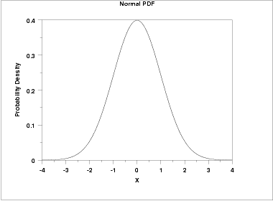
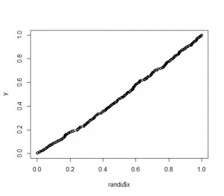
Normal Distribution Profile

Slide 8
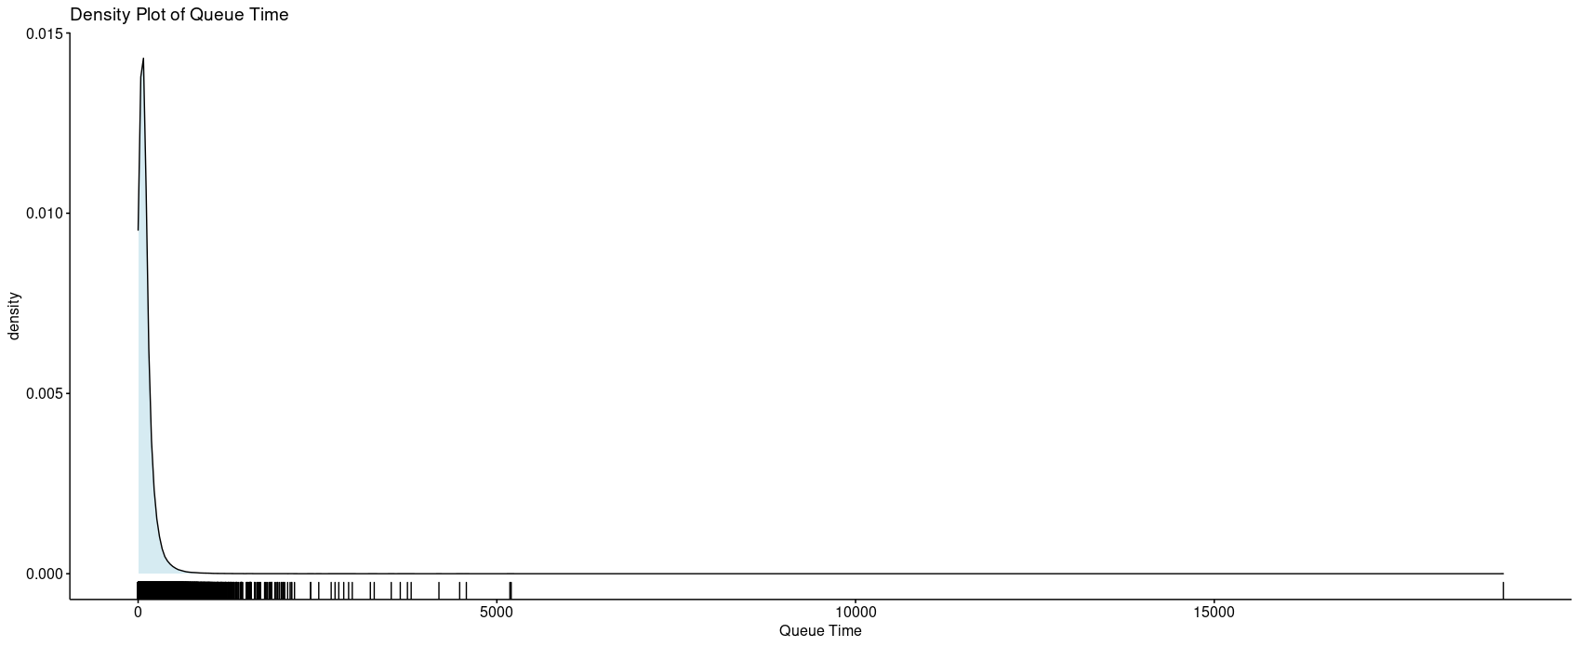
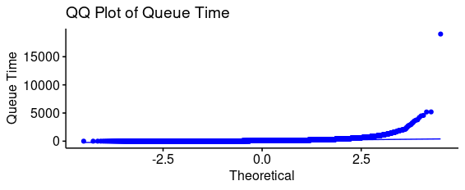
QueueTime

Slide 9
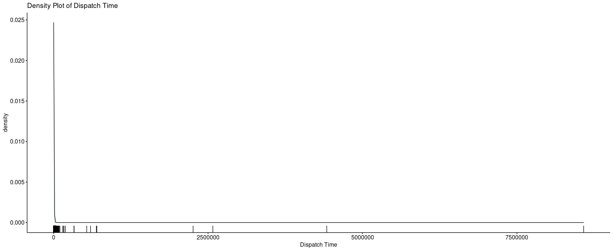
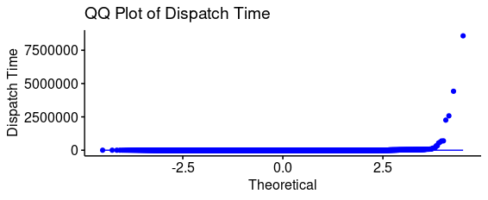
DispatchTime

Slide 10
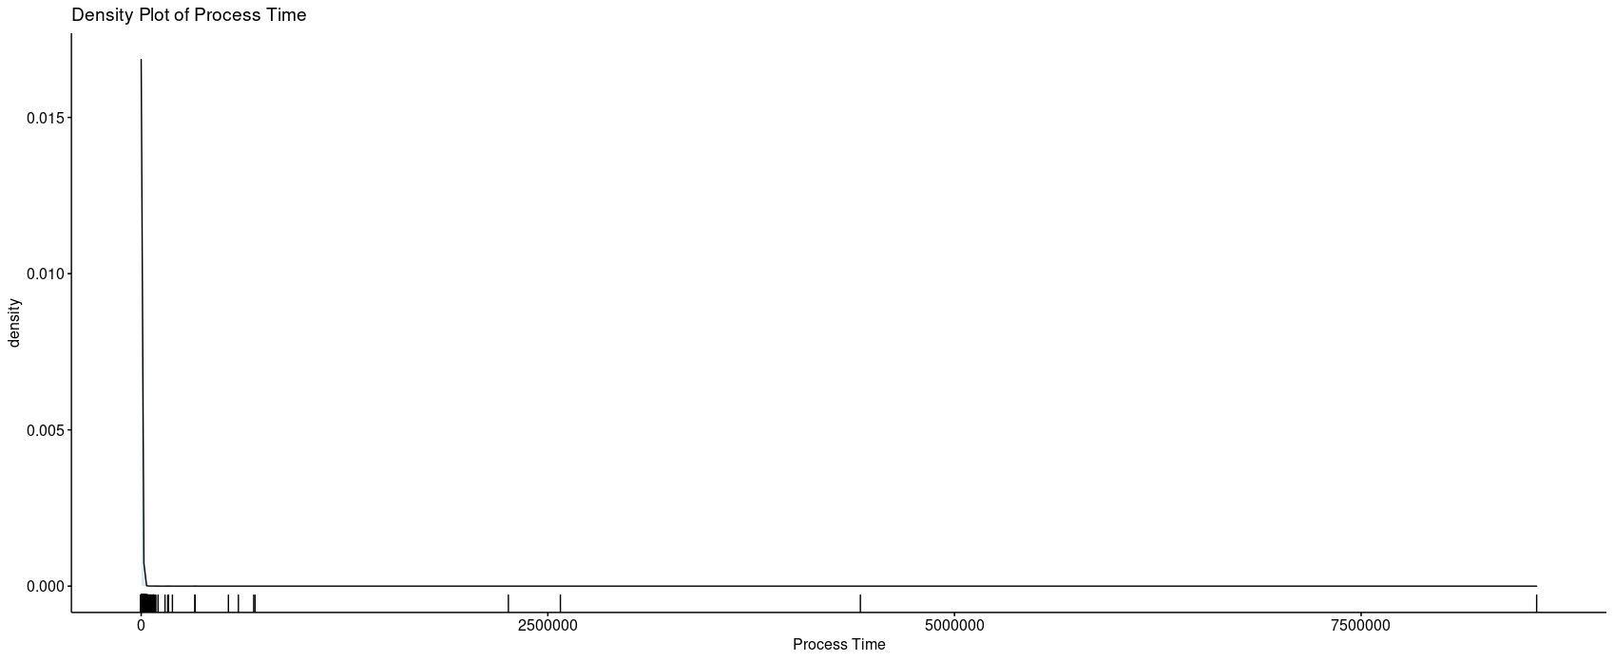
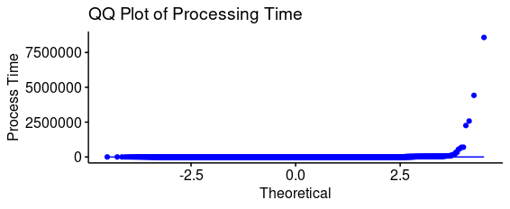
ProcessTime

Slide 11
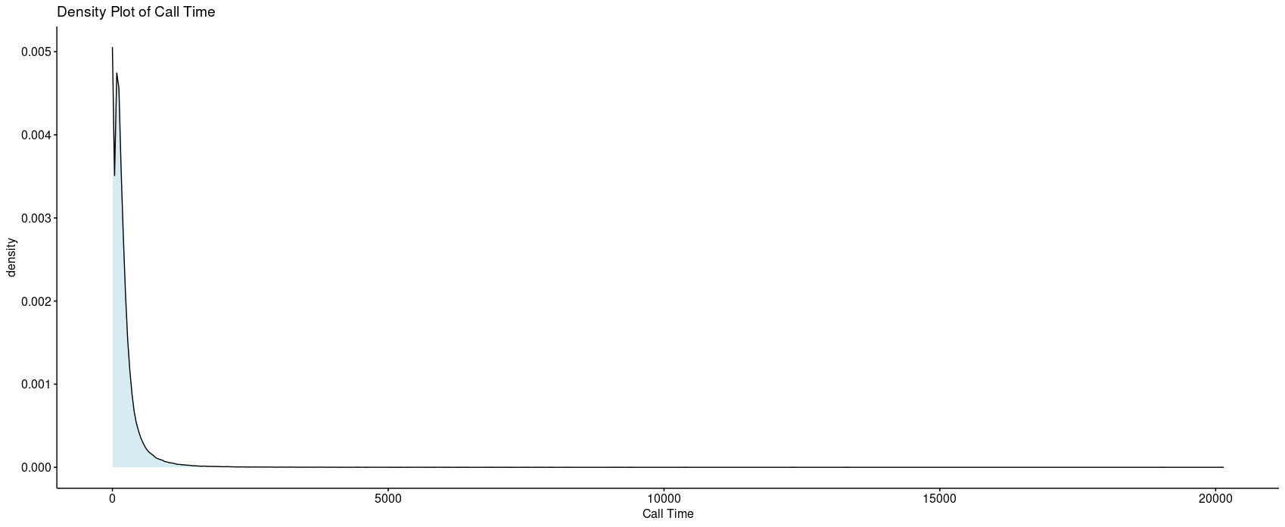
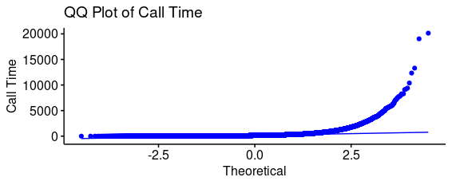
CallTime

Slide 12
Results of normality tests
All four variables show a non-normal distribution with a heavy right skew.
Based on this, the data qualifies for the use of nonparametric tests.
These tests will use population medians rather than population means as the measure of central tendency for analysis.
The medians for the four computed variables are as follows:
Variable | Median
QueueTime | 76 seconds
DispatchTime | 46 seconds
CallTime | 127 seconds
ProcessTime | 150 seconds

