Slide 1

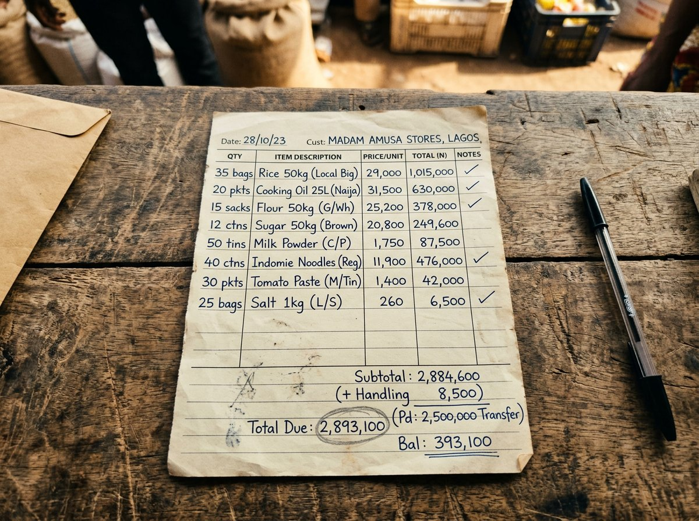
Leda
Stop the WhatsApp chaos.
Clear your ledger.
Voice notes, blurry photos and market slang in.
Structured orders and a balanced ledger out.
HACKATHON DEMO · BUILT FOR NIGERIA'S WHOLESALE DISTRIBUTORS
leda-seven.vercel.app
Notes:
Open on the deployed app. One line: Leda turns the WhatsApp messages Nigerian distributors already receive into orders, verification and a ledger.

Slide 2
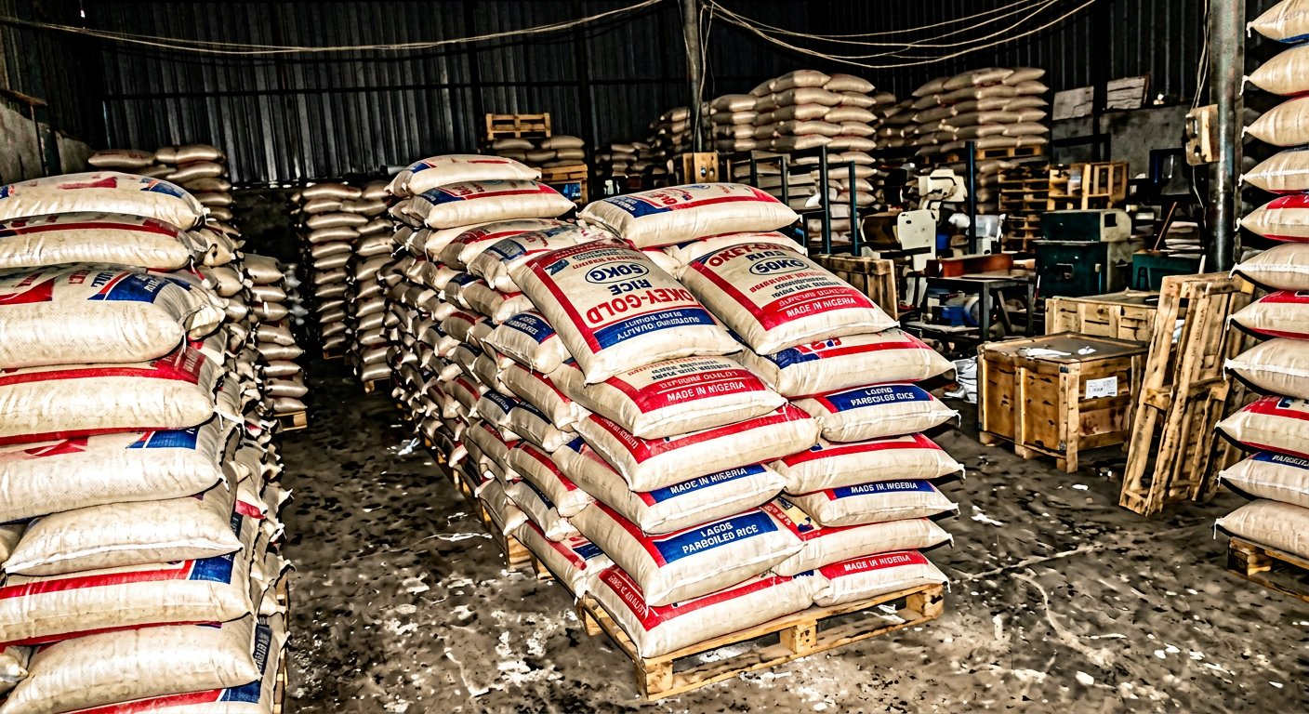




THE PROBLEM
Nigeria's wholesale trade runs on WhatsApp.
Every order is a voice note
"Send me like fifty, make e remain small." Pidgin, slang and nicknames for products — typed into a notebook by hand.
Every proof is a blurry photo
Handwritten order slips and stacked bags. Two rice brands look the same at 6am.
Every payment is a screenshot
Transfers arrive with unclear references. Matching them to invoices takes the whole evening.
leda-seven.vercel.app
Notes:
The distributor is not the problem. The channel is. Retailers will never stop sending voice notes; the tooling has to meet them there.

Slide 3



THE PRODUCT
Meet Sabi: decode, verify, reconcile.
Decode
Verify
Reconcile
Voice note, photo or text becomes order lines against the distributor's own catalog — each line with a confidence score.
Anything uncertain is a flag with Sabi's reasoning and two concrete options. One click resolves it; one click asks the retailer.
Every retailer gets a virtual account. Transfers auto-match to invoices and post to an append-only ledger.
leda-seven.vercel.app
Notes:
Three verbs. Everything in the demo maps to one of them.

Slide 4
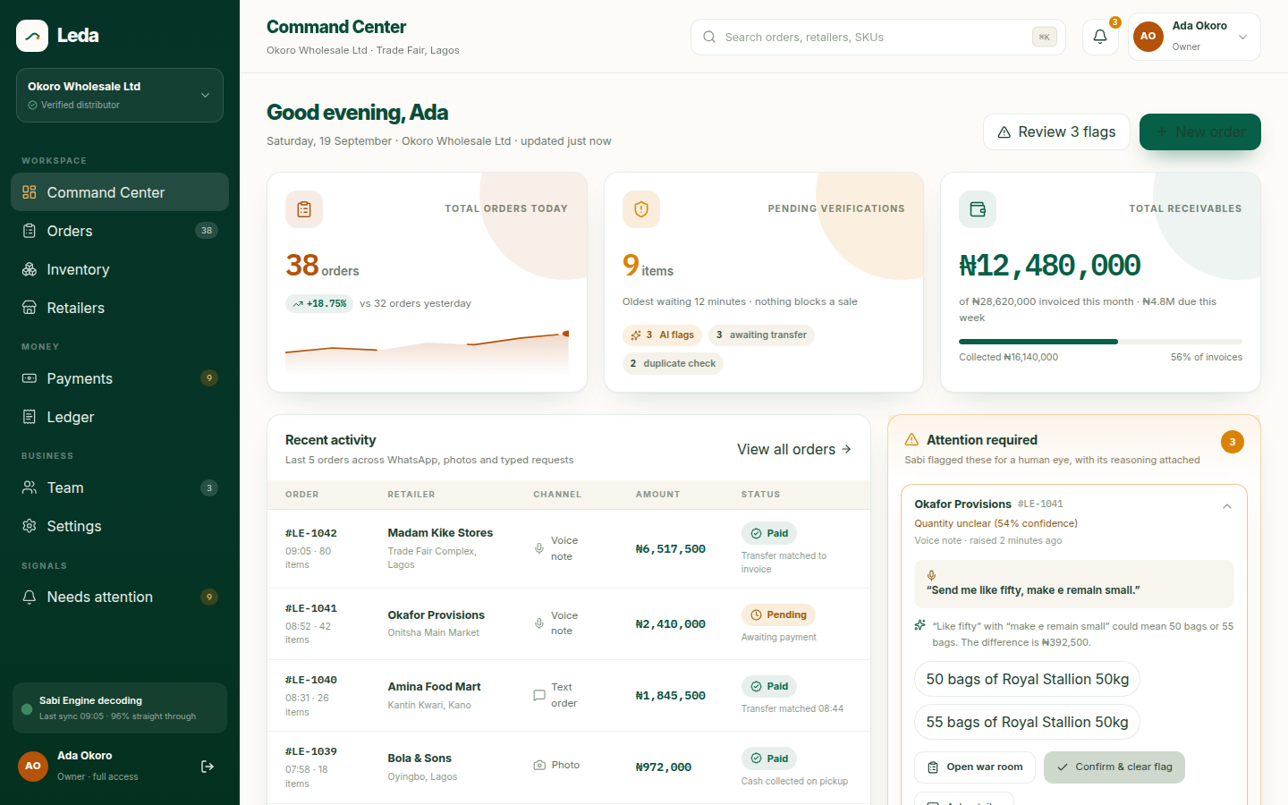
THE COMMAND CENTER
Today's orders, what needs a human, what's owed.
38 orders today
Voice, photo and text, one queue
9 pending verifications
3 AI flags · 3 transfers · 2 duplicates
₦12.48M receivables
Live from the ledger, not a spreadsheet
leda-seven.vercel.app
Notes:
Show the Attention Required panel: the 54% flag on LE-1041 is the story we follow for the rest of the demo.

Slide 5




HOW SABI WORKS
From a 42-second voice note to a confident order.
WhatsApp
Whisper
Claude
Order
Cloud API webhook.
Media stored untouched.
Transcript with a Pidgin
prompt hint + product names.
Structured output against the
catalog, slang aliases, history.
Lines with confidence.
Under 85 = human check.
Flag: Quantity unclear (54% confidence)
₦392,500
“Send me like fifty, make e remain small.”
“Like fifty” with “make e remain small” could mean 50 or 55 bags of Royal Stallion 50kg. Sabi offers both and states the money at stake instead of guessing.
difference between the two readings
leda-seven.vercel.app
Notes:
Key design choice: the model is rewarded for honesty. A flag with two options beats a confident wrong guess when the distributor's money is on the line. Every provider sits behind an interface with a fake, so the pipeline is fully testable offline.

Slide 6
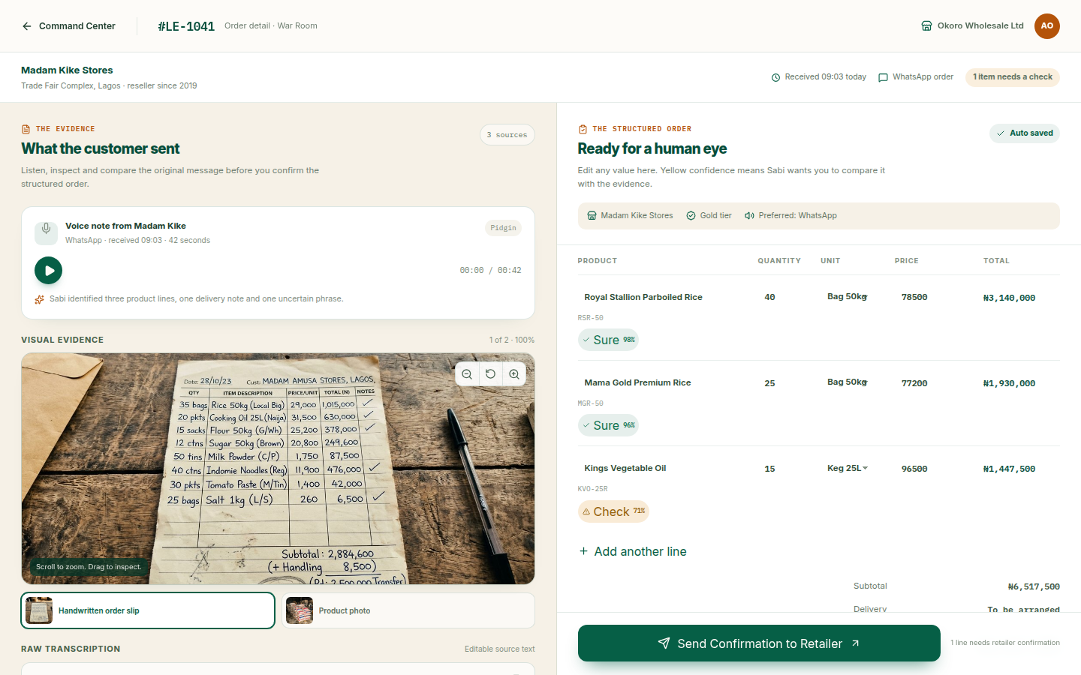



THE WAR ROOM
Evidence on the left, the order on the right.
Original signals stay original
Voice note, slip photo and raw transcript are stored once and never rewritten by the model.
Sure / Check badges
Green lines matched clearly. Amber lines wait for a human to compare them to the evidence.
One confirmation
Resolving the flags unlocks Send. The retailer gets the WhatsApp confirmation; the invoice posts to the ledger.
leda-seven.vercel.app
Notes:
Demo beat: click the amber badge, compare to the slip, resolve the 55 bags option, press Send.

Slide 7




THE MONEY
Every transfer finds its invoice.
Virtual account
Webhook
Auto-match
Ledger
Paystack dedicated account per retailer. The account number is the reference.
HMAC-verified. Unique on reference, so a replayed event changes nothing.
Amount equals one pending order, or the narration names it. Otherwise: review queue.
Append-only journal. Corrections are new rows. Balance is a sum, never a field.
Entry | Reference | Debit | Credit | Balance
Invoice raised | LE-1043 | 5,682,500 |  | 8,772,500
Payment received | LE-1043 |  | 5,682,500 | 3,090,000
From the live demo run:
voice note → LE-1043 → confirmed → paid,
replay ignored, balance closes.
leda-seven.vercel.app
Notes:
Money invariants: NUMERIC(18,2) never floats; payments unique per provider reference; ledger append-only; unmatch posts a reversing adjustment.

Slide 8
WHAT'S LIVE TODAY
Not a mockup. A working system.
47
16
28
5
API endpoints
Postgres tables
tests, SQLite + Postgres
providers, each with a fake
Onboarding creates real accounts, imports catalogs and retailers server-side, sends team invitations
WhatsApp intake → Whisper → Claude structured output → order, flags, notifications
War Room review, flag resolution, ask-the-retailer, confirmation with stock reservation
Paystack virtual accounts, idempotent webhook, auto-match / manual match, ledger with CSV export
Frontend on Vercel, API on FastAPI, database on Supabase
leda-seven.vercel.app
Notes:
Numbers from the repo at demo time. The fakes matter: the whole product runs offline, which is how we tested it end to end.

Slide 9





ARCHITECTURE
Boring where it should be, clever where it counts.
React 19 · Vite · Tailwind
FastAPI · SQLAlchemy 2.0
PostgreSQL on Supabase
Landing, onboarding,
Command Center, War Room.
Typed client generated
from OpenAPI.
Async, Pydantic v2, Alembic.
Role-gated, tenant-scoped.
Money as NUMERIC(18,2).
16 tables. Append-only
ledger. Evidence never
mutated.
INTEGRATIONS — every one behind a Protocol with a local fake
Meta WhatsApp Cloud API
OpenAI Whisper
Claude Opus 5
Paystack DVAs
Resend
leda-seven.vercel.app
Notes:
Claude call: beta.messages.parse with a Pydantic DecodedOrder schema, adaptive thinking, cached system prompt and catalog, server-side refusal fallbacks.

Slide 10
LIVE DEMO
Five minutes, one order, start to finish.
1
Onboard
Create a distributor, import a catalog and retailers, invite a colleague.
2
Retailer sends a voice note
“Send me like fifty, make e remain small…” arrives on WhatsApp.
3
Command Center
LE-1043 appears with two flags and Sabi's reasoning.
4
War Room
Compare to the evidence, pick 55 bags, send the confirmation.
5
Transfer lands
Paystack credits the virtual account; the order is paid and the ledger closes.
leda-seven.vercel.app
Notes:
If the network is unhappy, every step also works against the local fakes. Have the seeded database ready as a fallback.

Slide 11



WHAT'S NEXT
From working system to working business.
Connect the live rails
Pilot with distributors
Then grow
Verified WhatsApp business number
Paystack DVA approval
Dashboard and War Room on live data
3 distributors in Lagos and Onitsha
Measure decode accuracy on real Pidgin
Tune the 85 confidence threshold
Credit scoring from ledger history
Multi-branch businesses
Inventory forecasting from order flow
leda-seven.vercel.app
Notes:
The ask depends on the hackathon: access to a WhatsApp Business verification partner and one distributor willing to pilot are worth more than anything else.

Slide 12
Every voice note becomes an order.
Every transfer finds its invoice.
Try it
leda-seven.vercel.app
Thank you.

