Slide 1

Hands on
Exploring Machine learning with Spark & Real-world Scalable Architecture
Prakshi Yadav
Data Engineer @Episource

Slide 2
Prerequisites
Python Programming
Higher level understanding of Distributed computing
Map-Reduce Paradigm

Slide 3
What was covered earlier?
Installation
Resilient Distributed Datasets (RDD)
Create RDDs
RDD transformations
Spark SQL

Slide 4
What we will cover today?
Exploring Real-world Architectures
Scalable Data Processing Pipeline

Slide 5

Business Problem at
Clinical Text - Medical Records of patients
Distributions of Medical Charts
Client → Operations Team → Team Leads → Medical Coders
ICD-10 Coding by Medical Coders
International Classification of Diseases - codes for diseases, signs and symptoms, abnormal findings, complaints, social circumstances, and external causes of injury or diseases
Category - Hierarchical Condition Category (HCC) vs No HCC Example: Viral Fever - A92.8 - HCC - billable Whooping cough - A37 - No HCC - Non Billable
Revenue based on no. of HCC Charts being coded
Each Medical Coder codes 10-12 charts/day depending on expertise

Slide 6

Challenges:
Processing of thousands of files
Dynamic distribution of files for processing
Fault tolerant architecture
Data security is the priority
Cost minimization
Fully Automated data pipeline

Slide 7
General way to APPROACH
Maintain a separate data store
Keep dedicated servers running all day to process files.
Server maintenance is an overhead
Less flexibility to scale the resources.

Slide 8
Serverless path
Event-based asynchronous approach to application design
Launch clusters only when required.
Three simple steps:
Start
Process
Terminate
Reduced operational costs
Deploy in Minutes
Enhanced scalability, better performance, and lower infrastructure and maintenance costs

Slide 9
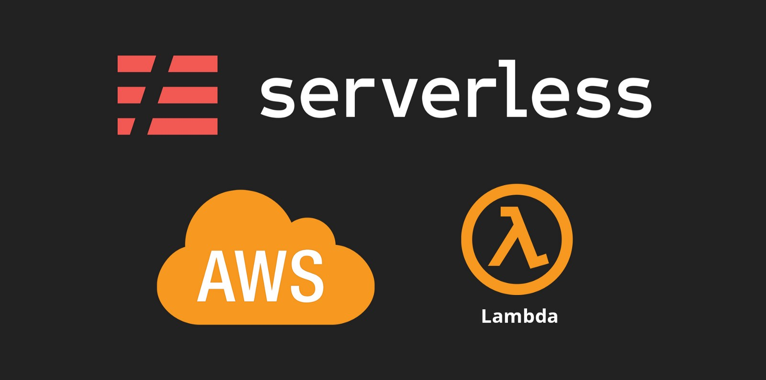
WHat makes it serverless?
Trigger
EMR Cluster is launched only when there are files to process.
Lambda function is triggered by a cloudwatch event
Lambda function contains the code to launch an EMR Cluster.
Cluster is terminated automatically once the processing is over.

Slide 10
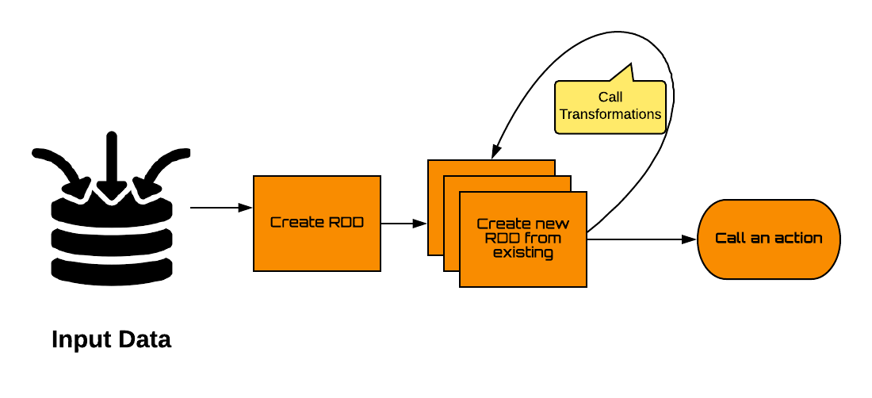
Ideal Spark applications

Slide 11
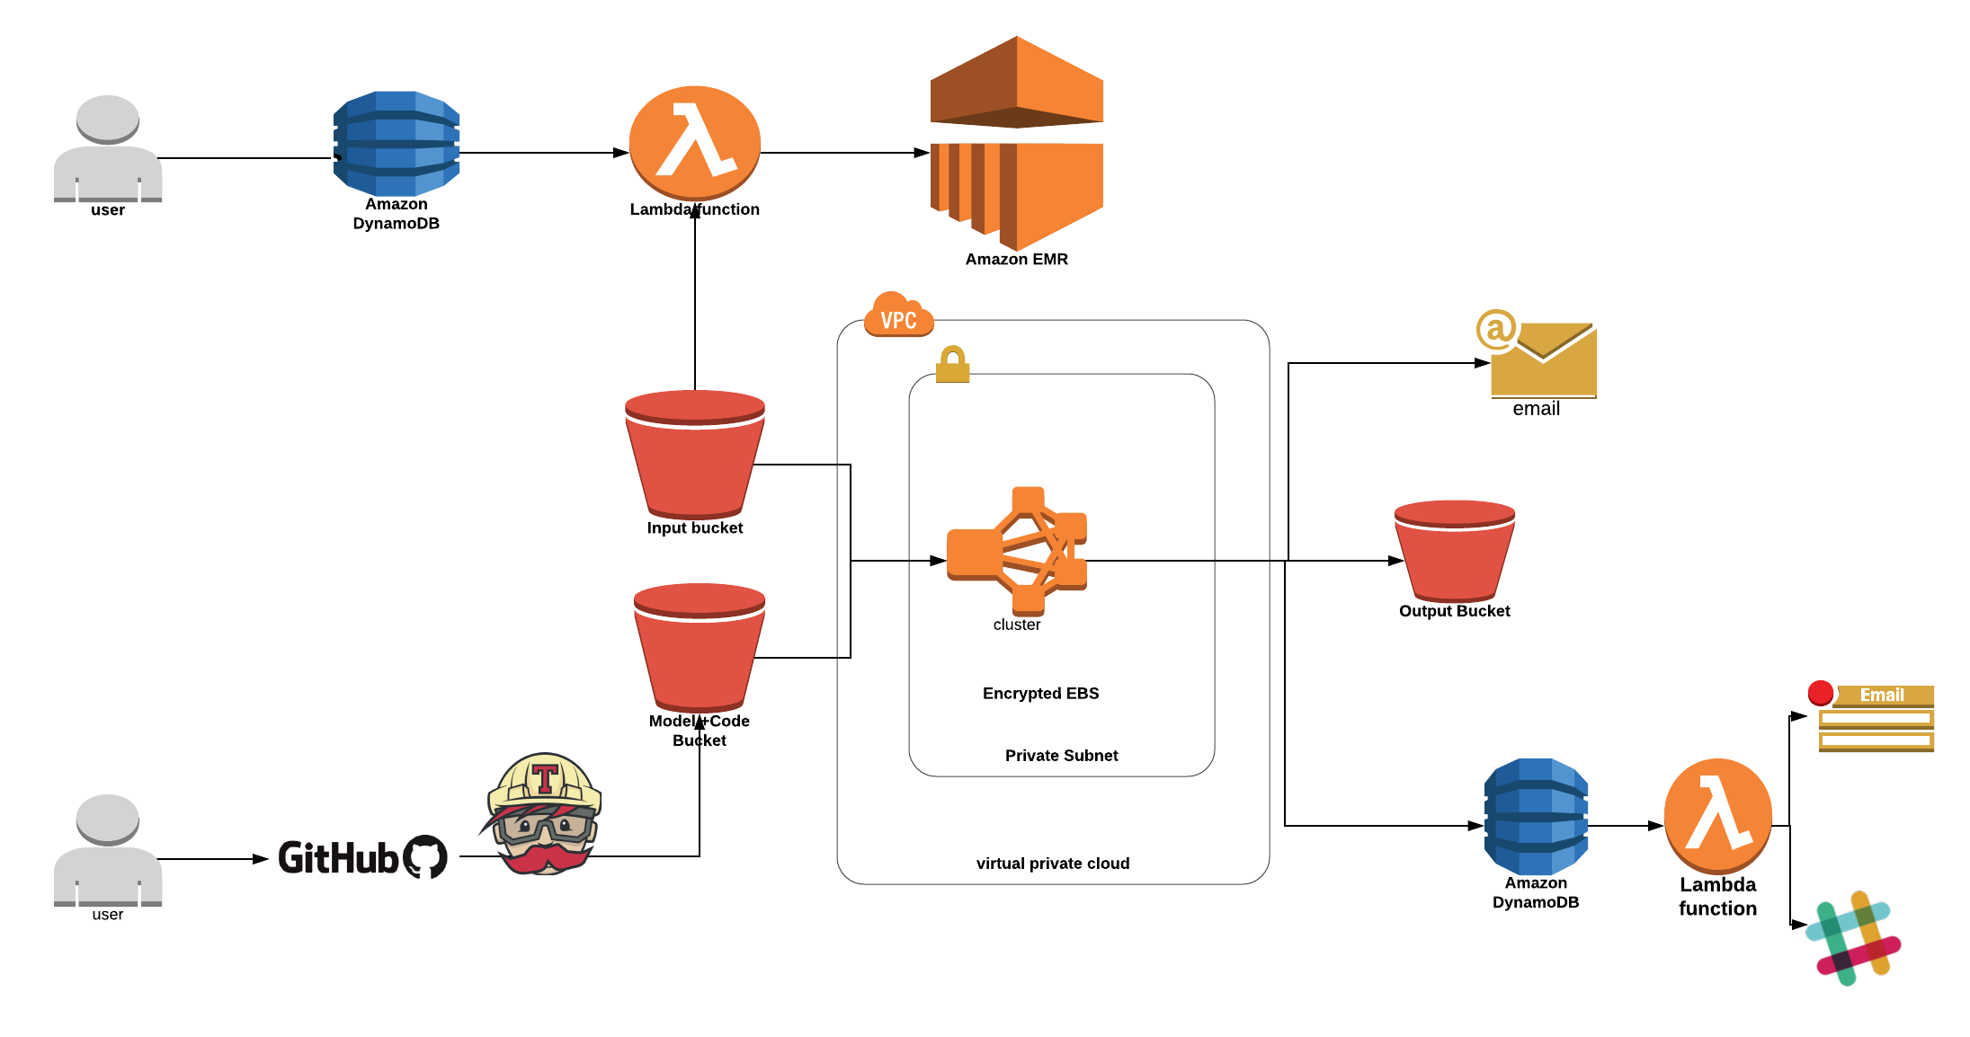
Serverless Data processing pipeline

Slide 12
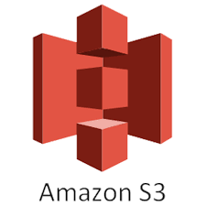
Where is data stored?
Scales - just keep putting files, and it will never fill up.
Upload and download your data with SSL encrypted end points
Provides multiple options for encrypting data at rest.
Low Cost - $0.023 per GB
Reading data in a Spark application is as simple as calling - sc.textFile(“s3n://<bucketname>”)
Object Storage

Slide 13
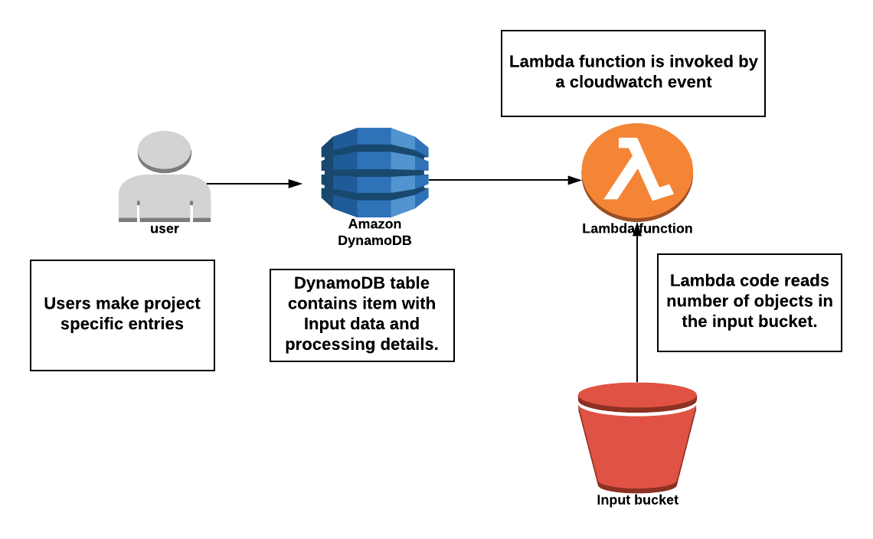
What Triggers the pipeline?

Slide 14
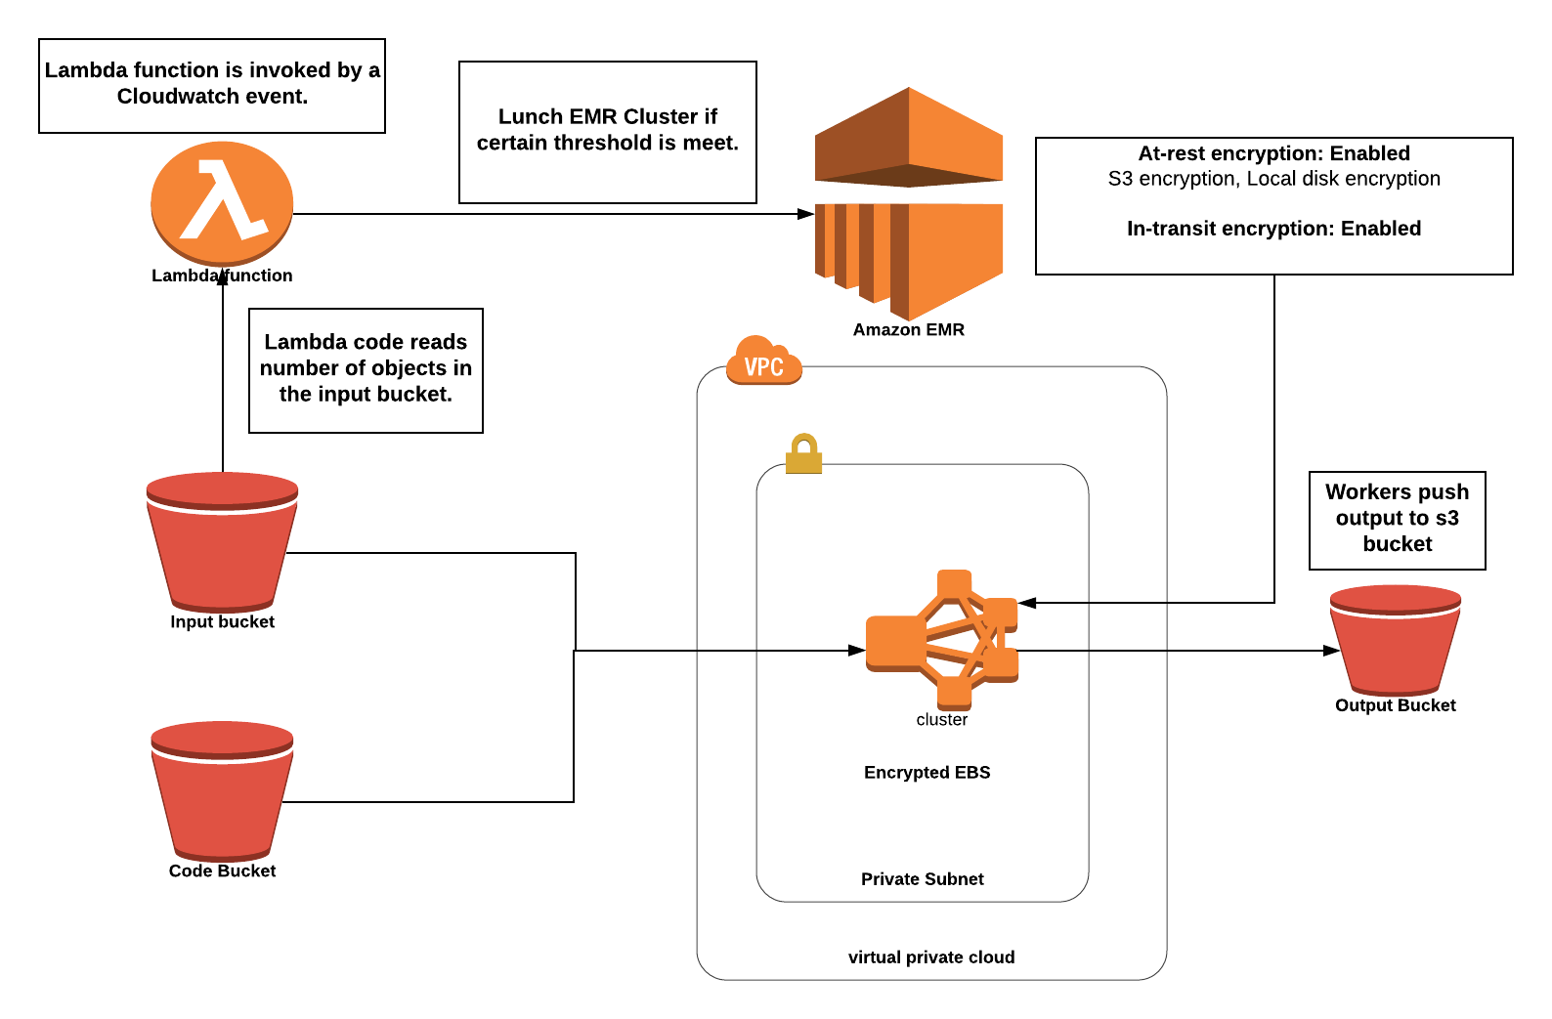
Batch processing with EMR

Slide 15

Apache spark architecture
Single Master & Multiple Workers.
Driver Program resides on Master node.
Multiple executors may reside on a worker node.

Slide 16

What role does a driver play in a spark architecture?
Runs the main () function of the application and is the place where the Spark Context is created
Translates the RDD’s into the execution graph and splits the graph into multiple stages
Converts User Application into tasks
Exposes the information about the running spark application through a Web UI at port 4040.
So, Smart Driver is more important!

Slide 17
Role of cluster manager
Responsible for acquiring resources on the spark cluster and allocating them to a spark job.
3 different types of cluster managers:
Hadoop YARN
Apache Mesos
Simple standalone spark cluster manager
Allocation and deallocation of various physical resources such as memory for client spark jobs, CPU memory, etc.

Slide 18
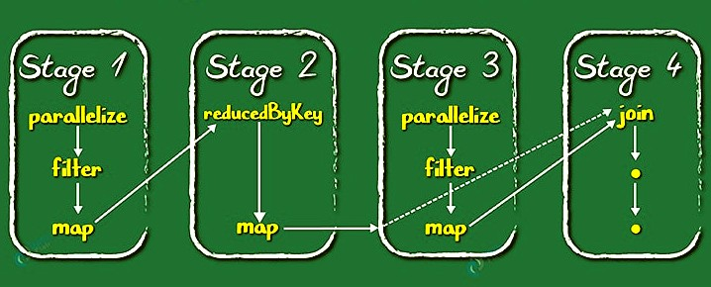
DAG SCHEDULER
Stages depends on transformations on RDDs
Narrow transformation: Doesn't require the data to be shuffled across the partitions. for example, Map, filter etc.
Wide transformation - requires the data to be shuffled for example, reduceByKey etc.
Wide transformations results in stages

Slide 19
RUN Time architecture of a spark application
Creates a logical DAG from the RDD transformation and actions given in the application
Physical execution plan with set of stages
Creates tasks and send them to the Cluster
Cluster manager then launches executors on the worker nodes depending on resource allocation
Executors registers themselves with the driver program.
Executors start executing the various tasks assigned by the driver program
If main() ⇒ exits the call SparkContext.stop()

Slide 20
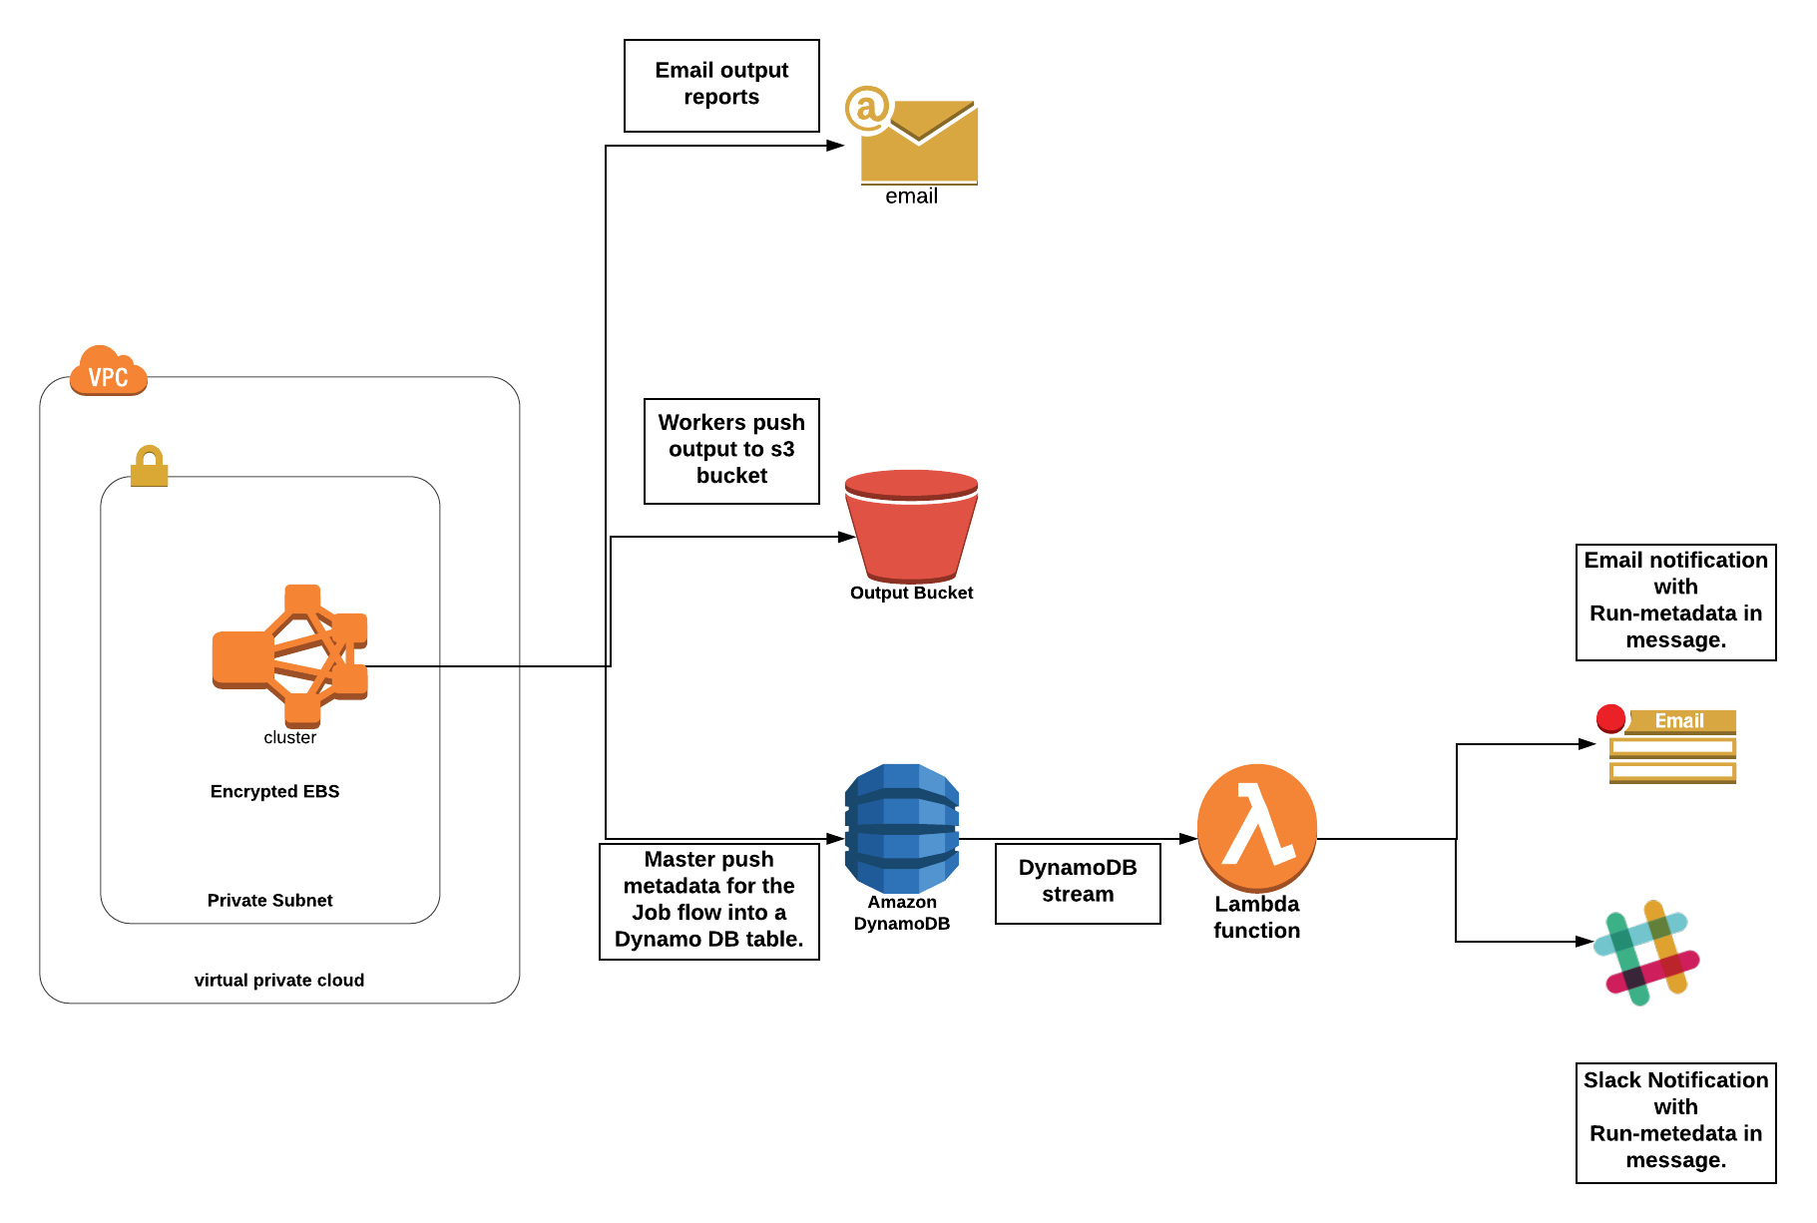
NOTIFICATION SYSTEM
After every run, a notification is sent to the user which contains run-metadata in the message

Slide 21
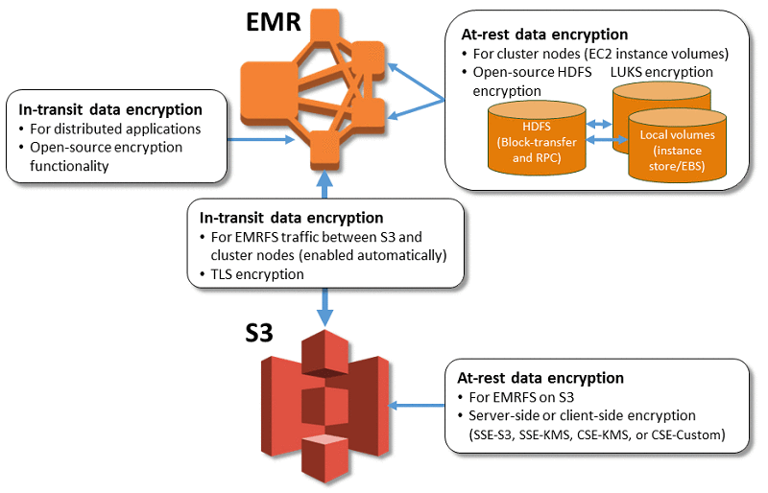
Data security in our architecture
Security configurations: Templates for security configurations which can be attached to EMR Clusters.
SC provides:
At-rest data encryption
In-transit data encryption

Slide 22

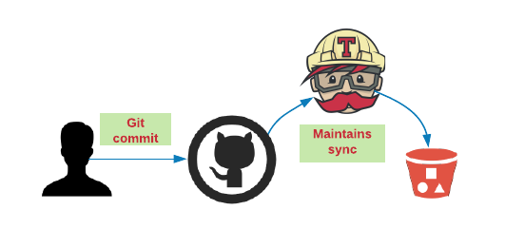
Code maintenance
Our code base resides on Git.
EMR fetches code from s3 bucket so it’s necessary to create a sync between Git and s3
Travis CI - continuous integration service
Travis CI sync the S3 bucket with git repo on every commit to the master branch

Slide 23

QUESTIONS?

