Slide 1
Momentum Capital Partners， LP.
GP： Weiqi Tong, Yichen Song, Yating Liu, Yu Sheng
LP： Eric Yeh
Notes:
Welcome to the investment fair, inclusive for columbia alumni of hedge fund members

Slide 2
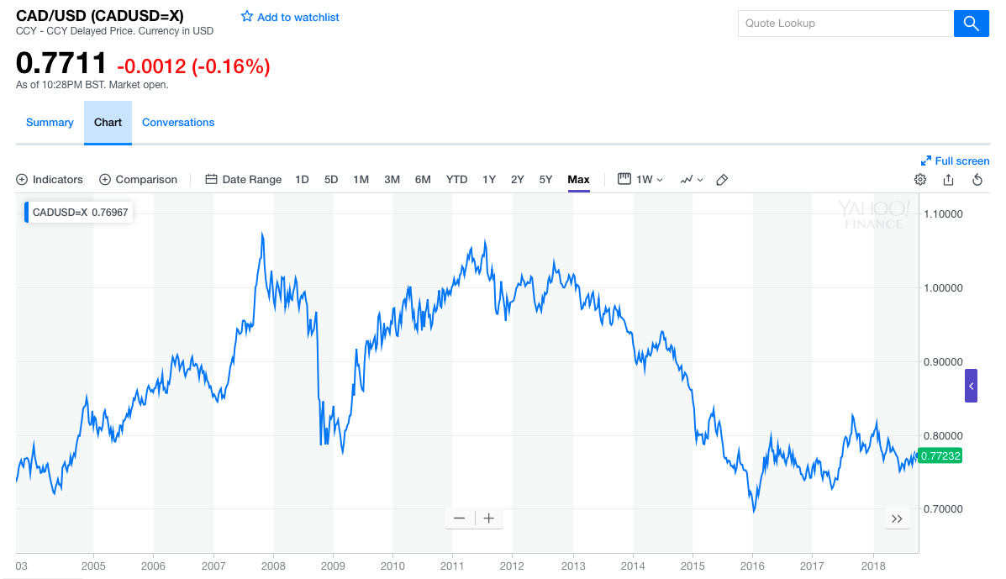

Slide 3
Intro to Momentum
Originated from equity markets -Jegadeesh & Titman (1993, 2001)
A trend-following strategy
buying securities that have had high returns over the past several months, and selling those that have had poor returns over the same period
Time-series momentum
Cross-sectional momentum（*）

Slide 4
Economic Intuition
Profit continuation
No generally accepted explanation for momentum returns yet
Several major approaches to explain:
transaction costs or limitations on short selling
temporary market inefficiency
behavioral biases including slow information diffusion
None of these can account for the extent to which returns from momentum exist in currency markets
Notes:
我在想这里我们是不是应该分开介绍momentum的economic intuition 和 signal的
risk-based and characteristics-based explanations
covariance risk with standard factors seems irrelevant
macroeconomic risk seems irrelevant
cognitive biases or informational issues
evidence of return continuation and subsequent reversals over longer horizons of up to 36 months, which is consistent with behavioral biases, such as investor under- and over-reaction
traders and markets tended to give positive feedback to recent information about asset prices, thus reinforcing price trends as they are in effect
Okunev and White (2003) suggested that momentum in the foreign exchange market is derived from two main sources: central bank intervention and the presence of noise traders. Noise traders, acting on the historical movements of exchange rates contribute a large proportion of the liquidity in the foreign exchange market and therefore can have a strong influence on the short-term direction of exchange rates. Behavioural finance literature has revealed that such traders are also susceptible to positive feedback mechanisms which can result in market inefficiencies including price momentum. This is driven by the trader’s propensity to extrapolate a currency’s current observed appreciation or depreciation into their expectations for the short run, creating a bandwagon effect of trend- following (Malkiel 2003).

Slide 5
Universe
Foreign Exchange（FX）market (required by our LP)
FX markets are more liquid and feature huge transaction volumes and low transaction costs
populated largely by sophisticated professional investors
no natural short-selling constraints that prevent the shorting to fully implement momentum strategies.
USD fund
Trade on G10
Spot price
Notes:
Why spot: forward is traded over the counter. might involve higher transaction cost for an individual investor
why G10: more liquid, easier to implement, reduce country risk(stable economy)

Slide 6
Signal: Relative Strength Indicator(RSI)
A momentum oscillator that measures the speed and change of price movements.
Formula:
RSI=100*average of upward price change/(average of upward price change+average of downward price change)
Usually between 0 and 100
Default time frame is 14 trading days

Slide 7
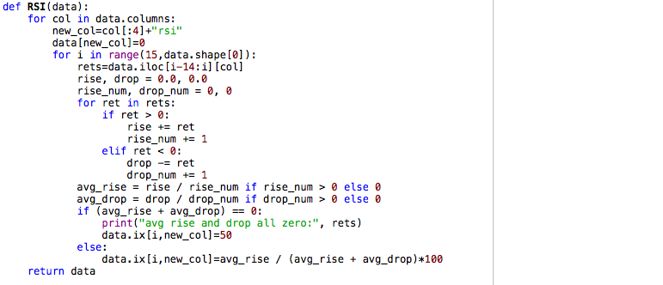
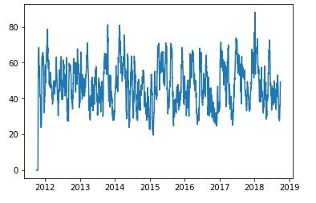
RSI Calculation:
Based on change of exchange rate, calculate RSI for 9 currencies(G10 excluding USD)
Notes:
>70 overbought <30: oversold
Choose RSI as signal:
Assume there are x days of rise and n-x days of drop in the past n days. Choose n=14 as default
Calculate the average rise in x days as Xr, and average drop as Xd.
RSI=Xr/(Xd+Xr)*100
RSI should be in [0,100].

Slide 8
Portfolio Construction
“long-short” momentum portfolios
Trading frequency: monthly
Sizing:
Filtering: long 3 best performing currencies, short 3 worst performing currencies
Hedging :
Dollar neutral
Money management：
Equal weighting
Net exposure set to zero, i.e long/short each currency with 1/3 of total assets
Notes:
Equal weighting: because momentum effect is the most significant in more risky currencies in less developed markets, momentum effect comes along with risks. To do more risks, we use equal weighting

Slide 9
Execution
Instrument:
Trade spot
Timing:
Time delay from data collection and signal generations is negligible since we rebalance the portfolio at a fixed frequency (20 trading days, etc.)
Agent:
Broker
Transaction costs:
operational costs(to broker): 4 cents/1K
spreads(bid-ask spread): we use ask price for buy and bid price for sell
Notes:
momentum is sensitive to transaction costs, so we decrease the frequency of trading to 3 months.
Broker: we are a small start-up, that do not have direct access to the system, so broker will be needed
Include forward rate (interest rate difference) when backtesting

Slide 10
Execution
Calculate RSI
for past 14 days
Close Previous
Positions
Rank RSI
Rebalance and
use new allocation
Calculate
Daily Return
Long highest 3 FX
Short lowest 3 FX
1/3 each FX

Slide 11
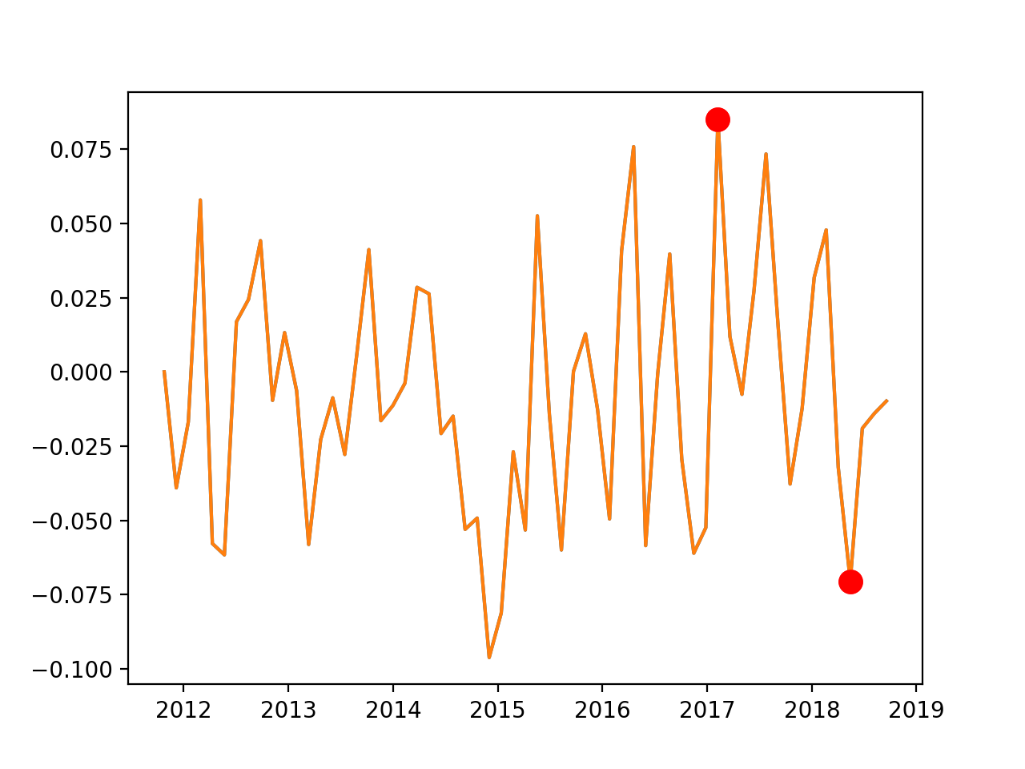
Evaluation - Return
Backtest
sharpe ratio：-0.9911
annual return：-0.92%

Slide 12
Evaluation - Risk
From our simulation:
volatility：0.0410
higher moments，kurtosis: 3-0.4885
Drawdown: 2.66
From real life:
Brexit
trade war

Slide 13
Potential Improvements
include forward rate
when we rebalance portfolio: in order to reduce transaction cost, if the signal tells us to long or short the same currency
Short: Margin call & Squeeze Risk
include more currency: emerging markets
Look back window
RSI could indicate overbought and oversold (mean reversion), combine other signals
Stop loss
Notes:
excess returns from momentum in the FX market can exceed those seen in equity markets even after adjusting for transaction costs, but may be more predominant with emerging market currencies

Slide 14
Evaluation - Operations
Data: Bloomberg
Accessibility: can easily access foreign exchange market through broker
Complexity: simple strategy, not much computational power required
Fixed cost: rent, wage
Regulation: US Regulations: limited leverage
Operational risk: cannot make an order through a broker in emergency
Model risk: best used with refinements to its application or in conjunction with other, confirming technical indicators.
Notes:
Regulation https://www.investopedia.com/articles/forex/011515/us-regulations-forex-brokers.asp
Sudden large price movements can create false buy or sell signals in the RSI.
(no, since we are students and work in Uris, data are downloaded using free quota in Uris and no advanced technology needed)

Slide 15
Evaluation - Correlation
Daily
Macro: interest rate
Common strategy
Portfolio: no other strategies in the portfolio
Other strategies: FX carry
Timing
Stress : dollar neutral
Events : ban on importing natural resources, trade war
Notes:
(where investors take a long position in a high yielding currency, and fund it by borrowing through a short position in a low yielding currency)

Slide 16
Evaluation - Competition, Evolution, Benefits and Marketability
Competition
were temporarily profitable but profits often tend to deteriorate over time as more traders learn about these strategies and start to exploit them
Evolution
Use volatility or trading volume as time span
Use overlapping portfolio
Benefits
Help us with other FX strategies due to a better relationship with broker
Marketability
easy to explain

Slide 17
Q&A
Notes:
1. why do we rebalance the portfolio every month? backtesting
2. In evolution: Use volatility or trading volume as time span and use overlapping portfolio
3. implementation:
4.
Join momentum capital, earn profit tomorrow哈哈哈哈

