Slide 1


On-Time Flight Performance Analysis
Executive Business Review - VP & Director of Data Science
John Hupperts

Slide 2
Itinerary
Company Overview
Dataset – Background
Dataset – Technical Synopsis
Analysis – Questions, Wrangling, Insights
Business Actions, Further Work
Appendix: Databricks Platform

Slide 3

Company Overview
Online Marketplaces for Travel Services
Portfolio of Consumer Brands
Airlines
Lodging
Car Rental
Cruises
Experience Packages
Business Synergies – Leverage Data Across Markets
Merchants: Buy & Sell
Agents: Broker for Fees
SEC Form 10-K 2021
Notes:
Conglomerate
Strategically positioned to leverage data science & engineering across markets & business units in the company
Portfolio of business consisting of merchandised & brokered tickets/bookings

Slide 4
Dataset – Background
DOT BTS On-Time Performance of Domestic Flights
Categorical Flight Delay-Causes & Cancellations
Delayed: Arrived >15min Late
Possibly Multiple Delay-Causes Per Flight
Delay Cause | Delay Definition
Air Carrier | Airline’s fault
Extreme Weather | Bad weather
National Aviation System (NAS) | Air Traffic Control
Late-Arriving Aircraft | Aircraft arrives late from previous flight
Security | Security breach, dangerous events, or >29 min TSA lines
Notes:
The U.S. Department of Transportation's (DOT) Bureau of Transportation Statistics (BTS) tracks the on-time performance of domestic flights operated by large air carriers
Data is available courtesy of Freedom of Information Act

Slide 5
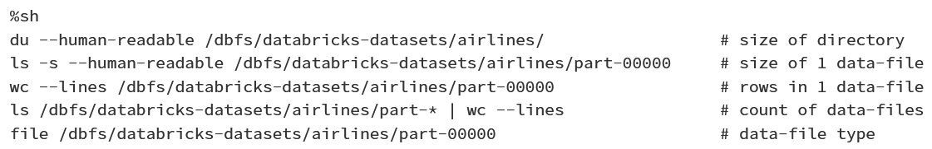
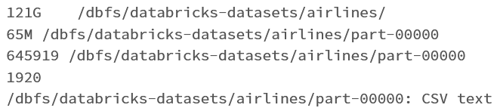
Dataset – Technical Synopsis
Data resided on Databricks simulated file system
121G Directory, 1920 CSV files
Each CSV ~65M, ~645k rows

Slide 6
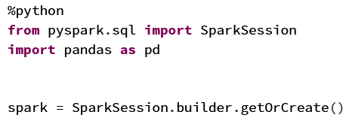

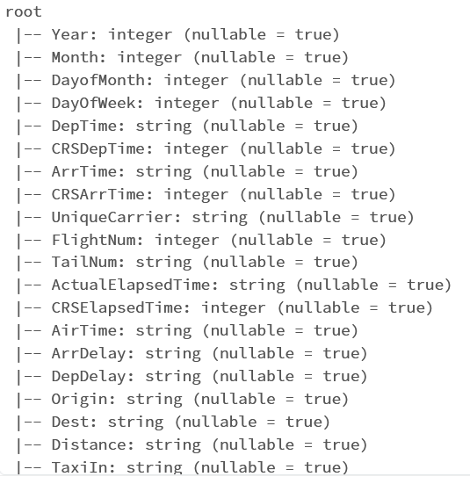
Dataset – Technical Synopsis
Inferred Schema
Integers & Strings

Slide 7
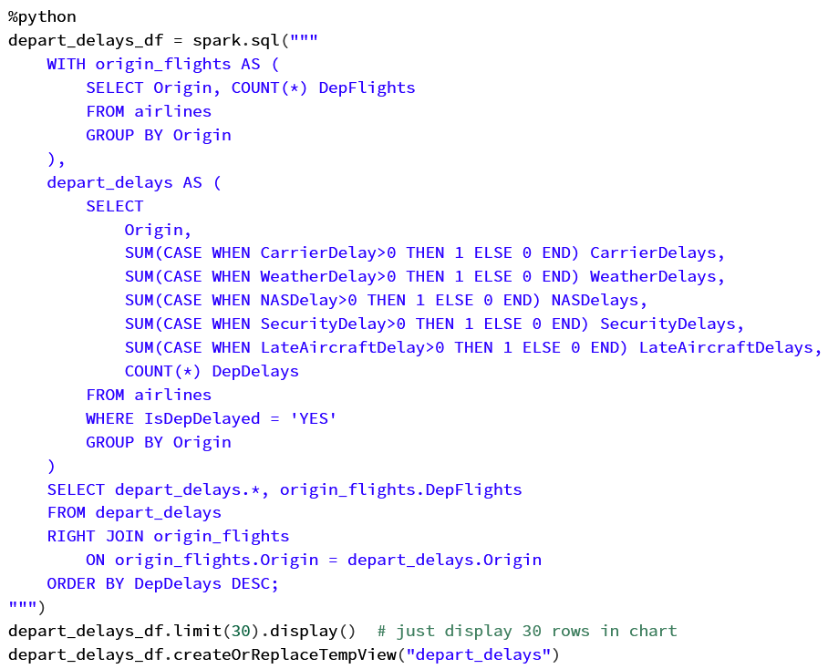
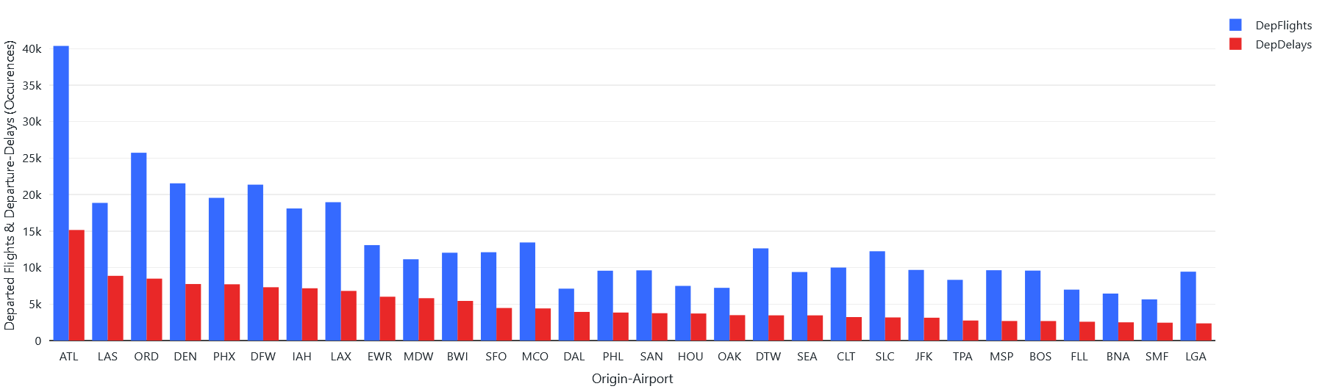
Analysis Delay Occurrences
By ratio of departure-delay occurrences to departures, which origin-airports have the most departure-delays?
For each origin-airport, what proportion of total departures is delayed by each delay-cause?
Irregular departure-delay ratios among top 30
Notes:
1 delayed flight can have multiple causes

Slide 8
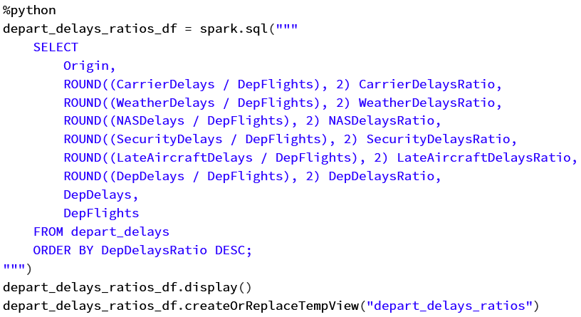
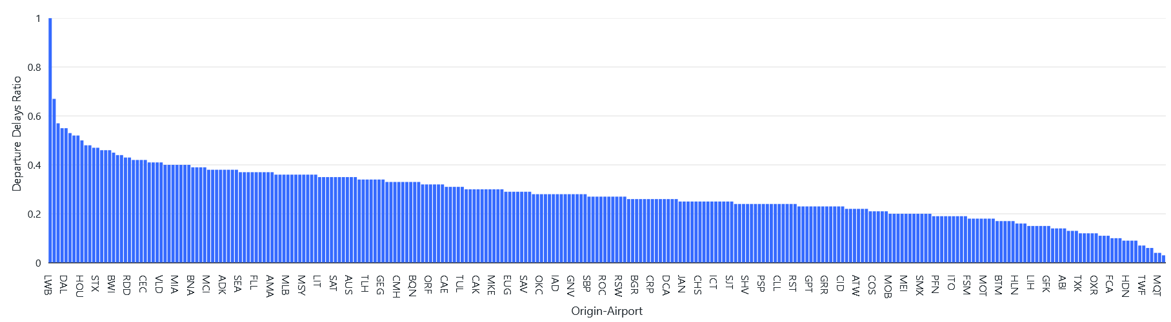
Analysis Delay Occurrences
By ratio of departure-delay occurrences to departures, which origin-airports have the most departure-delays?
For each origin-airport, what proportion of total departures is delayed by each delay-cause?
Very broad range of delay-ratios across airports
Notes:
1 delayed flight can have multiple causes

Slide 9
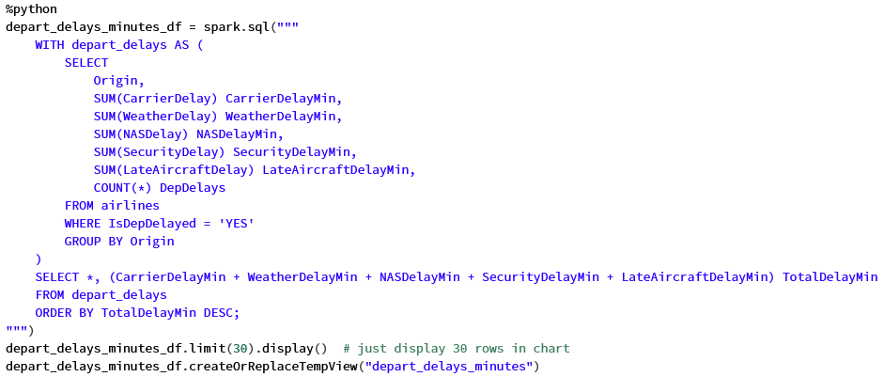
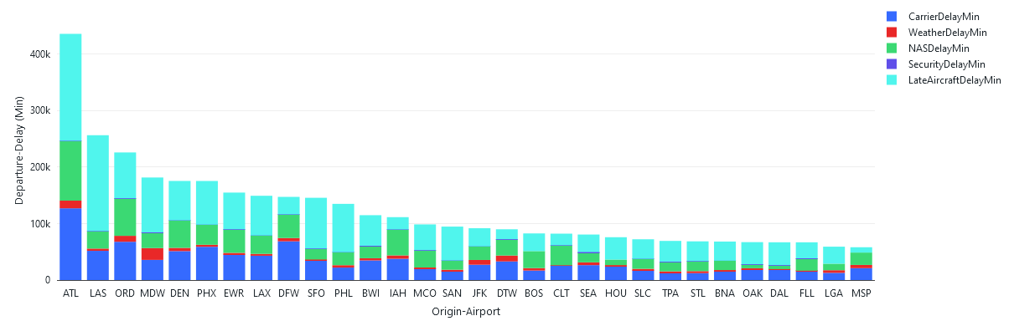
Analysis Delay Time
By summation of departure delay-time, which origin-airports have the most delay-time?
For each origin-airport, how much delay-time is each delay-cause responsible for?
Irregular skew of delay-causes among airports
Notes:
1 delayed flight can have multiple causes

Slide 10
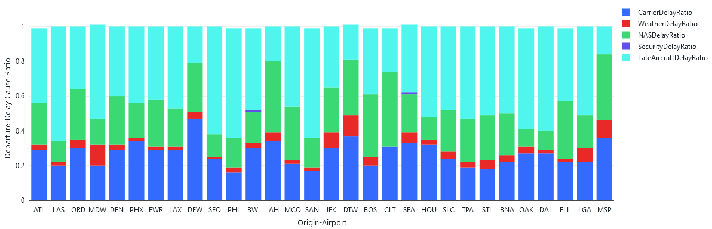
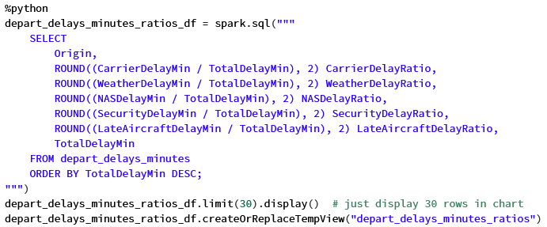
Analysis Delay Time
For each origin-airport, what's the distribution of total departure delay-time among delay-causes?
Different skews of delay-causes among airports, better visualized independent of volume
Notes:
1 delayed flight can have multiple causes

Slide 11
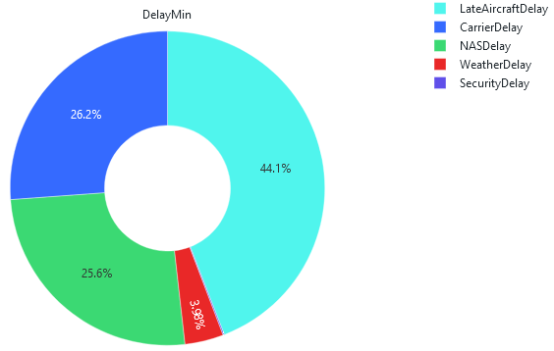
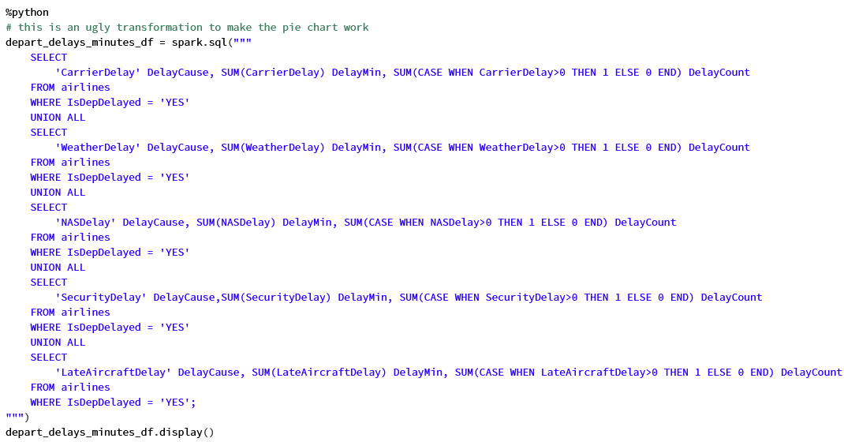
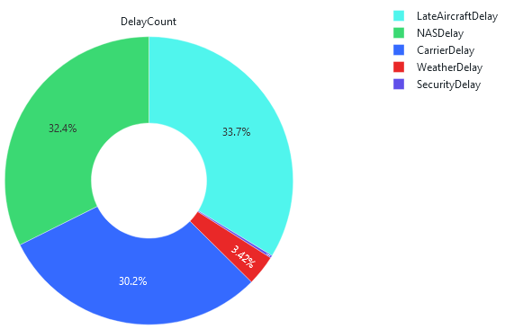
Analysis Delay Time
Among all origin-airports, what's the distribution of total departure delay-time among delay-causes?
Few Security delays
Notes:
1 delayed flight can have multiple causes

Slide 12
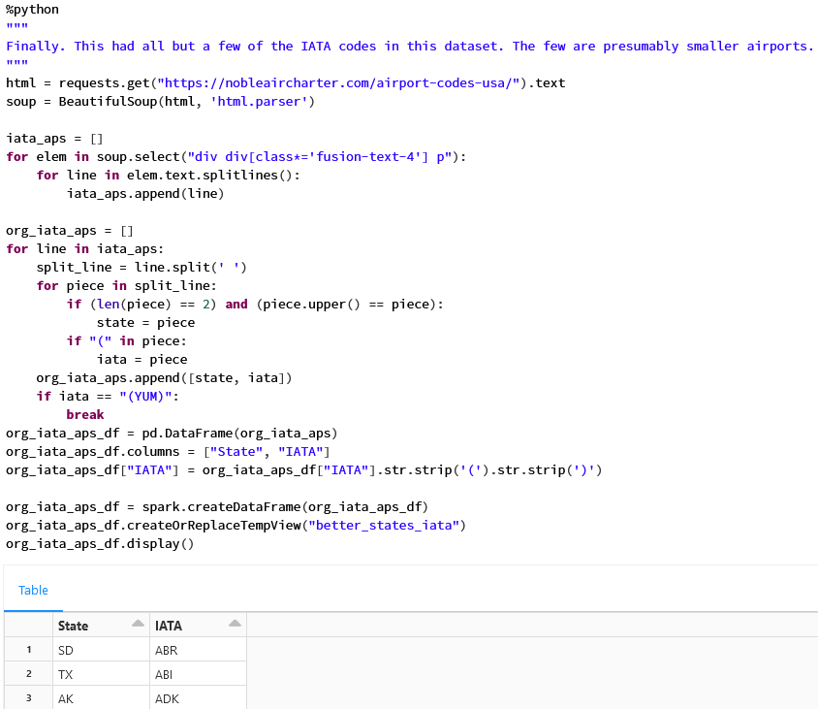
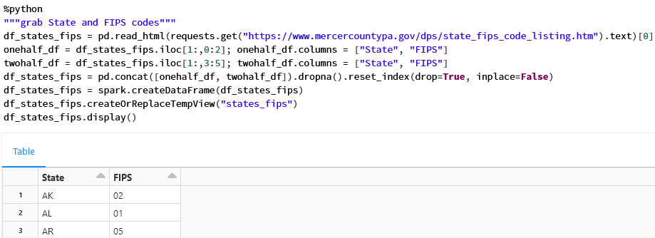
Analysis Geography & Weather
Are there geographic areas where a larger share of departure-delays is due to weather?
Map IATA codes to States & Map States to FIPS
Notes:
1 delayed flight can have multiple causes

Slide 13
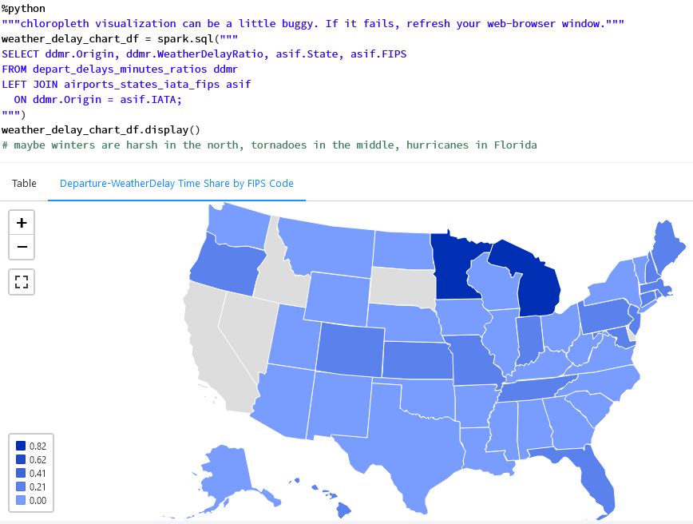
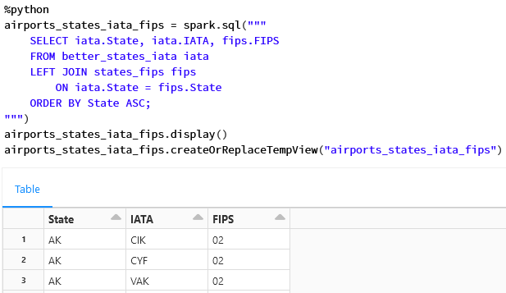
Analysis Geography & Weather
Are there geographic areas where a larger share of departure-delays is due to weather? (Cont.)
Join IATA, States, & FIPS
Notes:
1 delayed flight can have multiple causes

Slide 14
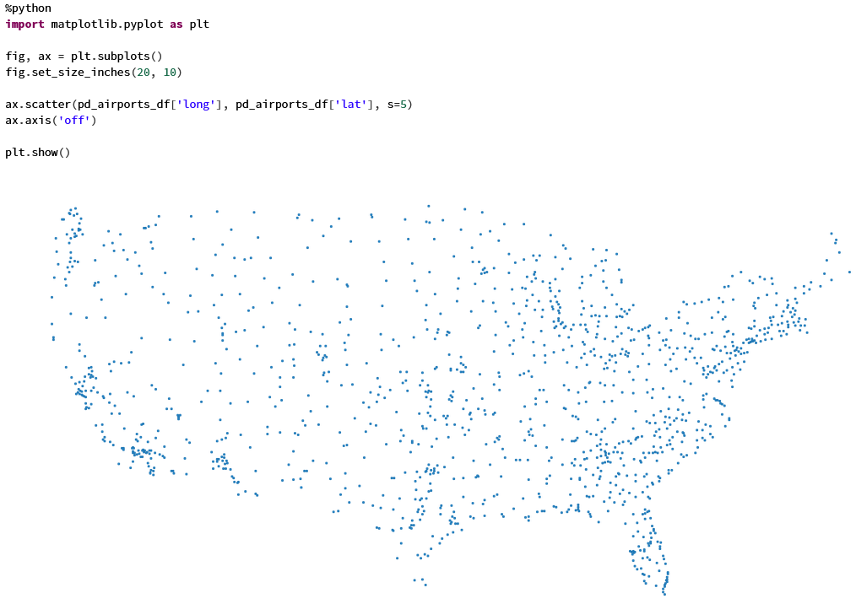
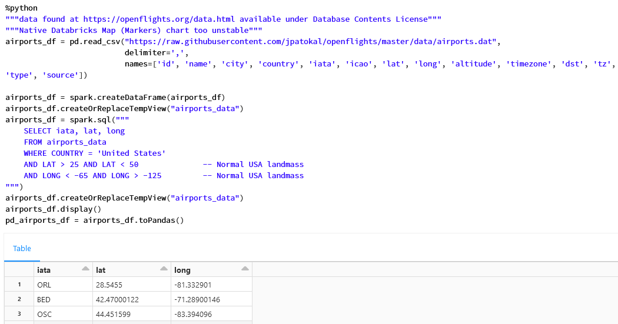
Analysis Geography & Path
Can insights be gleaned from a visual of a random sample of flight paths?
Grab lat., long. coordinates for domestic airports
Notes:
1 delayed flight can have multiple causes

Slide 15
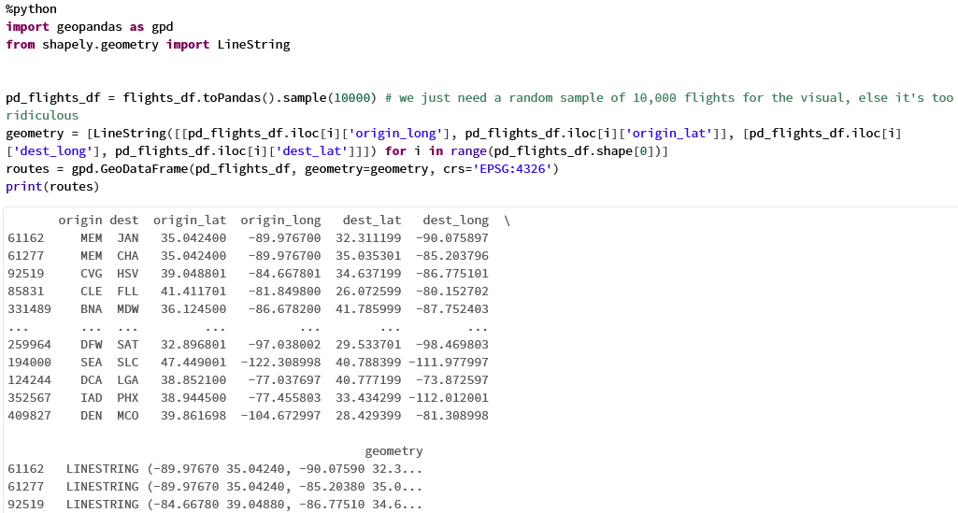
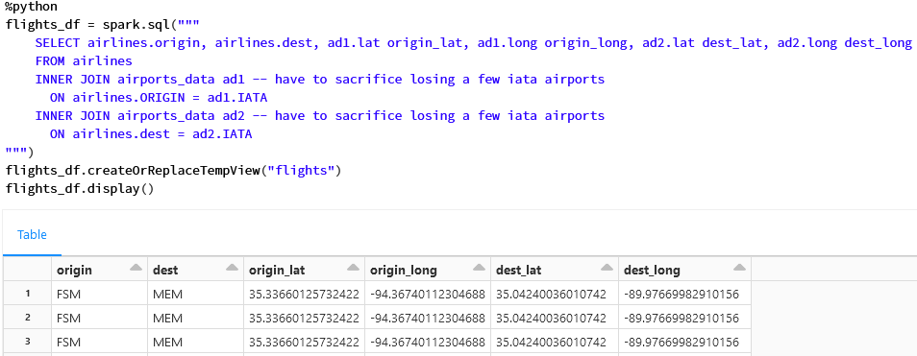
Analysis Geography & Path
Can insights be gleaned from a visual of a random sample of flight paths? (Cont.)
Join lat., long coordinates to flight origins & destinations
Calculate path-lines
Notes:
1 delayed flight can have multiple causes

Slide 16
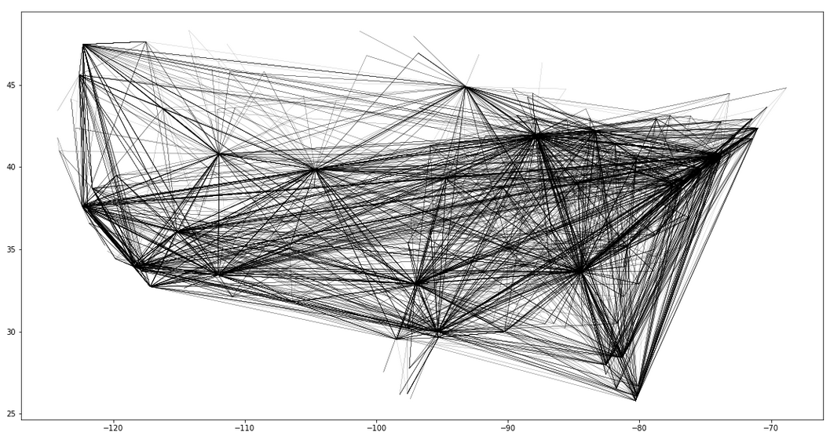
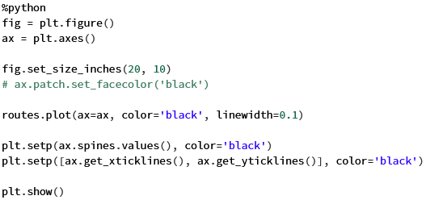
Analysis Geography & Path
Can insights be gleaned from a visual of a random sample of flight paths? (Cont.)
Overlay this on a map with major cities highlighted
Notes:
1 delayed flight can have multiple causes

Slide 17
Business Actions, Further Work
Unfortunately, dataset wasn’t very robust; no actionable business insights
However, if augmented with more thorough data to feed Expedia’s offering portfolio AI…
Could better weight portfolio of merchandised & brokered tickets with respect to flight delay & cancellation risk
Example: Mid-summer is peak tornado season – more delayed/canceled flights
Expedia could rebalance its flight ticket offerings to have a greater share of brokered tickets rather than merchandised tickets to alleviate its risk of claims for refunds by customers
If unable to expediently rebalance its portfolio of merchandised & brokered tickets, perhaps Expedia could sell off assets in other businesses to raise cash and shore up liquidity to repay those refunds.
Could offer favorable discounted lodging accommodations to customers facing canceled flights
Harvest some goodwill & addl. revenue from sale of lodging
Interesting candidate for integration: Weather data
Pattern of more frequent inclement weather in certain locations due to climate change, affecting travel behavior

Slide 18
Appendix: Databricks Platform
Cohesive, well packaged, collaborative Cloud development environment for Apache Spark w/ integrated tools: Web UI, Notebooks, COS
Multiple languages/kernels in 1 notebook
I used Python & PySpark mostly
But, in dev., was nice to use SQL against Spark tables w/o boiler plate
If moved into production…
Data engineering SME should improve utilization of Spark
Architect set up a well optimized data lake for storage; DeltaLake
Job scheduler like Apache Airflow
Access controls for collaboration

