Slide 1


On-Time Flight Performance Analysis
Executive Business Review - VP & Director of Data Science
John Hupperts

Slide 2
Itinerary
Company Overview
Dataset – Background
Dataset – Technical Synopsis
Analysis – Questions, Wrangling, Insights
Business Actions, Further Work
Appendix: Databricks Platform

Slide 3

Company Overview
Online Marketplaces for Travel Services
Portfolio of Consumer Brands
Airlines
Lodging
Car Rental
Cruises
Experience Packages
Business Synergies – Leverage Data Across Markets
Merchants: Buy & Sell
Agents: Broker for Fees
SEC Form 10-K 2021
Notes:
Conglomerate
Uniquely positioned to leverage data science & engineering across markets & business units in the company
Portfolio of business consisting of merchandised & brokered tickets/bookings

Slide 4
Dataset – Background
DOT BTS On-Time Performance of Domestic Flights
Categorical Flight Delay-Causes & Cancellations
Delayed: Arrived >15min Late
Possibly Multiple Delay-Causes Per Flight
Delay Cause | Delay Definition
Air Carrier | Airline’s fault
Extreme Weather | Bad weather
National Aviation System (NAS) | Air Traffic Control
Late-Arriving Aircraft | Plane arrives late from previous flight
Security | Security breach, dangerous events, or >29 min TSA lines
Notes:
The U.S. Department of Transportation's (DOT) Bureau of Transportation Statistics (BTS) tracks the on-time performance of domestic flights operated by large air carriers
Data is available courtesy of Freedom of Information Act

Slide 5
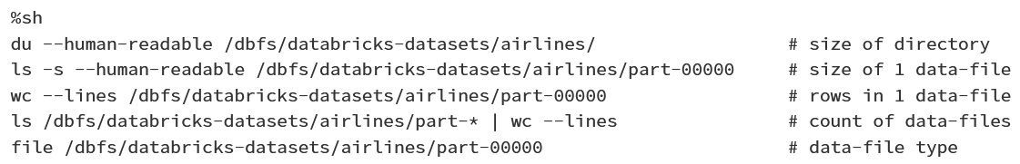
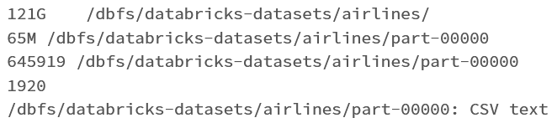
Dataset – Technical Synopsis
Data resided on Databricks simulated file system
121G Directory, 1920 CSV files
Each CSV ~65M, ~645k rows

Slide 6
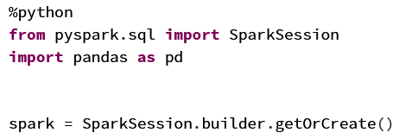

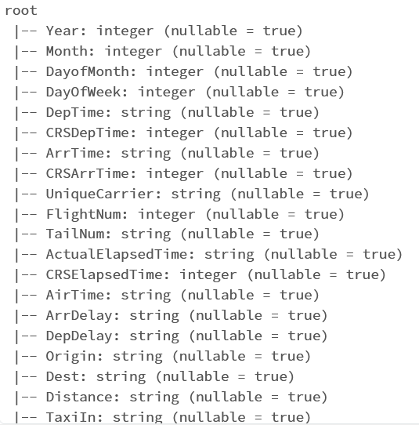
Dataset – Technical Synopsis
Inferred Schema
Integers & Strings

Slide 7
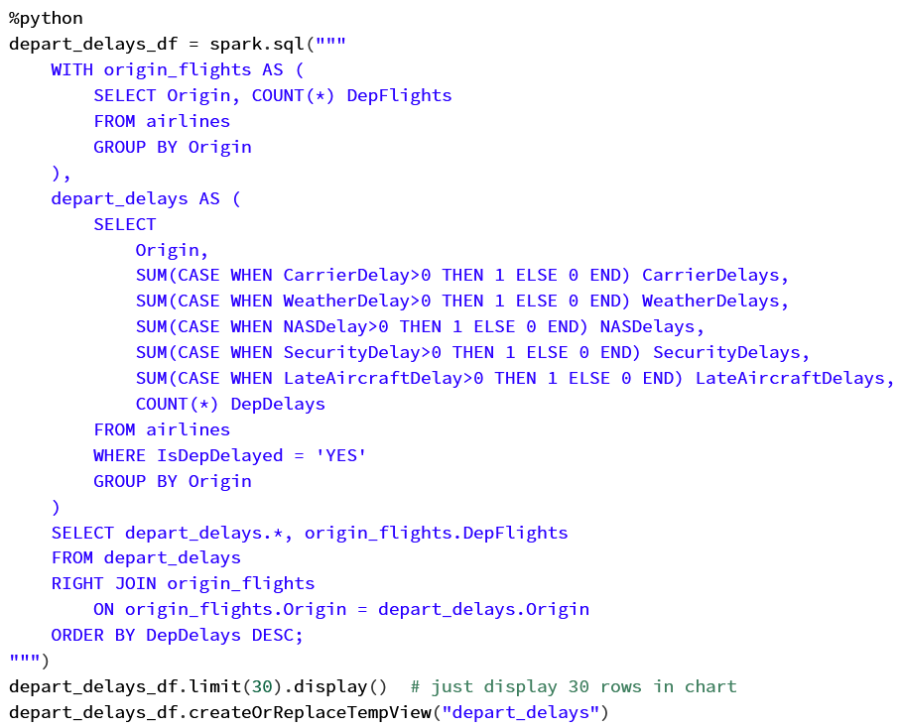
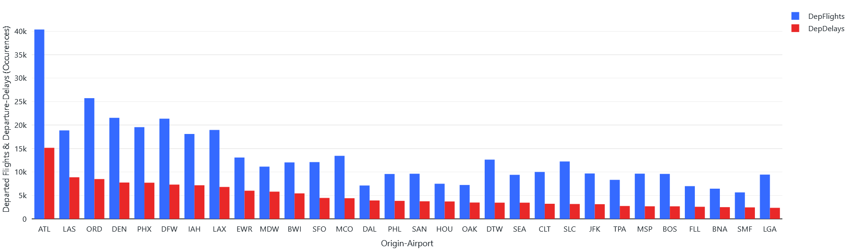
Analysis Delay Occurrences
By ratio of departure-delay occurrences to departures, which origin-airports have the most departure-delays?
For each origin-airport, what proportion of total departures is delayed by each delay-cause?
Irregular departure-delay ratios among top 30
Notes:
1 delayed flight can have multiple causes
Selecting a count of departed flights by each origin-airport,
Sum up counts for each delay-cause where there’s more than 0 minutes of delay,
Join those up
What you see here is just the top 30 origin-airports by volume of departed-flights

Slide 8
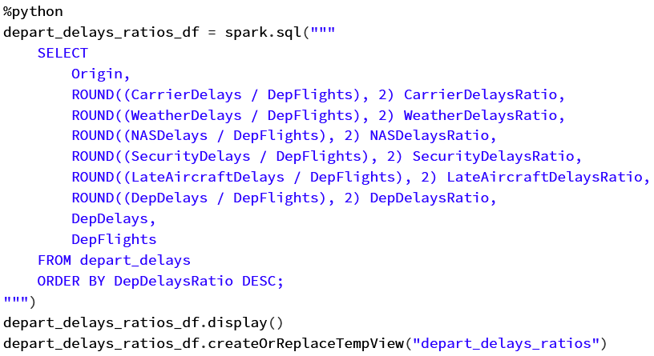
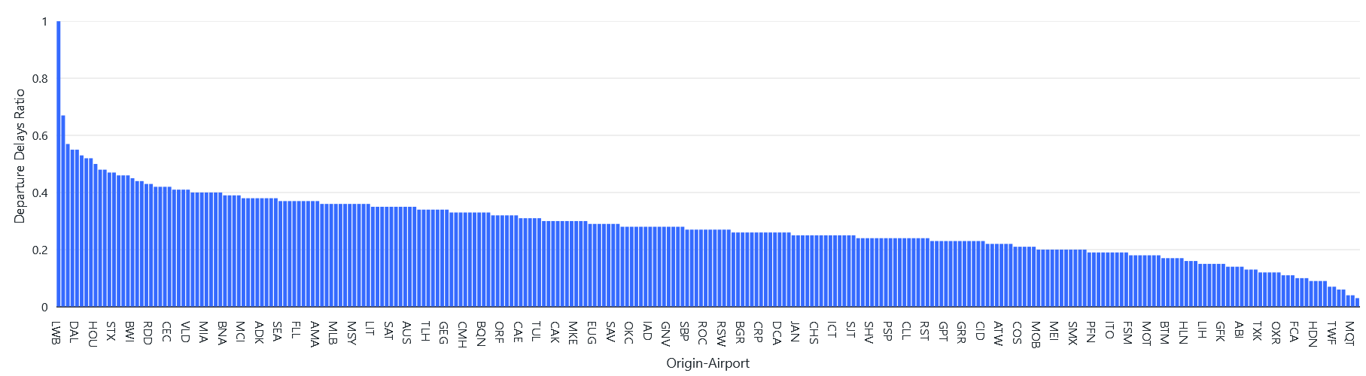
Analysis Delay Occurrences
By ratio of departure-delay occurrences to departures, which origin-airports have the most departure-delays? (Cont.)
For each origin-airport, what proportion of total departures is delayed by each delay-cause? (Cont.)
Very broad range of delay-ratios across airports
Notes:
1 delayed flight can have multiple causes
This query’s a little overblown, all that matters here is that I’m grabbing the rounded fraction of delay-occurrences over flights by origin-airport from view I created in the last slide
There’s quite possibly some outliers here; they probably have a very little sample size.
I’ll factor that out a bit in the next sections, albeit with delay-time rather than delay-occurrences, but independent of volume
Also, I’ll tend to focus on just the top 30 origin-airports by volume of departed-flights, which should remove those anomalies

Slide 9
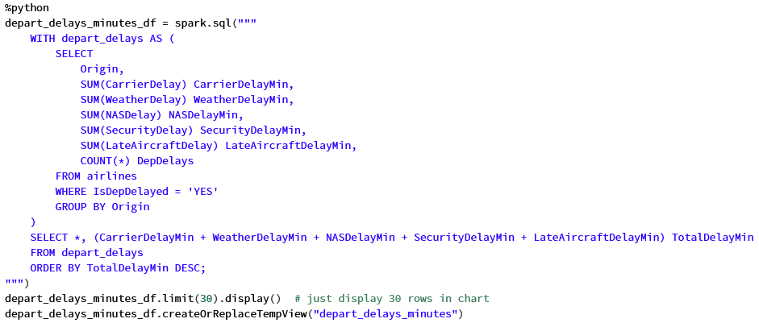
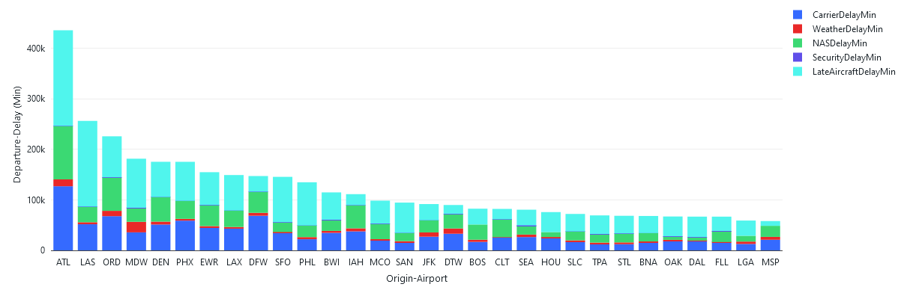
Analysis Delay Time
By summation of departure delay-time, which origin-airports have the most delay-time?
For each origin-airport, how much delay-time is each delay-cause responsible for?
Irregular skew of delay-causes among airports
Notes:
1 delayed flight can have multiple causes
Grabbing the sums of each delay-causes’ minutes and grouping by origin-airport
You can see I have to do a bit of math to calculate the total delay time of all causes for each origin-airport, summing up all causes’ times. That’s not shown in this visualization, though, but is useful to see in the result set.
Stacked bar chart. Irregular skew

Slide 10
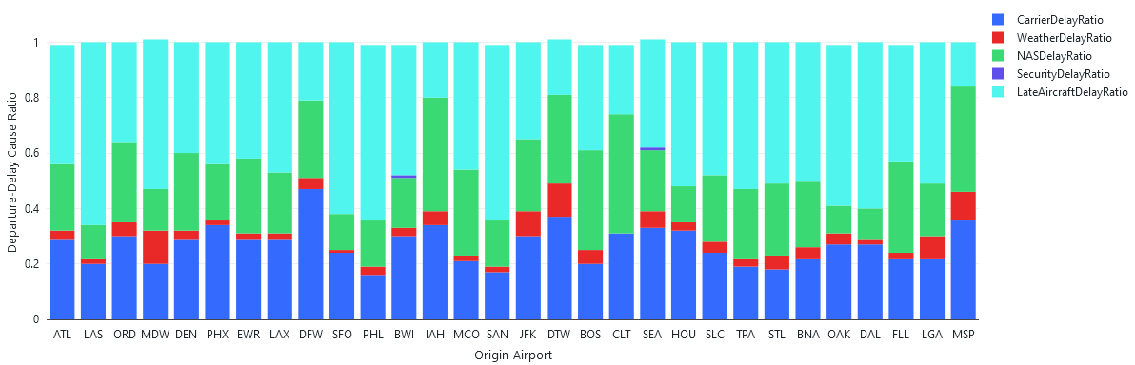
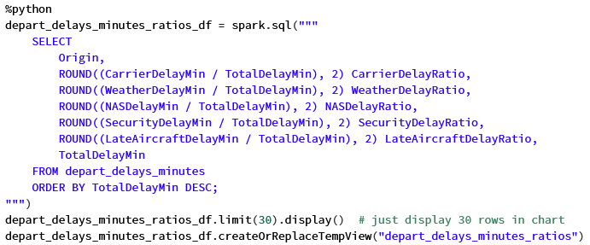
Analysis Delay Time
For each origin-airport, what's the distribution of total departure delay-time among delay-causes?
Different skews of delay-causes among airports, better visualized independent of volume
Notes:
1 delayed flight can have multiple causes
I’m grabbing the rounded fraction of delay-cause-minutes over total-delay-minutes by origin-airport
This visualization gives you a better feel for each delay-causes’ share of delay-time by origin-airport, independent of total-delay-time

Slide 11
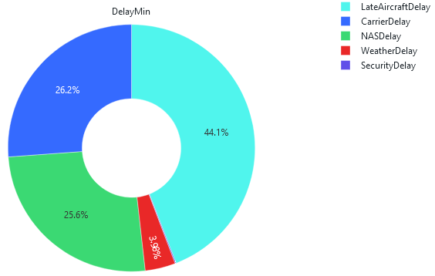
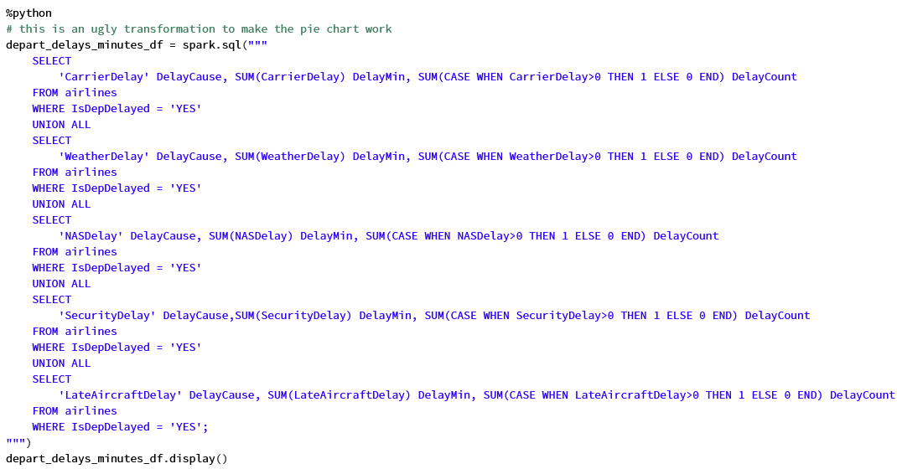
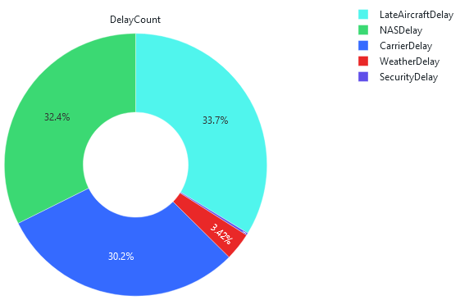
Analysis Delay Time
Among all origin-airports, what's the distribution of total departure delay-time among delay-causes?
Few Security delays
Notes:
1 delayed flight can have multiple causes
Here I had to do a bit of work to essentially transpose the delay-cause data in a way so that in the result set, I had a delay-cause field. So that’s why this query is a bit ugly with the unions.
I did that so I could make these pie charts.
I was surprised to see how small weather was. I was happy to see security issues are basically unobservable.

Slide 12
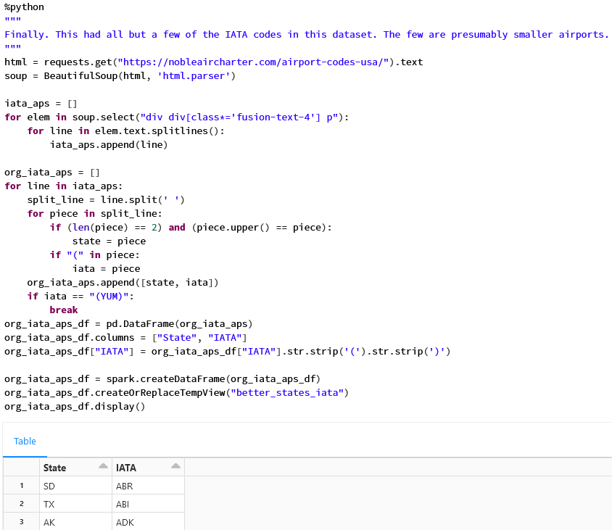
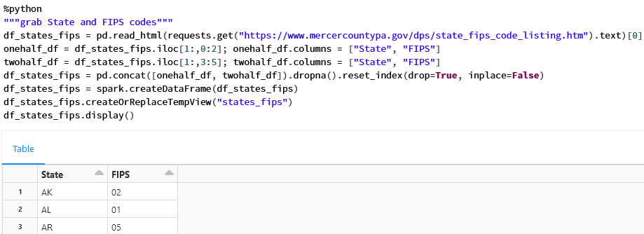
Analysis Geography & Weather
Are there geographic areas where a larger share of departure-delays is due to weather?
Map IATA codes to States & Map States to FIPS
Notes:
1 delayed flight can have multiple causes
I wanted to bolster up the dataset a bit to do something a little more interesting
So, I used the requests library to fetch some IATA codes & FIPS datasets from the internet.
IATA: International Air Transport Association airport codes
FIPS: Federal Information Processing Standards geographical area codes
I had to do a bit of wrangling to pull the data out of the HTML elements and stuff to build out my dataframes.
I actually originally went out and did this for FAA codes rather than IATA codes, so that was a bit frustrating to realize, then I went out and got some IATA code dataset that wasn’t very good before I stumbled upon this good dataset.
FAA: Federal Aviation Administration airport codes

Slide 13
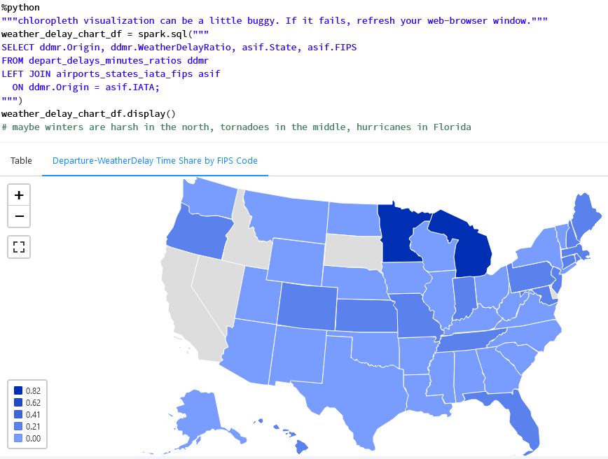
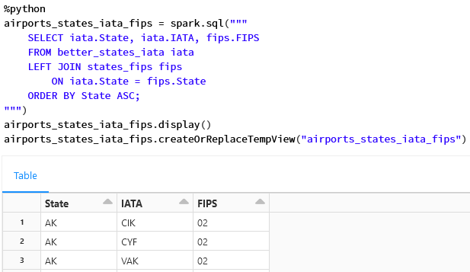
Analysis Geography & Weather
Are there geographic areas where a larger share of departure-delays is due to weather? (Cont.)
Join IATA, States, & FIPS
Notes:
1 delayed flight can have multiple causes
Join IATA, States, FIPS, to delay-time ratios dataset
Mapped it on this choropleth chart
Harsh winters in north, tornado alley, hurricanes in FL

Slide 14
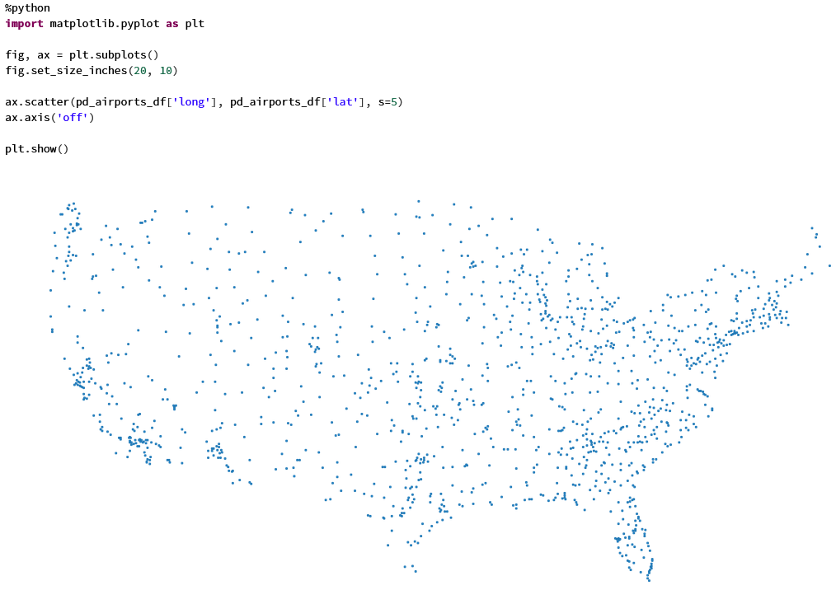
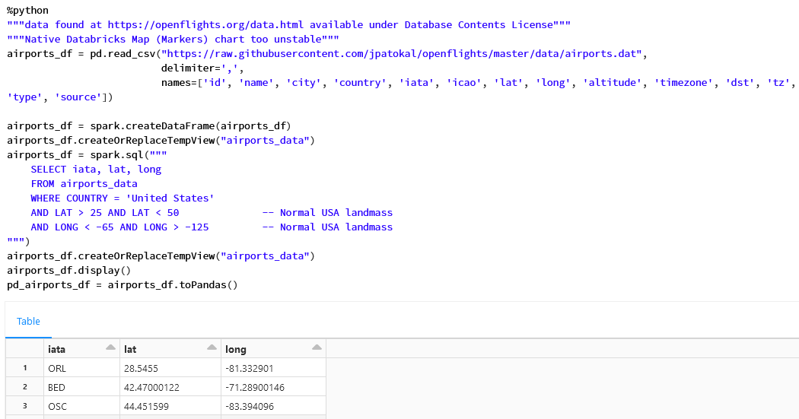
Analysis Geography & Path
Can insights be gleaned from a visual of a random sample of flight paths?
Grab lat., long. coordinates for domestic airports
Notes:
1 delayed flight can have multiple causes
That was pretty cool, but I wondered if some insights could be gleaned from a visual of random sample of flight paths
I found this great dataset that had the lat, longs of IATA airports on the internet, so I pulled that into a dataframe and filtered it down to Normal US Landmass lat, longs
Which you see here
A lot of people must live on the East & West coasts from the density of airports we see

Slide 15
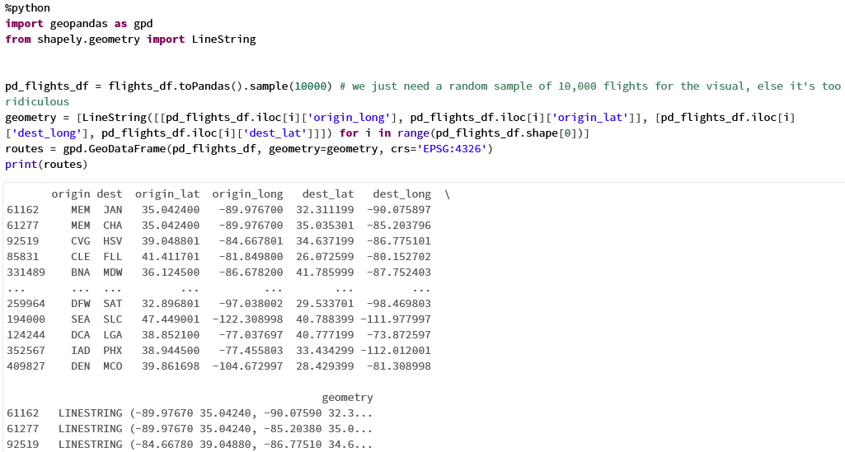
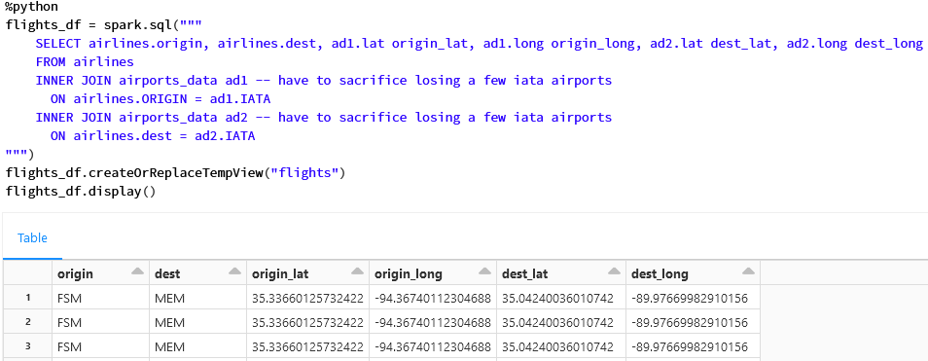
Analysis Geography & Path
Can insights be gleaned from a visual of a random sample of flight paths? (Cont.)
Join lat., long coordinates to flight origins & destinations
Calculate path-lines
Notes:
1 delayed flight can have multiple causes
I joined that lat, long information onto the flight-origin and destination data so that I had the coordinates for origin & destination for each flight
I grabbed a random sample of 10,000 flights from that
I used this complicated Python library called shapely that has some nice functions for planar geometric math stuff to calculate the lines/vectors from each origin to destination

Slide 16
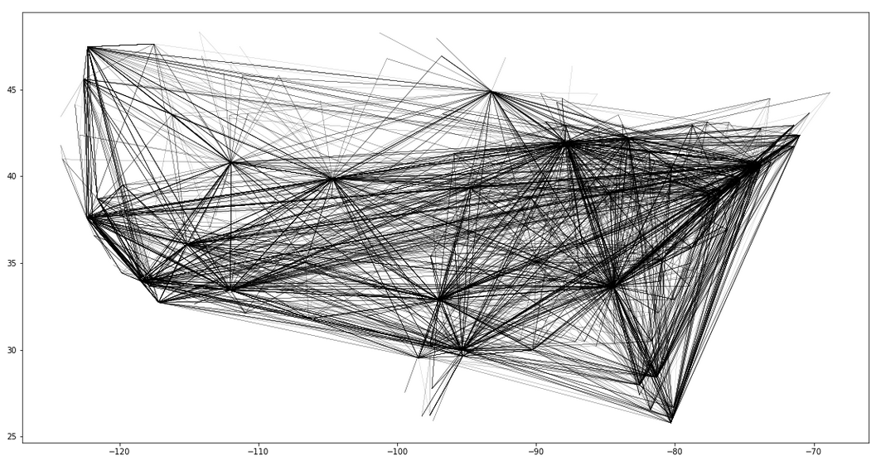
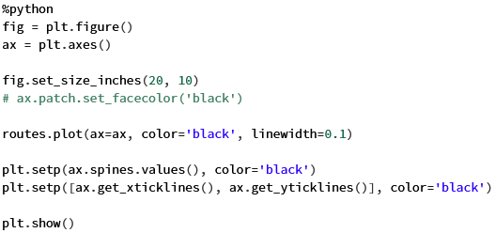
Analysis Geography & Path
Can insights be gleaned from a visual of a random sample of flight paths? (Cont.)
Overlay this on a map with major cities highlighted
Notes:
1 delayed flight can have multiple causes
Finally, I plotted the 10,000 flight lines on a chart, which you see
Looks like a lot of people flying to and from California, Florida, NE, Maybe Chicago

Slide 17
Business Actions, Further Work Expanded Use Cases, Addl. Datasets
Unfortunately, dataset wasn’t very robust; no actionable business insights
However, if augmented with more thorough data to feed Expedia’s offering portfolio AI…
Could better weight portfolio of merchandised & brokered tickets with respect to flight delay & cancellation risk
Example: Mid-summer is peak tornado season – more delayed/canceled flights
Expedia could recognize conditions & rebalance its flight ticket offerings to have a greater share of brokered tickets rather than merchandised tickets to alleviate its risk of claims for refunds by customers
If unable to expediently rebalance its portfolio of merchandised & brokered tickets, perhaps Expedia could sell off assets in other businesses to raise cash and shore up liquidity to repay those refunds.
Could offer favorable discounted lodging accommodations to customers facing canceled flights
Harvest some goodwill & addl. revenue from sale of lodging
Interesting candidate for integration: Weather data
Pattern of more frequent inclement weather in certain locations due to climate change, affecting travel behavior

Slide 18
Appendix: Databricks Platform
Cohesive, well packaged, collaborative Cloud development environment for Apache Spark w/ integrated tools: Web UI, Notebooks, COS
Multiple languages/kernels in 1 notebook
I used Python & PySpark mostly
But, in dev., was nice to use SQL against Spark tables w/o boiler plate
If moved into production…
Data engineering SME should improve utilization of Spark
Architect set up a well optimized data lake for storage; DeltaLake
Job scheduler like Apache Airflow
Access controls for collaboration

