Slide 1


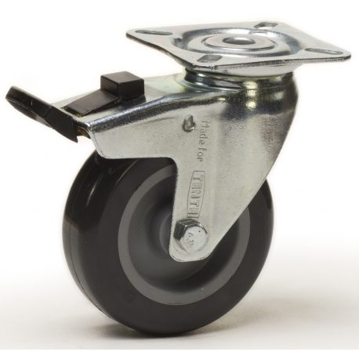
1300mm
1000mm
1000mm
870mm

