Slide 1
BUPT_PRIS at TREC 2014 Knowledge Base
Acceleration Track
Yuanyuan Qi
Pattern Recognition and Intelligent System Lab.,
Beijing University of Posts and Telecommunications, Beijing, China.
Nov. 20 2014

Slide 2
Content
Challenge & Strategy
  New Situation and Challenge
  Strategy
Vital Filtering
  System overview
  Query expansion
  Features generation
  Vital classification
  Result
Stream Slot Filling
  System overview
  Query expansion and co-reference resolution
  Pattern learning and matching
  Result
Q&A？

Slide 3
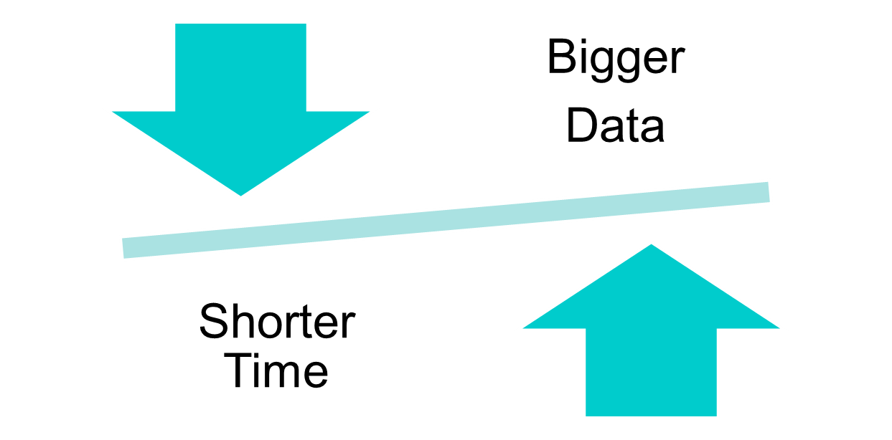
Challenge & Strategy
Notes:
This year we have to cope with 1 T byte Data at last ,compare with last year is twice.
We have to spend more time to download and preprocess the data with the same number of severs.
But in fact this year we have less severs.
And the worse news is the time turn shorter for the time of releasing data near the end of July.
Which means we only have nearly half time of the last year to use.

Slide 4
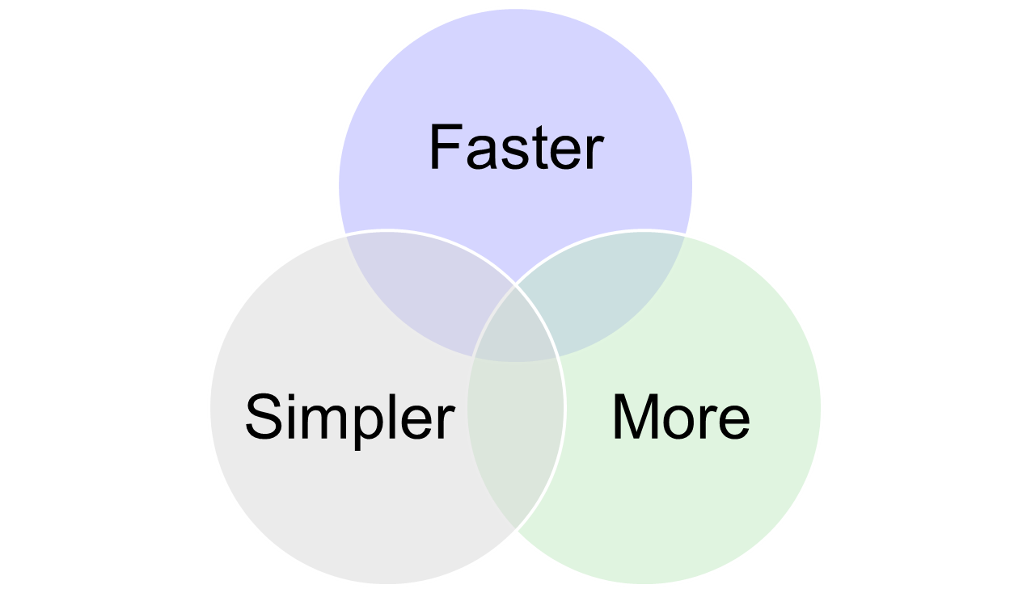
Challenge & Strategy
Notes:
Faster——Indexed the data we have filtered with ElasticSearch，Which Speed up a lot our methods processing
Simpler——This year we treat the task as a classification task ,we choose simpler method without Manual annotation or complicated applied requirements
More—— We Focus attention on finding better and more features for classifiers.

Slide 5
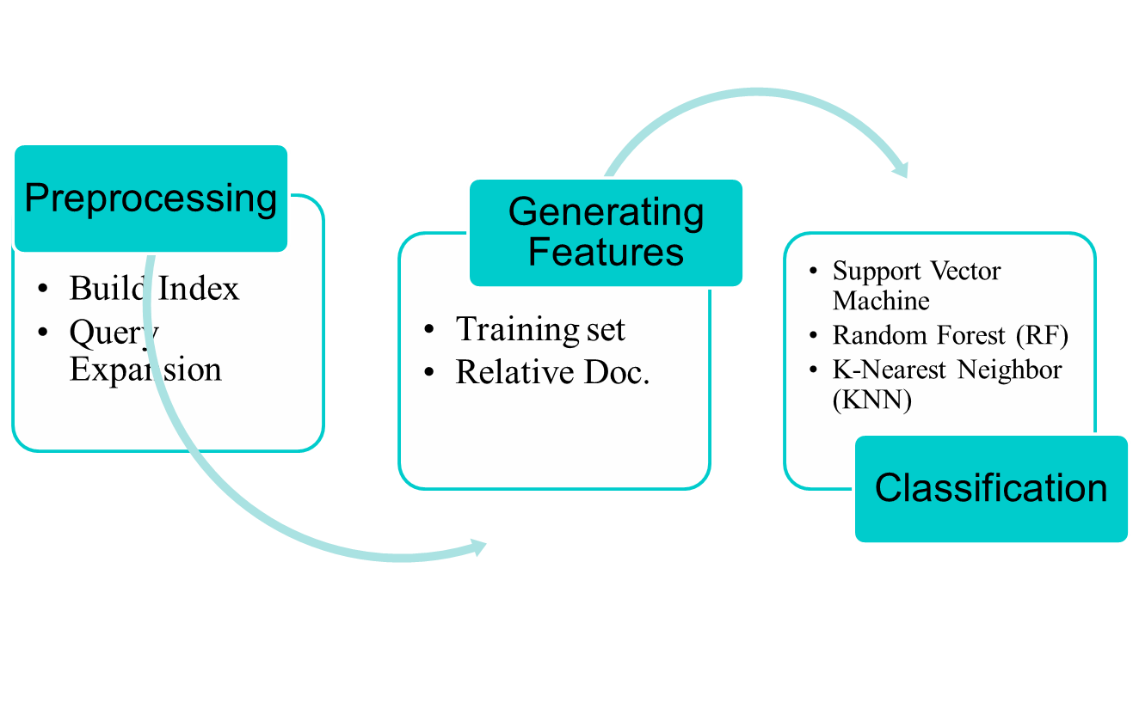
Vital Filtering(VF)
Notes:
we decompress the corpus and filter the field what we are interested in. Then we indexed the data we have filtered with ElasticSearch.
The purpose of indexing is to make it convenient and fast for our algorithms.
At the same time we expand the entities with the DBpedia and wiki, then we used the training set to train a classifier

Slide 6
Vital Filtering(VF)
Query Expansion
  The entity has a DBpedia page we extract keywords from the corresponding DBpedia page as expansion terms
  The entity doesn’t have a DBpedia page we extract keywords from the corresponding twitter page as expansion terms
query
redirect
entity
label
Support docs
wiki
category
profile
Notes:
we extracted entity from the data offered by office and for each entity extracted label and category from support documents
if we can Link N layer to be pointing to the page again ,we can treat such word as profile. Considering for precision,The N is one
Doesn’t have :The system chooses alternative names and the link of homepage as expansion terms from the corresponding twitter page and then visits the homepage to extract key words of homepages as expansion terms

Slide 7
Vital Filtering(VF)
Features generation
To present the document, we extract 10 features of one document as follows:
  number of target name of an entity;
  number of redirect name of an entity;
  number of category of an entity;
  number of target name in one document;
  number of redirect name in one document;
Notes:
第一个特征应该就是他的本名了;不出意外的话值应该就是1(normally the number of target name of an entity is one)
The forth one I the times of an entity appears in one doucument

Slide 8
Vital Filtering(VF)
Features generation
To present the document, we extract 10 features of one document as follows:
  number of category in one document;
  An entity’s first mention place in the document;
  An entity’s last mention place in the document;
  length of a document;
  the cosine similarity of the document and the mean value of related documents of an entity
Notes:
The ninth is the total words of a documents
The tenth, we calculate the tf-idf of each word (not include the stop words) for one document ,then we get a document vector with thousands of dimensions

Slide 9
Vital Filtering(VF)
Vital classification
We treat the task as a classify task, so we use three different ways to classify the vital documents:
  Support Vector Machine (SVM);
  we choose Radial Basis Function as kernel function
  Random Forest (RF);
  we set the number of trees is 10
  K-Nearest Neighbor (KNN);
  we make the k=5
Use the training data to learn the models parameters with the ten features as input
Notes:
SVM的优点:we chose svm for it good performance of generalization and relatively low requirements of data scale ,non liner svm gets faster processing speed than liner svm, we chose radial basis function as the kernel function.
A random forest is a meta estimator that fits a number of decision tree classifiers on various sub-samples of the dataset and use averaging to improve the predictive accuracy and control over-fitting.
The goods of RF is: in big data and high dimensionality ,RF is hard to appear overfitting and has fast processing speed still.
In the Random Forest way, we set the number of trees is 10
Knn is simple ,visual and easy classifier .
In the KNN way, we make the k=5;

Slide 10
Vital Filtering(VF)
Result:
Table 1 The best result with useful + vital
Table 2 The best result with vital only
 | P | R | F | SU
Run 1 | 0.837 | 0.789 | 0.812 | 0.808
Run 2 | 0.928 | 0.772 | 0.843 | 0.828
Run 3 | 0.916 | 0.723 | 0.808 | 0.793
Run 4 | 0.875 | 0.240 | 0.377 | 0.482
 | P | R | F | SU
Run 1 | 0.185 | 0.907 | 0.307 | 0.000
Run 2 | 0.201 | 0.879 | 0.328 | 0.000
Run 3 | 0.245 | 0.836 | 0.380 | 0.034
Run 4 | 0.200 | 0.245 | 0.220 | 0.170
Notes:
Run 1 baseline
Run 2 refers to nonlinear Svm
Run 3 is random forest here we set the random trees is 10
Run 4 is k nearest neibour and set the k=5

Slide 11
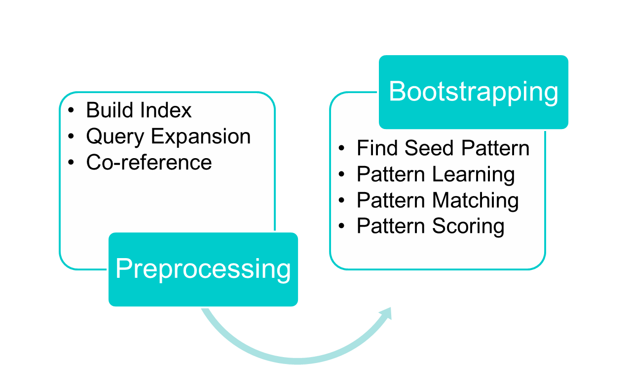
Stream Slot Filling
Notes:
For the Streaming Slot Filling task, our system achieved the goal of filling slots by employing a pattern learning and matching method.this is the system overview ,first is also preprocessing which include:
with query expansion and co-reference resolution, we found relative sentences (to make the search faster, we built index using ElasticSearch).
This year we chose the method of bootstrapping. Which included:

Slide 12
Stream Slot Filling
Query expansion and co-reference resolution
  We use the method of query expansion from VF task directly
  The office offered information of co-reference resolution in the data structure

Slide 13
Stream Slot Filling
Pattern learning
  Find Seed Pattern
    Different patterns for those 52 slots separately
    36 slots are same to the TAC-KBP slot filling task and the rest slots are manually collected training data
    Match query and slot value on the dependency tree of the sentence
Notes:
We had to find different patterns for those 52 slots separately.
Fortunately, for those slots we found 36 slots which were same to the TAC-KBP slot filling task. For the rest slots, we just collected some training data manually.
we could get training data, formed by sentences with specific query and slot valueThen, we used another toolkit to parse each sentence and matched query and slot value on the dependency tree of the sentence. This year the official offered BBN serif tagging but without any instruction,we cannot take Proper use of it, so additionally used other toolkit to parse each sentence and match…

Slide 14
Stream Slot Filling
Pattern learning
  Bootstrapping for More Patterns
    10GB clean text from the official corpus for dependency tree parsing
    Implemented bootstrapping method for only one iteration concerning the semantic drift
    Pruned by their frequency of occurrence and literal length.
Notes:
Due to unbearable computing time, we only took around 10GB clean text from the official corpus for dependency tree parsing,
and implemented bootstrapping method for only one iteration concerning the semantic drift.
After gathering lots of patterns by bootstrapping, we pruned them by their frequency of occurrence and literal length.

Slide 15
Stream Slot Filling
Pattern matching
      Find Relative Sentences(for 109 queries)
        Built an index to speed up the searching
        Trigger words we obtained from VF task
        The co-reference resolution information officially supplied
Notes:
For prediction task, firstly we had to find relative sentences mentioned our 109 queries.
With trigger words we obtained from task 1 and the coreference resolution information officially supplied, we could search for relative sentences, which we believed would contain most of the answers.

Slide 16
Stream Slot Filling
Pattern matching
  Pattern Matching
    Parsed relative sentences
    Match queries (or alias) and the specific entity type
      Both query and slot entity type existed
      Path existed in pattern list relative to the entity type
Notes:
After found those relative sentences and parsed them with Parser, we could match queries (or alias) and the specific entity type. If both query and slot entity type existed, we would extract the dependency tree path between them and matched that path with our pattern.
Then if that path existed in pattern list relative to the entity type, we add the slot value into our candidate set with the length of the pattern as a weight.

Slide 17
Stream Slot Filling
Pattern matching
  Pattern scoring
    Scored those candidates by summing their weights and set a threshold to limit the untrustworthy answers
Notes:
After traveling through all the relative sentences, we scored those candidates by summing their weights and seting a threshold to limit the untrustworthy answers.

Slide 18
Stream Slot Filling
Result：
Table 3 the result of SSF with 4 metrics
Run 1 is system without filtering too short patterns
Run 2 is system filter too short patterns
 | Sokals-neath metric | cosine metric | dot metric | C-TT metric
Run 1 | 90.317 | 41.723 | 601.000 | 380.000
Run 2 | 91.514 | 61.120 | 782.000 | 481.000

Slide 19
Q&A?

Slide 20
Thank You!

