Slide 1
Virtual Surround Sound Headphones
Michael MacMullin
Supervised by Dr. Siu O'Young

Slide 2
Contents
Introduction
Project Overview
Components
Hardware
Software
Implementation
Future Considerations

Slide 3
Introduction
Surround Sound: What is it?
Surround sound refers to the application of multi-channel audio to physical channels “surrounding” an audience
Virtual Surround Sound Headphones
A system to convey the surround sound audio experience through a standard set of 2.0 headphones

Slide 4
Project Overview
Project Criteria
To develop a system that creates a Virtual Surround Sound environment
The system will allow a user to experience surround sound in isolation from other individuals
The system should be compatible with any standard set of headphones
The system will operate under the Windows OS

Slide 5
Project Overview
Design
Virtual Set of Speakers
This virtual set up will consist of a set of point sound sources that will be placed in virtual space with a specific pattern, location, and orientation
Input
Sensors will be used to track angle and direction a persons head is facing
Audio Channel Manipulation
Remixing of multi-channel audio will be based off of the sensor information

Slide 6
Software Components
System Software
Must be capable of taking a 5.1 encoded audio file and creating a set of associated buffers
The modeled audio out put will be mixed back into 2.0 channel
Environment Modeling
Loudness
Inter-aural Intensity Difference
Inter-aural Time Difference
Muffling

Slide 7
Hardware Components
Devices
Nintendo Wiimote
On board processing for input data
Bluetooth connectivity through standard USB HID interface
An on board IR camera detecting up to 4 LED hot spots used for generating rotation axis (yaw)
An on board 3 axis accelerometer to generate the two remaining axis of rotation (roll, and pitch)

Slide 8
Software Implementation
Building a Simple Media player
Loading a WAV file
Parsing the WAV file
Virtual Environment Setup
Virtual Speakers
Audio Listener
OpenAL
Graphical feed back
Used to display the current orientation based on accelerometer and IR input
DirectX

Slide 9
Software Implementation
Loading WAV file
Dealing with 5.1 encoded audio implies using the WAV WAVE_FORMAT_EXTENSIBLE
Using the Extensible wave format defines a DWORD in the header of the WAV file indicating which channels are present
With this information along with the standard WAV header file information we can detect which speaker channels are present and parse out the data

Slide 10
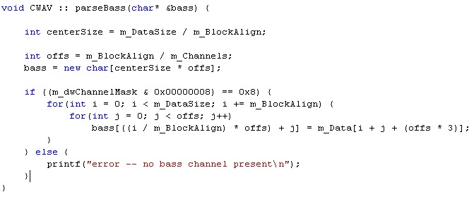
Software Implementation
Channel Parsing Example

Slide 11
Software Implementation
Virtual Environment Setup
Handled using the OpenAL library
For organization a simple structure was constructed to represent a speaker defined by the following:
Position
Direction
Cone angle
Audio Listener is Defined by the following
Orientation
The WAV data is attached to OpenAL Sources defined by a set of Speakers and the Listener hears the modified audio from the Sources defined by Input

Slide 12
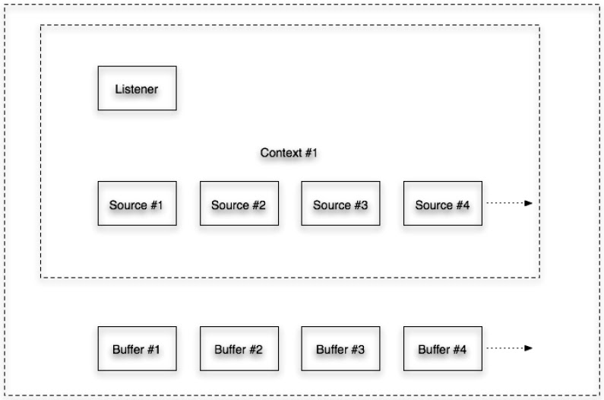
Software Implementation
High level structure of OpenAL

Slide 13
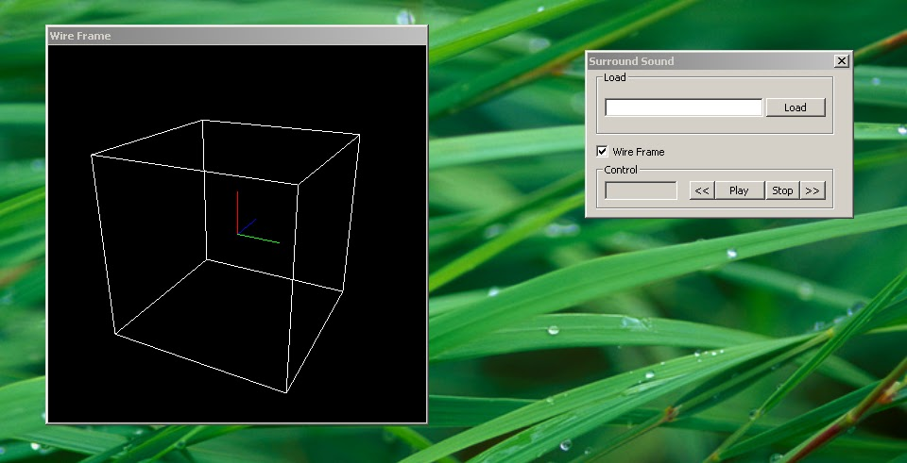
Software Implementation
Graphical feedback
Implemented using DirectX using a simple wire frame model
Outer white frame represents the virtual environment enclosure
Inner colored axis represents the Listener orientation

Slide 14
Software Implementation
Input Gathering
Connecting the Wiimote to PC via Bluetooth module
Windows DDK
Calibration
Polling

Slide 15
Software Implementation
Input Gathering
Connecting the Wiimote to PC via Bluetooth module
Windows DDK works only with Bluetooth stacks that support the standard HID interface
Enumeration of devices is based off the vender and product ID's of the Nintendo Wiimote
Vender ID = 0x057E
Product ID = 0x0306
Calibration (Accelerometers)
Read data from Wiimote using the message 0x17 from address 0x016 and reading 7 bytes
Calibration (IR)
Write the desired Sensitivity settings for the IR dots to be used along with the mode of operation

Slide 16
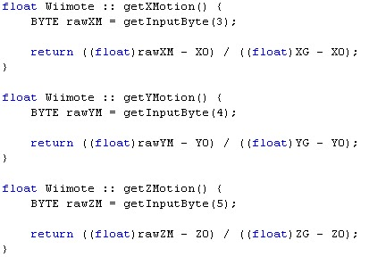
Software Implementation
Polling
Polling is used to gather information from the Wiimote
The input buffer is parsed for the corresponding information needed
Through the use of the DDK we can parse the input buffer once it is received

Slide 17
Future Considerations
Develop and build smaller compact hardware
Use electronic gyros to measure yaw motion instead of IR
Add support for more file types

Slide 18
Questions

