Slide 1
Pintos: Threads Project
Slides by: Vijay Kumar
Updated by Godmar Back

Slide 2
Introduction to Pintos
Simple OS for the 80x86 architecture
Capable of running on real hardware
We use bochs, qemu to run Pintos
Provided implementation supports kernel threads, user programs and file system
In the projects, strengthen support for these + implement support for virtual memory

Slide 3
Development Environment
Use the machines in McB 124 for the projects
Alternately, log on to one of the machines in McB 124 remotely using SSH
  ssh –Y yourlogin@rlogin.cs.vt.edu (for trusted X11 forwarding)
Use CVS
  for managing and merging code written by the team members
  keeping track of multiple versions of files

Slide 4
CVS Setup
Start by choosing a code keeper for your group
Keeper creates repository on ‘ap2’
Summary of commands to setup CVS
  ssh ap2
  cd /shared/cs3204
  mkdir Proj-keeper_pid
  setfacl --set u::rwx,g::---,o::--- Proj-keeper_pid
  # for all other group members do:
  setfacl -m u:member-pid:rwx Proj-keeper_pid
  setfacl -d --set u::rwx,g::---,o::--- Proj-keeper_pid
  # for all group members, including the keeper, do:
  setfacl -d -m u:member_pid:rwx Proj-keeper_pid
  cvs -d /shared/cs3204/Proj-keeper_pid init
  cd /home/courses/cs3204/pintos/pintos
  cvs -d /shared/cs3204/Proj-keeper_pid import -m "Imported sources" pintos foobar start

Slide 5

Using CVS
checkout & update
import
ssh transport
Development machine
in McB124
contains “working directory”
commit
Other useful CVS commands
- diff
- add
- remove
- update
ap2.cs.vt.edu containing
repository

Slide 6
Getting started with Pintos
Set env variable CVS_RSH to /usr/bin/ssh
export CVS_RSH=/usr/bin/ssh
If you don’t, it will assume “rsh” which is not a supported service. Connection failures or timeouts will result.
Check out a copy of the repository to directory ‘dir’
  cvs -d :ext:your_pid@ap2.cs.vt.edu:/shared/cs3204/Proj-keeper_pid checkout -d dir pintos
Add ~cs3204/bin to path
  export PATH=~cs3204/bin:$PATH
Build pintos
  cd dir/src/threads
  make
  cd build
  pintos run alarm-multiple

Slide 7
Project 1 Overview
Extend the functionality of a minimally functional thread system
Implement
  Alarm Clock
  Priority Scheduling
    Including priority inheritance
  Advanced Scheduler

Slide 8
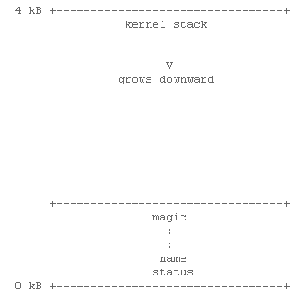
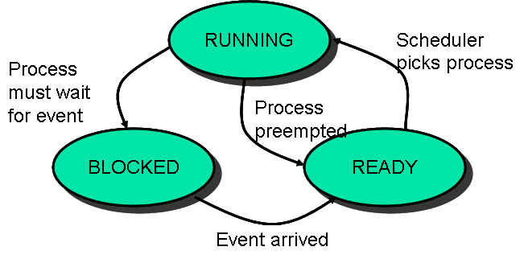
Pintos Thread System
struct thread
{
tid_t tid; /* Thread identifier. */
enum thread_status status; /* Thread state. */
char name[16]; /* Name (for debugging purposes). */
uint8_t *stack; /* Saved stack pointer. */
int priority; /* Priority. */
/* Shared between thread.c and synch.c. */
struct list_elem elem; /* List element. */
You add more fields here as you need them.
#ifdef USERPROG
/* Owned by userprog/process.c. */
uint32_t *pagedir; /* Page directory. */
#endif
/* Owned by thread.c. */
unsigned magic; /* Detects stack overflow. */
};

Slide 9
Pintos Thread System (contd…)
Read threads/thread.c and threads/synch.c to understand
  How the switching between threads occur
  How the provided scheduler works
  How the various synchronizations primitives work

Slide 10
Alarm Clock
Reimplement timer_sleep( ) in devices/timer.c without busy waiting
  /* Suspends execution for approximately TICKS timer ticks. */
  void timer_sleep (int64_t ticks){
  int64_t start = timer_ticks ();
  ASSERT (intr_get_level () == INTR_ON);
  while (timer_elapsed (start) < ticks)
  thread_yield ();
  }
Implementation details
  Remove thread from ready list and put it back after sufficient ticks have elapsed

Slide 11
Priority Scheduler
Ready thread with highest priority gets the processor
When a thread is added to the ready list that has a higher priority than the currently running thread, immediately yield the processor to the new thread
When threads are waiting for a lock, semaphore or a condition variable, the highest priority waiting thread should be woken up first
Implementation details
  compare priority of the thread being added to the ready list with that of the running thread
  select next thread to run based on priorities
  compare priorities of waiting threads when releasing locks, semaphores, condition variables

Slide 12
Priority Based Scheduling
MAX
Only threads with the highest priority run
If more than one, round-robin
6
Higher Priority
3
2
MIN

Slide 13
Priority Inversion
Strict priority scheduling can lead to a phenomenon called “priority inversion”
Supplemental reading:
  What really happened on the Mars Pathfinder? [comp.risks]
Consider the following example where
prio(H) > prio(M) > prio(L)
  H needs a lock currently held by L, so H blocks
  M that was already on the ready list gets the processor before L
  H indirectly waits for M
  (on Path Finder, a watchdog timer noticed that H failed to run for some time, and continuously reset the system)

Slide 14
Priority Donation
When a high priority thread H waits on a lock held by a lower priority thread L, donate H’s priority to L and recall the donation once L releases the lock
Implement priority donation for locks
Handle the cases of multiple donations and nested donations

Slide 15
Multiple Priority Donations: Example
Medium Priority thread
static void a_thread_func (void *lock_)
{
struct lock *lock = lock_;
lock_acquire (lock);
msg ("Thread a acquired lock a.");
lock_release (lock);
msg ("Thread a finished.");
}
Low Priority thread
lock_acquire (&a);
lock_acquire (&b);
thread_create ("a", PRI_DEFAULT + 1, a_thread_func, &a);
msg ("Main thread should have priority %d. Actual priority: %d.", PRI_DEFAULT + 1, thread_get_priority ());
thread_create ("b", PRI_DEFAULT + 2, b_thread_func, &b);
msg ("Main thread should have priority %d. Actual priority: %d.", PRI_DEFAULT + 2, thread_get_priority ());
High Priority thread
static void b_thread_func (void *lock_)
{
struct lock *lock = lock_;
lock_acquire (lock);
msg ("Thread b acquired lock b.");
lock_release (lock);
msg ("Thread b finished.");
}
High
via ‘b’
Low
Medium
via ‘a’

Slide 16
Nested Priority Donations: Example
Medium Priority thread
Low Priority thread
static void m_thread_func (void *locks_)
{
struct locks *locks = locks_;
lock_acquire (locks->b);
lock_acquire (locks->a);
msg ("Medium thread should have priority %d.
Actual priority: %d.", PRI_DEFAULT + 2,
thread_get_priority ());
…}
lock_acquire (&a);
locks.a = &a;
locks.b = &b;
thread_create ("medium", PRI_DEFAULT + 1, m_thread_func, &locks);
msg ("Low thread should have priority %d. Actual priority: %d.", PRI_DEFAULT + 1, thread_get_priority ());
thread_create ("high", PRI_DEFAULT + 2, h_thread_func, &b);
msg ("Low thread should have priority %d. Actual priority: %d.", PRI_DEFAULT + 2, thread_get_priority ());
High Priority thread
static void h_thread_func (void *lock_)
{
struct lock *lock = lock_;
lock_acquire (lock);
…}
High
Medium
Low
via ‘b’
via ‘a’

Slide 17
Advanced Scheduler
Implement Multi Level Feedback Queue Scheduler
Priority donation not needed in the advanced scheduler – two implementations are not required to coexist
  Only one is active at a time
Advanced Scheduler must be chosen only if ‘–mlfqs’ kernel option is specified
Read section on 4.4 BSD Scheduler in the Pintos manual for detailed information
Some of the parameters are real numbers and calculations involving them have to be simulated using integers.
  Write a fixed-point layer (header file)

Slide 18
Suggested Order
Alarm Clock
  easier to implement compared to the other parts
  other parts not dependent on this
Priority Scheduler
  needed for implementing Priority Donation and Advanced Scheduler
Priority Donation | Advanced Scheduler
  these two parts are independent of each other
  can be implemented in any order but only after Priority Scheduler is ready

Slide 19
Debugging your code
printf, ASSERT, backtraces, gdb
Running pintos under gdb
  Invoke pintos with the gdb option
  pintos --gdb -- run testname
  On another terminal invoke gdb
  gdb kernel.o
  Issue the command
  target remote localhost:1234
  All the usual gdb commands can be used: step, next, print, continue, break, clear etc
  Use the pintos debugging macros described in manual

Slide 20
Tips
Read the relevant parts of the Pintos manual
Read the comments in the source files to understand what a function does and what its prerequisites are
Be careful with synchronization primitives
  disable interrupts only when absolutely needed
  use locks, semaphores and condition variables instead
Beware of the consequences of the changes you introduce
  might affect the code that gets executed before the boot time messages are displayed, causing the system to reboot or not boot at all
  use gdb to debug

Slide 21
Tips (contd…)
Include ASSERTs to make sure that your code works the way you want it to
Integrate your team’s code often to avoid surprises
Use gdb to debug
Make changes to the test files, if needed
Test using qemu simulator and the –j option with bochs (introduces variability whereas default options run in reproducibility mode)

Slide 22
Grading & Deadline
Tests – 50%
  All group members get the same grade
Design – 50%
  data structures, algorithms, synchronization, rationale and coding standards
  Each group member will submit those individually: you can discuss them in the group, and ask each other questions – but must create write-up individually. Instructions will be posted on the website.
Due September 25, 2006 by 11:59pm
Good Luck!

