Slide 1
Introduction to JavaScript

Slide 2
Topics
What is JavaScript?
Why JavaScript?
Including JavaScript in HTML
Hello World Example Script
JavaScript Comments

Slide 3
What is JavaScript?
Created by Netscape
  Originally called LiveWire then LiveScript
A client-side scripting language
  Client-side refers to the fact that it is executed in the client (software) that the viewer is using. In the case of JavaScript, the client is the browser.
  A server-side language is one that runs on the Web server. Examples: PHP, Python
Interpreted on-the-fly by the client
  Each line is processed as it loads in the browser

Slide 4
JavaScript is not Java
Completely different types of languages that just happen to be similarly named
  JavaScript - programs are interpreted in the browser
  Java - programs are compiled and can be run as stand alone applications

Slide 5
Why JavaScript?
It’s easier to learn than most programming languages
It allows you to make interactive Web pages
It can be fun!

Slide 6
Including JavaScript in HTML
Two ways to add JavaScript to Web pages
  Use the <script>…</script> tag
  Include the script in an external file -- more about this later in the semester
Initially, we will only use the <script>…</script> tag

Slide 7
Hello, World!
Typically, in any programming language, the first example you learn displays “Hello, World!”
We are going to take a look at a Hello World example and then examine all of its parts.

Slide 8
Hello World in JavaScript
<!DOCTYPE html>
<html>
<head>
<title>Hello World Example</title>
</head>
<body>
<script type="text/javascript">
<!--
document.write("<h1>Hello, world!</h1>");
//-->
</script>
</body>
</html>

Slide 9
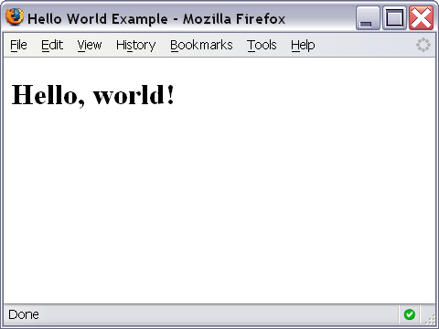
Hello World Screenshot

Slide 10
The <script>…</script> tag
The code for the script is contained in the <script>…</script> tag
<script type="text/javascript">
.
.
.
</script>

Slide 11
Hiding JavaScript from Older Browsers
Some older browsers do not support JavaScript
We need to tell those browsers to ignore what is in the <script> tag
<script type="text/javascript">
<!--
some JavaScript code
//-->
</script>

Slide 12
Displaying text
The document.write() method writes a string of text to the browser
<script type="text/javascript">
<!--
document.write("<h1>Hello, world!</h1>");
//-->
</script>

Slide 13
document.write()
Ends in a semicolon
document.write("<h1>Hello,world!</h1>");
Enclosed in quotes -- denotes a "string"

Slide 14
Comments in JavaScript
Two types of comments
  Single line
    Uses two forward slashes (i.e. //)
  Multiple line
    Uses /* and */

Slide 15
Single Line Comment Example
<script type="text/javascript">
<!--
// This is my JavaScript comment
document.write("<h1>Hello!</h1>");
//-->
</script>

Slide 16
Multiple Line Comment Example
<script type="text/javascript">
<!--
/* This is a multiple line comment.
* The star at the beginning of this line is optional.
* So is the star at the beginning of this line.
*/
document.write("<h1>Hello!</h1>");
//-->
</script>

Slide 17

Find the Bug!
<script type="text/javascript">
<!--
/* This is my JavaScript comment
* that spans more than 1 line.
*
document.write("<h1>Hello!</h1>");
//-->
</script>

