Slide 1
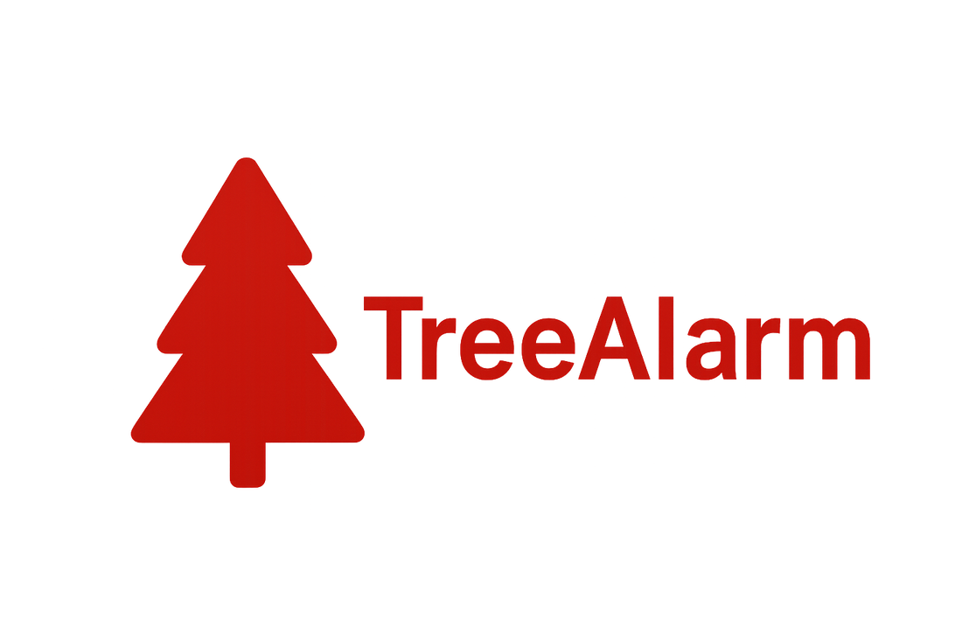
TreeAlarm VMS
Video surveillance: recording, archive, and automatic search for people and vehicles
System overview · new: the camera follows an object by itself · finding a person across every camera · less disk space used · link with the TreeAlarm monitoring map · 2026

Slide 2
What this is about
• What the system does, and how an ordinary person — an operator or a guard — uses it.
• New: the camera follows an object in the frame by itself, and a person or a vehicle can be looked for across every camera at once.
• New: the archive shrinks itself — what matters in the frame stays sharp, and noticeably less space is needed.
• How the cameras link to the TreeAlarm monitoring map — a separate, optional capability.
• What it costs and how to install it.
TreeAlarm VMS · treealarm.dev
2

Slide 3
PART 1
What the system does
In plain words — no technical detail

Slide 4
In short
• Connects ordinary IP cameras¹ and records video from them around the clock.
• Shows the live picture in a browser and lets you rewind the archive to any moment — like a video recorder, but across all cameras at once.
• Notices people, faces and vehicles in the frame by itself and marks those moments, so nobody has to watch a whole day for two minutes of it.
• Runs on your own server. The video goes nowhere, and it needs neither a subscription nor an internet connection to work.
• The system is free to use.
TreeAlarm VMS · treealarm.dev
4

Slide 5
What you get out of it
• The moment you need is found in minutes, not hours: the system has already marked when someone was in the frame.
• You do not need a person watching monitors all day — the marked events are enough to look at.
• Nothing depends on someone else's cloud: no paying for storage, no risk of the footage vanishing with someone else's service.
• Almost any cameras will do: if a camera speaks ONVIF² — and nearly every camera of recent years does — what is already installed need not be replaced.
• The archive takes less space, which means it is kept longer on the same disks.
TreeAlarm VMS · treealarm.dev
5

Slide 6
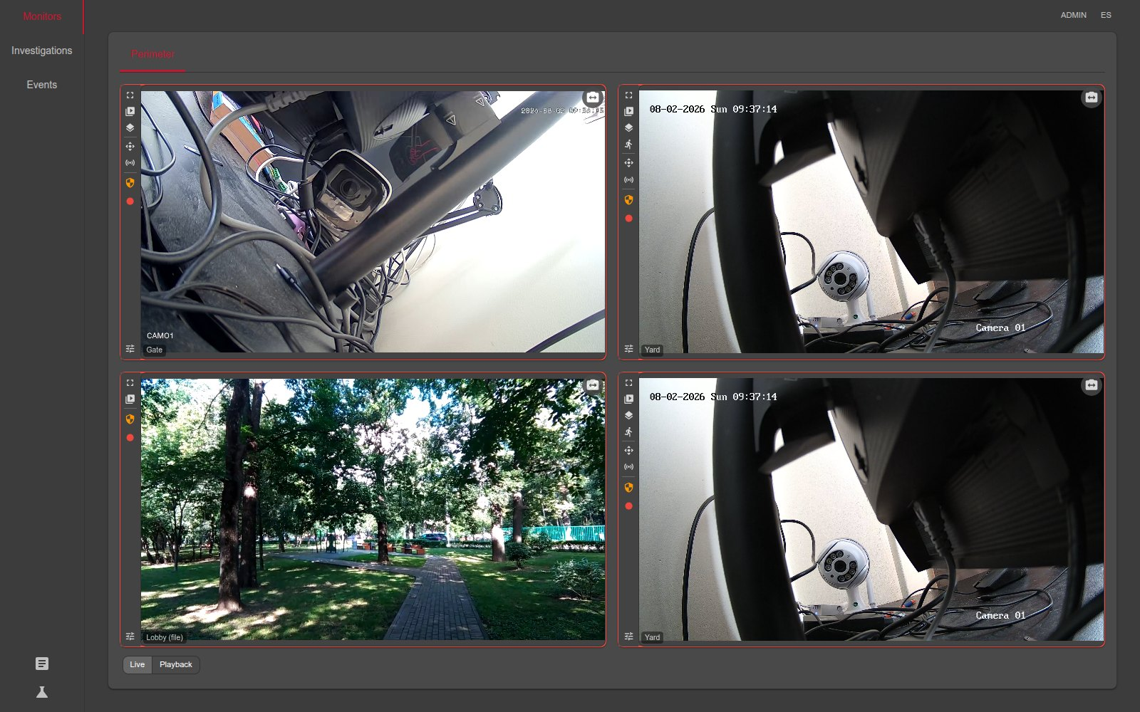
Several cameras on one screen
• The screen is split into 2, 4, 6, 8, 9, 12 or 16 cells — whatever is comfortable. An administrator defines the set of cameras; the operator simply opens a ready-made screen.
• Each cell is independent: leave one live, rewind another into the past, blow a third up to full screen.
• A pan-tilt-zoom camera (PTZ³) is driven right from here — turn it, zoom in, jump to a saved viewpoint.
• Any member of staff can assemble a temporary screen of the cameras they need to look into an incident, and hand it over to a colleague.
• Each cell takes the stream that fits its own size, so even a wall of sixteen cameras does not choke.
Four cameras on one screen. The bars at the bottom show which stretches of time were recorded.
TreeAlarm VMS · treealarm.dev
6

Slide 7
The camera follows the object by itself
• The operator clicks a person or a vehicle in the picture, and the PTZ camera keeps it in frame from then on.
• Or nobody clicks: the camera is told what to prefer, and picks a target by itself — around the clock, even when no one is watching.
• It does not chase the centre of the frame, it only keeps the object from leaving it, so the picture is not twitched for nothing.
• If the object disappears for a second, the camera recognises it by appearance and keeps following the same one, not the first one it sees.
• Every camera is taught once, by the system itself: it turns the camera a little and watches which way the picture went. A camera mounted sideways is still driven the right way.
TreeAlarm VMS · treealarm.dev
7

Slide 8
Finding the moment you need
• All the cameras on the screen rewind together, with one control: you see the same moment from every angle at once.
• You can go to a specific date and time, step half a minute back or forward, or skip to the previous day that has any recording at all.
• Below the picture there is a timeline: you see at a glance where recordings exist, where the camera was off, and where the system marked events.
• One click from the event list and you are already watching that moment from every camera.
TreeAlarm VMS · treealarm.dev
8

Slide 9
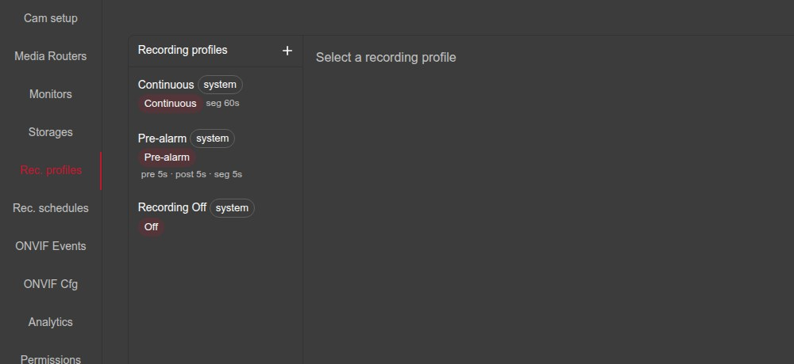
How the system decides when to record
• Record all the time — the simplest option: record while the camera is on.
• Record only on alarm — and here is the point: the system always holds the last few seconds in memory, so the recording keeps what happened before the trigger, not only after it.
• Do not record at all — for a camera that is only ever watched live. Recording and detection begin once the camera is armed⁴.
• How many seconds to keep before the event and how many after is set with ordinary numbers in the settings.
Three ready-made recording modes. They can be adjusted, and more can be added.
TreeAlarm VMS · treealarm.dev
9

Slide 10
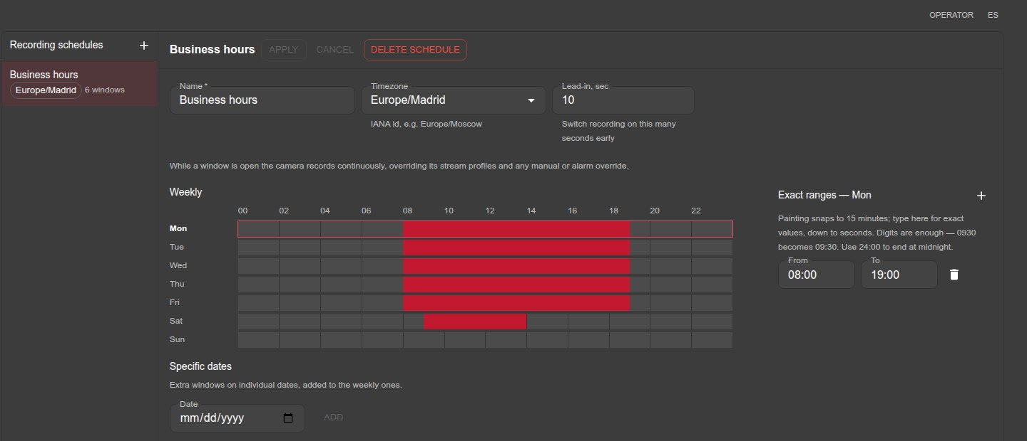
Recording schedule
• The schedule is painted with the mouse on a weekly grid: shade the working hours and that is when recording happens.
• If you need to be exact, hours and minutes can be typed in, and one-off dates — holidays, single events — set separately.
• Recording can start slightly before the shift begins, so the first minutes are not lost.
Business hours painted across the week with the mouse.
TreeAlarm VMS · treealarm.dev
10

Slide 11
Disks and reliable storage
• A camera is given not one disk but several, in order. If the first is full or has gone away, recording moves to the next by itself and nothing is lost.
• You can add as many disks as you need, network storage included.
• Old recordings and event images are deleted automatically — by age and by space used — so the disk does not quietly fill up.
• If there is nowhere to write — no disk assigned, a disk not answering, or one taken out of service — the system says so at once and names the reason.
• The camera list shows which camera is recording right now and which one merely has footage kept.
TreeAlarm VMS · treealarm.dev
11

Slide 12
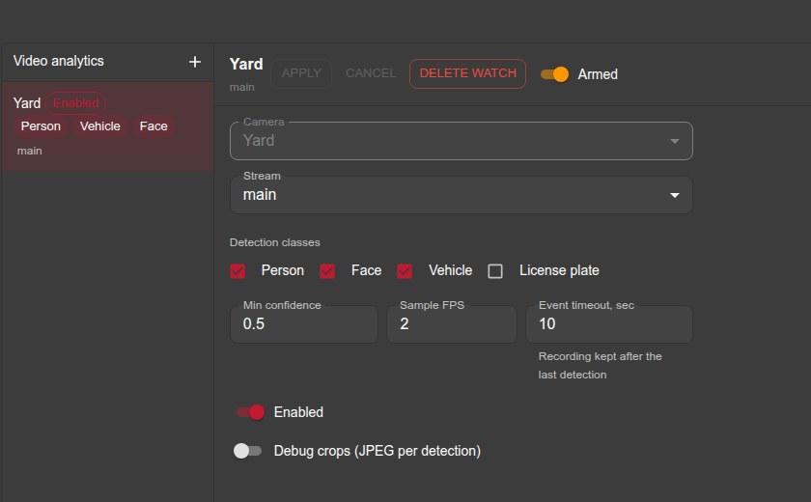
The system watches the camera for you
• The system can find people, faces and vehicles in the frame. Nothing needs to be downloaded or set up separately — it is all inside.
• It is switched on per camera: vehicles matter in one place, people in another, and some cameras need not be loaded at all.
• The settings are simple: what to look for, how confident the system must be, and how often to look at the picture.
• The camera need not be armed for this: one that simply records around the clock is marked up with events too.
• It runs on an ordinary server; a graphics card is optional. Detection takes its own stream from the camera, so it does not steal the picture from the operator.
Setting up detection for one camera: what to look for and how strict to be.
TreeAlarm VMS · treealarm.dev
12

Slide 13
What the operator sees
• A list of events: when, on which camera, how long it lasted, with small pictures showing what was there.
• On live video a frame is drawn around the person or vehicle, so it is immediately clear what the system noticed.
• A person who walks past five cameras stays one event, not five. The system recognises them by appearance and links the sightings together — including when they leave the frame and come back.
• From any event, one click into the archive lands exactly on that moment.
TreeAlarm VMS · treealarm.dev
13

Slide 14
Finding the same person on other cameras
• Click a person in the picture, or a thumbnail in an event, and the system shows where else they were caught on camera, and when.
• A photograph works too: upload one and the system looks for similar appearances in the archive.
• It works for people, faces, vehicles and licence plates.
• You set the period, the cameras, and how strict the likeness must be — stricter means less noise in the answer.
• Every appearance found opens in the archive in one click, exactly at that moment.
• It is a hint, not an identification: the system shows who looks similar, and the person decides.
TreeAlarm VMS · treealarm.dev
14

Slide 15
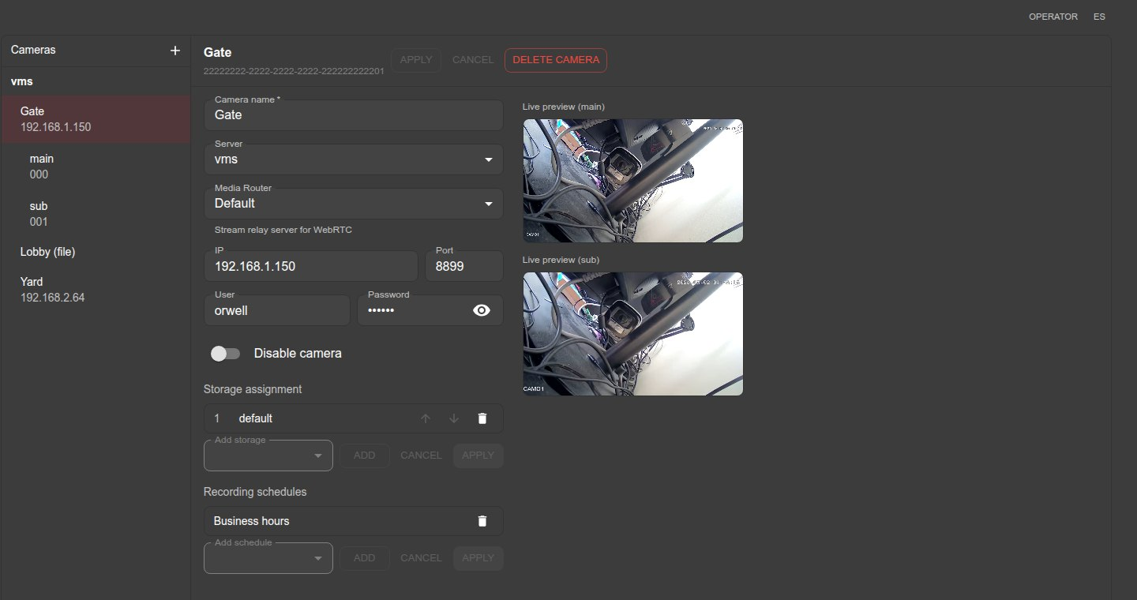
How cameras are added
• The system searches the network for cameras and shows what it found — you just pick the ones you want. If a camera is not found, it can be added by address by hand.
• Here too you say, for each camera, which disks to record to and on what schedule.
• A plain video file can stand in for a camera, and the system will treat it exactly like one. Handy for showing the system to a customer, or for going through an incident that is already recorded.
On the left, the list of cameras; on the right, the settings of the selected one and its live picture.
TreeAlarm VMS · treealarm.dev
15

Slide 16
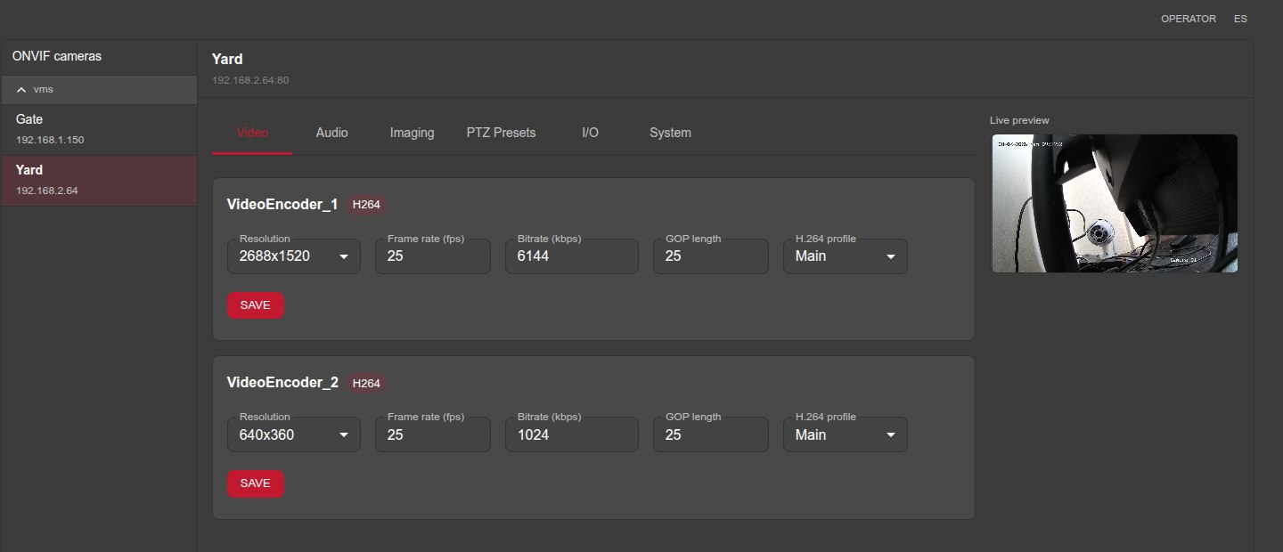
Setting up the camera itself
• There is no need to go into each camera's own web interface: picture quality, brightness, sound, movement and relays are all set from one place.
• Only the settings the camera actually supports are shown — nothing extra, and nothing that would fail.
• The camera's clock is set from here too. That matters more than it looks: if the clock is ten minutes out, the footage lands at the wrong time in the archive and becomes hard to find.
Quality settings read from the camera, with its live picture alongside.
TreeAlarm VMS · treealarm.dev
16

Slide 17
Alarms from the cameras themselves
• Many cameras can notice movement, a line being crossed, entry into a forbidden area, or a sensor being triggered.
• The system takes those signals, starts recording on them, and files them in the same event list as what it found itself.
• Ready-made presets for the usual cases are included, and you can see exactly what the camera sends — so setting it up is quick even with an unfamiliar model.
TreeAlarm VMS · treealarm.dev
17

Slide 18
Who is allowed to see what
• Sign-in can be turned on, or left off — in a small closed network, for instance.
• Rights are given per camera and per action: watch live, watch the archive, move the camera, control it, download recordings.
• Downloading a recording is a separate right. You can allow watching the archive while forbidding taking it off site.
• Rights are enforced on the server, not merely by hiding buttons: knowing the address does not get you around them.
TreeAlarm VMS · treealarm.dev
18

Slide 19
PART 2 · NEW
The archive now takes less space
What matters in the frame stays sharp, everything else is squeezed

Slide 20
What the problem was
• A video archive is disks, and disks run out. The longer you must keep the footage, the more money goes into hardware.
• Ordinary video compression does not know what matters in the frame. An empty wall and the plate of an arriving car are stored in equal detail.
• Yet the system already knows where the person or the vehicle was — it found them there itself.
• So only those places need to be stored in detail, and everything else can be simpler.
TreeAlarm VMS · treealarm.dev
20

Slide 21
How it works
The camera records
as usual
The system spots
people and vehicles
Later, unhurried,
it re-compresses
What matters
stayed sharp
The file takes
half the space
• Live recording is untouched: the camera records as it always did. Re-compression happens afterwards — it can be set to run at night or at the weekend, when the server is free.
• If nothing happened in a recording, it is not touched at all: there is nothing to save there, and re-compressing video for no reason only makes it worse.
• It all happens by itself, on a schedule. Nothing is required of the operator.
TreeAlarm VMS · treealarm.dev
21

Slide 22
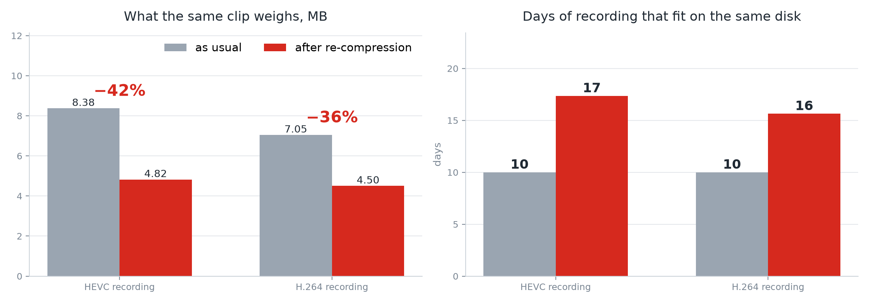
What came out of it
• Recordings where something happened weigh less: almost half on the test scene, a fifth on a real archive.
• The saving grows the smaller the share of the frame that has to stay sharp.
• On the same disk the archive lives twelve to seventeen days instead of ten.
• Quality where a person or vehicle was does not drop; with nothing to gain, the original is kept.
HEVC and H.264⁵ are two common ways of compressing video; both were tested. The chart is a 1280×720 test recording; on a 2688×1520 clip from a real archive the saving is about a fifth. Recordings where nothing happened are not re-compressed.
TreeAlarm VMS · treealarm.dev
22

Slide 23
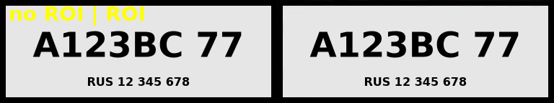
The licence plate reads the same
• Exactly what the recording exists for — a plate, a face, someone at a door — stays readable.
• What gets worse is what there was nothing to look at: tarmac, a wall, the sky.
• We checked separately that the quality margin is not taken tight around the object but with a margin around it: that is safer, and it costs almost nothing in space.
The same frame: on the left the recording was stored as usual, on the right after re-compression, in half the file size.
TreeAlarm VMS · treealarm.dev
23

Slide 24
What the administrator sets
• Whether to switch it on is decided per camera. In some places the saving is significant, in others it is not needed at all.
• How many hours after recording it may be re-compressed — so that fresh footage, which is exactly what people are looking at, is left alone.
• How much of the frame the objects must take up for a recording to be touched at all: if someone is standing right against the camera, there is nothing to save from.
• The interface shows which stretches of the archive are already re-compressed, so the operator always knows what they are looking at.
TreeAlarm VMS · treealarm.dev
24

Slide 25
PART 3
Link with the monitoring map
Cameras as objects on the TreeAlarm map. A separate and optional capability.

Slide 26
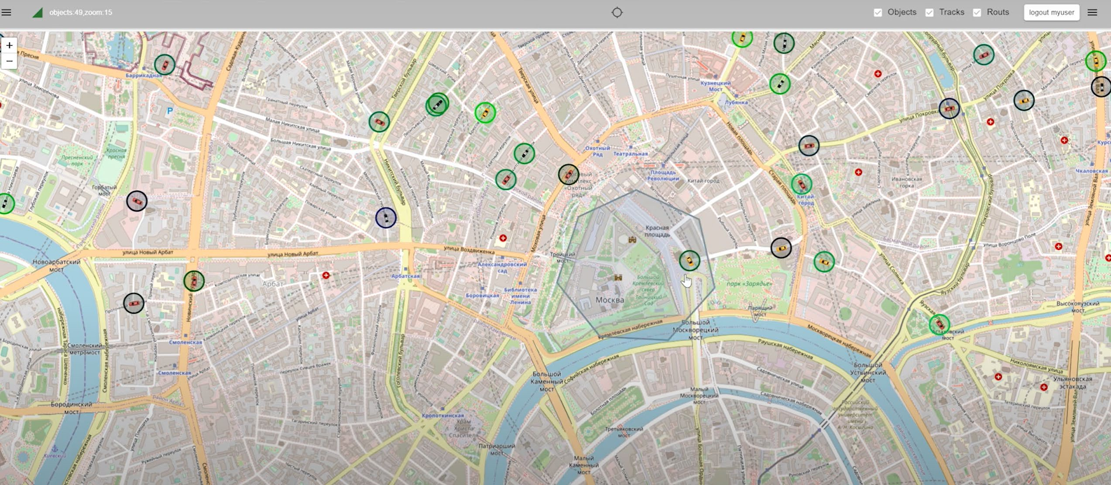
TreeAlarm — a map of how things are
• TreeAlarm shows objects on a map — buildings, rooms, equipment, sensors — and their state.
• Objects nest inside one another: city, plant, workshop, server room, sensor. An alarm travels upwards, so a problem is visible on the overview at once, and then you can drill down to the exact sensor.
• Not only the current state is kept but the whole history: you can go back a week and see what was happening and what led to what.
• There is an event log, floor plans for objects with no place on a map, and small extra modules — polling equipment over the network, for example.
The general view: objects on the map, their state shown by colour.
TreeAlarm VMS · treealarm.dev
26

Slide 27
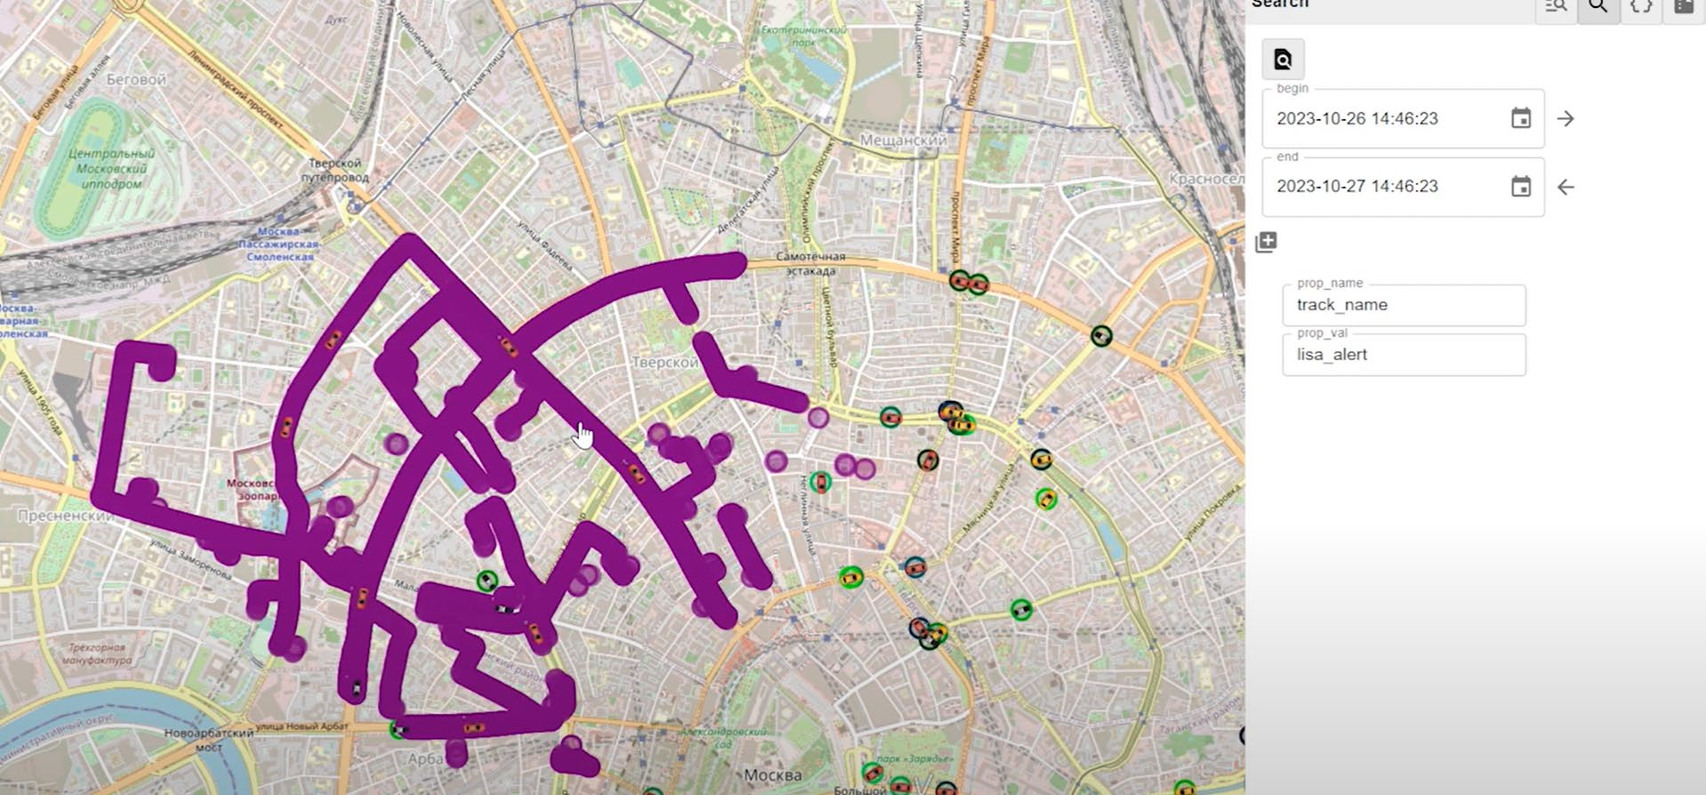
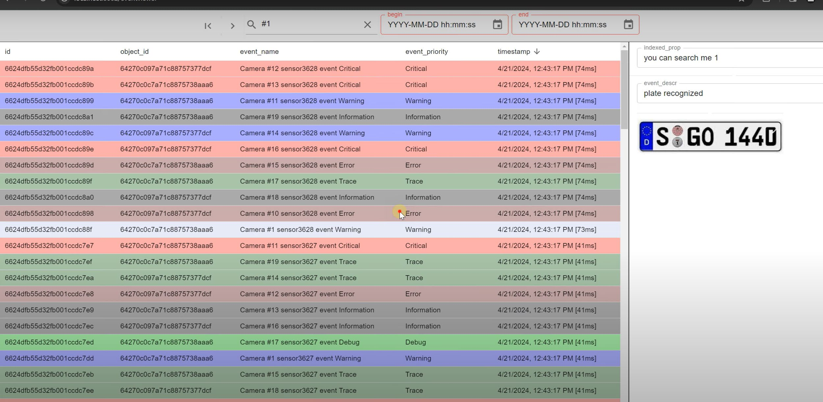
History and the event log
Searching the history: where objects were over a chosen period.
The event log with search and attached data.
• Not only how things are now is kept, but how they were — for any day in the past.
• You can search both by parameters and by an area of the map.
TreeAlarm VMS · treealarm.dev
27

Slide 28
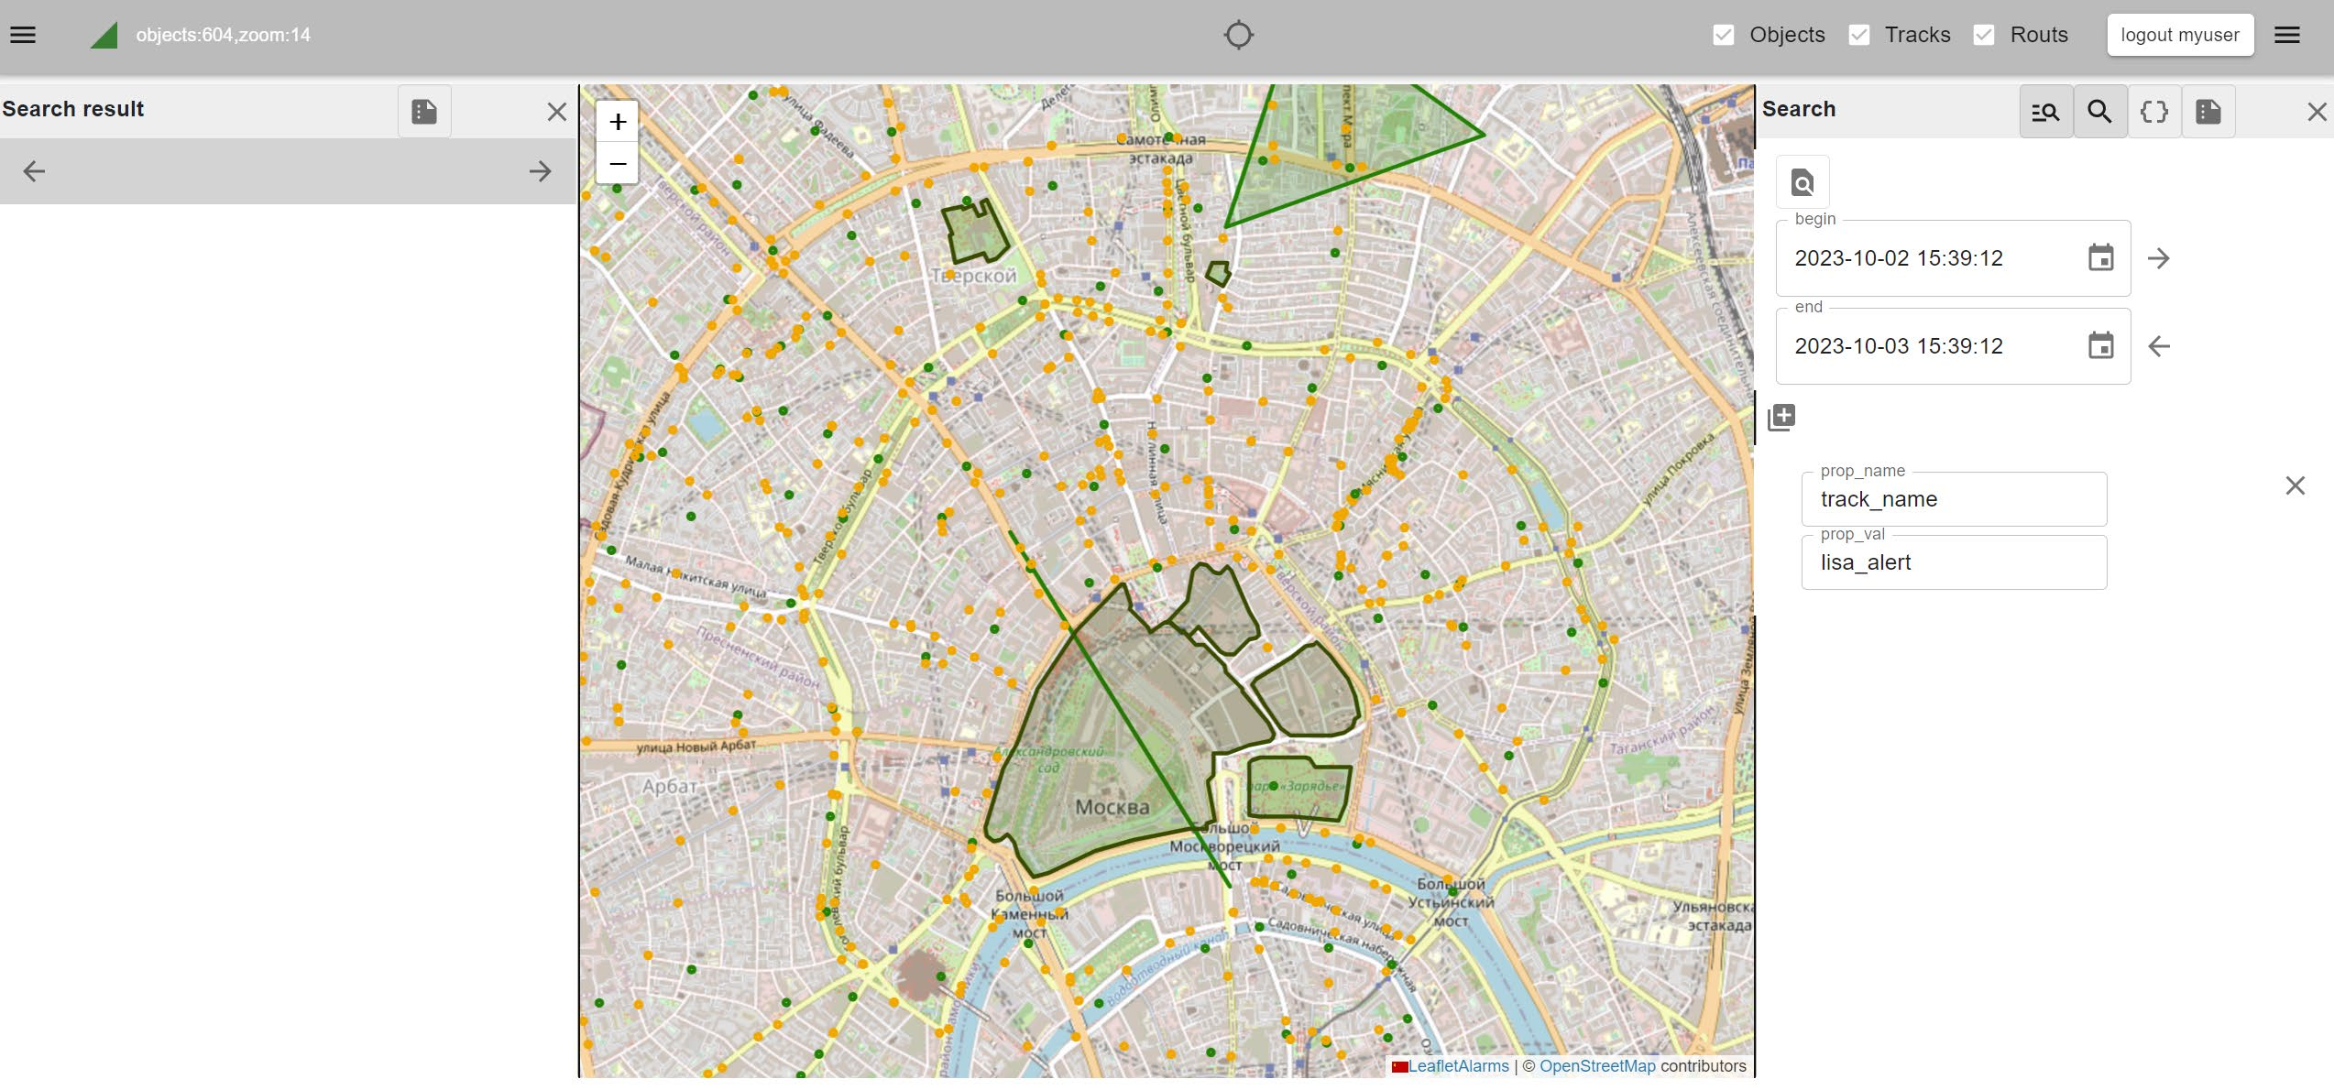
What the link gives you
• Cameras appear on the map as objects by themselves — there is no need to enter them a second time by hand.
• Click a camera on the map and you immediately see its live video, or rewind its archive.
• From the map you can turn the camera, arm it, and start recording.
• Camera alarms land in the shared event log next to readings from the rest of the equipment, so there is one picture of the site.
• Sign-in is shared: a member of staff already signed into the monitoring system does not log in a second time.
• If the link is not wanted, it is simply switched off, and the video system works on its own.
The TreeAlarm interface: the object list, the map, and the properties of the selected object.
TreeAlarm VMS · treealarm.dev
28

Slide 29
Installation and cost
• It installs on one ordinary server⁶ running Linux with a single command — the system is packaged with Docker⁷. No dedicated video specialist is needed.
• Everything is kept on your side: recordings, settings and the database. Stopping and starting the system does not lose recordings.
• Nothing is pre-configured: you add your cameras, choose a disk and a schedule, and the system runs.
• The system is free to use. The source code is provided on request.
• What is needed from you: a server, disk space for the archive, and a network reaching the cameras. For a dozen cameras an inexpensive machine is enough.
TreeAlarm VMS · treealarm.dev
29

Slide 30
Glossary: the words with numbers
¹ IP camera | A camera that joins the network like a computer and sends video over a cable or Wi-Fi. An old analogue camera needs a converter first.
² ONVIF | The common language cameras of different makes speak. If a camera knows it, the system finds it on the network and configures it itself.
³ PTZ | A camera that can be turned, tilted and zoomed remotely, without anyone walking up to it.
⁴ Armed | The mode in which the system pays attention to a camera: records on alarm and runs detection. A disarmed camera merely shows a picture.
⁵ H.264 and HEVC | Two ways of compressing video. HEVC (also called H.265) is newer and squeezes harder; H.264 is older but every browser and phone understands it.
⁶ Server | An ordinary computer that runs around the clock with the system on it. No dedicated rack is required.
⁷ Docker | A way of installing programs in one piece, together with everything they need. It is what reduces the installation to a single command.
TreeAlarm VMS · treealarm.dev
30

Slide 31
APPENDIX
For technical specialists
The same, with exact names and numbers

Slide 32
Technical properties
Camera input | RTSP, device control over ONVIF
Live to browser | WebRTC / WHEP through the gateway: the browser never addresses the media server directly. H.265 is passed through as received; re-encoding to H.264 runs on VA-API, falling back to CPU
Archive | Fragmented MP4, played back over HLS; H.264 and H.265 written as received, without re-encoding
Detection | OpenVINO on CPU or GPU: YOLO11 (people, vehicles) and a separate face detector; appearance matching across cameras
Archive re-compression | Intel Quick Sync (VPL, mfxExtEncoderROI), VA-API or CPU (x265 / x264) — chosen automatically, a GPU is not required
Sign-in and rights | Keycloak (optional), per-camera rights over five actions, enforced on the server on every request
Deployment | Docker Compose with prebuilt images; ports 5134/tcp, 8554/tcp, 8889/tcp and 8189/udp (WebRTC media)
Tracking and search | One control loop per camera, target from CV/ONVIF detections, mount calibration; similarity search over Re-ID embeddings (person, face, vehicle, plate)
Browsers: an H.264 archive plays everywhere. H.265 needs Firefox with libavcodec-extra, Chrome on a system with current VA-API, or hardware decoding on macOS and Windows 11.
TreeAlarm VMS · treealarm.dev
32

Slide 33
Architecture, and the re-compression numbers
• A set of small services communicating over gRPC; configuration changes propagate by published events rather than polling.
• It scales sideways: several MediaMTX media routers, several recorder-plus-storage pairs across nodes, detection workers sharded by hash, and a replicated stateless web layer.
• Re-compression: the zone around a detected object is given a negative QP delta and the background a positive one; rectangles are aligned to the encoder's block grid.
• Measured on a 1280×720 test scene at CQP 28 on Intel Quick Sync: HEVC 8.38 → 4.82 MB (−42%), H.264 7.05 → 4.50 MB (−36%). On a 2688×1520 clip from a real archive, 39.55 → 31.23 MB: protection is spent against an area budget, or large objects make the file grow.
• The margin around the box matters more than the strength of the boost: widening it from 0 to 64 px gains ten times more than tripling the QP delta, at the same file size.
• Live HEVC→H.264 transcoding goes through the same library: decode and encode on VA-API, 43% less CPU per stream (i7-12700, iGPU). Where the browser understands H.265 there is no transcode at all.
TreeAlarm VMS · treealarm.dev
33

Slide 34
In short
• A finished video system: it records, stores, shows, and finds people and vehicles in the frame by itself. It installs on your server and works without an internet connection.
• New: the camera follows an object by itself, a person or a vehicle can be looked for across every camera at once, and the archive takes noticeably less space — while plates and faces stay readable.
• If you want, the cameras plug into the TreeAlarm monitoring map and become part of it. But the system is self-sufficient and runs on its own.
Free to use · source code on request
treealarm.dev · Telegram: @treealarm
TreeAlarm VMS · treealarm.dev
34

