Slide 1
Career Application Agent
A stateful, evidence-grounded workflow for finding roles, verifying openings, and generating reviewable application packages.
Discover
Verify
Ground
Validate
current roles
official posting
candidate evidence
release quality
Project output: resume · cover letter · notes · provenance · application history
treeflow-ai / career-application-agent

Slide 2
AI drafting needs controls
The agent separates role status, candidate evidence, and quality gates.
Stale openings
Search results and copied job descriptions are not proof that a role is still open.
Unsupported claims
A job description lists desired skills, not facts about the candidate.
Unreviewed output
A fluent resume can still contain broken links, chronology drift, or inflated scope.
Design principle
Use AI for interpretation and drafting; keep facts, opening status, and release quality behind evidence and deterministic checks.
treeflow-ai / career-application-agent

Slide 3
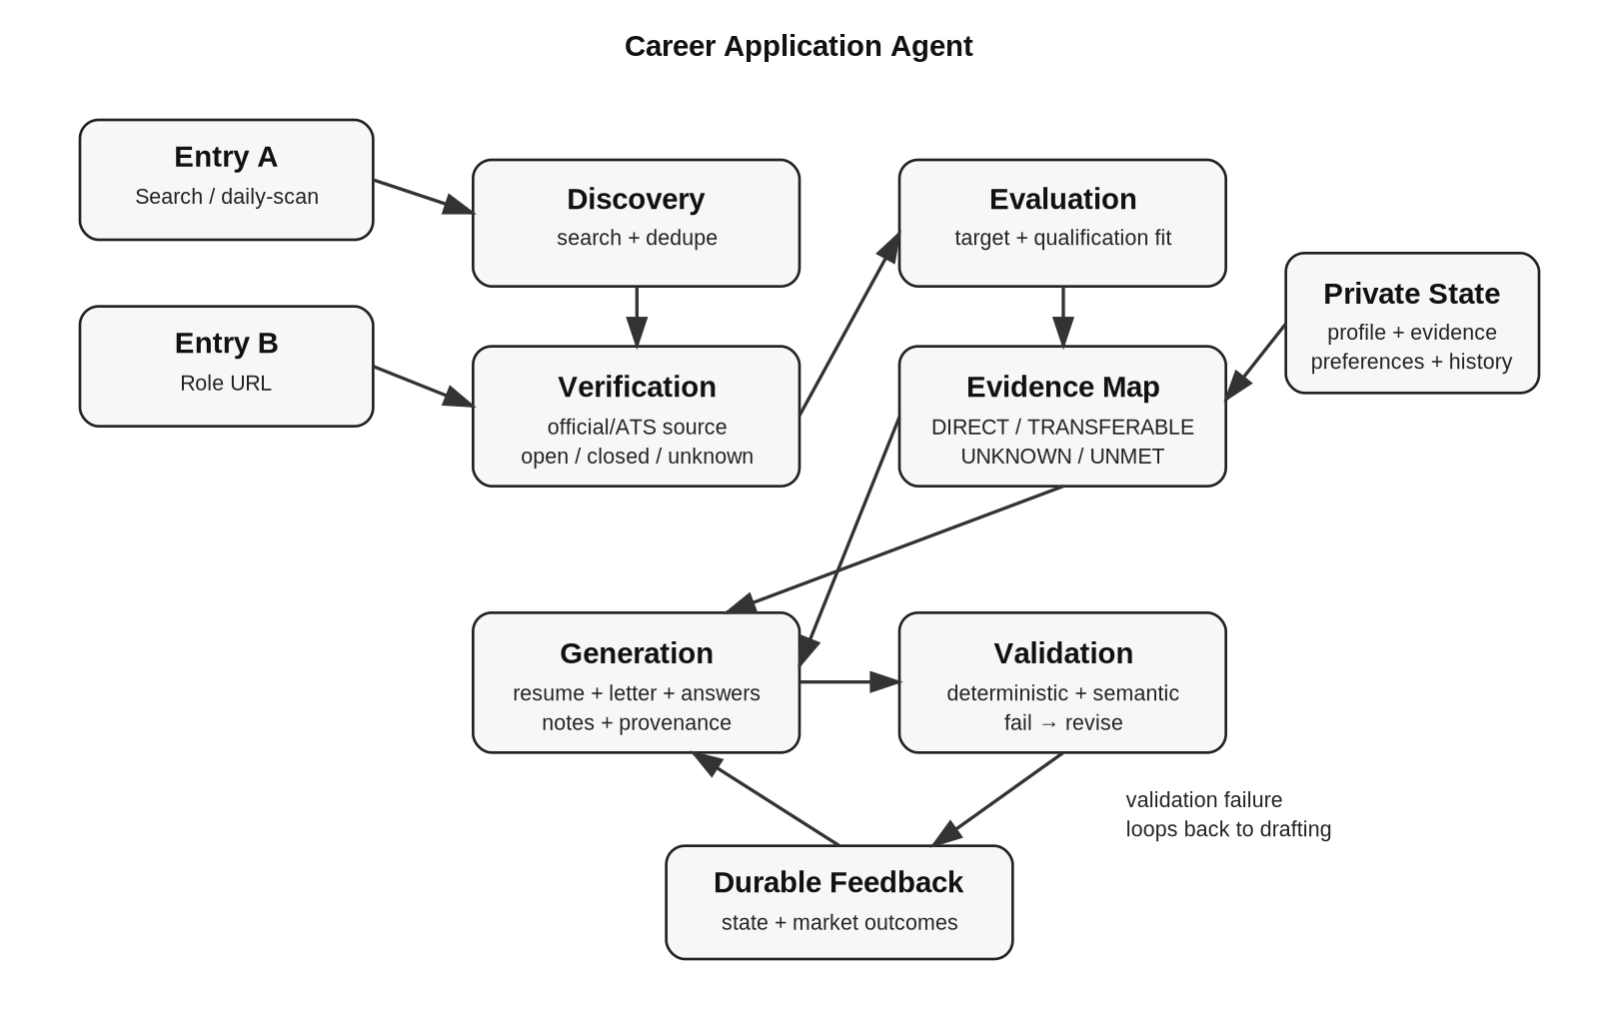
End-to-end workflow
Two entry paths feed the same evidence-grounded application pipeline.
treeflow-ai / career-application-agent

Slide 4
Evidence grounding
The job description is role evidence, not candidate evidence.
DIRECT
strong verified evidence
TRANSFERABLE
adjacent evidence, described carefully
UNKNOWN
not established; ask or record a gap
UNMET
confirmed missing requirement
JD requirements
Evidence IDs
Grounded draft
Provenance
Controls prevent named-tool leakage, invented metrics, date drift, unsupported ownership claims, and cross-document inconsistencies.
treeflow-ai / career-application-agent

Slide 5
What to review in the repository
The repo is designed to be skimmed visually, then inspected through samples and tests.
README
quick overview + setup
Fast takeaway
This is not a single resume prompt.
It is a stateful agent workflow with explicit evidence boundaries, opening verification, validation, and durable application history.
docs/architecture.svg
workflow diagram
samples/
fictional end-to-end run
skills/
reusable agent procedures
scripts/ + tests/
release gates and regression tests
treeflow-ai / career-application-agent

Slide 6
Design choices
The agent is designed around failure modes, not just prompt convenience.
1. Ground claims in evidence
The job description can influence selection and wording, but it cannot create candidate facts. Claims must trace back to verified or user-confirmed evidence.
2. Separate reasoning from invariants
LLM skills handle interpretation, fit analysis, and drafting. Code enforces hard boundaries such as evidence IDs, link integrity, privacy, and state rules.
3. Fail to unknown
If a job opening, tool claim, metric, date, or qualification cannot be verified, the system records a gap instead of inventing certainty.
Use AI for judgment and drafting; use checks for facts, safety, and release quality.
treeflow-ai / career-application-agent

Slide 7
How to use and verify it
The repository is meant to be inspected through example data, workflow traces, and release gates.
Use path
• Copy example profile/evidence files into local ignored files.
• Start with a search goal or a specific role URL.
• Verify official opening status before drafting.
• Map JD requirements to DIRECT / TRANSFERABLE / UNKNOWN / UNMET.
• Generate reviewable materials, then validate before release.
Mechanical validation
Schemas, required files, private-file guardrails, hyperlinks, and state-history merge behavior.
Grounding validation
Evidence IDs must exist; unknown or unmet requirements cannot become candidate claims.
Human/semantic review
A reviewer checks relevance, scope, tone, and whether the output is ready to submit.
Release gate: python scripts/release_gate.py
treeflow-ai / career-application-agent

