Slide 1

CHAPTER 13
EDUCATION
GROUP 11
Yunlin Chen
Linlin Huang
Shiyou Li
Zecheng Liang
Kuo Zhen

Slide 2
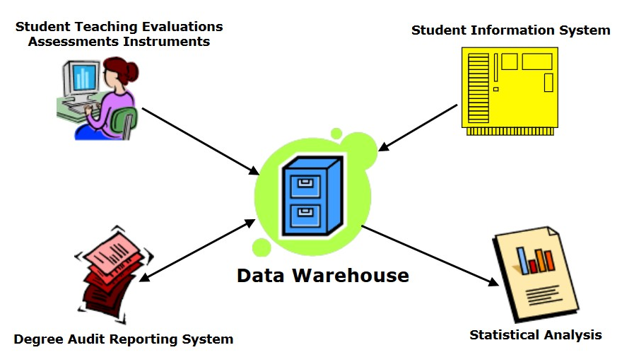
Why DW in a university?
Application
Admission
Registration
Attendance
Placement

Slide 3
Registration System
Why type of fact is needed to store your registrations?
Trans? Snapshot?
Term
Course
Registration
Student
Instructor
Notes:
Add an animation to bring up the question: how do we measure registration???

Slide 4
How popularity of various courses/instructors is changing over time… What measure to use?
Term
Course
Registration
Measure?
Student
Instructor
Notes:
Add an animation to bring up the question: how do we measure registration???

Slide 5
Registration Factless Fact Table
Fact table that does not have any measure… Just an intersection of dimensions
StudentID | CourseID | InstructorID | Term | Course Registration Count (=1)
xxx180001 | MIS6309 | AXL144730 | FALL19 | 1
xxx180002 | MIS6309 | AXL144730 | FALL19 | 1
... | ... | ... | ... | ...
How many students registered for MIS6309 in FALL19?
How many classes did student XXX180001 take in FALL19?

Slide 6
Can we use a table that is not factless?
Course | Instructor | Term | Number of Registration
MIS 6309 | AXL144730 | FALL 19 | 60
MIS 6324 | JXC111031 | SPRING 18 | 48
... | ... | ... | ...
Problems???

Slide 7
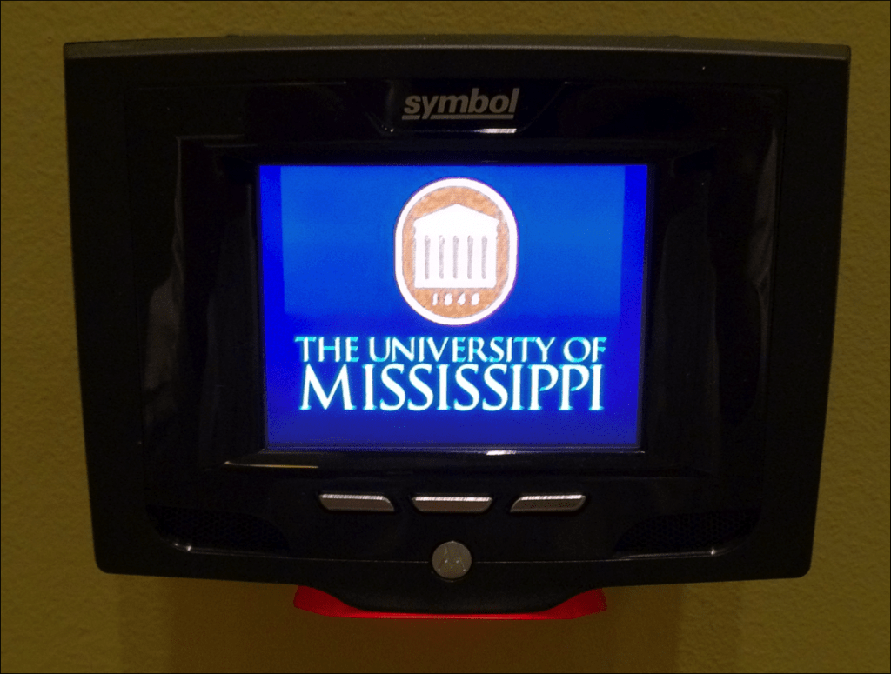
Attendance Fact
Date
Course
Instructor
Student
Facility

Slide 8
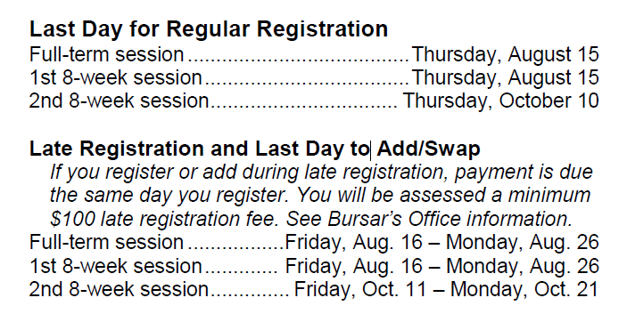
Course Registration/Drop Check
Question:
Do we need to check the information everyday before the drop deadline?

Slide 9
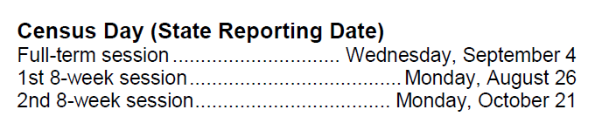
Solution
In UTD, we have one census day.
Why does UTD set one day for census?

Slide 10
Registration as Periodic Snapshot
StudentID | CourseID | InstructorID | Term | Census | Course Registration Count (=1)
xxx180001 | MIS6309 | AXL144730 | FALL19 | CD1 | 1
xxx180001 | MIS6309 | AXL144730 | FALL19 | CD2 | 1
Suppose: we have three census days in one semester

Slide 11
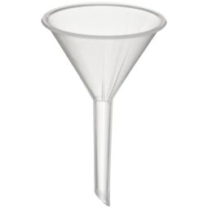
Applicant Pipeline
Application
Submitted
Date
File Completed Date
Decision Notification
Date
Applicant Enroll-Withdraw Date
What type of fact should we use?

Slide 12
Applicant Pipeline Advantage
Applicant info at all stages
One row per applicant
Revisit and update
Funnel… Analysis of lags between dates
All the dates are role-playing dimension

Slide 13
Summary
Factless Fact Table – Registration as Transaction Fact
Factless Fact Table – Registration as Periodic snapshot
Application Pipeline Data as Accumulating snapshot

Slide 14
THANK YOU!

