Slide 1

ONLINE FOOTWEAR STORE
FOOTLAND
Ms. Jetty Benjamin
Assistant Professor
Department of Computer Application
Treesa Thomas
RMCA 2023 – 2025: S3
AJC23MCA-2063

Slide 2
PROJECT OVERVIEW
Footland is an online footwear shopping platform designed to offer a seamless and engaging shopping experience for a diverse range of users. Guests can explore products and add items to the cart without needing an account, while registered users enjoy full access to login, manage profiles, view exclusive offers, make purchases, and track orders. Admin users oversee product and customer management, with tools for adding, editing, and analyzing products to optimize sales and customer satisfaction. The platform features intuitive browsing, personalized recommendations, advanced search options, and a secure checkout process. By providing robust functionality for admins and customers alike, Footland aims to drive sales growth, enhance customer loyalty, and set a high standard in the online footwear shopping space.

Slide 3
The modules of the system are:
Admin
Can login to dashboard.
Add new products.
View the products.
View the customers.
Can take analysis of the sales .

Slide 4
Customer
Register account in aqua motus with email verification.
Login to the dashboard
Browse the product.
View the product details.
Auto filteration.
Add to wishlist.
Add to Cart.

Slide 5
Customer
Saved for later.
Order summary in pdf format.
Order Confirmation .
Logout

Slide 6
Guest User
Browse products
View the product details.

Slide 7
Technologies used
Front End - HTML, CSS, JavaScript, Bootstrap
Backend - Python, Django Framework, MYSQL
LITERATURE REVIEW
The literature shows that e-commerce has transformed retail by providing convenience, variety, and a personalized shopping experience, especially in niche markets like footwear. Key studies highlight the importance of intuitive navigation, secure checkout, and responsive design to increase user engagement and conversion rates. For platforms like Footland, offering tailored experiences for guest users, registered customers, and admins is essential to create a seamless journey. Research also emphasizes the role of data analytics for inventory management and sales optimization, empowering businesses to respond dynamically to customer trends. Moreover, robust security measures are vital for protecting user data, as trust directly impacts purchasing behavior. Overall, integrating these elements positions Footland to deliver an enhanced, trustworthy, and competitive shopping experience in the online footwear market.

Slide 8
SYSTEM STUDY
Existing System Drawbacks
Limited search and filter options: Finding specific footwear based on style, occasion, or custom needs can be difficult due to limited filtering options and basic categorization.
Inconsistent product descriptions: Variations in product listings, such as incomplete details or unclear sizing information, can lead to confusion and dissatisfaction for users.
Proposed System Advantages
Personalized Product Recommendations: The system provides tailored product recommendations based on user behavior, shopping history, and preferences. This ensures users see relevant products that match their style and needs.
Customizable Footwear: Users can personalize select footwear items by choosing different designs, materials, and colors, giving them a unique and creative shopping experience.

Slide 9
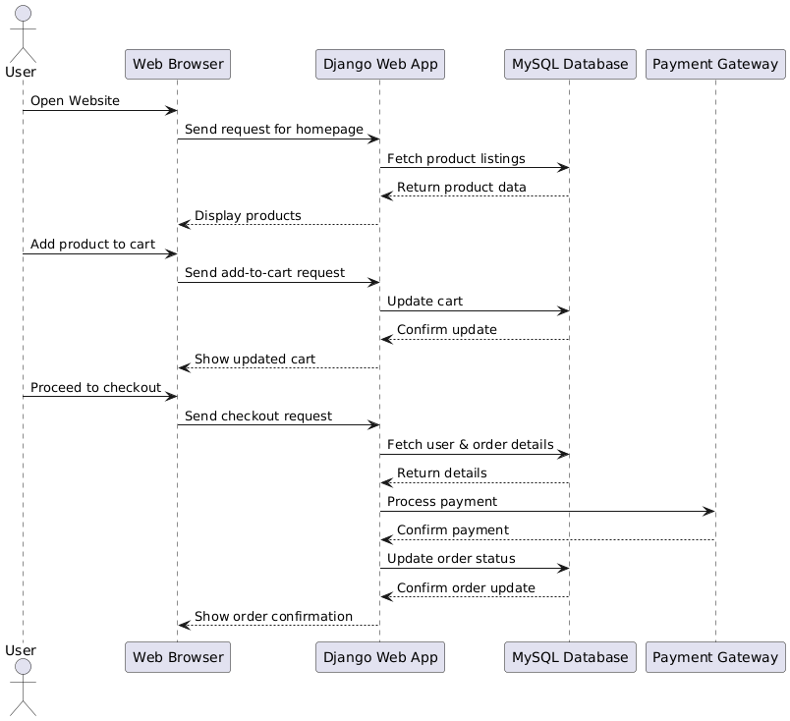
SYSTEM FLOW

Slide 10
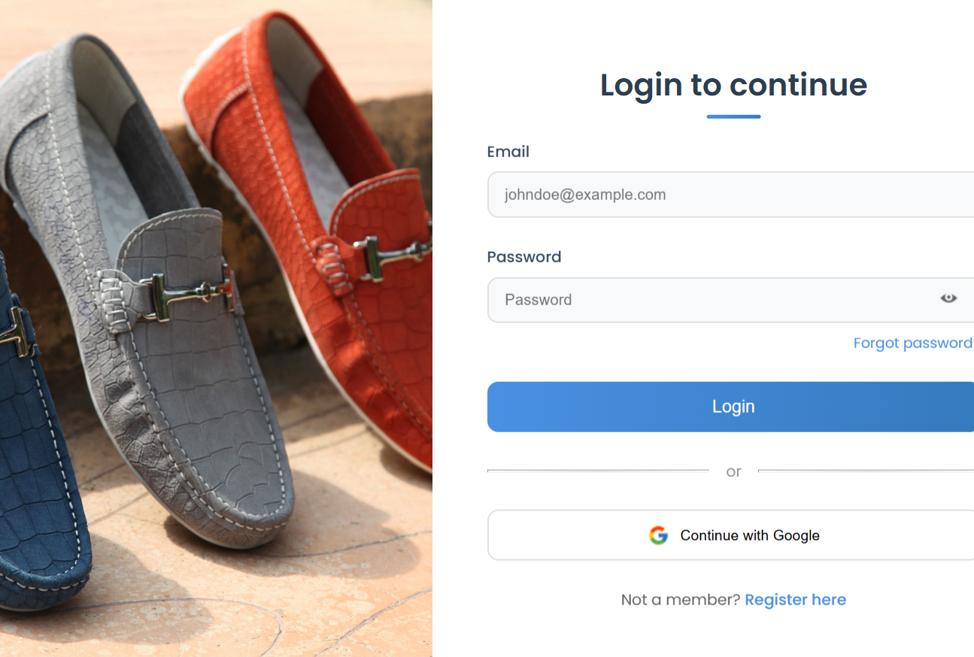
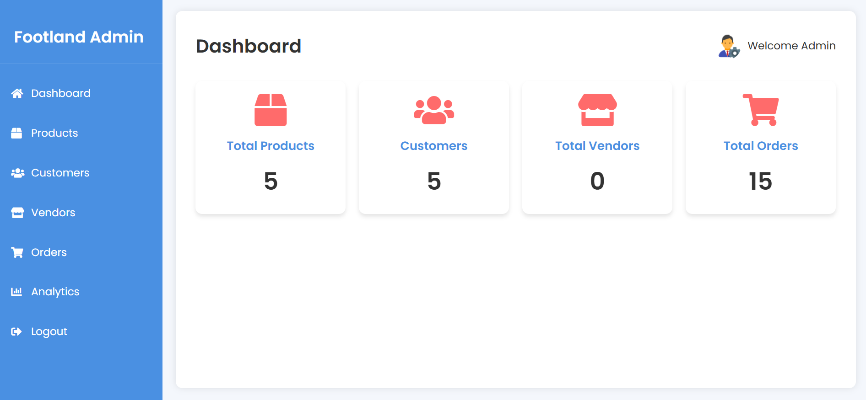
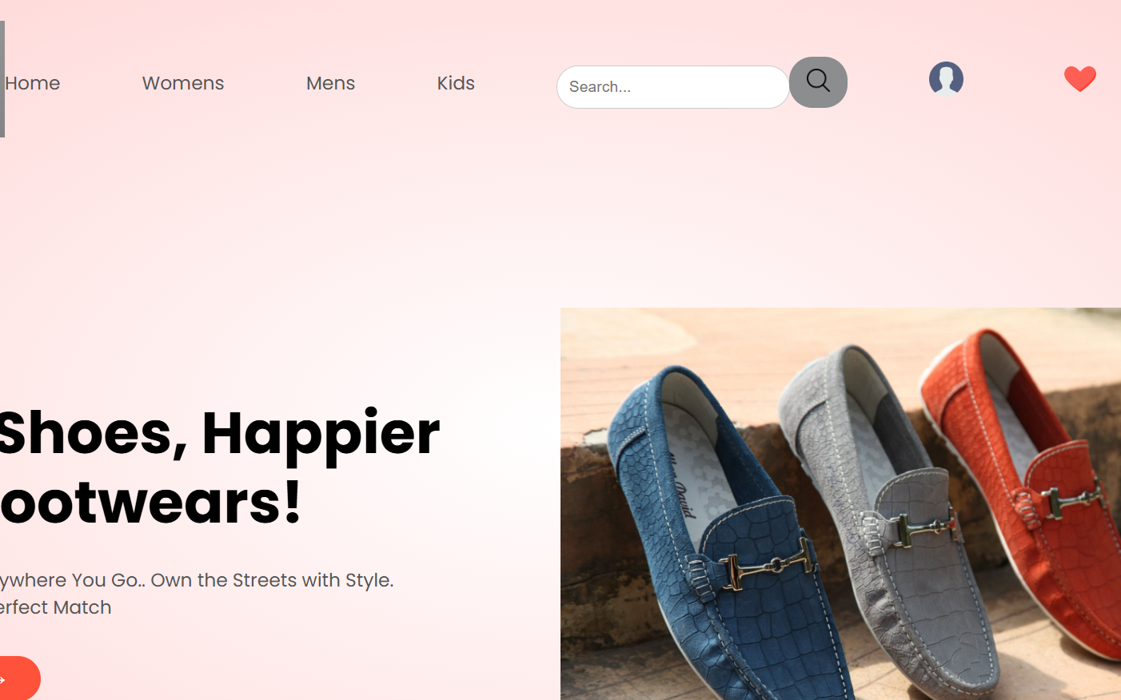
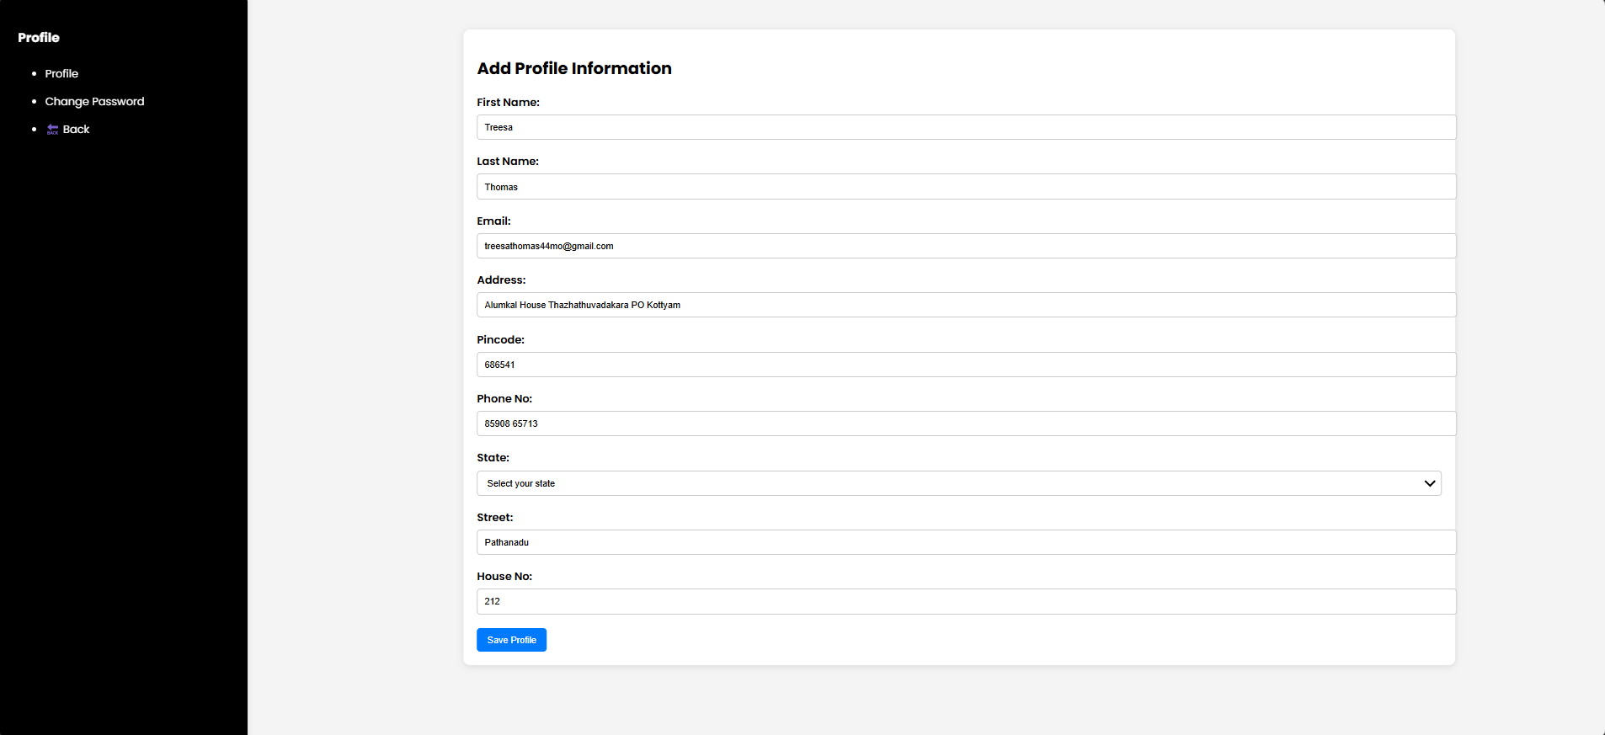
Figure 1: Login Page
Figure 2: Admin Dashboard
Figure 3: User dashboard
Figure 4: User profile

Slide 11
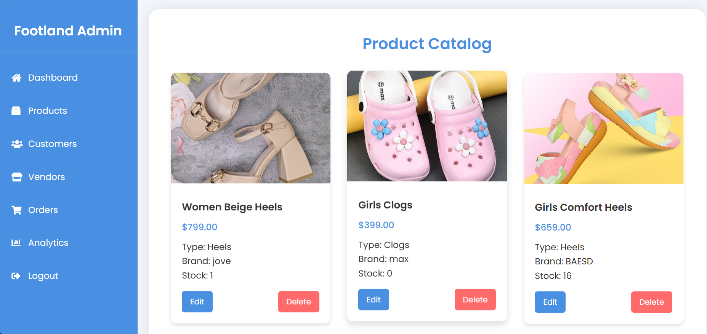
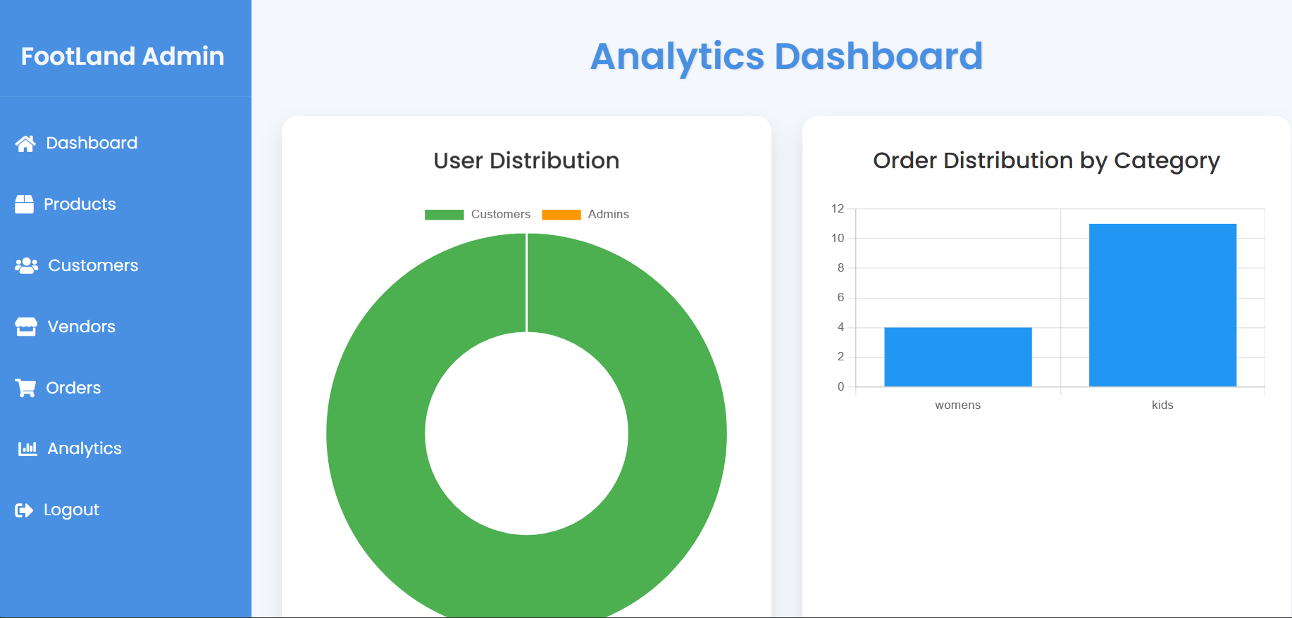
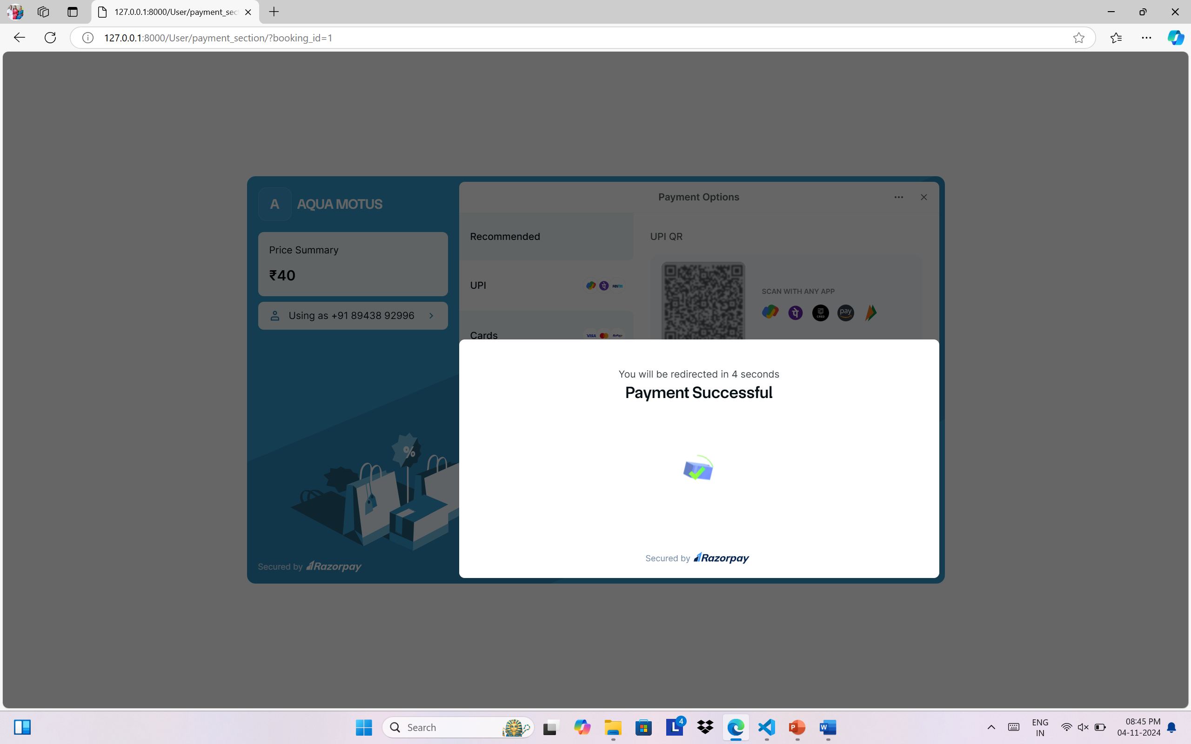
Figure 5: View product catalog
Figure 6: Analytics
Figure 8: Payment

Slide 12
CONCLUSION AND FUTURE SCOPE
Conclusion
Footland provides a seamless, user-centered shopping experience by catering to guests, registered users, and admins with features like advanced search, secure checkout, and personalized account management. By integrating vendor support and personalized recommendations, Footland is positioned to drive sales growth and set a high standard in the online footwear market.
Future Scope
Future developments include integration with smart technologies, enhanced accessibility, vendor integration, and AR, all aimed at creating a seamless experience.

Slide 13
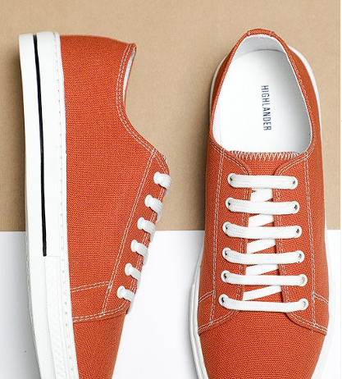
THANK YOU!

