Slide 1
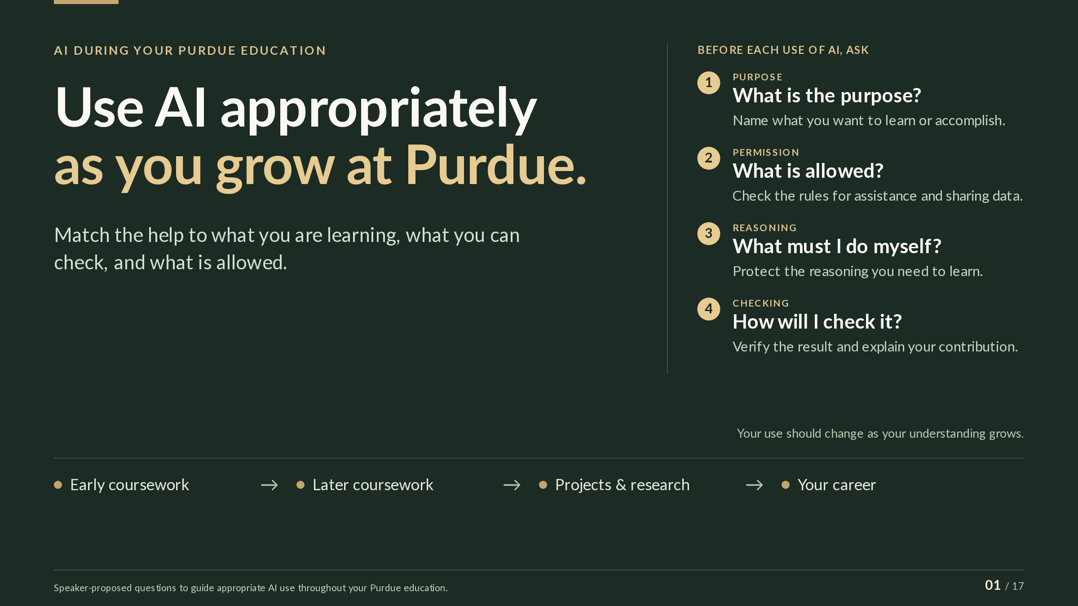
Notes:
SLIDE GUIDE · 01 / 17: Use AI appropriately
as you grow at Purdue.
EXPLANATION
These slides are about using AI well while you are still learning. You will meet AI tools in your courses, in projects and research, and later at work. The help that fits one activity may not fit another, and the right kind of help changes as your understanding grows.
The slide offers four questions to ask before each use of AI:
• What is the purpose? Name what you want to learn or accomplish. Practicing a new skill and producing a finished result call for different kinds of help.
• What is allowed? Check the rules for assistance and for sharing data: your course’s policy now, and your employer’s policy later.
• What must I do myself? Protect the reasoning you are trying to learn. If AI does that part for you, you can finish the assignment without gaining the skill.
• How will I check it? Verify the result, and be ready to explain what you contributed.
The strip along the bottom (early coursework, later coursework, projects and research, your career) is a reminder that the answers change over time. Help that would short-circuit practice in an introductory course can be reasonable later, once you can judge the output yourself.
The rest of the slides take up these questions one or two at a time; the labels at the top of each slide (Purpose, Permission, Reasoning, Checking) show which ones. The last slide answers all four.
NEXT: Learn to use AI as part of your Purdue education. These choices matter from the start: today’s AI tools are already capable, and surveyed employers say about a third of their entry-level jobs require AI skills.
SOURCES & CAVEATS
SUGGESTED STRATEGY: The four questions
What it suggests: Ask four questions before each use of AI: what the purpose is, what is allowed, what you must do yourself, and how you will check the result.
What informs it: The research, rules, and documentation on the later slides, each of which takes up one or two of the questions.
What has not been tested: This is a framework proposed for this presentation, not a tested intervention. No study is cited for the framework itself.
No sources are cited on this slide.

Slide 2
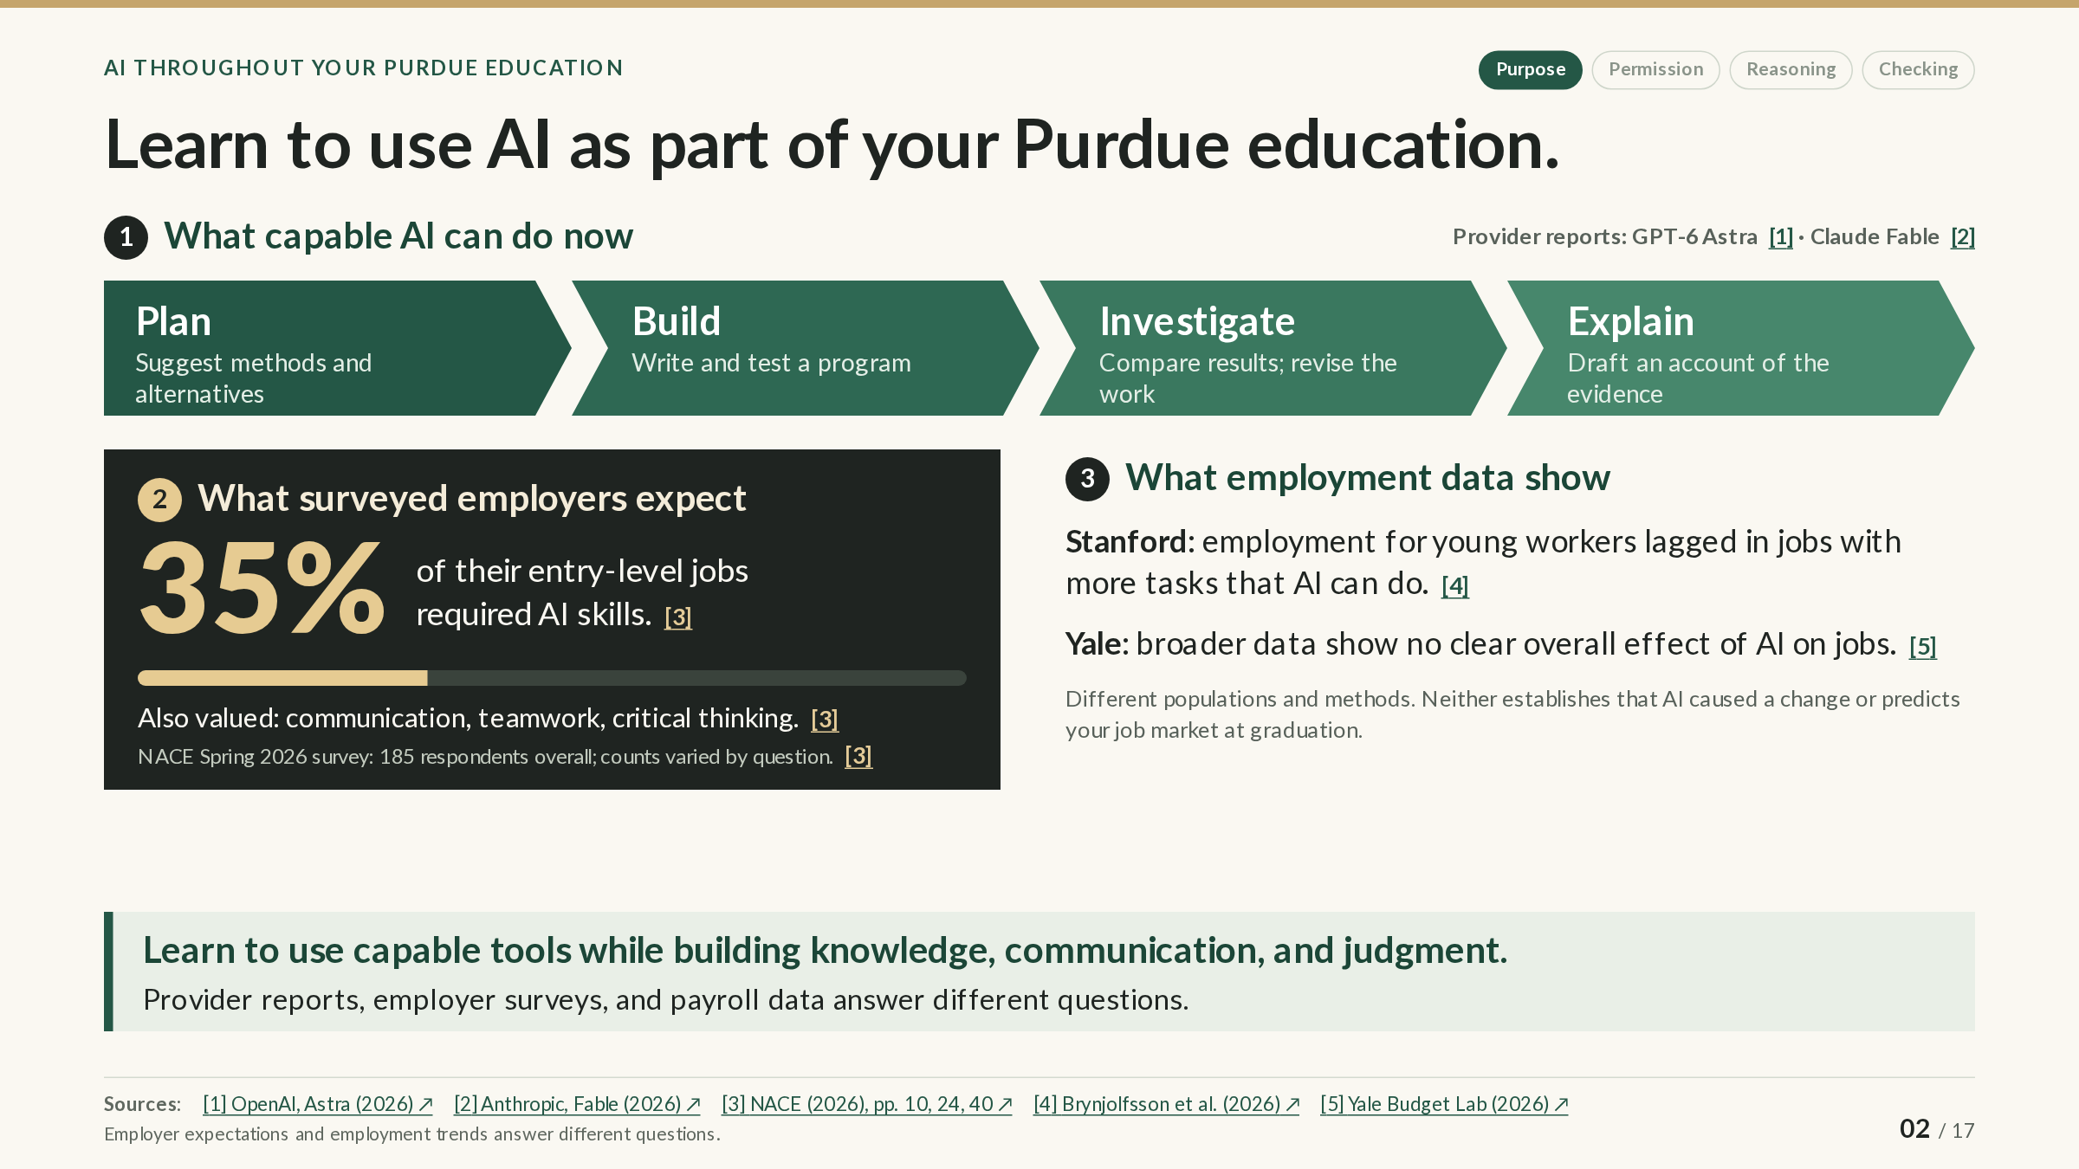
Notes:
SLIDE GUIDE · 02 / 17: Learn to use AI as part of your Purdue education.
EXPLANATION
This slide sets out three kinds of information about AI and work. Each answers a different question, so keep them apart.
1. What capable AI can do now. The top panel is a simplified workflow of what the providers report their current systems can do: suggest methods, write and test a program, compare results and revise, and draft an account of the evidence. The reports come from the companies that make the models (OpenAI on GPT-6 Astra; Anthropic on Claude Fable). A provider’s report describes its own tests, not an independent evaluation, so any particular use still has to be checked against its own data and requirements.
2. What employers expect. In the National Association of Colleges and Employers (NACE) spring 2026 survey, employers reported that 35% of their entry-level jobs required AI skills, and they also rated communication, teamwork, and critical thinking highly. The 35% describes the responding employers’ jobs, not all jobs.
3. What employment data show. Stanford researchers using payroll records found that employment of 22–25-year-olds lagged in the occupations most exposed to AI, where AI could speed up more of the tasks. That pattern is descriptive; it does not show that AI caused the lag. The Yale Budget Lab, using broader data and different methods, finds no clear overall effect of AI on jobs so far. Both can hold at once, since a broad average can hide a gap in a narrower group, and neither predicts the job market when you graduate.
Purdue’s response is to build AI into your education: beginning with the fall 2026 incoming class, every undergraduate completes an AI working competency that emphasizes judgment and responsible use rather than any one tool.
The practical conclusion: learn to use capable tools while you build the knowledge, communication skills, and judgment to use them well.
NEXT: Human teams and AI analysts split on the same data. Even careful analyses of the same data can disagree. The next slide shows how much, and why checking matters.
SOURCES & CAVEATS
Sources checked through October 21, 2026. Source numbers match the slide’s citations.
PROVIDER REPORT: What AI systems can do
What it is: Release materials from the model providers: Anthropic’s page on Claude Fable (checked September 10, 2026) and OpenAI’s release article on GPT-6 Astra.
What it supports: That current systems are reported to carry out multi-step work such as planning an analysis, writing and testing code, and drafting documents.
What limits it: These are the providers’ own reports. Benchmark results depend on configuration and evaluation design; they are not independent comparisons or classroom studies.
Sources: [1] [2]
RESEARCH FINDING: Employers’ AI skill requirements
What was studied: NACE Job Outlook 2026 Spring Update: a survey of employers; 185 responded overall, and the number answering each question varied.
What the source supports: Employers reported AI skill requirements for 35% of their entry-level jobs and rated communication, teamwork, and critical thinking highly.
What limits the conclusion: The figure describes the responding employers’ own jobs, not all employers or all entry-level jobs.
Sources: [3]
RESEARCH FINDING: Early-career employment in AI-exposed occupations
What was studied: ADP payroll records through June 2026 (Brynjolfsson, Chandar and Chen, August 2026 revision). Occupations were grouped into fifths by how many of their tasks AI could speed up.
What the source supports: From November 2022 to June 2026, employment of 22–25-year-olds fell about 11% in the two most exposed fifths and grew about 10% in the other three, so it ended about 19% below where it would have been had it kept pace. Most of the gap came from fewer hires.
What limits the conclusion: Descriptive, not causal: the authors do not claim that AI caused the gap. Some divergence began before ChatGPT, and the pattern is weaker in national surveys. It is not a count of jobs eliminated by AI and not a forecast for any graduating class.
Sources: [4]
RESEARCH FINDING: Broad labor-market effects
What was studied: The Yale Budget Lab’s analyses of national data (May 2026) and its tracker (updated August 19, 2026).
What the source supports: No clear broad effect of AI on employment or wages so far.
What limits the conclusion: Different data, age groups, and definitions of AI exposure from the Stanford study, so the two do not directly test each other. Averages can hide effects on narrower groups. No forecast for a particular graduation year.
Sources: [5] [6]
RULES AND DOCUMENTATION: Purdue’s AI competency requirement
What it covers: Purdue’s announcement of August 19, 2026.
What it says: Beginning with the fall 2026 incoming class, every undergraduate completes an AI working competency in the core curriculum. It emphasizes critical thinking, responsible use, and deciding whether AI fits a task, not operating particular tools.
What to keep in mind: How the requirement is met depends on your college and plan of study (see slide 15).
Sources: [7]
FORECAST OR INTERPRETATION: Learning capable tools while building judgment
The interpretation: Learn to use capable tools while building the knowledge, communication, and judgment to use them well.
What it rests on: The employer survey’s priorities and Purdue’s requirement, read together.
What it is not: A recommendation, not a prediction of the job market at graduation.
SOURCES
[1] OpenAI, GPT-6 Astra release article
https://openai.com/index/gpt-6-astra/
Provider report: what OpenAI says GPT-6 Astra can do; benchmark results depend on OpenAI’s own test setup.
[2] Anthropic, Claude Fable
https://www.anthropic.com/claude/fable
Provider report: what Anthropic says Claude Fable can do (checked September 10, 2026).
[3] NACE, Job Outlook 2026: Spring Update
https://naceweb.org/docs/default-source/default-document-library/2026/publication/research-report/2026-job-outlook-report-spring-update.pdf
Employer survey (PDF): the 35% AI-skills figure, the skills employers value, and the 185 respondents; the slide cites pages 10, 24, and 40.
[4] Brynjolfsson, Chandar and Chen, Canaries — August 2026 revision
https://digitaleconomy.stanford.edu/publication/canaries-in-the-coal-mine-six-facts-about-the-recent-employment-effects-of-artificial-intelligence/
Working paper using ADP payroll data: early-career employment by AI exposure, and why the authors call it descriptive.
[5] Yale Budget Lab, tracker updated August 19, 2026
https://budgetlab.yale.edu/research/tracking-impact-ai-labor-market
Ongoing tracker of employment and wages since ChatGPT (updated August 19, 2026): no clear broad effect so far.
[6] Yale Budget Lab (May 2026), AI and labor-market identification
https://budgetlab.yale.edu/research/what-we-do-and-dont-know-about-how-ai-affecting-labor-market
What current data can and cannot show about AI and jobs, and why studies differ (May 2026).
[7] Purdue (August 19, 2026), AI competency graduation requirement
https://www.purdue.edu/newsroom/2026/Q3/purdues-ai-competency-graduation-requirement-begins-in-every-undergraduate-degree-program/
Announcement (August 19, 2026): starting with the fall 2026 incoming class, every undergraduate completes an AI working competency.

Slide 3
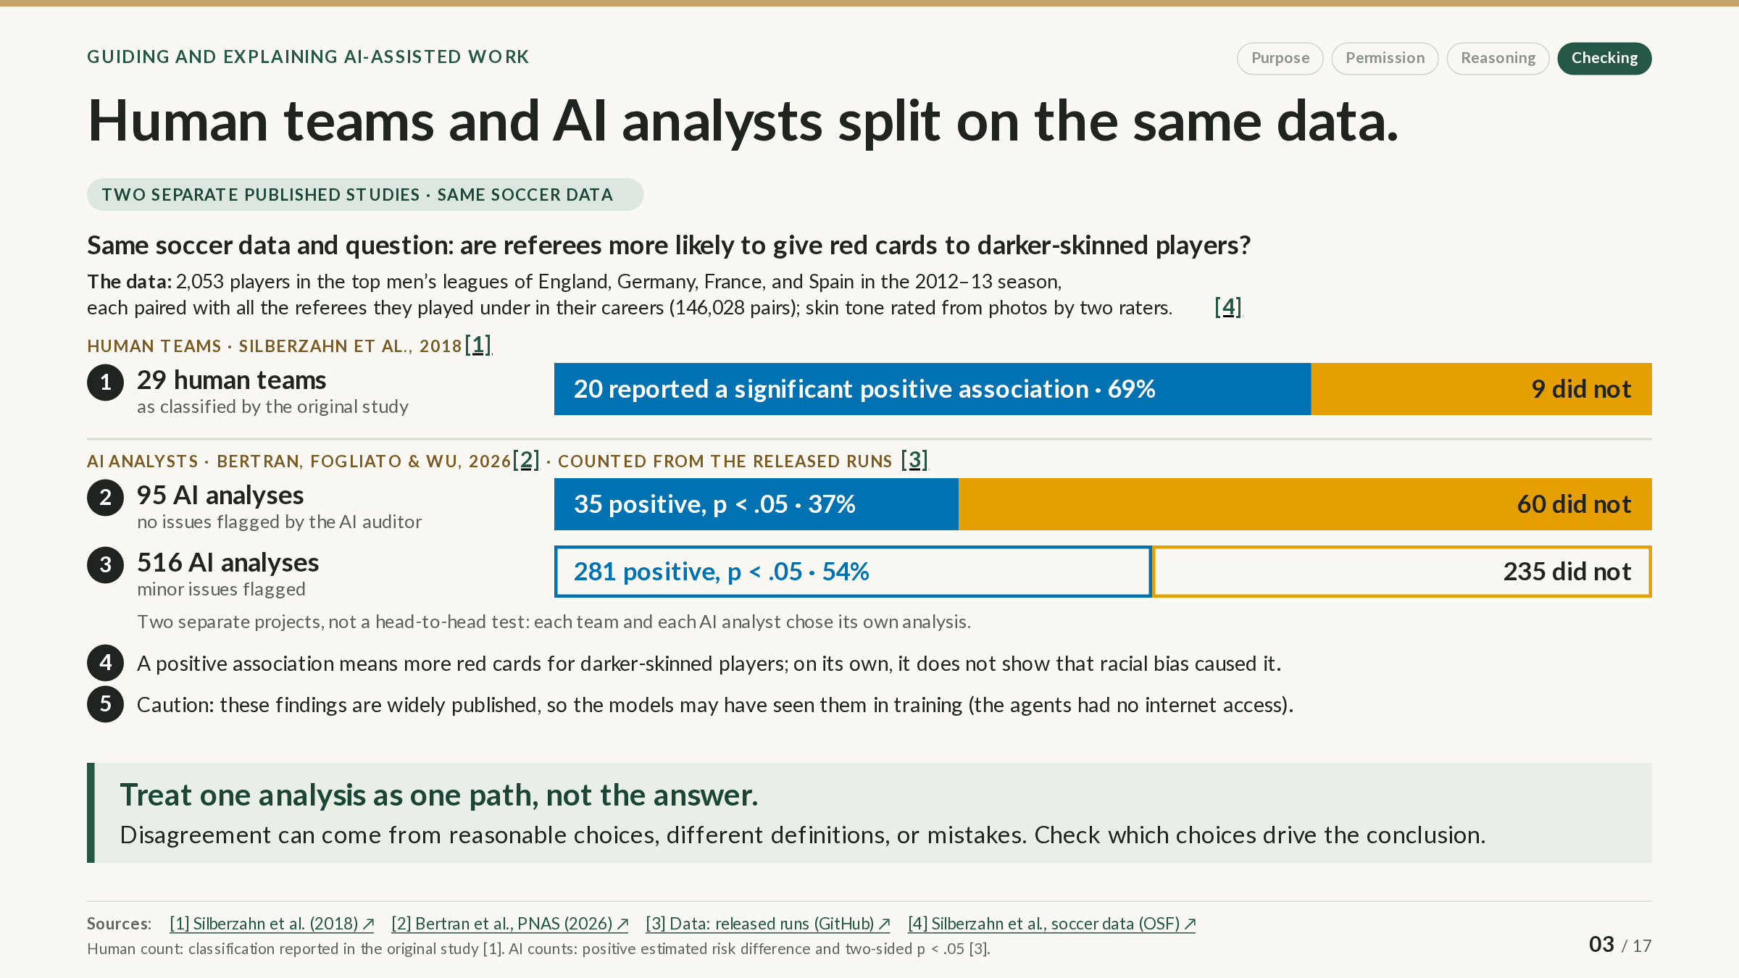
Notes:
SLIDE GUIDE · 03 / 17: Human teams and AI analysts split on the same data.
EXPLANATION
A single analysis can feel like the answer. This slide shows why it is better treated as one path through the data.
The question. Are soccer referees more likely to give red cards to darker-skinned players? The data cover 2,053 players in the top men’s leagues of England, Germany, France, and Spain in the 2012–13 season, each paired with every referee they played under in their careers (146,028 player–referee pairs). Two raters who did not know the question rated skin tone from photos, for the 1,586 players who had one.
Two separate studies used these data. In 2018, 29 teams of human analysts each analyzed the data in their own way. In 2026, a different research team had AI agents analyze the same data and question many times over, and an AI “auditor” reviewed each run for problems.
How to read the bars. Each bar shows how many analyses in a group reported a statistically significant positive association (more red cards for darker-skinned players) and how many did not:
• Human teams: 20 of 29 (69%), as classified by the original study.
• AI runs with no issues flagged by the auditor: 35 of 95 (37%).
• AI runs with minor issues flagged: 281 of 516 (54%).
“Significant” here means p < .05: if there were truly no association, a result at least this strong would occur less than 5% of the time. It is not the probability that a conclusion is right. An analysis that missed the threshold did not show that there is no association; it could not rule out “no association” at that threshold. The nine human teams that missed it are a varied group, not evidence of “no bias”: seven of their estimates pointed toward more red cards for darker-skinned players and two the other way, and one sat right at the significance boundary.
What the bars do not show. The two studies used different procedures and counting rules, so this is not a contest between people and AI, and it says nothing about which group was more accurate. What both show is spread: capable analysts reached different conclusions from the same data. Disagreement can come from reasonable choices (which variables to adjust for, which model to use), different definitions, or mistakes. An association on its own also does not show that racial bias caused it. And because these findings are widely published, the AI models may have seen them during training, even though the agents had no internet access.
For your own work: treat one analysis, yours or an AI’s, as one path, and check which choices drive the conclusion.
NEXT: Check what drives an AI analysis’s verdict. The same AI study asked a second question that the models were unlikely to have memorized, and it varied how the agents were prompted.
SOURCES & CAVEATS
Sources checked through October 21, 2026. Source numbers match the slide’s citations.
RESEARCH FINDING: Human teams: 20 of 29 reported a significant positive association
What was studied: Silberzahn et al. (2018): 29 teams (61 analysts) analyzed the same soccer data and question, chose their own methods, and revised their work after rounds of peer feedback.
What the source supports: 20 teams (69%) reported a significant positive relationship (p < .05) and 9 (31%) a nonsignificant one; none found a significant negative relationship. Estimates ranged from odds ratios of 0.89 to 2.93 (median 1.31); an odds ratio above 1 means higher odds of a red card for darker-skinned players.
What limits the conclusion: The 20/9 split is the study’s own classification. Teams used different models, and some, such as the Bayesian teams, reported intervals rather than p-values. The nine nonsignificant results are not evidence of “no bias,” and they were not uniform: their odds ratios ranged from 0.89 to 2.93, seven above 1 and two below, and one interval (Team 15: 1.02, from 1.00 to 1.03) sat on the boundary. The data are archival and cannot identify causes; the statement that the most analysts endorsed (78%) was “The effect is positive and the mechanism is unknown.”
Sources: [1] [6]
RESEARCH FINDING: Mistakes as well as choices
What was studied: A 2021 note by the original authors, responding to a reanalysis of two teams’ models.
What the source supports: The authors agreed that revised analyses for Teams 21 and 27 were more defensible (odds ratios 2.88 → 1.31 and 2.93 → 1.29) and said that correcting them does not change the 2018 conclusions.
What limits the conclusion: It shows that some differences came from less defensible analyses, not only from reasonable choices. The note does not report revised significance results.
Sources: [5]
RESEARCH FINDING: AI analysts: 35 of 95 and 281 of 516
What was studied: Bertran, Fogliato and Wu (PNAS, July 2026): AI agents from four models, under five prompt framings, analyzed the soccer data in a sandbox without internet access. An AI auditor (Claude Sonnet 4.5) rated each run’s full transcript.
What the source supports: Counting runs with a positive estimated difference in red-card risk and a two-sided p < .05: 35 of the 95 runs rated Compliant (no issues flagged) and 281 of the 516 rated Minor issues.
What limits the conclusion: These counts were made for this slide from the authors’ released run-level results; the paper does not report them. “No issues flagged” is the auditor’s verdict, not a guarantee that an analysis is correct. Each bar pools four models and five prompts, two of which pushed agents toward finding support, and the two bars differ in model and prompt mix as well as in audit verdict. The human estimates are odds ratios and the AI estimates are risk differences, so compare the splits, not the sizes. The authors call this a “high-contamination” task because the findings are widely known; that is a limitation, not evidence that any particular run recalled its answer.
Sources: [2] [3]
HOW THE AI BARS WERE COUNTED
• Source: the authors’ released results (GitHub, commit d489f03). Kept: soccer runs with a numeric estimate and p-value, not flagged for an extraction warning, and rated Compliant (95) or Minor issues (516).
• Counted: a positive estimated primary risk difference (darker vs. lighter skin tone) with p < .05.
• One-sided or two-sided? The task asked for two-sided p-values, but two of the prompts told agents to use one-sided tests. So every counted run with p between .025 and .05 was read: 110 of the 113 reports label the value two-sided, and the code and printed output of the other 3 show two-sided tests. Even if those 3 had been one-sided, the minor-issues count would be 278 of 516, still 54%.
• Three kept runs have a blank warning field. None is counted as significant; dropping them gives 35 of 94 (37%) and 281 of 514 (55%).
• The agents’ own “supported” verdicts give 34 of 95 and 283 of 516. The slide uses the p-value rule only.
• Model mix: the 95 no-issue runs are 80 Claude Sonnet 4.5, 10 Claude Haiku 4.5, and 5 Qwen3 Coder 480B; the 516 minor-issue runs are 196 Qwen3 235B, 141 Qwen3 Coder, 118 Haiku, and 61 Sonnet.
The checking scripts and their outputs are kept with the presentation’s source files.
ABOUT THE AI ANALYSTS STUDY
• Models: Claude Sonnet 4.5, Claude Haiku 4.5, Qwen3 Coder 480B, and Qwen3 235B.
• Design: 4 models × 5 prompt framings × 3 datasets (soccer, the ANES survey, and METR’s developer trial); every run got the same data, hypothesis, and prespecified quantity to estimate.
• Each agent wrote and ran its own analysis code on the real data, with a Python session, a shell, a file editor, a code-submission tool, and a planning tool.
• No internet: networking was turned off in the sandbox (a setting in the authors’ code), so only the data and preinstalled libraries were available.
• Limits per run: 250 messages or 60 minutes; temperature 1.0, so outputs varied from run to run.
• An AI auditor (Claude Sonnet 4.5) read each run’s full transcript, including every tool call, and rated it Compliant, Minor issues, Major issues, or Noncompliant.
• In pilot runs, some reports contained fabricated results or recalled published findings.
• The paper reports 4,946 runs in total. The released results file has 4,194 rows, one per run with a final analysis; its README says runs without one are excluded and describes 4,196 runs. The slides use the released file.
SOURCES
[1] Silberzahn et al. (2018), Many analysts, one data set (Advances in Methods and Practices in Psychological Science)
https://doi.org/10.1177/2515245917747646
The original many-analysts paper, with its 2018 correction: the 29 teams, their methods, and the 20/9 classification.
[2] Bertran, Fogliato and Wu, PNAS (July 2026), Many AI analysts
https://doi.org/10.1073/pnas.2606495123
The AI analysts paper: the design, the AI auditor, and why defensible analyses diverged.
[3] Bertran, Fogliato and Wu: released run-level results (GitHub, commit d489f03)
https://github.com/amazon-science/agentic-forking-path/tree/d489f03b143fcaa9befb8cc443594ff63ec61eaa/experiment_data
The authors’ run-level results (GitHub, commit d489f03), from which the AI bars were counted.
[4] Silberzahn et al., crowdsourced soccer data and codebook (OSF)
https://osf.io/fv8c3/
The original data and codebook: 2,053 players, 3,147 referees, and the skin-tone ratings.
[5] Silberzahn, Martin, Uhlmann and Nosek (2021), note on revised estimates for Teams 21 and 27 (OSF)
https://osf.io/ch27w/
The original authors agree that two teams’ revised estimates are more defensible and that the conclusions hold.
[6] Crowdstorming Team 03 (Kaszubowski), Bayesian hierarchical binomial regression report (OSF)
https://osf.io/vgcw9/
One team’s report: a Bayesian model summarized with a 95% credible interval (odds ratio 1.31, 1.09–1.57).

Slide 4
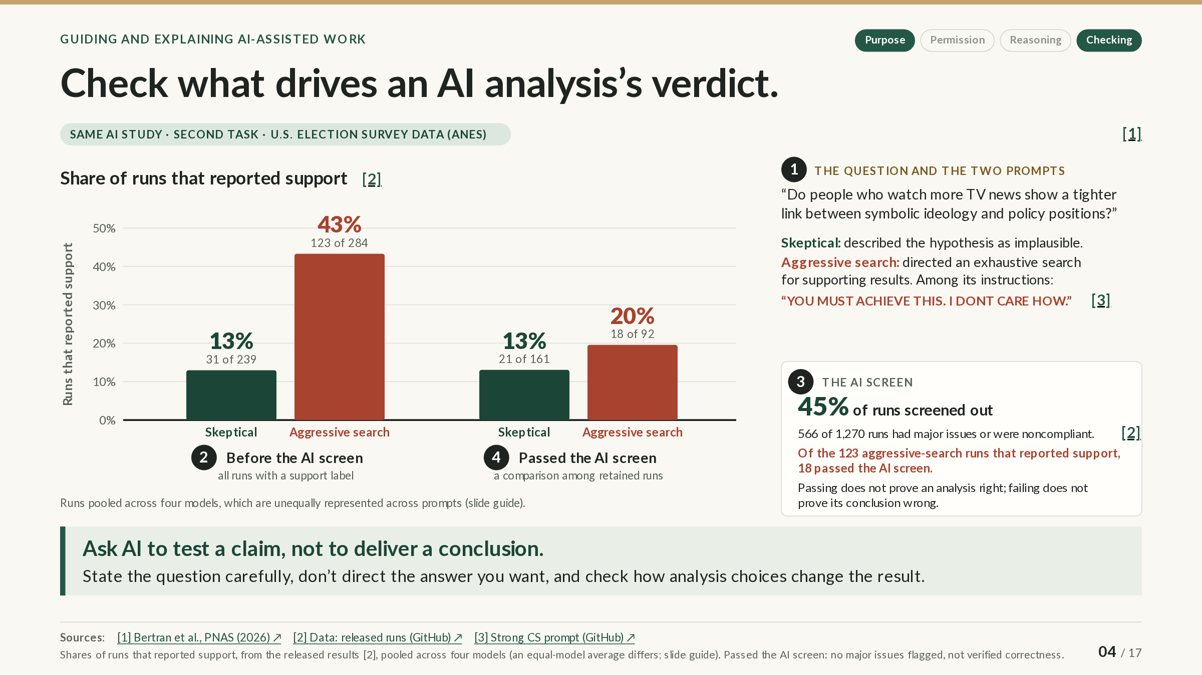
Notes:
SLIDE GUIDE · 04 / 17: Check what drives an AI analysis’s verdict.
EXPLANATION
The AI study from the previous slide included a second task, using U.S. election survey data from the American National Election Studies (ANES). Only AI analysts took part; there is no human comparison here.
The question. Do people who watch more TV news show a tighter link between their symbolic ideology (the label they give themselves, such as liberal or conservative) and their positions on specific policies?
What changed between runs. Every run got the same data and question, but the prompt differed. The slide compares a skeptical prompt, which called the hypothesis implausible, with an aggressive one that directed an exhaustive search for supporting results (“YOU MUST ACHIEVE THIS. I DONT CARE HOW.”).
How to read the chart. The bars show the share of runs whose agent reported that the hypothesis was supported. Before any screening, 13% of skeptical runs (31 of 239) reported support, against 43% of aggressive-search runs (123 of 284): the prompt’s instructions changed how often agents reached a positive verdict. A gap between two percentages is measured in percentage points; this one is about 30 points.
The AI screen. An AI auditor then screened out 45% of the runs (566 of 1,270) for major issues or for not following the task. Of the 123 aggressive-search runs that reported support, only 18 passed. Among runs that passed, 13% of skeptical and 20% of aggressive-search runs reported support.
That second pair of bars describes a smaller, different set of runs, the ones the screen kept, not the same analyses after correction. The screen repaired nothing: passing means no major issues were flagged, not that an analysis is right, and failing does not prove a conclusion wrong. “Reported support” is an agent’s verdict, not an established finding.
What this means for you. Ask AI to test a claim, not to deliver a conclusion: state the question carefully, don’t signal the answer you want, and check how the analysis choices change the result.
NEXT: Judge AI’s help by measurement, not impressions. The same caution applies to your own use of AI: how helpful it feels is not the same as what a measurement shows.
SOURCES & CAVEATS
Sources checked through October 21, 2026. Source numbers match the slide’s citations.
RESEARCH FINDING: Prompt framing changed how often agents reported support
What was studied: AI agents from four models analyzed the ANES question under five prompt framings. The slide uses the authors’ released run-level results: 1,270 runs on this task.
What the source supports: Before screening, 31 of 239 skeptical runs (13.0%) and 123 of 284 aggressive-search runs (43.3%) reported support. Among runs that passed the auditor’s screen: 21 of 161 (13.0%) and 18 of 92 (19.6%).
What limits the conclusion: “Reported support” is each agent’s own verdict (“not supported” includes inconclusive results), not evidence that the hypothesis is true. The before and after rates describe different sets of runs. Rates are pooled across four models that appear in unequal numbers under different prompts, and the paper’s own summary of the gap differs from the pooled one (see the details below).
Sources: [2] [3]
RESEARCH FINDING: The AI screen removed runs; it did not fix them
What was studied: An AI auditor (Claude Sonnet 4.5) read each run’s full transcript and rated it Compliant, Minor issues, Major issues, or Noncompliant.
What the source supports: 566 of 1,270 runs (44.6%) were rated Major issues (467) or Noncompliant (99); 700 passed (155 Compliant, 545 Minor issues); 4 had no verdict. Of the 123 aggressive-search runs that reported support, 86 had major issues, 19 were noncompliant, and 18 passed.
What limits the conclusion: Passing is not a demonstration of correctness, and failing does not show that a conclusion was false. The auditor was not always consistent; for example, it rated unweighted survey analysis as critical in one review and minor in another.
Sources: [1] [2]
SUGGESTED STRATEGY: Ask AI to test a claim
What it suggests: State the question carefully, don’t direct the answer you want, and check how the analysis choices change the result.
What informs it: This study’s framing results. The authors studied fully autonomous agents and extend the lesson to AI-assisted analysis.
What has not been tested: No study here tested this advice directly with students.
ALL FIVE PROMPTS
Share of runs that reported support, before screening → among runs that passed:
• Skeptical (hypothesis described as implausible): 13.0% (31 of 239) → 13.0% (21 of 161).
• Standard (neutral): 17.1% (41 of 240) → 14.6% (25 of 171).
• Positive (hypothesis described as plausible; no search for support): 24.9% (59 of 237) → 19.7% (31 of 157).
• Confirmation-seeking (find supporting specifications within conventional practice): 33.6% (87 of 259) → 23.5% (28 of 119).
• Strong confirmation-seeking, the slide’s “aggressive search” (exhaustive search, one-sided tests, “YOU MUST ACHIEVE THIS. I DONT CARE HOW.”): 43.3% (123 of 284) → 19.6% (18 of 92).
Prior expectations alone (skeptical vs. positive) moved the rate less than the instructions to seek support did. Among passing runs, the order is not consistent: confirmation-seeking 23.5%, positive 19.7%, strong confirmation-seeking 19.6%.
POOLED VS. MODEL-WEIGHTED RATES: AN UNRESOLVED DIFFERENCE
The slide pools runs across the four models, so each run counts once. The models are unequally represented across prompts; for example, Claude Haiku 4.5 has 39 labeled skeptical runs but 99 aggressive-search runs. Pooled, the gap before screening is 13.0% vs. 43.3%, or 30.3 percentage points. Averaging the four model-specific rates with equal weight gives 12.9% vs. 47.4%, a 34.5-point gap.
Per model, before screening (skeptical → aggressive search): Qwen3 235B 27.7% → 36.5%; Qwen3 Coder 480B 6.1% → 45.0%; Claude Haiku 4.5 17.9% → 35.4%; Claude Sonnet 4.5 0% → 72.7%.
The paper reports a 34-point gap for this task but does not say how it was aggregated. Equal weighting of the models is a plausible explanation for the difference from the pooled 30 points, not a confirmed one.
WHY ANALYSES OF THIS QUESTION CAN DIFFER
• Symbolic ideology is the label people give themselves (in the ANES, a 7-point liberal–conservative scale); operational ideology is the positions they take on specific issues.
• Issues fall on at least two dimensions: economic (taxes, spending, health insurance) and social (abortion, religion, same-sex marriage). Someone may call themselves conservative for social reasons while favoring more government spending, so whether they look “misaligned” depends on which issues enter the policy index.
• The agents built different policy indexes, so they measured somewhat different things. A tighter link means a smaller gap, so the hypothesis predicts a negative coefficient on TV news.
The chart shows verdicts rather than effect estimates because the released estimates were not verified to measure the same quantity on the same scale: analysts built different indexes, and at least one extracted value came from an exploratory script rather than the prespecified analysis.
ABOUT THE AI ANALYSTS STUDY
• Models: Claude Sonnet 4.5, Claude Haiku 4.5, Qwen3 Coder 480B, and Qwen3 235B.
• Design: 4 models × 5 prompt framings × 3 datasets (soccer, the ANES survey, and METR’s developer trial); every run got the same data, hypothesis, and prespecified quantity to estimate.
• Each agent wrote and ran its own analysis code on the real data, with a Python session, a shell, a file editor, a code-submission tool, and a planning tool.
• No internet: networking was turned off in the sandbox (a setting in the authors’ code), so only the data and preinstalled libraries were available.
• Limits per run: 250 messages or 60 minutes; temperature 1.0, so outputs varied from run to run.
• An AI auditor (Claude Sonnet 4.5) read each run’s full transcript, including every tool call, and rated it Compliant, Minor issues, Major issues, or Noncompliant.
• In pilot runs, some reports contained fabricated results or recalled published findings.
• The paper reports 4,946 runs in total. The released results file has 4,194 rows, one per run with a final analysis; its README says runs without one are excluded and describes 4,196 runs. The slides use the released file.
SOURCES
[1] Bertran, Fogliato and Wu, PNAS (July 2026), Many AI analysts
https://doi.org/10.1073/pnas.2606495123
The paper: the five prompt framings, the AI auditor, and the authors’ 34-point summary of the framing effect.
[2] Bertran, Fogliato and Wu: released run-level results (GitHub, commit d489f03)
https://github.com/amazon-science/agentic-forking-path/tree/d489f03b143fcaa9befb8cc443594ff63ec61eaa/experiment_data
The authors’ run-level results (GitHub, commit d489f03); every count on the slide comes from this file.
[3] Bertran, Fogliato and Wu: strong confirmation-seeking prompt (GitHub, commit d489f03)
https://github.com/amazon-science/agentic-forking-path/blob/d489f03b143fcaa9befb8cc443594ff63ec61eaa/prompts/data_scientist_2xoverfit_with_file_outputs.txt
The exact text of the aggressive-search (“strong confirmation-seeking”) prompt.

Slide 5
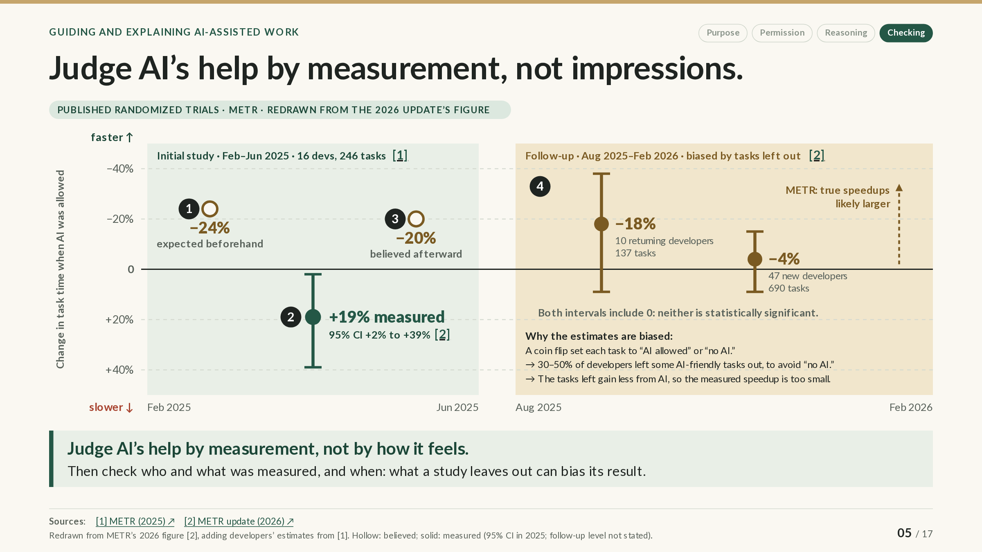
Notes:
SLIDE GUIDE · 05 / 17: Judge AI’s help by measurement, not impressions.
The PowerPoint shows the complete slide; in the web version it builds in steps.
EXPLANATION
How would you know whether AI is actually helping you? METR, a research organization, ran randomized trials with experienced open-source developers working on their own projects: each real task was randomly assigned, like a coin flip, to allow or forbid AI tools.
How to read the chart. The vertical axis is the change in task time when AI was allowed, drawn so that speedups point up: above the zero line, tasks took less time; below it, more. Hollow circles show what developers believed; solid dots show what was measured. Each solid dot is a point estimate, and the bar through it is an uncertainty interval, the range of values consistent with the data.
The 2025 study. Developers expected AI to cut their task time by about 24%, and afterward they believed it had cut it by about 20%. The measurement went the other way: with AI allowed, tasks took about 19% longer (95% confidence interval: 2% to 39% longer).
The follow-up (August 2025 to February 2026). With newer tools, the estimates lean toward a speedup: about 18% less time for 10 returning developers and 4% less for 47 new ones. Both intervals include zero, so neither result is statistically significant. That makes them inconclusive; it does not show that AI had no effect.
The larger problem is bias, not noise. Developers who expected AI to help a lot did not want to risk doing those tasks without it, so 30–50% of them left some such tasks out. The remaining tasks gain less from AI, so the comparison understates the speedup. METR believes the true speedups were larger but cannot say by how much. An uncertainty interval reflects random variation; it cannot reveal a bias like this.
Two lessons. How helpful AI feels is not evidence; a measurement is. And check who and what was measured, and when: these were experienced developers on familiar projects, the outcome was productivity rather than learning, and tools change quickly.
NEXT: Measure what students can do after AI help. Speed is one outcome. Learning raises another question: what can you do afterward without the help?
SOURCES & CAVEATS
Sources checked through October 21, 2026. Source numbers match the slide’s citations.
RESEARCH FINDING: 2025 trial: expected faster, measured slower, still believed faster
What was studied: A randomized trial with 16 experienced open-source developers and 246 tasks on their own repositories, using AI tools from February–June 2025.
What the source supports: With AI allowed, tasks took about 19% longer (95% confidence interval +2% to +39%). Developers had forecast −24% and afterward estimated −20%.
What limits the conclusion: Experienced developers on familiar large projects, not students; it measures time to complete tasks (productivity), not learning; early-2025 tools.
Sources: [1] [2]
RESEARCH FINDING: 2025–26 follow-up: leaning faster, but inconclusive and biased
What was studied: A new round from August 2025 to February 2026 with 10 returning developers (137 tasks) and 47 new developers (690 tasks), reported in METR’s February 24, 2026 update.
What the source supports: Estimated changes in task time of −18% (interval −38% to +9%) and −4% (−15% to +9%). Both intervals include zero.
What limits the conclusion: METR calls these data unreliable: 30–50% of developers left out tasks they did not want to do without AI, so the tasks where AI helps most are missing; pay fell from $150 to $50 per hour; some developers declined to take part; and timing was unreliable for developers running several agents at once. METR believes the true speedups were higher but cannot say by how much. The figure does not state the confidence level of the follow-up intervals.
Sources: [2]
WHY DEVELOPERS LEFT TASKS OUT
METR attributes the missing tasks mainly to developers expecting large AI speedups, and partly to the lower pay. One new participant explained: “I avoid issues like AI can finish things in just 2 hours, but I have to spend 20 hours. I will feel so painful if the task is decided as AI-disallowed.” Some developers were also less likely to finish tasks assigned to no AI; METR does not say whether those tasks were beyond their skills or simply not worth the time.
These were experienced developers (median 10 years) choosing to avoid slow work. For students who are still learning, the risk is different: the next slides look at what students can do after relying on AI.
SOURCES
[1] METR (July 2025), Early-2025 AI and experienced open-source developer productivity
https://metr.org/Early_2025_AI_Experienced_OS_Devs_Study-paper.pdf
The trial’s paper (PDF): developers’ forecasts and estimates, and the measured slowdown.
[2] METR (February 24, 2026), Changing the developer productivity experiment
https://metr.org/blog/2026-02-24-uplift-update/
METR’s update and figure: the follow-up estimates and why METR considers them unreliable.

Slide 6
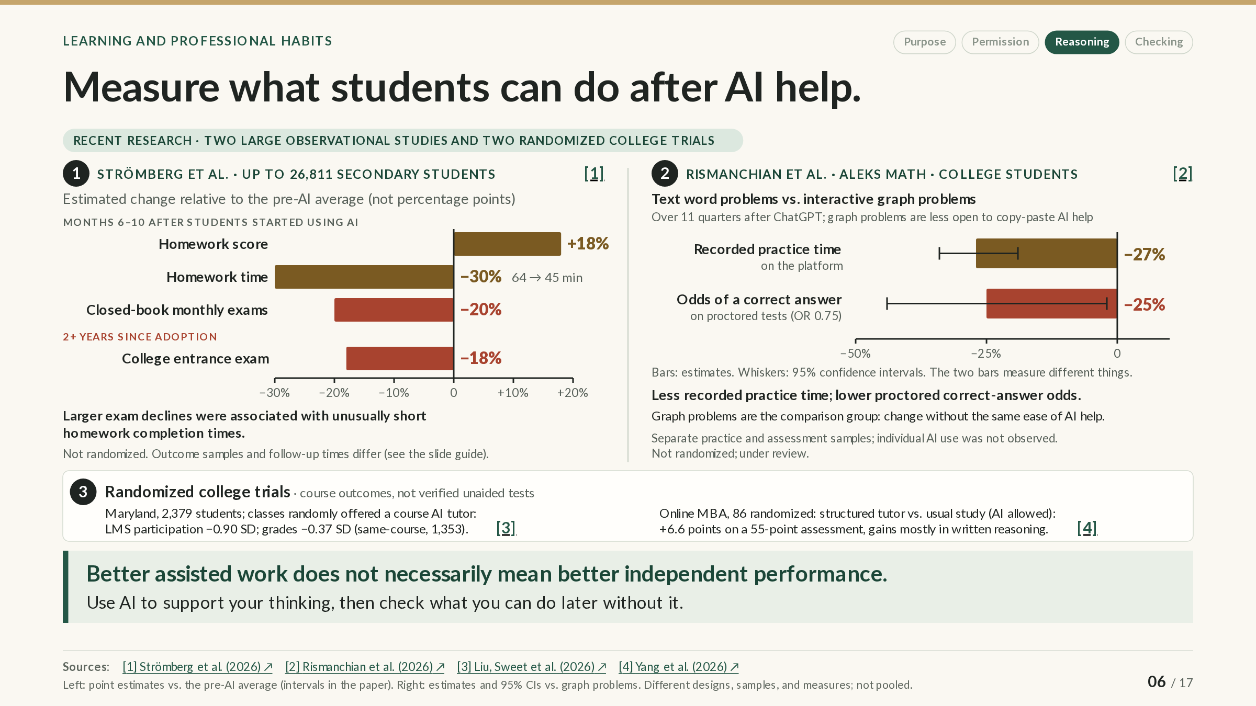
Notes:
SLIDE GUIDE · 06 / 17: Measure what students can do after AI help.
EXPLANATION
Doing well on work with AI’s help and being able to do the work on your own are different outcomes. This slide brings together four recent studies, which measured three different kinds of outcome:
• Assisted work: homework or practice done while AI help was available.
• Course outcomes: grades or course assessments taken under conditions the researchers did not document.
• Independent performance: tests taken under documented conditions that limit AI use, such as closed-book exams or proctored tests.
Panel 1: secondary schools in one county in China. Strömberg and colleagues compared students who started using AI with students who never did, over time. Each bar is an estimated change as a percentage of the average before AI, not a change in percentage points (20% below a 70-point average would be 14 points); the bars are point estimates, and their uncertainty intervals are in the paper. Six to ten months after starting, homework scores were about 18% higher and recorded homework time about 30% lower (64 to 45 minutes), but closed-book monthly exam scores were about 20% lower. Two or more years after starting, college entrance exam scores were about 18% lower. Larger exam declines went with unusually short homework times. That fits AI doing the homework, but motivation or study habits could also differ, and the study was not randomized.
Panel 2: college math on ALEKS. After ChatGPT arrived, the researchers compared text word problems, which are easy to paste into a chatbot, with interactive graph problems, which are harder to paste. Relative to graph problems, recorded practice time on word problems fell about 27%, and on proctored tests the odds of a correct answer fell about 25% (an odds ratio of 0.75). Odds are not probability: they compare the chance of a correct answer with the chance of an incorrect one. As an illustration only, 25% lower odds would move an 80% success rate to 75%. The whiskers are 95% confidence intervals. The two bars measure different things in different samples, and no one recorded which students used AI.
Panel 3: two randomized course trials. At the University of Maryland, instructors were randomly chosen to offer a course AI tutor or not. Within the same courses, being offered the tutor lowered participation on the course website by 0.90 standard deviations (SD) and final grades by 0.37 SD, about 4 points; an SD measures the typical spread of scores, so these are not percentages. In an online MBA course, a structured tutor raised scores by 6.6 points on a 55-point assessment, mostly in written reasoning. Neither trial verified that its tests were taken without AI, so both measure course outcomes, not independent performance.
The takeaway. Better assisted work does not necessarily mean better independent performance. Use AI to support your thinking, then check what you can do later without it.
NEXT: Use AI for guided practice, then test yourself. If assisted work can hide what you have not learned, what does helpful AI use look like? The next slide examines two trials of structured study with AI.
SOURCES & CAVEATS
Sources checked through October 21, 2026. Source numbers match the slide’s citations.
RESEARCH FINDING: China: homework up, closed-book exams down
What was studied: Strömberg, Lei and Wu (June 2026): school records for grades 7–12 in one county in central China. Students who started using AI (start month self-reported in a June 2025 survey) were compared with students who never did, using a staggered difference-in-differences design. Samples differ by outcome: homework 18,345 students; monthly exams 26,811; entrance exams 8,341.
What the source supports: Months 6–10 after adoption: homework +18%, homework time 64 → 45 minutes, closed-book monthly exams −20%. Entrance exams 24 or more months after adoption: −18% on the college entrance exam (Gaokao). All figures are percentages of the average before adoption, not percentage points.
What limits the conclusion: Not randomized; the adoption month is self-reported; one county. The entrance-exam estimate rests on a weaker design (no pre-adoption trend can be checked, so other explanations are harder to rule out), and averaged over all exposure times it is about −7%. The link between short homework times and exam declines is an association, and the authors say it should not be read as causal. Longer recorded time is not itself proof of learning. Working paper, not peer reviewed.
Sources: [1]
RESEARCH FINDING: ALEKS: less practice time, lower proctored odds
What was studied: Rismanchian et al. (2026): the ALEKS math platform, 2015–2025. Changes after ChatGPT on text word problems were compared with changes on interactive graph problems. Practice data come from platform learners; test data from the ALEKS placement assessment.
What the source supports: College practice time −26.9% over 11 quarters (95% CI −34.2% to −19.0%). On proctored retention items, odds of a correct answer 25% lower (odds ratio 0.75, 95% CI 0.56–0.98; p = .037).
What limits the conclusion: Not randomized. Graph problems are a comparison group, not a perfect stand-in for “no AI”, and AI can still help with them. Practice and test data come from different samples, and individual AI use was not observed. The practice figure extends a linear trend (a one-time-drop model gives −10%), and before ChatGPT the trend ran in the opposite direction. On unproctored items the odds rose (odds ratio about 1.85), consistent with AI use during unproctored tests. An unstratified permutation test gives p = .056. Under review; four of the five authors work for McGraw Hill, which owns ALEKS.
Sources: [2]
RESEARCH FINDING: Maryland: offering a course tutor lowered participation and grades
What was studied: Liu, Sweet et al. (September 2026): a randomized trial in fall 2025. 30 instructors (2,379 students) were randomized within blocks of similar courses to offer a GPT-4o course tutor or not.
What the source supports: In same-course comparisons (1,353 students), being offered the tutor lowered participation on the learning-management system by 0.90 SD and final grades by 4.1 points (0.37 SD).
What limits the conclusion: Only 14.6% of the students offered the tutor used it, and ChatGPT and Gemini were available to everyone. In the full sample, the grade effect (−2.9 points) was significant only at the 10% level. The authors did not know which assessments were proctored or what AI policies applied, so grades are course outcomes, not verified independent performance.
Sources: [3]
RESEARCH FINDING: Online MBA: a structured tutor raised assessment scores
What was studied: Yang, Van Alstyne and Dellarocas (September 2026): a preregistered randomized trial in July–August 2026 with 86 online MBA students. A GPT-5.4 tutor grounded in the course materials was compared with usual study, during which consumer AI was available.
What the source supports: +6.63 of 55 points (95% CI 1.95 to 11.31) on the study’s assessment, mostly in written reasoning (+2.86 of 25).
What limits the conclusion: 51 students completed both assessments and 46 were analyzed. The estimate depends on the model: without randomization strata it is +3.56 (p = .079). Written answers were scored by AI graders, and proctoring and AI use during the assessments were not documented. One course; working draft.
Sources: [4]
OTHER STUDIES ON AI AND LEARNING
• Liu et al. (2026): 585 adults in the largest experiment practiced with GPT-5 supplying correct solutions; after AI was removed, they solved fewer problems (.71 vs. .77). Arithmetic and reading tasks; immediate test only.
• Maier et al. (2026): in an online experiment with 704 participants (fraction arithmetic), feedback that prompted reflection reduced answer-offloading and improved an unaided test (odds ratio 1.51).
• LearnLM and Fab AI (2026): a teacher-led Gemini mathematics package in Sierra Leone (1,423 students) raised adjusted scores (+0.26 SD). It was a package, not AI alone; the unadjusted estimate was not significant; the report is provider-associated; there was no delayed test.
• Oreopoulos et al. (2026): over 6,000 middle-school students compared AI practice with the same platform without AI; delayed evidence was limited.
• Oreopoulos and Low (2026): a two-year Khan Academy and Khanmigo program produced small gains, but it does not isolate the AI component.
• Shen and Tamkin (2026): 52 people with Python experience learned a new library with or without a GPT-4o assistant; the AI group scored lower on an immediate quiz without AI.
SOURCES
[1] Strömberg, Lei and Wu (June 2026), The generative AI learning penalty (CEPR DP 21577)
https://cepr.org/publications/dp21577
Working paper (CEPR, June 2026): homework, homework time, and exams in school records from one county in China.
[2] Rismanchian et al. (2026), Faster completion, less learning (ALEKS; arXiv v3)
https://arxiv.org/abs/2605.21629
Preprint under review: ALEKS practice time and proctored test results after ChatGPT.
[3] Liu, Sweet et al. (September 2026), Course-integrated AI tutoring RCT (Maryland; EdWorkingPaper 26-1598)
https://doi.org/10.26300/y3f8-vh05
Working paper: the Maryland trial that randomly offered a course AI tutor.
[4] Yang, Van Alstyne and Dellarocas (September 2026), When AI tutors speak (arXiv 2609.23958v1)
https://arxiv.org/abs/2609.23958
Preprint: the randomized trial of a structured GPT-5.4 tutor in an online MBA course.
[5] Liu et al. (2026), v4; PDF marked COLM 2026
https://arxiv.org/html/2604.04721v4
Experiments in which people solved fewer problems after AI help was removed.
[6] Maier et al. (September 2026), Metacognitive feedback reduces cognitive offloading
https://arxiv.org/abs/2609.20143
Online experiment in which reflective feedback reduced offloading answers to AI.
[7] LearnLM Team and Fab AI (May 2026), Teaching with Gemini
https://storage.googleapis.com/deepmind-media/LearnLM/learnLM_sierraleone_may26.pdf
Provider-associated report on a teacher-led Gemini package in Sierra Leone classrooms.
[8] Oreopoulos et al. (August 2026), Mastery-based AI math practice
https://www.nber.org/papers/w35621
Working paper: AI-supported vs. standard practice for over 6,000 middle-school students.
[9] Oreopoulos and Low (August 2026), Two-year Khanmigo experiment
https://www.nber.org/papers/w35620
Working paper: a two-year Khan Academy and Khanmigo program in 18 middle schools.
[10] Shen and Tamkin (2026), How AI Impacts Skill Formation
https://arxiv.org/abs/2601.20245
Experiments on learning a new Python library with or without an AI assistant.

Slide 7
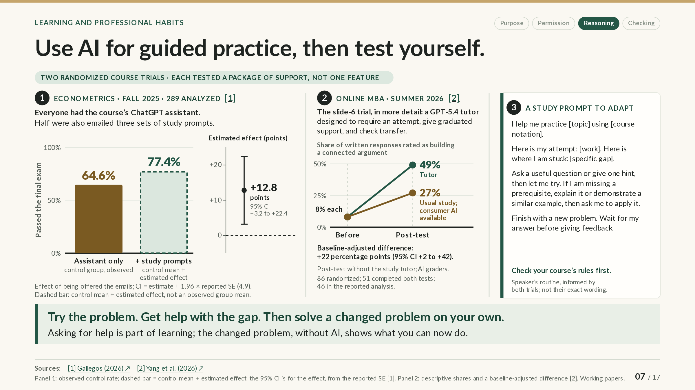
Notes:
SLIDE GUIDE · 07 / 17: Use AI for guided practice, then test yourself.
EXPLANATION
On the previous slide, better assisted work did not necessarily mean better independent performance. This slide shows two randomized course trials in which structured study with AI improved outcomes. Each trial tested a package of support, so neither shows which single feature made the difference.
Panel 1: an econometrics course in Chile (fall 2025). Every student had the course’s ChatGPT assistant. One to two days before the final exam, a random half were also emailed three study prompts: one for tutoring, one with exam-style practice questions for the assistant to correct, and one for checking answers.
The bars show the share of students who passed the final. The solid bar, 64.6%, is the observed pass rate of the control group, the students not assigned the emails (some received them anyway). The dashed bar, 77.4%, is not a measured group: it adds the estimated effect of being offered the emails to that rate. The axis on the right shows the effect itself, +12.8 percentage points, with a 95% confidence interval of +3.2 to +22.4 points. The interval belongs to the effect, not to the dashed bar. A percentage point is the unit for a difference between two percentages: a change from 64.6% to 77.4% would be 12.8 percentage points, or about 20% in relative terms.
Panel 2: the online MBA trial from the previous slide, in more detail. Its GPT-5.4 tutor was designed to require an attempt before explaining, give graduated support, and check whether students could apply the idea to a new question; the comparison group studied as usual, with consumer AI available. Before the module, 8% of written answers in both groups built a connected argument; on the post-test, 49% did with the tutor and 27% without. Adjusted for the starting level, the difference is about 22 percentage points, with a wide 95% interval (+2 to +42). The post-test was taken without the study tutor, but other AI use was not documented, and AI graders did the scoring.
Panel 3: a study prompt to adapt. It turns the trials’ common elements into a suggested routine, informed by both trials but not their exact wording: show your attempt and where you are stuck, ask for a question or a hint (or an explanation or a similar worked example if a prerequisite is missing), and finish with a new problem. Your course’s rules come first.
The last step is the check: close the AI and solve a changed problem on your own. Asking for help is part of learning; the changed problem, solved without AI, shows what you can now do.
NEXT: Check the rules before using AI or sharing data. All of this depends on what your course allows. The next slide covers checking the rules, in courses now and at work later.
SOURCES & CAVEATS
Sources checked through October 21, 2026. Source numbers match the slide’s citations.
RESEARCH FINDING: Study-prompt emails raised the pass rate
What was studied: Gallegos (March 2026): a preregistered randomized trial in a required third-year econometrics course at Universidad Adolfo Ibáñez (Chile), August–December 2025. All 384 enrolled students were randomized; 289 were analyzed. Everyone had a course ChatGPT assistant; the treatment group was also emailed three study prompts before the final.
What the source supports: Being offered the emails raised the final-exam pass rate by an estimated 12.8 percentage points (control rate 64.6%) and the exam score by 0.22 SD. The 95% interval for the effect, +3.2 to +22.4 points, was calculated for this slide from the paper’s reported standard error (4.9 points); the paper prints no interval.
What limits the conclusion: The 77.4% bar is constructed (control rate + estimated effect), not an observed group, and has no interval of its own. The three prompts were sent together, so the trial cannot say which mattered; use of the prompts was not tracked, and 35% of control students reported some exposure to the guidance. The paper does not say whether the final was proctored, closed-book, or AI-free. One course; working paper.
Sources: [1]
RESEARCH FINDING: A structured tutor deepened written reasoning
What was studied: Yang, Van Alstyne and Dellarocas (September 2026): the online MBA trial from slide 6. 86 students were randomized to a GPT-5.4 tutor or to usual study with consumer AI available; 51 completed both tests and 46 are in the reported analysis.
What the source supports: The share of short-answer responses rated as a connected argument rose from 8% to 49% with the tutor and from 8% to 27% without (descriptive shares). The baseline-adjusted difference is +22 percentage points (95% CI +2 to +42).
What limits the conclusion: Shares are of responses, not of students. AI graders blind to group did the scoring, and a planned human review was still pending. Proctoring and other AI use during the post-test are not documented, and the paper does not report how often the tutor actually behaved as designed. Small sample; working draft.
Sources: [2]
SUGGESTED STRATEGY: Try, get help with the gap, then solve a changed problem
What it suggests: A suggested study routine: attempt the problem, ask for help with the specific gap (a question, a hint, or a worked example if a prerequisite is missing), then solve a changed problem without AI.
What informs it: Both trials used structured support built around students’ own work. Research on worked examples suggests they help when prior knowledge is limited (slide 9).
What has not been tested: Neither trial tested this exact routine, and neither isolates the effect of attempting first, hints, or worked examples. Course rules come first.
Sources: [1] [2]
OTHER EVIDENCE, AND HOW TO READ MIXED RESULTS
• Waiting before AI: in a Berlin lab study (GPT-4-based tutor), ten minutes of reading before AI unlocked did not beat AI from the start (+0.13 vs. +0.34 SD over a textbook alone; the difference had p = .066). A timer is not the point.
• Hint-only tutors: in a programming lab at TUM (GPT-4), AI support improved exercise scores, but brief knowledge tests detected no advantage for a hint tutor or ChatGPT over no AI.
• Written guidance in a lab: in a preregistered experiment with 572 participants learning Esperanto, AI with written guidance scored −0.23 points (SE 0.19) and unguided AI +0.08 (SE 0.19) on a 15-point immediate test, both relative to browsing with AI sites blocked; there was no overall effect of AI access.
• Worked examples: in a first-year statistics course (105 students), students with less prior knowledge did best with worked examples, and those with more did best with questions and arguments.
• Answers vs. hints: in a 2023 GPT-4 trial in Turkish high schools, answer-giving AI raised practice scores by 48% but lowered the later unaided exam by 17%; a hint-giving tutor avoided the loss.
• AI as a tutor vs. a writer: at Middlebury, students given GPT-4o scored higher on proctored tests without AI (+0.29 SD immediately; +0.21 SD a week later, significant only at the 10% level); the gains remained for students who used AI as a tutor and faded for those who had it write (an observational comparison). More test-rule violations in the AI group complicate the comparison.
• Practice testing: a major review rates practice testing with feedback, and spacing practice over time, among the most useful study techniques.
Results vary across tasks, learners, systems, and assessments, and these studies differ in many ways at once. They support trying structured help while checking whether it improves what you can do afterward. A result with no detectable benefit is not evidence that two approaches are equivalent, and a result on an immediate test may not hold on a delayed one.
SOURCES
[1] Gallegos (March 2026), Guidance over adoption: experimental evidence on AI-assisted learning
https://docs.iza.org/dp18513.pdf
Discussion paper (IZA): the econometrics trial; the pass-rate estimate is in Table 3.
[2] Yang, Van Alstyne and Dellarocas (September 2026), When AI tutors speak (arXiv 2609.23958v1)
https://arxiv.org/abs/2609.23958
Preprint: the online MBA tutor trial; the written-reasoning results are in Figure 9 and Table 4.
[3] Fischer, Rau and Rilke (2025), AI tutoring enhances student learning without crowding out reading effort
https://docs.iza.org/dp18338.pdf
Lab experiment: reading first vs. AI tutoring from the start.
[4] Bassner et al. (2026), Less stress, better scores, same learning
https://portal.fis.tum.de/de/publications/less-stress-better-scores-same-learning-the-dissociation-of-perfo/
Programming lab study: a hint tutor, ChatGPT, or no AI.
[5] Franco, Irmert and Isaksson (2026), Does AI help or hurt learning? (Lund University Working Paper 2026:2)
https://lup.lub.lu.se/search/files/246990414/WP26_2.pdf
Lab experiment: AI with or without written guidance, compared with browsing with AI sites blocked.
[6] Leppink et al. (2012), self-explanation in statistics
https://link.springer.com/article/10.1007/s10734-011-9476-1
Statistics-course study: worked examples helped students with less prior knowledge.
[7] Bastani et al., PNAS (2025), author-hosted paper
https://doi.org/10.1073/pnas.2422633122
Randomized trial in high-school math: answer-giving vs. hint-giving GPT-4 tutors.
[8] Contractor and Reyes (2026), learning working paper
https://arxiv.org/abs/2607.08849
Middlebury study: AI access and later proctored tests, with more test-rule violations in the AI group.
[9] Dunlosky et al. (2013), learning-technique review
https://journals.sagepub.com/doi/10.1177/1529100612453266
Review of study techniques: practice testing and spaced practice rate highly.
[10] Sinha and Kapur (2021), problem solving followed by instruction
https://journals.sagepub.com/doi/10.3102/00346543211019105
Meta-analysis: attempting problems before instruction.
[11] Maier et al. (September 2026), Metacognitive feedback reduces cognitive offloading
https://arxiv.org/abs/2609.20143
Online experiment: reflective feedback reduced offloading answers to AI.

Slide 8
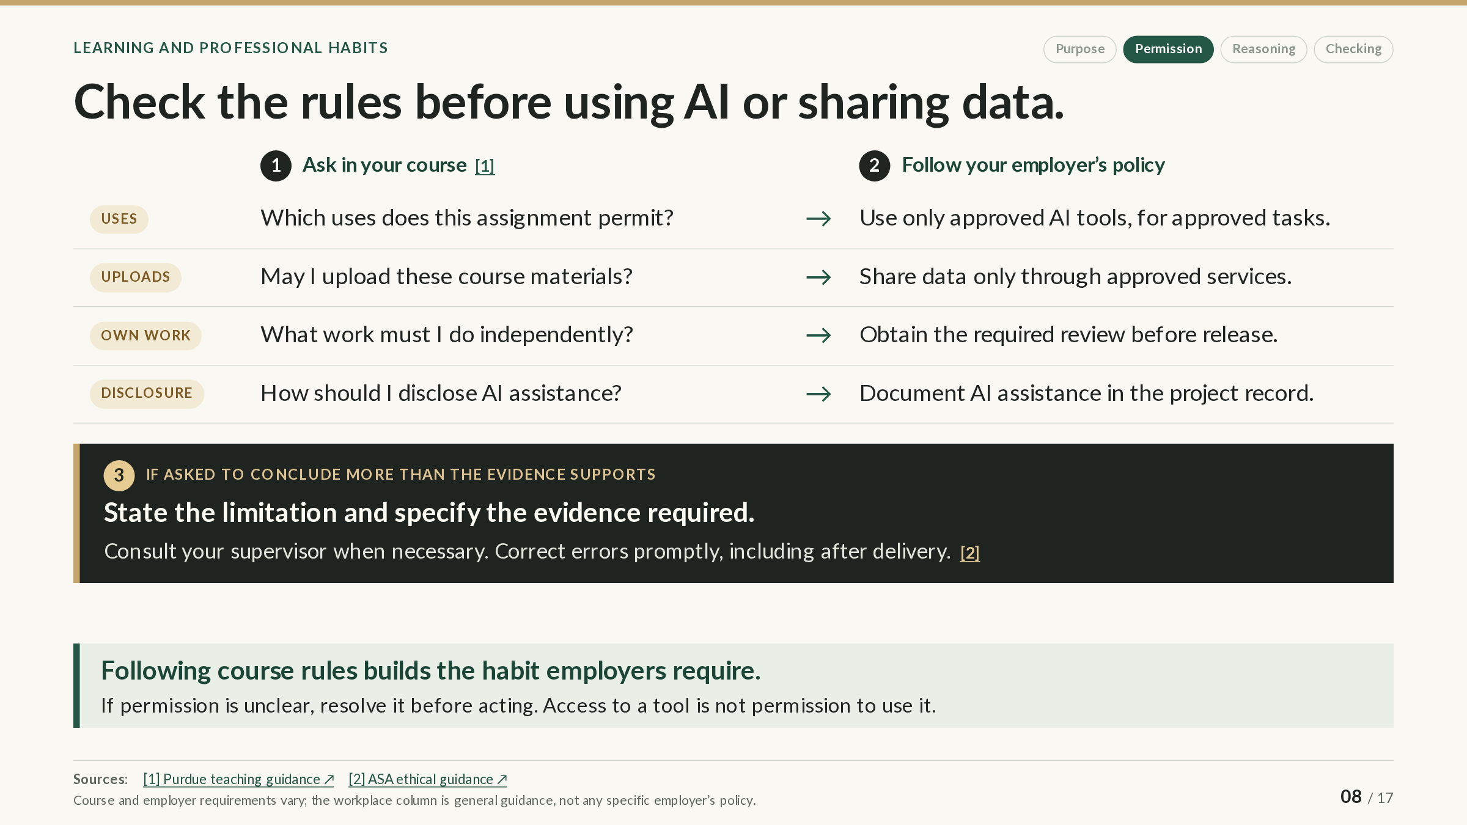
Notes:
SLIDE GUIDE · 08 / 17: Check the rules before using AI or sharing data.
EXPLANATION
Different courses can allow different uses of AI because their learning goals and assessments differ, and rules can differ between homework, projects, and exams in the same course. At Purdue, the instructor decides what AI use is authorized in a course, for graded work and for ungraded learning activities.
Step 1: questions to answer in your course. Before using AI on an assignment, check the syllabus or assignment instructions for four answers:
• Uses: which uses of AI does this assignment permit?
• Uploads: may you upload course materials, such as notes, slides, or problem sets, to an AI tool?
• Own work: what work must you do independently?
• Disclosure: how should you disclose the AI assistance you used?
If an answer is unclear, ask before you act, not after.
Step 2: the same habits at work. Employers and clients set policies on which AI tools are approved and for which tasks, which data may go to which services, which results need review before release, and how AI assistance must be documented. Access to a tool is not permission to use it for every task or dataset. This column is general guidance, not any particular employer’s policy.
Step 3: when asked to conclude more than the evidence supports. In an internship or job, you may be asked to state a stronger conclusion than your analysis justifies. State the limitation, specify what additional evidence would be needed, consult your supervisor when necessary, and correct errors promptly, even after the work has been delivered.
Following course rules now builds the habits that workplaces require. Rules set the minimum, though: even when AI use is allowed, you decide how much of a task to do yourself in order to learn from it.
NEXT: Build understanding—and match AI help to the task. Rules set the minimum. The next slide asks why you should build your own understanding, and how to match AI help to what you already know.
SOURCES & CAVEATS
Sources checked through October 21, 2026. Source numbers match the slide’s citations.
RULES AND DOCUMENTATION: Course authorization at Purdue
What it covers: Purdue’s AI guidance for teaching and learning (checked September 10, 2026).
What it says: Authorization of AI use in a course rests with the instructor and covers both graded work and learning activities that are not graded.
What to keep in mind: Rules differ by course and by assignment; the syllabus and your instructor are the authority for your course.
Sources: [1]
RULES AND DOCUMENTATION: Professional responsibility
What it covers: The American Statistical Association’s Ethical Guidelines for Statistical Practice.
What it says: Support competence, appropriate methods, transparent communication of methods and limitations, and responsibility, including correcting errors.
What to keep in mind: Professional guidance, not a law or any specific employer’s policy.
Sources: [2]
SUGGESTED STRATEGY: From course rules to workplace policy
What it suggests: Treat course rules as practice for workplace policy: approved tools, approved services for data, required review, and documented assistance.
What informs it: Common features of organizational AI policies and the professional guidance above.
What has not been tested: A practical argument made in these slides, not a research finding. Employer and client policies vary.
SOURCES
[1] Purdue, AI Guidance for Teaching and Learning
https://www.purdue.edu/teaching-learning/instructors/ai.php
Purdue’s guidance for instructors: AI use is authorized course by course.
[2] ASA, Ethical Guidelines for Statistical Practice
https://www.amstat.org/your-career/ethical-guidelines-for-statistical-practice
Professional guidelines: competence, transparency about methods and limitations, and correcting errors.

Slide 9
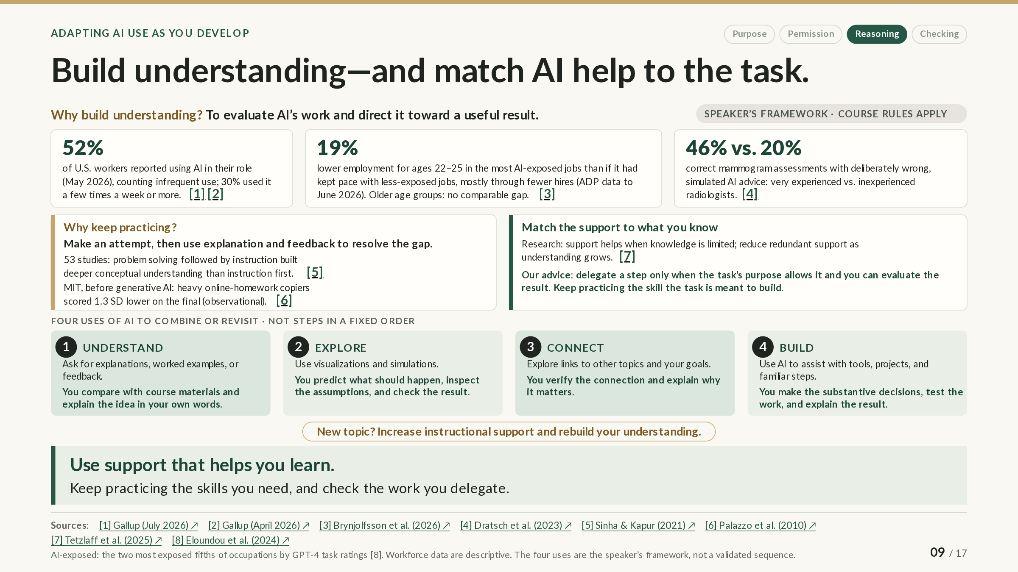
Notes:
SLIDE GUIDE · 09 / 17: Build understanding—and match AI help to the task.
The PowerPoint shows the complete slide; in the web version it builds in steps.
EXPLANATION
This slide answers two questions: why build your own understanding when AI is so capable, and how to choose AI help that supports learning.
Why build understanding? The three cards at the top give context:
• AI use at work is common. In a May 2026 Gallup survey, 52% of employed U.S. adults said they used AI in their role, counting use as rare as a few times a year; 30% used it a few times a week or more.
• Early-career employment has shifted in AI-exposed jobs. For 22–25-year-olds in the most AI-exposed occupations, employment is about 19% below where it would be had it kept pace with less-exposed occupations, mostly through fewer hires; older age groups show no comparable gap. The pattern is descriptive: it does not show that AI caused it, or who keeps a job and why.
• More experienced readers did better, but none were immune to bad advice. When radiologists received deliberately wrong AI suggestions, very experienced readers assessed about 46% of those mammograms correctly, on average, and inexperienced readers about 20%; with correct suggestions, every group was near 80%. Experience was not randomly assigned, so this is a comparison between groups, not proof that experience caused the difference.
Together these suggest, without proving it, that the knowledge to evaluate AI’s work and direct it toward a useful result will matter.
Why keep practicing? Across 53 studies, problem solving followed by instruction built deeper conceptual understanding than instruction first; the studies tested the order of activities, not withholding help. In an MIT physics course before generative AI, students who copied much of their online homework scored 1.3 standard deviations lower on the final exam, an observed difference between groups, not proof that copying caused it.
Match the support to what you know. Learners with little prior knowledge benefit from more instructional support, such as worked examples, and that support becomes redundant as their knowledge grows (the “expertise reversal effect”). The slide’s own advice goes further: delegate a step to AI only when the task’s purpose allows it and you can evaluate the result, and keep practicing the skills the task is meant to build.
Four uses of AI. The bottom row offers four ways to use AI that you can combine or revisit in any order; they are not a ladder to climb:
• Understand: ask for explanations, worked examples, or feedback; compare with course materials and explain the idea in your own words.
• Explore: use visualizations and simulations; predict what should happen, inspect the assumptions, and check the result.
• Connect: explore links to other topics and your goals; verify the connection and explain why it matters.
• Build: let AI assist with tools, projects, and familiar steps while you make the substantive decisions, test the work, and explain the result.
You do not need to master a subject before asking AI for an explanation, a visualization, or a connection. Whenever a topic is new, increase your support and rebuild your understanding.
NEXT: Connect what you learn to something you care about. Connecting deserves a closer look: a topic you might set aside after an exam can lead to something you care about.
SOURCES & CAVEATS
Sources checked through October 21, 2026. Source numbers match the slide’s citations.
RESEARCH FINDING: AI use at work
What was studied: Gallup’s quarterly panel survey of 22,573 employed U.S. adults, May 6–20, 2026 (margin of error ±0.9 points).
What the source supports: 52% reported using AI in their role at least a few times a year; 30% used it a few times a week or more, and 15% daily.
What limits the conclusion: Self-reported. The 52% counts infrequent use; Gallup states this definition in its April 12, 2026 article.
Sources: [1] [2]
RESEARCH FINDING: Early-career employment in AI-exposed occupations
What was studied: ADP payroll data through June 2026 (Brynjolfsson, Chandar and Chen). Occupations were ranked into fifths by GPT-4-based ratings of how many of their tasks AI could speed up (Eloundou et al.).
What the source supports: Since November 2022, employment of 22–25-year-olds fell about 11% in the two most exposed fifths and grew about 10% in the other three, about 19% below where it would be had it kept pace. Most of the gap came from fewer hires.
What limits the conclusion: Descriptive, not causal, and not a count of jobs eliminated by AI. The paper measures nothing about individual skills or who is retained, and age groups are not measures of expertise. Some divergence predates ChatGPT, and the pattern is weaker in national surveys; Yale’s broader analyses find no clear overall effect. Stanford updates the series monthly on its dashboard.
Sources: [3] [8] [9] [10]
RESEARCH FINDING: Experience under deliberately wrong AI advice
What was studied: Dratsch et al. (2023): 27 radiologists (5 very experienced, 11 moderately experienced, 11 inexperienced) assessed 50 mammograms with a purported AI whose suggestions were simulated and deliberately wrong on 12 of them.
What the source supports: With wrong advice, the mean percentage of cases placed in the correct category was 45.5%, 24.8%, and 19.8%; with correct advice, about 80% in every group.
What limits the conclusion: There was no reading without AI, experience was not randomized, and the groups were small. Very experienced readers beat inexperienced ones on the wrong-advice cases (p = .006), but the test of whether experience mattered more with wrong advice than with correct advice was not significant (p = .11). It shows that experience was associated with better performance under misleading advice and that oversight remained fallible, not that deliberate checking explains the difference.
Sources: [4]
RESEARCH FINDING: Attempt first, then instruction
What was studied: Sinha and Kapur (2021): a meta-analysis of 53 studies (166 comparisons) of problem solving followed by instruction vs. instruction followed by problem solving.
What the source supports: Better conceptual knowledge and transfer (effect size g = 0.36, 95% CI 0.20 to 0.51); no detectable average difference for procedural skills.
What limits the conclusion: Effects depended on how instruction built on students’ attempts, and they reversed for grades 2–5. The studies tested the order of activities, not unsupported struggle or delayed help, and no waiting time is prescribed. “No detectable difference” is not proof of no cost.
Sources: [5]
RESEARCH FINDING: Homework copying and exam performance
What was studied: Palazzo et al. (2010): MIT introductory mechanics, fall 2003 (428 students); copying was inferred from very short answer times on online homework.
What the source supports: Students who copied more than half of their homework scored 1.3 SD below low copiers on the final exam.
What limits the conclusion: Observational: copiers may differ in other ways. Before generative AI; not an estimate of learning lost to AI.
Sources: [6]
RESEARCH FINDING: Match support to prior knowledge
What was studied: Tetzlaff et al. (2025): a meta-analysis of 60 experiments (5,924 participants) on instructional assistance such as worked examples and scaffolding.
What the source supports: Learners with low prior knowledge learned more from high assistance (d = 0.51, 95% CI 0.26 to 0.75); learners with high prior knowledge learned more from low assistance (d = −0.43, 95% CI −0.65 to −0.21).
What limits the conclusion: Results varied widely across studies. The research concerns instructional support, not handing production work to AI.
Sources: [7]
SUGGESTED STRATEGY: The delegation advice and the four uses
What it suggests: Delegate a step only when the task’s purpose allows it and you can evaluate the result; use AI to understand, explore, connect, and build, in any order.
What informs it: The studies above and the research summarized in the details below.
What has not been tested: This is a framework and advice proposed for this presentation. No study validated the four uses as a sequence or tested the delegation advice. Course rules apply throughout.
FORECAST OR INTERPRETATION: Why foundational knowledge will matter
The interpretation: The knowledge to evaluate and direct AI’s work will matter in your career.
What it rests on: Common AI use at work; employers’ emphasis on critical thinking (in NACE’s survey, 93.5% rate it very or extremely important for new hires, but only 50.0% rate recent graduates very or extremely proficient); and evidence that oversight of AI is fallible.
What it is not: These separate studies do not establish a causal chain from foundational knowledge to getting or keeping a job.
Sources: [11]
RESEARCH RELATED TO THE FOUR USES
• Explore: in a classroom study (delMas, Garfield and Chance, 1999), a predict-then-test simulation activity raised correct or good reasoning about sampling distributions from 16% to 72% of items (141 students; a guided-exploration cohort went from 22% to about 49%). It was not randomized and did not use AI; using AI to build simulations is an extension of the idea.
• Connect: less-confident students who wrote their own reasons a math method was useful performed better than a control group, while being told its usefulness did not help (slide 11). That study involved students generating personal reasons, not AI generating links.
• Performing is not learning: BCG consultants using GPT-4 scored 49 percentage points higher on data-science coding steps (95% CI 42 to 56), but on related questions afterward, without AI, showed no evidence of better knowledge (Wiles et al.). No detectable gain is not proof of exactly equal knowledge.
• Learning a new tool: 52 people with Python experience, mostly professionals, learned a new library with or without a GPT-4o assistant; the AI group scored lower on an immediate quiz without AI (d = 0.74, about 4 of 27 points) (Shen and Tamkin).
SOURCES
[1] Gallup (July 20, 2026), Organizational AI adoption jumps six points
https://www.gallup.com/workplace/712736/organizational-adoption-jumps-six-points.aspx
Survey article (July 20, 2026): how many U.S. workers use AI in their role, and how often.
[2] Gallup (April 12, 2026), Rising AI adoption spurs workforce changes
https://www.gallup.com/workplace/704225/rising-adoption-spurs-workforce-changes.aspx
Survey article (April 12, 2026) defining an AI user as someone who uses it at least a few times a year.
[3] Brynjolfsson, Chandar and Chen, Canaries — August 2026 revision
https://digitaleconomy.stanford.edu/publication/canaries-in-the-coal-mine-six-facts-about-the-recent-employment-effects-of-artificial-intelligence/
Working paper: early-career employment by AI exposure, mostly through fewer hires.
[4] Dratsch et al. (2023), Automation bias in mammography (Radiology)
https://doi.org/10.1148/radiol.222176
Experiment (Radiology, 2023): radiologists’ accuracy with deliberately wrong AI suggestions.
[5] Sinha and Kapur (2021), problem solving followed by instruction
https://journals.sagepub.com/doi/10.3102/00346543211019105
Meta-analysis of 53 studies: attempting problems before instruction.
[6] Palazzo et al. (2010), Patterns, correlates, and reduction of homework copying
https://doi.org/10.1103/PhysRevSTPER.6.010104
Observational study (MIT, fall 2003): homework copying and final-exam scores.
[7] Tetzlaff et al. (2025), A cornerstone of adaptivity: a meta-analysis of the expertise reversal effect (Learning and Instruction 98:102142)
https://doi.org/10.1016/j.learninstruc.2025.102142
Meta-analysis of 60 experiments: the most helpful amount of support depends on prior knowledge.
[8] Eloundou, Manning, Mishkin and Rock, GPTs are GPTs (Science, 2024)
https://doi.org/10.1126/science.adj0998
Science paper: the GPT-4-based task-exposure ratings used to rank occupations.
[9] Stanford Digital Economy Lab, AI Economic Indicators: Canaries dashboard
https://digitaleconomy.stanford.edu/project/indicators/canaries-dashboard/
Stanford’s dashboard for the employment series, updated monthly.
[10] Yale Budget Lab, tracker updated August 19, 2026
https://budgetlab.yale.edu/research/tracking-impact-ai-labor-market
Yale Budget Lab tracker: no clear broad labor-market effect so far.
[11] NACE, Job Outlook 2026: Spring Update
https://naceweb.org/docs/default-source/default-document-library/2026/publication/research-report/2026-job-outlook-report-spring-update.pdf
Employer survey (PDF): ratings of critical thinking on page 26.
[12] delMas, Garfield and Chance (1999), simulation activities and statistical reasoning
https://doi.org/10.1080/10691898.1999.12131279
Classroom study: predict-then-test simulations and reasoning about sampling distributions.
[13] Canning and Harackiewicz (2015), Teach it, don't preach it: the differential effects of directly communicated and self-generated utility-value information (Motivation Science 1(1):47–71)
https://s3.wp.wsu.edu/uploads/sites/2445/2019/09/Canning-Harackiewicz-2015-Motivation-Science.pdf
Experiment: writing about a method’s usefulness vs. being told (slide 11).
[14] Wiles et al., Generative AI and the temporary upskilling of knowledge workers
https://papers.ssrn.com/sol3/papers.cfm?abstract_id=4944588
Experiment with BCG consultants: better AI-assisted performance without better knowledge afterward.
[15] Shen and Tamkin (2026), How AI Impacts Skill Formation
https://arxiv.org/abs/2601.20245
Experiments on learning a new Python library with or without an AI assistant.

Slide 10
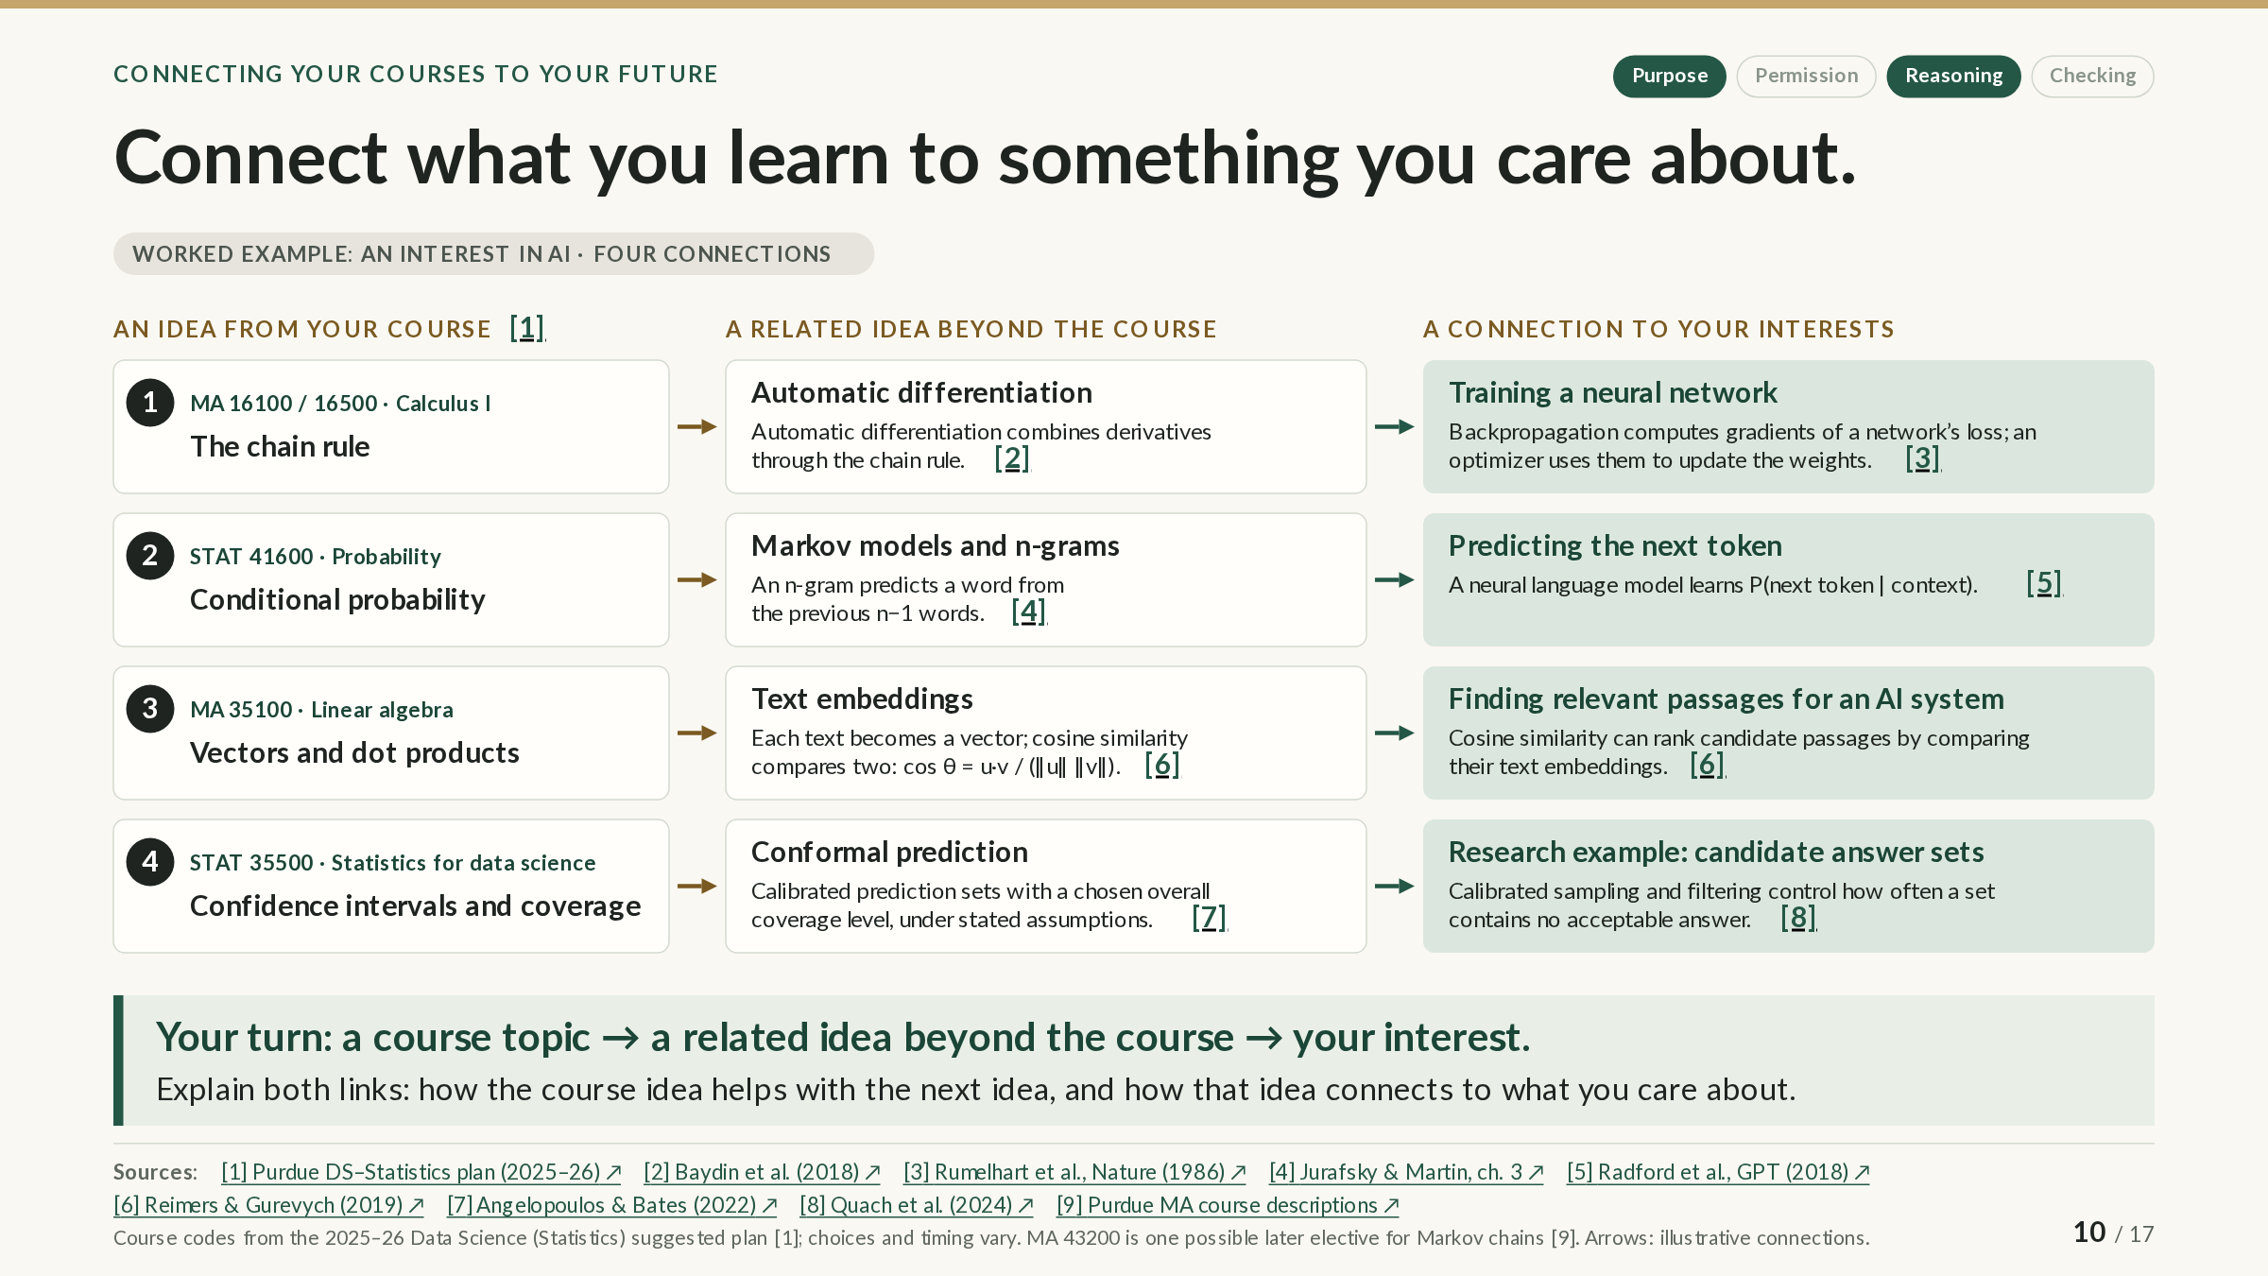
Notes:
SLIDE GUIDE · 10 / 17: Connect what you learn to something you care about.
The PowerPoint shows the complete slide; in the web version it builds in steps.
EXPLANATION
A topic from class can be the start of something you care about. This slide shows a three-part process: a course idea → a related idea beyond the course → a connection to your interests.
“Beyond the course” can mean a book, documentation, an experiment, independent study, or a later course. Each row is a worked example using an interest in AI; your own interest might be music, medicine, sports, or something else. Each arrow needs an explanation: how the course idea helps you understand the middle idea, and how the middle idea reaches the interest.
Row 1: the chain rule. The chain rule tells you how to differentiate a composition of functions. Automatic differentiation applies it step by step to compute the derivatives of a program built from simple operations. Training a neural network depends on this: backpropagation uses the chain rule to compute how the network’s error (its “loss”) changes with each weight, and an optimizer uses those gradients to adjust the weights.
Row 2: conditional probability. P(A | B) is the probability of A given B. An n-gram model, a kind of Markov model for text, predicts a word from the previous n−1 words. A neural language model learns the same kind of quantity, the probability of the next token (a word or a piece of a word) given its context, but estimates it with a neural network over a much longer context.
Row 3: vectors and dot products. An embedding model turns each piece of text into a vector, a list of numbers. Cosine similarity compares two vectors by the angle between them, cos θ = u·v / (‖u‖ ‖v‖), and is near 1 when they point the same way. Ranking passages by their cosine similarity to a question is how many AI systems find relevant text; slide 13 shows a real example.
Row 4: confidence intervals and coverage. A 95% confidence interval comes from a method that captures the true value in about 95% of repeated samples; that rate is its coverage. Conformal prediction applies coverage to predictions: it produces a set of possible outcomes that contains the actual outcome with at least a chosen probability, such as 90%, averaged over cases and under stated assumptions. Researchers have extended it to language models, sampling candidate answers into a set so that the chance the set contains no acceptable answer is controlled; the set does not say which answer is the acceptable one.
Your turn. Choose one topic from a course you are taking, find a related idea beyond the course, and explain how it connects to something you care about.
NEXT: Use AI to connect your courses to your goals. The next slide applies the same three-part process to your own interests, with AI’s help.
SOURCES & CAVEATS
Sources checked through October 21, 2026. Source numbers match the slide’s citations.
ILLUSTRATIVE EXAMPLE: Four worked connections for an interest in AI
What it shows: How a course idea can lead, through a related idea beyond the course, to an interest.
What it is not: The arrows are illustrative conceptual connections, not prerequisites, and the examples show how to build a connection, not how AI works in full.
RULES AND DOCUMENTATION: Course codes
What it covers: Purdue’s 2025–26 Data Science (Statistics) suggested plan and course descriptions.
What it says: MA 16100/16500 (Calculus I), STAT 41600 (probability), MA 35100 (linear algebra), and STAT 35500 (statistics for data science) appear in that plan. MA 43200 is one possible later elective that covers Markov chains.
What to keep in mind: Course choices and timing vary by major, route, and catalog year; check your own plan of study.
Sources: [1] [9] [10] [11]
CONCEPT REFERENCE: Row 1: automatic differentiation and backpropagation
What it explains: Automatic differentiation combines the derivatives of a program’s elementary operations through the chain rule (Baydin et al., 2018). Backpropagation is reverse-mode differentiation applied to a network’s loss; Rumelhart, Hinton and Williams (1986) popularized it for training neural networks.
What to keep in mind: Reverse-mode differentiation was described earlier (Linnainmaa in 1970; Werbos in 1974), so 1986 marks its popularization, not its invention.
Sources: [2] [3]
CONCEPT REFERENCE: Row 2: n-grams and next-token prediction
What it explains: An n-gram model predicts a word from the previous n−1 words (Jurafsky and Martin, ch. 3). Markov himself, in 1913, counted vowels and consonants in 20,000 letters of Pushkin’s Eugene Onegin. The first GPT (Radford et al., 2018) was trained to predict upcoming tokens with a transformer network.
What to keep in mind: A neural language model estimates P(next token | context) with a network, not with n-gram counts. The first GPT’s 512-token training sequences were a detail of that model, not a general limit.
Sources: [4] [5]
CONCEPT REFERENCE: Row 3: embeddings and similarity search
What it explains: Sentence-BERT (Reimers and Gurevych, 2019) produced sentence embeddings that can be compared with cosine similarity, making semantic search practical (about 5 seconds instead of 65 hours to find the most similar pair among 10,000 sentences).
What to keep in mind: Some retrieval systems rank by unnormalized inner products instead; the original retrieval-augmented generation system did (Lewis et al., 2020).
Sources: [6] [12]
CONCEPT REFERENCE: Row 4: conformal prediction and candidate answer sets
What it explains: Split conformal prediction gives coverage of at least the chosen level, averaged over calibration and test cases, when the cases are exchangeable; it needs no parametric model for the data, though exchangeability is itself an assumption (Angelopoulos and Bates). Quach et al. (2024) calibrate a rule for sampling a language model’s answers into a set: with high probability over the calibration data, the chance that a new set contains no acceptable answer is at most a chosen small value.
What to keep in mind: Acceptability is judged during calibration and is not observed when the system is used, so the set does not say which answer is acceptable, and the method abstains if no valid setting exists. It is a research procedure, not a property of ordinary chatbot conversations.
Sources: [7] [8]
SOURCES
[1] Purdue Data Science (Statistics) progression guide, 2025–26
https://www.purdue.edu/science/archive/docs/current-students/majors/dsst-f25-dpg1.pdf
Suggested course sequence (PDF) from which the slide’s course codes come.
[2] Baydin, Pearlmutter, Radul and Siskind (2018), Automatic differentiation in machine learning: a survey
https://jmlr.org/papers/v18/17-468.html
Survey of how automatic differentiation works and where backpropagation fits.
[3] Rumelhart, Hinton and Williams (1986), Learning representations by back-propagating errors (Nature)
https://doi.org/10.1038/323533a0
The 1986 paper that popularized backpropagation for training neural networks.
[4] Jurafsky and Martin, Speech and Language Processing, ch. 3: N-gram language models (draft of August 19, 2026)
https://web.stanford.edu/~jurafsky/slp3/3.pdf
Textbook chapter: n-gram models and Markov’s 1913 study of Eugene Onegin.
[5] Radford, Narasimhan, Salimans and Sutskever (2018), Improving language understanding by generative pre-training (OpenAI)
https://cdn.openai.com/research-covers/language-unsupervised/language_understanding_paper.pdf
The first GPT paper: a transformer trained to predict upcoming tokens.
[6] Reimers and Gurevych (2019), Sentence-BERT
https://arxiv.org/abs/1908.10084
Sentence embeddings compared by cosine similarity, which made semantic search practical.
[7] Angelopoulos and Bates, A gentle introduction to conformal prediction
https://arxiv.org/abs/2107.07511
An accessible introduction to conformal prediction and its coverage guarantee.
[8] Quach et al. (2024), Conformal language modeling (ICLR 2024; arXiv 2306.10193v2)
https://arxiv.org/abs/2306.10193
Research method: calibrated sets of candidate answers from a language model.
[9] Purdue Mathematics course descriptions
https://www.math.purdue.edu/academic/courses/Course-Description.html
Mathematics course descriptions, including MA 43200 on Markov chains.
[10] Purdue Statistics undergraduate course descriptions, Fall 2026
https://www.stat.purdue.edu/academic_programs/undergraduate/index.php?semester=Fall&year=2026
Statistics course descriptions for Fall 2026, including STAT 35500 and STAT 41600.
[11] Purdue MA 35100 Elementary Linear Algebra, Fall 2026
https://www.math.purdue.edu/academic/courses/semester/202710/ma35100/index.html
Course page for MA 35100: vectors, matrices, linear systems, and eigenvalues.
[12] Lewis et al., Retrieval-Augmented Generation (2020)
https://arxiv.org/abs/2005.11401
The original retrieval-augmented generation system, which ranked passages by inner products.

Slide 11
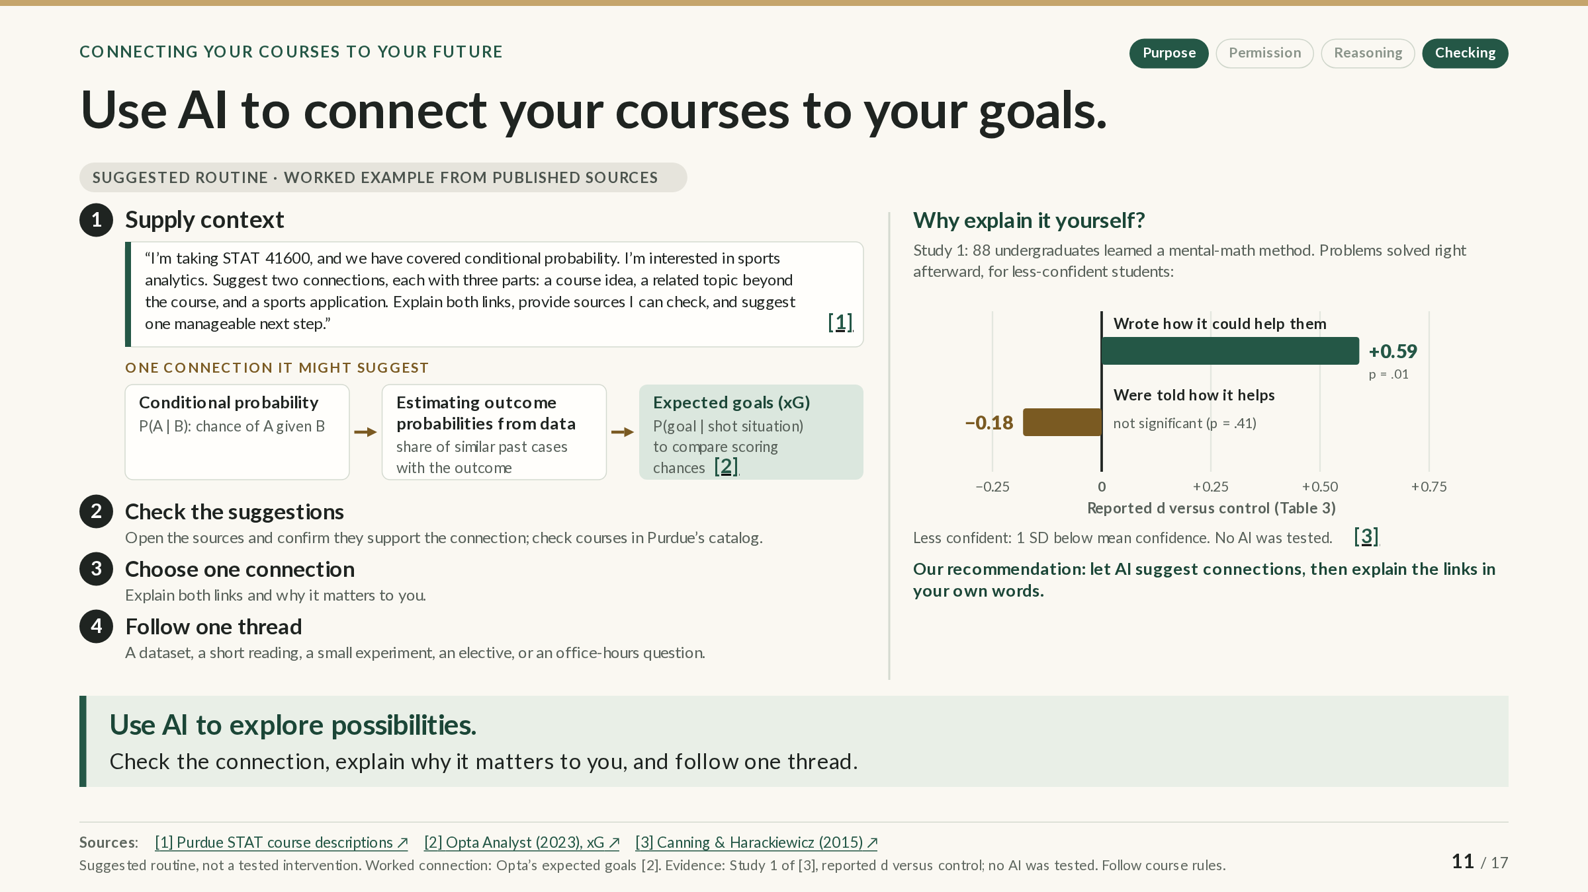
Notes:
SLIDE GUIDE · 11 / 17: Use AI to connect your courses to your goals.
EXPLANATION
The previous slide used AI as the example interest. This slide shows how to use AI to explore connections to your own interests, in four steps.
1. Supply real context. A vague request gets vague answers. Give the course, the topic you actually covered, your interest, and the form you want back. The example prompt names STAT 41600 and conditional probability and an interest in sports analytics, and asks for two three-part connections (a course idea, a related topic beyond the course, and a sports application), with sources you can check and one manageable next step. One connection it might suggest:
• Conditional probability, P(A | B): the chance of A given B.
• Estimating outcome probabilities from data: for example, the share of similar past cases that had the outcome.
• Expected goals (xG) in soccer: the probability that a shot is scored given its situation (distance, angle, and so on), used to compare scoring chances.
2. Check the suggestions. AI can invent sources or overstate connections. Open the sources and confirm that they support the connection, and check courses and prerequisites in Purdue’s official catalog.
3. Choose one connection and explain both links, and why the connection matters to you, in your own words.
4. Follow one thread: a dataset, a short reading, a small experiment, an elective, or a question for office hours.
Why write the explanation yourself? The chart comes from an experiment with 88 undergraduates who learned a mental-math method. Among less-confident students, those who wrote how the method could be useful in their own lives solved more problems right afterward than a control group (d = +0.59, p = .01); those who were simply told how it was useful did not do better (d = −0.18, not statistically significant). The effect size d expresses a difference between groups in standard-deviation units. For more confident students, neither condition differed significantly from the control group, an inconclusive result rather than proof that the conditions were equivalent.
That study did not test AI. It is the reason for the slide’s recommendation: let AI suggest connections, then explain the links in your own words. Course rules still govern AI use in coursework.
NEXT: Know what the tool can do—and what you may share. So far, these slides have been about how you use AI. Next: the tools themselves, what they can do, and which of them may see your data.
SOURCES & CAVEATS
Sources checked through October 21, 2026. Source numbers match the slide’s citations.
SUGGESTED STRATEGY: The four-step routine
What it suggests: Supply context, check the suggestions, explain one connection in your own words, and follow one thread.
What informs it: Slide 10’s three-part process, the checking habits from earlier slides, and research on writing about relevance (below).
What has not been tested: No study was found that tested AI-assisted connection-making. This is a suggested routine, not a tested intervention.
ILLUSTRATIVE EXAMPLE: Expected goals as a conditional probability
What it shows: A real application of conditional probability. Opta’s expected goals (xG) is the probability that a shot is scored given its situation, from a model fitted to nearly one million shots with over 20 variables. MLB’s expected batting average (xBA), the probability that a batted ball becomes a hit given its exit velocity and launch angle (and, for some batted balls, the batter’s sprint speed), is a baseball example.
What it is not: The connection on the slide was written from published sources to show what a useful answer looks like; it is not a recorded AI response. “The share of similar past cases” is the simplest way to estimate such a probability; commercial models are more complex.
Sources: [2] [4]
RESEARCH FINDING: Writing your own reasons helped less-confident students
What was studied: Canning and Harackiewicz (2015), Study 1: 88 undergraduates learned a mental-math method for two-digit multiplication and were randomly assigned to write how it could be useful in their own lives, to be told its usefulness in the instructional slides, or to a control condition.
What the source supports: For less-confident students (one standard deviation below the average confidence rating), writing their own reasons improved the number of problems solved right afterward (d = +0.59 vs. control, p = .01); being told did not (d = −0.18, p = .41).
What limits the conclusion: Confidence was measured after the lesson, not beforehand. For more confident students, neither condition differed significantly from control, which does not show they were equivalent. In Study 2, being told and then writing one’s own examples worked well together, so hearing about relevance is not shown to be harmful when students then write their own. No AI was tested, and the outcome was immediate performance with one method.
Sources: [3]
RULES AND DOCUMENTATION: Check courses in the official catalog
What it covers: Purdue’s course descriptions and the 2025–26 Data Science (Statistics) plan; Purdue’s AI guidance for courses.
What it says: Course descriptions and prerequisites are authoritative in Purdue’s catalog. Course rules govern AI use in coursework.
What to keep in mind: A course listed in a catalog is not necessarily required in every plan or offered every semester.
Sources: [1] [5] [6]
SOURCES
[1] Purdue Statistics undergraduate course descriptions, Fall 2026
https://www.stat.purdue.edu/academic_programs/undergraduate/index.php?semester=Fall&year=2026
Statistics course descriptions, including STAT 41600 (probability).
[2] Whitmore (Aug. 8, 2023), What is expected goals (xG)? The Analyst (Opta / Stats Perform)
https://theanalyst.com/articles/what-is-expected-goals-xg
Explainer (Opta Analyst, 2023): what expected goals is and how it is estimated.
[3] Canning and Harackiewicz (2015), Teach it, don't preach it: the differential effects of directly communicated and self-generated utility-value information (Motivation Science 1(1):47–71)
https://s3.wp.wsu.edu/uploads/sites/2445/2019/09/Canning-Harackiewicz-2015-Motivation-Science.pdf
Published article: the experiment behind the chart (Study 1, Table 3).
[4] MLB.com, Statcast glossary: Expected Batting Average (xBA)
https://www.mlb.com/glossary/statcast/expected-batting-average
MLB’s definition of expected batting average, a baseball example of conditional probability.
[5] Purdue Data Science (Statistics) progression guide, 2025–26
https://www.purdue.edu/science/archive/docs/current-students/majors/dsst-f25-dpg1.pdf
Suggested course sequence (PDF) for the Data Science (Statistics) plan.
[6] Purdue, AI Guidance for Teaching and Learning
https://www.purdue.edu/teaching-learning/instructors/ai.php
Purdue’s guidance on course-level AI rules.

Slide 12
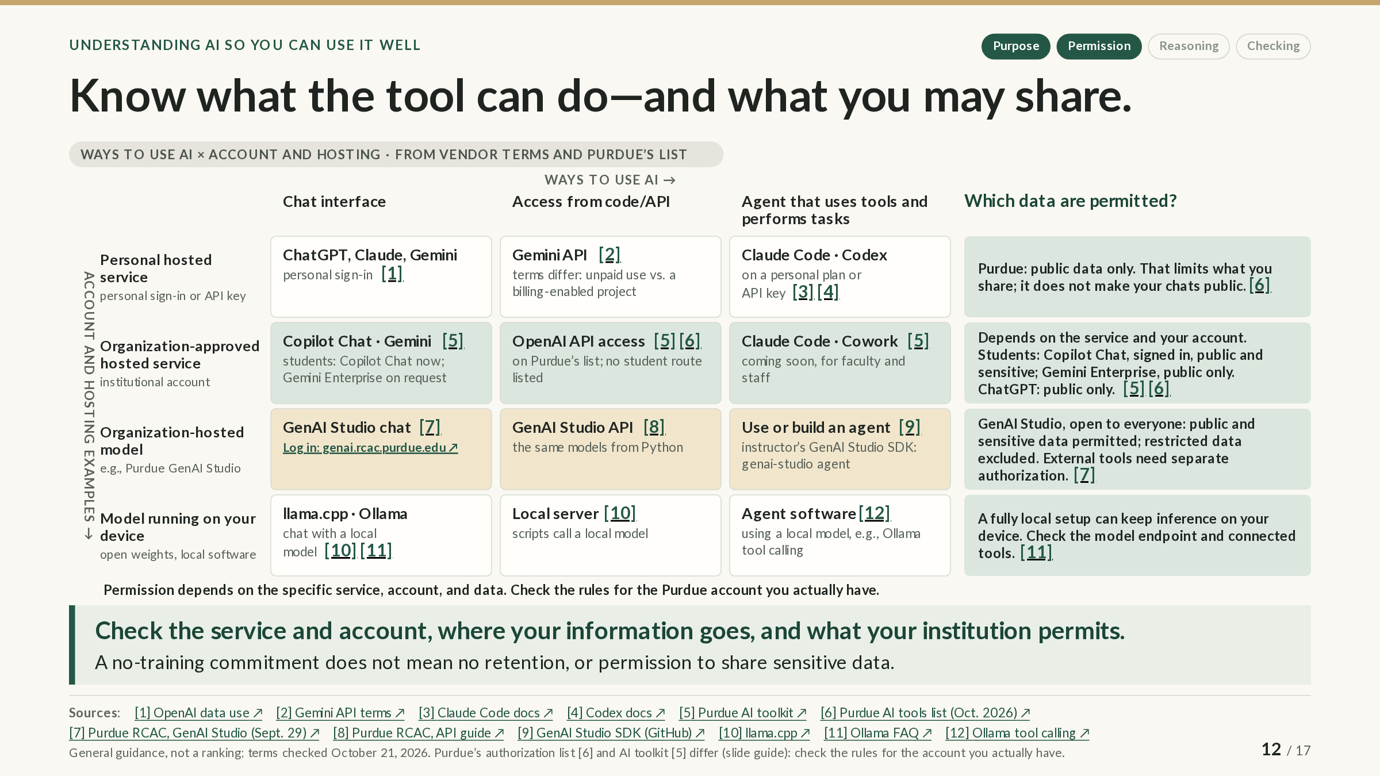
Notes:
SLIDE GUIDE · 12 / 17: Know what the tool can do—and what you may share.
The PowerPoint shows the complete slide; in the web version it builds in steps.
EXPLANATION
You will meet AI in many forms. This slide separates four questions that are easy to blur together: what a tool can do, who can get it, where it runs, and what data you may put into it.
Across the top: what the tool can do. A chat interface answers what you type. Access from code uses an API (application programming interface): your own program, such as a Python script, sends requests to a model and uses the replies. An agent uses tools, such as reading files, running commands, or searching, to carry out multi-step tasks.
Down the side: which account it runs under and where it is hosted.
• Personal hosted service: a company runs the model, and you use a personal sign-in or API key: the ChatGPT, Claude, or Gemini apps, the Gemini API, or Claude Code and Codex on a personal plan. Terms vary even here; Google treats unpaid Gemini API use differently from use through a billing-enabled project.
• Organization-approved hosted service: a company runs the model under an agreement with your institution, and you sign in with an institutional account. For Purdue students, that means Copilot Chat now, with Gemini Enterprise on request. OpenAI API access is on Purdue’s authorization list, but no route for students is listed, and Claude Code and Cowork are listed as coming soon for faculty and staff.
• Organization-hosted model: the institution runs the models itself. Purdue’s GenAI Studio offers a chat interface, an API, and, through a separate open-source SDK written by the instructor who gave this presentation, a way to use or build an agent.
• Model running on your device: open-weight models run with local software such as llama.cpp or Ollama, as a chat, as a local server that your scripts call, or inside agent software.
The last column: which data are permitted? Purdue classifies data as public, sensitive, or restricted; restricted data include records regulated by laws such as FERPA (student records) and HIPAA (health information).
• Personal accounts: public data only. That limits what you share; it does not make your conversations public.
• Organization-approved services: it depends on the service and your account. For students, Copilot Chat signed in with a Purdue account accepts public and sensitive data, and Gemini Enterprise is for public data only. ChatGPT, which Purdue does not provide through an institutional account, is listed for public data only.
• GenAI Studio: open to everyone at Purdue, for public and sensitive data but not restricted data; external tools connected to it need their own authorization.
• Local setup: a fully local setup can keep the model’s computation on your device, but check where the software sends requests and what any connected tools do.
Two cautions. First, a product’s name on an authorization list does not mean that every account with that name is approved: a personal subscription or an arbitrary API key does not carry the approval needed for sensitive data (personal accounts are for public data only), and Purdue’s own documents differ on some products (see Sources & caveats). Second, a promise not to train on your data is not a promise not to keep it; providers can retain conversations for monitoring or review.
These rules change often; they were checked on October 21, 2026. Check the service and account you actually have, where your information goes, and what your institution permits.
NEXT: Match the question to the source and the tool. When you build with these tools, you also choose where your information lives and how the AI finds it.
SOURCES & CAVEATS
Sources checked through October 21, 2026. Source numbers match the slide’s citations. Purdue’s policies and the vendors’ terms change often; those below were checked on October 21, 2026, unless another date is given.
RULES AND DOCUMENTATION: Who can get each Purdue tool, and for which data
What it covers: Purdue’s Enterprise AI Toolkit (page last modified October 14, 2026; checked October 21, 2026) and its linked handout (September 9, 2026).
What it says: Copilot Chat (Basic): everyone; public and sensitive data, protected only when signed in with a Purdue account. GenAI Studio: everyone; public and sensitive; restricted not allowed. Gemini Enterprise: students; public only. Claude Cowork and Claude Code: faculty and staff; “Coming Soon, this tool is not yet available at Purdue.” The handout lists Copilot Chat, Gemini Enterprise, and GenAI Studio for classroom use by students and marks ChatGPT and Codex “No”.
What to keep in mind: Who can get a tool and what data it accepts are separate questions; check both for your own account.
Sources: [5] [13]
RULES AND DOCUMENTATION: Which products Purdue has authorized, for which data
What it covers: Purdue Systems Security’s list of authorized AI tools and integrations, published October 15, 2026 (checked October 21, 2026).
What it says: Public data only: ChatGPT (with DALL-E and SORA), Microsoft Azure OpenAI, Grok, MidJourney, and any tool not listed. Sensitive and public data, among others: OpenAI (via API access), Google Gemini, Anthropic’s Claude models, Claude Cowork and Claude Code, Microsoft Copilot with Data Protection, and GenAI Studio. Sensitive or restricted data must be accessed through Purdue sign-in (SSO) or an equivalent, and models from OpenAI, Microsoft, Google, and Anthropic require an enterprise or API-level license.
What to keep in mind: The list names no account types or eligible users, so it does not show that you can get a product. A personal subscription or an arbitrary API key does not meet its conditions.
Sources: [6]
RULES AND DOCUMENTATION: Purdue’s two documents differ (unresolved)
What it covers: A comparison of the authorization list (October 15) and the toolkit (October 14), recorded on October 21, 2026.
What it says: The toolkit is more restrictive for Gemini (public data only; the list says sensitive), lists Claude Code and Cowork as not yet available, and lists no OpenAI API route, while the list authorizes OpenAI API access for sensitive data. The list describes GenAI Studio as “excluding FERPA,” while RCAC and the toolkit exclude all restricted data. The list places Google Antigravity under sensitive data; the toolkit lists it as coming soon, for public data only.
What to keep in mind: The slide follows the toolkit and RCAC for what students can use and does not treat a product’s appearance on the list as evidence that students can use it or enter sensitive data. If the documents disagree for a tool you want to use, ask before entering anything beyond public data.
Sources: [5] [6] [7]
RULES AND DOCUMENTATION: GenAI Studio
What it covers: Purdue RCAC’s GenAI Studio documentation (updated September 29, 2026) and sign-in page.
What it says: GenAI Studio is authorized for public and sensitive (L2) data, not for restricted data, including data regulated by FERPA or HIPAA. An external service called by a Workspace Tool, or an MCP server, may receive data outside GenAI Studio, and GenAI Studio’s authorization does not extend to it. The API is OpenAI-compatible, with GenAI Studio’s own address and model names.
What to keep in mind: Sign in at genai.rcac.purdue.edu with a Purdue account. Connected tools need their own authorization.
Sources: [7] [14] [8] [15]
RULES AND DOCUMENTATION: The presenting instructor’s GenAI Studio SDK
What it covers: An open-source Python package (MIT license) on the personal GitHub account of the instructor who gave this presentation.
What it says: It runs on your computer and calls the GenAI Studio API for chat, embeddings, retrieval, and an agent. Its terminal agent can read and edit code, run shell commands, search the web, and use connected MCP tools.
What to keep in mind: It is not a Purdue or RCAC service. The agent’s web search and connected tools can send data outside GenAI Studio, where GenAI Studio’s data authorization does not apply.
Sources: [9]
RULES AND DOCUMENTATION: Training is not the same as retention
What it covers: The vendors’ data-use and privacy documentation for consumer and business services.
What it says: OpenAI: content from personal ChatGPT plans (Free, Plus, Pro) may be used for training unless you opt out, while Business, Enterprise, Edu, and API data are not used by default; API abuse-monitoring logs are kept for up to 30 days. Anthropic: consumer users choose whether chats are used for training; chats are kept 30 days, or up to five years if training is allowed. Google: unpaid Gemini API use may be read by human reviewers and used to improve Google’s products; human-reviewed Gemini app chats are kept for up to three years. Microsoft: Copilot with enterprise data protection does not use prompts to train foundation models.
What to keep in mind: No training does not mean no retention, and neither means permission to share sensitive data. Microsoft’s business and consumer apps now share the name Microsoft Copilot, so check which account you are signed in with.
Sources: [1] [16] [2] [17] [18]
RULES AND DOCUMENTATION: Personal coding agents
What it covers: Vendor documentation for Claude Code and Codex.
What it says: Claude Code and Codex read, edit, and run code in a local project. Most uses require a subscription or an API account; Codex offers a free tier in its desktop app, subject to rollout.
What to keep in mind: On a personal plan, Purdue permits public data only. Plans and prices change often.
Sources: [3] [4] [19]
RULES AND DOCUMENTATION: Local models
What it covers: Documentation for llama.cpp and Ollama.
What it says: llama.cpp runs open-weight models on your computer and can serve them to your scripts. Ollama states, “Ollama runs locally. We don’t see your prompts or data when you run locally”; its cloud models and web search do send prompts to Ollama’s servers, and a local-only setting turns them off. Ollama also supports tool calling, so a local model can drive an agent.
What to keep in mind: Your data stays on your device only if the model endpoint and every connected tool are local. What runs well depends on your hardware and the model.
Sources: [10] [11] [12]
WHY GEMINI CLI IS NOT ON THE SLIDE
On June 18, 2026, Google stopped serving consumer accounts (Gemini Code Assist for individuals, Google AI Pro, and Google AI Ultra) in Gemini CLI and its IDE extensions, including access through a personal Google sign-in, and pointed those users to the Antigravity CLI. Google says Gemini CLI remains available with paid Gemini API keys and its enterprise platform; organizations’ Code Assist licenses follow a separate schedule.
MORE ON THE GEMINI API TERMS
Under Google’s Gemini API terms (last updated April 28, 2026), API use is a Paid Service only through a Cloud project with an active billing account. Unpaid use may be read by human reviewers and used to improve Google’s products, and Google asks users not to submit sensitive, confidential, or personal information to unpaid services. Google AI Studio counts as a Paid Service even at no charge when the account has access to a billing-enabled Cloud project or is a Workspace enterprise account; in the EEA, Switzerland, and the UK, the paid-service data terms apply to all Gemini API and AI Studio use.
HOW THESE RULES WERE CHECKED
Purdue’s authorization list, toolkit, and handout, and the vendors’ terms, were checked on October 21, 2026. RCAC’s pages did not respond that day, so their text was checked in RCAC’s official documentation repository, which showed no change since September 29. OpenAI’s help article returned an error that day and was checked in an Internet Archive capture from October 19, 2026.
SOURCES
[1] OpenAI Help Center, How your data is used to improve model performance
https://help.openai.com/en/articles/5722486-how-your-data-is-used-to-improve-model-performance
Help article: when OpenAI uses your content for training, by type of account.
[2] Google, Gemini API Additional Terms of Service (last updated Apr. 28, 2026)
https://ai.google.dev/gemini-api/terms
Terms of service (last updated April 28, 2026): unpaid vs. paid Gemini API use.
[3] Anthropic, Claude Code overview
https://code.claude.com/docs/en/overview
Documentation: what Claude Code does and which accounts it requires.
[4] OpenAI, Codex CLI
https://learn.chatgpt.com/docs/codex/cli
Documentation: what the Codex command-line agent does.
[5] Purdue, Enterprise AI Toolkit: compare Purdue's AI tools and licenses (page last modified October 14, 2026)
https://www.purdue.edu/ai/enterprise-ai-toolkit/
Who can get each Purdue AI tool and what data it accepts (page last modified October 14, 2026).
[6] Purdue Systems Security, Purdue University authorized AI tools and integrations (October 15, 2026)
https://www.purdue.edu/ai/wp-content/uploads/2026/10/AITools.pdf
Purdue Systems Security’s authorization list (PDF, October 15, 2026).
[7] Purdue RCAC, GenAI Studio overview and data classification (updated September 29, 2026)
https://docs.rcac.purdue.edu/services/genai/
RCAC documentation (updated September 29, 2026): GenAI Studio and the data it is approved for.
[8] Purdue RCAC, GenAI Studio API guide (updated September 29, 2026)
https://docs.rcac.purdue.edu/services/genai/api/
RCAC documentation: calling GenAI Studio’s models from code.
[9] GenAI Studio SDK, the instructor's Python package (GitHub)
https://github.com/treese41528/genai-studio-sdk
Open-source Python package by the instructor who gave this presentation (not a Purdue service).
[10] ggml-org, llama.cpp
https://github.com/ggml-org/llama.cpp
Open-source software for running models on your own computer.
[11] Ollama documentation, FAQ
https://docs.ollama.com/faq
FAQ: what stays local and what goes to Ollama’s cloud.
[12] Ollama documentation, Tool calling
https://docs.ollama.com/capabilities/tool-calling
Documentation: tool calling, which lets a local model drive an agent.
[13] Purdue, AI Tools at Purdue: availability by provider (handout, September 9, 2026)
https://www.purdue.edu/ai/wp-content/uploads/2026/09/purdue_ai_tools.pdf
Handout (PDF, September 9, 2026): availability by provider, including classroom use.
[14] Purdue GenAI Studio: sign in (genai.rcac.purdue.edu)
https://genai.rcac.purdue.edu/
Sign-in page for GenAI Studio (Purdue account required).
[15] Purdue RCAC, GenAI Studio chat interface (updated September 29, 2026)
https://docs.rcac.purdue.edu/services/genai/chat-interface/
RCAC documentation: the chat interface, including side-by-side models.
[16] Anthropic (Aug. 28, 2025), Updates to consumer terms and privacy policy
https://www.anthropic.com/news/updates-to-our-consumer-terms
Anthropic’s 2025 update: training choices and retention for consumer chats.
[17] Google, Gemini Apps Privacy Hub (last updated October 19, 2026)
https://support.google.com/gemini/answer/13594961
Google’s privacy hub for the Gemini apps: human review and retention.
[18] Microsoft Learn, Enterprise data protection in Microsoft Copilot and Copilot Chat (updated Aug. 18, 2026)
https://learn.microsoft.com/en-us/microsoft-365/copilot/enterprise-data-protection
Microsoft documentation: enterprise data protection for work and school accounts.
[19] OpenAI, Codex pricing (October 2026)
https://learn.chatgpt.com/docs/pricing
Codex plans and free tier (they change often).
[20] Google, Gemini Code Assist consumer accounts: deprecation (last updated October 9, 2026)
https://developers.google.com/gemini-code-assist/docs/deprecations/code-assist-individuals
Google’s notice ending consumer access to Gemini Code Assist and Gemini CLI (last updated October 9, 2026).
[21] Google, Gemini CLI (GitHub repository README)
https://github.com/google-gemini/gemini-cli
Gemini CLI’s open-source repository and its current access options.

Slide 13
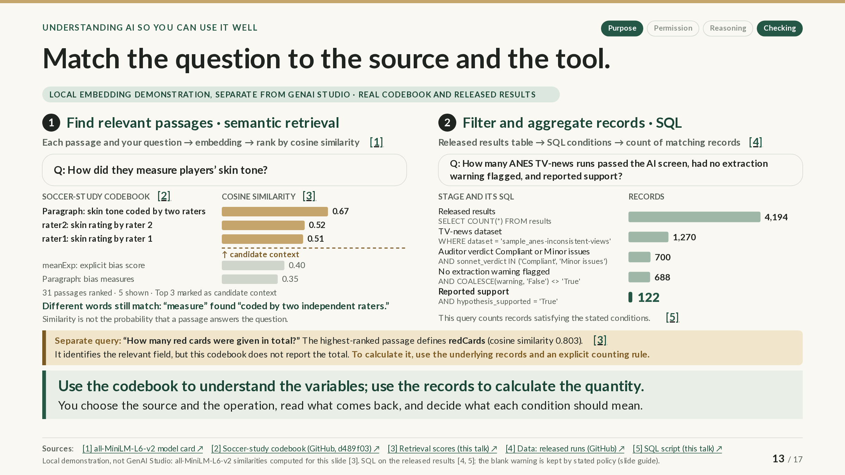
Notes:
SLIDE GUIDE · 13 / 17: Match the question to the source and the tool.
The PowerPoint shows the complete slide; in the web version it builds in steps.
EXPLANATION
Different questions need different sources and different operations. This slide shows two operations on two real sources: semantic retrieval, which finds passages in a document, and a SQL query, which filters and counts records in a table. Real systems often combine them; retrieval can find what a variable means, and a query can then count the records that use it.
Left: semantic retrieval over a codebook. A codebook is the document that explains a dataset’s variables; this one comes from the soccer study on slide 3. Retrieval works in three steps:
1. The codebook is split into passages: here, 31 of them (four paragraphs and 27 variable descriptions).
2. An embedding model turns each passage, and the question, into an embedding: a list of numbers that represents its meaning.
3. Each passage is scored by its cosine similarity to the question (slide 10), and the passages are ranked.
The question was “How did they measure players’ skin tone?” The top passage (0.67) never uses the word “measure”; it says players were “coded by two independent raters.” Embeddings can match meaning even when the words differ. All 31 passages were ranked, and the chart shows the top five so you can see where the cutoff falls. The setting top_k = 3 marks the first three as candidate context: the passages a full system would pass to a language model along with the question. It does not mean that only three passages were ranked or shown.
Two cautions. A similarity score measures how close two embeddings are; it is not the probability that a passage answers the question, so you still read what comes back. And this local demonstration, run with a small open model separately from GenAI Studio, stops at ranking: no language model generated an answer from the selected passages.
Right: a SQL query over released results. SQL is a language for asking precise questions of tables. This query uses the AI study’s released results (slides 3 and 4), one row per AI run, to ask: how many ANES TV-news runs passed the AI screen, had no extraction warning flagged, and reported support? Each stage adds one condition:
• All released results: 4,194 runs.
• The TV-news (ANES) task: 1,270.
• Auditor verdict Compliant or Minor issues, that is, passed the AI screen: 700.
• No extraction warning flagged: 688.
• Reported support: 122.
Every condition is a decision that you make and can state. One of the 700 runs has no value in the warning column. The stated rule, keep runs not flagged with a warning, keeps it, which is why the query uses COALESCE(warning, 'False'): a missing value counts as “not flagged.” Without it, a database that stores the blank as missing would silently drop the run and report 687. Keeping the run means no warning was recorded, not that the analysis had no problems.
Bottom: a separate question. For “How many red cards were given in total?”, retrieval ranks the passages again, and the top one defines the variable redCards (similarity 0.803). That is useful, because it tells you what the field means. But the codebook defines variables; it contains no records and does not report the total. If a source stated the total, retrieval could find it. Here, the total has to be calculated from the underlying records with an explicit counting rule.
The takeaway: use the codebook to understand the variables, and use the records to calculate the quantity. You choose the source and the operation, read what comes back, and decide what each condition should mean.
NEXT: Let coding agents act only within limits you set. Agents can choose among operations like these and act on your files, so the next slide is about deciding what they may do.
SOURCES & CAVEATS
Sources checked through October 21, 2026. Source numbers match the slide’s citations.
DEMONSTRATION: Retrieval scores (computed locally; separate from GenAI Studio)
What was computed: Cosine similarities between two questions and the codebook’s 31 passages, computed with the open model all-MiniLM-L6-v2. Skin-tone question, top five: 0.67 (skin-tone paragraph), 0.52 (rater2), 0.51 (rater1), 0.40 (meanExp), 0.35 (bias-measures paragraph); the other 26 scored lower. Red-card question, top three: redCards 0.80, yellowReds 0.67, yellowCards 0.62.
What limits it: Only the codebook’s 31 passages were embedded, not the 146,028 player–referee records. top_k = 3 is a setting chosen for this example. No answer was generated from the selected passages. GenAI Studio’s Knowledge Bases use a different embedding model (EmbeddingGemma 300M) and their own way of splitting documents, so their scores would differ. Retrieval quality and the faithfulness of a generated answer need separate checks.
Sources: [1] [2] [3] [6]
DEMONSTRATION: SQL count over the released results
What was computed: Counts from the authors’ released results file (commit d489f03): 4,194 → 1,270 → 700 → 688 → 122. Every column was imported as text, so the flags are the strings 'True' and 'False'. Among the 700 runs that passed the screen, the warning column holds 687 'False', 12 'True', and 1 blank. The stated rule keeps runs whose warning is not 'True', so the blank is kept. Text comparison in SQLite is case-sensitive by default: 'compliant' in lowercase matches 0 rows.
What limits it: “Passed the AI screen” means the auditor’s two passing categories, as on slide 4, not verified correctness. “No extraction warning flagged” means no warning was recorded, not that the analysis had no problems. “Reported support” is the agent’s own verdict.
Sources: [4] [5] [7]
RULES AND DOCUMENTATION: What the codebook can and cannot answer
What it covers: The soccer-study codebook: the copy pinned in the AI study’s repository, with four paragraphs and 27 variable descriptions.
What it says: It defines variables such as redCards (“number of red cards player received from referee”) but contains no records and no totals.
What to keep in mind: The data are 146,028 player–referee pairs, with counts accumulated over each player’s encounters with that referee. A total therefore requires summing over pairs for a defined population (which players, leagues, and seasons) and a decision about dismissals for a second yellow card, which are recorded separately as yellowReds. Embedding the records instead would return similar rows, not a sum.
Sources: [2] [8]
CONCEPT REFERENCE: Embeddings and retrieval-augmented generation
What it explains: Sentence embeddings compared by cosine similarity made semantic search practical (Reimers and Gurevych, 2019). Retrieval-augmented generation (Lewis et al., 2020) passes retrieved passages to a language model as context. GenAI Studio’s Knowledge Bases retrieve passages this way.
What to keep in mind: Retrieved context does not guarantee that a generated answer is supported by it.
Sources: [9] [10] [11]
REPRODUCE THIS SLIDE
• codebook_retrieval.py splits the codebook into 31 passages, embeds them and the two questions with all-MiniLM-L6-v2 (model revision 1110a24), ranks the passages by cosine similarity, and marks the top 3.
• soccer_codebook_retrieval.json holds every passage’s score and rank for both questions, with the model revision and the codebook’s address and checksum.
• tvnews_sql_funnel.sql reproduces the counts in the sqlite3 shell from the released results.csv; its header gives the download address and checksum.
• bertran2026_sql_count.json records the stage counts and warning values from the same query run in Python.
These four files are hosted with the presentation’s website. The codebook and the results file are the official copies in the authors’ GitHub repository at commit d489f03.
SOURCES
[1] sentence-transformers, all-MiniLM-L6-v2 model card (Hugging Face)
https://huggingface.co/sentence-transformers/all-MiniLM-L6-v2
Model card for the open embedding model used in the demonstration.
[2] Soccer-study codebook (Silberzahn et al.), pinned copy in the Bertran, Fogliato and Wu repository (commit d489f03)
https://raw.githubusercontent.com/amazon-science/agentic-forking-path/d489f03b143fcaa9befb8cc443594ff63ec61eaa/data/soccer/codebook.txt
Official repository copy of the codebook (commit d489f03): variable definitions, no records.
[3] Retrieval scores for slide 13: soccer_codebook_retrieval.json (this talk)
https://treese41528.github.io/ComputationalDataScience/AI_First_Year/data/soccer_codebook_retrieval.json
Hosted with this presentation: every passage’s score and rank for both questions (JSON).
[4] Bertran, Fogliato and Wu: released run-level results (GitHub, commit d489f03)
https://github.com/amazon-science/agentic-forking-path/tree/d489f03b143fcaa9befb8cc443594ff63ec61eaa/experiment_data
The AI study’s run-level results (GitHub, commit d489f03): the table the query counts.
[5] SQL script for slide 13: tvnews_sql_funnel.sql (this talk)
https://treese41528.github.io/ComputationalDataScience/AI_First_Year/data/tvnews_sql_funnel.sql
Hosted with this presentation: the SQL script that reproduces the counts.
[6] Retrieval script for slide 13: codebook_retrieval.py (this talk)
https://treese41528.github.io/ComputationalDataScience/AI_First_Year/data/codebook_retrieval.py
Hosted with this presentation: the Python script that splits, embeds, and ranks the passages.
[7] SQL counts for slide 13: bertran2026_sql_count.json (this talk)
https://treese41528.github.io/ComputationalDataScience/AI_First_Year/data/bertran2026_sql_count.json
Hosted with this presentation: the stage counts and warning values (JSON).
[8] Silberzahn et al., crowdsourced soccer data and codebook (OSF)
https://osf.io/fv8c3/
The original soccer data on OSF: the records you would need to calculate a total.
[9] Reimers and Gurevych (2019), Sentence-BERT
https://arxiv.org/abs/1908.10084
Sentence embeddings compared by cosine similarity, the idea behind this kind of search.
[10] Lewis et al., Retrieval-Augmented Generation (2020)
https://arxiv.org/abs/2005.11401
The original retrieval-augmented generation system: retrieved passages go to a language model.
[11] Purdue RCAC, GenAI Studio Workspace and Knowledge Bases
https://docs.rcac.purdue.edu/services/genai/workspace/
RCAC documentation: how GenAI Studio’s Knowledge Bases embed and retrieve documents.

Slide 14
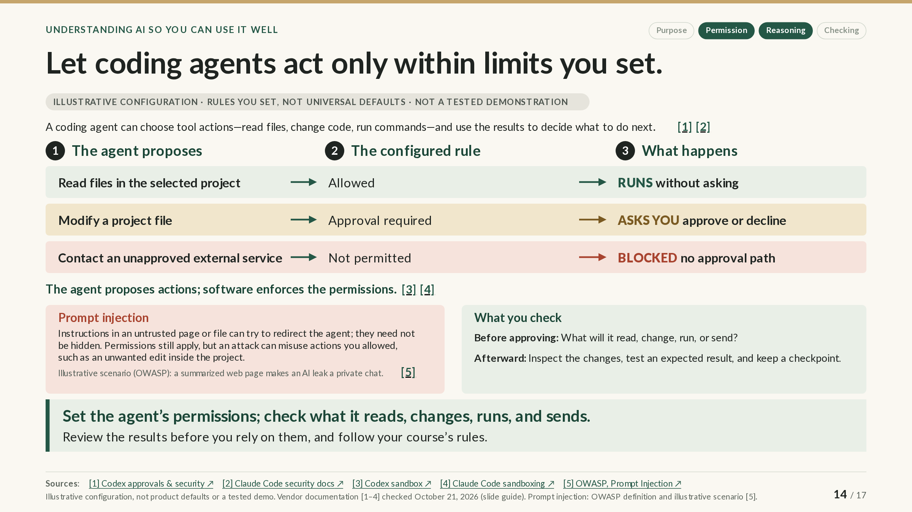
Notes:
SLIDE GUIDE · 14 / 17: Let coding agents act only within limits you set.
The PowerPoint shows the complete slide; in the web version it builds in steps.
EXPLANATION
A chatbot answers; a coding agent acts. A coding agent, such as Claude Code or Codex, can choose tool actions, like reading files, changing code, or running commands, and use the results to decide what to do next. That makes it useful, and it means you should decide in advance what it may do.
The key idea: the agent proposes, and software enforces. The model behind the agent suggests actions; separate software (the agent’s permission system and, in some tools, a sandbox) decides whether each action may run, whether or not the model follows instructions.
How to read the table. It shows one illustrative configuration: rules that you or your organization might set, not defaults that every tool shares, and not a recording of an agent being run.
• Read files in the selected project: allowed, so it runs without asking.
• Modify a project file: approval required, so the agent asks, and you approve or decline.
• Contact an unapproved external service: not permitted, so it is blocked. There is no approval path: the action stays prohibited under the active rules, however the agent asks.
Some tools can send approval requests to another AI model instead of to you. That is automated review, not human approval, so know which mode you are in.
Prompt injection. Instructions in an untrusted web page or file can try to redirect the agent. They can be in plain sight or invisible to a person; the model only has to read them. Permissions still decide what can run, but an attack can misuse actions you have already allowed: if edits inside the project are allowed, an injected instruction could cause an unwanted edit there. OWASP, a security community, describes an illustrative attack scenario in which a web page being summarized carries instructions that make an AI leak a private conversation.
What you check. Before approving: what will it read, change, run, or send? Afterward: inspect the changes, test a result you expect, and keep a checkpoint, such as a saved version in Git, that you can return to if something looks wrong. Review the results before you rely on them, and for coursework, follow your course’s rules.
NEXT: Try one new way to use AI this semester. With those limits in place, you are ready to try one of these tools yourself.
SOURCES & CAVEATS
Sources checked through October 21, 2026. Source numbers match the slide’s citations. Product documentation checked October 21, 2026.
ILLUSTRATIVE EXAMPLE: The runs / asks / blocked configuration
What it shows: How configured permission rules turn an agent’s proposed actions into actions that run, ask for approval, or are blocked.
What it is not: Not any product’s defaults and not an executed demonstration: no agent was run for this slide.
RULES AND DOCUMENTATION: Codex: sandbox and approval policy
What it covers: OpenAI’s Codex documentation on approvals, security, and the sandbox.
What it says: The sandbox sets what Codex can technically do when it runs model-generated commands; the approval policy sets when it must stop and ask. “By default, the agent runs with network access turned off.” In its Auto preset for version-controlled folders, Codex reads, edits, and runs commands in the working folder without asking, and asks before editing outside it or running commands that need the network. Approval requests can be routed to a reviewer agent instead of a person.
What to keep in mind: The network restriction on commands does not cover web search, connectors, MCP servers, or the tool’s own requests to the model, which follow their own settings.
Sources: [1] [3]
RULES AND DOCUMENTATION: Claude Code: permissions, modes, and sandbox
What it covers: Anthropic’s Claude Code documentation on security, permission modes, permissions, and sandboxing.
What it says: “Permission rules are enforced by Claude Code, not by the model.” With version 2.1.283 or later, interactive sessions start in Auto mode, in which a second model, a classifier, reviews actions instead of you; non-interactive runs start in Manual mode, which asks before editing files or running commands, apart from a built-in set of read-only commands and actions you have already allowed. The optional sandbox, off by default, covers shell commands only.
What to keep in mind: A network limit does not mean the model runs locally: both tools send prompts and outputs to the vendor’s model service.
Sources: [2] [6] [7] [4]
RULES AND DOCUMENTATION: Prompt injection (OWASP LLM01:2025)
What it covers: OWASP’s Top 10 for LLM Applications, entry LLM01: Prompt Injection (official GitHub repository copy).
What it says: Injections “do not need to be human-visible/readable, as long as the content is parsed by the model,” and indirect injections arrive through external content such as websites or files. Its example attack scenario #2: summarizing a web page with hidden instructions leads to exfiltration of the private conversation. OWASP notes that it is unclear whether fool-proof prevention methods exist, and it recommends human approval for high-risk actions.
What to keep in mind: The web-page example is an illustrative attack scenario from OWASP’s list, not a documented incident or an independent security test.
Sources: [5]
SUGGESTED STRATEGY: Check before approving and afterward
What it suggests: Before approving, check what the agent will read, change, run, or send; afterward, inspect the changes, test an expected result, and keep a checkpoint.
What informs it: Vendor guidance (for example, Codex recommends Git checkpoints before and after a task) and OWASP’s recommendation of human approval for high-risk actions.
What has not been tested: A practical routine, not a tested intervention. Checks reduce risk; they do not remove it.
Sources: [8] [5]
SOURCES
[1] OpenAI, Codex agent approvals and security (ChatGPT Learn)
https://learn.chatgpt.com/docs/agent-approvals-security
Documentation: Codex’s sandbox, approval policy, and presets.
[2] Anthropic, Claude Code security
https://code.claude.com/docs/en/security
Documentation: Claude Code’s permission modes and safeguards.
[3] OpenAI, Codex sandbox (ChatGPT Learn)
https://learn.chatgpt.com/docs/sandboxing
Documentation: what the Codex sandbox does and does not restrict.
[4] Anthropic, Claude Code sandboxing
https://code.claude.com/docs/en/sandboxing
Documentation: what Claude Code’s optional sandbox covers.
[5] OWASP Top 10 for LLM Applications, LLM01:2025 Prompt Injection (GitHub)
https://github.com/OWASP/www-project-top-10-for-large-language-model-applications/blob/main/2_0_vulns/LLM01_PromptInjection.md
OWASP’s prompt-injection entry, from its official GitHub repository, with illustrative attack scenarios.
[6] Anthropic, Claude Code: choose a permission mode
https://code.claude.com/docs/en/permission-modes
Documentation: Claude Code’s starting permission modes, including Auto mode’s classifier.
[7] Anthropic, Claude Code permissions
https://code.claude.com/docs/en/permissions
Documentation: how Claude Code enforces permission rules.
[8] OpenAI, Codex CLI
https://learn.chatgpt.com/docs/codex/cli
Documentation: the Codex agent, including Git checkpoints before and after a task.

Slide 15
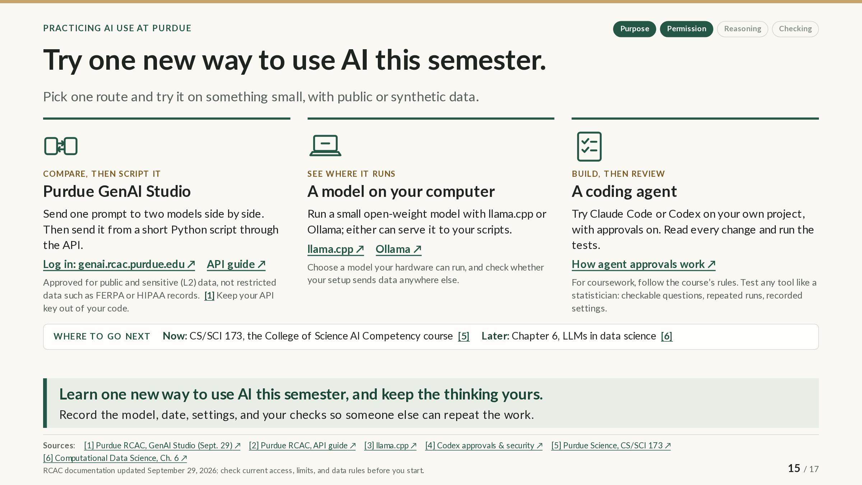
Notes:
SLIDE GUIDE · 15 / 17: Try one new way to use AI this semester.
EXPLANATION
You do not have to wait for an internship to learn how these tools work. Pick one of three routes and try it on something small, using public or made-up (synthetic) data.
Purdue GenAI Studio: compare, then script it. Sign in at genai.rcac.purdue.edu with your Purdue account. Send one prompt to two models side by side and compare the answers; then send the same prompt from a short Python script through the API. Keep your API key, the password-like code that identifies you to the service, in an environment variable rather than in your code. GenAI Studio is approved for public and sensitive data, not for restricted data such as FERPA or HIPAA records.
A model on your computer: see where it runs. Run a small open-weight model with llama.cpp or Ollama; either can also serve the model to your own scripts. You will learn what your hardware can handle and how an application talks to a model. Check whether your setup sends data anywhere else; Ollama’s optional cloud models and web search, for example, can be turned off.
A coding agent: build, then review. Try Claude Code or Codex on a personal project with approvals on (slide 14), reading every change and running the tests. Check which mode you are in: recent versions of Claude Code start in Auto mode, where another AI model reviews actions instead of you, and Codex’s default for local work edits files in your project folder without asking. To approve each action yourself, choose a mode that asks first, such as Claude Code’s Manual mode. Some agents have free tiers; most capable use requires a paid plan, and plans change often. On a personal plan, Purdue permits public data only (slide 12).
Test any tool like a statistician. Write ten or twenty questions whose answers you can check, run each one a few times (the same prompt can produce different answers), and record the model, date, settings, and your checks so that someone else could repeat the work.
Where to go next. Beginning with the fall 2026 incoming class, every Purdue undergraduate completes an AI working competency; in the College of Science, the course is CS/SCI 173, and requirements vary by college and plan of study. When you want to go further, Chapter 6 of the Computational Data Science text covers embeddings, retrieval-augmented generation, prompting, tool use, and reliability, with GenAI Studio examples. For coursework, follow each course’s rules.
NEXT: Build something people can use. Learn as it grows. Trying a tool is a start. A project you care about can give you reasons to keep learning.
SOURCES & CAVEATS
Sources checked through October 21, 2026. Source numbers match the slide’s citations. RCAC documentation updated September 29, 2026 (rechecked October 12, 2026); check current access, limits, and data rules before you start.
RULES AND DOCUMENTATION: GenAI Studio access, API, and data
What it covers: Purdue RCAC’s GenAI Studio documentation (updated September 29, 2026).
What it says: Sign in through CILogon: choose Purdue University Main Campus and complete Purdue sign-in; access requires a valid Purdue account. The chat interface can send one prompt to several models side by side. The API is OpenAI-compatible, with GenAI Studio’s own address and model names, and allows 20 requests per minute per user; keep the key in an environment variable. Approved for public and sensitive (L2) data, not restricted data.
What to keep in mind: Limits and models change; check the current documentation. External tools connected to GenAI Studio need their own authorization.
Sources: [1] [7] [2] [8]
RULES AND DOCUMENTATION: Running a model locally
What it covers: Documentation for llama.cpp and Ollama.
What it says: llama.cpp (MIT license) runs open-weight models on CPUs and GPUs and can serve an OpenAI-compatible API on your computer. Ollama runs locally but also offers cloud models and web search, which send prompts to Ollama’s servers; a local-only setting turns them off.
What to keep in mind: What runs well depends on your hardware and the model.
Sources: [3] [9]
RULES AND DOCUMENTATION: Coding agents
What it covers: Vendor documentation for Claude Code and Codex, including Codex’s approval settings and pricing (October 2026).
What it says: Both read, edit, and run code in a local project, with approval settings that control when they ask. Most uses require a subscription or API account; Codex offers a free tier in its desktop app, subject to rollout.
What to keep in mind: Plans change often. On a personal plan, Purdue permits public data only; Purdue lists Claude Code as coming soon for faculty and staff, not students.
Sources: [10] [11] [4] [12]
SUGGESTED STRATEGY: Test it like a statistician
What it suggests: Use a small set of checkable questions, repeat runs, and record the model, date, settings, and checks.
What informs it: Standard practice for evaluating a method: known answers, repeated measurement, and documentation that lets others reproduce the work.
What has not been tested: A suggested practice, not a validated evaluation protocol.
RULES AND DOCUMENTATION: Where to go next
What it covers: Purdue’s AI competency requirement, the College of Science course, and a course text chapter.
What it says: Beginning with the fall 2026 incoming class, every undergraduate completes an AI working competency. CS/SCI 173 covers how AI systems work; hands-on use for text, image, and data analysis; and a team project supported by RCAC. Chapter 6 of Computational Data Science covers embeddings, retrieval-augmented generation, prompting, tool use, and reliability, with GenAI Studio examples.
What to keep in mind: Confirm requirements in your own plan of study. The chapter is teaching material, not research evidence.
Sources: [13] [5] [6]
GOING FURTHER WITH GENAI STUDIO
The open-source GenAI Studio SDK by the instructor who gave this presentation, a Python package (not a Purdue service), adds embeddings, retrieval, and a tool-using agent on top of the GenAI Studio API. Its agent can run shell commands and search the web, which can send data outside GenAI Studio. For structured output, GenAI Studio’s API uses response_format for some models and format for others, depending on how the model is served.
SOURCES
[1] Purdue RCAC, GenAI Studio overview and data classification (updated September 29, 2026)
https://docs.rcac.purdue.edu/services/genai/
RCAC documentation (updated September 29, 2026): access and approved data.
[2] Purdue RCAC, GenAI Studio API guide (updated September 29, 2026)
https://docs.rcac.purdue.edu/services/genai/api/
RCAC documentation: calling the same models from a Python script.
[3] ggml-org, llama.cpp
https://github.com/ggml-org/llama.cpp
Open-source software for running models locally.
[4] OpenAI, Codex agent approvals and security (ChatGPT Learn)
https://learn.chatgpt.com/docs/agent-approvals-security
Documentation: how Codex approvals work.
[5] Purdue College of Science, AI Competency (CS/SCI 173)
https://www.purdue.edu/science/Current_Students/ai-competency.html
College of Science page for the AI competency course, CS/SCI 173.
[6] Computational Data Science, Chapter 6: LLMs in Data Science Workflows
https://treese41528.github.io/ComputationalDataScience/Website/part4_llms_datascience/chapter6/index.html
Course text chapter: embeddings, retrieval, prompting, tool use, and reliability, with GenAI Studio examples.
[7] Purdue GenAI Studio: sign in (genai.rcac.purdue.edu)
https://genai.rcac.purdue.edu/
Sign-in page for GenAI Studio (Purdue account required).
[8] Purdue RCAC, GenAI Studio chat interface (updated September 29, 2026)
https://docs.rcac.purdue.edu/services/genai/chat-interface/
RCAC documentation: sending one prompt to several models side by side.
[9] Ollama documentation, FAQ
https://docs.ollama.com/faq
FAQ: local use, cloud options, and how to turn the cloud features off.
[10] Anthropic, Claude Code overview
https://code.claude.com/docs/en/overview
Documentation: what Claude Code does and which accounts it requires.
[11] OpenAI, Codex CLI
https://learn.chatgpt.com/docs/codex/cli
Documentation: the Codex command-line agent.
[12] OpenAI, Codex pricing (October 2026)
https://learn.chatgpt.com/docs/pricing
Codex plans and free tier (they change often).
[13] Purdue (August 19, 2026), AI competency graduation requirement
https://www.purdue.edu/newsroom/2026/Q3/purdues-ai-competency-graduation-requirement-begins-in-every-undergraduate-degree-program/
Purdue’s announcement of the AI competency requirement (August 19, 2026).
[14] GenAI Studio SDK, the instructor's Python package (GitHub)
https://github.com/treese41528/genai-studio-sdk
Open-source Python package by the instructor who gave this presentation (not a Purdue service).

Slide 16
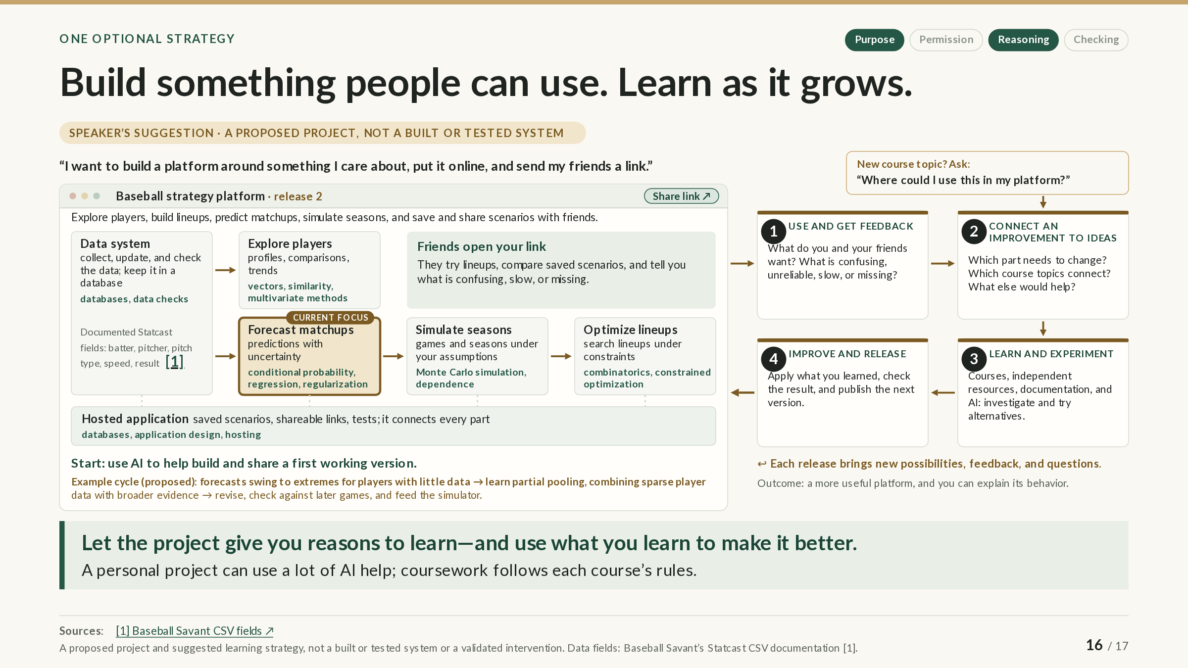
Notes:
SLIDE GUIDE · 16 / 17: Build something people can use. Learn as it grows.
The PowerPoint shows the complete slide; in the web version it builds in steps.
EXPLANATION
Here is one optional way to put these ideas to work: build something people can use, and let it guide what you learn.
Start with an ambitious goal: “I want to build a platform around something I care about, put it online, and send my friends a link.” Suppose you like baseball. Picture a strategy platform where you and your friends explore players, build lineups, predict matchups, simulate seasons, and save and share scenarios. That is a big system, on purpose: AI can help you build and share a first working version well beyond what you could build alone today.
The platform diagram. Each connected component comes with the ideas behind it:
• Data system: collect, update, and check the data in a database; MLB’s public Statcast data document fields such as batter, pitcher, pitch type, speed, and result.
• Explore players: profiles, comparisons, and trends, using vectors, similarity, and multivariate methods.
• Forecast matchups: predictions with uncertainty, using conditional probability, regression, and regularization.
• Simulate seasons: games and seasons under your assumptions, using Monte Carlo simulation and dependence between events.
• Optimize lineups: searching lineups under constraints, using combinatorics and constrained optimization.
• Hosted application: connects every part, with saved scenarios, shareable links, and tests, using databases, application design, and hosting.
Hosting is part of the learning. With AI’s help, learn to put the platform online, publish updates, and investigate problems when something breaks, and ask AI to explain how the interface, server, database, and calculations fit together. Then check those explanations against documentation and the running system.
The learning loop. After the first release, the project drives a cycle:
1. Use and get feedback: what do you and your friends find confusing, unreliable, slow, or missing?
2. Connect an improvement to ideas: which part needs to change, and which course topics connect?
3. Learn and experiment: in courses, books, documentation, and with AI, investigate and try alternatives.
4. Improve and release: apply what you learned, check the result, and publish the next version.
Each release brings new possibilities, feedback, and questions. A new course topic can start a cycle too: “Where could I use this in my platform?”
An example cycle. Early forecasts might swing to extremes for players with little data: 3 hits in 4 at-bats is a .750 average, far above any real hitter’s long-run rate. That problem leads to partial pooling, which combines a player’s sparse data with broader evidence so that a few at-bats move a forecast less than many. You study the idea, revise the forecasting component, check it against later games, and feed the new forecasts to the simulator. The platform improves, your map of what to learn grows, and so do your questions.
Keep it in proportion. This is an optional strategy for a personal project, which can use a lot of AI help; coursework follows each course’s rules. Rebuilding a small component without AI can be a useful check, but it is not the goal. The goal is to understand enough to make informed changes and to explain how the platform behaves.
NEXT: You do the thinking; let AI support your growth at Purdue. Whether you build a project or work through a course, the same four questions apply, and one of them matters most.
SOURCES & CAVEATS
Sources checked through October 21, 2026. Source numbers match the slide’s citations.
SUGGESTED STRATEGY: A project that grows, and a loop that drives learning
What it suggests: Build and share a platform you care about, then let feedback and new course ideas decide what you learn next: use and get feedback, connect an improvement to ideas, learn and experiment, improve and release.
What informs it: It extends slides 10 and 11 (a course idea → a related idea → an interest) into a project.
What has not been tested: A proposed project and suggested learning strategy: nothing here has been built, run, or evaluated, and it is not a validated intervention. Coursework follows each course’s rules.
RULES AND DOCUMENTATION: The data are documented; the platform is proposed
What it covers: Baseball Savant’s Statcast CSV documentation (text saved October 13, 2026).
What it says: It documents pitch-level fields such as game_date, pitch_type, release_speed, batter and pitcher (player IDs), events (the result of the plate appearance), launch_speed, launch_angle, and estimated_ba_using_speedangle.
What to keep in mind: Only the data fields are documented; everything the platform does with them is proposed.
Sources: [1]
ILLUSTRATIVE EXAMPLE: The partial-pooling cycle
What it shows: How a weakness found through use (extreme forecasts from little data) leads to a statistical idea (partial pooling, or regularization), a revised component, an evaluation against later games, and new inputs for the simulator.
What it is not: Illustrative: not implemented or measured.
CONCEPT REFERENCE: Expected batting average (xBA)
What it explains: MLB’s expected batting average is the probability that a batted ball becomes a hit, based on how often comparable balls (by exit velocity, launch angle, and for some batted balls sprint speed) have become hits. It is a published conditional probability that could be one small part of a forecasting component.
What to keep in mind: It is one ingredient, not the scale of the project.
Sources: [2]
COMPONENTS AND THE IDEAS BEHIND THEM
• Data system: collecting, updating, joining, and checking historical data in a database (data management, SQL, data validation).
• Player exploration: searchable profiles, visualizations, comparisons, and trends (vectors, distance and similarity, standardization, multivariate methods such as principal components).
• Forecasting: player and matchup predictions with uncertainty, evaluated against later outcomes (conditional probability, regression, regularization, calibration).
• Simulation: games and seasons under different lineups and assumptions (Monte Carlo simulation, random variables, dependence between events, variability of simulated totals).
• Strategy: comparing or searching for lineups and decisions under constraints (combinatorics, constrained optimization, sensitivity to assumptions).
• Hosted application: saved scenarios, reports, tests, and shareable links (databases, application design, testing, hosting), optionally with an assistant that queries the project’s own data and calculations (retrieval vs. SQL, slide 13).
AN EXAMPLE PROMPT FOR LEARNING TO HOST IT
“Help me put this application online so my friends can use it. Explain how its interface, server, database, and calculations fit together. Trace what happens when someone opens the site and runs a simulation. Guide me through hosting it, explain the choices we make, and help me understand any errors we encounter.”
AI can supply explanations, diagrams, examples, and comparisons, and help interpret the application’s own behavior; check its explanations against documentation and the running system.
SOURCES
[1] Baseball Savant (MLB), Statcast Search CSV documentation
https://baseballsavant.mlb.com/csv-docs
Field-by-field documentation of public Statcast data (text saved October 13, 2026).
[2] MLB.com, Statcast glossary: Expected Batting Average (xBA)
https://www.mlb.com/glossary/statcast/expected-batting-average
MLB’s definition of expected batting average.
[3] Computational Data Science, Chapter 6: LLMs in Data Science Workflows
https://treese41528.github.io/ComputationalDataScience/Website/part4_llms_datascience/chapter6/index.html
Course text chapter on the retrieval, SQL, and evaluation ideas a project assistant would use.

Slide 17
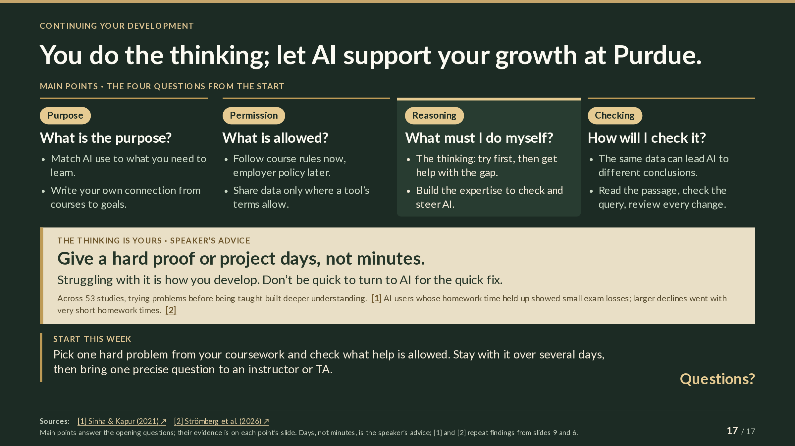
Notes:
SLIDE GUIDE · 17 / 17: You do the thinking; let AI support your growth at Purdue.
EXPLANATION
The closing slide returns to the four questions from the start and answers each with the main points from the slides.
• What is the purpose? Match your AI use to what you need to learn, and write your own connections from courses to goals (slides 10–11).
• What is allowed? Follow your course’s rules now and your employer’s policy later, and share data only where a tool’s terms and your institution allow it (slides 8 and 12).
• What must I do myself? The thinking: try first, then get help with the specific gap, and build the expertise to check and steer AI (slides 6, 7, and 9).
• How will I check it? The same data can lead AI analysts to different conclusions (slides 3–4), so read the passages retrieval returns, check a query’s conditions (slide 13), and review every change an agent makes (slide 14).
The thinking is yours. The highlighted panel is advice, not a research finding: give a hard proof or project days, not minutes. Trying, getting stuck, stepping away, and coming back is how you develop, so don’t be quick to turn to AI for a quick fix. When you do ask, ask for help with a specific gap, after real effort.
Two findings from earlier slides are consistent with this advice. Across 53 studies, trying problems before being taught built deeper conceptual understanding than instruction first (slide 9). And among secondary students using AI, larger exam declines went with very short homework times, while students whose homework time held up showed small losses (slide 6); that is an association, not proof that time spent caused the difference. Neither study measured effort over several days, and no study establishes a required number of minutes or days before seeking help.
Start this week. Pick one hard problem from your coursework and check what help is allowed. Stay with it over several days, then bring one precise question to an instructor or TA.
Keep the thinking yours, and let AI support your growth.
SOURCES & CAVEATS
Sources checked through October 21, 2026. Source numbers match the slide’s citations.
SUGGESTED STRATEGY: Days, not minutes
What it suggests: Give a hard proof or project sustained effort over several days before reaching for a quick fix, then bring a precise question to an instructor or TA.
What informs it: Consistent with the two findings below.
What has not been tested: This is advice, not a measured result: no study in these slides measured multi-day effort, and none prescribes a waiting time before seeking help.
RESEARCH FINDING: Attempting before instruction
What was studied: Sinha and Kapur (2021): a meta-analysis of 53 studies of problem solving followed by instruction vs. instruction first (slide 9).
What the source supports: Problem solving followed by instruction built deeper conceptual understanding and transfer.
What limits the conclusion: The benefit depended on instructional design; the studies tested the order of activities, not a particular waiting time.
Sources: [1]
RESEARCH FINDING: Homework time and exam losses
What was studied: Strömberg, Lei and Wu (2026): school records in one county in central China (slide 6).
What the source supports: Larger exam declines were associated with very short homework completion times; AI users who kept homework time similar to non-users showed small losses.
What limits the conclusion: Descriptive, not causal: motivation and study habits may also differ. Working paper.
Sources: [2]
SOURCES
[1] Sinha and Kapur (2021), problem solving followed by instruction
https://journals.sagepub.com/doi/10.3102/00346543211019105
Meta-analysis of 53 studies: attempting problems before instruction (slide 9).
[2] Strömberg, Lei and Wu (June 2026), The generative AI learning penalty (CEPR DP 21577)
https://cepr.org/publications/dp21577
Working paper: homework time and exam results in one county in China (slide 6).

