Slide 1

The Battle of Neighborhoods
Finding the best location for a new Chinese restaurant

Slide 2
Introduction
Being one of the largest city with an growing population, there is no doubt about the business opportunities in Toronto, Canada. Multiculturalism is seen through the various neighborhoods. Downtown Toronto being the hub of interactions between ethnicities brings many opportunities for entrepreneurs to start or grow their business. It is a place where people can try the best of each culture, either while they work or just passing through.

Slide 3
Data
The data that will be required will be a combination of CSV files that have been prepared for the purposes of the analysis from multiple sources which will provide the list of neighborhoods in Toronto (via Wikipedia), the Geographical location of the neighborhoods (via Geocoder package) and Venue data pertaining to Chinese restaurants (via Foursquare). The Venue data will help find which neighborhood is best suitable to open a Chinese restaurant.
Data Source 1: Toronto Neighborhoods via Wikipedia
Data Source 2: Geographical Location using Geocoder Package
Data Source 3: Venue Data using Foursquare

Slide 4
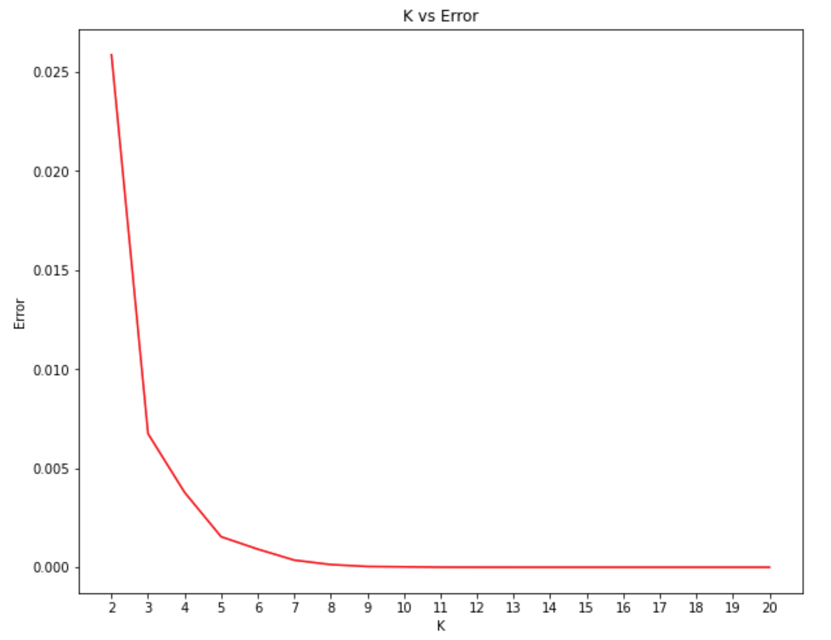
Methodology – K-Mean Clustering

Slide 5
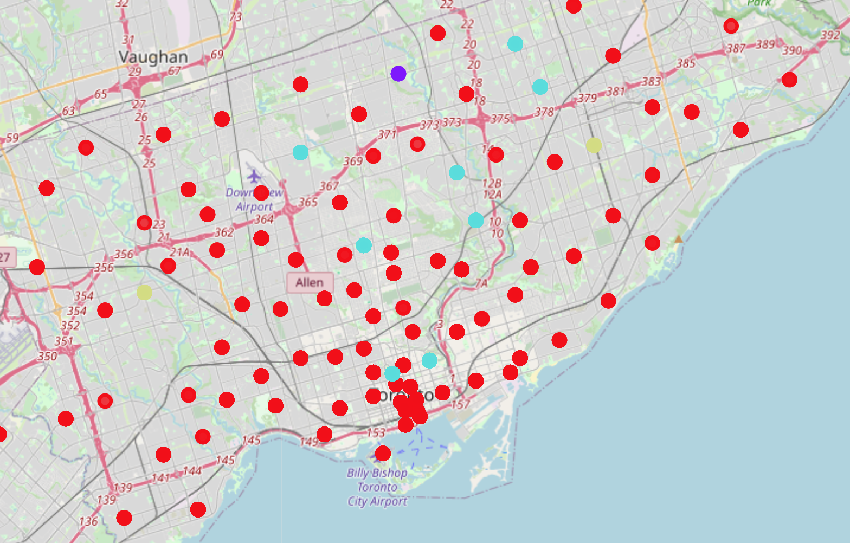
Methodology – K-Mean Clustering

Slide 6
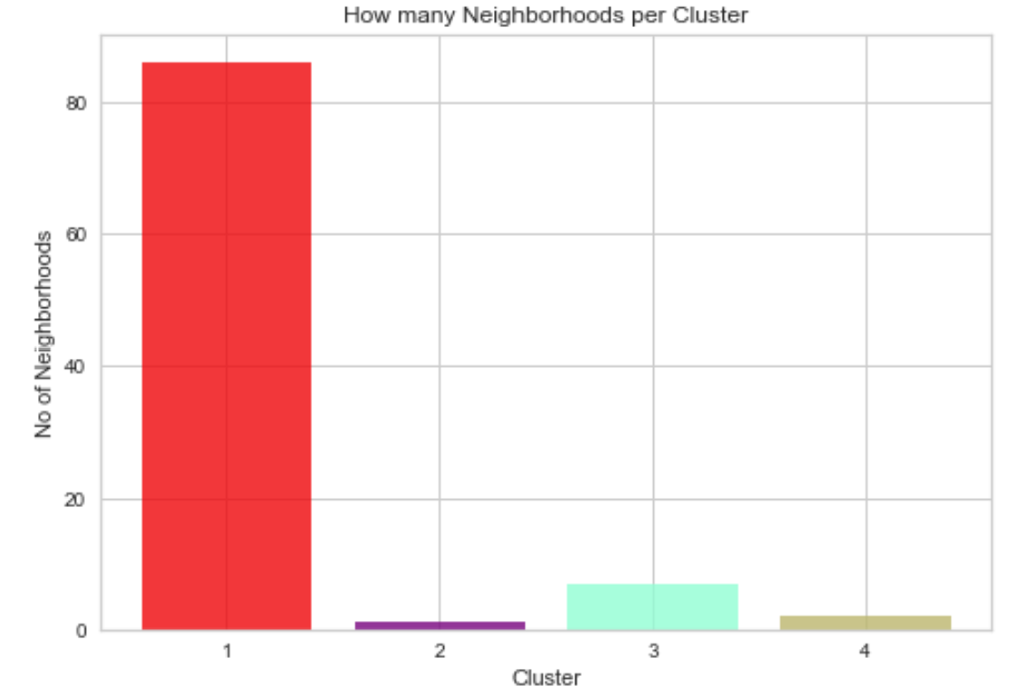
Methodology – K-Mean Clustering

Slide 7
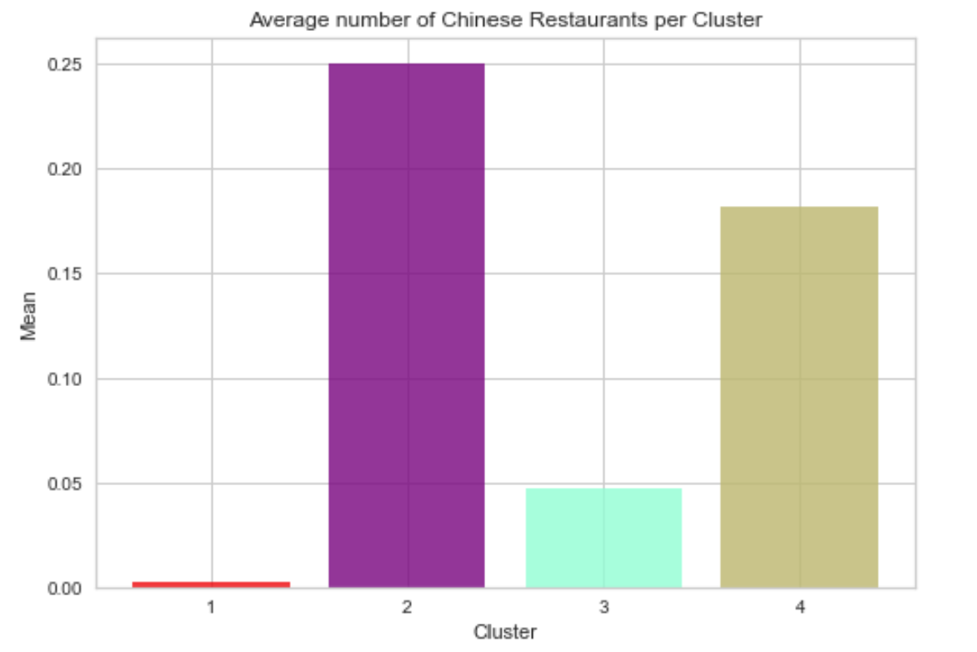
Methodology – K-Mean Clustering

Slide 8
Results and Discussion
Most of the Chinese Restaurants are in cluster 2 represented by the purple. The Neighborhoods located in the North York area that have the highest average of Chinese Restaurants are Bedford Park and Lawrence Manor East. Even though there is a huge number of Neighborhoods in cluster 1, there is little to no Chinese Restaurant. We see that in the Downtown Toronto area (cluster 3) has the second last average of Chinese Restaurants. Looking at the nearby venues, the optimum place to put a new Chinese Restaurant in Downtown Toronto as there are many Neighborhoods in the area but little to no Chinese Restaurants, therefore, eliminating any competition.

Slide 9
Conclusion
In conclusion, to end off this project, we had an opportunity on a business problem, and it was tackled in a way that it was similar to how a genuine data scientist would do. We utilized numerous Python libraries to fetch the information, control the content and break down and visualize those datasets. We have utilized Foursquare API to investigate the settings in neighborhoods of Toronto, get a great measure of data from Wikipedia which we scraped with the Beautifulsoup Web scraping Library. We also visualized utilizing different plots present in seaborn and Matplotlib libraries. Similarly, we applied AI strategy to anticipate the error given the information and utilized Folium to picture it on a map.

