Slide 1

SAVANA

Slide 2

FINALYEAR PROJECT

Slide 3

Introduction

Slide 4
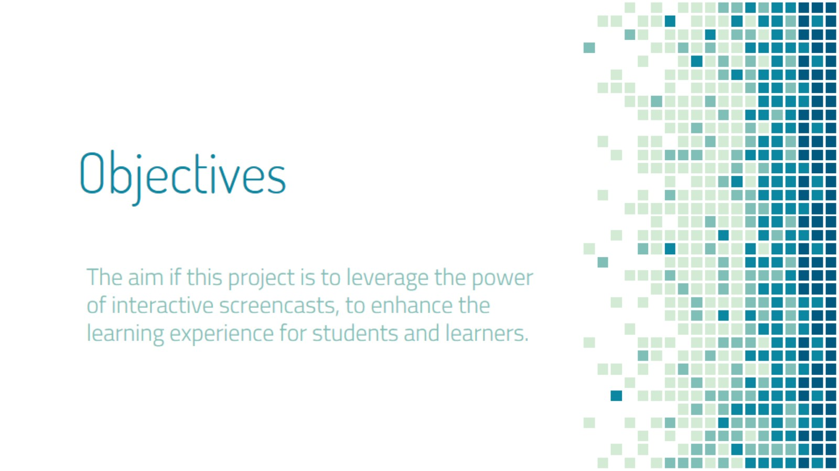
Objectives

Slide 5
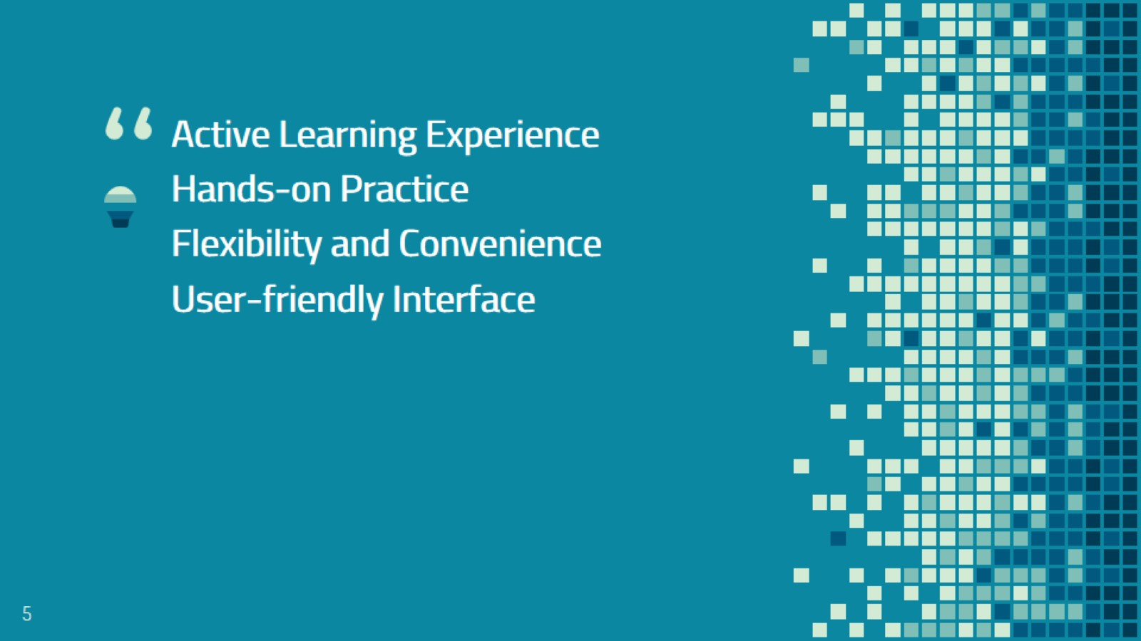

Slide 6
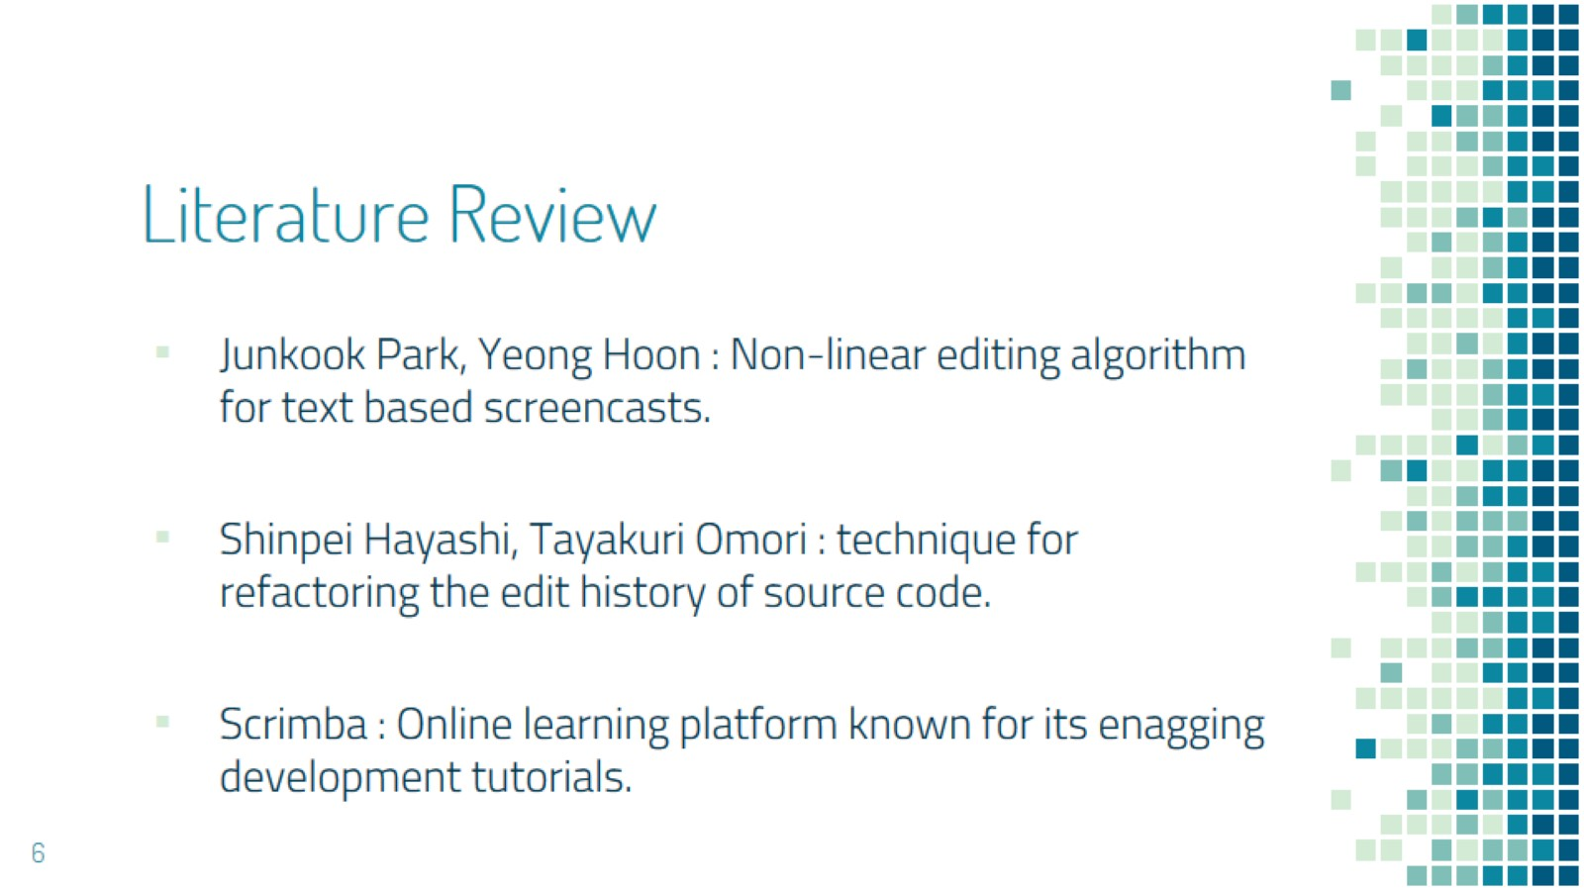
Literature Review

Slide 7
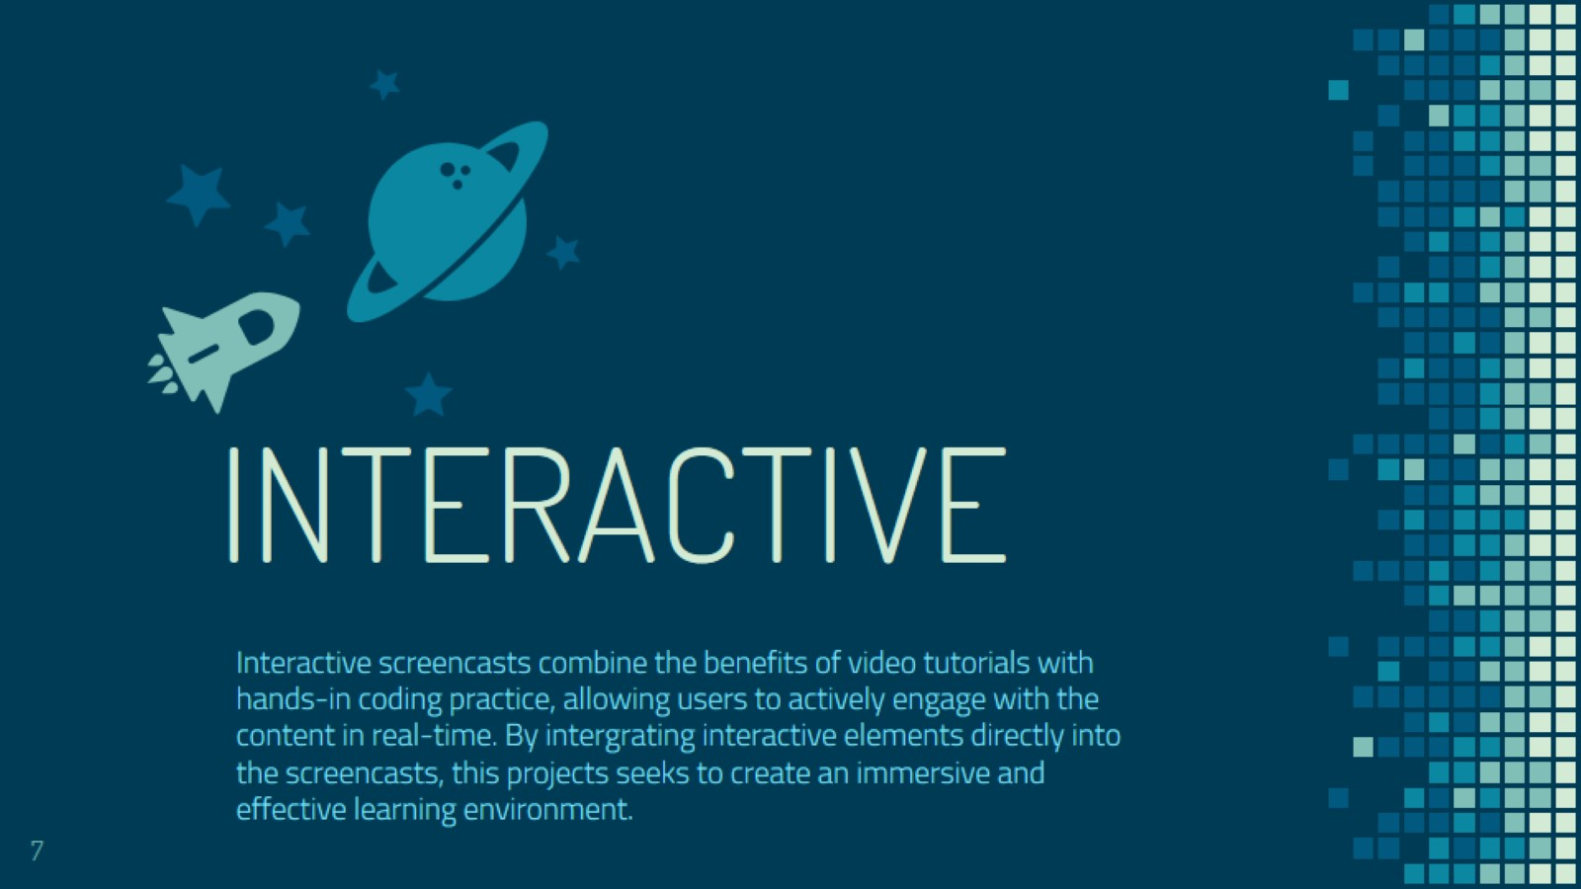
INTERACTIVE

Slide 8
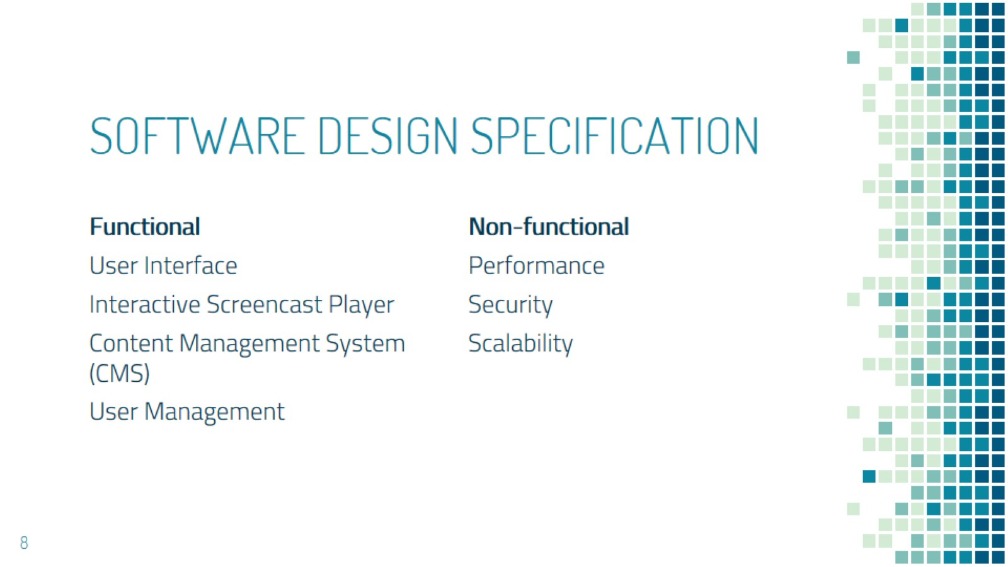
SOFTWARE DESIGN SPECIFICATION

Slide 9
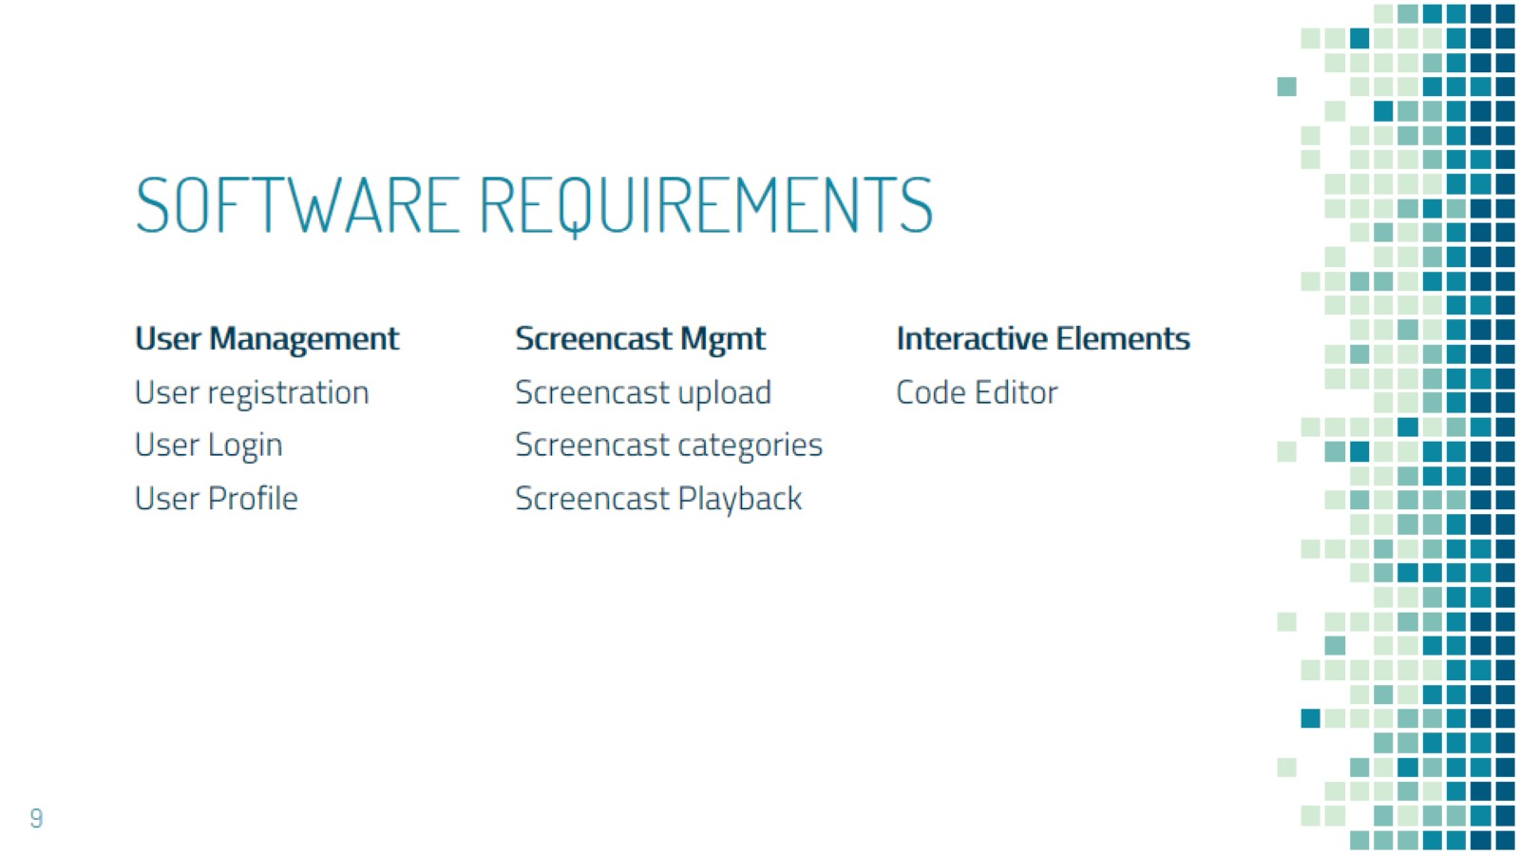
SOFTWARE REQUIREMENTS

Slide 10
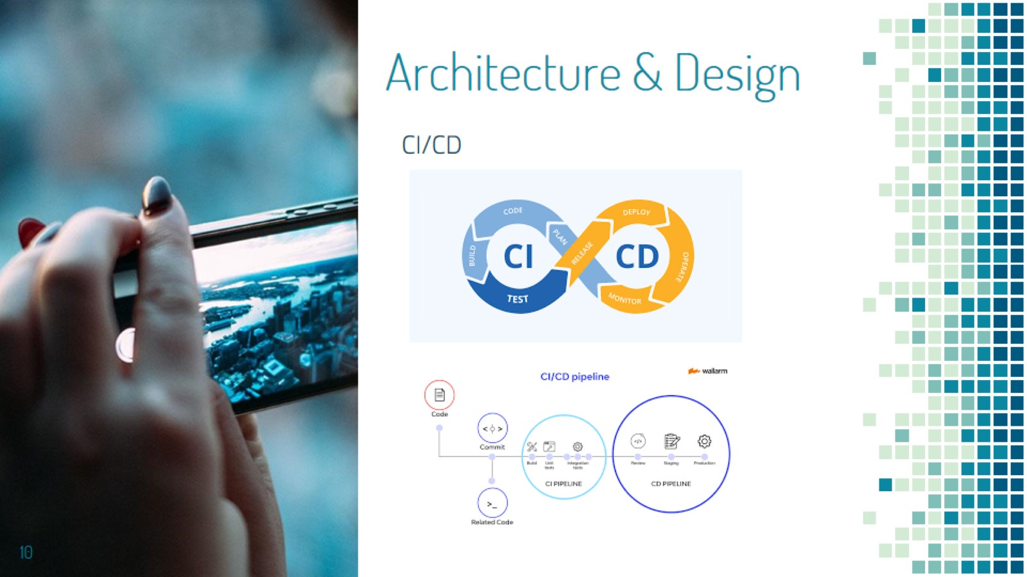
Architecture & Design

Slide 11
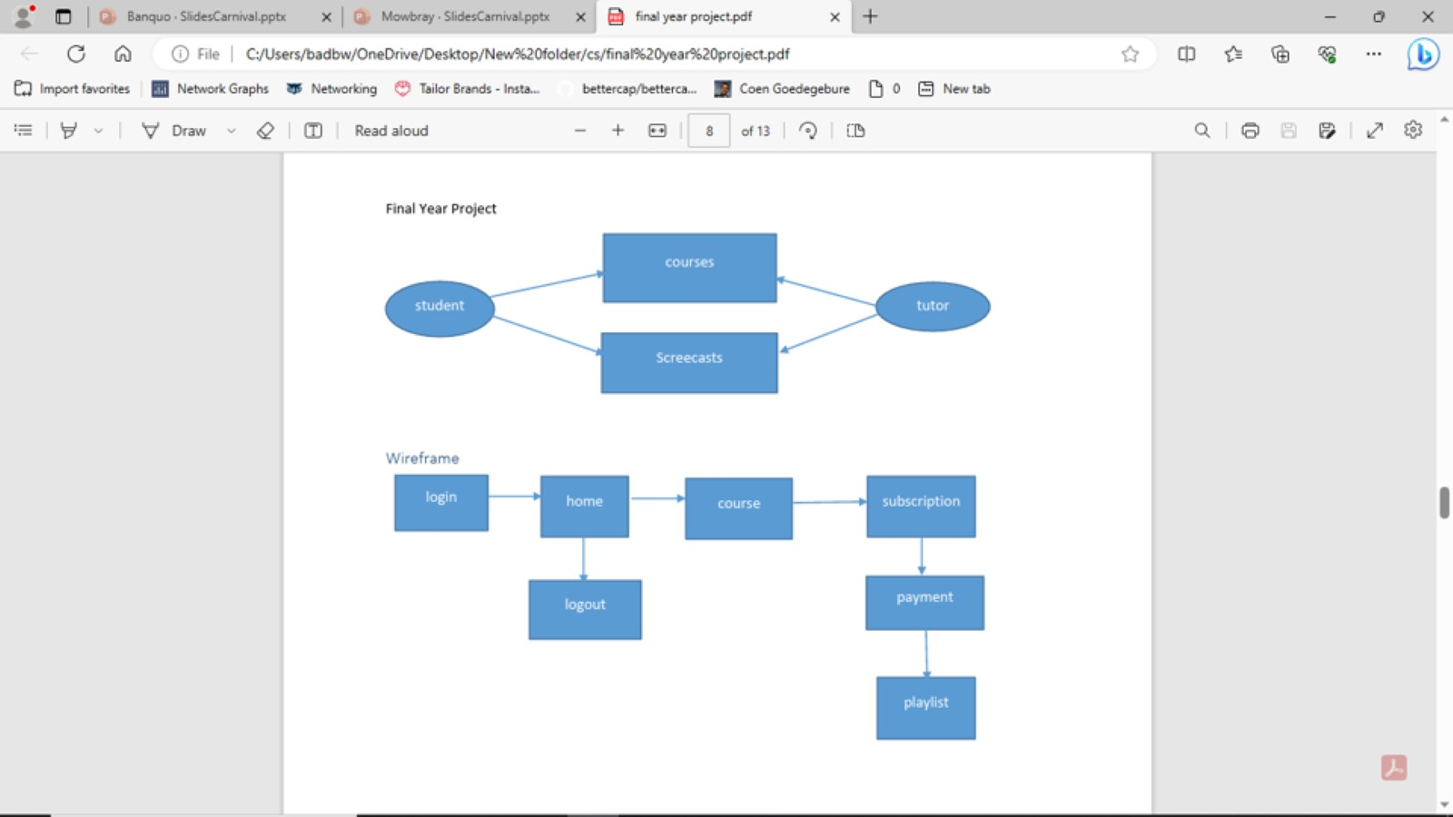

Slide 12
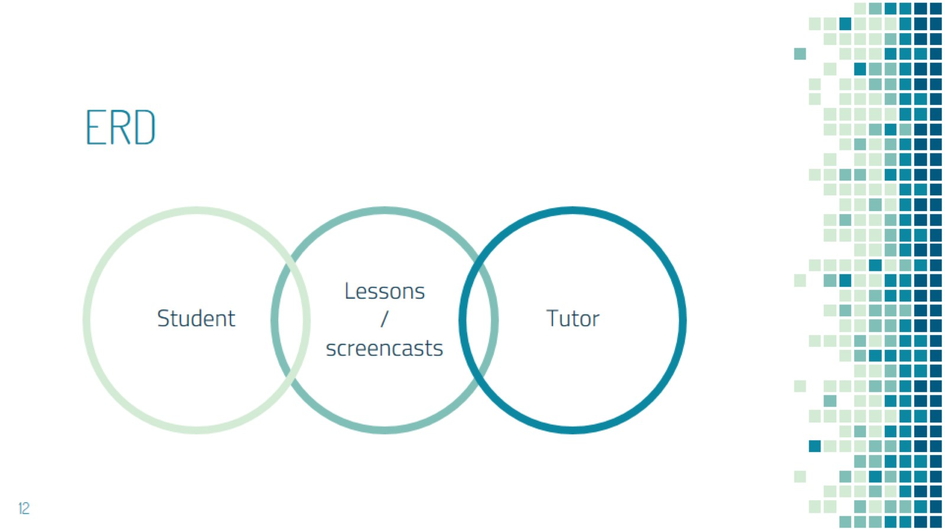
ERD

Slide 13

ONLINE

Slide 14
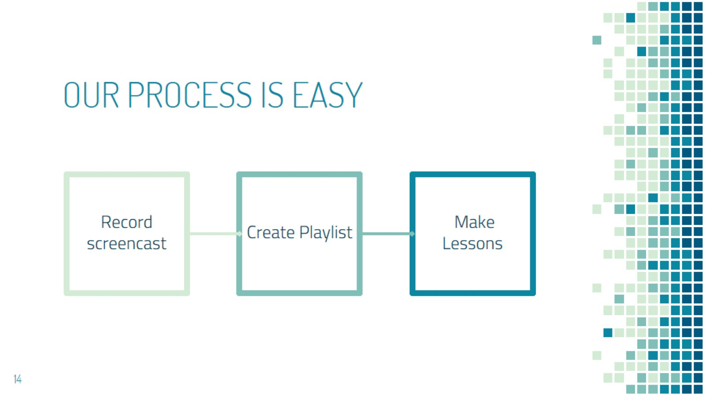
OUR PROCESS IS EASY

Slide 15
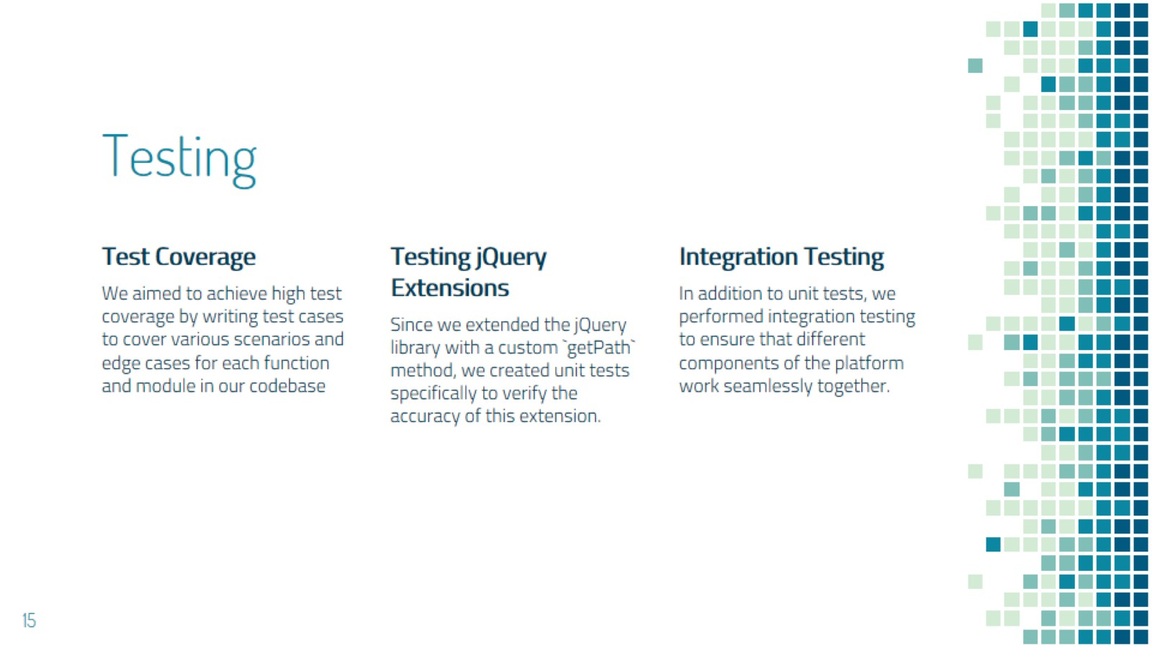
Testing

Slide 16
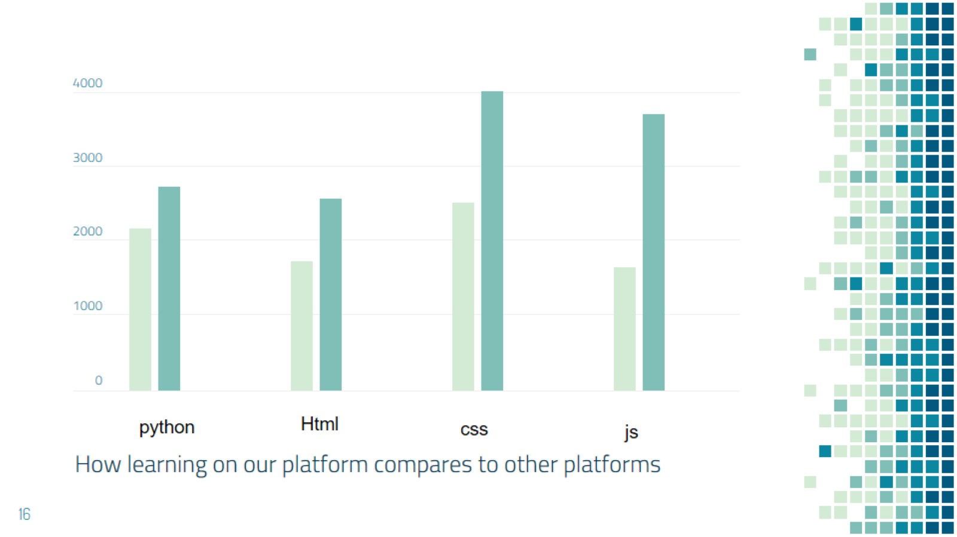

Slide 17
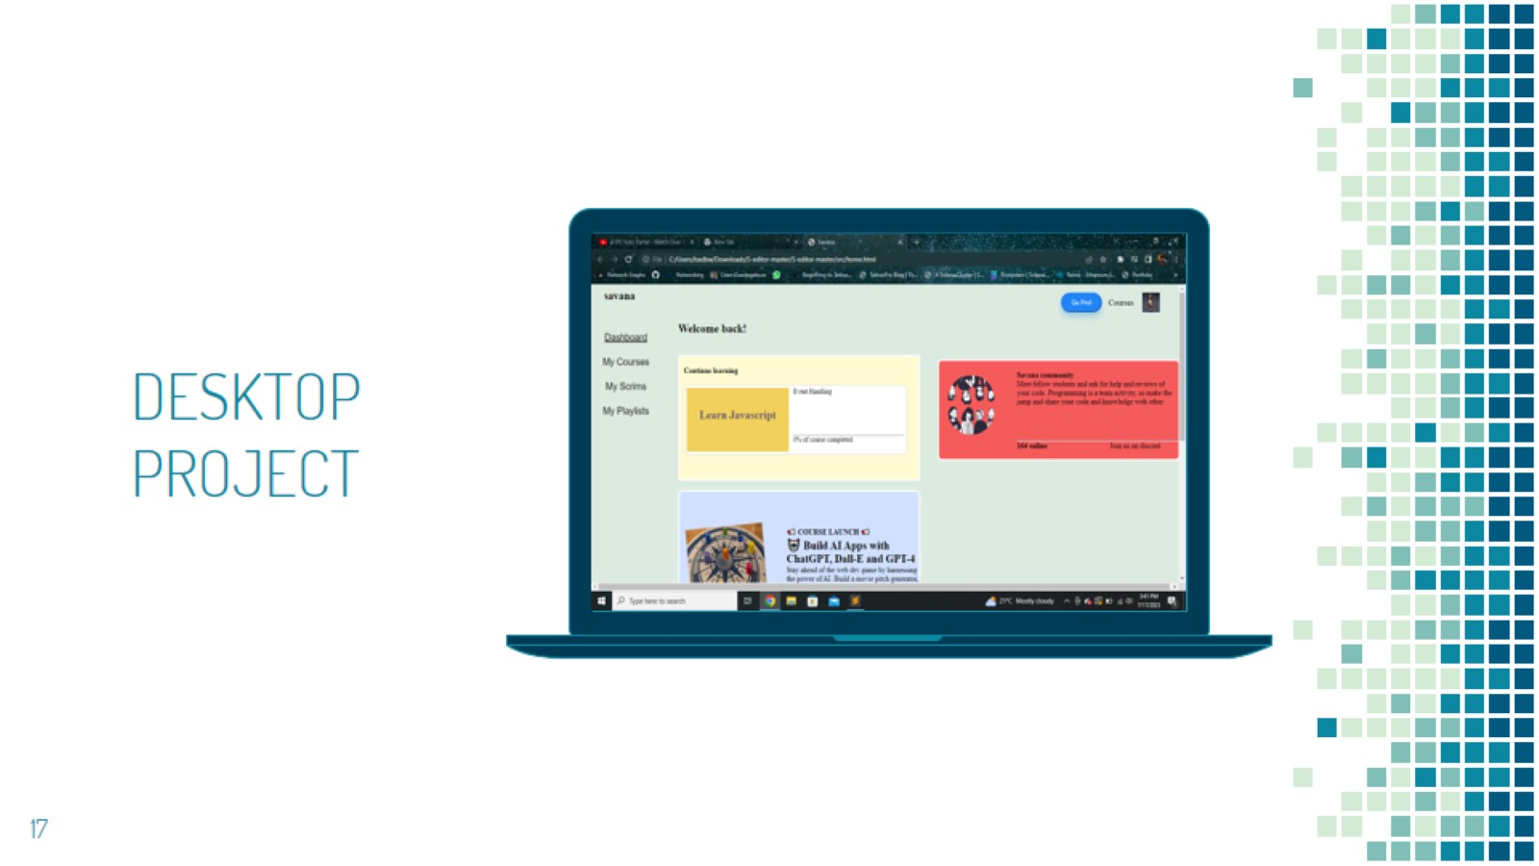

Slide 18
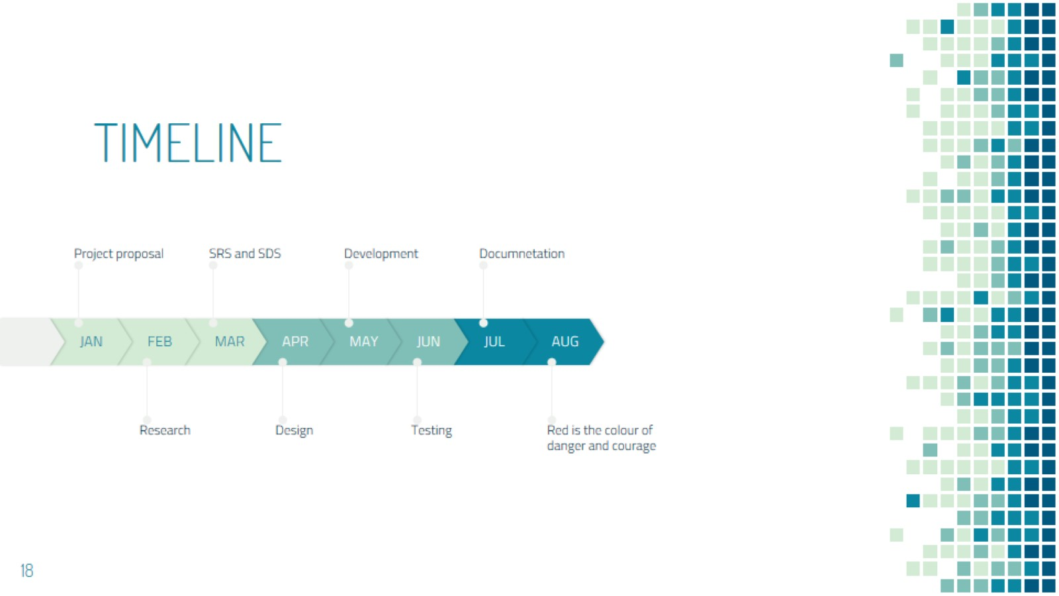
TIMELINE

Slide 19
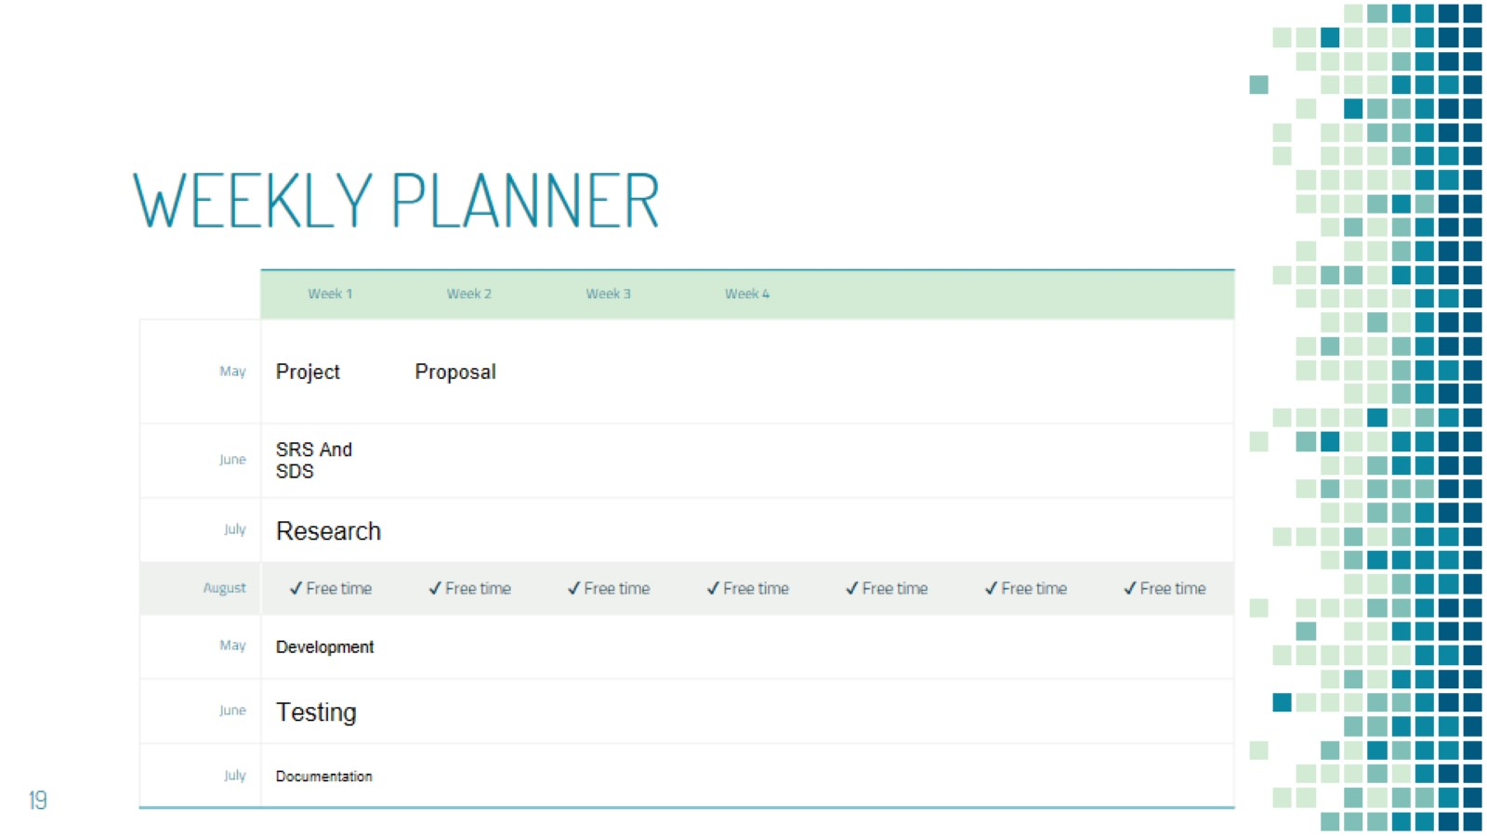
WEEKLY PLANNER

Slide 20

THANKS!

