Slide 1
I Liek Trainz (Visual Bonus Round One/1!111!1!!!1!!!)
By: THIS GUY

Slide 2
Question 1
[I-] M | [IO3-] M | [H+] M | Rxn Rate (M/s)
0.010 | 0.10 | 0.010 | 0.60
0.040 | 0.10 | 0.010 | 2.40
0.010 | 0.30 | 0.010 | 5.40
0.010 | 0.10 | 0.020 | 2.40

Slide 3
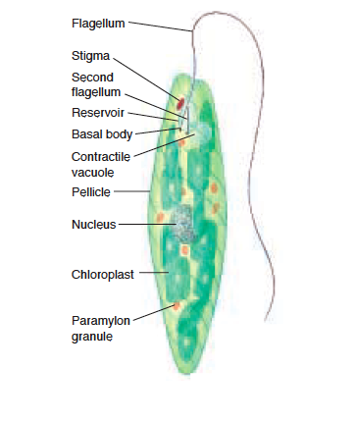
Question 2
A
B
C
D
E

Slide 4
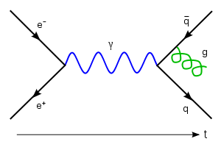
Question 3
A
B

Slide 5
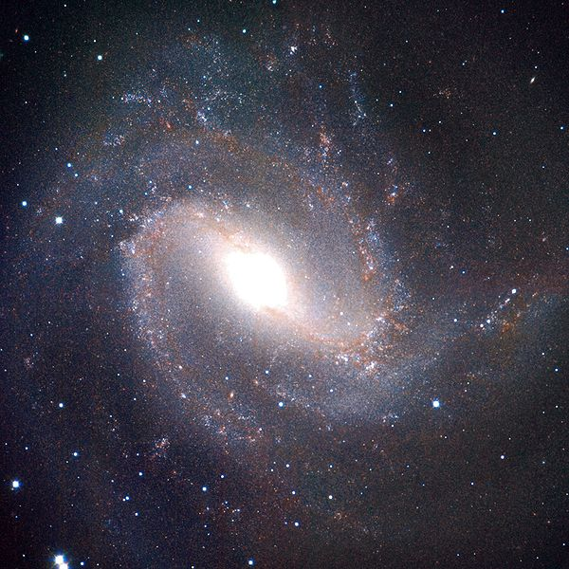
Question 4

Slide 6
Question 5

Slide 7
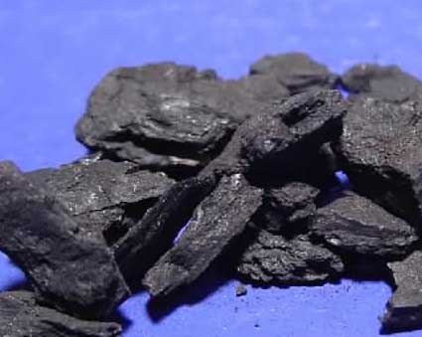
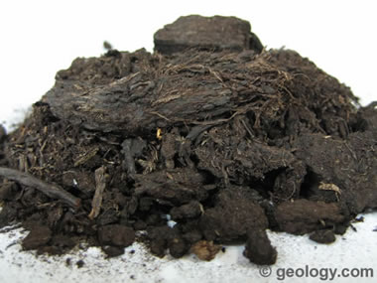
Question 6
A
B

Slide 8
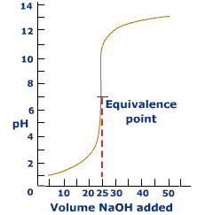
Question 7

Slide 9
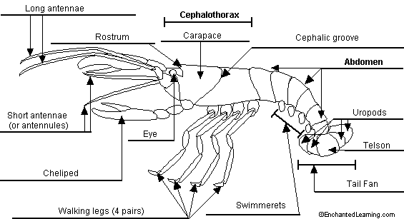
Question 8
D
C
A
B

Slide 10
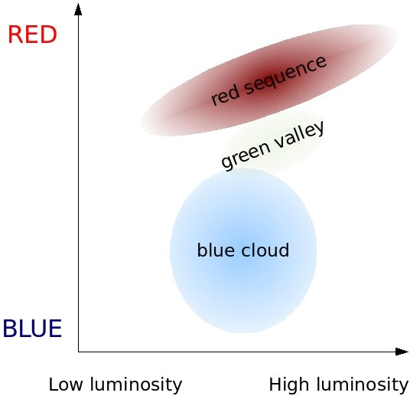
Question 10

Slide 11
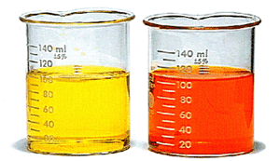
Question 13

Slide 12
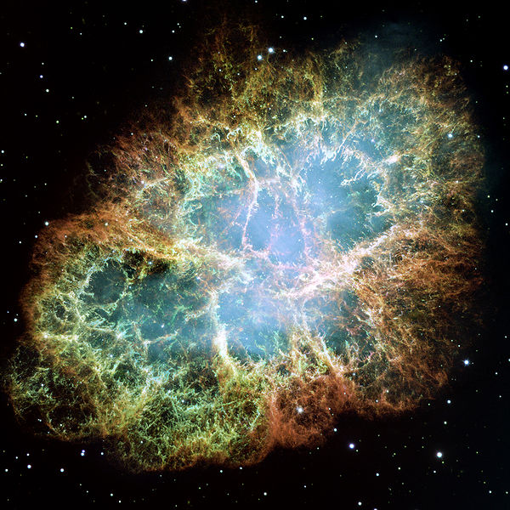
Question 16

Slide 13
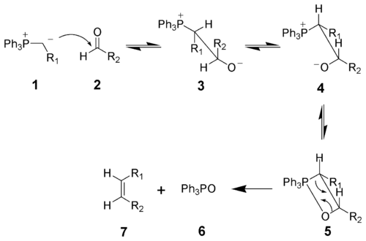
Question 19

