Slide 1
Visual Bonuses for 11/24 Round
Siddharth Trehan

Slide 2
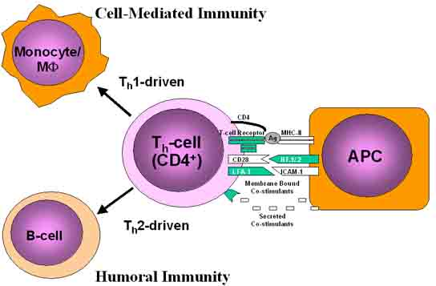
1
A
C
B

Slide 3
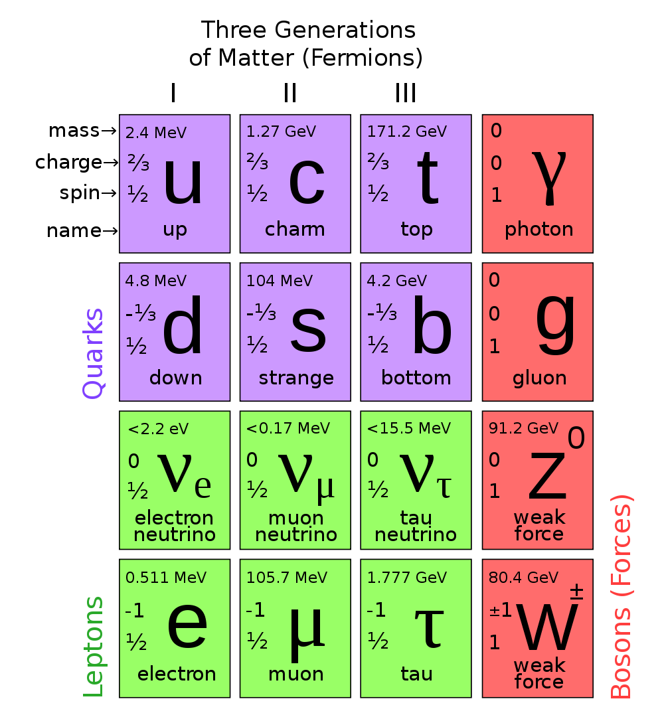
2
A
C
B

Slide 4
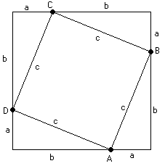
3

Slide 5
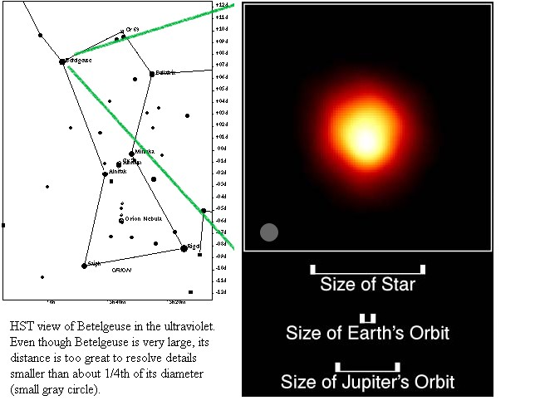
4

Slide 6
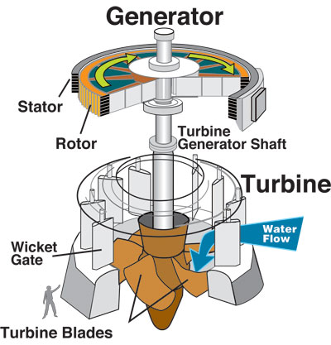
5
A
C
D
B

Slide 7
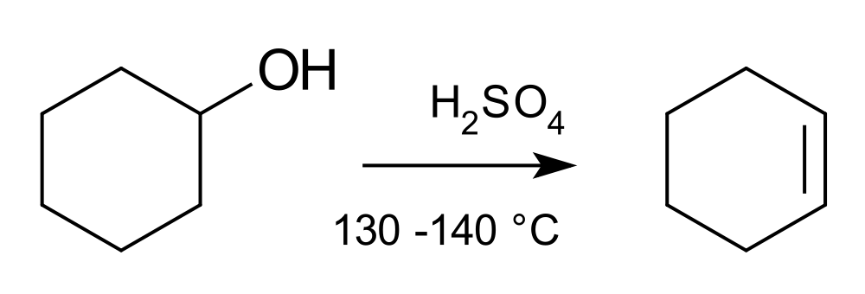
6
A

Slide 8
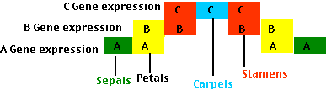
7
B
D
A
C

Slide 9
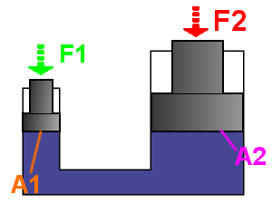
8
A is area of the surface, F is force exerted on that surface.

Slide 10
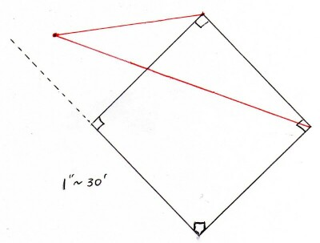
9
C
10 m
B
15 m
x m
8 m
D
A

Slide 11
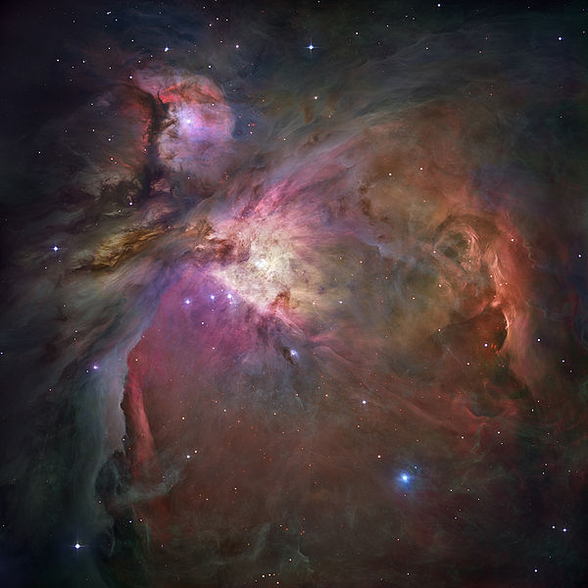
10

