Slide 1
Visual Bonuses for Round 11/21
Siddharth Trehan

Slide 2
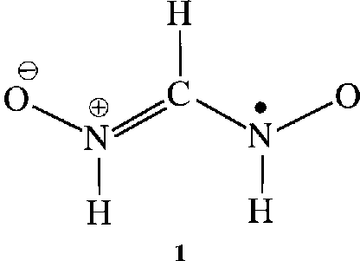
14
E
A
C
B
D

Slide 3
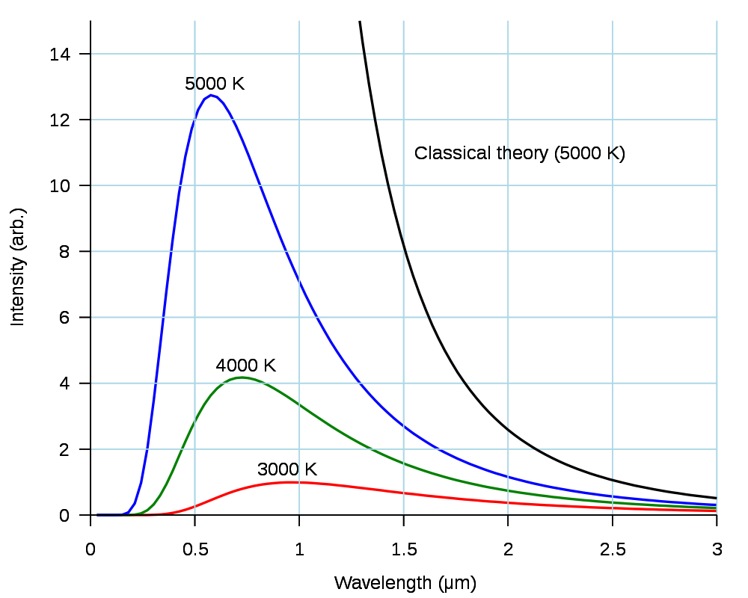
15
C
F
A
D
E
B

Slide 4
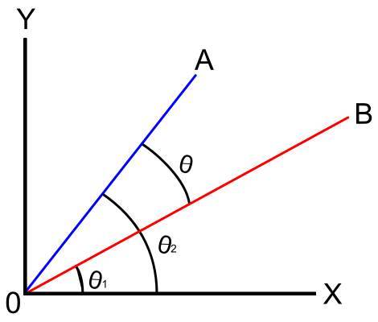
16
<1, 1>
<3, 4>

Slide 5
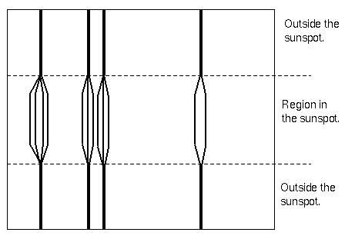
17

Slide 6
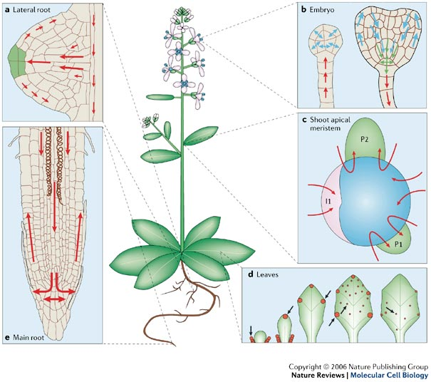
19

Slide 7
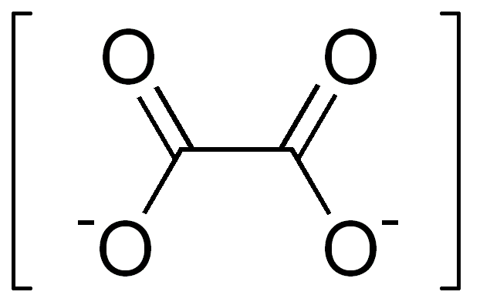
20
A
B
D
C

Slide 8
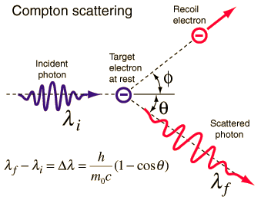
21
B
B
A
A

