Slide 1
Visual Bonuses for “AssortedFull1-11”
By Siddharth Trehan

Slide 2
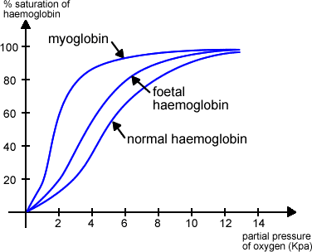
W
X
Y

Slide 3
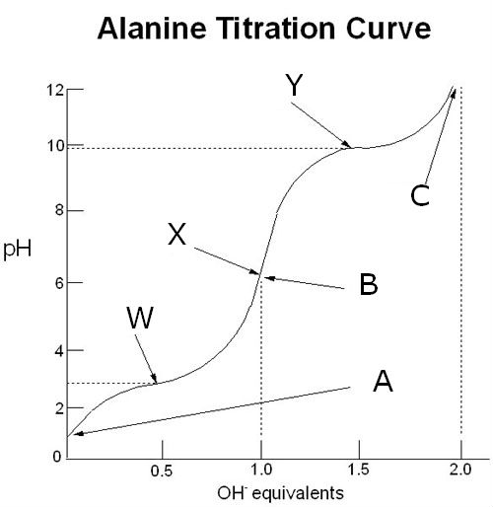

Slide 4
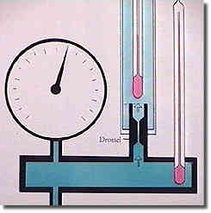
Manometer
Thermometer
Throttle

Slide 5
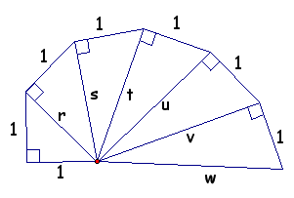

Slide 6
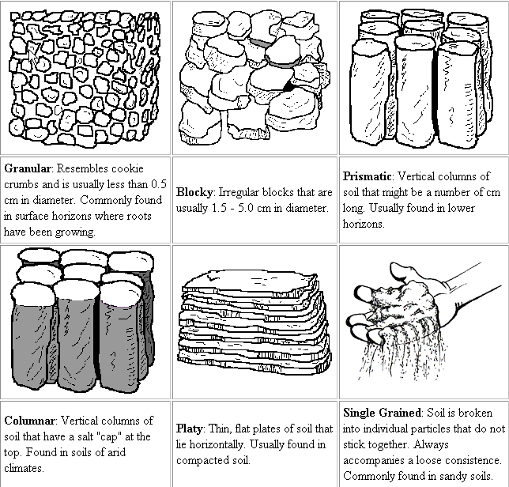
A
B
C
D
E
F

Slide 7
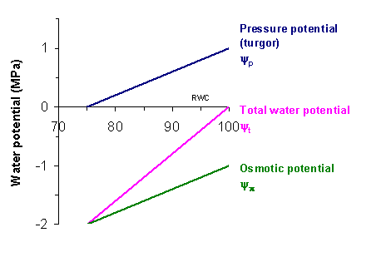

Slide 8
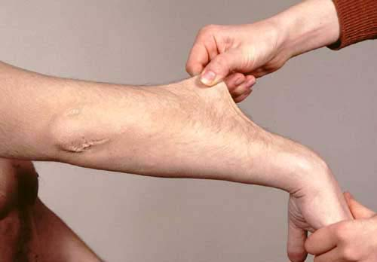

Slide 9


Slide 10
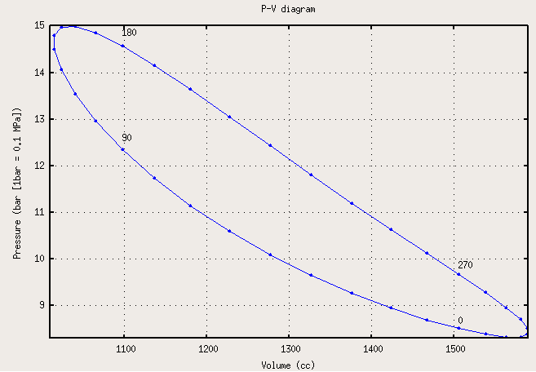

Slide 11
