Slide 1
Visual Bonuses for “AssortedFull12-23”
Siddharth Trehan

Slide 2
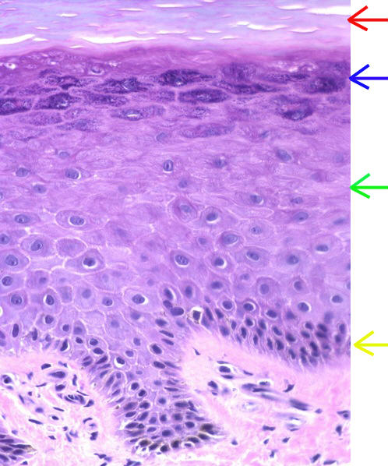

Slide 3
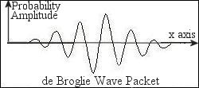

Slide 4
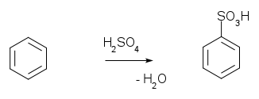

Slide 5


Slide 6
1
1 | 1
1 | 2 | 1
1 | 3 | 3 | 1
1 | 4 | 6 | 4 | 1
1 | 5 | 10 | 10 | 5 | 1
1 | 6 | 15 | 20 | 15 | 6 | 1
1 | 7 | 21 | 35 | 35 | 21 | 7 | 1
1 | 8 | 28 | 56 | 70 | 56 | 28 | 8 | 1

Slide 7
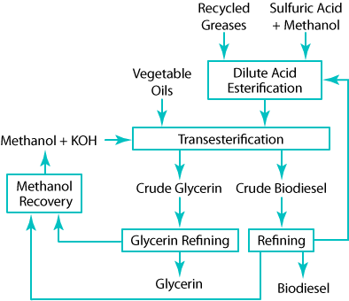
W
X
Y
Y
Y
Source: DOE Website

Slide 8
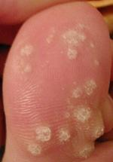
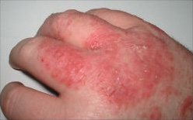
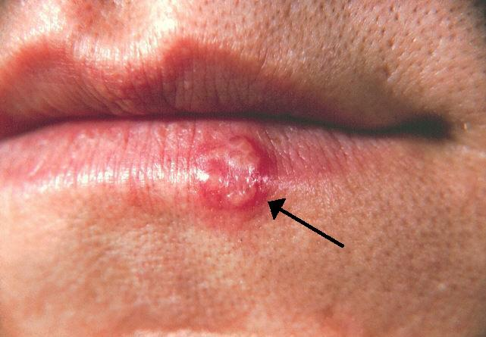
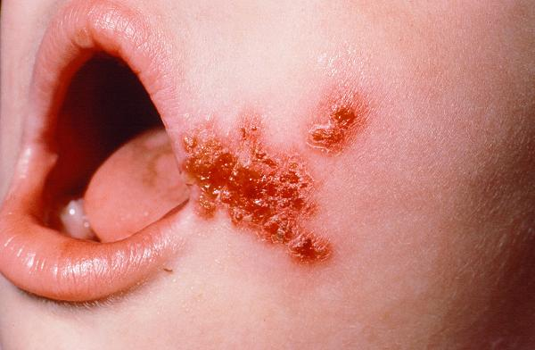
X
W
Y
Z

Slide 9
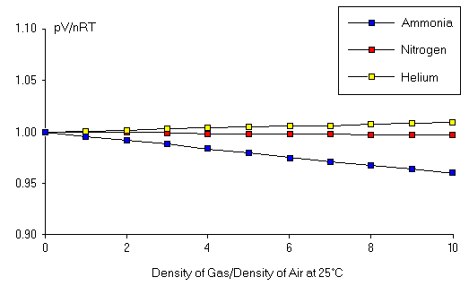
W
X
Y

Slide 10
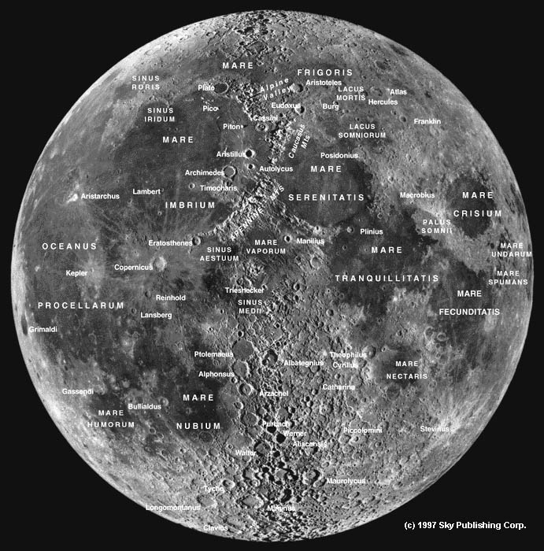
A
B
C
F
D
E

Slide 11
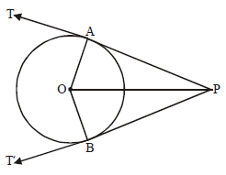

Slide 12
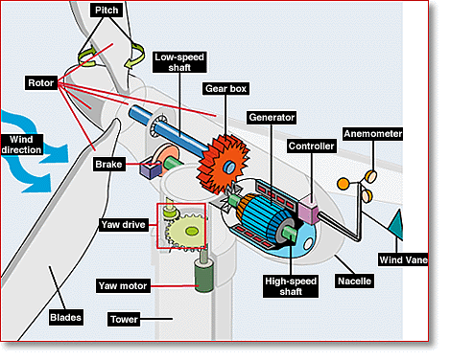
X
W
Y
Z

Slide 13
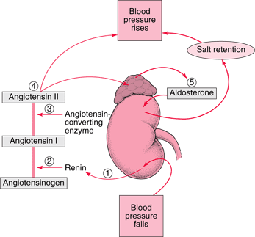
W
A
X
B
Y

Slide 14
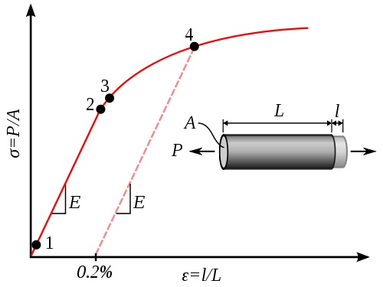

Slide 15
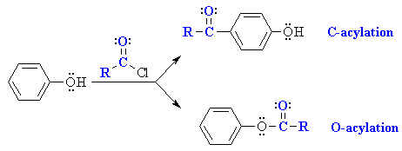
A
W
B

Slide 16
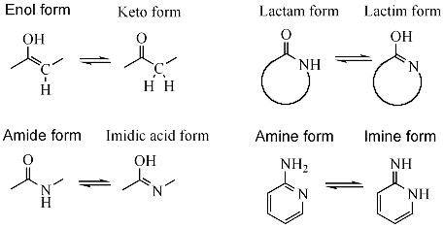
B
C
D
A
E
F
G
H

Slide 17
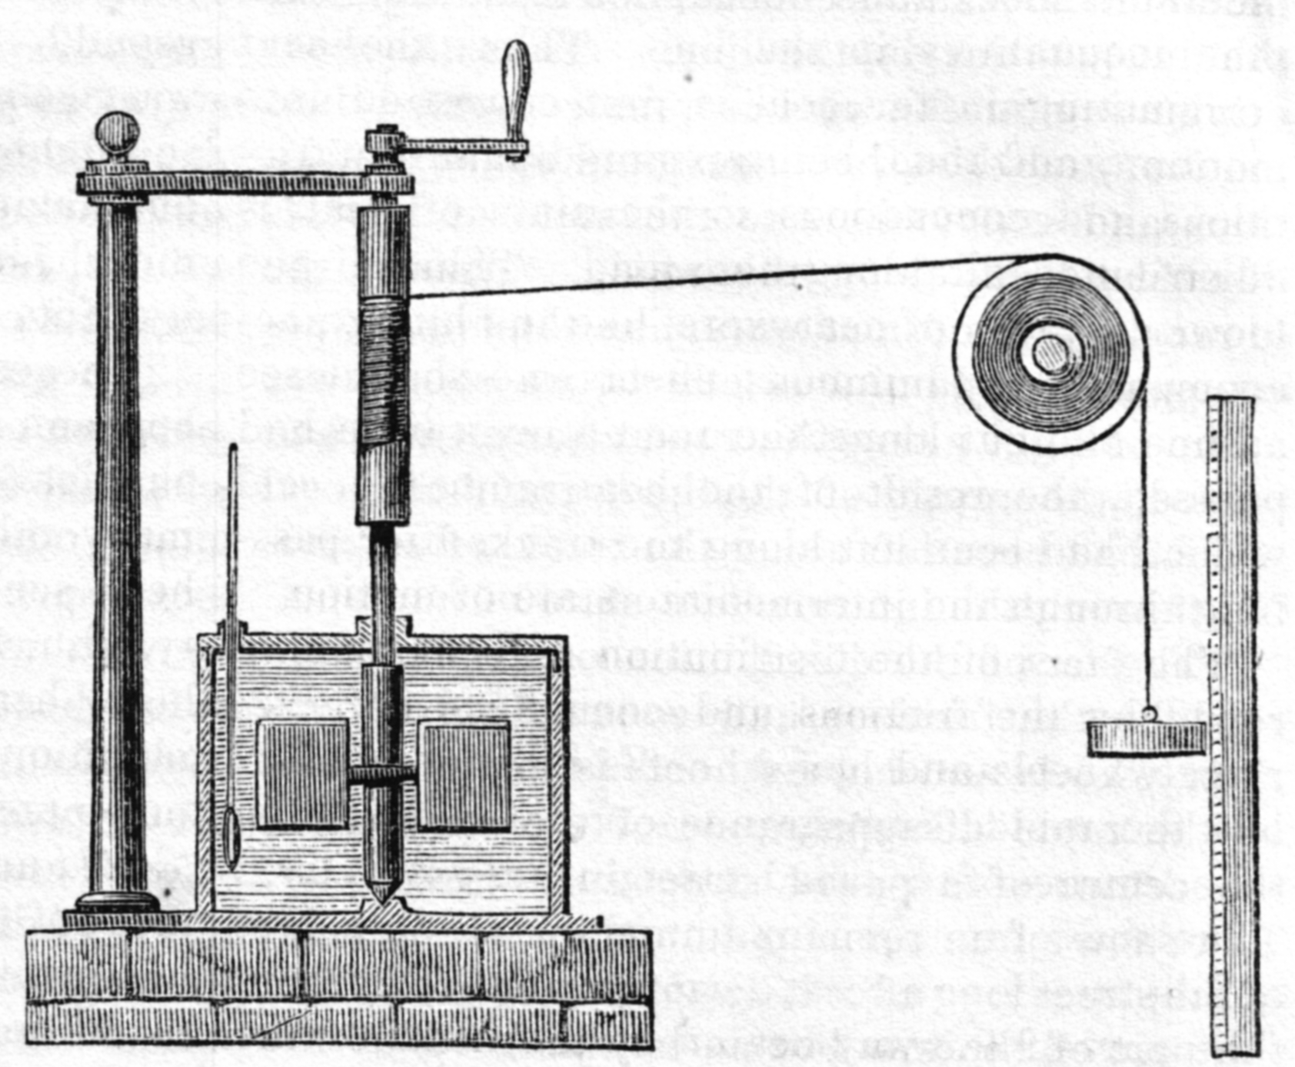

Slide 18
