Slide 1
Science Bowl Visual Bonuses
11/28

Slide 2
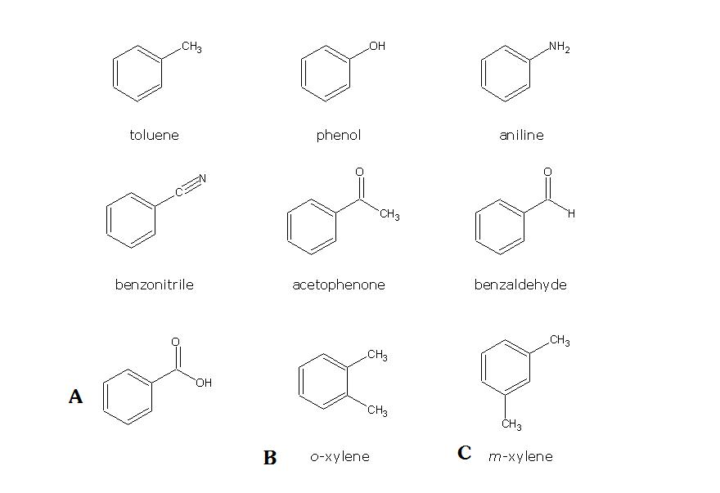

Slide 3
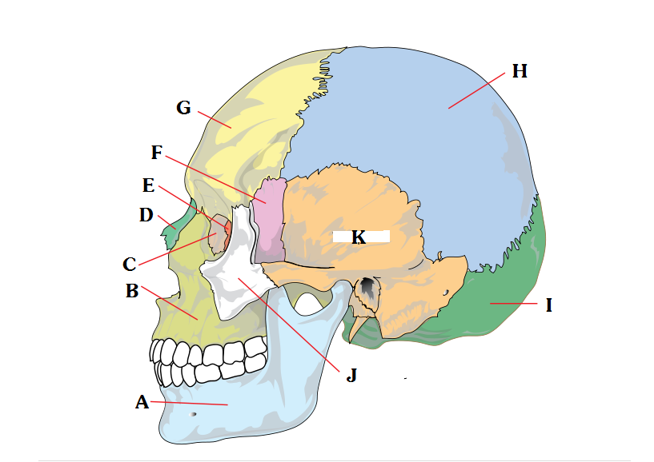


Slide 4


Slide 5
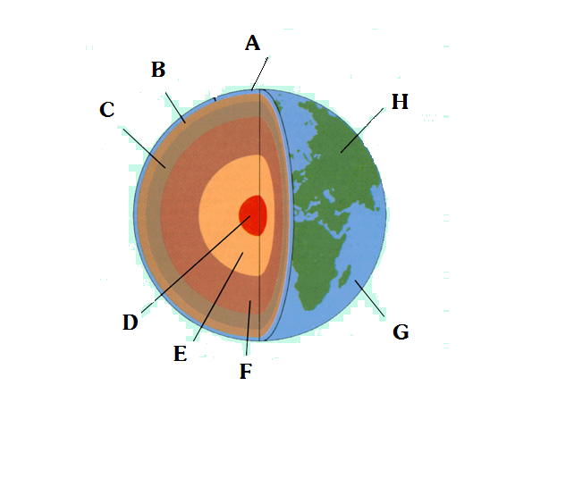

Slide 6
