Slide 1
Assorted Round 11-1 Visual Bonuses
Andrew Chen

Slide 2
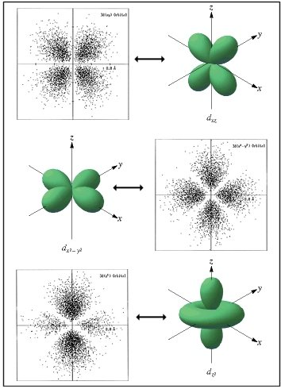

Slide 3
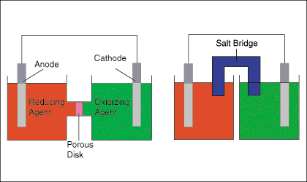

Slide 4
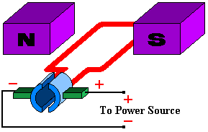
A

Slide 5
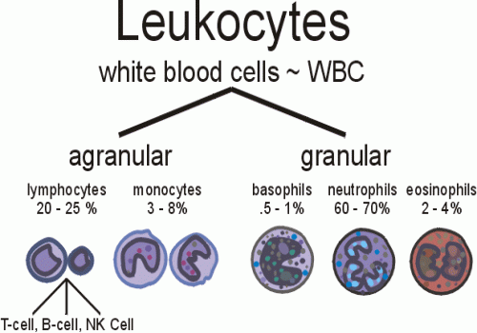
?

Slide 6
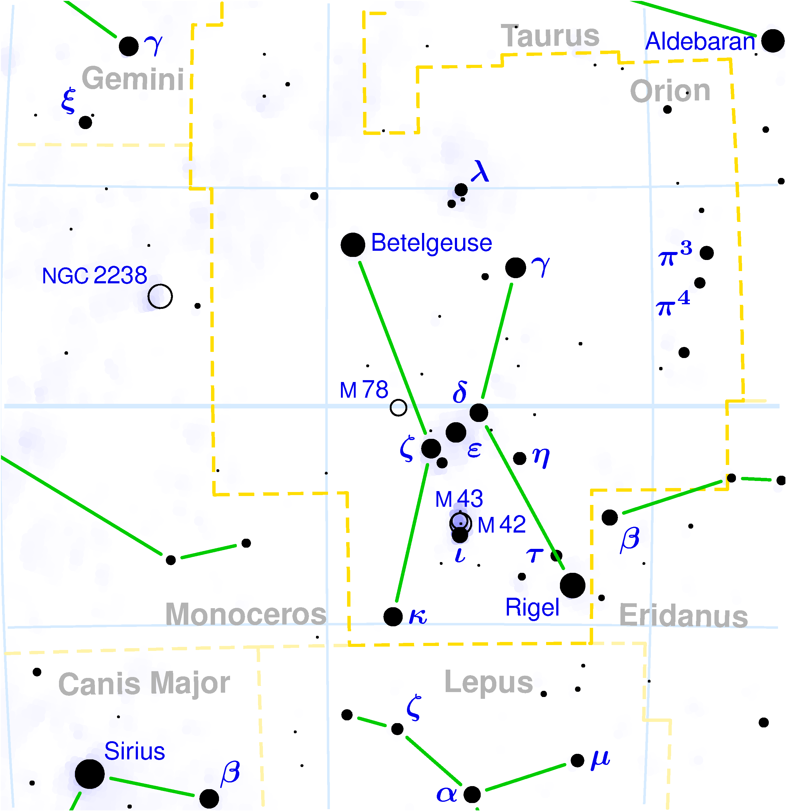

Slide 7
2 0 -1
3 1 2
1 3 0

Slide 8
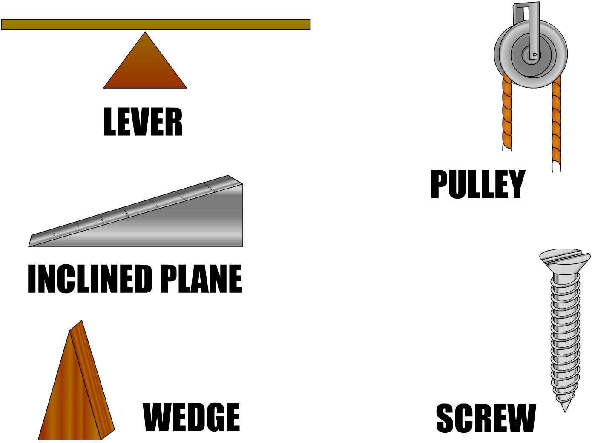
A
D
B
E
C

Slide 9
__ Fe²⁺ + __ O₂ + __ H₂O →
__ Fe₂O₃ + __ H⁺

Slide 10
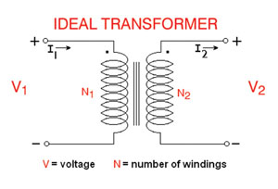

Slide 11
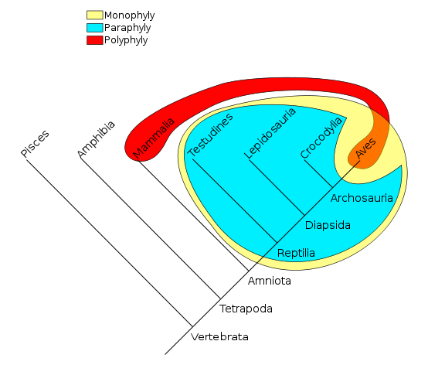

Slide 12
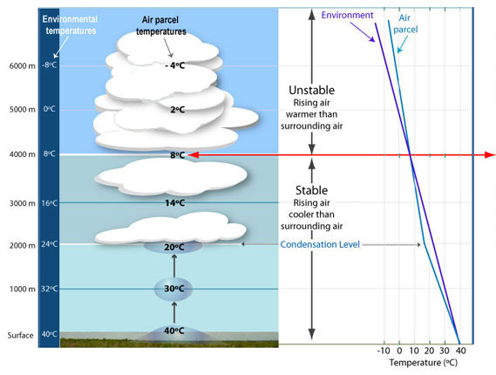

Slide 13
