Slide 1
Science Bowl Visuals
Jeffrey Baucom

Slide 2
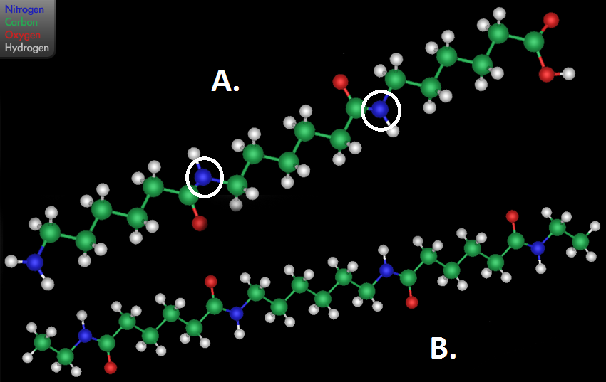

Slide 3
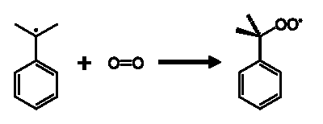
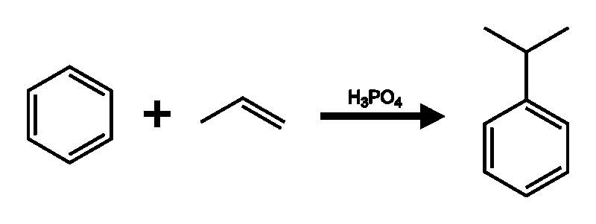


A
B
C
D

