Slide 1
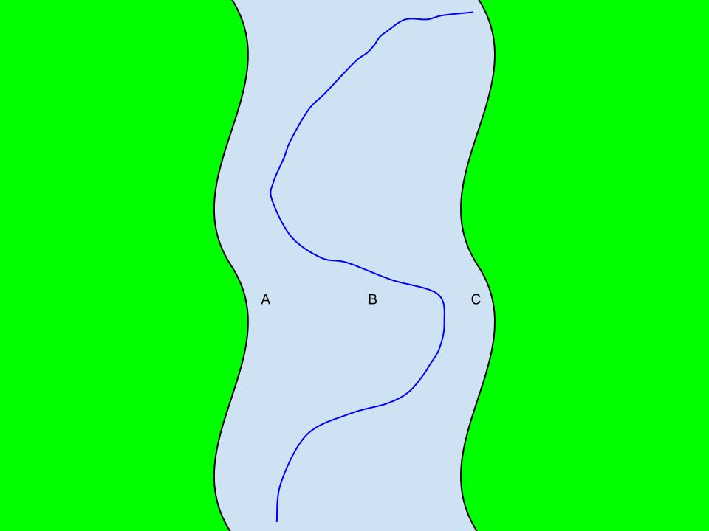
Bonus #2

Slide 2
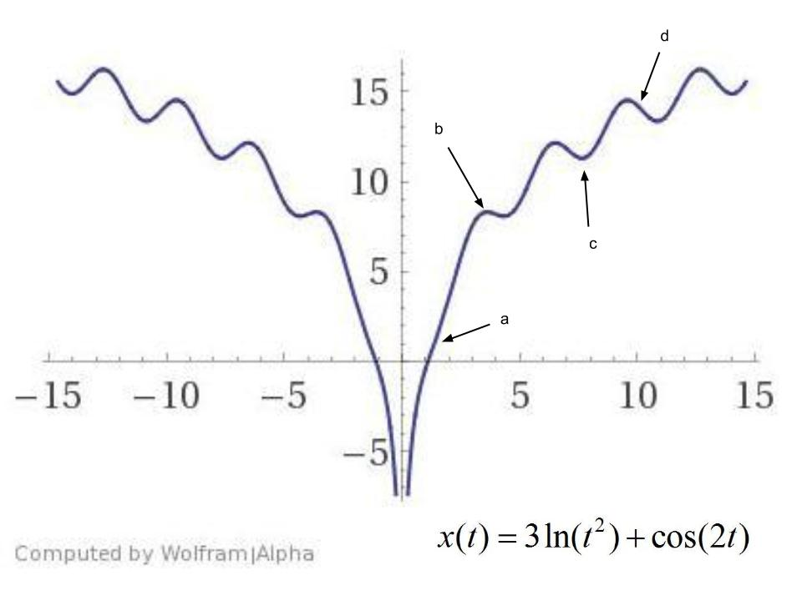
Bonus #4

Slide 3
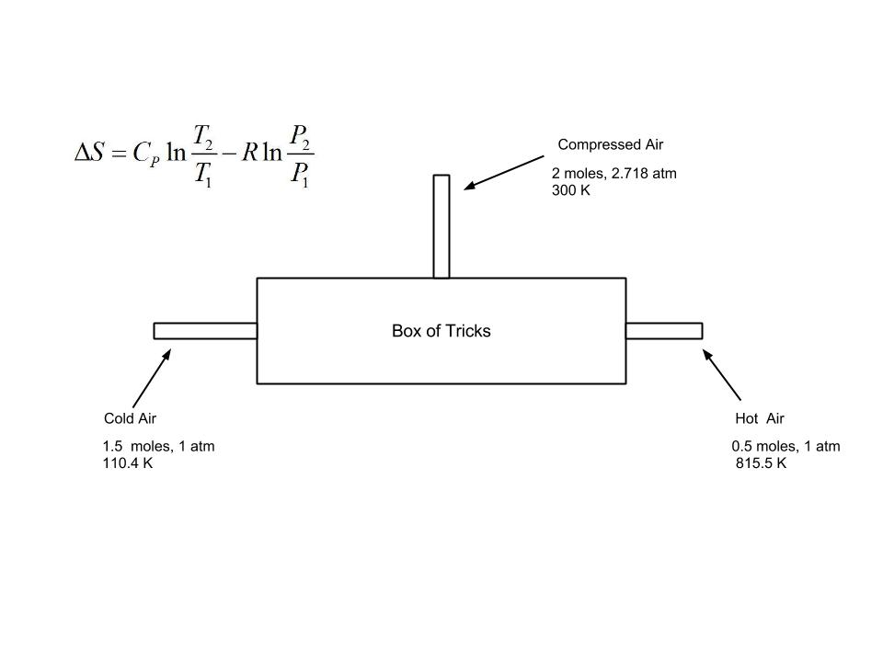
Bonus #6

Slide 4

Bonus #7

Slide 5
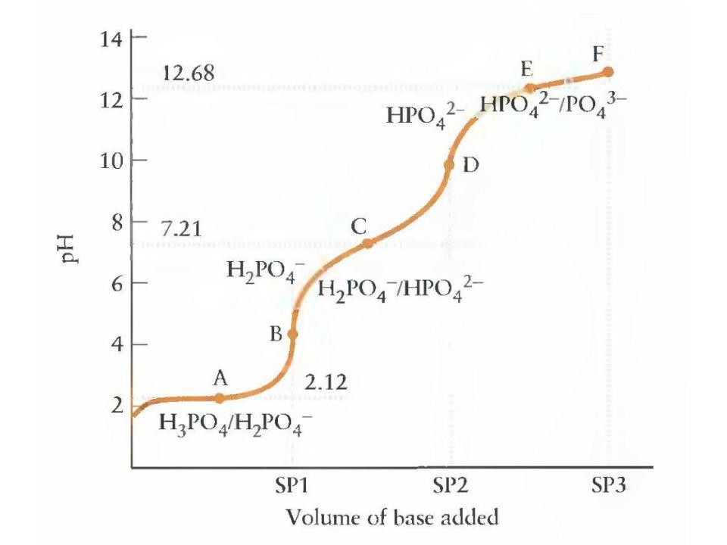
Bonus #9

Slide 6
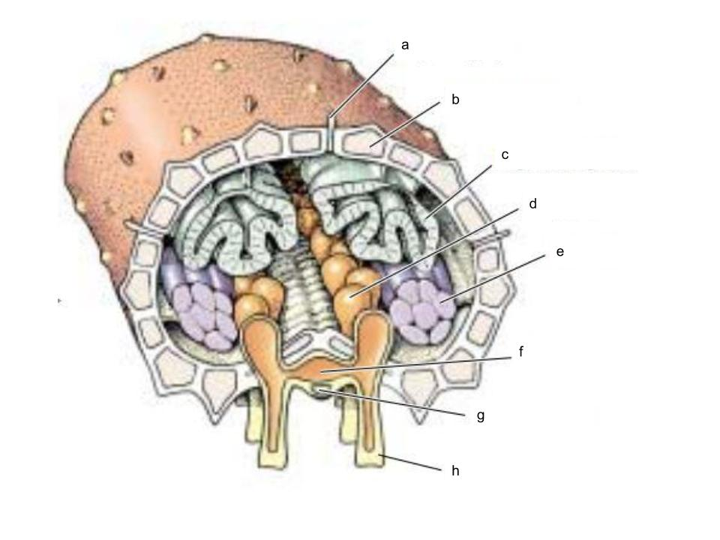
Bonus #11

Slide 7
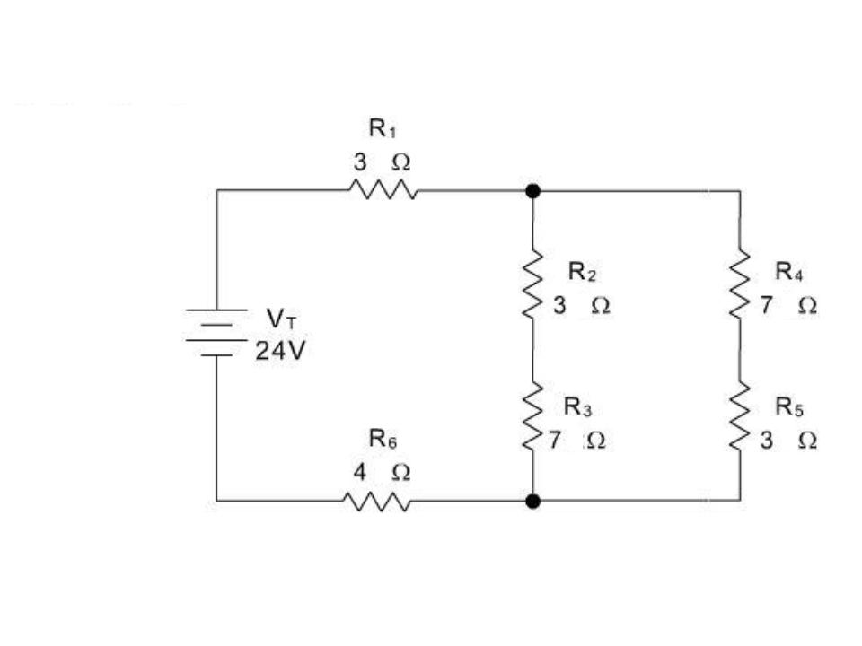
Bonus #16

Slide 8
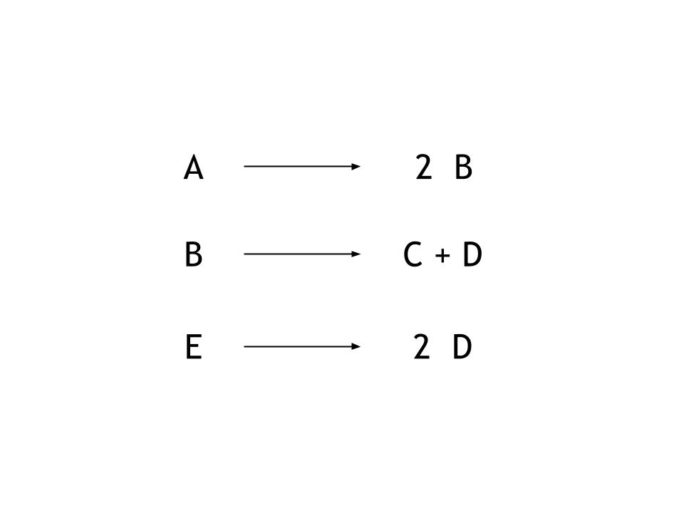
Bonus #18
1.
2.
3.

Slide 9
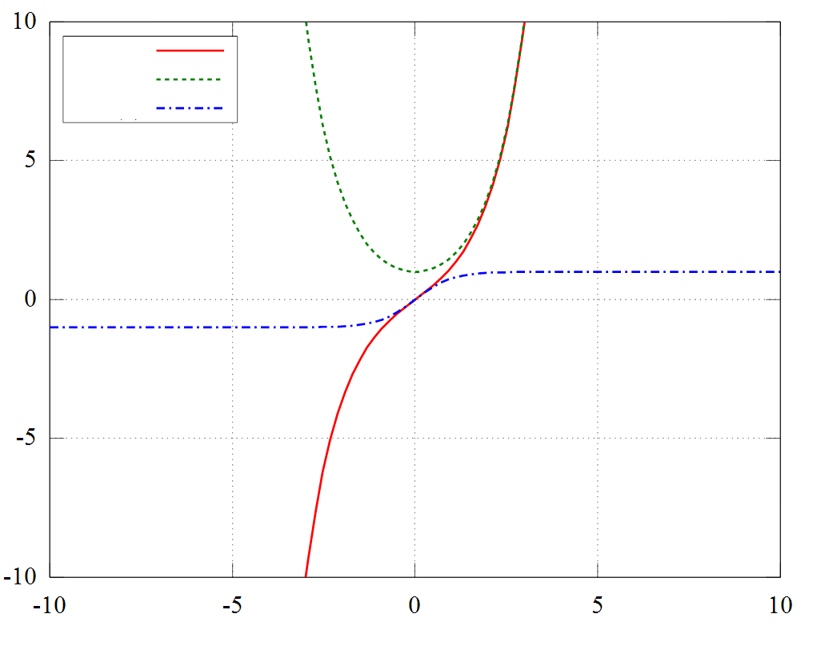
Bonus #19

Slide 10
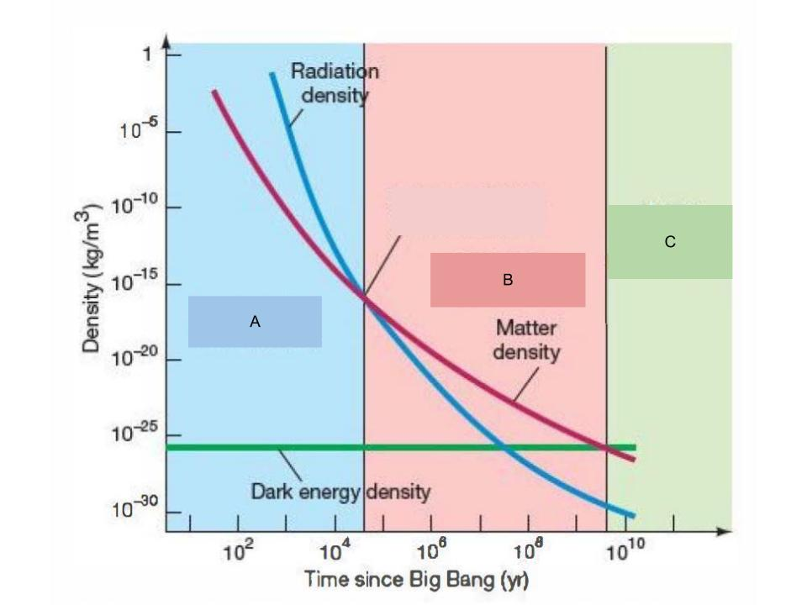
Bonus #20

Slide 11
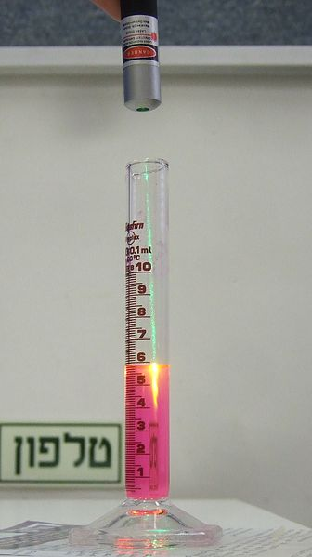
Bonus #21

