Slide 1
Obligatory Title Slide, yay
Matt Kempster

Slide 2
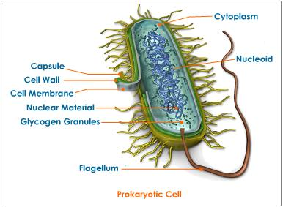
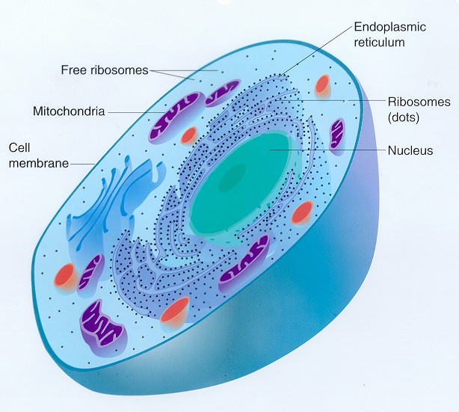
B
D
A
C
1
2

Slide 3
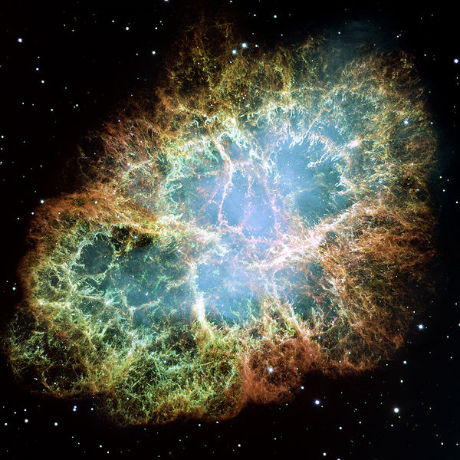
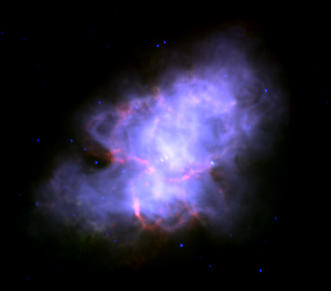
2
1

Slide 4
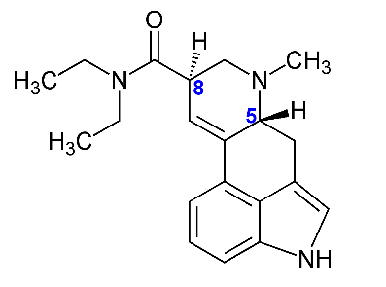

Slide 5
1
2
4
2
3
-2
3
4
-4

Slide 6
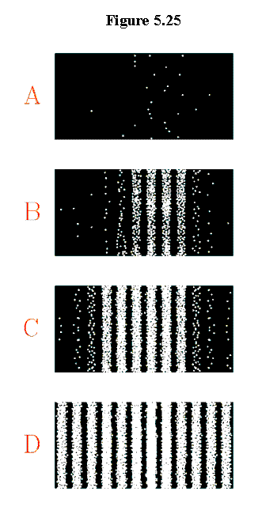


Slide 7
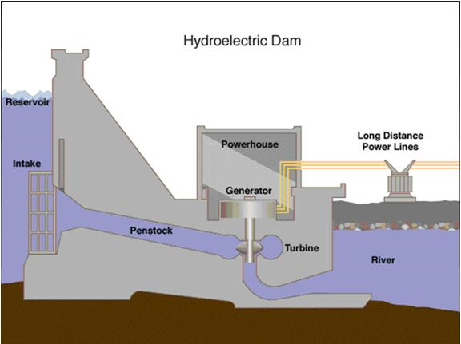
B
A

Slide 8
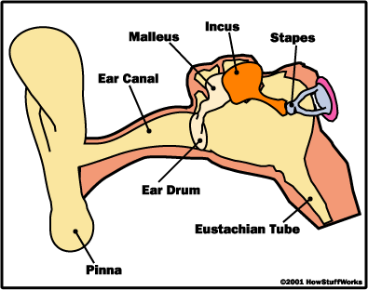
A
B
C

Slide 9
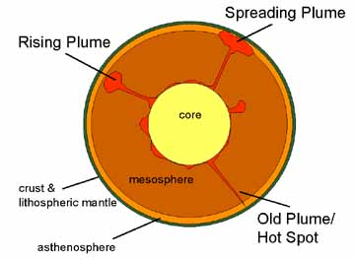
B
A
C
D

Slide 10
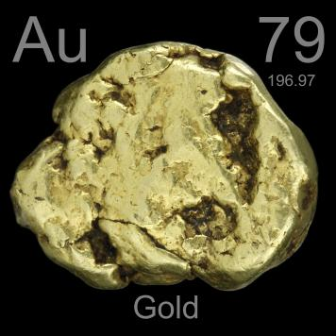
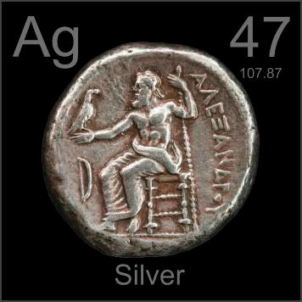
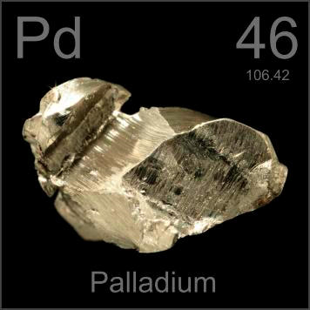
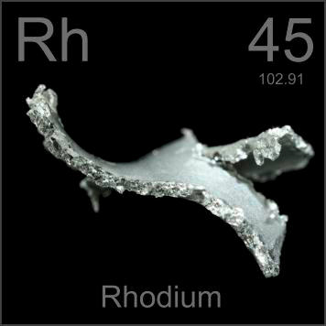
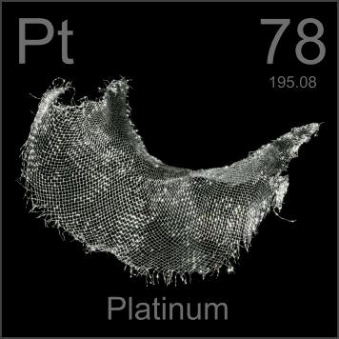
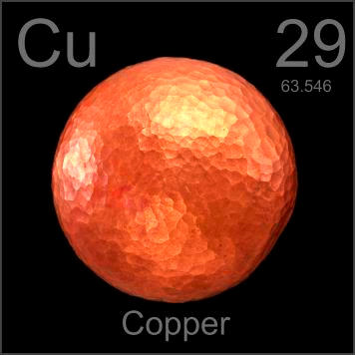

Slide 11
1, 11, 21, 1211, 111221, ______, 13112221, 1113213211, 31131211131221, 13211311123113112211, 11131221133112132113212221, 3113112221232112111312211312113211, 1321132132111213122112311311222113111221131221..

Slide 12
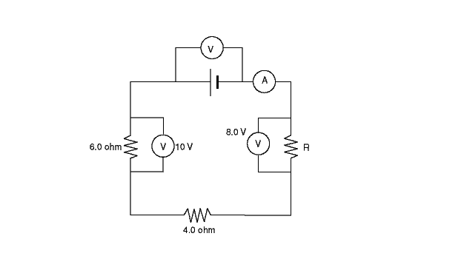

Slide 13
