Slide 1
Visual Bonuses 11/27/10
Nikhil Kotha

Slide 2
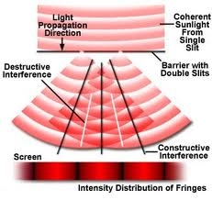
B
C
A
D
E
?

Slide 3
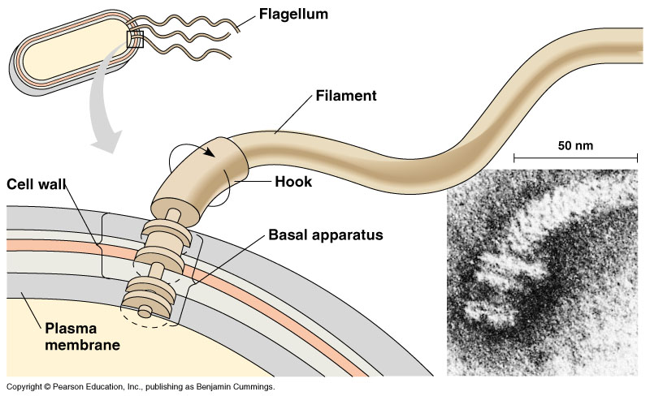
C
D
B
E
F
A

Slide 4
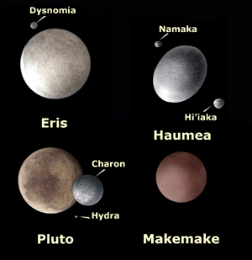
A
D
E
B
C

Slide 5
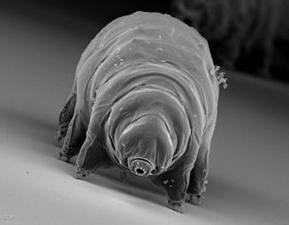
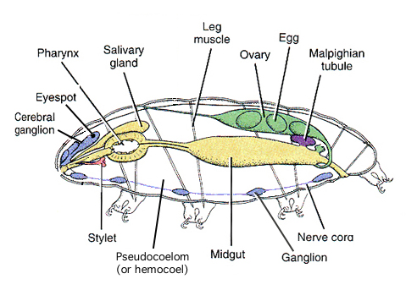
D
E
C
B
A
F

Slide 6
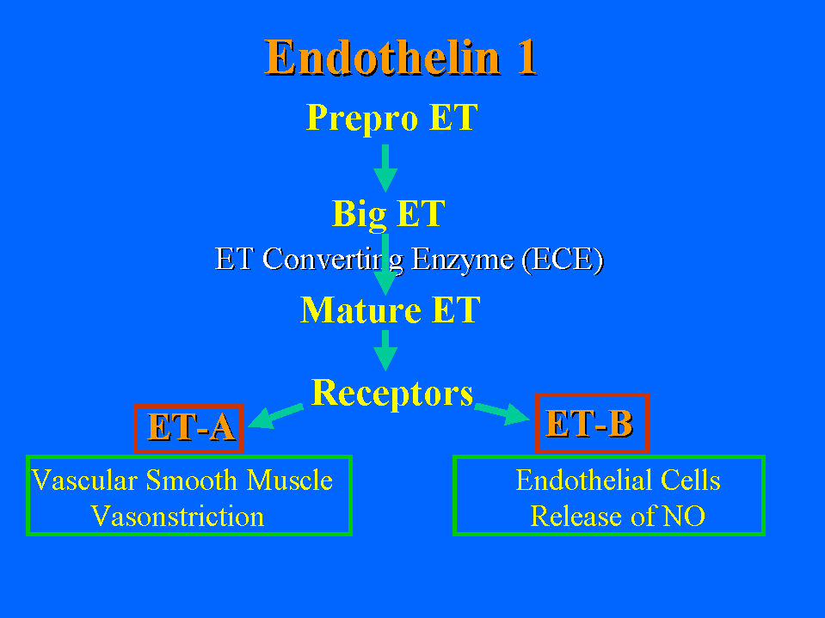
B
A

Slide 7
See attached word document for table

