Slide 2
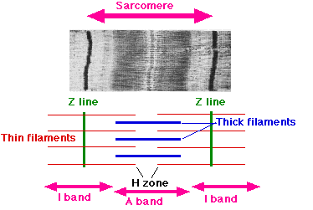
1a
1b
1a
2a
2b
2a

Slide 3
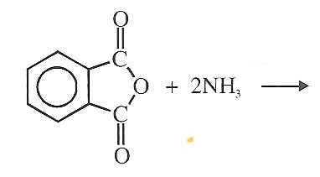

Slide 4
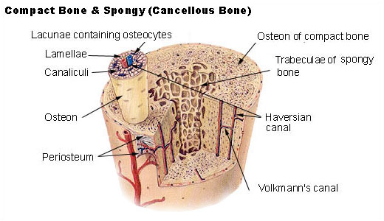
A
B
C

Slide 5


Slide 6
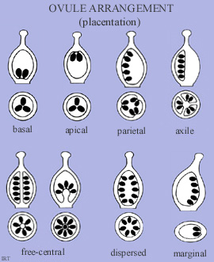
A
B
C
D
E

Slide 7
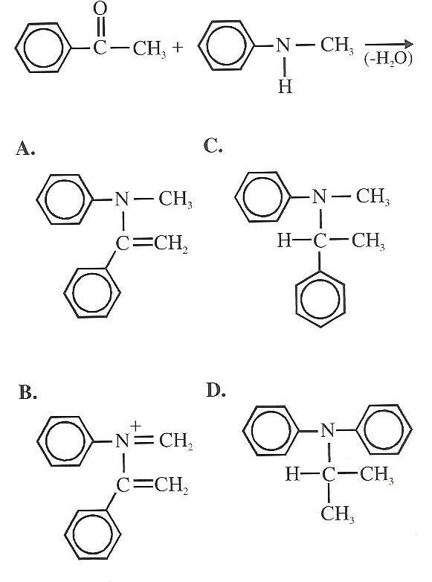
W
Y
X
Z

Slide 8
X X X X X
X X X X X
X X X X X
X X X X X
X X X X X
X X X X X
X X X X X
X X X X X
X X X X X
X X X X X
X X X X X
X X X X X
B

Slide 9
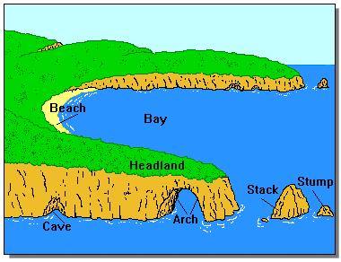
A
E
C
B
D

Slide 10
 | True Positive | True Negative
Test Positive | 2 | 18
Test Negative | 1 | 182

Slide 11
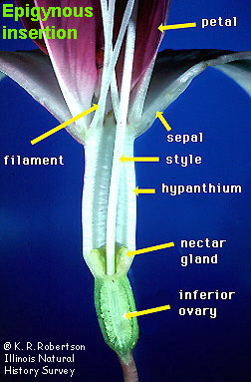
A
B

Slide 12

A

Slide 13
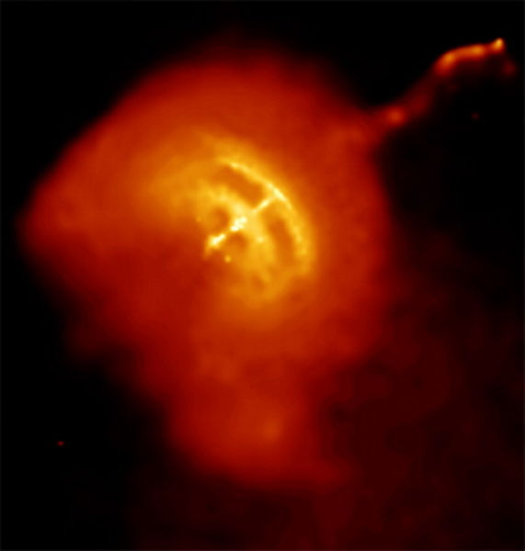

Slide 14
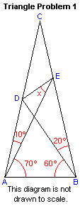

Slide 15
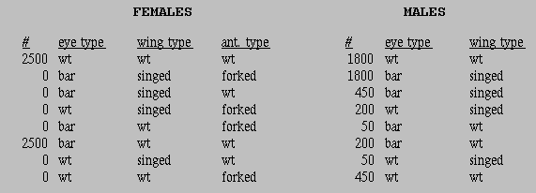
F1
Parent 1 phenotype
Parent 2 phenotype

