Slide 1
Analytical Report on Movies

Slide 2
Questions Presented
Each year, Hollywood releases vast numbers of movies to diverse audiences all over the world. Of these scores of films, only a scant few are chosen to win an Academy Award, and fewer still win the Award for Best Picture.
How might it be possible to predict in advance whether a film will win an Academy Award for Best Picture?
Is it possible to assess the quality of a movie based on its relative probability of winning an Academy Award?
Useful for film critics looking to assess the Oscar chances for the current year’s films
Useful for individuals within the Motion Picture Academy itself looking to assess the relative quality of the films presented to them for consideration as an aid in their decision-making process.

Slide 3
Initial Preparations: Getting the Data
Obtained two datasets containing both general movie data and data indicating whether films were nominated for academy awards.
The general movie dataset contains imdb data obtained from Kaggle at <https://www.kaggle.com/antoniobap/imdb-v3/data>.
The academy award data was obtained from the University of Waterloo at <https://cs.uwaterloo.ca/~s255khan/oscars.html>. All of these films had at least won an Academy Award for Best Picture.

Slide 4
Initial Preparations: Merging and Subsetting
Merged both datasets into one.
Following the merge, created two subset dataframes based on the age of the films.
The first set consisted of all movies between 1927 and 2014 inclusive (the years common to both of the original datasets).
The second set consisted only of newer movies produced from 2015-2016

Slide 5
Initial Preparations: Subsetting
The first set consisted of all movies between 1927 and 2014 inclusive (the years common to both of the original datasets).
Subset this dataset further into another set called won_movies, indicating those movies that had won a Best Picture Academy Award and received other Oscar nominations, thus allowing for a closer analysis of the characteristics of Oscar-winning movies in order to compare them to the set as a whole.

Slide 6
Initial Preparations: Subsetting
The second set consisted only of newer movies produced from 2015-2016
This set could be used for a comparison to the older movies to show how trends in filmmaking, such as budgeting and the types of movie genres commonly produced, may have changed over time.

Slide 7
Data Analysis

Slide 8
Data Analysis: Language and Country
Ran tables contrasting language and country for the older movies, won_movies and the new movies sets
Both the older and newer films were primarily English, even where they were made in other countries.
In the case of the Oscar-winning films, as shown below, all of the movies were in English and made primarily in either the US or the UK.
 | China | France | Germany | UK | Unknown | USA
English | 1 | 1 | 2 | 12 | 18 | 53

Slide 9
Data Analysis: Duration
The results for duration indicated that the average length of Oscar-winning movies was longer than the length of other movies in general
Approximately 140 minutes for Oscar-nominated movies compared to 108 and 107 minutes for older and newer movies, respectively
Duration ranged from 62-330 minutes for older movies, 65-240 minutes for Oscar-winning movies and 72-187 minutes for newer movies (2015-2016)

Slide 10
Data Analysis: Ratings
Predictably, the Oscar-winning movies were rated higher than the general population or the newer movies.
Oscar-winning movies had average and median ratings of approximately 7.8 and 8
Older movies had average and median ratings of approximately 6.4 and 6.6
Newer movies had average and median ratings of approximately 6.1 and 6.3
The Oscar-winning movies also had narrower ranges than the other sets.
5.8 to 9.2 for Oscar-winning movies—smaller range due to consistently higher ratings
1.6 to 9.3 for older movies
2.2 to 9.1 for newer movies

Slide 11
Data Analysis: Budget and Gross
Extremely large spreads in both gross and budget
Figures were not adjusted for inflation
Relationship between gross and budget is more important here

Slide 12
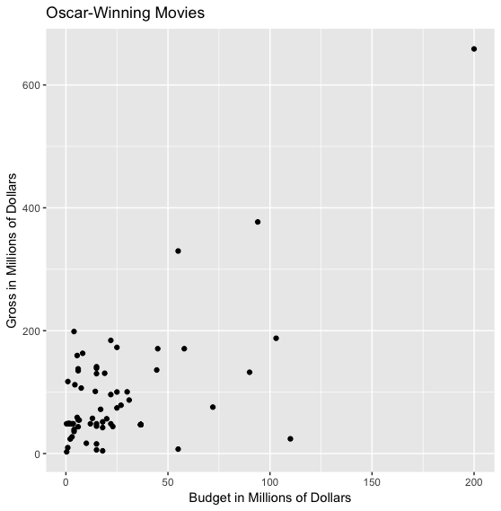
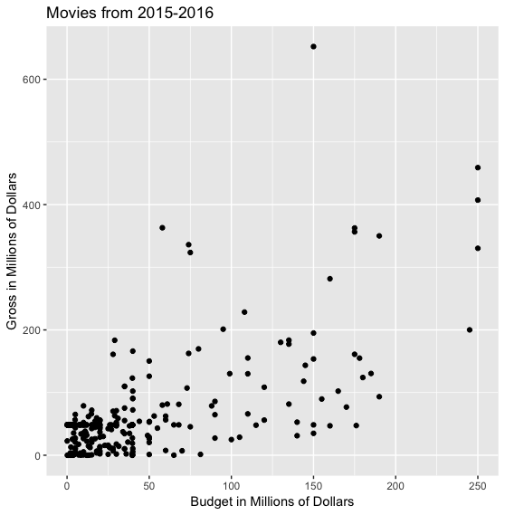
Data Analysis: Budget and Gross—Correlation Charts
The Oscar-winning movies and the newer movies both displayed a fairly positive correlation between a film's budget and the amount it ultimately grossed, with correlations of 0.63 and 0.64, respectively.

Slide 13
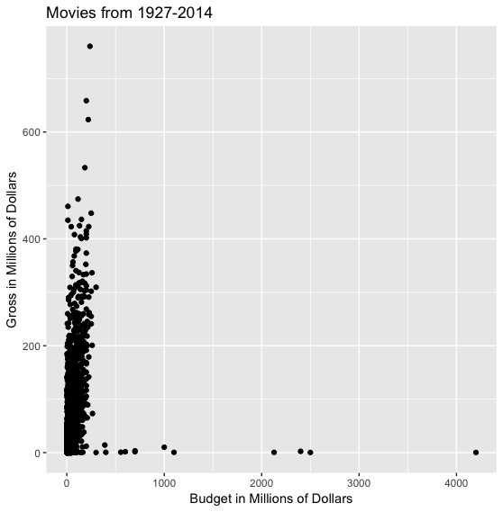
Data Analysis: Budget and Gross—Correlation Charts
The general population of older movies showed a much lower correlation between these two variables at only 0.20.
Likely due to figures not being adjusted for inflation
Possibly also due to older filmmakers stretching their dollars more

Slide 14
Data Analysis: Genres
21 total genres that were counted in each dataset: Action, Adventure, Biography, Comedy, Crime, Drama, Musical, Western, Family, Film Noir, History, Mystery, Romance, Sport, War, Fantasy, Sci Fi, Thriller, Documentary, Horror and Animation.
The most common genre in every case was Drama.
The least common genres, were Westerns for the general movie population from 1927-2014, Sci Fi, Documentary, Animation, Fantasy, Horror and Mystery for the Oscar-nominated movies and Documentary for the newer movies.

Slide 15
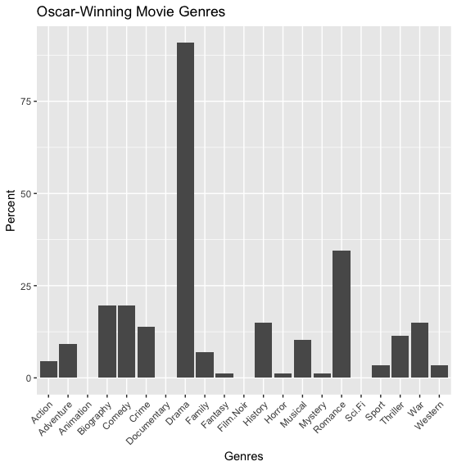
Data Analysis: Genre Distribution Charts

Slide 16
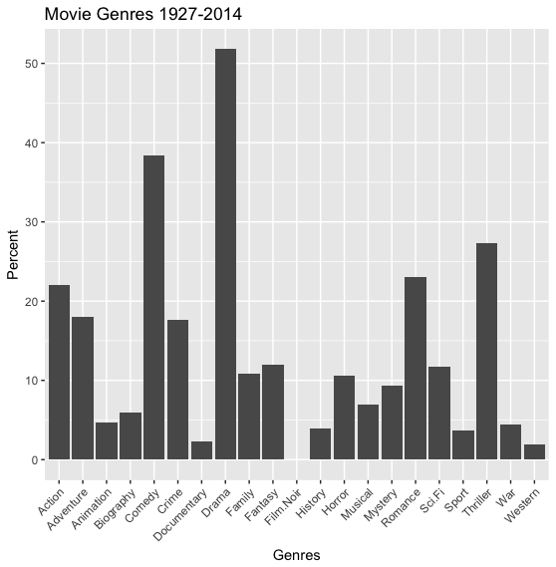
Data Analysis: Genre Distribution Charts

Slide 17
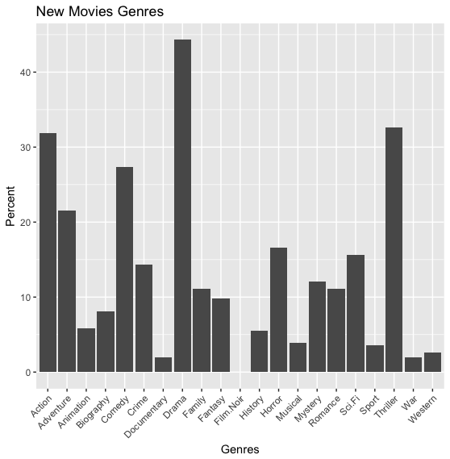
Data Analysis: Genre Distribution Charts

Slide 18
Data Analysis: Genres
As will be observed, the Oscar-winning movies are dominated primarily by Drama and Romance movies.
This is also the case for the movies from 1927-2014, but with greater representation from Comedies, Thrillers and Action and Adventure films.
The influence of changing public tastes may be seen in the New Movies, where Thrillers, Action, Adventure, Sci Fi and Horror (less conventionally “dramatic” genres) are more common than in prior years.
Additionally, Animation is a relatively new category at the Academy Awards, thus accounting for its absence from the Oscar-winning dataset.

Slide 19
Data Analysis: Directors and Actors
Most frequent Oscar-winning directors
Billy Wilder, Clint Eastwood, David Lean, Elia Kazan, Francis Ford Coppola, Frank Capra, Fred Zinnemann and Milos Forman
Most frequent directors (1927-2014)
Steven Spielberg, followed by Barry Levinson, Brian De Palma, Clint Eastwood, Joel Schumacher, Martin Scorsese, Oliver Stone, Renny Harlin, Ridley Scott, Robert Rodriguez, Robert Zemeckis, Ron Howard, Spike Lee, Steven Soderbergh, Tim Burton, Tony Scott and Woody Allen
Most frequent directors (2015-2016)
David O. Russell, James Wan, Jaume Collet-Serra, Patricia Riggen, Robert Schwentke, Roland Emmerich and Steven Spielberg

Slide 20
Data Analysis: Directors and Actors
Most frequent actors from Oscar-winning movies
Morgan Freeman, followed by Robert De Niro, Al Pacino, Anthony Hopkins, Beth Grant, Claude Rains, Clint Eastwood, Colin Firth, Jack Hawkins, John Gielgud, Judd Hirsch, Karl Malden, Kate Winslet, Leonardo DiCaprio, Marlon Brando, Meryl Streep, Oliver Reed, Ray Walston, Robert Duvall, Robert Shaw, Scoot McNairy and Susannah York
Most frequent actors (1927-2014)
Robert De Niro, followed by Bruce Willis, Matt Damon, Morgan Freeman, Nicolas Cage and Steve Buscemi
Most frequent actors (2015-2016)
Chris Hemsworth and Robert De Niro, followed by Bradley Cooper, Johnny Depp, Scarlett Johansson and Tom Hardy

Slide 21
Data Analysis: Directors and Actors
Caveats
The compiler of these datasets did not always include the most important actors in a given film.
Left out Arnold Schwarzenegger and Sharon Stone from "Total Recall”
May also account for the presence of actors here such as "Scoot McNairy" in the Oscar-winning dataset
Thus, the actors variables may have limited predictive utility for those films that included lesser-known actors at the expense of omitting the main actors, although this did not occur in every case.

Slide 22
Data Analysis: Summary
It appears that a number of factors characterize successful potentially Oscar-winning movies.
Drama films made in English in either the US or UK
moderately long (approximately two to two and a half hours in length)
high imdb ratings (greater than 7/10)
relatively large budgets and high box office values (budgets not much greater than $100 million and grossing not much more than $200 million).
While the caliber of directors and actors involved in a film's production may be persuasive evidence that a movie will turn out to be successful, it is not determinative.
Accordingly, variables such as duration, language, country, rating, budget, gross and the genre variables should be used as predictor variables when attempting to make predictions as to whether a film is likely to win an Academy Award for Best Picture.

Slide 23
Regression Analysis

Slide 24
Regression Analysis: Constructing a Model
United the previously divided datasets (based on the year the films were released) into a single dataset called all_movies.
Transformed the nominations variable into a binary “Yes/No” variable, since all positive hits here were for movies that won the Best Picture Oscar.
Divided this set again for training and testing purposes.
80% of all_movies became a training subset called movies_train, while the remaining 20% was set aside as the testing set called movies_test.

Slide 25
Regression Analysis: Constructing a Model
Created a number of preliminary models with different combinations of predictor variables and assessed each one to determine which was optimal.
Variables of primary significance were duration (length of a film measured in minutes), gross, rating (a film's imdb rating, on a scale of 1 to 10, with 10 being the highest) and the genre variables

Slide 26
Regression Analysis: Constructing a Model
Two models proved to be the strongest
The first model, called movies.mod7, included duration, gross, rating, the genre variables as well as a language variable (indicating the language in which the movie was made).
Forward step model (called fwd_model) ultimately chose as predictor variables rating, country, duration, budget, gross, country (the country in which the film was produced), and the genre variables Drama, Mystery, Sci.Fi, Animation, Romance, Fantasy, Documentary, Horror, War and Family.

Slide 27
Regression Analysis: Evaluating the Models
After running the models on the training set, the predict functions on both models were run over the test set with an initial threshold of .5 (the point above where a positive hit for an Oscar win may be said to lie).
ROC curves plotting the model’s sensitivity vs. false positive rate (1 - specificity) showed the models’ overall accuracy and gave optimal thresholds for each.
The following ROC plots show ROC curves for movies.mod7 and fwd_model, respectively.

Slide 28
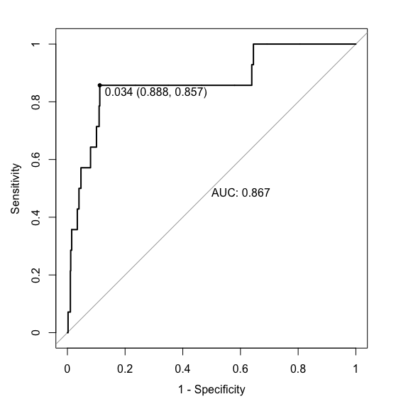
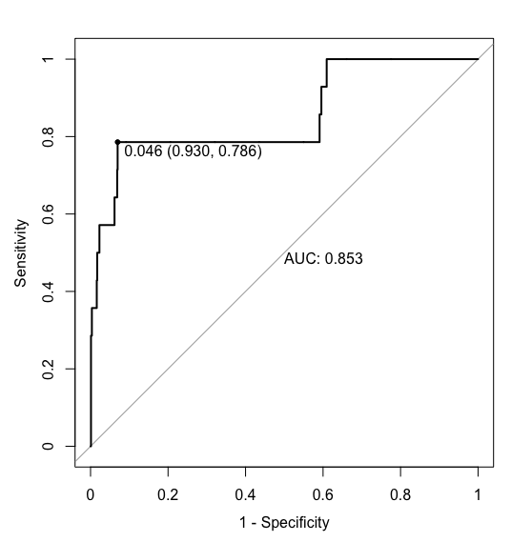
Regression Analysis: Evaluating the Models

Slide 29
Regression Analysis: Evaluating the Models
The optimal thresholds were shown to be 0.034 and 0.046 with Areas Under the Curve (AUC) of 0.867 and 0.853, respectively, thus showing a lower AUC under the test set for fwd_model.
Ran the predictions using these new optimal thresholds for both models (first movies.mod7, then fwd_model) to produce the following matrices comparing predictions to the actual “Yes/No” value for the nominations variable

Slide 30
Regression Analysis: Evaluating the Models
movies.mod7 | No | Yes
No | 774 | 2
Yes | 99 | 12
fwd_model | No | Yes
No | 812 | 4
Yes | 61 | 10

Slide 31
Regression Analysis: Evaluating the Models
For movies.mod7 there was a Sensitivity (True Positive rate) of 85.7%, a Specificity (True Negative rate) of 88.7%, a False Negative rate of 14.3% and a False Positive rate of 11.3%
For fwd_model there was a Sensitivity of 71.4%, a Specificity of 93.0%, a False Negative rate of 28.6% and a False Positive rate of 7.0%.
Movies.mod7 had a higher Sensitivity and lower False Negative rate than fwd_model.
For this reason it was ultimately chosen to be applied to make predictions on specific movies in the dataset.

Slide 32
Regression Analysis: Applying the Model
Two films were chosen from the dataset that both had equal values for rating in order to control for the strength of the rating variable by itself.
"The Artist”
"Casino Royale”
Both films had imdb ratings of 8, just above the average rating of 7.8 for Oscar-winning films.
Applied movies.mod7 to the predict function for both films

Slide 33
Regression Analysis: Applying the Model
Prediction probability output:
"The Artist" has a much higher likelihood of winning (approximately 14.5% vs. 3.8%, with very small standard errors)
This model correctly predicted that "The Artist" would win a Best Picture Oscar
The model was also able to make (or at least confirm) a "subjective" assessment as to the quality of both films, if such quality can be measured by the relative probability of winning a Best Picture Oscar and by the other awards won by each film
As revealed by the imdb profile for both films, "The Artist" actually won the Best Picture Oscar for 2012, but "Casino Royale” did not.
Name | Fit | SE.Fit | Rating
The Artist | 0.14514413 | 0.05291039 | 8
Casino Royale | 0.03848228 | 0.03382990 | 8

Slide 34
Regression Analysis: Applying the Model
Given the low predictive threshold of .034 used here, this model’s higher sensitivity and higher false positive rate resulted in a False Positive error in incorrectly predicting that "Casino Royale" would also win a Best Picture Oscar, although this error was very small.
The probability that "Casino Royale" would win was approximately 3.8%, while the prediction threshold used here was 3.4%.
Over the threshold by less than 1%.

Slide 35
Regression Analysis: Applying the Model
Another explanation for the False Positive error is that certain key predictor variables had values for "Casino Royale" that were more characteristic of Oscar-winning films.
Duration for "Casino Royale" was 144 minutes, just slightly above the average of 140 minutes for Oscar-winning films.
Higher false positive rate is a necessary trade-off when using a higher sensitivity model
Therefore, this model appears to be accurate on the whole, but may be overly sensitive where a particular film has values close to characteristic values for Oscar-winning films for one or more strong predictor variables.

Slide 36
Concluding Remarks and Recommendations

Slide 37
Areas for Further Investigation
Financial variables adjusted for inflation
Improved actor data
The three actors listed for any given film would all be principal actors in the film
Use the director and actor variables on a subset of the overall movies dataset that looks only at the most frequently appearing directors and actors over a particular span of years.
Parse out the most frequent of the plot keywords for use as predictor variables

Slide 38
Recommendations for Use
Look up the film on www.imdb.com and obtain the following pieces of information:
The film's imdb rating,
Its length in minutes,
The amount in dollars the film grossed at the box office
The language in which the film was made
All of the film's genre categories:
Action, Adventure, Biography, Comedy, Crime, Drama, Musical, Western, Family, History, Mystery, Romance, Sport, War, Fantasy, Sci.Fi, Thriller, Documentary, Horror or Animation

Slide 39
Recommendations for Use
Construct a dataframe with each one of these pieces of information as a single column
Use the following template code to accomplish this, filling in the appropriate values within the parentheses following the c after each variable:
new_movie_data <- data.frame(duration = c(), rating = c(), gross = c(), language = c(), Action = c(), Adventure = c(), Biography = c(), Comedy = c(), Crime = c(), Drama = c(), Musical = c(), Western = c(), Family = c(), History = c(), Mystery = c(), Romance = c(), Sport = c(), War = c(), Fantasy = c(), Sci.Fi = c(), Thriller = c(), Documentary = c(), Horror = c(), Animation = c())

Slide 40
Recommendations for Use
Run the predict function over this dataframe using the movies.mod7 model
Use the following code to run the predict function: predict(movies.mod7, newdata = new_movie_data, type = “response”)
The output will be a decimal value indicating the probability that the film in question will win an Academy Award for Best Picture.
If this number is greater than the threshold value chosen in advance (in the preceding example, the optimal threshold was found to be .034), this indicates that the movie in question is likely to win a Best Picture Oscar.

Slide 41
Recommendations for Use
If the same information for two or more movies are inserted into the dataframe, the movies may be compared as to their relative probabilities of winning a Best Picture Oscar.
Therefore, using this model as suggested it may be possible to predict in advance whether a film will win an Academy Award for Best Picture and to assess its relative quality.

Slide 42
Questions?

