Slide 1
Image Recognition Analysis

Slide 2
Questions Presented
Can we utilize machine learning to correctly identify images by training on pre-labeled images that were previously labeled by a different machine?
In other words, can machines teach machines to recognize images?

Slide 3
Initial Preparations: Getting the Data
Data obtained from Open Images Dataset V4 located at https://storage.googleapis.com/openimages/web/download.html.
Full set consists of 9,178,275 images with 19,995 classes.
Smaller subset of data consisting of 1,743,042 training images with 601 classes.

Slide 4
Initial Preparations: Simplifying and Merging the Data
Need to simplify data due to hardware limitations.
Get Machine Confidence level from larger set, but still use smaller subset
Solution: Merge smaller and larger dataframes on ImageID and LabelName.

Slide 5
Initial Preparations: Simplifying and Merging the Data
Create column of English labels from dictionary equating labels to class names
Ensure good level of confidence in labels by having Human_Confidence = 1 (certain)
Remove duplicate ImageId’s from dataframe
simplify problem to single-label image classification
End result: reduced and simplified dataset
959,927 images
512 unique ClassNames (label names)

Slide 6
Exploratory Data Analysis

Slide 7
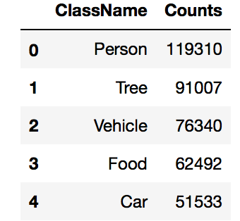
Data Analysis: Labels
512 unique class names
Took counts of each
Top 5 Highest Counts:

Slide 8
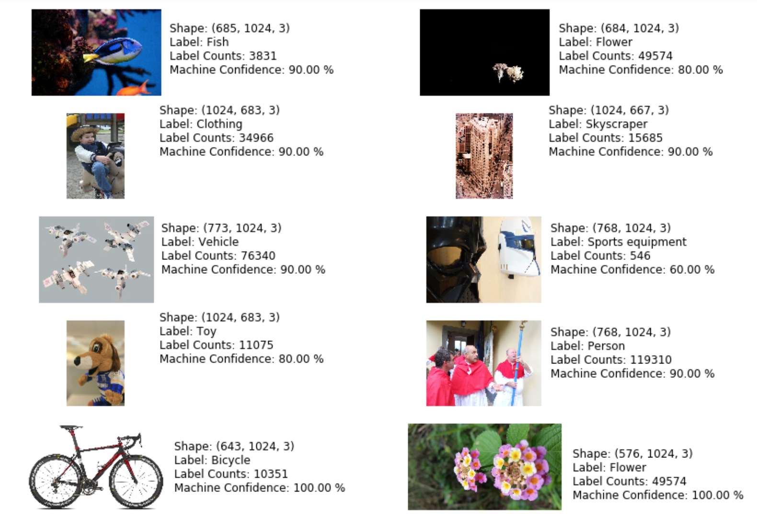
Data Analysis: Labels and Images
10 random images were drawn:

Slide 9
Data Analysis: Labels and Images
Image shapes, labels, label frequencies and machine confidence levels shown for each sample image
Machine confidence: Percent confidence machine had in applying label
Lowest frequency label was "Sports equipment" at 546 instances in the dataset—lowest machine confidence
Masks are Star Wars-themed masks, not sports masks
Generic labels use sometimes, but labels appear accurate overall
Images labeled “Clothing”, “Vehicle” and “Toy”

Slide 10
Data Analysis: Labels and Images

Slide 11
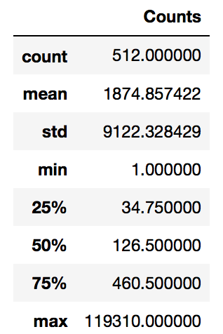
Data Analysis: Label Frequency Statistics
Statistics of Label Frequencies
Large maximum compared to the third quartile and the large standard deviation of the counts (approximately 9,122)
I looked at the median value of 126.5, rather than at the mean value

Slide 12
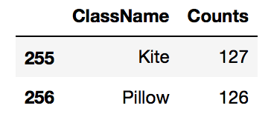
Data Analysis: Label Frequency Statistics
Corresponding labels that had counts of 126 and 127.
"Pillow" had a count of 126
"Kite" had a count of 127
Labels/ClassNames with the median (50%) frequencies.

Slide 13
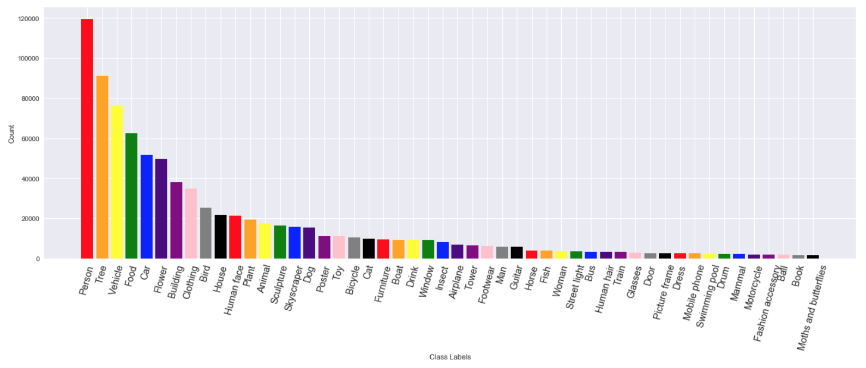
Data Analysis: Label Count Distribution—Top 50 Labels

Slide 14
Data Analysis: Label Count Distribution—Top 50 Labels
Plotted top 50 most frequent ClassNames
"Person" was by far the most frequent term, followed by "Tree" and "Vehicle”.
Counts fall off fairly rapidly after the top 6-8
All labels after "Bird" appear 20,000 or less times in the dataset.

Slide 15
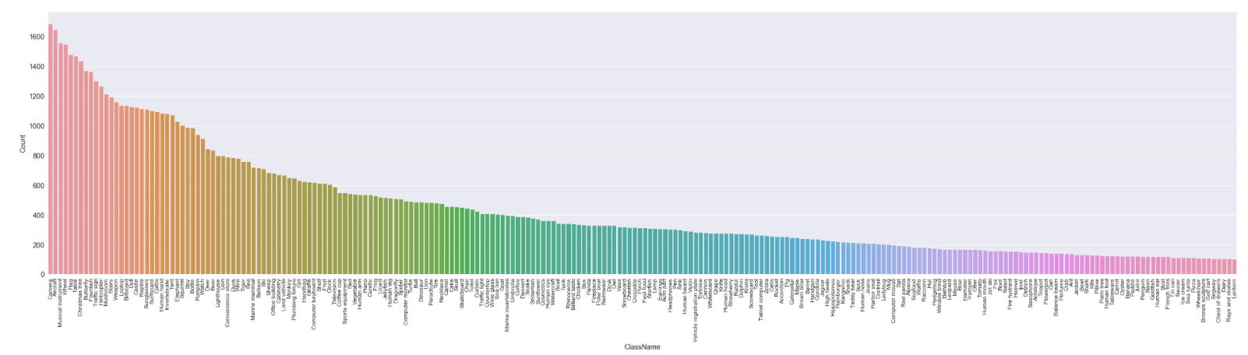
Data Analysis: Label Counts Over 100--Distribution

Slide 16
Data Analysis: Label Counts Over 100--Distribution
Smoother decline in label frequencies over a wide variety of different types of labels, as also indicated by the much smaller standard deviation of 359.75.

Slide 17
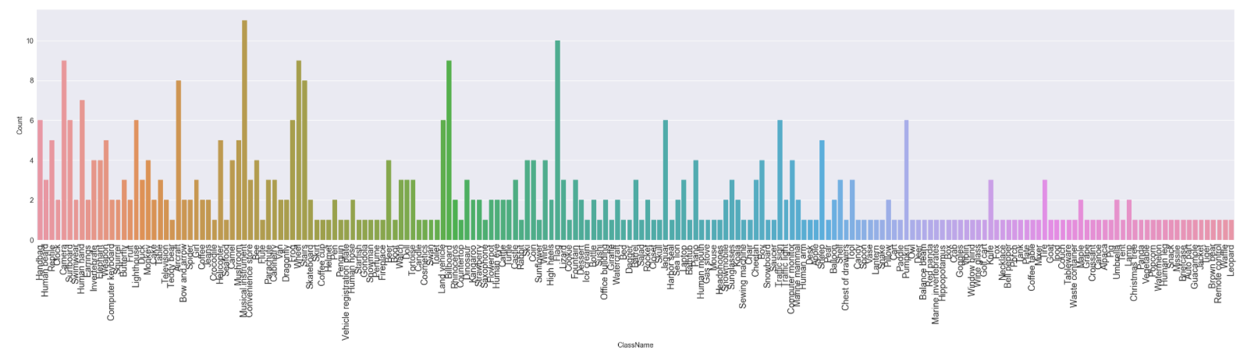
Data Analysis: Counts--Every 250 Labels--Distribution

Slide 18
Data Analysis: Counts--Every 250 Labels--Distribution
Choppy distribution of ClassName counts, over a much smaller range
No count much greater than 10.

Slide 19
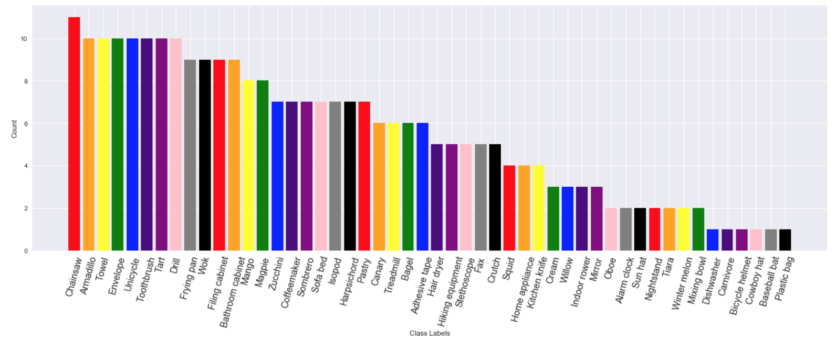
Data Analysis: Bottom 50 Label Counts--Distribution

Slide 20
Data Analysis: Bottom 50 Label Counts--Distribution
Plotted bottom 50 least frequent ClassNames.
None had a count much greater than 10.
Least frequent labels (at only one each):
"Cowboy hat", "Dishwasher", "Plastic bag", "Bicycle helmet", "Baseball bat" and "Carnivore”

Slide 21
Questions?

