Slide 1
Image Recognition Analysis

Slide 2
Questions Presented
Can we utilize machine learning to correctly identify images by training on pre-labeled images that were previously labeled by a different machine?
In other words, can machines teach machines to recognize images?

Slide 3
Initial Preparations: Getting the Data
Data obtained from Open Images Dataset V4 located at https://storage.googleapis.com/openimages/web/download.html.
Full set consists of 9,178,275 images with 19,995 classes.
Smaller subset of data consisting of 1,743,042 training images with 601 classes.

Slide 4
Initial Preparations: Simplifying and Merging the Data
Need to simplify data due to hardware limitations.
Get Machine Confidence level from larger set, but still use smaller subset
Solution: Merge smaller and larger dataframes on ImageID and LabelName.

Slide 5
Initial Preparations: Simplifying and Merging the Data
Create column of English labels from dictionary equating labels to class names
Ensure good level of confidence in labels by having Human_Confidence = 1 (certain)
Remove duplicate ImageId’s from dataframe
simplify problem to single-label image classification
End result: reduced and simplified dataset
959,927 images
512 unique ClassNames (label names)

Slide 6
Exploratory Data Analysis

Slide 7
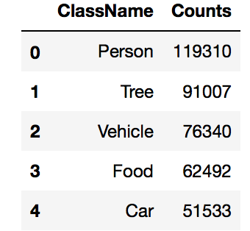
Data Analysis: Labels
512 unique class names
Took counts of each
Top 5 Highest Counts:

Slide 8
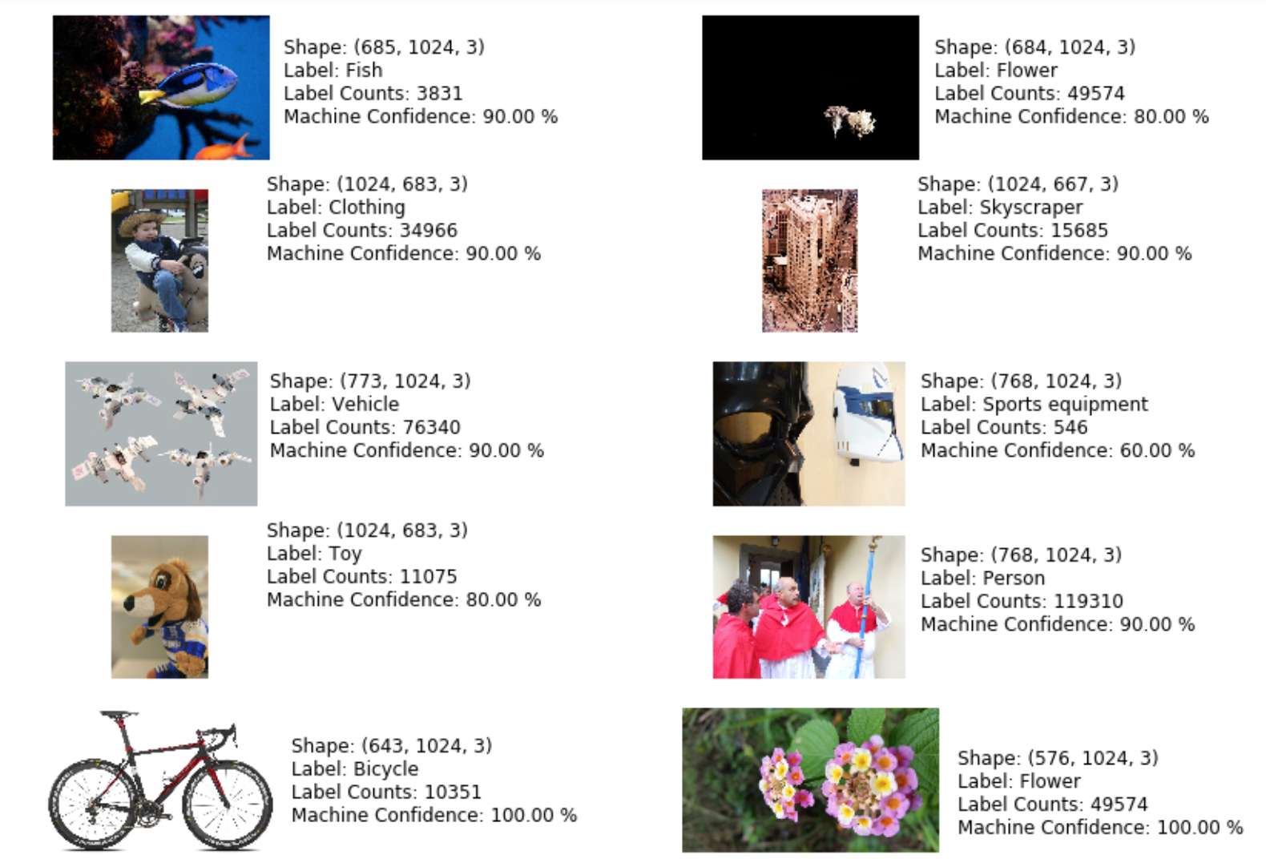
Data Analysis: Labels and Images
10 random images were drawn:

Slide 9
Data Analysis: Labels and Images
Image shapes, labels, label frequencies and machine confidence levels shown for each sample image
Machine confidence: Percent confidence machine had in applying label
Lowest frequency label was "Sports equipment" at 546 instances in the dataset—lowest machine confidence
Masks are Star Wars-themed masks, not sports masks
Generic labels use sometimes, but labels appear accurate overall
Images labeled “Clothing”, “Vehicle” and “Toy”

Slide 10
Data Analysis: Labels and Images

Slide 11
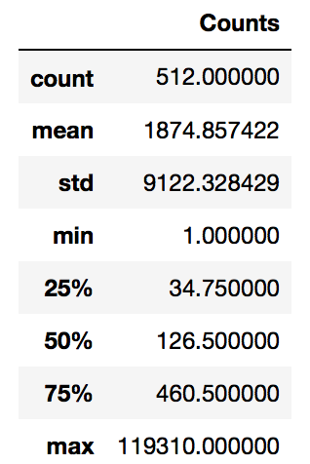
Data Analysis: Label Frequency Statistics
Statistics of Label Frequencies
Large maximum compared to the third quartile and the large standard deviation of the counts (approximately 9,122)
I looked at the median value of 126.5, rather than at the mean value

Slide 12
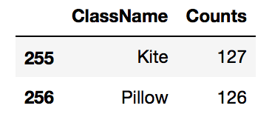
Data Analysis: Label Frequency Statistics
Corresponding labels that had counts of 126 and 127.
"Pillow" had a count of 126
"Kite" had a count of 127
Labels/ClassNames with the median (50%) frequencies.

Slide 13
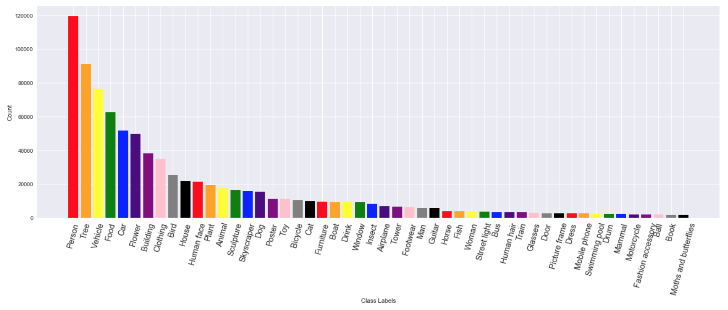
Data Analysis: Label Count Distribution—Top 50 Labels

Slide 14
Data Analysis: Label Count Distribution—Top 50 Labels
Plotted top 50 most frequent ClassNames
"Person" was by far the most frequent term, followed by "Tree" and "Vehicle”.
Counts fall off fairly rapidly after the top 6-8
All labels after "Bird" appear 20,000 or less times in the dataset.

Slide 15
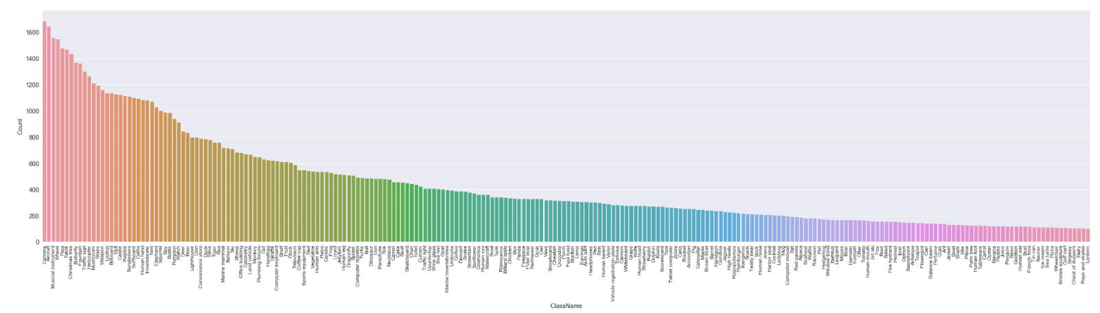
Data Analysis: Label Counts Over 100--Distribution

Slide 16
Data Analysis: Label Counts Over 100--Distribution
Smoother decline in label frequencies over a wide variety of different types of labels, as also indicated by the much smaller standard deviation of 359.75.

Slide 17
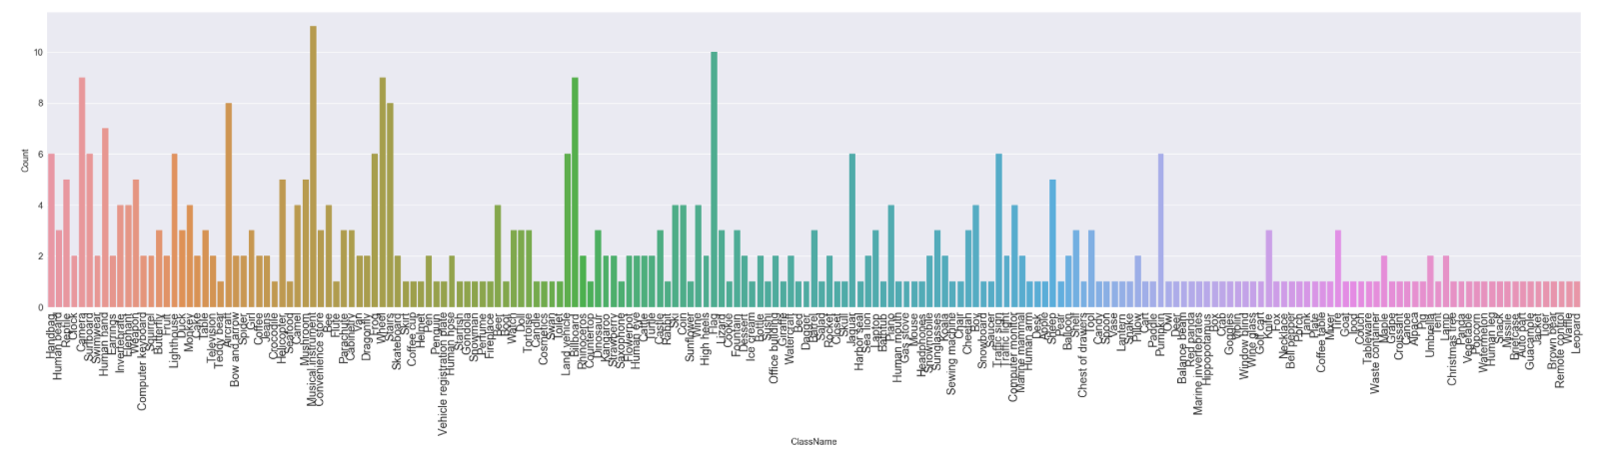
Data Analysis: Counts--Every 250 Labels--Distribution

Slide 18
Data Analysis: Counts--Every 250 Labels--Distribution
Choppy distribution of ClassName counts, over a much smaller range
No count much greater than 10.

Slide 19
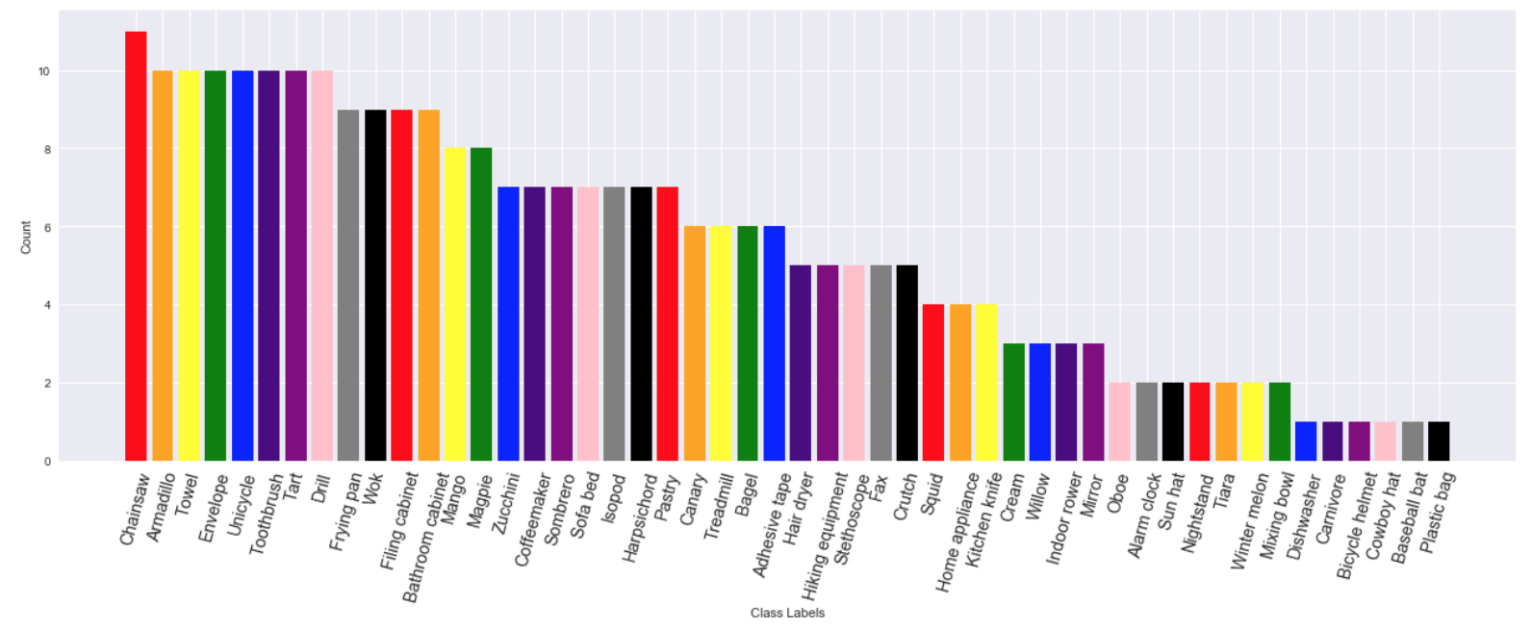
Data Analysis: Bottom 50 Label Counts--Distribution

Slide 20
Data Analysis: Bottom 50 Label Counts--Distribution
Plotted bottom 50 least frequent ClassNames.
None had a count much greater than 10.
Least frequent labels (at only one each):
"Cowboy hat", "Dishwasher", "Plastic bag", "Bicycle helmet", "Baseball bat" and "Carnivore”

Slide 21
Machine Learning

Slide 22
Machine Learning: First Attempt--VGG16
Transfer learning as best approach for greatest possible accuracy.
Adapt VGG16 model
Standard input shape of (150, 150, 3), where 3 is the number of color channels
Previously trained on the Imagenet dataset.
VGG16 base model consists of:
two 2-dimensional convolutional layers,
a max pooling layer repeated twice, followed by
three 2-dimensional convolutional layers followed by
a max pooling layer repeated three times.
Final max pooling layer had dimensions of (4, 4, 512)

Slide 23
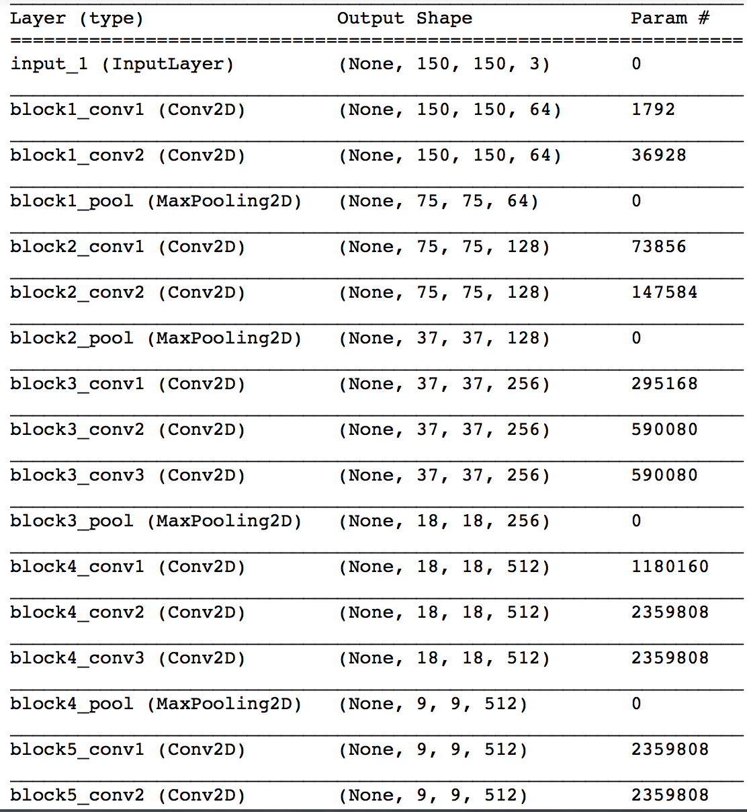
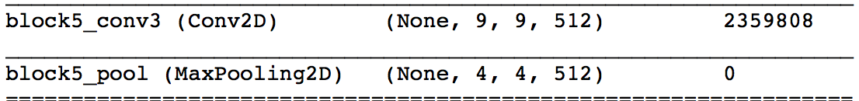
Machine Learning: VGG16

Slide 24
Machine Learning: VGG16
Created remainder of model that took in values from the pre-trained VGG16 base model.
One dense layer with 256 channels/dimensions
Using relu activation function (returns the input value itself for positive values and 0 for negative values),
Dropout layer with 50% dropout
(random disconnection of some neurons to compensate for any that may be dead/inactive)
Final dense layer using softmax activation
(limiting the final output value to between 0 and 1 for classification purposes to obtain a probability)
512 channels (one for each unique label)

Slide 25
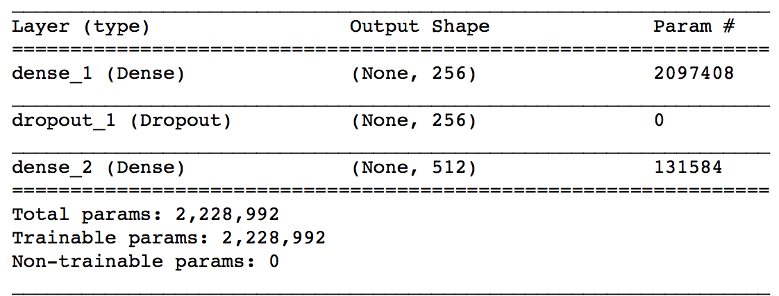
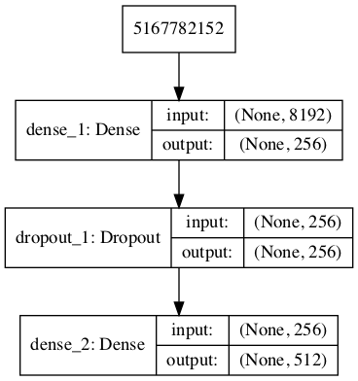
Machine Learning: VGG16

Slide 26
Machine Learning: VGG16
Compiled the model using Adam optimizer
Initial learning rate of 2e⁻⁵ (Adam uses adaptive learning rates)
Loss function defined by categorical crossentropy
Grows larger when the difference between the predicted probability and 1 is large for a given label
Set the class weights for the labels to "balanced”
Size of the class weights set in inverse proportion to the label counts for each unique ClassName
Due to the imbalanced numbers of different labels noted in the statistical analysis above

Slide 27
Machine Learning: VGG16
Training set of 5000 total images and labels
Trained the model using a 20% validation split, a batch size of 20 and 40 training epochs.
The validation accuracy was ultimately approximately 45%.
A marked improvement over trial models not using transfer learning with validation accuracies not exceeding 10%.

Slide 28
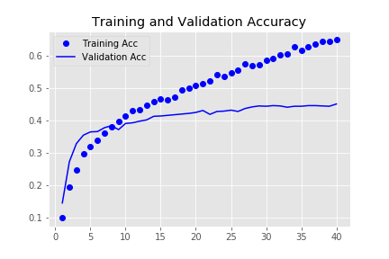
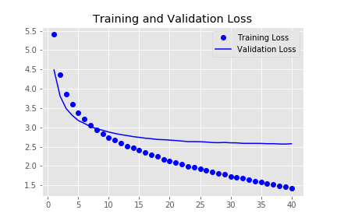
Machine Learning: VGG16

Slide 29
Machine Learning: VGG16
Plotted the training and validation accuracy and loss.
At or near the 9th or 10th epoch validation accuracy fell below the training accuracy and validation loss rose above the training loss
Substantially overfitting by the end of training
64.83% training accuracy compared to 45.10% validation accuracy
Considering the foregoing issues, I abandoned this model in search of a better one.

Slide 30
Machine Learning: Second Attempt--Xception
Xception model uses separable convolutional layers to fully separate spatial and channel features of the input to make training both easier.
Also uses residual connections such that some earlier layers are connected to later layers, bypassing some of the intervening layers.
Highly effective on image classification tasks.
Larger network—partial (beginning and end) shown below

Slide 31
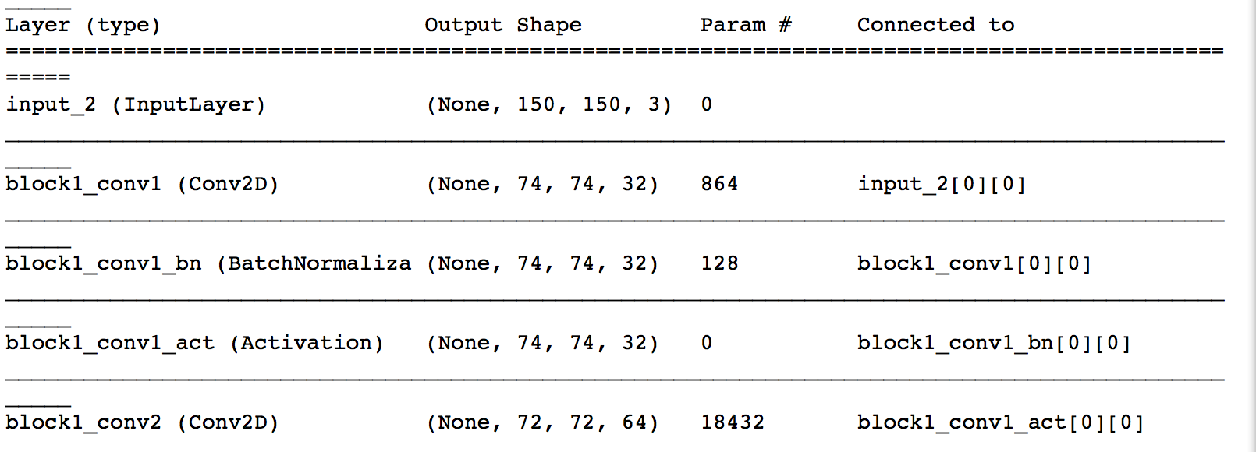
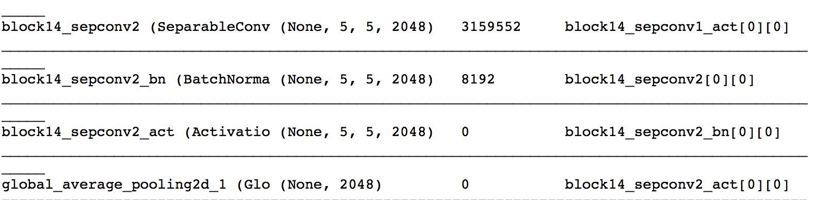
Machine Learning: Xception Model (Partial—Top and Bottom)

Slide 32
Machine Learning: Xception
Created Xception base model with the same image size used for the VGG16 model at (150, 150, 3)
Created final part of the model that took in input that was processed by the Xception base model
2048 input channels
matches the final number of output channels at the end of the base model.
One dense layer with 1024 channels/dimensions
Relu activation function
Dropout layer with 50% dropout
Final dense layer using softmax activation with 512 channels (one for each unique label)

Slide 33
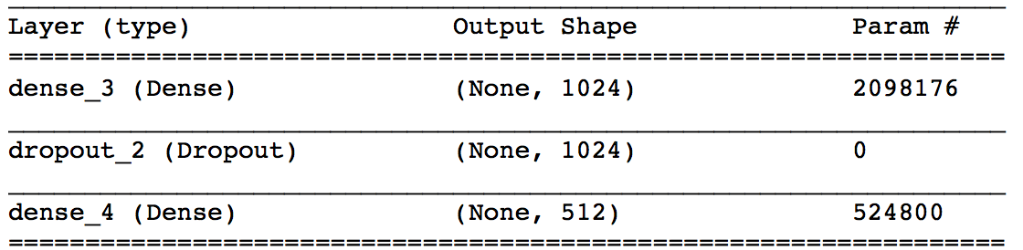
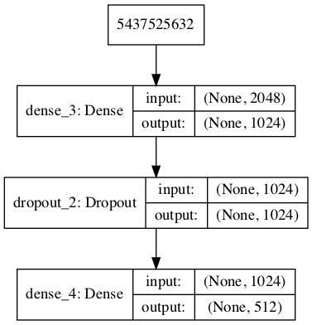
Machine Learning: Xception

Slide 34
Machine Learning: Xception
Compiled the model using the Adam optimizer
same initial learning rate of 2e⁻⁵ as before
categorical crossentropy loss function
Used the same callbacks and class weight balancing as before.

Slide 35
Machine Learning: Xception
Training set of 5000 total images and labels
Trained the model using a 20% validation split, a batch size of 20 and 40 training epochs, as before.
The validation accuracy improved here to approximately 58%.
The final validation accuracy was 57.50% after stopping at the 35th epoch due to Early Stopping.

Slide 36
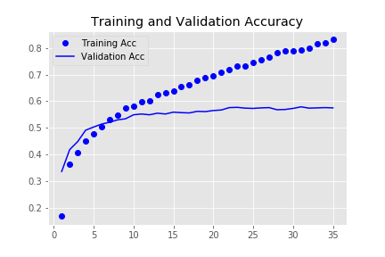
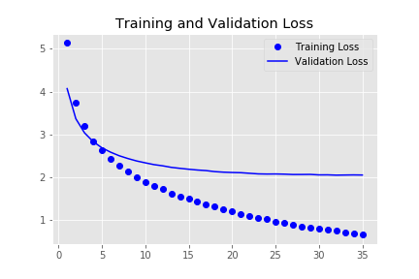
Machine Learning: Xception

Slide 37
Machine Learning: Xception
Plotted the training and validation accuracy and loss
At or near the 6th or 7th epoch validation accuracy fell below the training accuracy and the validation loss rose above the training loss
Substantially overfitting by the end of training
83.15% training accuracy compared to 57.50% validation accuracy

Slide 38
Machine Learning: Tuning
Keep the Xception model due to the substantially improved results.
Need to further improve the model's accuracy
Tune Hyperparameters
Hyperas and Talos packages—poor performance
Use optimum image size and obtain new base pre-trained model
Double training set size to 10,000 (before validation withhold)

Slide 39
Machine Learning: Improved Xception Model—Xception II
Use the alternative Xception base model with larger image size of (299, 299, 3)
Recommended image size for the Xception model
Increased number of images used in training the data to improve accuracy.
Extracted 12,500 total images and labels
Split into a train and test set using an 80%-20% split
Training set consisted of 10,000 images and labels
Test set consisted of 2500 images and labels (ensuring that the test set had the same number of unique class names as the training set at 512 each).

Slide 40
Machine Learning: Xception II
Created final part of the model that took in input from new base model (same overall structure as before)
2048 input channels
matches the final number of output channels at the end of the base model.
One dense layer with 1024 channels/dimensions
Relu activation function
Dropout layer with 50% dropout
Final dense layer using softmax activation with 512 channels (one for each unique label)

Slide 41
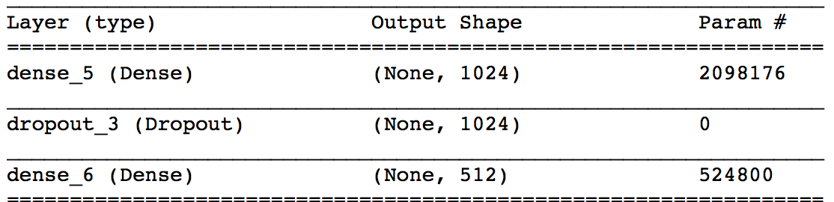
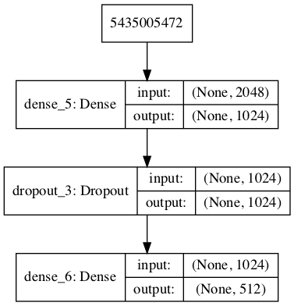
Machine Learning: Xception II

Slide 42
Machine Learning: Xception II
Compiled the model using the Adam optimizer with an initial learning rate of 0.00001
Based in part hyperparameter optimization process combined with personal experimentation
Categorical crossentropy loss function
Same callbacks and class weight balancing as before

Slide 43
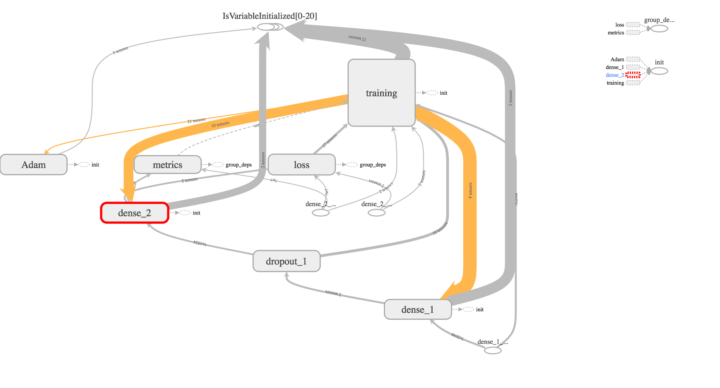
Machine Learning: Xception II Compiled Model Structure

Slide 44
Machine Learning: Xception II
Trained the model using a 20% validation split
8000 samples (twice the number used in the two previous models)
Batch size of 20
70 training epochs
Final validation accuracy was 69.05% at the 70th epoch
Started at the previous 40 training epochs and increased to 70 when I saw that further improvement was possible
Validation accuracy appeared to be leveling off at this point where no substantial further improvement was likely

Slide 45
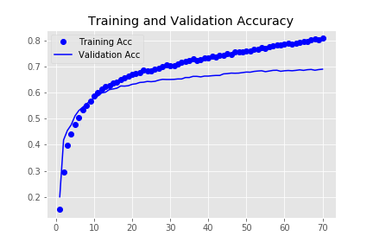
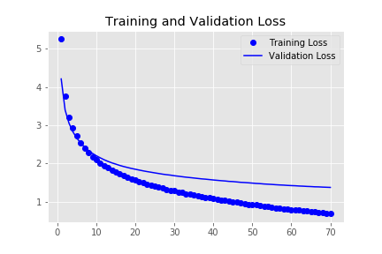
Machine Learning: Xception II

Slide 46
Machine Learning: Xception II
Plotted the training and validation accuracy and loss
At or near the 15th epoch where validation accuracy fell below training accuracy and validation loss rose above training loss
Substantially later than in the previous models
Degree of overfitting was substantially less than it had been in previous models
80.88% training accuracy compared to 69.05% validation accuracy

Slide 47
Machine Learning: Xception II--Scoring
Testing Accuracy: 66.64%--Close to Validation Accuracy
Overall (average) precision, recall and F1 scores were close to the test accuracy
Precision was .61
Model correctly predicted a given label 61% of the time the model predicted the given label as being applicable
Recall was .67
Model correctly predicted the label 67% of the time that the given label was actually applicable to the given image
F1 score (the harmonic mean of the precision and recall) was 63.

Slide 48
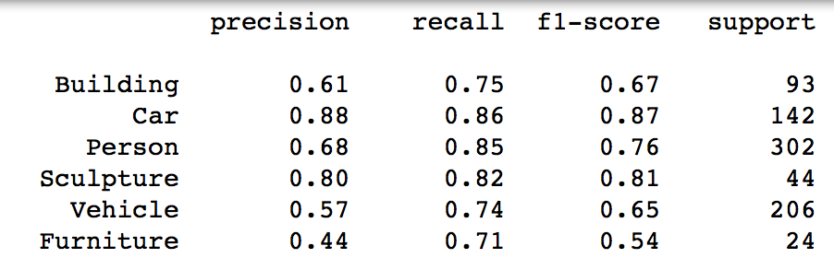
Machine Learning: Xception II--Scoring
Variation in classification scores for individual labels
Label Frequency
Pre-training
Peculiarities in images

Slide 49
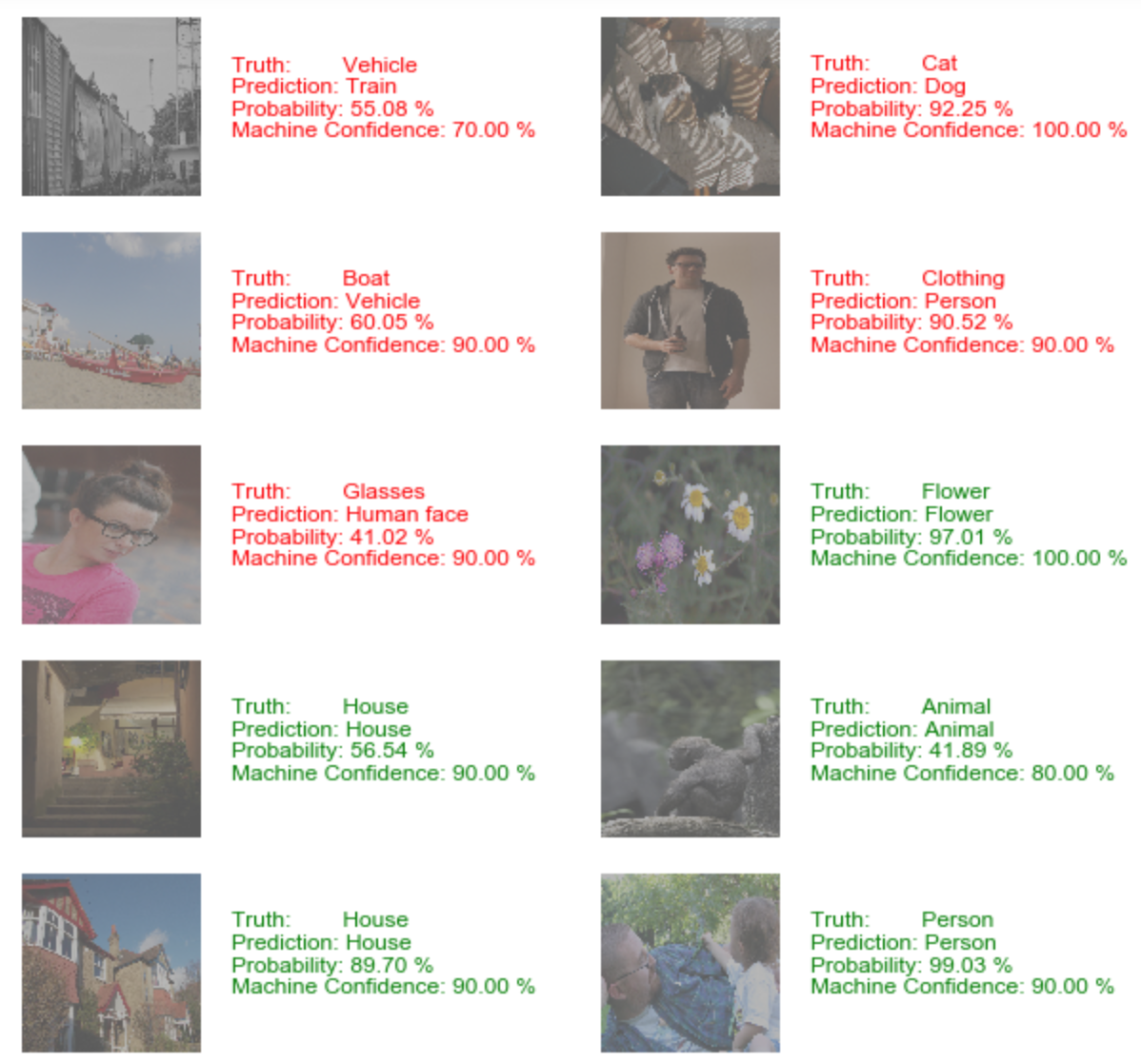
Machine Learning: Xception II--Sampling

Slide 50
Machine Learning: Xception II--Sampling
Evaluated 10 randomly sampled images from Test set
Half correctly labeled by model (in Green)
Flower, two houses, an animal and a person
All true labels had machine confidences of 80.00% or greater

Slide 51
Machine Learning: Xception II--Sampling
Only the animal (apparently a monkey) had a model prediction probability of less than 50%
Lowest machine confidence of 80.00%.
Monkey’s posture?
First "House" image
Low model prediction probability: 56.54%
Interior of the house?
Second "House" image had
High 89.70% model probability
Exterior of the house?

Slide 52
Machine Learning: Xception II--Sampling

Slide 53
Machine Learning: Xception II--Sampling
Errors appear to be false errors here
Train
Predicted “Train” 55.08%
“Vehicle”—Machine Confidence 70.00%
Synonyms
Woman wearing glasses
Predicted "Human face” 41.02%
“Glasses”—Machine Confidence 90.00%
Both Labels apply

Slide 54
Machine Learning: Xception II--Sampling

Slide 55
Machine Learning: Xception II--Sampling
More difficult error--image of two animals
Predicted as "Dog" by the model—92.25%
True label "Cat”—100% Machine Confidence
Expanded image for further investigation

Slide 56
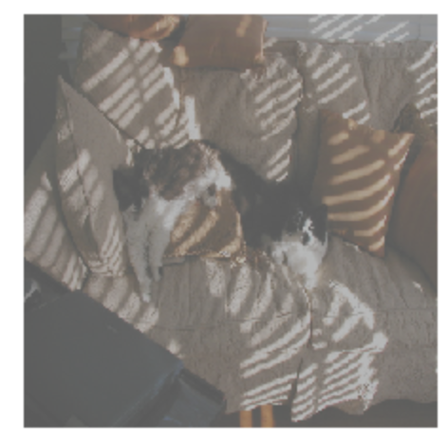
Machine Learning: Xception II--Sampling

Slide 57
Machine Learning: Xception II--Sampling
Animal in black and white fur definitely a cat
Other animal in orange and white fur
Another larger cat or small dog?
Model may still be correct here
Therefore, generally model is accurate overall

Slide 58
Concluding Remarks and Recommendations

Slide 59
Concluding Remarks
Xception Model II is largely accurate
High level of accuracy, overall precision and recall
Model likely even more accurate due to false errors
Despite operating within hardware constraints and limiting the problem to single-label classification

Slide 60
Conclusions?
Can machines be used to train other machines for image classification tasks?

Slide 61
Conclusions Drawn
Xception Model II largely agreed with predecessor model that predicted the ground-truth labels for each image initially.
Machines can be trained to accurately recognize pre-labeled images that were previously classified by a different machine that likely utilized a different model.
Effectively allows machines to train machines
Provide substantial cost-savings in future image classification endeavors

Slide 62
Recommendations
Future projects to implement for further development of Xception Model II:
Substantially increase number of training images
Multilabel classification
Variable length output for variable number of labels per image

Slide 63
Questions?

