Slide 1
Analysis of Traffic Fatalities in 2015

Slide 2
Questions Presented
Can we target the times and places where fatal accidents are most likely to occur?
Are human factors such as impairment due to drugs, alcohol or even distraction greater factors than environmental factors such as weather, road conditions or lighting conditions in causing serious fatal accidents?

Slide 3
Initial Preparations: Getting the Data
Obtained the data from the 2015 Traffic Fatalities provided by NHTSA available at https://www.kaggle.com/nhtsa/2015-traffic-fatalities.
Consisted of 17 related csv files containing common unique case identifiers.
Accompanying NHTSA documentation defines the meanings of the codes used.
Fatality Analysis Reporting System (FARS) Analytical User’s Manual for 1975-2015.

Slide 4
Initial Preparations: Merging the Datasets
Merged the following datasets using the pandas merge function: Accident, Vehicle, Person, Distract, Drimpair, Factor, Maneuver, Violatn and Vision.
First Vehicle was merged to Accident on the common key ST_CASE into a new dataframe called traffic. Person was then merged to traffic on the common keys ST_CASE and VEH_NO.
The remaining datasets were placed into a list (to_merge = [distract, dr_impair, factor, maneuver, violation, vision]) and then merged to traffic via a for loop on ST_CASE and VEH_NO.

Slide 5
Initial Preparations: Cleaning the Data
Searched for outliers in the few numerical columns using value_counts function.
TRAV_SP (the travel speed), VSPD_LIM (speed limit) and AGE all contained inordinately large values that were actually codes for Unknown-type values (999, 998, etc).
Converted all to zero and the existing zeroes in Age to 1 to avoid confusion with infants.

Slide 6
Initial Preparations: Cleaning the Data
Created binary variable equivalents of several existing categorical variables with a _BIN prefix.
The final binary variable created was called SERIOUS_FATALS, based on the FATALS column where FATALS (number of fatalities in a given accident) was greater than 1.
Prepared for later use with machine learning algorithms with SERIOUS_FATALS the intended target variable.

Slide 7
Data Analysis

Slide 8
Data Analysis: Time Variables
Mean, median and most frequent Month for fatalities is July
Mean and median Weekday was Wednesday, but most frequent Weekday is Saturday.
Mean and median Hour is somewhere between 1pm and 2pm, but most frequent Hour is 5pm (Rush Hour).

Slide 9
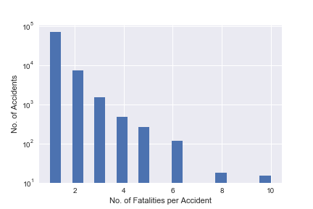
Data Analysis: Fatalities

Slide 10
Data Analysis: Fatalities
Most common number of deaths per accident was 1.
69,811 accidents in 2015
9,808 SERIOUS_FATALS in 2015.
12.32% of all fatalities that year
Most common number of serious fatalities per accident was 2.
7,379 accidents in 2015

Slide 11
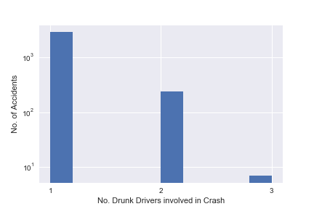
Data Analysis: Drunk Drivers

Slide 12
Data Analysis: Drunk Drivers
Total number of drunk drivers in serious fatalities was 3,136.
Drunk drivers were involved in 31.97% of serious fatalities.
Usually only 1 drunk driver involved (2,886 accidents).
Occasionally there were 2 (243 accidents), but never more than 3 drunk drivers involved (7 accidents).

Slide 13
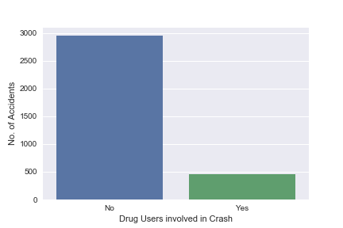
Data Analysis: Drug Users

Slide 14
Data Analysis: Drug Users
The total number of drug users involved in serious fatalities was 450.
Drug users were involved in 13.23% of serious fatalities.

Slide 15
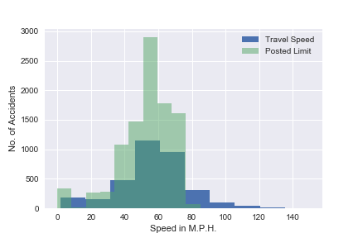
Data Analysis: Travel Speed

Slide 16
Data Analysis: Travel Speed
Majority of the travel speeds were contained within posted limits
1,360 accidents involved excess speed (over the posted limit)
13.87% of serious fatalities
Average excess speed was 71 m.p.h.
Average amount over limit was 21 m.p.h.

Slide 17
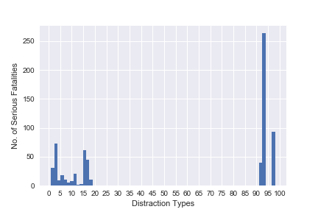
Data Analysis: Driver Distraction
Legend:
0 : Not Distracted
93 : Inattention (Inattentive), Details Unknown
98 : Other Distraction
3 : By Other Occupant(s)
17 : Distraction/Inattention
92 : Distraction (Distracted), Details Unknown
15 : Other Cellular Phone Related
1 : Looked But Did Not See

Slide 18
Data Analysis: Driver Distraction
Total accidents involving distracted drivers was 690 and accounted for 7.04% of serious fatalities.
Most common distraction was general inattention.
Most common specific types of distractions were those resulting from other vehicle occupants (10.58%) and from cell phone-related distractions (5.36%).

Slide 19
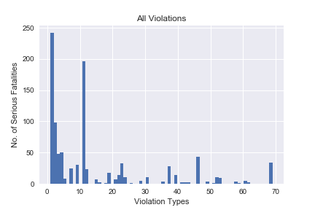
Data Analysis: Traffic Violations
Legend:
0 : None
1 : Manslaughter or Homicide
11 : Driving While Intoxicated (Alcohol or Drugs) or BAC above Limit
2 : Willful Reckless Driving; Driving to Endanger; Negligent Driving
72 : Other Driver License Violations
4 : Inattentive, Careless, Improper Driving
3 : Unsafe Reckless (Not Willful, Wanton Reckless) Driving
46 : Fail to Yield Generally

Slide 20
Data Analysis: Traffic Violations
Total accidents in which drivers were charged was 993 and accounted for just 10.12% of serious fatalities.
Most common violation charged was Manslaughter or Homicide.
Later excluded impairment and speed offenses to avoid double counting.

Slide 21
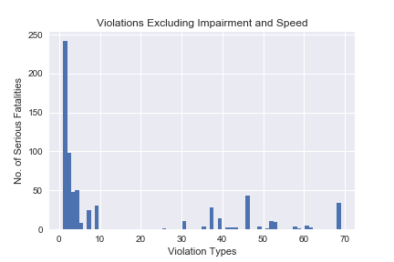
Data Analysis: Traffic Violations
Legend:
0 : None
1 : Manslaughter or Homicide
11 : Driving While Intoxicated (Alcohol or Drugs) or BAC above Limit
2 : Willful Reckless Driving; Driving to Endanger; Negligent Driving
72 : Other Driver License Violations
4 : Inattentive, Careless, Improper Driving
3 : Unsafe Reckless (Not Willful, Wanton Reckless) Driving
46 : Fail to Yield Generally

Slide 22
Data Analysis: Traffic Violations
Total non-impairment-related and non-speed-related violations charged was 676 and accounted for just 6.89% of serious fatalities.
No charges were filed in 8,443 cases.
May therefore need greater deterrent to driver behaviors that lead to serious fatalities in the future.

Slide 23
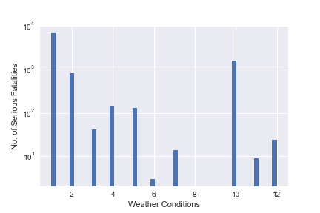
Data Analysis: Weather
Legend:
1 : Clear
10 : Cloudy
2 : Rain
4 : Snow
5 : Fog, Smog, Smoke
3 : Sleet, Hail
12 : Freezing Rain or Drizzle
7 : Blowing Sand, Soil, Dirt
11 : Blowing Snow
6 : Severe Crosswinds

Slide 24
Data Analysis: Weather
Total accidents with adverse weather was 2,759 and accounted for 28.13% of serious fatalities.
Most common type of adverse weather was cloudiness.
However, in most accidents involving serious fatalities the weather was clear (in 6,974 instances).

Slide 25
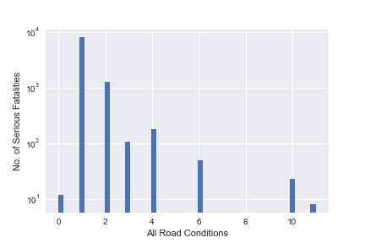
Data Analysis: Road Conditions
Legend:
1 : Dry
2 : Wet
4 : Ice/Frost
3 : Snow
6 : Water (Standing or Moving)
10 : Slush
0 : Non-Trafficway Area or Driveway Access
11 : Mud, Dirt, Gravel

Slide 26
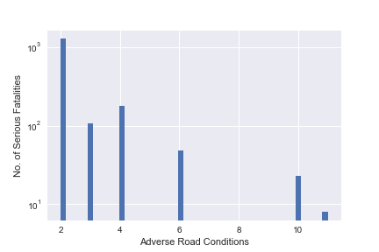
Data Analysis: Road Conditions
Total number of accidents with adverse road conditions was 1,653 and accounted for 16.85% of serious fatalities.
Most common type of adverse road condition was wetness.
However, the majority of serious fatalities (8,027 instances) involved dry road conditions.

Slide 27
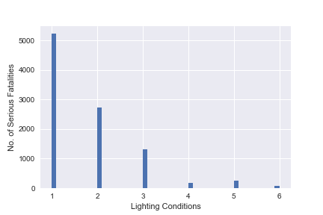
Data Analysis: Lighting
Legend:
1 : Daylight
2 : Dark – Not Lighted
3 : Dark – Lighted
5 : Dusk
4 : Dawn
6 : Dark – Unknown Lighting

Slide 28
Data Analysis: Lighting
Total accidents with adverse lighting conditions was 3,235 and accounted for 32.98% of serious fatalities.
Most common type of adverse lighting condition was darkness with no or inadequate lighting (2,730 instances).
However, there were daylight conditions in most serious fatalities (5,234 instances).

Slide 29
Data Analysis: Causation Summary
Proportion of Solely Human-Caused Serious Fatalities: 35.59 %
Proportion of Solely Environment-Related Serious Fatalities: 20.58 %
Proportion of Combined Human and Environment-Caused Serious Fatalities: 43.83 %

Slide 30
Data Analysis: Conclusions
In most cases there is a shared combination of human and environment-related causes of serious fatalities.
Where only one or the other factor is solely present, human-related factors are more often than not to blame.

Slide 33
Machine Learning Analysis

Slide 34
Machine Learning Analysis: Final Preparations
Filtered dataset to Person Type ('PER_TYP') equal to 1, Driver of a Motor Vehicle In-Transport
Dropped a number of variables that contained duplicative information in an effort to simplify the model and reduce the chances of overfitting.
Dropped irrelevant index variables that were used to initially create the dataset from separate datasets during the data wrangling phase, such as 'ST_CASE', 'VEH_NO' and 'PER_NO'.

Slide 35
Machine Learning Analysis: Final Preparations
Categorical variables converted to binary
Some by hand: where the variable could be easily summarized by two classes (Rural(1) or Urban(0) or Traffic Control Device functioning or not (VTCONT_F = 1 or 0), for example)
Others had potentially useful details:
Converted number codes to values with dictionary based on NHTSA manual
Used get_dummies function to convert to binaries

Slide 36
Machine Learning Analysis: Final Preparations
Numerical variables, Travel Speed ('TRAV_SP'), the driver's age ('AGE') and the number of drunk drivers involved in the accident ('DRUNK_DR') were scaled by dividing by twice the standard deviations
Placed them on roughly the same footing as the binaries so as not to unduly skew the data

Slide 37
Machine Learning Analysis: Final Preparations
Split data into input data X and target variable y, where y = SERIOUS_FATALS, fatalities in an accident greater than 1
Split both variables X and y into train and test sets, X_train, X_test, y_train and y_test using the train_test_split function, with test size at 20% of the whole and training size at 80%.
Finally, used oversampling in imblearn package to rebalance the classes in order to eliminate the imbalance between 0’s and 1’s in the data (almost 10:1 ratio of 0’s to 1’s).

Slide 38
Machine Learning Analysis: Model Selection—Logisitic Regression
Used a feature selection algorithm, recursive feature elimination (RFE) from sklearn, in order to narrow the data down to the most useful features.
selected 18 features out of the total 76 with 1 being the strongest
Performed a grid search over the C hyperparameter using GridsearchCV
used a fairly wide grid from -5 to 10 in logspace.
Grid search settled on a C-value of 15264.18.

Slide 39
Machine Learning Analysis: Model Selection—Logisitic Regression
Accuracy Score on Training Set: 59.96%
Accuracy Score on Test Set: 59.20%
Precision (Correct positives out of all positives predicted): .58
Recall (Correct positives out of all actual positives): .67
F1 Score (overall effectiveness of method from 0.0 to 1.0): .62
No overfitting, but scores not strong.

Slide 40
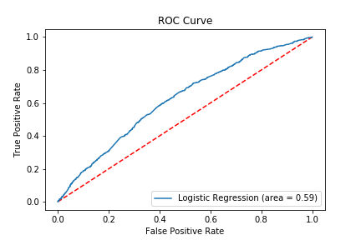
Machine Learning Analysis: Model Selection—Logisitic Regression
ROC Curve—Plot of False Positives vs. True Positives
Greater area above diagonal line equals better model
Poor results for this model—need different model.

Slide 41
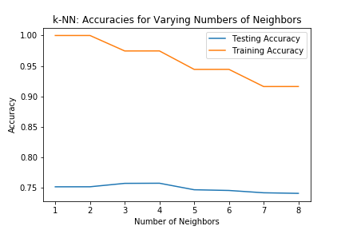
Machine Learning Analysis: Model Selection—K-Nearest Neighbors
K-Nearest Neighbors produced strongest results—classifies new data points based on distance from nearest neighbor data points in training set
Stable technique works well on rigid datasets such as this one.
Need optimum number k of neighbors to work with
4 gives max, but 7 reduces overfitting—best tradeoff

Slide 42
Machine Learning Analysis: Model Selection—K-Nearest Neighbors
Accuracy Score on Training Set: 91.62%
Accuracy Score on Test Set: 74.20%
Precision (Correct positives out of all positives predicted): .76
Recall (Correct positives out of all actual positives): .71
F1 Score (overall effectiveness of method from 0.0 to 1.0): .71
Some overfitting, but strong scores

Slide 43
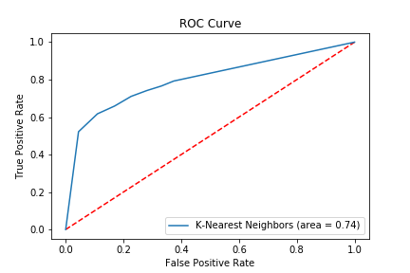
Machine Learning Analysis: Model Selection—K-Nearest Neighbors
ROC Curve—Plot of False Positives vs. True Positives
Greater area above diagonal line equals better model
Larger Area Under the Curve (AUC)—stronger model

Slide 44
Machine Learning Analysis: Model Selection—K-Nearest Neighbors
Larger Area Under the Curve (AUC)—stronger model than Logistic Regression

Slide 45
Machine Learning Analysis: Conclusions
Ultimately able to reduce the extent of the overfitting by selecting a higher k-value at k=7, rather than at k=4,
Appeared to provide the best trade-off between reducing overfitting and maximizing accuracy.
This model also provided improved Precision, Recall and F1 scores and a much greater area under the curve in the model's ROC plot.
Model appears to have maximized its predictive power and successfully predicted the occurrence of serious fatalities at a high rate with the given data.

Slide 46
Concluding Remarks and Recommendations

Slide 47
Conclusions
We have shown that when using this model and the accompanying analysis of the data,
it may be possible to predict in advance whether a serious fatality will occur,
to determine the likely causes of such accidents and
to make recommendations based on this analysis to prevent serious fatalities from occurring.

Slide 48
Conclusions?
What can we conclude about serious fatalities?

Slide 49
Conclusions Drawn
Serious fatalities typically occur on weekends (especially Saturdays) during the summer months (particularly July)
Clear weather on dry, well-lit, level roads traveling at highway speeds
Not necessarily speeding or at intersections
Relatively rural areas
Alcohol is often a factor

Slide 50
Recommendations
Increase police presence on highways and county roads during the summer months and weekends
particularly in more rural communities
Increase the number and frequency of DUI checkpoints at these times
Increase community education and outreach concerning the dangers of driving while impaired during these periods

Slide 51
Questions?

