Slide 1
Essential of E-Business
Pokhara University
BBA Semester-VIII
Course Code: CMP-261 Credit Hours:3

Slide 2
Essential of E-Business
Course Objectives
Define the nature and scope of e-business technologies
Understand the application of e-business technologies within business firms.
Know the organizational dimension of e-business implementation
Know how to reflect the likely nature of future challenges and opportunities.

Slide 3
Essential of E-Business
Chapter outlines
Unit 1: Introduction 6 Hours
Concept of e-business; Nature, scope, and impact of e-business technologies; Difference between e-business and e-commerce; History and development of e-business; Advantages of e-business; Business model for e-products and e-services; Contribution of e-business technologies to economic growth, market, competitiveness, and productivity.
Unit 2: Technologies in e-business 8 Hours
Introduction; e-business technologies - hardware, e-business software applications, internet and World Wide Web; Database management system; e-business security; Online payment technology; IT/IS evaluation and e-business; Social consequences of e-business technologies.
Unit 3: Digital Marketing 7 Hours
Concept; Effects of e-business technologies on marketing strategy, customer retention and e-CRM; Measuring the extent of digital marketing activity; Market analysis; Digital marketing tools; Viral marketing.

Slide 4
Essential of E-Business
Chapter outlines
Unit 4: E-Business and Operations management 6 Hours
Difference between purchase and procurement; Market solutions - sell-side, buy-side, and market place; Integration of product catalogue; Procurement service providing.
Unit 5: E-Contracting 4 Hours
Concept of generic services - information, negotiation, archiving, enforcement, reconciliation; Structure of a contract; Digital signature; Legal affairs.
Unit 6: Online Distribution 5 Hours
Components of a distribution system; Characterization of online distribution; hybrid distribution networks; Model for electronic software distribution.
Unit 7: E-Payment System 6 Hours
Characteristics of payment system; Classification of payment systems - E-cash, E-check, overview of smart card; Applications of IPSec.
Unit 8: E-Business Plan Development 3 Hours
Students must develop an E-Business Plan; The business plan must incorporate IT-features that would address complete requirements to run a specified business.

Slide 5
Essential of E-Business
Basic Texts
Jonathan R. J. E-Business A management perspective, Oxford University Press, New Delhi.
Chan, H., Lee, R. Dillon, T., and Chang, E. E-Commerce: Fundamentals and Applications, John Wiley & Sons, New Delhi.
References
Kulkarni, P., Jahirabadkar, S. and Chande, P. E-Business. Oxford University Press, New Delhi.
O’Brien, J. A., Marakas, G. M., and Behl, R. Management Information Systems. Tata McGraw Hill, New Delhi.
Rajaraman, V. Introduction to Information Technology. Prentice Hall of India, New Delhi.

Slide 6
Essential of E-Business
E-Business: Introduction
Chap01
Context: Technology
Chp02
Context:
Market
Chp03
E-Business
Operations
Chp04
E- Contracting
Chp05
Online
Distribution
Chp06
Review:
E-business Plan Development
Chp08
E-Payment
Chp07
Figure: Structure/spirit of the subject

Slide 7
Essential of E-Business
Unit – One
Introduction
Concept of e-business;
Nature, scope, and impact of e-business technologies;
Difference between e-business and e-commerce;
History and development of e-business;
Advantages of e-business;
6. Business model for e-products and e-services;
7. Contribution of e-business technologies to economic growth, market, competitiveness, and productivity.

Slide 8
Essential of E-Business
Unit – One : Introduction
Concept of e-business:
How we defined e-business while studying MIS in last semester-
e-business is the use of the Internet and other networks and information technologies to support (electronic) e-commerce, enterprise communications and collaboration, and Web-enabled business processes both within a networked enterprise, and with its customers and business partners.
Networked enterprises, e-business, e-commerce, e-payment
Is that all?
What about changes in individual lives, family, community, business world..

Slide 9
Essential of E-Business
Unit – One : Introduction
Nature, Scope and impact of E-business:
What is happening in business world? What are e-business practices?
Technology? Business? Government? Society? …….
Continuous changes are there in e-business technologies like:
Hardware
Software
Internet (web-browsers, e-mail, social networks)
Mobile business solutions to location based services
ERP (e-procurement)

Slide 10
Essential of E-Business
Unit – One : Introduction
Nature, Scope and impact of E-business:
Background:
E-business technological changes are:
Miniaturization of technology
Impressive devices
Social networks (Internet based)
Discovery, sharing, use, and collaboration
Online business platforms including e-procurement
Supply chain management (outsourcing, In-sourcing, retail links)
Levelled playing field for all scale enterprises
These are internationally recognized, transformational drivers of social and economic growth for individuals, organizations, nations, regions for development.

Slide 11
Essential of E-Business
Unit – One : Introduction
Nature, Scope and impact of E-business:
So,
Economic transformation (development) can be achieved in two broad ways:
Doing new and better things: innovative products/services or more effective substitutes of existing products/services.
2. Doing things better. Bring efficiency in existing tasks and services for individuals / organizations.
And this is possible because:
The ICT sector alone contributed for nearly a quarter of GDP growth in north America and Europe from 1999 to 2004.

Slide 12
Essential of E-Business
Unit – One : Introduction
Nature, Scope and impact of E-business:
In social transformation sector,
E-business technologies have changed-
The scale, style, and mechanisms of communication between individuals, groups, networked people.
Consumer behaviour in consumption of physical goods and digitized products (downloadable music, video, software, games) , services and information goods (news, views, gossips)
Substitution of existing and conventional channels of retail business to online portals
Consumer decision making process due to search technologies.
In positive advocacies of Internet society is that “Internet has seen as a force for good- providing opportunities, for social cohesion, enriching the quality of life, and promoting diversity (supply side) and inclusiveness (demand side)”.

Slide 13
Essential of E-Business
Unit – One : Introduction
Nature, Scope and impact of E-business:
In social transformation sector (contd.),
The critical advocacies of Internet are “Creating and extending consequences of digital divides between groups within society, countries, resulting into economic polarization, social exclusion, fear of undesirable results of mass participation like news gathering and politics”.
What is the challenge?
Distinguish opportunities and challenges arising from technological possibilities through e-business innovation.
Identify genuine and clear-cut improvements in efficiency and effectiveness from e-business technologies over cost addition and no-net benefits or reducing efficiency.

Slide 14
Essential of E-Business
Unit – One : Introduction
Nature, Scope and impact of E-business:
In social transformation sector (contd.),
For Example:
1) Introduction of interactive white boards, projector-laptop use in class room is assumed to be of prima facie benefit of learning environment but it is derived from existing teaching technique being exploited (becta, 2003).
2) Use of mobile phones (smart) by employees of commercial enterprises are likely to cause a wide variety of unanticipated processes and behavioural changes, both positive and negative. Goldman (2001) demonstrated 45% decline in laptop use and employees availability by an extra hour in office.
Such trends are in varieties of forms and dynamic in nature.

Slide 15
Essential of E-Business
Unit – One : Introduction
Nature, Scope and impact of E-business:
Challenges in commercial sector,
For Example:
1) Whether innovation in and implementation of e-business can profitably complement current business models ( If yes How?).
2) Whether such technologies can-alternatively-lead to new, potentially more effective but also commercially sustainable ways of doing business. (If yes how to transform?)
Such questions and examples are numerous.
We listen the success stories. So what about the failed ones?

Slide 16
Essential of E-Business
Unit – One : Introduction
Nature, Scope and impact of E-business:
Opportunities and challenges of digitized music and its consequences due to the impact of e-business models,
Example case: digital downloading of music
1) The creation of new market for physical products (portable players)
2) The creation of new, information based services like internet radio, music search and download systems.
3) Changed customer behaviour for music products, vanishing of old products.
4) New ways for artist to obtain direct access to consumers / listeners through youtube, myspace, own network.
5) Debate over ethical issues in relation to intellectual property rights and unauthorised downloading and sharing.
Is this the end of the story? What is the impact on other sectors?

Slide 17
Essential of E-Business
Unit – One : Introduction
Nature, Scope and impact of E-business:
Impact on….
Government/regulation sector
As a consequence, music publishers, retailers, trade associations, and software companies have had to invest in the development of digital rights management tools.
Government have had to move to develop policy to regulate this new area.
Implementation of World Intellectual Property organization (WIPO) Copyright treaty of 1996.
Also, there are chances of implementation of the treaty at different stages by the countries in different stages of development (Commisson on Intellectual Property Rights (2002).

Slide 18
Essential of E-Business
Unit – One : Introduction
Nature, Scope and impact of E-business:
Impact on….
Commercial firms
1. Organization need to develop appropriate human resource strategies for incorporation / implementation of new changes.
Educate, Train, develop their manpower for effective and profitable exploitation of e-business technologies.
Workout for long term strategies for sustainability.
Non-Government / not-for profit organizations
1) These type of organizations are diverse in nature as charities, not-for-profit services, trade associations, social communities, and political parties- can also employ e-business technologies to improve their effectiveness and efficiency. Example of OXFAM generated $44 million online donation (15% of total funds) to the Disasters Emergency Committee Appeal.

Slide 19
Essential of E-Business
Unit – One : Introduction
Nature, Scope and impact of E-business:
Impact on….
Individual levels
1. Witnessed some of the most profound changes in their capabilities and potential (many individual success stories).
Development in user-created content, social networking, citizen journalism, information search, mobility in communication and service access have empowered to exploit online resources.
Such individual efforts have created secondary feedback effects for the strategies of business and other organizations.
Increase potential for independent peer-to-peer activity,
Potentially cutting out conventional intermediaries altogether.
Creating opportunities for new kind of business.

Slide 20
Essential of E-Business
Unit – One : Introduction
E-business and E-commerce: same or different? How?
The terms e-business, e-commerce and e-government are used in similar fashion.
E-commerce is the most popularly used –or abused term.
This word was originally coined in 1960 for electronic fund transfer systems (EFTS) and electronic data interchange (EDI).
Applegate et al. (1996) were amongst the first to identify three classes of e-commerce applications:
Business to customer (B2C) or sell-side commerce
Business to Business (B2B) or buy-side commerce)
Intra-organizational.
As per the researchers definitions, E-commerce is “the distributing, buying, selling, marketing and servicing of products or services over electronics systems such as Internet and other computer networks.”

Slide 21
Essential of E-Business
Unit – One : Introduction
E-business and E-commerce: same or different? How?
Above definition has a variety today and treated in the form of web-commerce included marketing and servicing activities.
E-business, a term originally used by IBM chairman Louis Gerstner, in synonymous with e-commerce, focusing on the commercial transactions that take place between buyers and sellers.
But there is a much broad and more holistic definition of e-business that incorporates whole value chains, and value networks between suppliers, intermediaries, and customers, and is much focused on economic transformation within and between business.

Slide 22
Essential of E-Business
Unit – One : Introduction
E-business and E-commerce: same or different? How?
So, the definition of e-business is
As per Aberdeen Group website, 2001
‘the automation of the entire spectrum of interactions between enterprises and their distributed employees, trading partners, suppliers and customers’.
As per (International Business Machines corps.) IBM
‘the transformation of key business processes through the use of internet technologies’.
So, this evolving for broad concept of e-business includes the digitization of international business process, as well as cooperative or collaborative processes between companies which are not necessarily transaction focused.

Slide 23
Essential of E-Business
Unit – One : Introduction
E-business and E-commerce: same or different? How?
E-government
The application of e-business technologies is equally useful for organizations with characteristics of businesses that have no profit motives. The such potential organizations are public sector, especially governments.
The adoption and investment on e-business technologies by the governments have been more significant to increase transparency of activities to the citizens, reducing the cost of activity, and increase effectiveness.
The e-business activities in the government are termed as e-government activities, and is defined as
‘The use of technology to enhance the access to and delivery of government services to benefit citizens, business partners and employees.’ – (Deloitte & Touche, 2003)

Slide 24
Essential of E-Business
Unit – One : Introduction
The History and development of E-business
The concept began broadly in the years between 1995 and 2001 which includes the dot.com boom and bust.
Before this time there was talks on commercial viability of ‘electronic marketing’ and ‘teleshopping’ in the 1970s and 1980s.
Three key concepts describe the innovation in e-business- disruptive innovation and sustaining innovation and radical innovation.
Christensen, 1997 –Disruptive innovation is ‘A technological innovation, product, or service that eventually overturns the prevailing status quo in the market’.
Companies engaging in disruptive innovation target customers who find existing value propositions too expensive or too complicated. They offer solutions that are ‘good enough’ at a lower price.

Slide 25
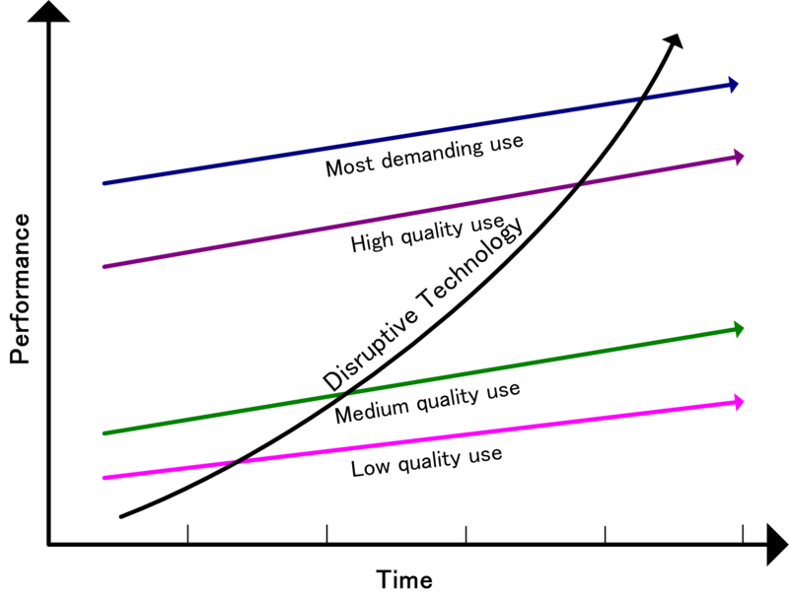
Disruptive innovation

Slide 26
Essential of E-Business
Unit – One : Introduction
The History and development trend of E-business
According to Christensen (1997) – Disruptive innovations offer considerably higher potential for growth than incremental investments using more conventional technology referred as Sustaining innovation. So, ‘incremental investments in products and services involving more conventional technology is sustaining innovation’.
Radical Innovation refers to the high risk innovation involving significant change ‘at a stroke’ in markets, products, or services, with a higher degree of uncertainty over likely outcomes. (example growth of VoIP and Skype are radical innovations)
Disruptive innovations work much more slowly and methodically through an industry than radical innovations.

Slide 27
The History and development trend of E-business
Some researchers and books have categorized two types of innovation.
Disruptive innovation
Sustaining innovation
Sustaining innovation are further categorized into
Evolutionary innovation
Revolutionary innovation (discontinuous or radical )

Slide 28
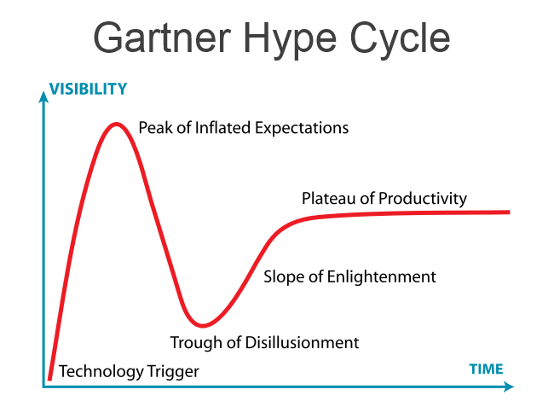
Essential of E-Business
Unit – One : Introduction
The History and development trend of E-business
One consistent feature of the history and development of e-business is hyperbola, particularly over emerging technologies. The concept was developed by Technology insight consultancy ‘Gartner’ in 1995. http://www.gartner.com/technology/home.jsp

Slide 29
Essential of E-Business
Unit – One : Introduction
The History and development trend of E-business
The five stages of Hype cycle are:
Technology Trigger:
Peak of inflated expectations:
Trough of disillusionment:
Slope of enlightenment:
Plateau of productivity:
Technology Trigger: A breakthrough, product launch or other event that generates significant press attention and interest. Example: biometrics and e-cash in 2006, mobile robots and cloud computing in 2008.
Peak of inflated expectations: Excessive visibility leads to overenthusiastic and unrealistic expectations. Example: smartcards in 1995, digital paper 2006, green IT in 2008.

Slide 30
Essential of E-Business
Unit – One : Introduction
The History and development trend of E-business (Contd.)
Trough of disillusionment: Failure to meet unrealistic expectations leads to abandonment of technology by press and other commentators, who move on ‘next big thing’. Example: 1995 personal Digital Assistants (PDAs), In 2006 wikis etc
Slope of enlightenment: Experimentations in rigor way to understand the benefits and practical application of technology by the users/organizations. Example: Speech recognition in 1995, desktop videoconferencing in 1996, location aware applications in 2008
Plateau of productivity: Finally, provided the technology has not become obsolete or superseded, it reaches a point at which benefits became once again widely demonstrated and accepted. Such stability allows further evolution. Example: Database mining and imaging in 2006, VoIP in 2008.

Slide 31
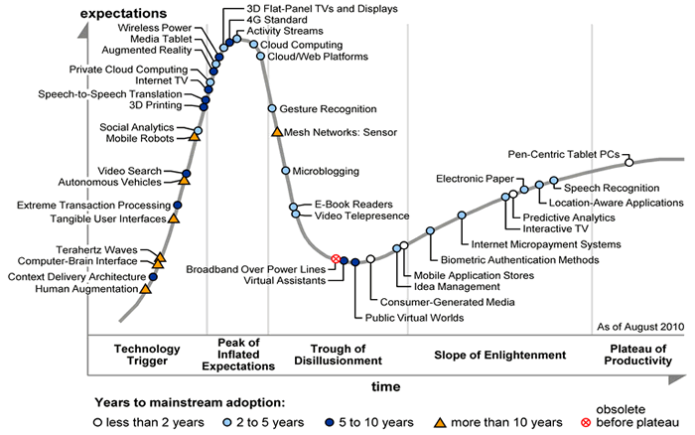
Gartner's Hype Cycle for emerging technologies (2010)

Slide 32
Essential of E-Business
Unit – One : Introduction
Moral of the Hype cycle Story
Be cautious about the ‘hype cycle’ of new technologies.
Some of the technologies may be commonly used,
Others may be rejected by businesses and users,
There is a chance of evidently premature of technology.
Identify the position of the technology in hype cycle.

Slide 33
Essential of E-Business
Unit – One : Introduction
Advantages and Disadvantages of E-business
Advantages:
World wide presence
Cost-effective Marketing and promotions
Developing a competitive strategies
Better customer service
Curtailing of Transaction cost
Reduced overhead costs
Disadvantages:
Sectoral limitations
Costly E-business Solutions for optimization
Issus of safety
Issue of Data security
Site Integrity
Issue of System Up-gradation

Slide 34
Essential of E-Business
Unit – One : Introduction
Business Model for e-business and e-services.
E-business – conducting business on the Internet, not only buying and selling, but also serving customers and collaborating with business partners
E-business model – an approach to conducting electronic business through which a company can become a profitable business on the Internet

Slide 35
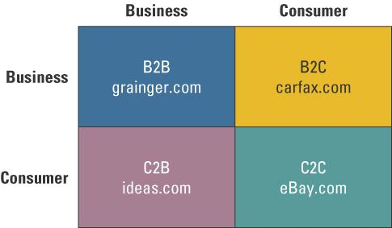
E-Business Models

Slide 36
Business-to-Business (B2B) Models
Business-to-business (B2B) – applies to businesses buying form and selling to each other over the Internet
E-procurement – the B2B purchase and sale of supplies and services over the Internet
Systematic sourcing – involves buying through pre-negotiated contracts with qualified suppliers.
Spot sourcing – businesses buy transaction-oriented commodity-like products and rarely involves a long-term or ongoing relationship between buyers and sellers

Slide 37
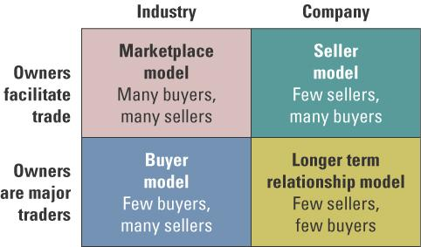
B2B exchanges are new organizational forms in digital space that can take place in the following:
Buyer model (few buyers, many sellers)
Marketplace model (many buyers, many sellers)
Longer term relationship model (few buyers, few sellers)
Seller model (few sellers, many buyers)

Slide 38
B2B exchanges
Buyer Model - Reverse auction – the winning bid is the lowest, rather than the highest
Seller model – appropriate when the supplier hosts value-added services on its Web site such as suppliers’ product catalog and customers’ order information
Longer term relationship model – items requiring a high degree of planning between buyers and sellers either in the design stage or in fulfillment
Marketplace model – allows a virtually infinite number of businesses to transact electronically with minimal cost

Slide 39
Consumer-to-Business (C2B)
Consumer-to-business (C2B) – applies to any consumer that sells a product or service to a business over the Internet
C2B facilitates the following:
Social interaction
Personal finance management
Purchasing products and information

Slide 40
Consumer-to-Consumer (C2C)
Consumer-to-consumer (C2C) – appliers to sites primarily offering goods and services to assist consumers interacting with each other over the Internet
C2C communities thriving on the Internet:
Communities of interest
Communities of relations
Communities of fantasy

Slide 41
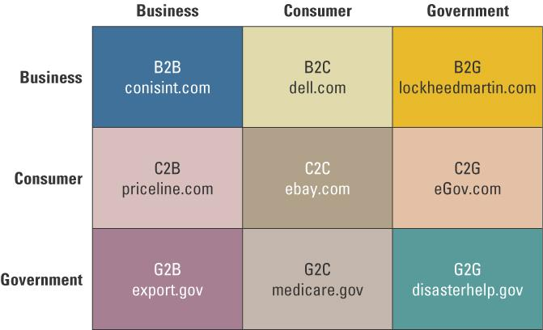
Extended E-Business Models

Slide 42
Specific e-business models as they relate to e-government
Consumer-to-government (C2G) – constitutes the areas where a consumer (or citizen) interacts with the government
Government-to-business (G2B) – includes all government interaction with business enterprises
Government-to-consumer (G2C) – governments dealing with consumers/citizens electronically
Government-to-government (G2G) – governments dealing with governments electronically

Slide 43
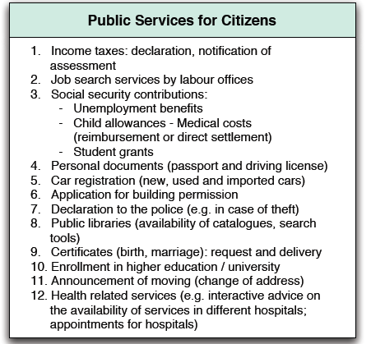
E-Government services for citizens (G2C)

Slide 44
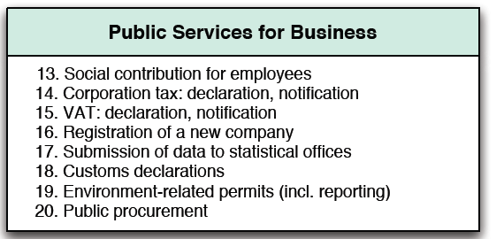
E-Government services for Business (G2B)

Slide 45
Future Trends: E-Channels, E-Portals, and E-Government
e-channel – Web-based business channel
e-portal – a single gateway through which to gain access to all the information, systems, and processes used by stakeholders of an organizations
e-government – the use of strategies and technologies to transform government(s) by improving the delivery of services and enhancing the quality of interaction between the citizen-consumer within all branches of government(s)

Slide 46
E-Business Challenges
Cost
Value
Security
Leverage existing systems
Interoperability

Slide 47
Contribution of e-business technologies to economic growth, market competitiveness, and Productivity
The benefits of appropriate ICT investment is due to (How e-business contributes?)
Lower transaction costs
Higher productivity
Enhanced capability for innovation
Revenue growth

Slide 48
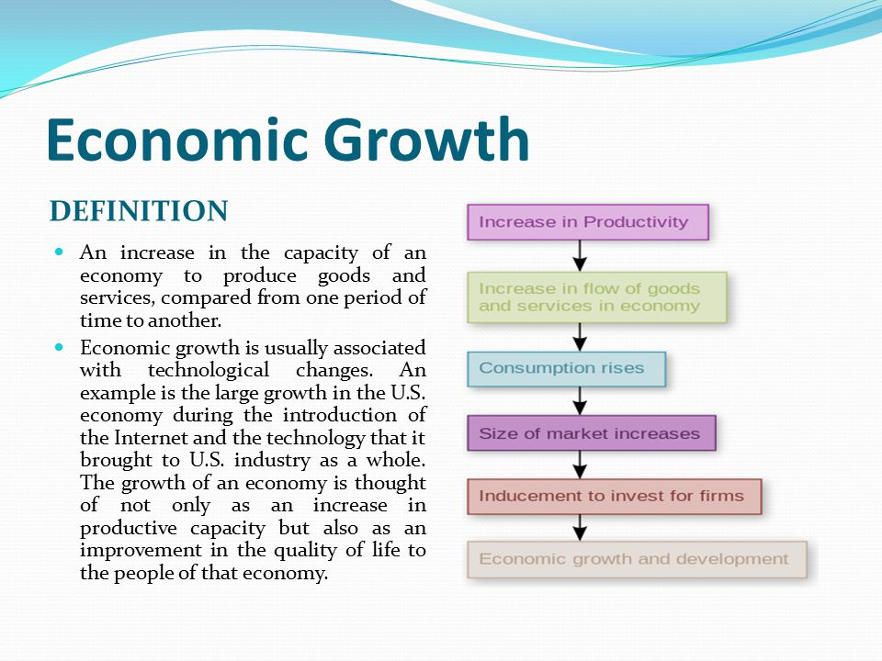

Slide 49
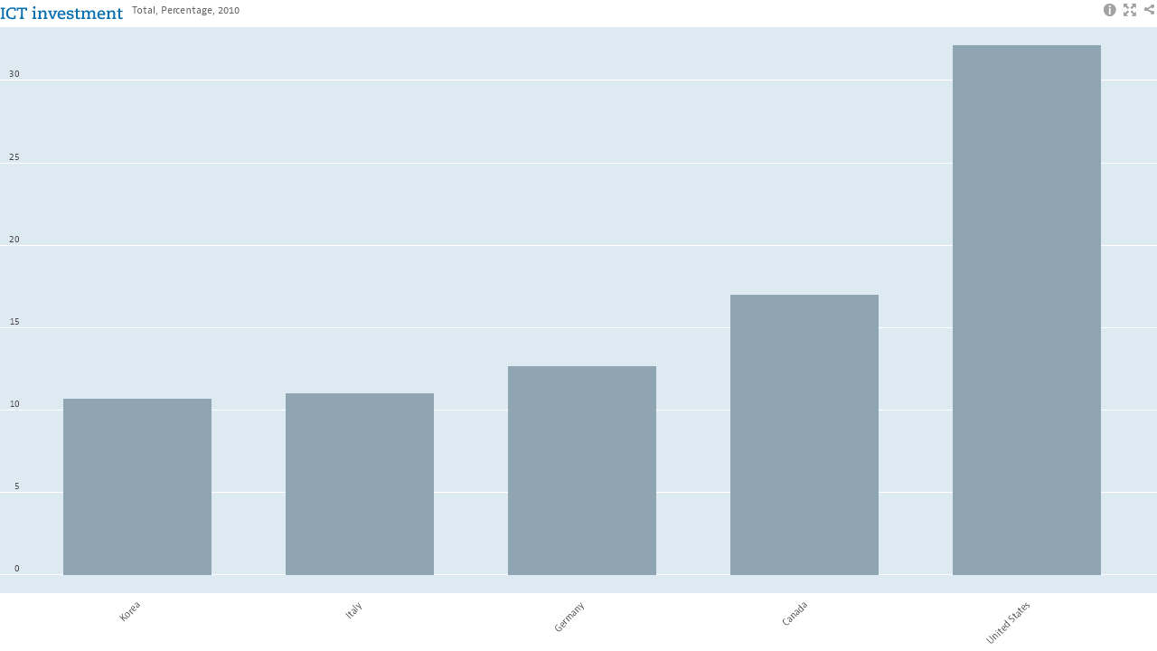
Total investment in ICT: total percentage (2010) Source: OECD data
30
25
20
15
10
5
0
Korea
Italy
Germany
Canada
USA

Slide 50
Contribution of e-business technologies to economic growth, market competitiveness, and Productivity
The economic benefits of email are considerable in commercial business (How e-mail contributes?)
Improved communications
Better access to information
Lower cost than compared to conventional methods of communication;
Improved efficiency in the work place;
The easier findings of new business opportunities; and
The ability to work more closely with customers and suppliers,

Slide 51
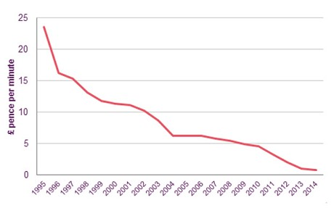
Falling cost of communications rate per minute of a UK company

Slide 52
Contribution of e-business technologies to economic growth, market competitiveness, and Productivity
The research studies showed that there were measurable effect of e-business not just in terms of productivity but in respect of value added for sales and purchases by manufacturing firms as well (Clayton, 2005).
The net effect makes sense if we assume that e-business makes markets more transparent, so that e-buying firms in particular benefit commercially from better pricing information.
Despite above facts, the net economic effects of e-mail and e-business may be less clear-cut and difficult to quantify at the firm level, international level, between countries.

Slide 53
Contribution of e-business technologies to economic growth, market competitiveness, and Productivity
There are three reasons in particular why we may find it specially difficult to establish the real benefits of e-business:
Problems in actually measuring the benefits
The invisibility of some of the investments made on intangibles activities that improved productivity. The most prominent being intangible knowledge derived form e-business technologies as a new factors of production.
The time taken for the benefits of e-business investment to emerge especially in long term.

Slide 54
Contribution of e-business technologies to economic growth, market competitiveness, and Productivity
The manufacturing firms and production technologies are able to benefit more from investment in production technologies by optimizing both value chains and operational processes. Also these firms are able to achieve higher levels of labor productivity.
Research suggests that young service firms are most likely to obtain economic benefits from e-business. This is because these firms are generally more flexible and more willing to adopt and implement e-business technologies, which in turn permits them to undertake more experimentation resulting in more experience.

Slide 55
Contribution of e-business technologies to economic growth, market competitiveness, and Productivity
With above discussion we conclude that there is no guaranteed ‘productivity win’ or improved performance from e-business investments firms make, rather it is important to take into account how they use investments on e-business.

Slide 56
Discussion questions (Prepare your self)
What are the difference between e-commerce and e-business?
What are the similarities and differences in the challenges faced in e-business and e-government?
Can you think of ways which you might measure the net effect of email on your personal productivity during the day? What steps might you take to improve that productivity?
What are the impact of e-business in individual, social, commercial and government sectors.
What are e-business models in B2B scenario.
What is meant by “Disruptive innovation”. Explain its stages with examples.
How manufacturing sector can get benefited by the adoption of e-business technologies.

Slide 57
Assignments – (15 marks, 1 week)
“Technological innovation does not guarantee business success. A new product development efforts should be coupled with a business model defining their ’go to market’ and ’capturing value’ strategies. Discuss.
“It is difficult to demonstrate the effects of e-business technologies on economic performance?” Elaborate with illustrations.
Find out three online e-business sites, write down the mission vision, objectives and analysis their business process.
Submit in loose paper.

