Slide 1
Essential of E-Business
Chapter outlines
Unit 1: Introduction 6 Hours
Concept of e-business; Nature, scope, and impact of e-business technologies; Difference between e-business and e-commerce; History and development of e-business; Advantages of e-business; Business model for e-products and e-services; Contribution of e-business technologies to economic growth, market, competitiveness, and productivity.
Unit 2: Technologies in e-business 8 Hours
Introduction; e-business technologies - hardware, e-business software applications, internet and World Wide Web; Database management system; e-business security; Online payment technology; IT/IS evaluation and e-business; Social consequences of e-business technologies.
Unit 3: Digital Marketing 7 Hours
Concept; Effects of e-business technologies on marketing strategy, customer retention and e-CRM; Measuring the extent of digital marketing activity; Market analysis; Digital marketing tools; Viral marketing.

Slide 2
Essential of E-Business
Chapter outlines
Unit 4: E-Business and Operations management 6 Hours
Difference between purchase and procurement; Market solutions - sell-side, buy-side, and market place; Integration of product catalogue; Procurement service providing.
Unit 5: E-Contracting 4 Hours
Concept of generic services - information, negotiation, archiving, enforcement, reconciliation; Structure of a contract; Digital signature; Legal affairs.
Unit 6: Online Distribution 5 Hours
Components of a distribution system; Characterization of online distribution; hybrid distribution networks; Model for electronic software distribution.
Unit 7: E-Payment System 6 Hours
Characteristics of payment system; Classification of payment systems - E-cash, E-check, overview of smart card; Applications of IPSec.
Unit 8: E-Business Plan Development 3 Hours
Students must develop an E-Business Plan; The business plan must incorporate IT-features that would address complete requirements to run a specified business.

Slide 3
Essential of E-Business
Unit – TWO
Technologies in e-business
Introduction;
e-business technologies - hardware, e-business software applications, internet and World Wide Web;
Database management system;
e-business security;
Online payment technology;
IT/IS evaluation and e-business;
Social consequences of e-business technologies.

Slide 4
Essential of E-Business
Unit – TWO
Technologies in e-business
Introduction (Significance / Why?)
ICT created opportunities and challenges in (e)-business.
Opportunities:
To build new business models
Better integrate organizations with customers and suppliers
Example: Relation of domestic broadband penetration and level of online consumption (transactions) by consumers
Challenges:
Change in technology are rapid,
new H/W and S/W solutions emerging almost weekly.
New ideas are anounced as leading edge and promising even more frequently.

Slide 5
Essential of E-Business
Unit – TWO
Technologies in e-business
Introduction (Significance / Why?)
Then what is the way out in between these opportunities and challenges; there remains the significance of this chapter.
Way out is to think in a more measureable way about
Classification of e-business technologies,
Their development processes,
Major issues on application in the business houses,
Security and standardization issues and their evaluation.
The answers of these questions definitely guide to find opportunities and tackle challenges.

Slide 6
Essential of E-Business
Unit – TWO: Technologies in e-business
E-Business Technologies:
Three Technologies:
Hardware
Software, and
Internet and www.
Hardware:
H/W is both backbone and engine of e-business. In many cases hardware is visible to system users as computers and its interfaces. But this is not all.
H/W includes various computers (main, mini, micro) computers in the series from large mainframe solutions through to system servers, application servers, desktops, laptops, smart mobile phones, PDAs to network infrastructures, peripheral devices like printers, card readers, bar code scanners, cables of all types, WiFi devices, power systems like Battery, UPS generators.
Thus Hardware represents integrated form of all computers, devices, medias and supporting power systems that are needed to run business activities electronically through Internet. (Fig 3.1 in book)

Slide 7
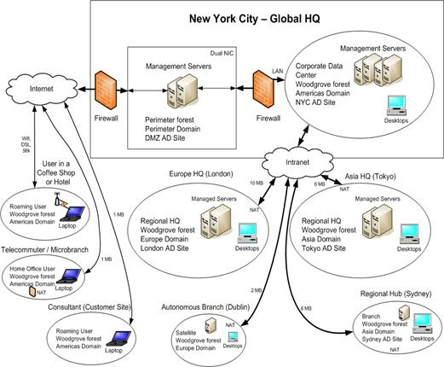

Slide 8
Essential of E-Business
Unit – TWO: Technologies in e-business
E-Business Technologies:
2. Software
In e-business, we normally consider web-based software technologies and applications. Vickery et al. (2003) categorized three integrative information technologies.
Computerized production systems like ERP, Materials requirement Planning (MRP), MRP II (Integrative Information) that integrate manufacturing activities, production planning, tracking, scheduling, and ordering.
ii. Integrative Information System, which create the possibility of transmitting and sharing information within the organization, and
iii. Integrated electronic data interchange which allows the sending and automation of electronic documents flow within and between organizations, customers, suppliers etc.

Slide 9
Essential of E-Business
Unit – TWO: Technologies in e-business
E-Business Technologies:
2. Software (contd.) History/ development
Began to evolve in late 1960s and 70s for MRP.
In 1970 and 80s, competition between Japan and USA resulted to develop JIT (just –in-time) software with EDI applications.
From 1990s growth of Internet changed the software technologies based on it.
From2004 onwards web based software applications like ERP, SCM, and CRM changed the entire concept of business.

Slide 10
Essential of E-Business
Unit – TWO: Technologies in e-business
E-Business Technologies:
2. Software (contd.) History/ development
According to Gammelgard et al. (2007), e-business systems must meet following general quality attributes:
Availability: refers to time during which system is accessible and available to use;
Reliability: the extent to which the system can perform required functions, under given conditions/ periods.
Data quality: accuracy, complete, and availability of data.
Functional fit: minimization of gap between business requirement and system delivery.
Security: extent to which the information is protected.
Interoperability: the ability to integrate systems and components.
Modifiability: ability to incorporate changes.
Safety: system should not cause death, injury, or negative impact on environment; and
Usability and user productivity: ensuring a positive impact on user performance and satisfaction.

Slide 11
Essential of E-Business
Unit – TWO: Technologies in e-business
E-Business Technologies:
3. Internet and www
Internet and www provides the concept of business to business(B2B) integration. Such integration happens in three levels:
Technical Integration: Data integration and exchange between companies;
Application Integration: Physical integration of software and hardware.
Business Integration: Business cooperation between organization. This includes sharing of business plans, schedules, and inventory information. Joint work in product development and customer service. This needs both technical and application integration.
The web based integration is often referred to a collaborative commerce (c-commerce).

Slide 12
Essential of E-Business
Unit – TWO: Technologies in e-business
E-Business Technologies:
Chen et al. (2007) defined c-commerce as
“the set of technologies and business practices that allows companies to build stronger relationships with their trading partners through integrating complex and cross enterprise processes governed by business logic and rules as well as work flows.”
In this regard, the most promising solution can be for supply chain collaboration and integration through web. This can support integration
Between companies, via a standard interface to customers and business partners,
Within the company- reducing time and the cost required to integrate internal systems, and finally,
Between the company and end users (internal and external) by delivering a better user experience

Slide 13
Essential of E-Business
Unit – TWO: Technologies in e-business
E-Business Technologies:
Data standardization and integration or DBMS
Data standardization is required for data exchange while in transmission of information through different media, applications and entities.
Without common standards, the possibility of translating data into a format recognized by another application, it is impossible to use electronic communication.
Data standardization was one of the first initiatives developed by organizations seeking to exchange information electronically.
EDI-based standards were among the earliest such standards.

Slide 14
Essential of E-Business
Unit – TWO: Technologies in e-business
E-Business Technologies:
Data standardization and integration or DBMS (contd.)
As an alternative to EDI, XML (extensible markup language) was created by the www consortium in 1996.
So, XML is the data interchange standard which allows the integration of inter-enterprise applications. XML was incorporated into various e-business framework dedicated to specific industries and is XML is widely used in web services.
System/Application Integration
Integration refers to mainly internal integration, between functions, divisions, and business units within countries, or between various locations of the company. Integration goes beyond data, information, and message exchange.

Slide 15
Essential of E-Business
Unit – TWO: Technologies in e-business
E-Business Technologies:
Data standardization and integration or DBMS (contd.)
So integration can be achieved in following three steps:
First step is internal integration; between functions, divisions, and business units within countries, or between various locations of the company.
The second step is integration with in business partners, customers, and suppliers known as business and process integration.
The third and final step is to integrate supply value chain in whole some basis.

Slide 16
B2B (Business-to-business) integration
Technical integration, which is on a data integration level and concentrates on the data exchange between companies.
Application integration: the physical integration of software and hardware.
Business integration: the extent of cooperation between organizations. Sharing plans, schedules and inventory information, joint work on product development and customer service.
To achieve business integration, companies need to be integrated on both technical and application levels.

Slide 17
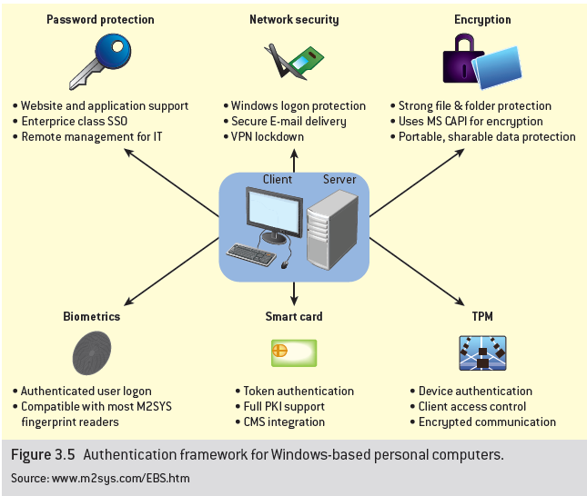
E-business security
Major issues in e-security
Confidentiality/disclosure
Data integrity
Authentication (identification)
Non-repudiability
Privacy
Anonymity

Slide 18
Essential of E-Business
Unit – TWO: Technologies in e-business
E-Business Technologies:
E-business Security
Security in e-business and web services can be assured through:
Confidentiality/disclosure: ensuring data cannot be accesses in any way in transit by third party.
Data integrity: ensuring data cannot be modified between sender and receiver.
Authentication: confirming that identity of sender/receiver is known and only the authorized user can access the system.
Non-repudiability: making sure that the sender cannot deny that a document has been received.
Privacy: preventing either sender or receiver is known to unauthorized person; and
Anonymity: respecting user anonymity-especially important in case if micropayments.

Slide 19
Essential of E-Business
Unit – TWO: Technologies in e-business
E-business Security
The simplest methods of authentication are passwords, but they do not guarantee high levels of security. However, technology alone does not guarantee the security if it is not supported by well developed, implemented, and reviewed security policies.
Techniques to ensure e-business security:
Secure socket layer (SSL) protocol: In this technique
Data are encrypted using public key cryptography. SSL provides authentication and data integrity protection. For example: HTTP protocol protected using SSL is referred to as HTTPS.
b. Public Key Infrastructure(PKI):
The public key infrastructure provides management of authentication services and distribution of certificates. PKI supports data encryption, integrity and non-repudiability. PKI is based on asymmetric key cryptography in which two keys are used for data encryption and decryption-public and private key. Public key is provided by central authority.

Slide 20
Essential of E-Business
Unit – TWO: Technologies in e-business
E-business Security (contd.)
Techniques to ensure e-business security:
Use of Smart cards:
In this technique smart cards can be used for authentication of transactions. Smart cards use chips for authentication purpose (instead of magnetic strips used earlier/now).
Now some banks had already started the service like PINsentry, which together with the credit card or authentication card, allows customers to identify themselves as account holder and perform banking transactions.
d. Biometric authentication:
In e-business transactions, for authentication purpose, biometric can also be used. For example, fingerprint, eye retina scanning, hand geometry, or voice recognition. Also there is ongoing work on DNA authentication.

Slide 21
Essential of E-Business
Unit – TWO: Technologies in e-business
E-business Security (contd.)
Techniques to ensure e-business security:
One of the most serious issues for every e-business is of course the threat of viruses and other forms of malware. They affect companies business operations, resulting in system failure, frauds, theft (passwords / data), and hijacking of computer itself.
Therefore, security issues need to be considered from holistic approach and significant ethical and regularly dimensions are required.

Slide 22
Essential of E-Business
Unit – TWO: Technologies in e-business
Online Payment Technology
In online transactions, Payment is one of the most important sensitive security related technologies especially in B2C scenario. In payment trust in security and privacy levels plays a key role in consumer confidence.
From technical point of view online payments are differentiated into small-value payments (micro-payments) and larger (>$10) macro payments.
Micropayments are often completed using mobile phones or debit/credit cards. For example: parking fees, bus fees, taxi fares, cinema or fun tickets, small retail purchases.
For such payment, account is setup through online or phone for one time, then system allows users to make micro payments by sending a text message that includes the bill info.

Slide 23
Essential of E-Business
Unit – TWO: Technologies in e-business
Online Payment Technology (contd.)
In some of the cases smart cards can also be used having the limited top-up value say $100. These cards can be toped-up online whenever required. Examples include e-wallet, XMLpay.
In micropayments user validation and receipt is the practice which later matched with credit/debit card bill.
challenges:
Several parties are involved in internet payment. The parties are seller(merchant), the buyer, and a third party (the issuer) who provides the payment services, as well as banks. In some cases, issuer can be bank or other financial institutions, who are involved in process of validation and authorization of transactions.
Legal requirements also needed to be accomplished and reflected. From social considerations the issues of anonymity, privacy, and acceptance need to be maintained by sellers.

Slide 24
Essential of E-Business
Unit – TWO: Technologies in e-business
IT/IS Evaluation and e-business
It is ‘the assessment or appraisal of the value, worth, and usefulness of an information system’ (Smithson & Hirschheim, 1998)
In organizational process, once the online business model is used, the central question remains to evaluate its impact on business.
IT/IS evaluation is an area that uses different methods and tools to assess costs, risks, benefits associated with a selected technology. Such evaluation is also called as justification, or in case of post-evaluation ‘an assessment’ or ‘appraisal’.
Challenges:
An emerging issue in IT evaluation is analysis of its impact in natural environment and society, both directly or through the support of different business models (Piotrowicz & Cuthbertson, 2009).

Slide 25
Essential of E-Business
Unit – TWO: Technologies in e-business
IT/IS Evaluation and e-business
Significance of IT/IS evaluation:
With the growth of e-business investment in IT has been a significant portion of organization’s cost, so there is a much concern about obtaining and demonstrating value for money.
Managers want to know what value is delivered after spending an increasing investment in IT especially when returns are not clearly visible and the promised benefits are not achieved.
When to evaluate the e-business?
The most common period of evaluation are:
Before system implementation;
When a system is selected and its impact can be assessed;
After system implementation, to evaluate the benefits achieved

Slide 26
Essential of E-Business
Unit – TWO: Technologies in e-business
IT/IS Evaluation and e-business
Common methods of IT/IS evaluation:
Normally financial methods like ROI, NPV, cost-beneft analysis dominate the tools. However variety of methods exists.
Common methods of IT/IS evaluation
Financial methods | Non-financial methods
Return on Investment (ROI) | Processes measurement
Economic Value Added | Process estimation
Cost benefit analysis | Workflow analysis
Bench marking (financial indicators only) | Pilot testing
 | Benchmarking
 | Informal evaluation
 | --- Opinion of managers, users
 | --- Common sense
 | ----Informal benchmarking

Slide 27
Essential of E-Business
Unit – TWO: Technologies in e-business
IT/IS Evaluation and e-business
Difficulties in IT/IS evaluation:
Understanding the mechanism (human & organizational) of investment decision making,
Understanding what the ‘value’ is and how it is defined,
Enabling system integration and ‘technology fit’
Organizational Political issues
Appreciating portfolio of evaluation tools and methods,
Understanding risks with investment on technologies and securities,
Understanding the scope and impact of IT infrastructure.

Slide 28
Essential of E-Business
Unit – TWO: Technologies in e-business
IT/IS Evaluation and e-business
Whenever new systems are implemented, generally evaluation includes costs, benefits, and risks
Costs:
Direct and indirect
Financial and non-financial
Initial investment and ongoing operational costs
Direct costs include: cost of H/W, S/W, accessories, system development, training, maintenance, network security, consultancy support, and overheads.
Indirect costs include: these costs are harder to identify and often much higher than direct ones. Like initial customization, reconfiguration, and update, selection of technology in application like use of direct application instead of web based solution.

Slide 29
Essential of E-Business
Unit – TWO: Technologies in e-business
IT/IS Evaluation and e-business
Benefits:
Evaluation benefits can be strategic, tactical and operational. Also the benefits can be financial, non-financial and intangible. Typical benefits of e-business model identified by four IT companies are:
Level | Perspectives
 | customer | Business process | Learning & growth | Financial
Strategic | Increased service | Effective SCM | Increased control, competitiveness, cooperation & communication | Fraud prevention
Operational |  | Increased efficiency, transparency, new biz. opportunities | Improved monitoring & control, reporting, information supply | Improved financial results, reducing costs,
Tactical |  | Improved operations, reduce transactions | Improved access to information | Reduce bank transfer cost, reduce warehousing & transportation costs.

Slide 30
Essential of E-Business
Unit – TWO: Technologies in e-business
IT/IS Evaluation and e-business
Risks:
Risk is related to different investment strategies like decision not to invest in information technology. Another important risk is security. The project related and impact related risks are:
Benefits delivery risks: factors that may influence the realization of business benefits.
Technology delivery risks: factors that may influence system delivery in terms of time, quality, and budget.
These risks can be minimized by effective use of the kind of project management tools and techniques.

Slide 31
Essential of E-Business
Unit – TWO: Technologies in e-business
Social consequences of e-business technologies
Following are the social consequences of e-business:
Concept of digital divide over access to e-business technologies shall reflect in business process.
A group of demographics like adults may not be integrated in main stream of e-business.
The internet ‘have-nots’ tend to be concentrated with some social, demographic, and economic groups.
Level of learning in students due to internet access to schools may lead to level difference in society.
Behavior change in people in the society due to technological determinism ( a view that technology determines behavior).
Costs to broadband internet access can create the biggest barrier to e-business technological innovation.

Slide 32
Essential of E-Business
Unit – TWO: Technologies in e-business
Social consequences of e-business technologies
Following are the social consequences of e-business:
Considering the development of ICT sector and its contribution in economic growth, ITU has employed ICT-Development Index (IDI).
IDI is derived from indicators which seek to ‘measure the overall ability of individuals in a country and access use of new ICTs’.
The new ITU index is superior to other indices in its country coverage, measurement of ICT , and its focus upon a richer mix of social and infrastructural indicators including ICT access, use and skills.
The IDI reflect the overall positioning of a country’s e-business capability level in comparison to 200 member countries of ITU.

Slide 33
Essential of E-Business
Unit – TWO: Technologies in e-business
Social consequences of e-business technologies
Indicators to measure ICT accesses, use and skills are:
(ICT access 40% weight, Use 40% weight & Skills 20%)
ICT access: (20% weight to each indicator)
Fixed telephones lines per 100 inhabitants.
Mobile cellular subscriptions per 100 inhabitants.
International internet BW (bps) per user internet user.
Proportion of households with a computer.
Proportion of households with internet access at home.
ICT use: (33% weight to each indicator)
6. Internet users per 100 inhabitants
7. Fixed broadband internet subscribers per 100 inhabitants
8. Mobile broadband subscribers per 100 inhabitants
ICT Skills: (33% weight to each indicator)
9. Adult literacy rate
10. Secondary gross enrollment ratio
11. Tertiary gross enrolment ratio

Slide 34
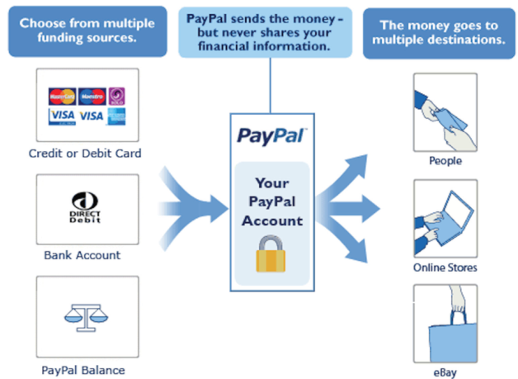
Long Case 3.2: PayPal
Developed in 1998, and in 2002 PayPal was bought by eBay
73mn active users world wide
In 2008 PayPal processed $USD 60bn in payments - a 27% increase on the previous year.
Almost 9% of global e-commerce transactions were completed via PayPal in 2007.
Person to Person transfer services
B2B and B2C transactions, often for SME e-business traders
Questions
What are the advantages, disadvantages, and threats of online payment technologies for the various stakeholders involved?

Slide 35
Discussion questions
Why IS/IT evaluation in important? In what way evaluation benefits the business process?
What are the costs, risks and benefits associated with e-business model.
What are the social consequences of e-business. How IDI defines the new measure of development stage of a nation in ICT.
Why standardization is important in e-business technologies. What are the prominent quality attributes of a good e-business technology solutions.
Identify the history of recent data thefts and loss in global and Nepalese(?) scenario.

Slide 36
Assignments
Why online payment is not so much popular in the countries like Nepal? What may be the consequences and challenges of micropayments in these countries?
What are the behavior change in people due to use of IT and its applications in society in Nepal?

