Slide 1
Essential of E-Business
Chapter outlines
Unit 1: Introduction 6 Hours
Concept of e-business; Nature, scope, and impact of e-business technologies; Difference between e-business and e-commerce; History and development of e-business; Advantages of e-business; Business model for e-products and e-services; Contribution of e-business technologies to economic growth, market, competitiveness, and productivity.
Unit 2: Technologies in e-business 8 Hours
Introduction; e-business technologies - hardware, e-business software applications, internet and World Wide Web; Database management system; e-business security; Online payment technology; IT/IS evaluation and e-business; Social consequences of e-business technologies.
Unit 3: Digital Marketing 7 Hours
Concept; Effects of e-business technologies on marketing strategy, customer retention and e-CRM; Measuring the extent of digital marketing activity; Market analysis; Digital marketing tools; Viral marketing.

Slide 2
Essential of E-Business
Chapter outlines
Unit 4: E-Business and Operations management 6 Hours
Difference between purchase and procurement; Market solutions - sell-side, buy-side, and market place; Integration of product catalogue; Procurement service providing.
Unit 5: E-Contracting 4 Hours
Concept of generic services - information, negotiation, archiving, enforcement, reconciliation; Structure of a contract; Digital signature; Legal affairs.
Unit 6: Online Distribution 5 Hours
Components of a distribution system; Characterization of online distribution; hybrid distribution networks; Model for electronic software distribution.
Unit 7: E-Payment System 6 Hours
Characteristics of payment system; Classification of payment systems - E-cash, E-check, overview of smart card; Applications of IPSec.
Unit 8: E-Business Plan Development 3 Hours
Students must develop an E-Business Plan; The business plan must incorporate IT-features that would address complete requirements to run a specified business.

Slide 3
Essential of E-Business
Unit – Three
Digital Marketing
Concept;
Effects of e-business technologies on marketing strategy, customer retention and e-CRM;
Measuring the extent of digital marketing activity;
Market analysis; Digital marketing tools;
Viral marketing.

Slide 4
Essential of E-Business
Unit –Three
Digital Marketing
Concept
ICT created opportunities and challenges in (e)-business.
Digital marketing techniques are evolving in such a rapid pace that trial and error experimentation is the order of the day. For example: launch of new advertisement system, products from face book, youtube, own web sites etc.
Significance?
Will digital marketing technique replace existing way of reaching customers? Can complement conventional mechanisms?
If yes, which marketing technique might complement or change firms’ marketing strategies.

Slide 5
Digital marketing techniques
First generation: email, search, and affiliate marketing
Second generation: electronic word of mouth (EWOM) using social networks and viral marketing

Slide 6
What do marketers do?
Two ways of thinking about marketing: as what marketers do and as a way of thinking about customers.
In developing a marketing strategy, organizations focus on the ways in which they can create and capture value for their customers.
This requires them to:
undertake some form of market analysis.
identify a specific target market leading to the identification of groups of customers in relation to whom the product or service’s value proposition can be developed and positioned
carry out a programme of actions in the market to ensure the sale of the product or service
Put mechanisms in place to retain existing customers, once acquired

Slide 7
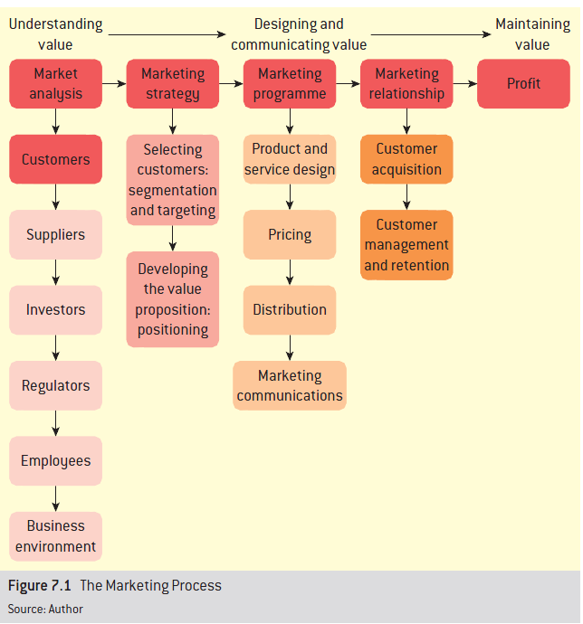
What do marketers do?

Slide 8
What do marketers do?
Normally, customers may not know what they want, or may not be able to express their needs effectively, and organizations may have to anticipate their latent needs.
Organizations do marketing through two different approaches
Market driven, and
Driving markets
Market driven firms seek to learn, understand, and respond to customers within a given market structure. Their focus is on customer satisfaction.
Driving markets firms seek to change the composition, roles and/or behaviour of players in a market, often focusing on customers’ latent needs, they do by focusing on customer value through collaboration with partners.

Slide 9
Differences between two marketing approaches.
Characteristics | Market driven | Driving markets
Marketing objectives | Obtaining customer satisfaction | Creating and maintaining customer value
Customer orientation | Expressed wants of consumers | Expressed wants and latent needs of consumers
Organization style | Responsive to market | Anticipating market
Time scale | Short-term | Long term
Organizational learning process | Customer focus Key account relationships Focus groups Concept testing | Customer observation Lead-user relationships Continuous experimentation, and Selective partnering

Slide 10
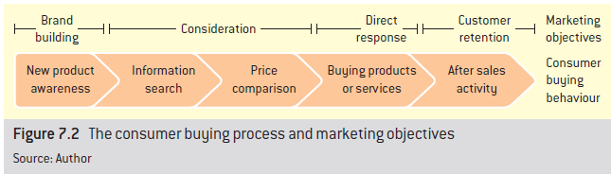
The effects of e-business technologies on marketing strategy
Marketing objectives
Brand building
Consideration
Direct response
Customer retention
Distinguish between first and second generation marketing tools
First e.g. email, search marketing
Second e.g. social networks, virtual worlds

Slide 11
The effects of e-business technologies on marketing strategy
Brand sponsorship and display advertising are thought to be best for attaining brand building objectives.
Search marketing appears to be most popular at the two pre-purchase stages (including information search and price comparison).
Referral via affiliates works best against consideration and direct response objectives.
Email marketing is strongly associated with both direct response and customer retention, whilst podcasts also seem to be particularly popular in relation to the objective of retention.
So-called emerging vehicles (which include blogs, virtual worlds, widgets, generated the highest number of ‘don’ knows’ amongst respondents (Court et al.,2007).

Slide 12
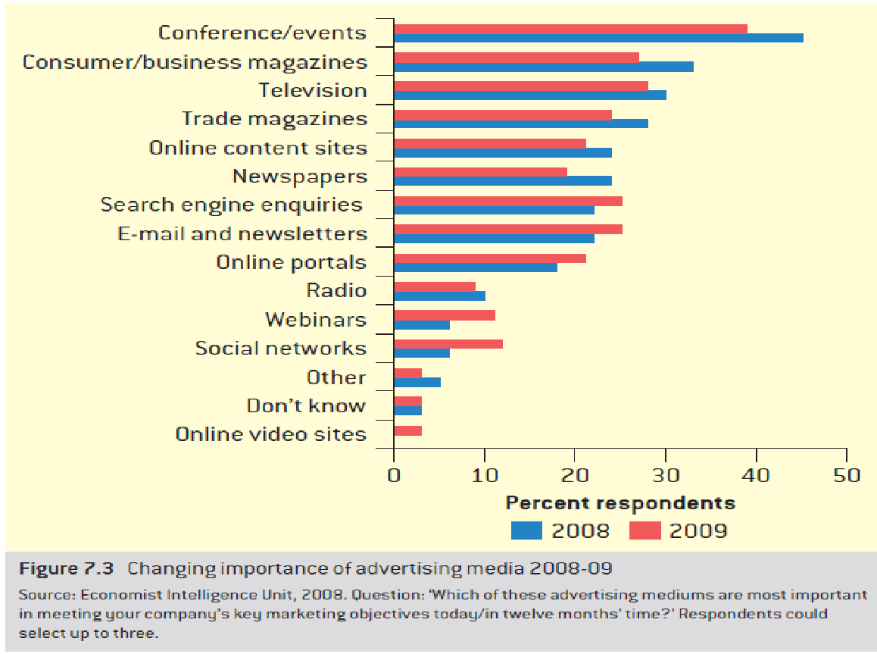
The effects of e-business technologies on marketing strategy

Slide 13
Barriers of digital marketing tools
Usage often over-reported
Barriers to actual usage include
Lack of measurement mechanisms: firms are often unwilling to adopt marketing techniques without a corresponding mechanism for measuring their effectiveness;
Lack of internal capabilities: whilst firms may be interested in principle in adopting a wide range of digital marketing techniques, the relative lack of skills and capabilities within the organization may slow down or prevent such adoption; and
Problems convincing management: fast-moving developments in digital marketing mean that, while there may be relatively well-informed individuals aware of such techniques within marketing departments, they have difficulty convincing less aware and more risk averse senior managers of the appropriateness of such techniques for particular firms
Difficulties in integrating conventional and digital marketing activities

Slide 14
The effects of e-business technologies on marketing strategy
The challenge of digital marketing
“The data flows are very complex and marketers are struggling to figure out how to manage them. Multiple streams of data, from advertising servers, search engines, websites, and offline activity, rarely measured in the same way, are bombarding marketing organizations.’
Edelman, 2007

Slide 15
Customer retention and e-CRM
CRM is defined conventionally as
“Using the appropriate mix of marketing tools to create and manage relationships with customers” –charted Institute of marketing, 2001
e-CRM
e-CRM (electronic-CRM) makes all kinds of interactions between all the parties involved possible, not just between firms and customers, but also with intermediaries and other business partners.
Features of e-CRM
More consistent
More trackable and measurable;
Faster
Cheaper, and
More customer-controlled

Slide 16
Customer retention and e-CRM
How effective is e-CRM?
While tracking 650 million visitors to eight different kinds of websites, and found a strong association between measures taken to increase customer retention and loyalty, and profitability (Agrawal et. al 2001)
The best performing sites achieves a customer conversion rate of 12% (against 2.5%) and repeat-purchase rate of 60% (against an average of 18%) better than poor performers.
Case : HP Technology@Work

Slide 17
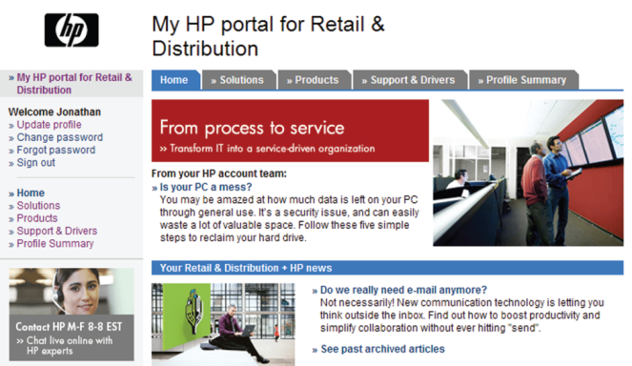
Customer retention and e-CRM
Case : HP Technology@Work

Slide 18
Customer retention and e-CRM
Case : HP Technology@Work
One of the world’s largest IT companies with revenue of over $104bn and with a portfolio of products ranging from printing and personal computing to software, service and IT infrastructure.
2003 merger with Compaq generated an urgent need for integrated communications with 1bn customers in 170 markets
Technology@Work engagement strategy
Benefits: raising brand awareness, reduction in inbound service calls, better sales-tracking capability
Questions
What other benefits accrue to HP from this integrated digital marketing activity? Are there any hidden costs to the business of engaging in this form of post-sales communication with customers?
Maintenance of HP brand in the mind of customers
Reduction of inbound service calls in call centres.
Increased re-purchase.
Estimated influence of around $100m in sales.

Slide 19
Measuring the extend of Digital Marketing Activity
No fully internationally comparable data available.
Very rapid growth of new promotional channels can quickly change the picture
Recent recession-related effects on both absolute advertising and marketing spending and mix
Other ways of understanding extent of DM activity
E.g. Google Trends data
Measuring ‘marketing buzz’ through vehicles such as Twitter
Longer terms trends in effectiveness of DM
Less effective: newspapers, Yellow Pages
More effective: Search Engine Marketing, social media, mobile

Slide 20
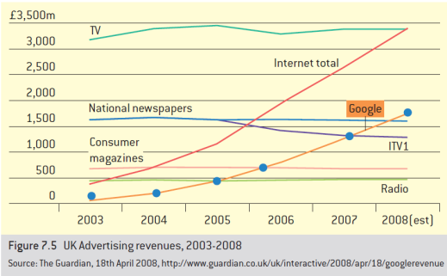
Measuring the extend of Digital Marketing Activity
What do the statistics show?

Slide 21
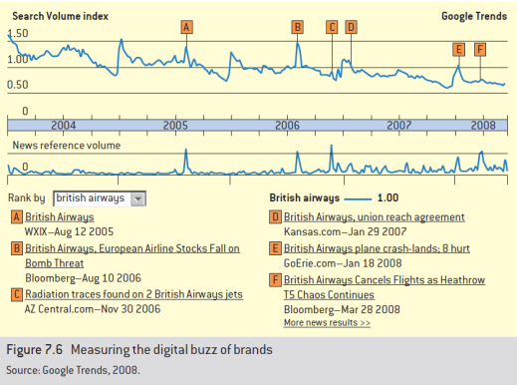
Measuring the extend of Digital Marketing Activity
What do the statistics show?

Slide 22
Digital marketing toolkit
Tool |  | Description | Examples
First generation digital marketing tools
Email Marketing | Targeted communications composed and transmitted from a computer network. |  |  | Email marketing service providers. www.e-dialog.com
Online advertising | Commercial messages placed on third-party web sites |  |  | Ad serving businesses. www.doubleclick.com
Podcasts/ video podcasts,/ webcasts | Digital media files distributed via electronic networks and listened to on an mp3 player / radio |  |  | Podcast aggregator www.podcast.com
Referrals & affiliate marketing | Revenue sharing between online advertisers/ merchants and other online publishers |  |  | Commission junction www.cj.com
Search Marketing | Website promotion through optimization of search engine results pages |  |  | Google adwords www.google.com/adwords

Slide 23
Digital marketing toolkit
Tool |  | Description | Examples
Second generation digital marketing tools
Blogs | Online journals or weblogs |  |  | www.shineyshiney.tv
Online gaming | Massive multiplayer games or networked games consoles |  |  | World of Warcraft Worldofwarcraft.com
Mashups | Integration of data from more than one source into a single application |  |  | www.mapdango.com
Social networks | Online aggregations of common interests, talents, or knowledge created and maintained by end users; commercially these can be manifested by brand communities |  |  | Harley davidson user forums www.hdforums.com
Virtual worlds (viral marketing) | Holistic online environments |  |  | www.secondlife.com
Widgets | Programs allowing immediate access to specific web-based content |  |  | www.clearspring .com

Slide 24
First Generation Marketing tools
Email Marketing
Email marketing benefits
Lower cost
Faster delivery & response
‘Push’ rather than ‘pull’
Better for niche markets
Performance more easily trackable
Email marketing costs
Information overload
Impact on brand reputation
Increasing legal issues
Effectiveness measurement
Open rate, click through rate, click-to-open

Slide 25
First Generation Marketing tools
Online advertising
‘It seems as though we are at the point where online advertising is an obsolete term. The best marketing initiatives are rarely limited to online channels, and the best ideas marketers are exploring are really not advertising at all.’ Edelman, 2007
Types
Standard image/text link
Flash
Rich media: animation, sound, video, interactivity,
Sponsored links
Challenges
‘Web ads don’t work’ – Jakob Nielsen
Average user exposed to 40,000 tv commercials a year
Ad blocking software
Essentials of a good online advertisement
Clarity
Relevance (with the site)
Content
Intention : What happens when clicked?

Slide 26
First Generation Marketing tools
Search Engine Marketing (SEM)
Search engine marketing
Biggest online target marketing opportunity
European SEM market size is Euro 8.1bn in 2012
Google
Biggest search engine marketer
AdWords (2000); AdSense (2002)
Placement or keyword targeting
Benefits of AdWords
Reach (80% US internet users employ Google)
Cost (no minimum spend; pay only for impressions or click throughs)
Timing (continuous matching of available adverts with users)
Flexibility (advert available for targeting within 15 minutes of uploading)
“Behavioural targeting firms are doing the rounds in Europe and America offering the prospect of working out what web surfers are thinking, perhaps even before they know it themselves.’ The Economist, 7 June 2008

Slide 27
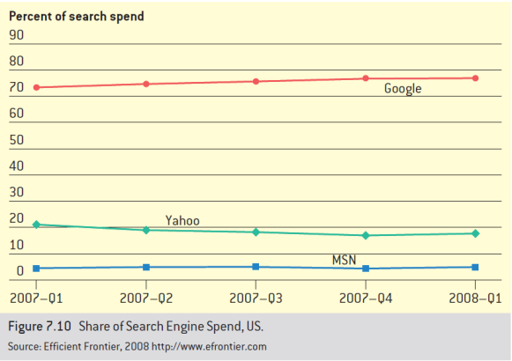
Search Engine Marketing (SEM)
What do the statistics show?

Slide 28
First Generation Marketing tools
Affiliate Marketing
Is a form of online promotion where individuals who introduce new clients to a business are compensated for their efforts.
In digital marketing application, online merchants or advertisers pay publishers only for results i.e. visitor making purchase or filling out a form.
Advantages of Affiliate Marketing
Improved brand awareness: increase exposure
Improved conversion: generates sales
Improved metrics: better accounting for referrals
Improved cost base: reduce duplication of commission
Risks with Affiliate Marketing
Earning Risks: risk of paying to own generated sales also
Cost risks: search cost may go high if not controlled
Reputational Risks: risks with the affiliated websites being non-credible

Slide 29
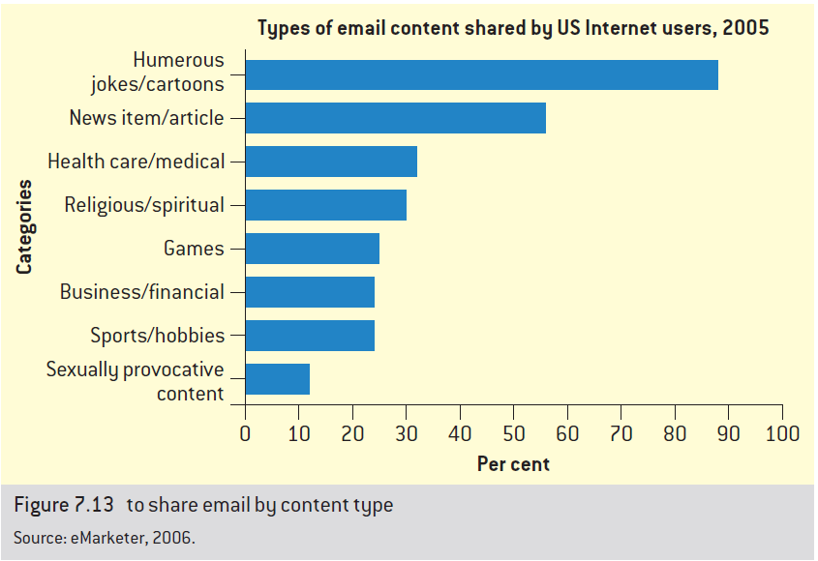
Second Generation Marketing tools

Slide 30
Second Generation Marketing Tools
Viral Marketing
Viral marketing:
“A mechanism that facilitates and encourages people to pass along a marketing message voluntarily.”
Term is Attributed to Professor Jeffrey Rayport, 1995 of Harvard Business school
Example: Just 10 emails sent to friends for given reasons results insignificant number of forwarding.
Objective: identify highly socially networked individuals who are capable and willing to pass a message along.

Slide 31
Second Generation Marketing Tools
Viral Marketing
Six rules of Viral Marketing
Stealth is the essence of market entry: Unusual product placements or contexts
What’s up front is free – payment comes later: free software with limited range of functions.
Let the behaviours of the target community carry the message: Chance to meet/talk/ take picture sports celebrity when sold tickets by fans
Look like a host, not a message: be a part of the message; eg. Nike: Just Do It, Being Human,
Exploit the strength of ‘weak ties’: Spread messages with individuals having weaker social ties
Invest to reach the tipping point: e-business sites reach faster than conventional channel if used proper channel. Normally half of the most popular content on youtube is commercial in nature.

Slide 32
Discussion questions/ Assignments
“Digital Marketing leveraged more opportunities in Marketing” critically discuss.
How marketers use DM in advertising to create profit.
What is difference between market driven and driving market approaches of marketing.
What are the effects of e-business technologies in marketing strategies.
What are prominent impediments of DM tools?
Do e-business technologies help in customer retention and e-CRM? If yes explain with arguments.
Describe first generations of DM tools with examples.
Viral marketing is being more effective tool of marketing using e-business technologies. Explain.

