Slide 1
Essential of E-Business
Chapter outlines
Unit 1: Introduction 6 Hours
Concept of e-business; Nature, scope, and impact of e-business technologies; Difference between e-business and e-commerce; History and development of e-business; Advantages of e-business; Business model for e-products and e-services; Contribution of e-business technologies to economic growth, market, competitiveness, and productivity.
Unit 2: Technologies in e-business 8 Hours
Introduction; e-business technologies - hardware, e-business software applications, internet and World Wide Web; Database management system; e-business security; Online payment technology; IT/IS evaluation and e-business; Social consequences of e-business technologies.
Unit 3: Digital Marketing 7 Hours
Concept; Effects of e-business technologies on marketing strategy, customer retention and e-CRM; Measuring the extent of digital marketing activity; Market analysis; Digital marketing tools; Viral marketing.

Slide 2
Essential of E-Business
Chapter outlines
Unit 4: E-Business and Operations management 6 Hours
Difference between purchase and procurement; Market solutions - sell-side, buy-side, and market place; Integration of product catalogue; Procurement service providing.
Unit 5: E-Contracting 4 Hours
Concept of generic services - information, negotiation, archiving, enforcement, reconciliation; Structure of a contract; Digital signature; Legal affairs.
Unit 6: Online Distribution 5 Hours
Components of a distribution system; Characterization of online distribution; hybrid distribution networks; Model for electronic software distribution.
Unit 7: E-Payment System 6 Hours
Characteristics of payment system; Classification of payment systems - E-cash, E-check, overview of smart card; Applications of IPSec.
Unit 8: E-Business Plan Development 3 Hours
Students must develop an E-Business Plan; The business plan must incorporate IT-features that would address complete requirements to run a specified business.

Slide 3
Essential of E-Business
Unit – Four
E-business and Operations Management
Difference between purchase and procurement;
Market solutions - sell-side, buy-side, and market place;
Integration of product catalogue;
Procurement service providing.

Slide 4
Purchase and Procurement: Introduction
Elements involved
Buyer
Seller
Organization
Process/function:
Supply Chain Management

Slide 5
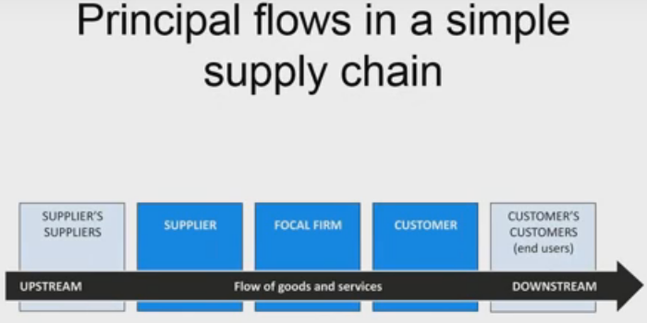
Introduction

Slide 6
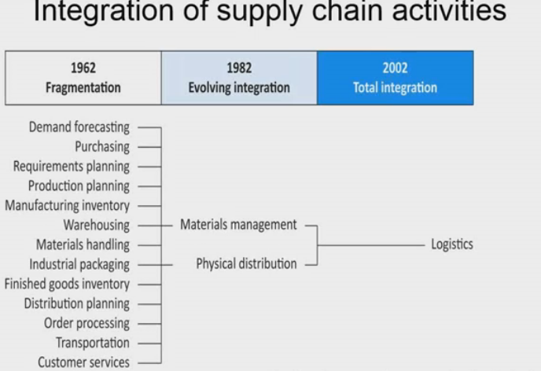
Introduction

Slide 7
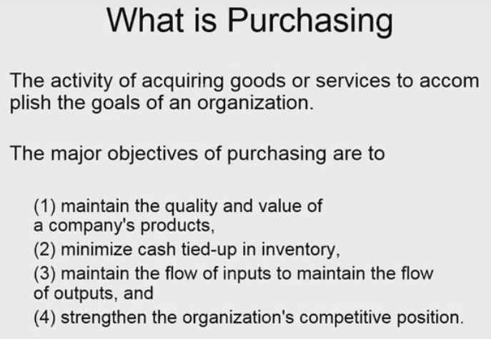
Difference between purchase &Procurement

Slide 8
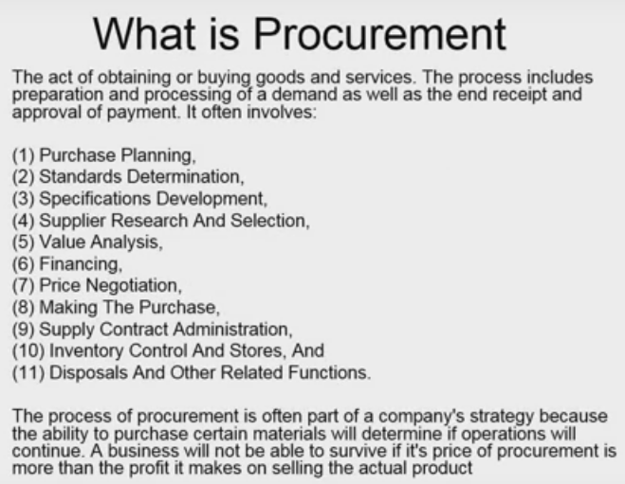
Essential of E-Business
Purchase and Procurement

Slide 9
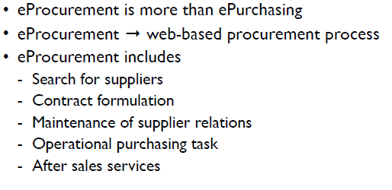
E-procurement

Slide 10
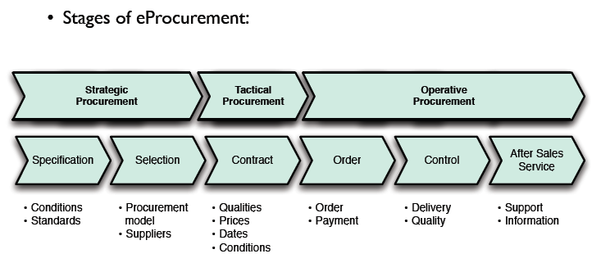
Internet based procurement process

Slide 11
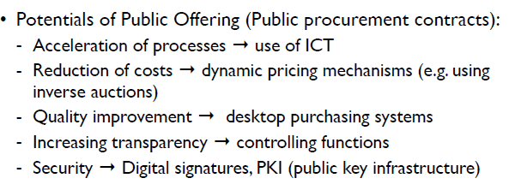
Internet based procurement process: Advantages

Slide 12
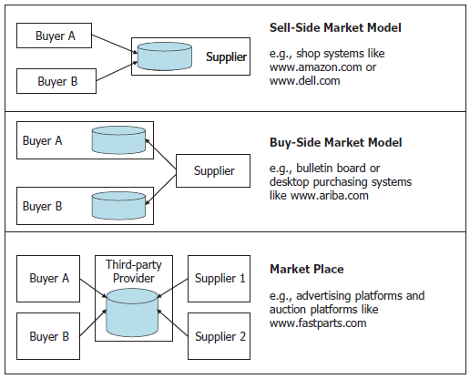
E-procurement solutions

Slide 13
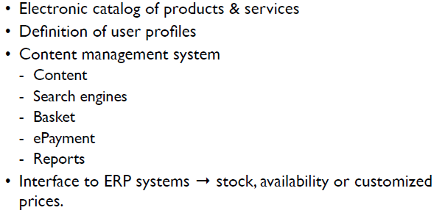
Component of a e-procurement model

Slide 14
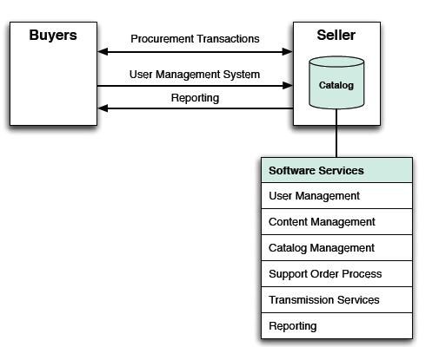
Seller-side procurement Model

Slide 15
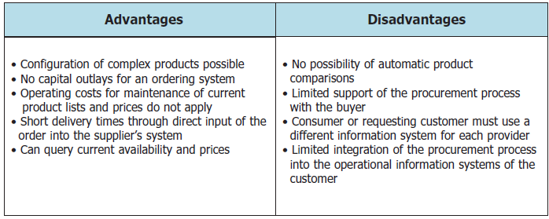
Pros & Cons of sell-side Model

Slide 16
Four drivers to adoption of sell-side e-commerce by business.
Free Marketing: The marketing cost are reduced due to the sales and advertising is done online.
Expand their market: It is beneficial for businesses to utilize sell-side e-commerce to increase the amount of consumers they can target across a larger geographic area.
Decrease amount of inventory needed/free-up capital: In online system, the company would be able to implement a JIT distribution system reducing the amount of inventory they would need to store.
Reduce the risk of loss: By doing business through sell-side e-commerce businesses will be able to reduce the risk of loss to the business.

Slide 17
Four barriers to adoption of sell-side e-commerce by business
Identification of products or services can be tricky due to poor quality content which includes descriptions and images as well as poor searching capabilities.
Cultural barriers which includes internet accessibility and language barriers.
Customers fear of change. Some customer would be more inclined to use the internet as a way to purchase goods and services as opposed to others. Therefore the customer base could be reduced by the adoption of sell side E-Commerce however this could depend on the target market.
Lack of technical competency. The customer might not have technical knowledge or understanding to use the online store.

Slide 18
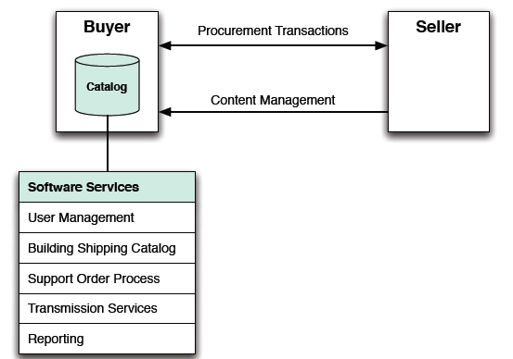
Buyer-side procurement Model

Slide 19
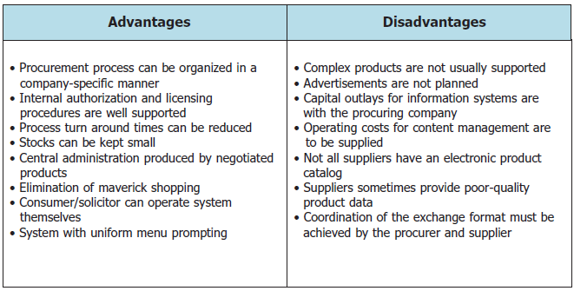
Pros & Cons of buy-side Model

Slide 20
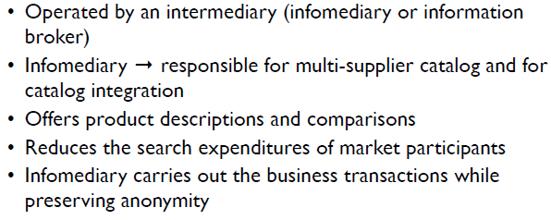
Market-place procurement Model

Slide 21
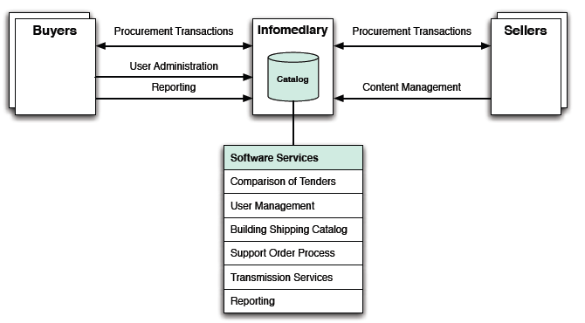
Market place procurement Model

Slide 22
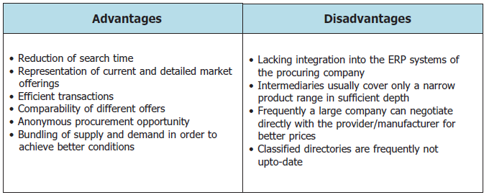
Pros & Cons of market-place Model

Slide 23
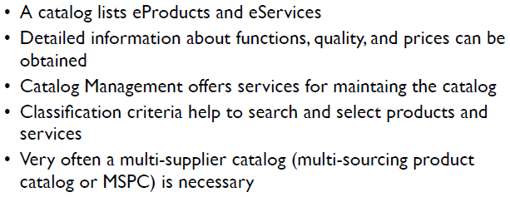
Catalog Management

Slide 24
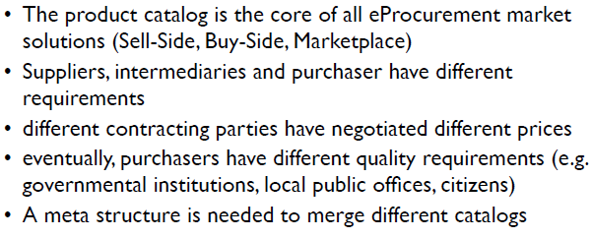
Catalog Integration

Slide 25
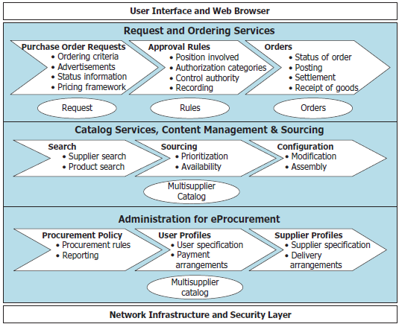
E-Procurement service providers

Slide 26
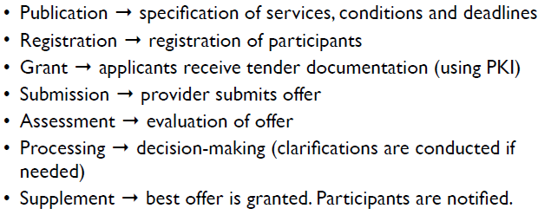
Public offering via Internet

Slide 27
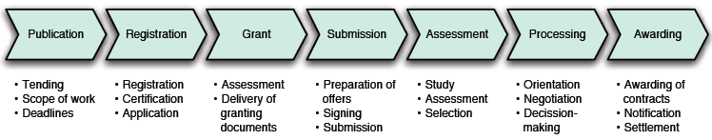
Public offering via Internet

Slide 28
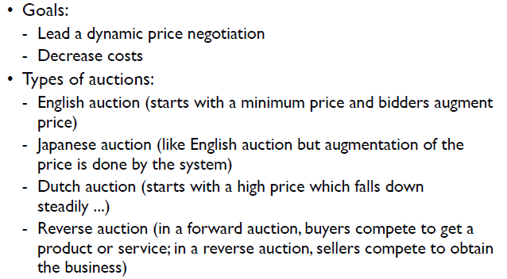
Conducting Auctions

Slide 29
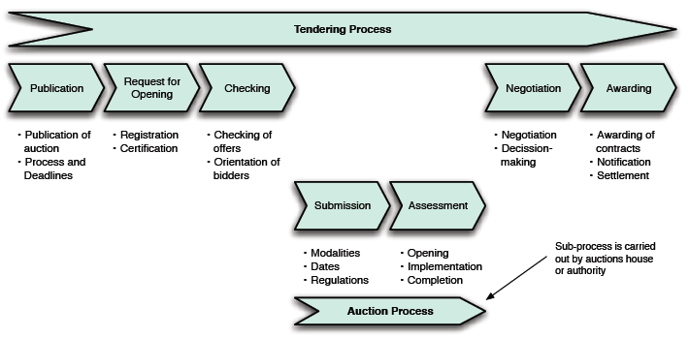
Tendering process with Auctions

Slide 30
Assignments
Write few paragraphs describing the current importance of ICT in your personal/ student/ professional life.
In what way e-procurement is efficient than conventional purchasing.

