Slide 1
Essential of E-Business
Chapter outlines
Unit 1: Introduction 6 Hours
Concept of e-business; Nature, scope, and impact of e-business technologies; Difference between e-business and e-commerce; History and development of e-business; Advantages of e-business; Business model for e-products and e-services; Contribution of e-business technologies to economic growth, market, competitiveness, and productivity.
Unit 2: Technologies in e-business 8 Hours
Introduction; e-business technologies - hardware, e-business software applications, internet and World Wide Web; Database management system; e-business security; Online payment technology; IT/IS evaluation and e-business; Social consequences of e-business technologies.
Unit 3: Digital Marketing 7 Hours
Concept; Effects of e-business technologies on marketing strategy, customer retention and e-CRM; Measuring the extent of digital marketing activity; Market analysis; Digital marketing tools; Viral marketing.

Slide 2
Essential of E-Business
Chapter outlines
Unit 4: E-Business and Operations management 6 Hours
Difference between purchase and procurement; Market solutions - sell-side, buy-side, and market place; Integration of product catalogue; Procurement service providing.
Unit 5: E-Contracting 4 Hours
Concept of generic services - information, negotiation, archiving, enforcement, reconciliation; Structure of a contract; Digital signature; Legal affairs.
Unit 6: Online Distribution 5 Hours
Components of a distribution system; Characterization of online distribution; hybrid distribution networks; Model for electronic software distribution.
Unit 7: E-Payment System 6 Hours
Characteristics of payment system; Classification of payment systems - E-cash, E-check, overview of smart card; Applications of IPSec.
Unit 8: E-Business Plan Development 3 Hours
Students must develop an E-Business Plan; The business plan must incorporate IT-features that would address complete requirements to run a specified business.

Slide 3
Essential of E-Business
Unit – Five
E-contracting
Concept of generic services –
-Information,
- negotiation,
- archiving,
- enforcement,
-reconciliation;
Structure of a contract;
Digital signature;
Legal affairs.

Slide 4
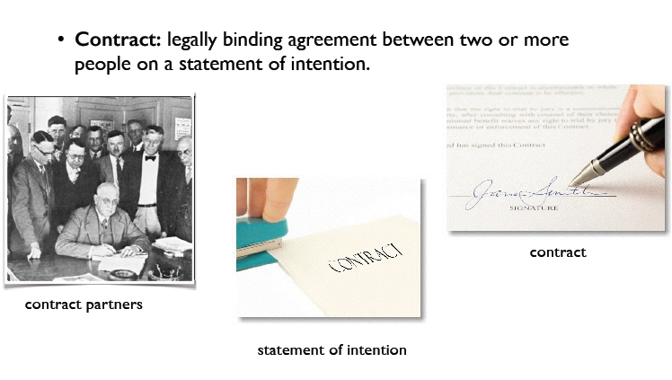
E-Contracting: Introduction/Structure

Slide 5
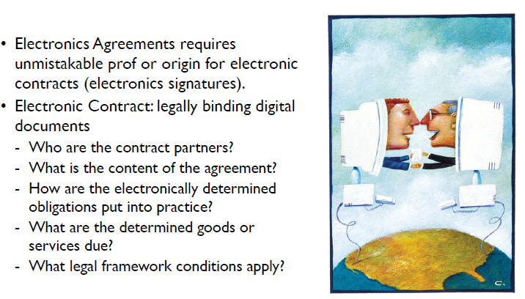
E-Contracting- information

Slide 6
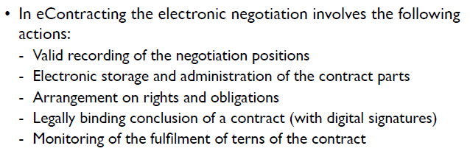
E-Contracting-negotiation

Slide 7
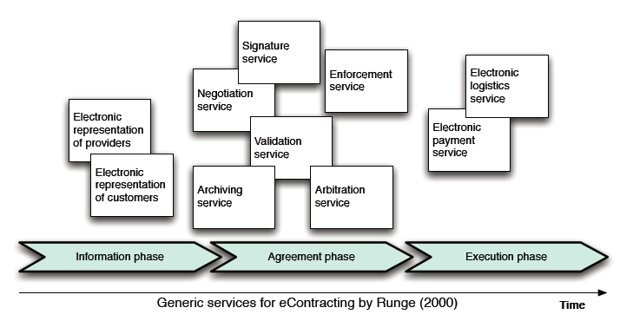
E-Contracting-negotiation process

Slide 8
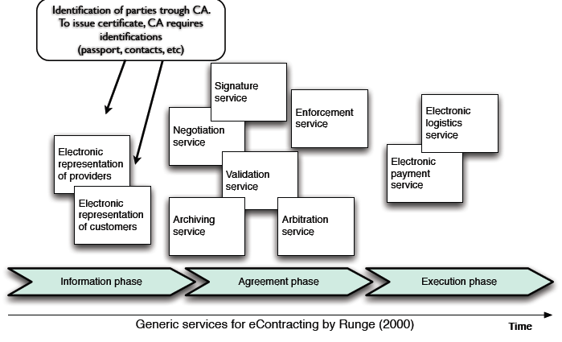
E-Contracting-negotiation process

Slide 9
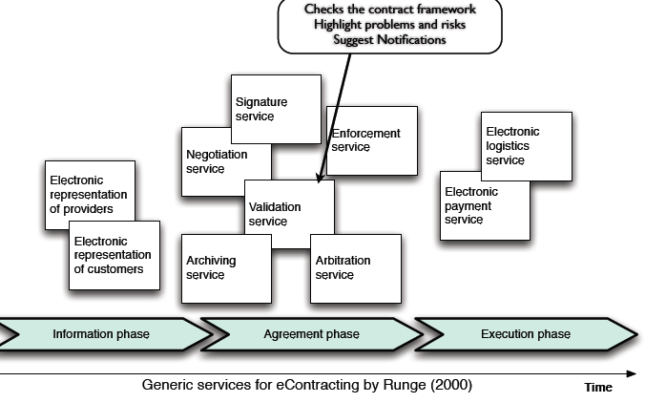
E-Contracting-negotiation process

Slide 10
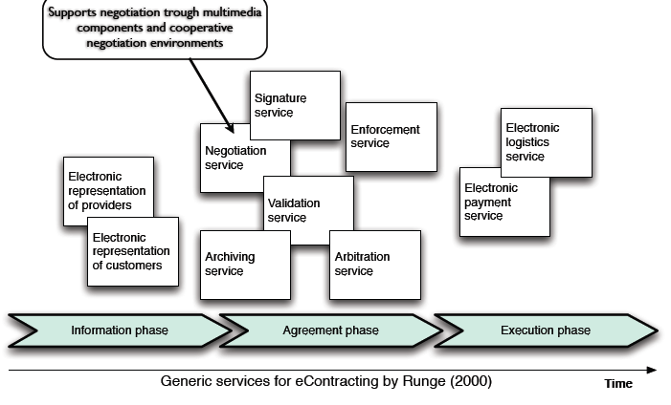
E-Contracting-negotiation process

Slide 11
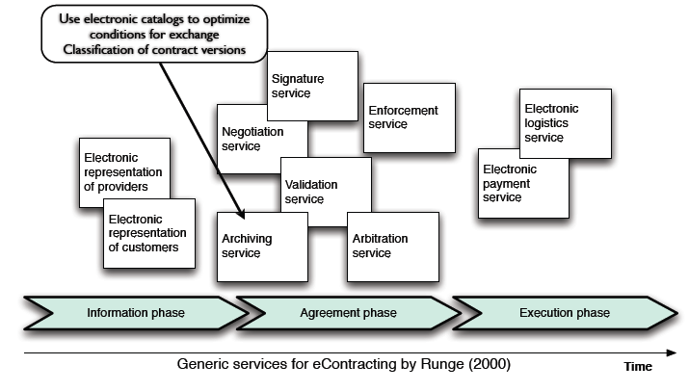
E-Contracting-negotiation process

Slide 12
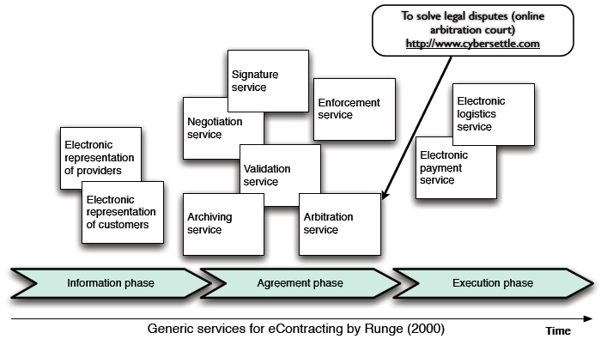
E-Contracting-negotiation process

Slide 13
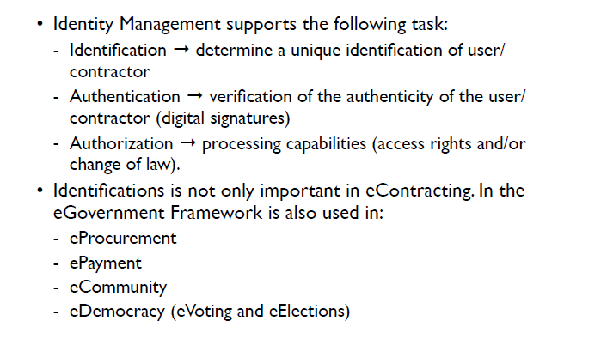
E-Contracting- Identity Management

Slide 14
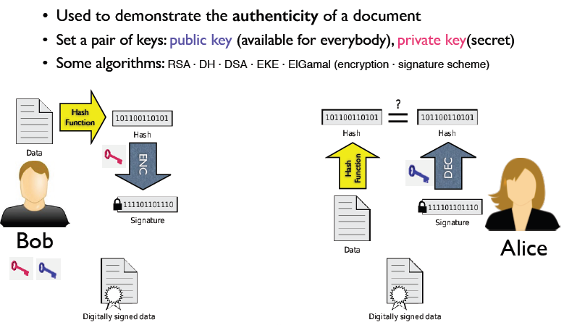
E-Contracting- Digital Signatures

Slide 15
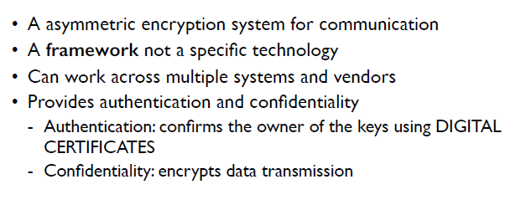
E-Contracting-Public Key

Slide 16
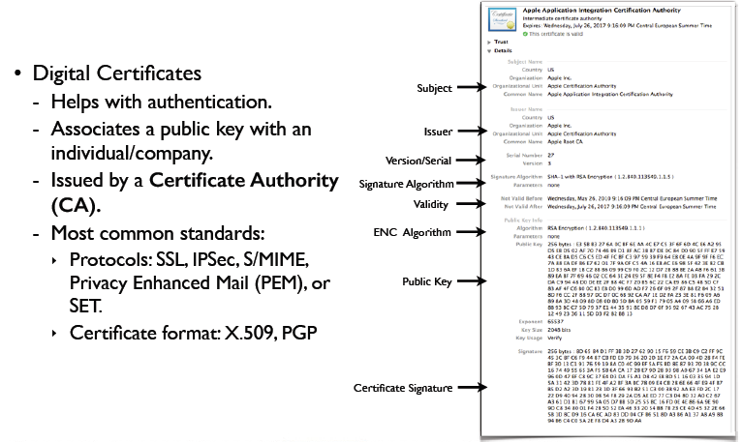
E-Contracting-Public key components

Slide 17
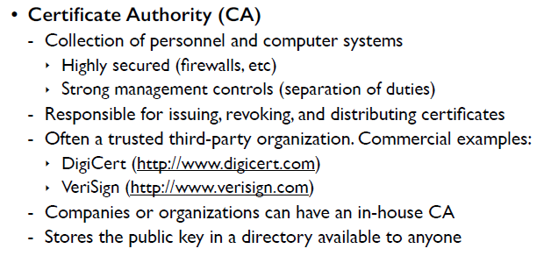
E-Contracting-Public key components

Slide 18
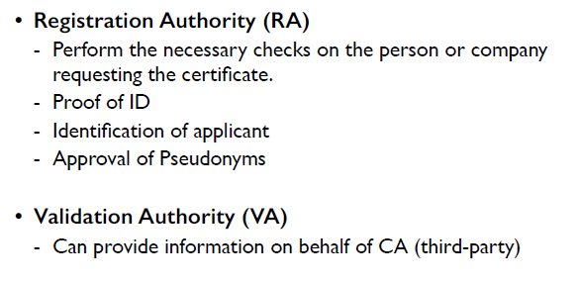
E-Contracting-Public key components

Slide 19
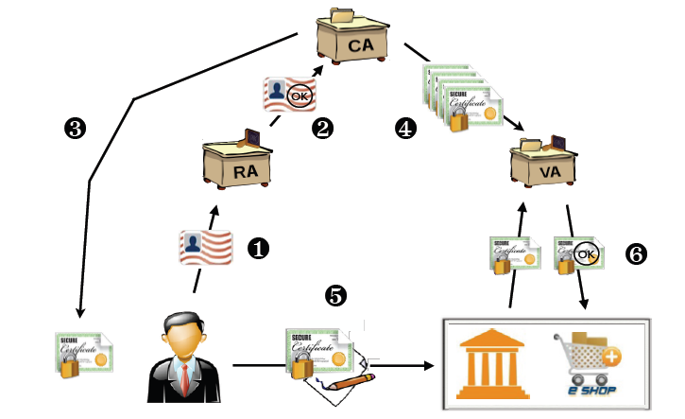
E-Contracting- How digital signatures applied?

