Slide 1
Essential of E-Business
Chapter outlines
Unit 1: Introduction 6 Hours
Concept of e-business; Nature, scope, and impact of e-business technologies; Difference between e-business and e-commerce; History and development of e-business; Advantages of e-business; Business model for e-products and e-services; Contribution of e-business technologies to economic growth, market, competitiveness, and productivity.
Unit 2: Technologies in e-business 8 Hours
Introduction; e-business technologies - hardware, e-business software applications, internet and World Wide Web; Database management system; e-business security; Online payment technology; IT/IS evaluation and e-business; Social consequences of e-business technologies.
Unit 3: Digital Marketing 7 Hours
Concept; Effects of e-business technologies on marketing strategy, customer retention and e-CRM; Measuring the extent of digital marketing activity; Market analysis; Digital marketing tools; Viral marketing.

Slide 2
Essential of E-Business
Chapter outlines
Unit 4: E-Business and Operations management 6 Hours
Difference between purchase and procurement; Market solutions - sell-side, buy-side, and market place; Integration of product catalogue; Procurement service providing.
Unit 5: E-Contracting 4 Hours
Concept of generic services - information, negotiation, archiving, enforcement, reconciliation; Structure of a contract; Digital signature; Legal affairs.
Unit 6: Online Distribution 5 Hours
Components of a distribution system; Characterization of online distribution; hybrid distribution networks; Model for electronic software distribution.
Unit 7: E-Payment System 6 Hours
Characteristics of payment system; Classification of payment systems - E-cash, E-check, overview of smart card; Applications of IPSec.
Unit 8: E-Business Plan Development 3 Hours
Students must develop an E-Business Plan; The business plan must incorporate IT-features that would address complete requirements to run a specified business.

Slide 3
Essential of E-Business
Unit – Six
Online Distribution
Components of a distribution system;
Characterization of online distribution;
hybrid distribution networks;
Model for electronic software distribution.

Slide 4
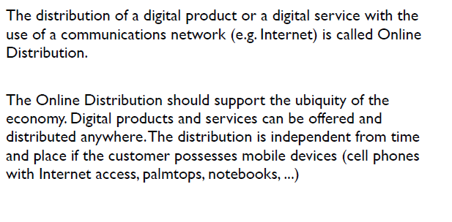
Online Distribution

Slide 5
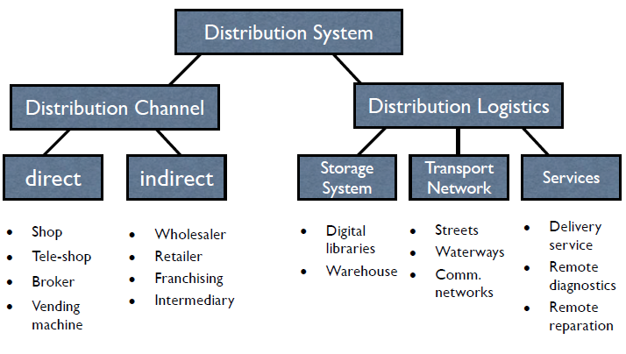

Component of a distribution systems

Slide 6
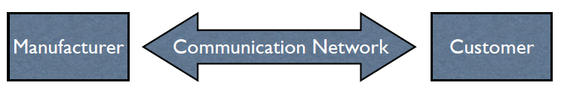
Direct Distribution Channel
Digital Transmission Medium

Slide 7
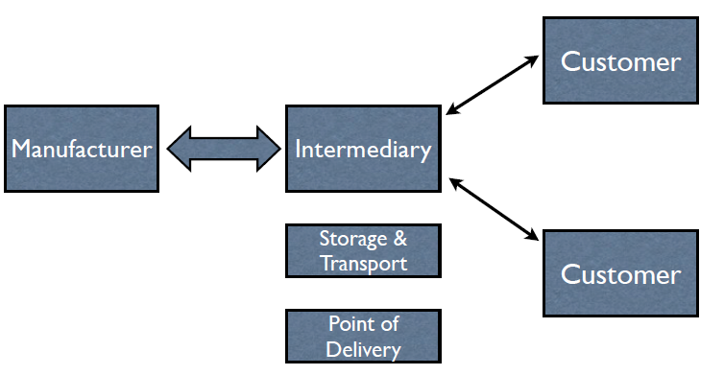
Indirect Distribution Channel

Slide 8
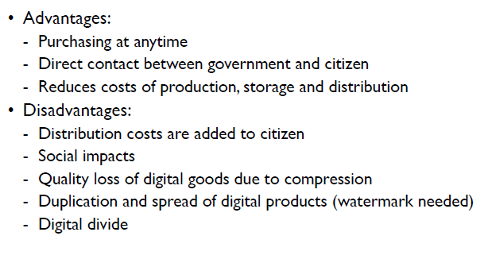
Advantages and Disadvantages of Online distribution channel

Slide 9
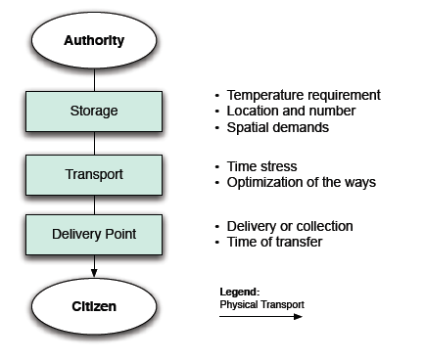
Offline Distribution channel (Logistics)

Slide 10
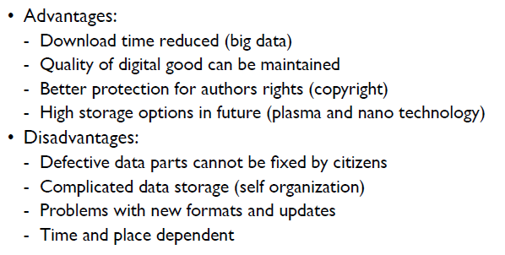
Advantages and Disadvantages of Offline distribution channel

Slide 11
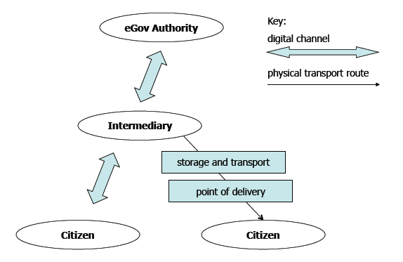
Hybrid Distribution Networks: Online and Offline both channels used.

Slide 12
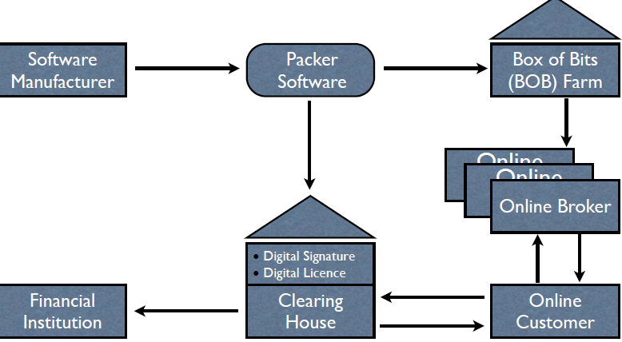
Model for electronic software distribution (ESD).

Slide 13
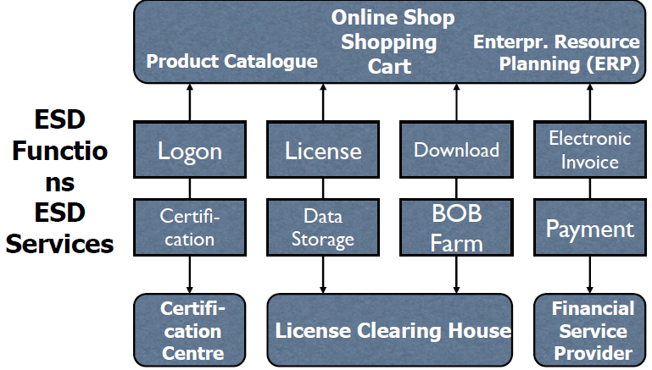
Architecture of an ESD system for online brokers

Slide 14
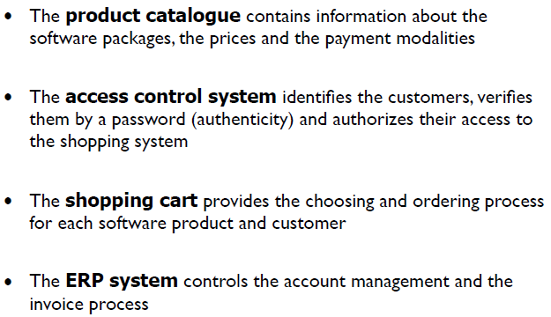
Standard Components of Software shopping system

Slide 15
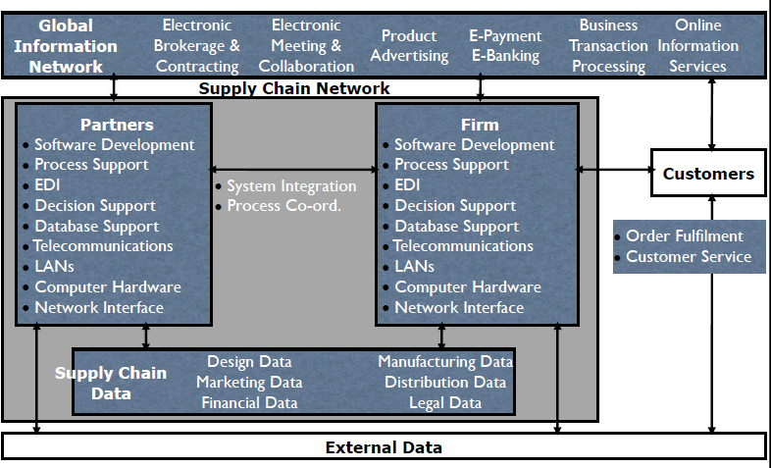
Infrastructure for web based SCM

Slide 16
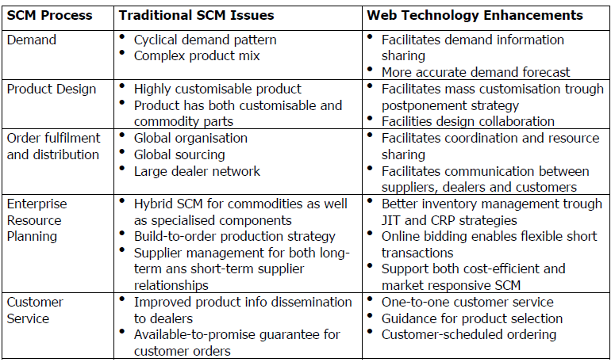
Traditional vs. web based SCM (Supply Chain Management)

