Slide 1
Essential of E-Business
Chapter outlines
Unit 1: Introduction 6 Hours
Concept of e-business; Nature, scope, and impact of e-business technologies; Difference between e-business and e-commerce; History and development of e-business; Advantages of e-business; Business model for e-products and e-services; Contribution of e-business technologies to economic growth, market, competitiveness, and productivity.
Unit 2: Technologies in e-business 8 Hours
Introduction; e-business technologies - hardware, e-business software applications, internet and World Wide Web; Database management system; e-business security; Online payment technology; IT/IS evaluation and e-business; Social consequences of e-business technologies.
Unit 3: Digital Marketing 7 Hours
Concept; Effects of e-business technologies on marketing strategy, customer retention and e-CRM; Measuring the extent of digital marketing activity; Market analysis; Digital marketing tools; Viral marketing.

Slide 2
Essential of E-Business
Chapter outlines
Unit 4: E-Business and Operations management 6 Hours
Difference between purchase and procurement; Market solutions - sell-side, buy-side, and market place; Integration of product catalogue; Procurement service providing.
Unit 5: E-Contracting 4 Hours
Concept of generic services - information, negotiation, archiving, enforcement, reconciliation; Structure of a contract; Digital signature; Legal affairs.
Unit 6: Online Distribution 5 Hours
Components of a distribution system; Characterization of online distribution; hybrid distribution networks; Model for electronic software distribution.
Unit 7: E-Payment System 6 Hours
Characteristics of payment system; Classification of payment systems - E-cash, E-check, overview of smart card; Applications of IPSec.
Unit 8: E-Business Plan Development 3 Hours
Students must develop an E-Business Plan; The business plan must incorporate IT-features that would address complete requirements to run a specified business.

Slide 3
Essential of E-Business
Unit – Seven
E-payment System
Characteristics of payment system;
Classification of payment systems –
- E-cash,
- E-check,
- overview of smart card;
Applications of IPSec.

Slide 4
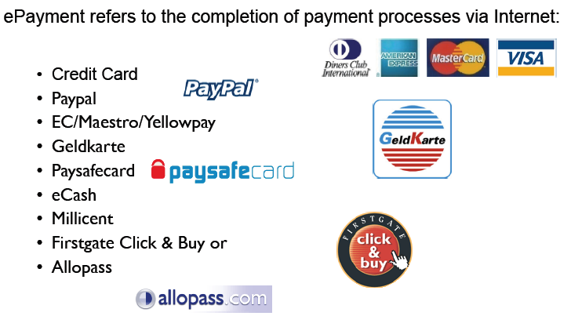
E-Payment

Slide 5
E-payment- characteristics
Electronic Payment process
A monetary transactions taking place using computer systems of buyers and sellers.
- Most vital step of e-commerce due to
A complex task
Security is the main issue
Wide variety of payment alternatives
New process are under development and testing
Variety of e-payments
- Web payment process
Electronic fund transfer
Secure electronic payments

Slide 6
E-Payment classification
E-Payment classification basis:
I- Classification based on amount of money
II- Confidentiality and anonymity of transaction
III- Time of Payment
III- Technical Solution

Slide 7
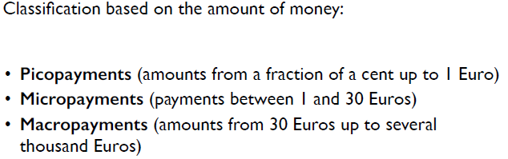
E-Payment classification I

Slide 8
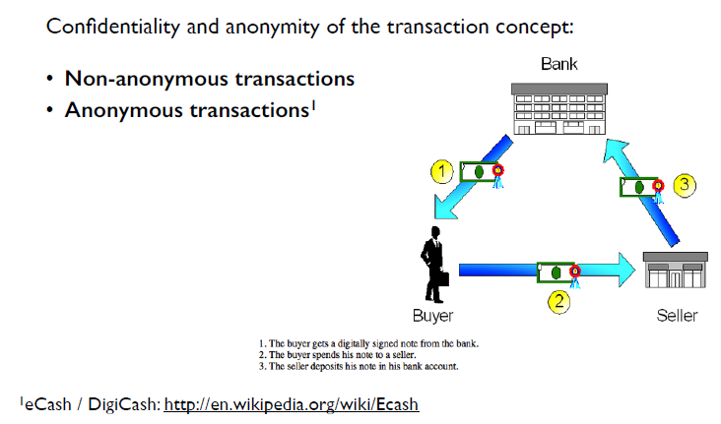
E-Payment classification II

Slide 9
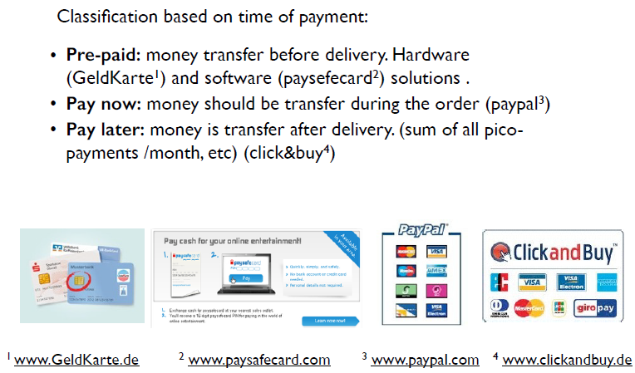
E-Payment classification III

Slide 10
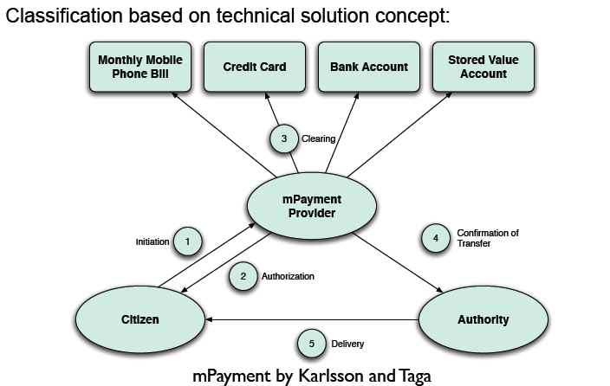
E-Payment classification IV

Slide 11
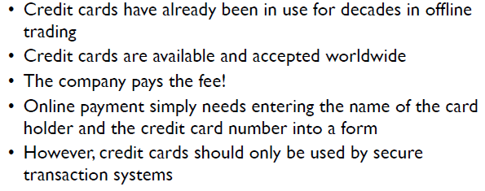
E-Payment with Cards

Slide 12
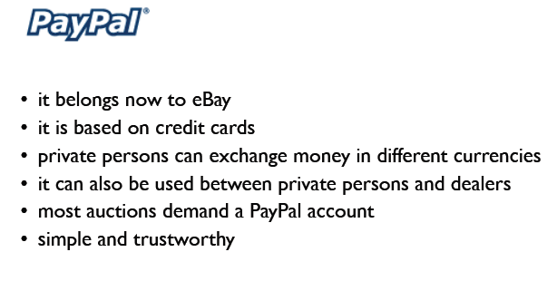
E-Payment with Cards- Example: PayPal

Slide 13
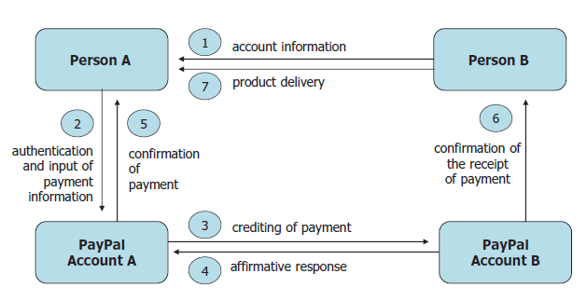
E-Payment with Cards- Example: PayPal (payment between two Individuals)

Slide 14
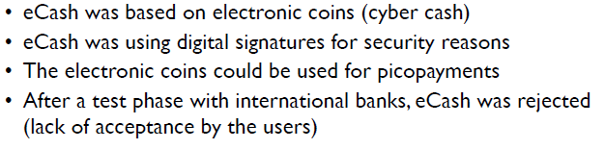
E-Cash An Innovative micropayment solution

Slide 15
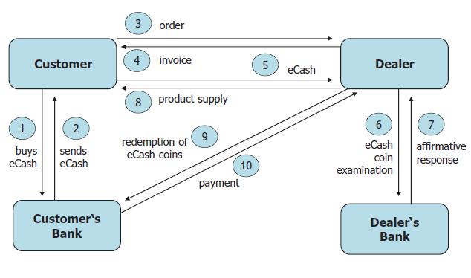
The E-Cash solution

Slide 16
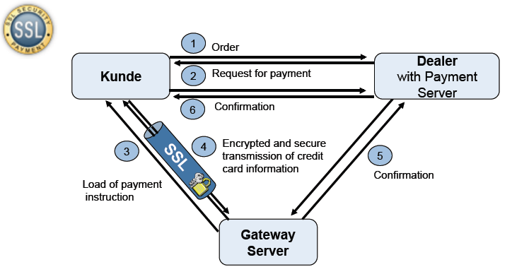
Security Solution on E-Payment: Secured Socket layer

Slide 17
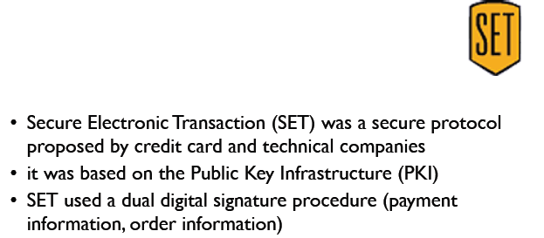
Secure Electronic Transaction (SET)

Slide 18
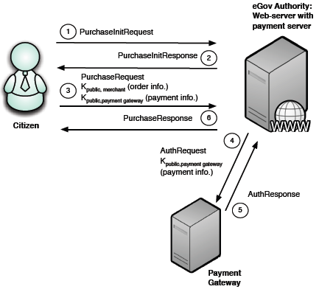
Use of Dual Signature: Public & Private Key

Slide 19
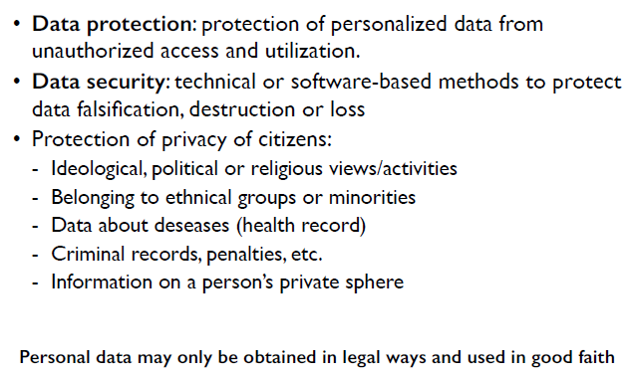
Security Issues on E-Payment systems Protection of Personal Data

Slide 20
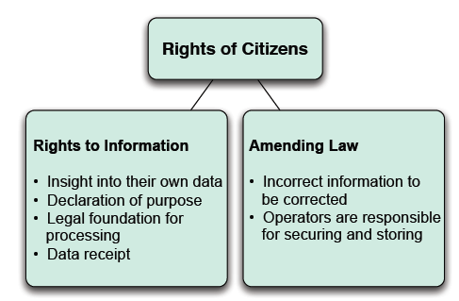
Security Issues on E-Payment systems Protection of Personal Data

Slide 21
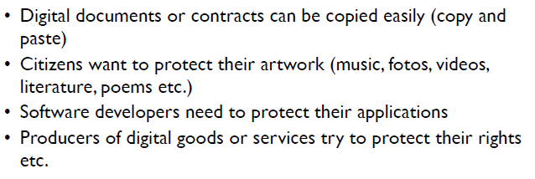
Security Issues on E-Payment systems Protection of Ownership

Slide 22
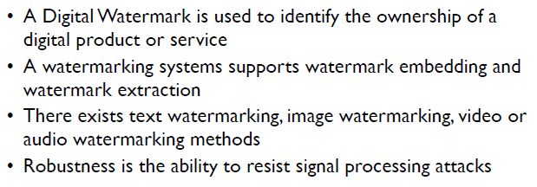
Security Issues on E-Payment systems Application of Digital Watermark

Slide 23
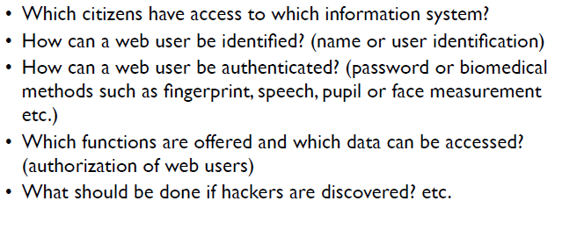
Security Issues on E-Payment systems Holistic Approach: Security Approach

Slide 24
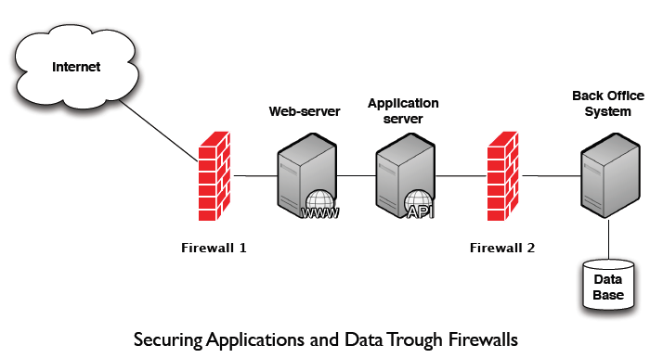
Security Issues on E-Payment systems Holistic Approach: Security Management

Slide 25
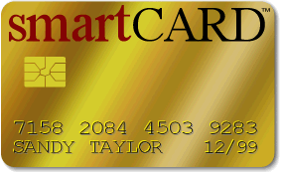
Smart Cards
Magnetic stripe
140 bytes, cost $0.20-0.75
Memory cards
1-4 KB memory, no processor, cost $1.00-2.50
Optical memory cards
4 megabytes read-only (CD-like), cost $7.00-12.00
Microprocessor cards
Imbedded microprocessor
(OLD) 8-bit processor, 16 KB ROM, 512 bytes RAM
Equivalent power to IBM XT PC, cost $7.00-15.00
32-bit processors now available
Intelligent, active devices with defenses
Notes:
52

Slide 26
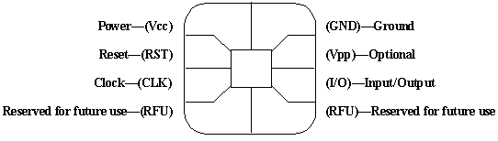
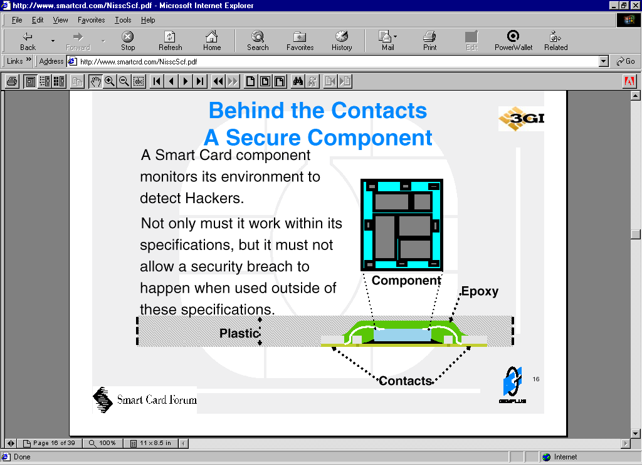
Smart Card Structure
Contacts:
Microprocessor
Contacts
Card
(Upside-down)
Epoxy
Contacts (8)
Notes:
52

Slide 27
Questions

