Slide 1

Notes:
Transferwise – Online Money Transfer

Slide 2
Company Context
Business Goal
User Need Opportunities
Solution and Experiments
Go To Market
Q&A

Slide 3
Company Context

Slide 4
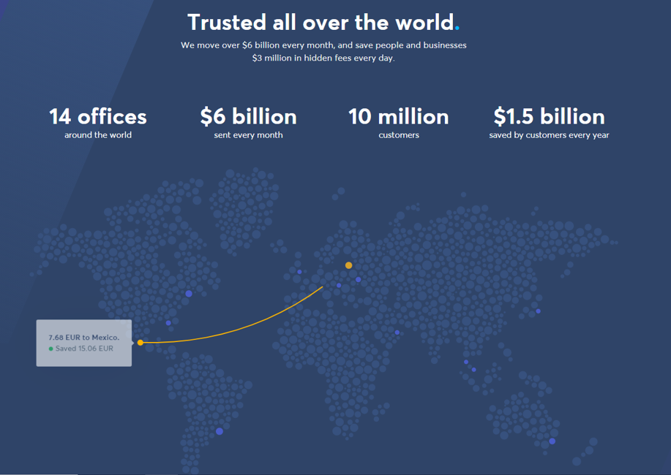
Who are we?
Vision: Make international payments simpler and fairer for users.
Notes:
Transferwise is a borderless, digital-only currency exchange platform
The company has pioneered the low-fee model, helping customers save ~90% on forex and remittance services compared to banks.
80 Plus Countries
50+ Currencies

Slide 5
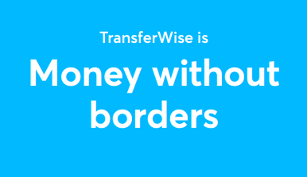
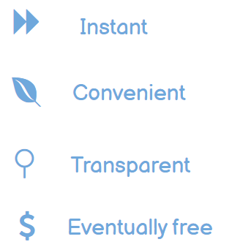
Mission
Making money move in any currency:
Notes:
We are powering money for people and business to pay, get paid, to spend, in any currency, wherever you are, whatever you are doing
We move money for people and businesses who live increasingly global lives. We help them send, spend, receive, pay and get paid – in any currency – for less

Slide 6
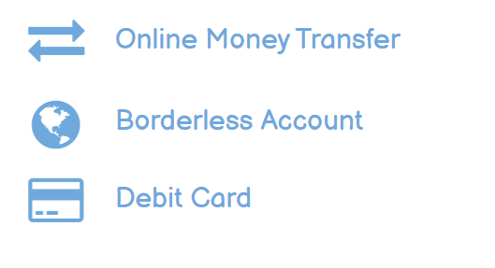
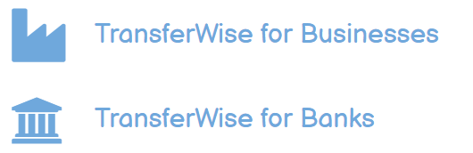
Products
Core Products (P2P, P2B, B2P)
B2B
Notes:
Suite of products that help people move, manage, spend and send money all around the world for less than incumbents for a faster way to do that and more convenient
Online Money Transfer (Sending money simple, cheap and fast)
Borderless Account (multi-currency account to both send and receive money from abroad)
Debit Card (spend money anywhere)
TransferWise for Business - Money Transfer services for Small- and medium-sized businesses (SMBs)
TransferWise for Banks - Partnering with Challenger Banks to offer international Money transfer services
P2P: International remittance to family/friends
P2B: Payment for e-commerce purchase online, Bill Payments (Utility, Mortgage payments)
B2P: Salaries to employees, freelancer working abroad
B2B: Supply chain payments to international vendors, suppliers (Pay invoices and people abroad, Integrate your accounting)
Automate work with our API
Problem: Cost of sending money abroad is not transparent and incumbent players (bank, PayPal, WU) use hefty markup on exchange rates (hidden fees baked in overall total cost of the transaction)
Solution: Bring transparency to international money transfer, help customer understand the problem along with speed and ease of transfer.
Strategy: Upfront Exchange rate and mid market exchange rate and compare

Slide 7
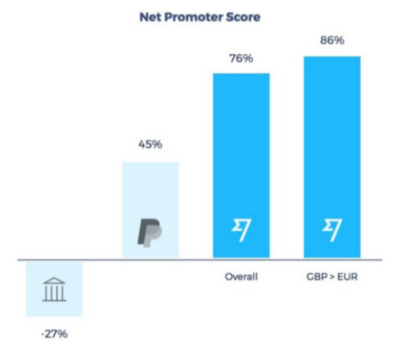

Key Success Metrics
Evangelism is the biggest driver of the growth!
Notes:
Over 60% of Transferwise revenue growth comes from word of mouth and this number has only grown over time.
Competitors
Autonomous Teams
NPS - likelihood of a customer to recommend the product to friends and colleagues
Two broad reasons while people recommend them.
Very Rational reasons (they talk directly about the product) – Customers talk about speed, price, convenience, coverage
Emotional reasons, where they talk about the mission – Transferwise calls this “cause-driven marketing”)
At Transferwise the solution is having independent autonomous teams. Each team has a clear focus which is tied to the mission — a set of concrete goals that would help the company achieve that mission.

Slide 8
Business Goal

Slide 9
Goal
To maximize long term value which is proportional to the number of Active Users will have at that time i.e., Improve retention
More Active Users
More Transactions
Faster Growth
Notes:
In most cases, it's not clear if a particular customer has churned or just dormant
How many customers stop using the product per month?
What are the main drivers for churn?
How to estimate retention improvement opportunities?

Slide 10
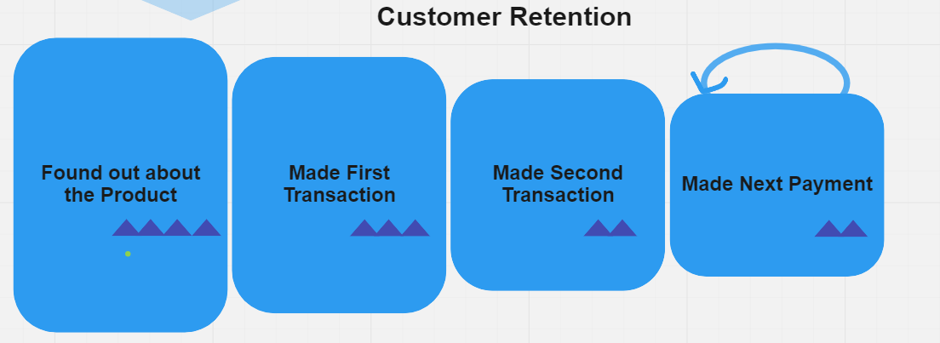
Understanding Customer Churn
No use case to use product
Doesn’t trust product
Doesn’t understand fees
Has better solution.
Failed to pay or use it.
Doesn’t have recurrent use case
Had a bad first transaction experience
Had exceptionally bad experience on previous transaction
Found a better alternative
Lost recurrent use case
Drop out reasons
Notes:
After customer made her first transfer if she has the repetitive scenario and she enjoyed the service her life in the service continues. She converts to second payment, then converts from second to a third, etc. Looking at retention at this angle allows to use all conversion funnel technics we know understand how much of customers we are losing at each step, and by talking with customers who have not converted, understand why they churned.

Slide 11
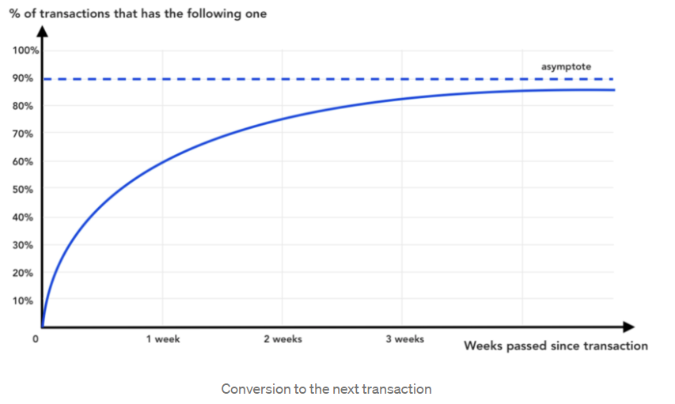
Retention Improvement Opportunities
Quantitative Insights – Study conversion to next transaction over time
10% transactions never convert to the next! i.e., churned
Inactivity time = 2.5 weeks
20 % churn rate!
50% false positive rate!
Notes:
We build a chart that shows conversion to next transaction over time. Let’s put days passed since the transaction on X-axis and on Y-axis show % of transactions that had a subsequent transaction after X days.
for selected transactions, 60% of them have at least one following successful transaction from the same customer 1 week after the transaction creation date
High frequency use cases - Most of them, however, converting in the first few days/weeks.
Then the chart growth slows down. Those are the transactions of customers with non-frequent use cases
Eventually, the chart tends to horizontal asymptote (a-sum-tote). Transfers above this asymptote will never convert to the next one
On our example chart asymptote lies on 90% level, it means that 10% of transactions never convert to the next.
This chart also helps to understand the quality of the simplest churn prediction model. For example, on our chart, if you wait for 2 and a half weeks, approximately 80% of transactions would have consequent ones. We can mark all customers who had not done the transaction for 2 and a half week as churned

Slide 12
Retention Improvement Opportunities
Qualitative Insights - Survey churned customers
Survey Question - “We’ve noticed that you have not used product recently, can you tell why?”
“I don’t have a need to use your product anymore”
Natural Churn!
“I will use the product soon.”
False positively identified as churned!
“I use another product instead.”
Actionable retention opportunity!
Why customers are switching?
It’s cheaper
It’s faster
Its more convenient
It has a feature that I need?
Notes:
Let's say we define customers who have not had a transaction for 2 and a half week. We can survey all customers marked as churned.
“I use another product instead.” collect qualitative feedback and also ask what product they start using instead
“I don’t have a need to use your product anymore” requires launches in new markets or launching new products
“I will use the product soon.” picked by customers who were false positively identified as churned. Soon - meaningfully short-term interval customers

Slide 13
Solutions

Slide 14





Solution Options – Improve Retention
Offer incentives, Reward loyalty
Add value added features
De-values the brand, Adoption Risk
Feasibility Risk
Notes:
Predict churn is that we can use the model to identify customer accounts where we don’t expect a transfer attempt in the foreseeable future
Offer promotional discounts on money transfer fees to existing customers
Build model to predict churn based on user transfer behavior for targeted offers
Generate Tiered offers - Higher discounts for larger money transfer amount

Slide 15

Solution Options – Improve Retention
What? | Offer incentives, Reward loyalty
How? | Offer promotional discounts on transfer fees to existing customers Build model to predict churn Generate Tiered offers
Riskiest Assumptions | De-values the brand, Adoption Risk
Notes:
Predict churn is that we can use the model to identify customer accounts where we don’t expect a transfer attempt in the foreseeable future
Offer promotional discounts on money transfer fees to existing customers
Build model to predict churn based on user transfer behavior for targeted offers
Generate Tiered offers - Higher discounts for larger money transfer amount

Slide 16
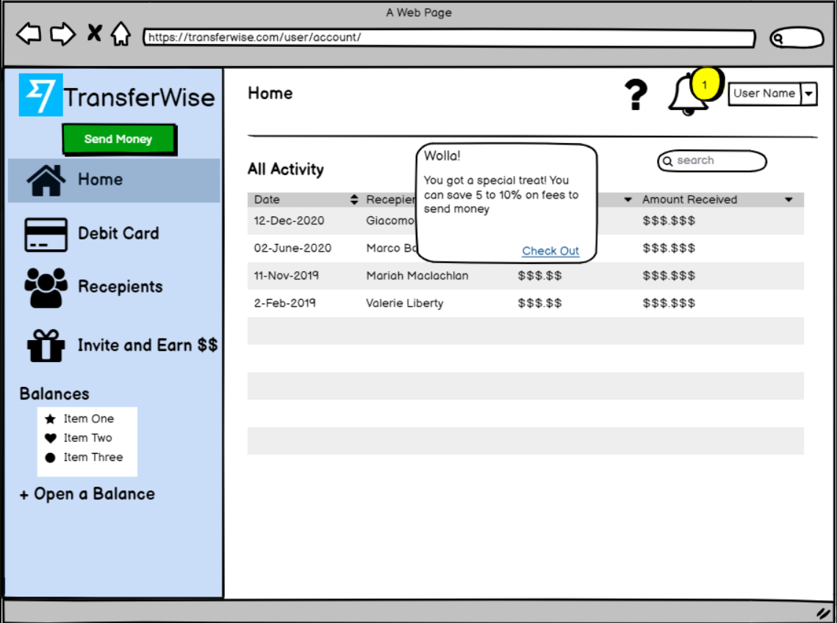
Solution – Offer incentives, Reward loyalty
Riskiest Assumption: Adoption Risk
High Fidelity MVP (website - Notification) – To test usability
Notes:
Essentially an interactive wireframe to test the workflow

Slide 17
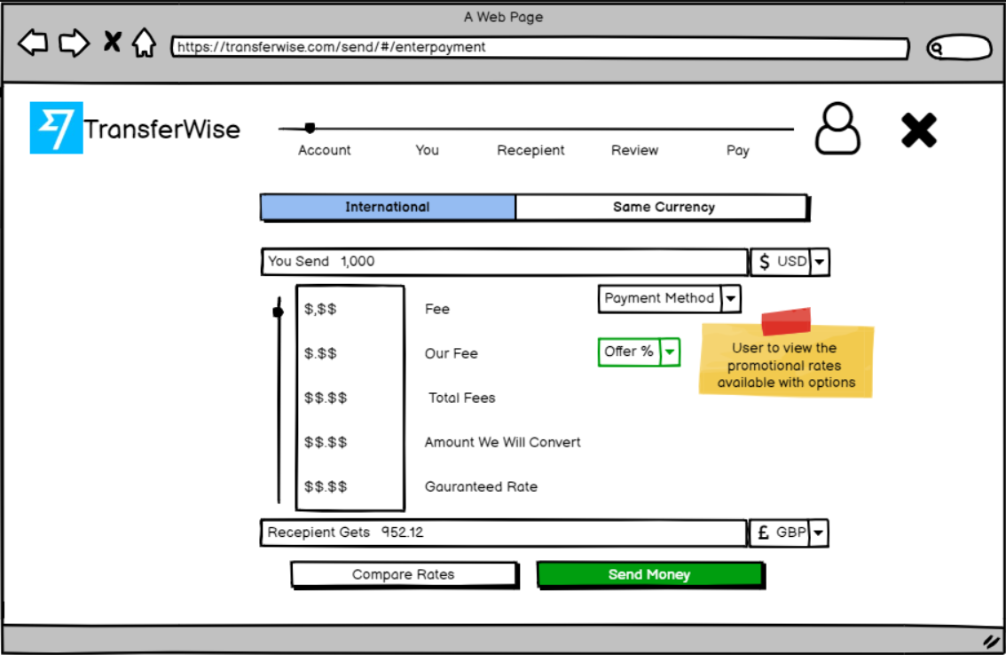
Solution – Offer incentives, Reward loyalty
Riskiest Assumption: Adoption risk
High Fidelity MVP (website) – To test usability, feasibility and user behavior
Notes:
3. HIGH-FIDELITY USER PROTOTYPES
Realistic looking, working simulation.
Good for communicating a proposed product to stakeholders.
Used in defensive user testing, not to see if they'll like it, but to learn if they won’t.
Feasibility: Test model to generate simple offers for targeted customers

Slide 18
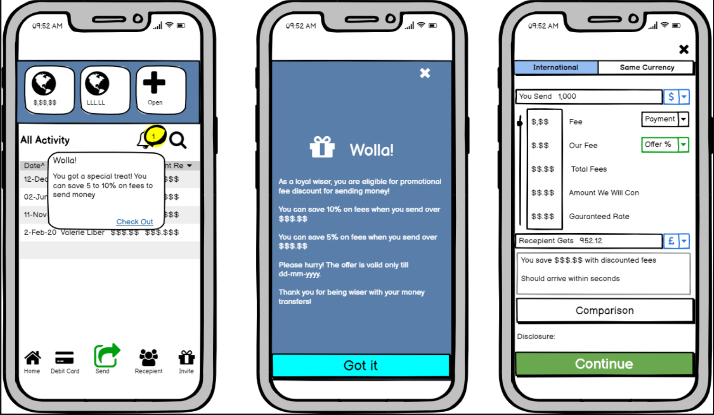
Solution – Offer incentives, Reward loyalty
Riskiest Assumption: Adoption risk
High Fidelity MVP (Mobile App) – To test usability, feasibility and user behavior
Notes:
3. HIGH-FIDELITY USER PROTOTYPES
Realistic looking, working simulation.

Slide 19
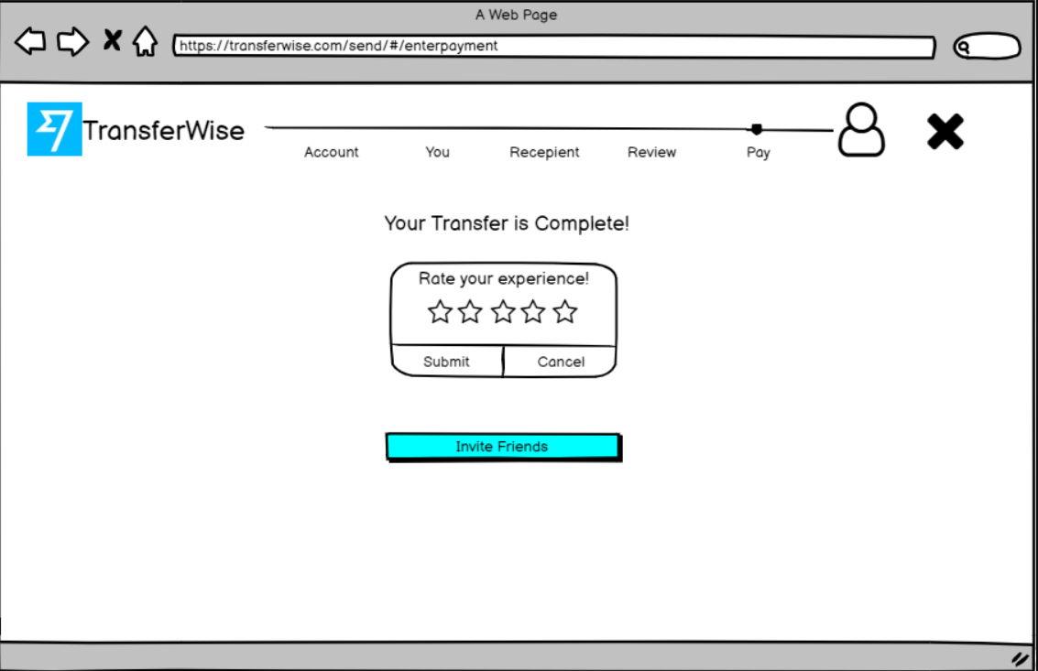
Solution – Offer incentives, Reward loyalty
Riskiest Assumption: De-values the brand
A/B Test –Ratings and referrals with and without promotional offer
Notes:
devalue the brand - See how things play out over time to see if the brand gets devalued.
together something quickly and cheaply that will let you determine Ratings and referrals with and without promotional offer

Slide 20

Solution – Offer incentives, Reward loyalty
MVP and A/B Test Findings
Ease of use
Users had in general positive feedback and happy to see additional savings
Users expressed willingness to share with friends.
User expected to understand more on offers (Update FQA)
Expiry date of the promotional offers to be highlighted to avoid dropouts.
Notes:
Hypothetical results

Slide 21
Go To Market

Slide 22

Go To Market - Messaging
Messaging
  Target Customers: Existing Users
  Expatriates: Special treat for you! Save more on top of the cheapest rates!
  Business Owners: Save more on your money transfer fees.
  Retirees living abroad: Make the best of your hard-earned money!
Notes:
Tweak messaging as by Persona. price-conscious persona

Slide 23


Go To Market – Launch Plan
Pre-Launch
Launch
Post-Launch
Activities
Metrics
Limited Release – Invite only Beta Assets - Instructor video, blogs, In product tooltip Reach Customers by Email, Notifications
Track social media mentions, blog views
Press Release Web Pages go-live New version available on App Store
Website Traffic, App version updates.
Gather Metrics and compare with objectives Gather feedback , testimonials Prepare for future campaigns
Monitor feature specific metrics Monitor product level success metrics Assess performance
Notes:
Objective –Retention (maximize long term value)
Decide metrics to measure success
Identify Target customers

Slide 24



How to Measure Success
Retention: The user liked promotional offer enough to use it again (and hopefully again and again…).
Goal | Maximize the % of users that return and transfer money on a monthly basis
Signals | # users who made at least one transfer in last month # users who stop using the product during the following month # of offers generated/Viewed/Redeemed (>75%)
Metrics | Retained users (# of people made transfer this month divided by the # of those same people that made transfer last month to get a percentage) Offer Effectiveness = No. of offers generated/ No. of offers used Net User Growth = No. of new customers – No. of customers stopped using our services
Notes:
The HEART framework is a methodology to improve the user experience (UX)
Happiness (Referral rate:)) No. of referrals (invite friend) request on using promotional offers
Engagement (Offer effectiveness)
Adoption: No of users using offers
Tax Success (Customer service contact rate) No. of times contacted customer service for questions or problems related to promotional offers.

Slide 25
Added Benefits

Slide 26

Potential Added Benefits
Creates word of mouth…..invite friends!
Creates a platform to cross-sell and upsell. ...
Creates communication opportunity
Notes:
A stronger emotional connection with customers – Personalized offers makes consumers feel valued and special.
More repeat customers in the long run - highly engaged consumers are more likely to become loyal customers.
Brand advocacy from your biggest fans - engaged customers spread the word to their own networks without the fuss of receiving free products or being entered in giveaways.

Slide 27
Q & A

Slide 28
Appendix

Slide 29
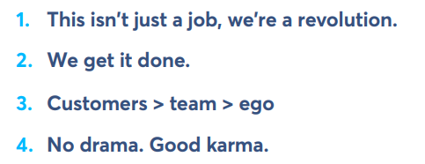
Core Values
We focus on our customers, and let their needs lead us. We use data to separate signals from noise. We challenge ourselves and take risks because that’s the only way to grow.
Notes:
We’re making a positive, important change in the world.
We take ownership of what we do. This thing belongs to all of us.
Customer voices should always be the loudest. We listen to and serve them as a team. Ego? Vanity? No. Stay humble
We start by assuming everyone has good intentions. We respect others’ worldviews and challenge arguments, not individuals

Slide 30






Key Personas
Identity
Pains
Money Recipient
What do they value?
Behavior
Alex - Expatriate | Phoebe - Freelancer | Tom - World traveler | Irene -Small Business owner | Rita – Retiree settled abroad | Susan – International Student
Slow, expensive and complicated Money transfer | Look for different providers for different currency | High transaction costs | High Cost and Complexity | Complicated money transfer | Sporadic funds need and timely availability of funds
Parents, Bill Pay | Herself from Employer | Spend money locally | Suppliers, Vendors in other countries | Receive pension, Social Security benefits | Herself from parents
Transparency | Availability of currency options and best rate | Instant availability of funds at low fee | Speed and accuracy of money sent | Ease of use and reliability | Fast speed
Checking money transfer rates frequently | Research cross border providers | Check user reviews, skeptical of low prices | Frequently Compares currency exchange rates | Options to receive recurring payments | Search for fast and best prices to inform Parents

Slide 31
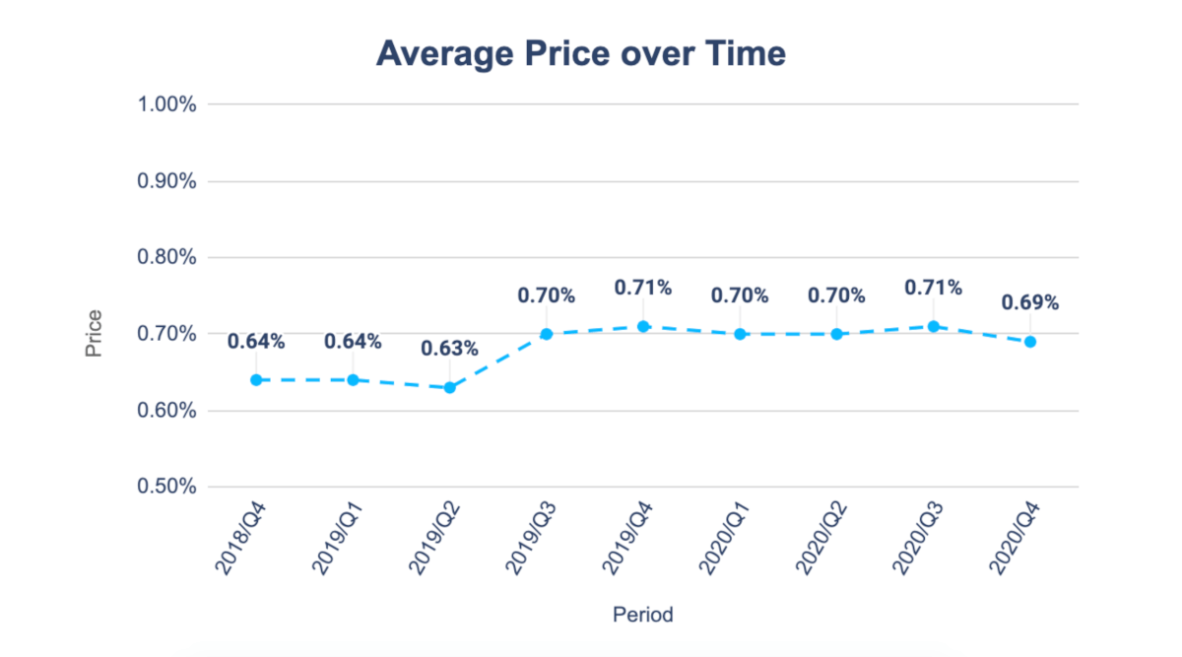
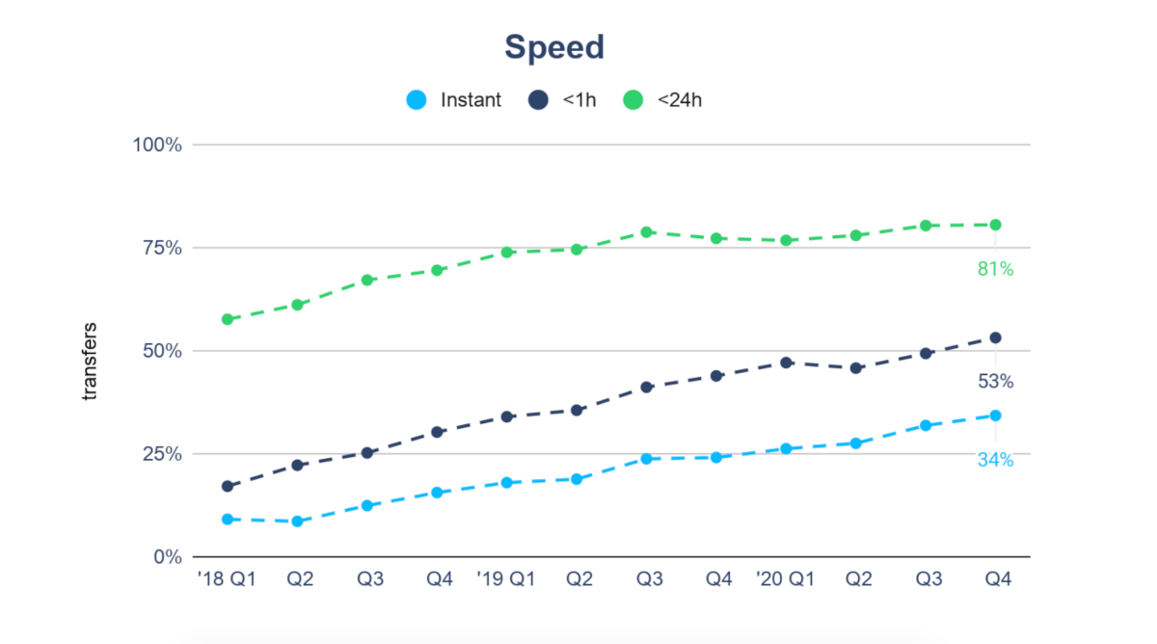
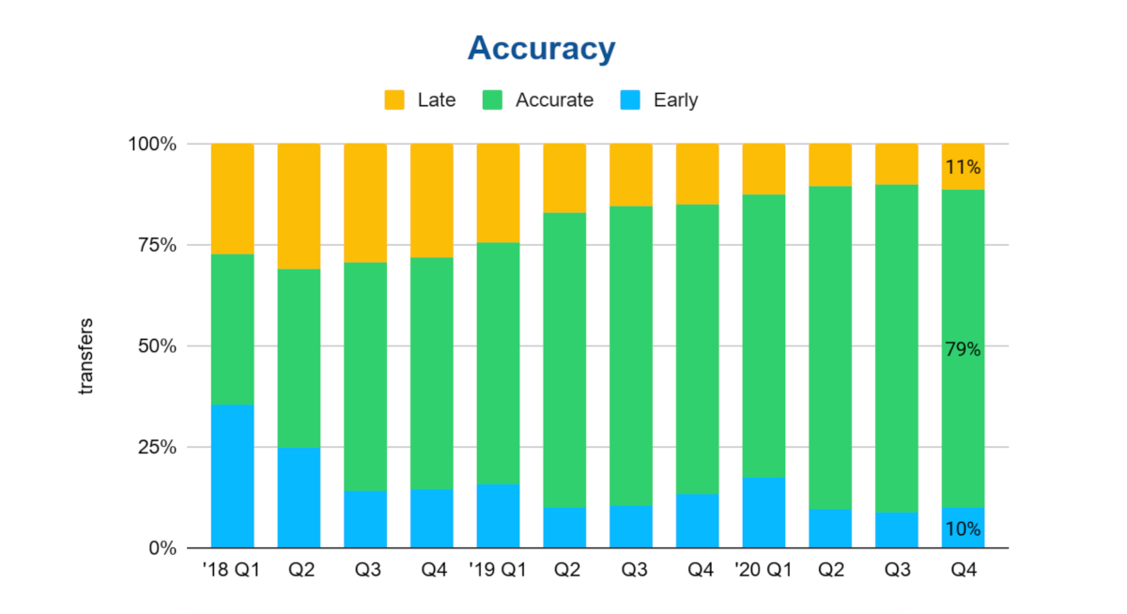
Key Success Metrics

Slide 32
Key Success Metrics
KPIs by Independent Autonomous Teams – tied to Mission
Team 1 – New currencies | Team 2 -Retention | Team 3 – Growth | Team 4 – Speed | Team 5……
Currency Wishlist requests No. of new currencies added No. of Transfers by currencies | Monthly Active Users Monthly Churned users Churn Rate Avg transfer fees saved Customer Lifetime Value (LTV) | Monthly net user growth No. of transactions Average Transaction Size Monthly profit per user | Percentage of transfer complete in 20 seconds (Instant) Within in hour, < 24 hours Accuracy of the delivery speed (Late, Accurate, Early)
Notes:
At Transferwise the solution is having independent autonomous teams. Each team has a clear focus which is tied to the mission — a set of concrete goals that would help the company achieve that mission.
The core reason why autonomous independent teams don’t lead to complete chaos is everyone having specific measurable goals that work towards the company achieving its mission.
They are also allowed to work across all products to do whatever is needed to reach those goals. It takes a huge amount of coordination across the product teams, so everyone is responsible for collaborating intensely with one another. Even though the coordination might seem like a handful, having fewer teams makes them ruthlessly prioritize around the most important initiatives.

Slide 33
Competitors
Banks, Credit Unions | HSBC, Chase, CitiBank etc.
Money Transfer Operators (MTOs) | Western Union, MoneyGram
Online Money Transfer Services | Xoom by Paypal, Remitly, OFX, WorldRemit
Foreign Exchange Providers | FXPro, Travelex

Slide 34
How Do we make money?
Primary: Money Transfer Fee (10x less than Banks!)
Future: Value-added banking services
  Account Balances
  License fees for Banks
  License fees for SMBs
Notes:
company makes ~0.7% on any currency-exchange done through their platform, or their partner platforms
with more than £1bn in deposits, Transferwise may start trying to make money in

Slide 35
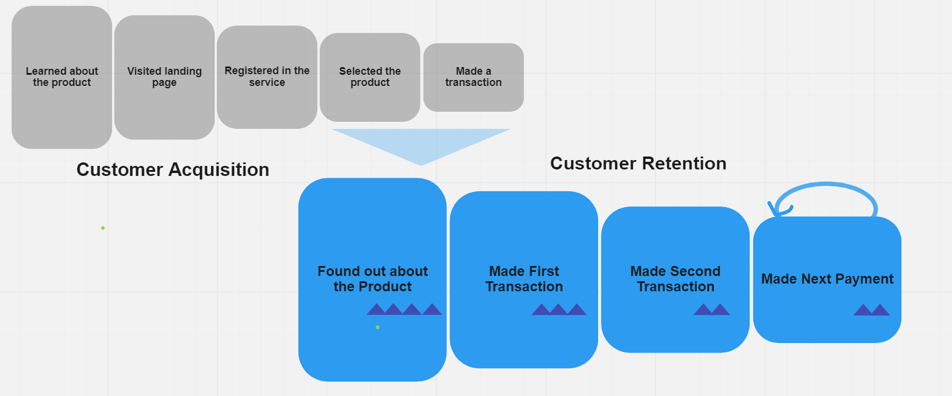
Customer Retention Problem Analysis
Notes:
Conversion funnels used widely in customer acquisition analysis.
Conversion to the second transaction is just the next step of the same funnel.
it is helpful to think about to think Retention in terms of conversion to the next transaction or session.
Funnel with cohort analysis (workflow steps over time) – customer behavior

Slide 36
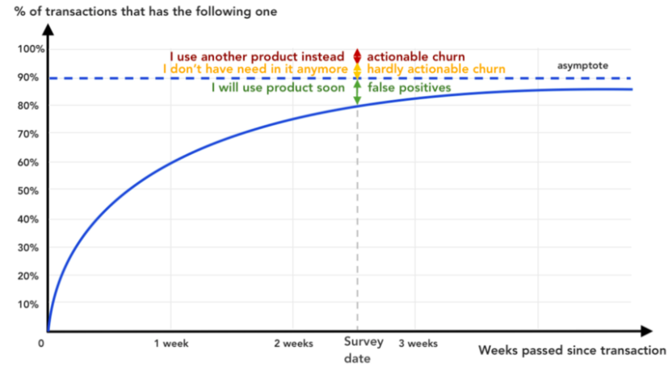
Retention Improvement Opportunities
Combine Quantitative and Qualitative insights to identify actionable opportunities
Actionable churn
Why customers are switching?
It’s cheaper
It’s faster
Its more convenient
It has a feature that I need?
Notes:
We need to have a large set of surveyed customers to get statistically significant results.
Based on survey results – we can estimate total retention opportunity you have.
If X % said that they use another product , t means X% of customers that was marked as “churned” after 2.5 weeks of inactivity switched to another product and potentially something, we can do to retain them.

Slide 37
Solution Options – Improve Retention
What? | Add value added features to drive engagement
How? | Ability to schedule recurring transfers Separate savings from their day-to-day spending balances
Risky Assumption | Adoption risk
Notes:
So whether you’re moving money between accounts, sending to family, or paying monthly bills - you’ll never miss a payment again.
For business owners too, managing payroll and recurring business expenses just got even more convenient. It’s free to schedule your transfers and you can choose to send at a single future date or on a recurring basis.

Slide 38

Go to Market – 4Ps
Product
Place
Send money / Receive money from abroad.
In Product notifications (Website, Mobile App) for targeted customer.
Lower Money transfer fees.
Earned media, internal blog, Email to existing users
Price
Promotion

Slide 39
How to measure success
Proxy Metrics:
Number of offers generated/Viewed/Used
Offer Effectiveness = No. of offers generated/ No. of offers used
Monthly Active Users (MAU) users who made at least one interaction with the product in last month
Monthly Churned Users (MCU) - Customers who stop using the product during the following month
Net User Growth = No. of new customers – No. of customers stopped using our services
Customer service contact rate: No. of times contacted customer service for questions or problems related to promotional offers.
Referral rate: No. of referrals (invite friend) request on using promotional offers

