Slide 1
Trempim - PROPOSAL Avikam Levi, Eitan Dubinski, Tal Ginzburg, Daniel Shamir
Software Engineering
Faculty of Engineering
Ben Gurion University of the Negev

Slide 2
Hitch
Project Title (English): Trempim
Project Title (Hebrew): טרמפים
Student Name | ID | Email | Phone | Signature
Avikam Levi Eitan Dubinski Tal Ginzburg Daniel Shamir | 319047023 325885002 322720137 314969056 | avikaml@post.bgu.ac.il Eitandu@post.bgu.ac.il Talgin@post.bgu.ac.il shamirda@post.bgu.ac.il | 0524264469 0522452400 0547057829 0546749295 | Add Sign

Slide 3
Customer
Customer Name
Customer Representative Person
Role
Email
Phone Number
Address
More Advisors?

Slide 4
Introduction
Public transportation cost: Cost rises each year.
No organized platform: Whatsapp is commonly used.
Safety: hitchhiking with strangers may be dangerous.

Slide 5
Project’s Motivation and Purpose
Motivation:
Today, students use whatsapp to find hitchhikes which is inconvenient and not very reliable.
Many students can’t afford to regularly take the bus or the train in order to mobilize to or from their destination.
Many students take hitchhikes from unfamiliar people which can lead to dangerous situations.
Purpose / Goals:
Help users find reliable hitchhikes using a designated platform.
Provide transparent information about the drivers and hitchhikers.
Help students cut costs when using hitchhikes.
Encourage friendly and respectful behavior among drivers and hitchhikers.

Slide 6
Project Description
What will be developed?
A mobile app for student hitchhiking.
User-friendly UI + backend API & database.
High-level functionality
Users management and verification – drives and hitchhikers.
Group management – according to area, destination and other preferances.
Ranking system – based on user experience.
Ride creation, search and matching.
Schedualed and recurring rides.
Real time tracking.
Trip management and communication between uses.

Slide 7
Customer – what exists? What provides?
What exists? Moovit had in the past a carpooling service which is now unavailable anymore. Today, students find hitchhikes using Facebook or Whatsapp mainly. There isn’t a functioning app for hitchhiking in Israel today and specificaly there isn’t one for students.

Slide 8
Project’s Risk Assesment (and how to overcome)
Challenge | How to overcome?
Physical safety and misidentification. | Require each user to upload a valid student identifier in addition to an ID card. Add live GPS tracking for the entire trip visible to the passengers and sharable to other trusted people.
Data privacy and misuse of location data. | Only collect and store data absolutely necessary for app functionality. Use end to end encryption and secure hashing/tokenization for all sensitive data.
Keeping track of location in real time. | We will use some existing tools such as Google Maps SDK and FusedLocationProviderClient to track the location of rides in real time.

Slide 9
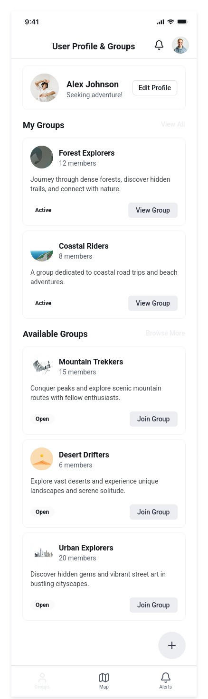
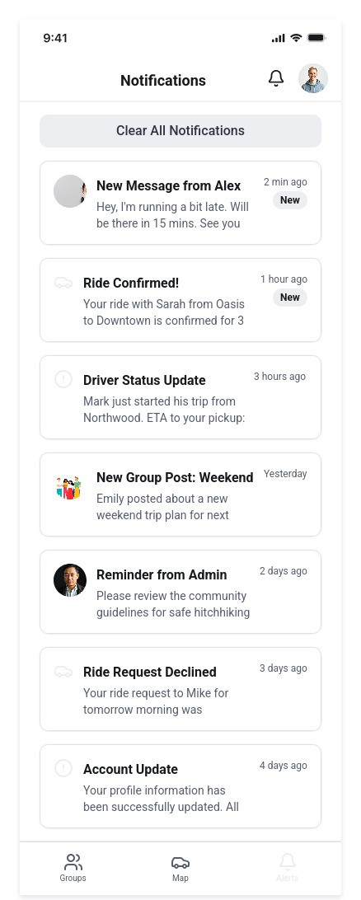
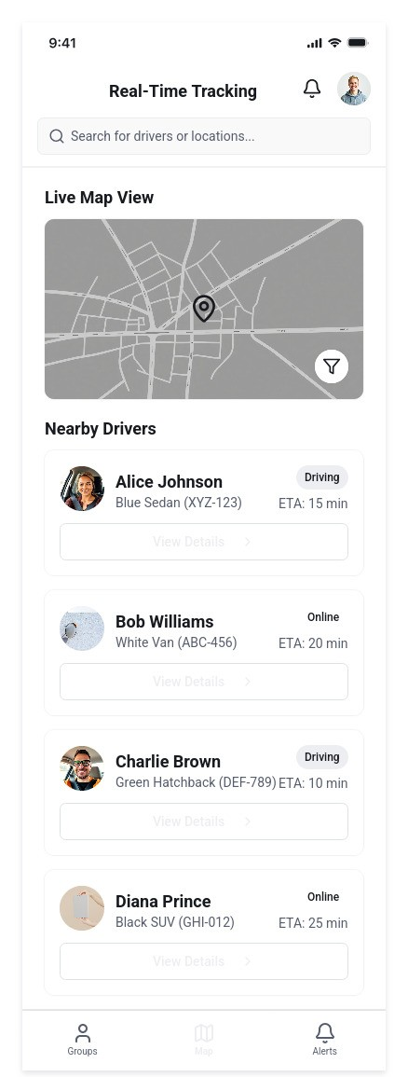
User Interface

Slide 10
Project’s Environments and Langugaes
Mobile UI: React Native (TypeScript) – for the app screens.
Backend API: Python (FastAPI) – for business logic and data flow.
GPS Tracking: Google Maps SDK and FusedLocationProviderClient – for real time GPS tracking.
Database & Storage: MySQL (SQL) – for storing users information.
Deployment: AWS – hosting the backend and the databases in the cloud.

Slide 11
Evaluation and Testing Plan
Request & offer flows: We will validate add/update/cancel flows for ride requests and offers, ensuring that status updates (pending, accepted, completed, canceled) are correctly reflected for both drivers and riders. We will also test notification delivery (ride accepted, canceled, or updated).
Safety & trust features: We will verify that student authentication (e.g., university email or ID) works reliably, that ride details are only visible to authenticated users, and that reporting/blocking features function correctly. We will simulate misuse scenarios (fake requests, cancellations, spam) to evaluate system response.
Data & analytics: We will test usage analytics using controlled datasets, checking ride frequency, average occupancy, and most common routes. We will verify that trends are accurately displayed to admins (e.g., peak demand hours, popular pickup spots) and that data aggregation preserves user anonymity.

Slide 12
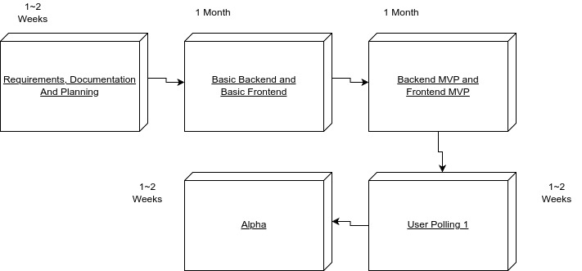
Project’s Steps – Semester A

Slide 13
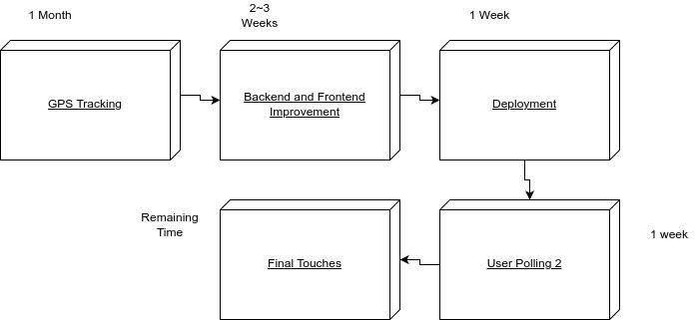
Project’s Steps – Semester B

Slide 14
Project’s Steps and Timeline
Week | Task | Description
1 | Specification and Planning | Requirements documents + Use cases.
2-4 | Basic Backend | SQL DB: Users, Rides. User management (CRUD). Manual Ride addition, deletion and updates. Implement users profiles and ratings.
5-7 | Basic Frontend | Creating the screens.
8-9 | Basic Notifications | Notification when a ride a user scheduled is due or when a new relevant ride is available.
9-10 | Multi-user | Synchronization between users.
11 | Basic UX Improvements | Simple, clean, user-friendly design. Navigation between screens.
12-13 | End of semester A | Full integration and release of Alpha version.

Slide 15
Project’s Steps and Timeline
Week | Task | Description
1-4 | Real time GPS tracking. | Integrate Google Maps SDK. Flow: Using the library, get the location of the user and display it in real time. Fallback: Show the user’s last known location.
5-7 | Real-time Multi-user | Transition from "manual" sync to real-time synchronization Test scenarios with simultaneous updates.
8-10 | Deployment in AWS | Deploy the app to production using AWS.
11-13 | Testing and Quality Assurance | Unit and integration tests.
14 | End of semester B | Full integration, and final presentation.

