Slide 1
YSI Presentation
A Template

Slide 2
First title
Some text goes here

Slide 3
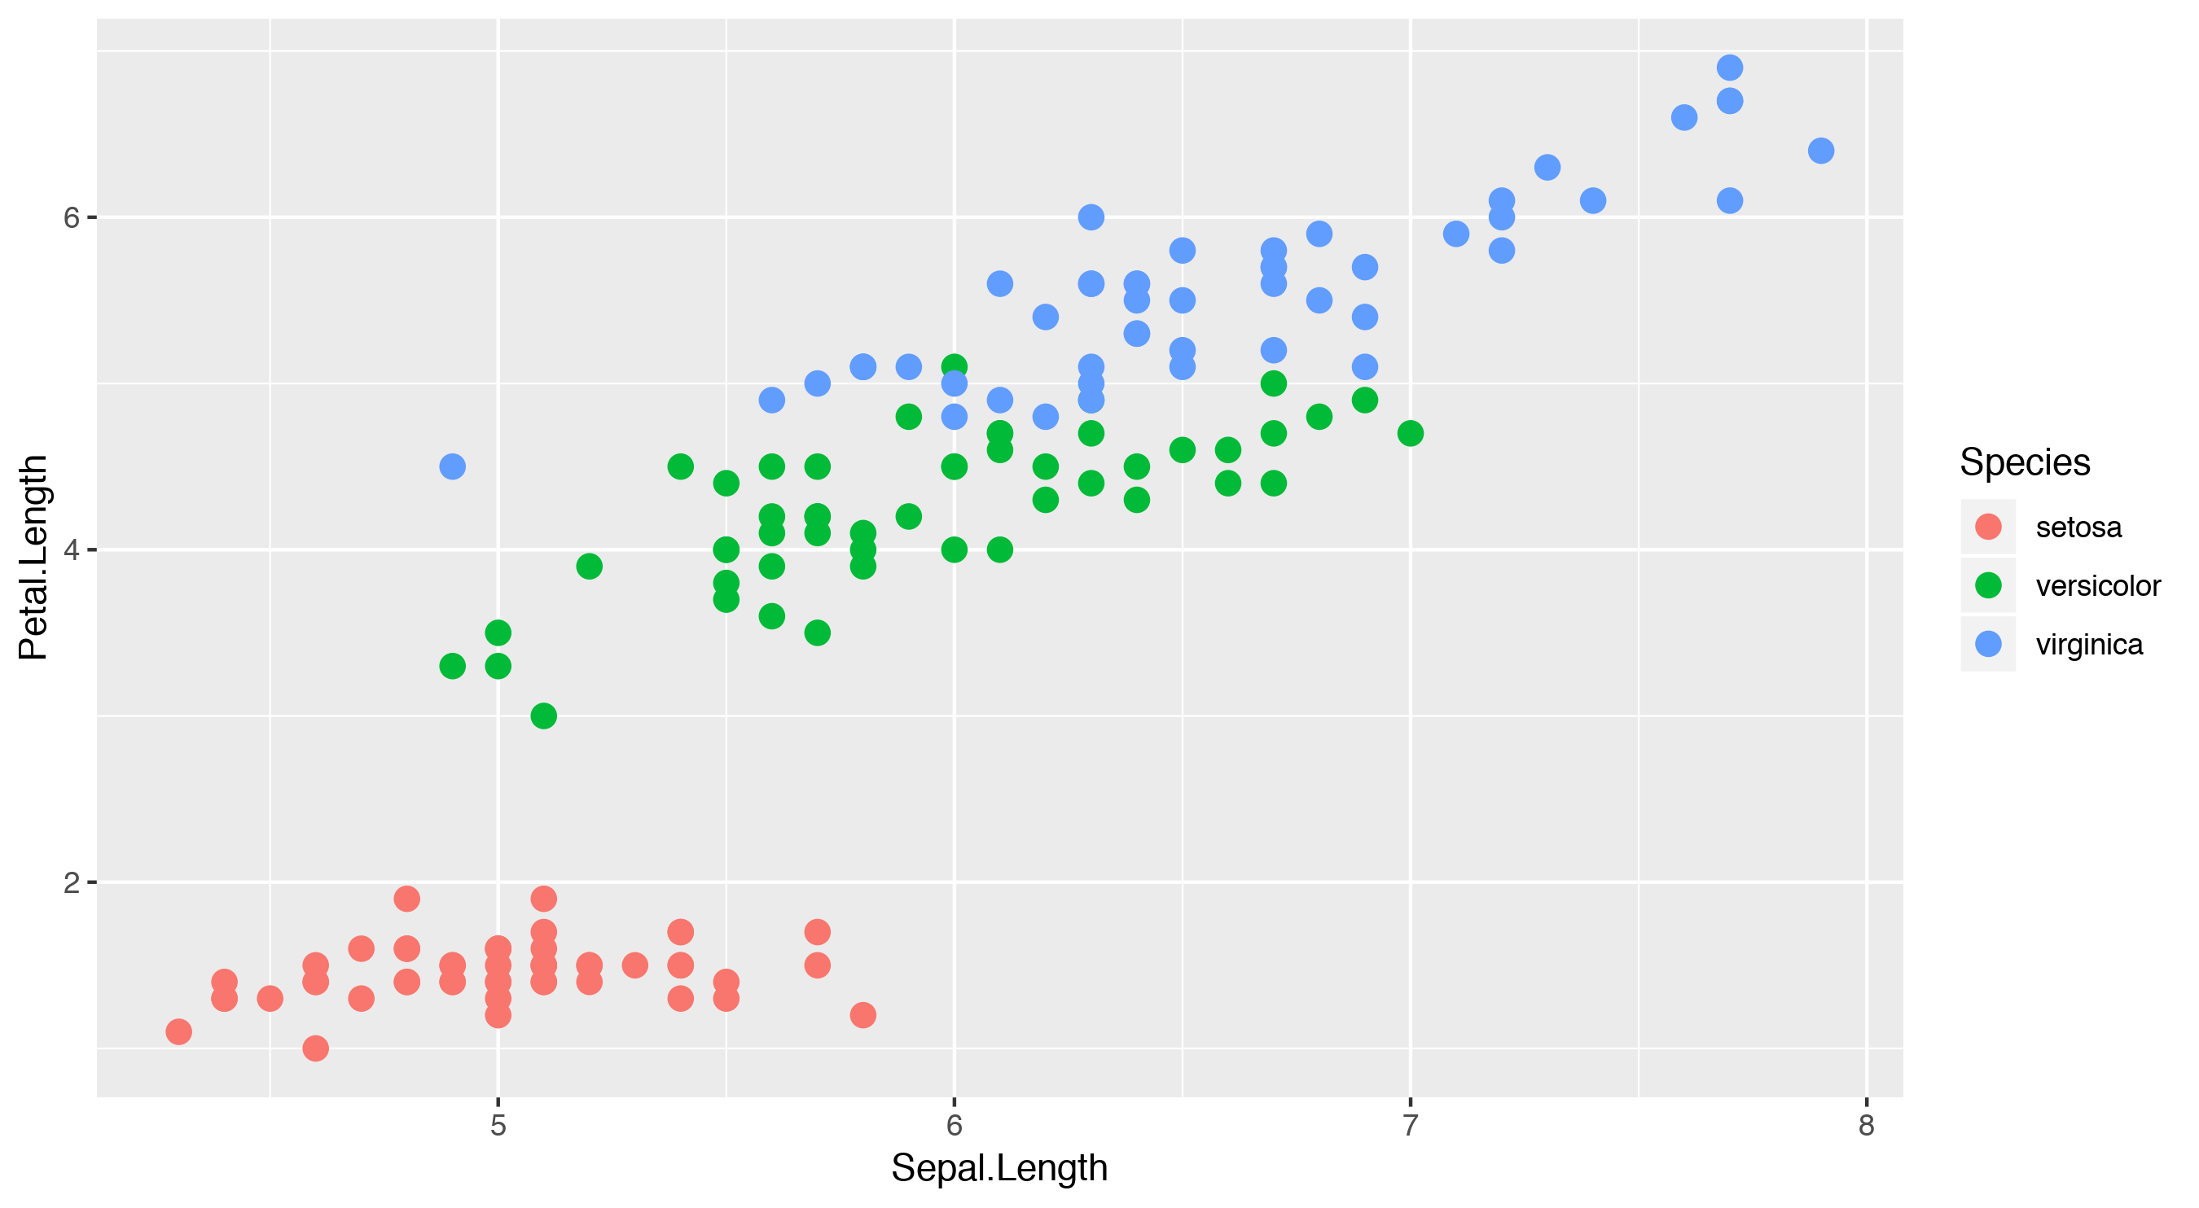
Third title

Slide 4
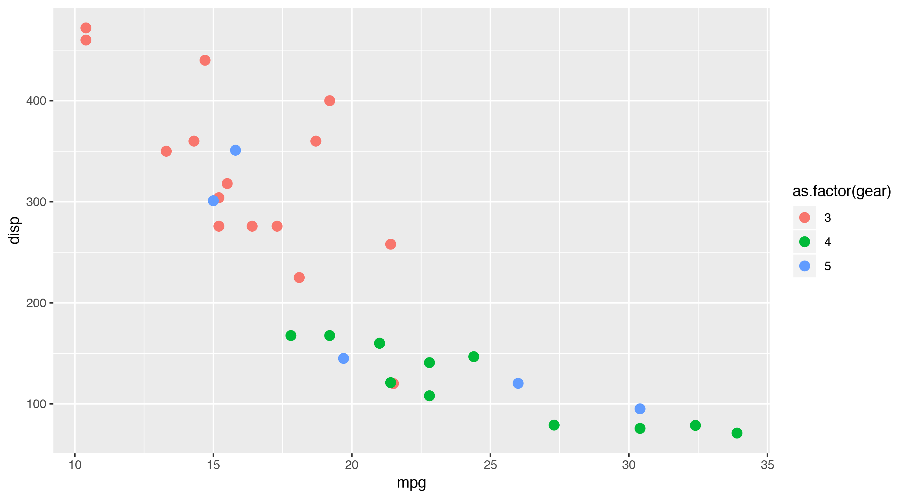
Fourth title

