Slide 1

Introduction to the TReNDs Cluster
Fall 2025
Slides and Resources: https://github.com/trendscenter/ClusterWorkshop

Slide 2
I’m here to help!
Hey! My name’s Dr. Bradley Baker, and I’m a postdoc here at the lab! BA: Philosophy/Math from NCF, MS: CS from UNM, PhD: CSE from GT
I do a lot of different things here at the lab! COINSTAC/BrainForge - Software Development and Distributed Learning Deep Learning - Model introspection and learning theory, applications Information Theory - Application metrics to Neuroimaging analysis CADASIL/HD - Studying Neurodegeneration with ICA/FNC/Many Models Mentor Students - Mostly undergraduates and masters students Informal IT Liason/Cluster Management - I help to manage our HPC system and work as a liaison between IT and our group to help facilitate our research.
Some other interests: I’m certified to sell culinary wild-foraged mushrooms! I volunteer at a wildlife rescue on the weekends! Philosophy/Ethics in Data Science and Research Computational Ecology and other biological applications Cyber Security (I watch every Defcon talk every year)

Slide 3
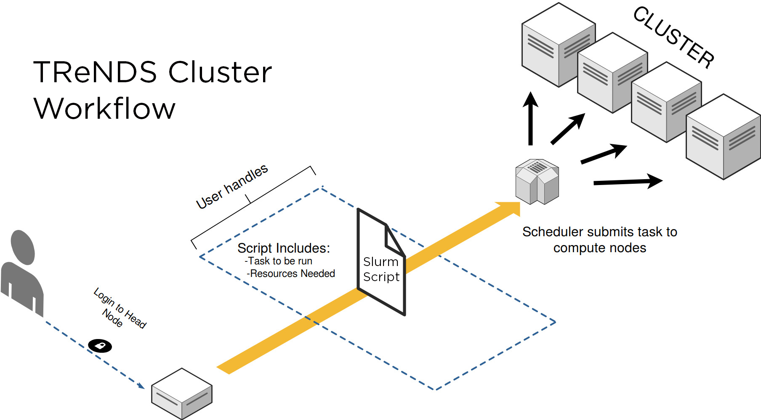

What is the TReNDs Cluster? Why should I care?
A set of computational resources with a shared file system
Submitted processes managed by SLURM, which allocates resources based on user request
Work with interactive sessions or BATCH scripting
X
Neuroimaging analysis is complex! Don’t run it on your laptop!

Slide 4
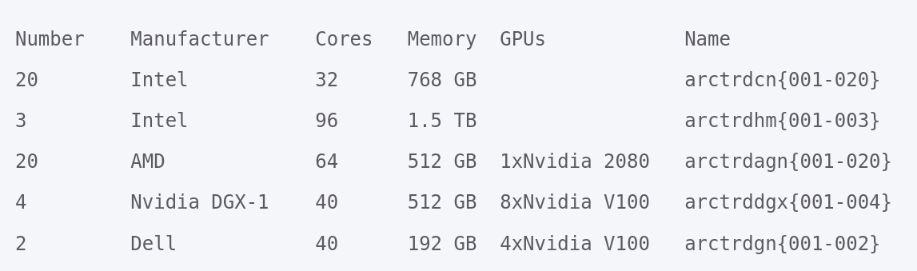
Overview of Available Resources
We actually have more than this now!

Slide 5
How do I get cluster Help?
Attend this Workshop!
Github Link: https://github.com/trendscenter/ClusterWorkshop
Then, check the wiki:
TReNDs Cluster Wiki: https://trendscenter.github.io/wiki/
Next, ask on the TReNDs slack:
#HPC-TIPS Slack Channel
Come to my HPC Office Hours! (M/F: 10-11 AM, W: 9.30-10.30 AM)
Finally, if we need to get IT involved!
HYDRA Tickets: hydra.gsu.edu (this is for CLUSTER-SPECIFIC questions)
Or GSU IT: for installing software primarily, or debugging your hardware

Slide 6
The Very Basics

Slide 7
Account Requests and SSH Installation
Step 1:
Navigate to: elpis.rs.gsu.edu
Login with GSU Credentials (if you don’t have them proceed to step 2)
If you already have an allocation for TReNDs, you’re done! Move to step 3.
Step 2:
Contact your PI to request an account or allocation.
They will contact the operations team to get your account set up
Step 3:
OSX, Linux and newer Windows versions come with SSH built in
On older Windows versions, you will need to install OpenSSH (IT will need to do this on managed machines)

Slide 8
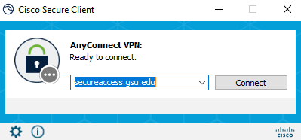
Configuring your VPN (Remote Only)
Check out the GSU installation and usage Guide: https://technology.gsu.edu/technology-services/it-services/security/virtual-private-network/
You will need to download the VPN client
(IT may need to install on a managed machine)
You will also need to set up DUO for two-factor authentication
Finally, use your GSU credentials and the address secureaccess.gsu.edu.

Slide 9



Working in the Terminal
Every Operating System has a built-in terminal for executing text-based commands on your computer!
On Windows: Open the start menu, and start typing powershell.
NOTE: IT does not allow MIN-GW or GIT-Bash from Windows
On OSX: In the Finder, open the /Applications/Utilities folder, then double-click Terminal
On Linux: You probably already know where your terminal is :] CTRL+SHIFT+T will open up the terminal on Ubuntu and many other graphical linux-based OSs
The terminal on any OS can do a lot of things, and will open up a whole new world of interacting with your computer!

Slide 10
Generating and Signing SSH Keypairs
Hands-on Walkthrough
mkdir ~/.ssh
cd ~/.ssh
Ssh-keygen -t ed25519 -f id_<campusid>
cat ~/.ssh/id_<campusid>.pub
Log into https://elpis.rs.gsu.edu/ and we will sign the certificate
Download the files, including id_<campusid>-cert.pub and move into your .ssh folder
mv ~/Downloads/id_<campusid>-cert.pub ~/.ssh
ssh-add ~/.ssh/id_<campusid>
Terminal Commands
mkdir - make directory
cd - change directory
cat - output file content
mv - move a file
Note
~ is shorthand for your home directory, where the terminal opens by default. Most terminals, including powershell, recognize this.

Slide 11
Configuring SSH
Hands on Walkthrough
Create the file ~/.ssh/config (on linux+OSX you can use touch ~/.ssh/config On windows you can use New-Item ~/.ssh/config)
Add the following to it
Host arclogin HostName arctrdlogin001.rs.gsu.edu User <campusid> ForwardAgent yes
(You can also add specific nodes and other things to ease access )
Extra Note To find out where you home directory is run: cd ~; pwd

Slide 12
Connecting to the Login Node
Hands on demonstration
ssh arclogin
And that’s it! You’re officially on the cluster

Slide 13
Still getting permission denied?!
Due to a recent change in security policy, the login node might be blocked without manually placing your key on the cluster.
Add the following to your config
Host arctrdcn017 HostName arctrdcn017.rs.gsu.edu User <campusid> ForwardAgent yes
Then, try ssh arctrdcn017
Next, create a file
touch ~/.ssh/authorized_keys
copy your public key (with the .pub extension) into that file
And then give it the correct permissions
chmod 600 ~/.ssh/authorized_keys
Then use exit to leave the dev node.

Slide 14
Best Practices: Login Node
The Login Node is everyone’s gateway to the Cluster.
If it goes down, people will be unable to work.
If it is busy running other processes, people will be unable to work
DO NOT RUN ANY ANALYSIS ON THE LOGIN NODE
DO NOT RUN VSCODE OR OTHER REMOTE GUIs ON THE LOGIN NODE
DO NOT LIST HUGE DIRECTORIES, OR DO OTHER FILESYSTEM OPERATIONS ON THE LOGIN NODE
Do not use it to copy files, move directories, etc. All of this uses the processing power needed on that node
In general, only use the login node to SUBMIT and MONITOR SLURM JOBS.

Slide 15
~Break~ Linux Tips Part 1
Command Line Text Manipulation
CAT: cat <filename>
HEAD: head -n 1 <filename>
TAIL: tail -n 1 <filename>
NANO Editor: nano <filename>
VIM Editor: vi <filename>
If you want to try it, add these lines to the file ~/.bashrc:
source /usr/share/lmod/lmod/init/bash module use /application/ubuntumodules/localmodules
Accessing the cluster
Log onto a node: ssh <node name> Log off: exit
Directory Navigation
Navigate to a directory: cd <directory name>
List its contents: ls <directory name>
Local Machine Resources
Processors: lscpu
RAM: free -h
Check current usage: top
htop
Check free space on the server: df -h
GPUs: nvidia-smi
nvtop

Slide 16
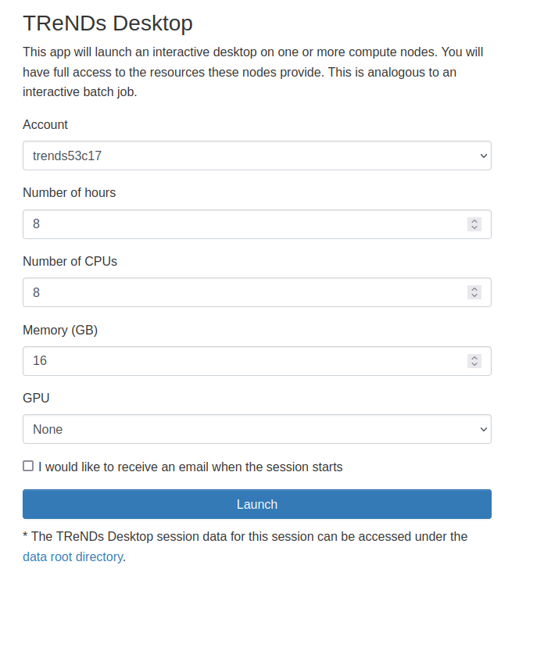
Visual Editing on the Cluster
Hemera: hemera.rs.gsu.edu
Log in with your credentials
Complete GUI-based access to the cluster via a desktop
Or specific applications: jupyter, MATLAB, etc
VSCode: code.visualstudio.com
Install VSCode from online
Install the Remote Development Extension
Make sure SSH is properly configured
Connect!

Slide 17
The Dev Nodes
What are they?
Three Machines which can be directly accessed without SLURM. These are useful for developing and testing code, navigating the cluster, transferring files, etc.
arctrdcn017.rs.gsu.edu (CPU-only)
arctrdagn019.rs.gsu.edu (GPU)
arctrdgndev101.rs.gsu.edu (GPU)
How to use them?
Add to your SSH config!
Host arctrdcn017
Hostname arctrdcn017.rs.gsu.edu
User <campusid>
Host arctrdagn019
Hostname arctrdagn019.rs.gsu.edu
User <campusid>
Host arctrdgndev101
Hostname arctrdgndev101.rs.gsu.edu
User <campusid>

Slide 18
Other Common Issues
Service not started (Windows): Set-Service -Name ssh-agent -StartupType Automatic -Status Running
This need to run as admin. If you have a managed machine, make a ticket with GSU IT.
Permission Denied (MAC):
Make sure these are in your ssh config: Host * AddKeysToAgent yes IgnoreUnknown UseKeychain UseKeychain yes ForwardAgent yes

Slide 19
Data Storage

Slide 20
Data Storage - No place like $HOME
What is your $HOME directory?
Where you land when you login by default
Limited storage space per user - don’t put too much in there
Instead use a directory in /data/users#

Slide 21
Data Storage - Your Users Directory
Everyone gets a personal directory under the /data/users# hierarchy. We recently redivided these directories
cd /data/users#
If you don’t have one - you can create one!
Check the other directories and see how many users are there.
Then add your directory somewhere to keep the balance!
mkdir /data/users#/<campusid>
TIP: Avoid hardcoding this location by using environment variables
export MYDATA=/data/users#/<campusid>

Slide 22
Data Storage - Transferring Data To/From the Cluster
IN GENERAL, DON’T PULL DOWN FULL DATA SETS. You will violate DUAs and storage agreements. If you want to pull single scans, check with your PI if it is ok to do so.
SIMILARLY, DO NOT PUT DATA WITH PHI FROM YOUR MACHINE ONTO THE CLUSTER. Talk to your PI about proper anonymization procedures
IN PRINCIPAL, FOLLOW HIPPA COMPLIANCE AND OTHER TRAINING. USE COMMON SENSE SECURITY PRACTICES
You can follow this guide to upload data with GLOBUS. Use the online form to place your data in /data/trends_public, then PROMPTLY MOVE IT
For smaller amounts of files and folders, you can use SCP/SFTP
sftp arctrdgndev101 cd /data/users#/<campusid> put local_filename.txt get remote_filename.txt

Slide 23
Data Storage - Where are data and applications?
Applications:
/trdapps
Neuromark Datasets:
/data/qneuromark
/data/neuromark2
Data sets from Collaborators:
/data/collaboration
These directories and other related ones are highly managed, i.e. you will not have permission to put data there.
If there is new data that will be put onto the cluster for your project, talk to your PI and they will help facilitate that process

Slide 24
Data Storage Best Practices
Avoid duplicating data sets that already exist
Use references to static copies
Write to your users directory, and reuse results when possible
Remove unneeded or duplicate data/results
Compress folders you want to save for the future
Use tar: https://www.geeksforgeeks.org/tar-command-linux-examples/
Or zip: https://ioflood.com/blog/zip-linux-command/
Use GitHub to store code ( do not place data there )
Use common sense security
Do not upload data with sensitive information (yours or others’)
Get permission before messing with things that you don’t own

Slide 25
Some Notes about Github
Git is an extremely useful tool for tracking changes in code
Learn the basics of using Git on the command line
git clone
git push
git pull
git add
git commit -m “my commit message”
Github allows storing and tracking of projects which you can share
We have a TReNDsCenter Github
Again use common sense
Avoid uploading large images and full data sets to github
Do not upload sensitive information (passwords, filesystem locations etc)
Make sure to manage access to repositories to protect your IP (and TReNDs’)
Take some time to carefully manage permissions
Delete unused repositories to avoid clutter
Add extensive documentation etc
Walkthrough: creating a github repository

Slide 26
End Part 1

Slide 27
Using SLURM - the Basics

Slide 28
What is SLURM?
Basically - users submit “jobs” and SLURM decides which nodes to use and manages multiple users
We use commands to monitor nodes and schedule jobs
Slurm lives here

Slide 29
The Slurm Queues
qTRD - general purpose computing : CPUs only
qTRDGPU - Hybrid Use + GPU computing: few GPUs per machine
qTRDHM - Many CPUs (32+) and High Memory: CPUs only
qTRDGPUH - High priority GPU nodes (Max 8 GPUs per user)
qTRDGPUM - Medium priority GPU nodes (Max 16 GPUs per user)
qTRDGPUL - Low priority GPU nodes (No limit)

Slide 30
Monitoring Jobs and Resources
There are three big commands for monitoring SLURM resources:
squeue - monitors jobs in the queues
sinfo - what nodes are available
sacct - monitor all jobs
(even completed)

Slide 31
Note - Queuing, Resources, and Preemption
SLURM will tend to prioritize new jobs submitted from multiple users, over many old jobs from one user
The exception to this is if one user gets a ton of jobs allocated, and the jobs take a long time.
Preemption and resource limits solve this issue on the GPU nodes. Users can only use so many resources with maximum priority. Even if they use more resources at lower priority, someone else can access those resources.
Preemption in theory suspends the job and it should restart when the resource is available again.
You can explicitly specify priority for other jobs too, but be wary of preemption.
Notes:
This doesn’t always work cleanly, and you should just be wary of needing to rerun low-priority GPU jobs.

Slide 32
Interactive Jobs - the SRUN command
srun - open up an interactive terminal on a cluster node
Hands on examples:
srun -p qTRD -A trends53c17 -c 4 --nodes=1 --ntasks-per-node=1 --mem=4G --time=1:00:00 --pty -J myInteractiveJob /bin/bash
srun -p qTRDGPU -A trends53c17 -c 4 --gres=gpu:2 --nodes=1 --ntasks-per-node=1 --mem=4G --time=1:00:00 --pty -J myInteractiveJob /bin/bash

Slide 33
Interactive Jobs - Requesting Resources
Let’s break apart those last two commands:
srun
-p qTRD
-A trends53c17
-c 4
--nodes=1
--ntasks-per-node=1
--mem=32G
--time=1:00:00
--pty
-J myInteractiveJob
/bin/bash
Interactive Job
The queue
The cluster account
# of GPU resources
# of CPUs
# of Nodes
# of Tasks
Amount of RAM
Timeout for Job
Run a terminal
Job Name
Command to run
srun
-p qTRDGPU
-A trends53c17
--gres=gpu:1
-c 4
--nodes=1
--ntasks-per-node=1
--mem=32G
--time=1:00:00
--pty
-J myInteractiveJob
/bin/bash

Slide 34
Requesting Resources - What can I request?
SLURM has a TON of options for requesting resources. You can research more in the documentation. These are the most common to use for SRUN:
-p, --partition
-A, --account
--gres
-c, --cpus-per-task
-n, --nodes
-N, --ntasks-per-node
--mem
-t, --time
--pty
-J, --job-name
The queue to use e.g. qTRD
The account you have on elpis
The GPU resources to request.
The CPU resources to request
The number of nodes to request
The number of tasks on each node
The amount of RAM to request
The time to run the job
Treat the job as a terminal
Give the job a name
Note: you can request specific GPU types with the following:
--gres=gpu:RTX:1, --gres=gpu:V100:1, --gres=gpu:A100:1, --gres=gpu:A40:1

Slide 35
What resources should I request?
Configurations that don’t exist will result in errors: e.g. requesting GPU resources on qTRD.
In general, request the minimum resources needed for a job.
Try to guess your needed runtime, and don’t leave sessions idle without using them.
Some rules of thumb:
Line up the resources you request so that resources will not be idle.
For example: qTRD Machines have 768 GB of RAM, and 32 CPUs. Therefore, try not to go above 768/32=24 GB of RAM per CPU. Otherwise, there will be idle CPUs with no RAM remaining, or idle RAM with no CPUs available.
Especially important for GPU nodes!!!!
For example: qTRDGPU machines have 512 GB of RAM and 64 GPUs, but only ONE GPU PER MACHINE. Try not to go above 6-7 GB of ram per CPU, and think about how many CPUs you really need for GPU jobs (usually no more than 4-8).
Leave some resources available for use with GPUs!

Slide 36
How do I check what’s available?
sinfo -O "nodehost:24,partition:.11,cpus:.8,memory:.8,cpusstate:.16,freemem:.8,gres:.20,gresused:.20,statelong:.8,time:.16"
arctrdcn004 qTRD 32 772475 0/0/32/32 770409 (null) (null)drained* 5-08:00:00
arctrdcn011 qTRD 32 772475 0/0/32/32 770308 (null) (null)drained* 5-08:00:00
arctrdcn001 qTRD 32 772475 0/0/32/32 769058 (null) (null) drained 5-08:00:00
arctrdcn005 qTRD 32 772475 1/31/0/32 769205 (null) (null) mixed 5-08:00:00
arctrdcn006 qTRD 32 772475 30/2/0/32 503255 (null) (null) mixed 5-08:00:00
arctrdcn008 qTRD 32 772475 30/2/0/32 332597 (null) (null) mixed 5-08:00:00
arctrdcn012 qTRD 32 772430 30/2/0/32 284176 (null) (null) mixed 5-08:00:00
arctrdcn013 qTRD 32 772430 30/2/0/32 518607 (null) (null) mixed 5-08:00:00
arctrdcn014 qTRD 32 772430 30/2/0/32 401048 (null) (null) mixed 5-08:00:00
arctrdcn015 qTRD 32 772430 30/2/0/32 425600 (null) (null) mixed 5-08:00:00
arctrdcn016 qTRD 32 772430 30/2/0/32 285430 (null) (null) mixed 5-08:00:00
arctrdcn009 qTRD 32 772475 32/0/0/32 408566 (null) (null)allocate 5-08:00:00
arctrdcn010 qTRD 32 772475 32/0/0/32 9286 (null) (null)allocate 5-08:00:00
arctrdcn007 qTRD 32 772475 0/32/0/32 767988 (null) (null) idle 5-08:00:00
qTRDEV 0 0 0/0/0/0 0 (null) (null) n/a 5-02:00:00
arctrdhm001 qTRDHM 96 1546353 28/68/0/96 920615 (null) (null) mixed 5-08:00:00
arctrdhm003 qTRDHM 96 1522597 14/82/0/96 1229108 (null) (null) mixed 5-08:00:00
arctrdhm002 qTRDHM 96 1546353 96/0/0/96 1521816 (null) (null)allocate 5-08:00:00
arctrdgn002 qTRDGPUH 40 772631 0/0/40/40 769880 gpu:1gpu:(null):0(IDX:N/A inval 5-08:00:00
arctrddgxa002 qTRDGPUH 192 1030556 64/128/0/192 989494 gpu:A100:8(S:0-1) gpu:A100:1(IDX:0) mixed 5-08:00:00
arctrddgxh001 qTRDGPUH 48 515482 24/24/0/48 367824 gpu:H100:4(S:0-1) gpu:H100:2(IDX:2-3) mixed 5-08:00:00
arctrdgn001 qTRDGPUH 40 385568 3/37/0/40 308427 gpu:V100:4(S:0-1) gpu:V100:2(IDX:0-1) mixed 5-08:00:00
arctrdagn047 qTRDGPUH 32 515489 0/32/0/32 457357 gpu:L40:4(S:0-1) gpu:L40:0(IDX:N/A) idle 5-08:00:00
arctrddgxa003 qTRDGPUH 192 1030556 0/192/0/192 1017877 gpu:A100:8(S:0-1) gpu:A100:0(IDX:N/A) idle 5-08:00:00
arctrddgxa004 qTRDGPUH 192 1030556 0/192/0/192 1011029 gpu:A100:8(S:0-1) gpu:A100:0(IDX:N/A) idle 5-08:00:00
…

Slide 37
Fair Resource Request Suggestion Table
Here’s an idea of how to USE resources fairly
queue | GPU Type | RAM per machine | # CPUs per machine | # GPUs per machine | Recommended MAX RAM per CPU | Recommend Max CPU-Only Usage on Hybrid Nodes | Recommend MAX resources per GPU
qTRD | N/A | 768 GB | 32 | N/A | 24 GB | N/A | N/A
qTRDHM | N/A | 1500 GB | 96 | N/A | ~15 GB | N/A | N/A
qTRDGPU | RTX | 512 GB | 64 | 1 | 7 GB | Leave 8 CPUs and 128GB free | 4 CPUs, ~128 GB RAM
qTRDGPU | A40 | 512 GB | 128 | 2 | 2 GB | Leave 16 CPUs and 256 GB RAM free | 4-8 CPUs, ~128 GB RAM
qTRDGPUL/M/H | V100 | 512 GB | 40 | 4 | DO NOT RUN CPU ONLY JOBS | N/A | 10 CPUs, ~128 GB per GPU
qTRDGPUL/M/H | A100 | 1000 GB | 192(-256) | 8 | DO NOT RUN CPU ONLY JOBS | N/A | 24 CPUs, ~128 GB per GPU

Slide 38
Interactive Jobs - Using Modules and TReNDs Apps
For a full list of software use:
module avail
To load a particular module:
module load matlab
To unload a module:
module unload matlab
Some software is available in /trdapps. You can access it by adding it to your PATH.
E.g. for linux binaries:
export PATH=$PATH:/trdapps/linux-x86_64/bin/
Or for MATLAB toolboxes:
>> addpath(genpath(‘/trdapps/linux-x86_64/matlab/toolboxes/GroupICATv4.0c/’));
source /usr/share/lmod/lmod/init/bash module use /application/ubuntumodules/localmodules

Slide 39
Interactive Jobs - Hands on Examples
MATLAB - Accessing GIFT
Step 0: Add the following to your .bashrc
source /usr/share/lmod/lmod/init/bash module use /application/ubuntumodules/localmodules
Step 1: Start the interactive job
srun -p qTRD -A trends53c17 -c 1 --nodes=1 --ntasks-per-node=1 --mem=4G --time=1:00:00 --pty -J matlab /bin/bash
Step 2: Load MATLAB, and open the MATLAB Command Line
module load matlab matlab
Step 3: Add GIFT to path
>>addpath(genpath('/trdapps/linux-x86_64/matlab/toolboxes/GroupICATv4.0c'));
Step 4+: Use GIFT Scripts in the Command Line
>>help icatb_loadData
PYTHON Command Line + NVTOP GPU
Step 0: do step 0 from the MATLAB example
Step 1: Start the interactive job
srun -p qTRDGPU -A trends53c17 -c 1 --nodes=1 --ntasks-per-node=1 --mem=1G --gres=gpu:1 --time=1:00:00 --pty -J python /bin/bas
Step 2: Load the python module
module load python
Step 3: Open the python command line
python3
Step 4: exit and run nvtop and nvidia-smi to check the GPU usage (none)
/trdapps/linux-x86_64/bin/nvtop nvidia-smi

Slide 40
Interactive Jobs - Best Practices
Do not leave interactive jobs running! Set reasonable time-limits and exit your jobs when finished.
In general interactive jobs are useful for debugging code and running small examples, but they are often inefficient for large analyses
Interactive jobs are also useful for moving around data in your folders (DO NOT USE THE LOGIN NODE TO MOVE OR LIST LARGE DIRECTORIES)
Experiment with different available modules! We have R, GCC, AFNI, ANTS, various other tools

Slide 41
~Break~

Slide 42
~Break: Linux Tips Part 2~
What are .bashrc and .bash-profile?
Basically, they contain commands which run on startup
Environment Variables and the PATH
Environment variables are available to all processes within a terminal.
Your PATH defines the locations where your terminal looks for executables
Use the .bashrc to export environment variables which you use frequently, such as the location of your directory, and to permanently modify your PATH if needed!
For example, add this to your .bashrc:
export MYDIR=/data/users#/campusid (for example using nano or vim)
Then run $ source ~/.bashrc (this just reloads the .bashrc file)
And try the command $ cd $MYDIR

Slide 43
~Break: Linux Tips Part 2~
You can also add useful shortcut commands to your .bashrc called aliases.
For example, try adding this to your .bashrc:
alias go2data=”cd /data/users#/campusid”
The language of the .bashrc and of the following section on SBATCH is BASH, a shell language. There are a ton of resources on learning the basics of BASH. Here are some quick tips that will be useful later: # Comments use the the Hashtag symbol # Save a string into the variable myvar myvar=”some string” # Access a variable by preceding it with $ echo $myvar # Save the output of a command in a variable by using asterisks myvar2=`echo $myvar` # Access input arguments by using $1, $2, $3, etc. echo $1

Slide 44
~ Break: Python Tips ~
For use of Python on the cluster, there are a few ways you can install packages. The easiest way to do it is to create your own miniconda3 installation:
mkdir -p /data/users#/<campusid>/bin/miniconda3 cd /data/users#/<campusid>/bin wget https://repo.anaconda.com/miniconda/Miniconda3-latest-Linux-x86_64.sh -O miniconda_install.sh bash miniconda_install.sh -b -u -p /data/users#/<campusid>/bin/miniconda3
<follow the instructions on the command line…>
Make sure you point the installation to the /data/users#/bin/miniconda3
Then, restart your terminal and you can use a full conda environment with full installation capabilities

Slide 45
SLURM - BATCH Processing

Slide 46
SLURM BATCH - Getting Started
Example Script
SBATCH jobs allow you to submit a process to run, and then walk away
To run a SBATCH job, you will create a script to run, and then use the sbatch command.
Unlike with SRUN, you can specify all of the options in a header within that script
Let’s create a script called JobSubmit.sh with the information on the right, and run it using the following command:
sbatch JobSubmit.sh
#!/bin/bash
#SBATCH -N 1
#SBATCH -n 1
#SBATCH -c 1
#SBATCH --mem=10G
#SBATCH -t 1:00:00
#SBATCH -e error%A.err
#SBATCH -o out%A.out
#SBATCH -A trends53c17
#SBATCH --mail-type=ALL
#SBATCH --mail-user=<your email>
#SBATCH --oversubscribe
# a small delay at the start often helps
sleep 10s
# print some message to the log
echo “hello sbatch world!”
# it can be helpful for debugging to get the node name
echo $HOSTNAME >&2
# a delay at the end is also good practice
sleep 10s

Slide 47
SLURM BATCH - Understanding the Header
The header in a SBATCH script defines the resources you want to request for that job! Just like we did before with SRUN. Plus, we have some additional options
These options define the location of error and output logs for your job!
These options define where SLURM will send E-Mail notifications when jobs complete!
Just leave the --oversubscribe option. Check the SLURM docs for more details.
The %A value places the job ID in the log name.
#!/bin/bash
#SBATCH -N 1
#SBATCH -n 1
#SBATCH -c 1
#SBATCH --mem=10G
#SBATCH -t 1:00:00
#SBATCH -e error%A.err
#SBATCH -o out%A.out
#SBATCH -A trends53c17
#SBATCH --mail-type=ALL
#SBATCH --mail-user=<your email>
#SBATCH --oversubscribe
# a small delay at the start often helps
sleep 10s
# print some message to the log
echo “hello sbatch world!”
# it can be helpful for debugging to get the node name
echo $HOSTNAME >&2
# a delay at the end is also good practice
sleep 10s

Slide 48
SLURM BATCH - Monitoring and Control
You can use the squeue command to monitor your jobs only: squeue -u <campusid>
Or the jobs in a particular queue: squeue -p qTRDGPU
You can also cancel your submitted jobs using scancel: scancel <jobid>
Or all of your jobs in the queue: scancel -u <campusid> Or all of your jobs on a particular queue: scancel -u <campusid> -p qTRDGPU
Check the SLURM documentation for more flags for these commands!

Slide 49
SLURM BATCH - Logging Tips
All of the options we had available for SRUN are also available for SBATCH, and they can also be specified when you call SBATCH on the command-line, rather than in the header.
This can be useful, for example, if you want to create logs dynamically as you submit your script multiple times:
sbatch -e err_myjob1_%A.err -o out_myjob1_%A.out JobSubmit.sh
sbatch -e err_myjob2_%A.err -o out_myjob2_%A.out JobSubmit.sh
You can imagine how this can be useful for submitting multiple jobs with different configurations!
You can also specify for jobs to exist in a folder, but if that folder doesn’t exist the job will error out quietly! This is a common bug!

Slide 50
SLURM BATCH - Array Jobs
SLURM Batch is perhaps most useful for submitting many jobs at once. Although you could use FOR-LOOPS to submit individual SBATCH calls, ARRAYS are the way to go!
Basically, it runs an SBATCH script N many times where each script gets a unique index i.e. the $SLURM_ARRAY_TASK_ID
This is useful when you have many jobs that can run in parallel, where each job uses a single index to grab a particular data set for example
The %a references the Array Index
#!/bin/bash
#SBATCH -p qTRD
#SBATCH -N 1
#SBATCH -n 1
#SBATCH -c 1
#SBATCH --mem=1g
#SBATCH -p qTRD
#SBATCH -t 1:00:00
#SBATCH -J basic_array
#SBATCH -e error%A-%a.err
#SBATCH -o out%A-%a.out
#SBATCH -A trends53c17
#SBATCH --oversubscribe
sleep 10s
echo $HOSTNAME >&2
echo Array Index: $SLURM_ARRAY_TASK_ID
sleep 10s
Try putting the above script into JobArray.sh, and run the following:
$ sbatch --array=1-4 JobArray.sh

Slide 51
SLURM BATCH - Array Job Tips
Accessing a particular line in a file using the $SLURM_ARRAY_TASK_ID
Suppose I have a file with a list of paths for individual subjects. I can grab the subject I need in a particular file by using
sed -n "$(( $SLURM_ARRAY_TASK_ID )) p" lines.txt
Try the example on the right in JobArray_sed.sh:
sbatch --array=100-476 JobArray_sed.sh
#!/bin/bash
#SBATCH -p qTRD
#SBATCH -N 1
#SBATCH -n 1
#SBATCH -c 1
#SBATCH --mem=1g
#SBATCH -t 1:00:00
#SBATCH -J sed_example
#SBATCH -e error%A-%a.err
#SBATCH -o out%A-%a.out
#SBATCH -A trends53c17
#SBATCH --oversubscribe
sleep 10s
echo $HOSTNAME >&2
echo Array Index: $SLURM_ARRAY_TASK_ID
cd $MYDIR/ClusterWorkshop/Examples/Basics
# this uses a bash trick to save the output from the sed command into a variable
lineFromFile=`sed -n "$(( $SLURM_ARRAY_TASK_ID )) p" lines.txt`
echo $lineFromFile
sleep 10s

Slide 52
SLURM BATCH - Array Job Tips 2
Rather than submitting a full array, you can use the modulus to indicate that only every Nth job will run simultaneously:
sbatch --array=1-5000%100 JobArray.sh
The cluster has an array size limit of 5000, so if you want to use higher indices, you’ll need to break up the submissions and reindex your arrays. E.g.
offset_index=$(($SLURM_ARRAY_TASK_ID + 10000))

Slide 53
SLURM BATCH - BEST PRACTICES
Just like with SRUN - be wary of letting jobs run for too long. Set reasonable time limits, and stop your jobs using scancel if you expect they are hanging or not using resources.
Keep a close eye on your jobs - if they are running forever, stop them!
Only request the resource you need! Use the same practices as we discussed with SRUN.
When submitting many jobs, try to find a way to use ARRAYS rather than submitting a huge number of SBATCH calls
Limit array sizes to whatever you need in a given time, and use the modulus to limit the amount of jobs that run simultaneously!

Slide 54
Putting it All Together

Slide 55
Hands on Example 1 - Single Subject Neuromark ICA
#!/bin/bash
#SBATCH -p qTRD #SBATCH -N 1
#SBATCH -n 1
#SBATCH -c 1
#SBATCH --mem=4G
#SBATCH -t 1:00:00
#SBATCH -e error%A.err
#SBATCH -o out%A.out
#SBATCH -A trends53c17
#SBATCH --mail-type=ALL
#SBATCH --mail-user=<your email>
#SBATCH --oversubscribe
#SBATCH -J cworkshop_multi_ica
# a small delay at the start often helps
sleep 10s
# print some message to the log
module load matlab
# CD into your directory
cd $MYDIR/Examples/SingleSubjectICA
# run the matlab batch script
matlab -batch 'gigica_step2'
# a delay at the end is also good practice
sleep 10s
Step 0:
cp /data/users2/bbaker/fbirn_subject_list.txt $MYDIR/ClusterWorkshop/Examples/
Step 1:
cd ClusterWorkshop/Examples/SingleSubjectICA
Step 2:
Modify gigica_step1.m if needed
Step 3:
sbatch JobSubmit.sh

Slide 56
Hands on Example 2 - Multi Subject Neuromark ICA
#!/bin/bash
#SBATCH -p qTRD #SBATCH -N 1
#SBATCH -n 1
#SBATCH -c 1
#SBATCH --mem=4G
#SBATCH -t 1:00:00
#SBATCH -e error%A_%a.err
#SBATCH -o out%A_%a.out
#SBATCH -A trends53c17
#SBATCH --mail-type=ALL
#SBATCH --mail-user=<your email>
#SBATCH --oversubscribe
#SBATCH -J cworkshop_multi_ica
# a small delay at the start often helps
sleep 10s
# load the matlab module
module load matlab
# CD into your directory
cd $MYDIR/Examples/MultiSubjectICA
# run matlab batch
matlab -batch 'gigica_step2'
# a delay at the end is also good practice
sleep 10s
Step 0:
cp /data/users2/bbaker/fbirn_subject_list.txt $MYDIR/ClusterWorkshop/Examples/
Step 1:
cd ClusterWorkshop/Examples/MultiSubjectICA
Step 2:
Modify gigica_step1.m if needed
Step 3:
sbatch --array=1-4 JobArray.sh

Slide 57
Hands on Example 3 - PyTorch with GPU
#!/bin/bash
#SBATCH -p qTRDGPU
#SBATCH -N 1
#SBATCH -n 1
#SBATCH -c 1
#SGATCH --gres=gpu:1
#SBATCH --mem=4G
#SBATCH -t 1:00:00
#SBATCH -e error%A.err
#SBATCH -o out%A.out
#SBATCH -A trends53c17
#SBATCH --oversubscribe
#SBATCH -J cworkshop_pytorch
# a small delay at the start often helps
sleep 10s
# activate conda
eval "$(conda shell.bash hook)"
conda activate cw_torch
# CD into your directory
cd $MYDIR/Examples/PytorchClassification
# run the matlab batch script
python mnist_classification.py
# a delay at the end is also good practice
sleep 10s
Step 0:
We are going to use a conda environment with pytorch installed. Do this in an interactive session:
conda create -y --name cw_torch
conda activate cw_torch
conda install -y pytorch torchvision torchaudio pytorch-cuda=11.8 -c pytorch -c nvidia
conda install -y -c conda-forge scikit-learn
Step 1:
cd ClusterWorkshop/Examples/PytorchClassification
Step 2:
sbatch JobSubmit.sh

Slide 58
Hands on Example 4 - PyTorch with GPU : Cross Validation
#!/bin/bash
#SBATCH -p qTRDGPU
#SBATCH -N 1
#SBATCH -n 1
#SBATCH -c 1
#SGATCH --gres=gpu:1
#SBATCH --mem=4G
#SBATCH -t 1:00:00
#SBATCH -e error%A_%a.err
#SBATCH -o out%A_%a.out
#SBATCH -A trends53c17
#SBATCH --oversubscribe
#SBATCH -J cworkshop_pytorch_cv
# a small delay at the start often helps
sleep 10s
# activate conda
eval "$(conda shell.bash hook)"
conda activate cw_torch
# CD into your directory
cd $MYDIR/Examples/PytorchClassificationCV
# run the matlab batch script
python mnist_classification.py -k $SLURM_ARRAY_TASK_ID
# a delay at the end is also good practice
sleep 10s
Step 0:
We are going to use a conda environment with pytorch installed
conda create -y --name cw_torch
conda activate cw_torch
conda install -y pytorch torchvision torchaudio pytorch-cuda=11.8 -c pytorch -c nvidia
pip install scikit-learn
Step 1:
cd ClusterWorkshop/Examples/PytorchClassificationCV
Step 2:
sbatch --array=0-4 JobSubmit.sh

Slide 59
EXTRA CREDIT

Slide 60
Flexible BATCH Scripting
You can use BASH arguments to supply variables to SBATCH scripts.
You can’t really dynamically allocate the SBATCH header, so use the flags as needed
Example:
$ sbatch -e myerror.e -o myout.o JobSubmit.sh arg1 arg2 arg3
#!/bin/bash
#SBATCH -p qTRD
#SBATCH -N 1
#SBATCH -n 1
#SBATCH -c 1
#SBATCH --mem=10G
#SBATCH -t 1:00:00
#SBATCH -A trends53c17
#SBATCH --oversubscribe
#SBATCH -J cw_ex_args
# a small delay at the start often helps
sleep 10s
# print some message to the log
echo “hello sbatch world!”
echo We got some arguments $1 $2 $3
# it can be helpful for debugging to get the node name
echo $HOSTNAME >&2
# a delay at the end is also good practice
sleep 10s

Slide 61
Building and Using Singularity Images
You can build singularity images using the docker client (restricted access)
Or you can build directly from remote docker repositories!
Example from here
module load singularity
singularity build fmriprep-<version>.simg docker://poldracklab/fmriprep:<version>
singularity run --cleanenv fmriprep.simg \ path/to/data/dir path/to/output/dir \ participant \ --participant-label label

Slide 62
Jupyter Notebooks without Hemera
Step 1: Create a slurm script to host the jupyter server
Step 2: Submit the job and recover the node address
Step 3: Run SSH tunnel to the node and use the port
Navigate to http://localhost:<port>
#!/bin/bash
#SBATCH -N 1
#SBATCH -n 1
#SBATCH -c 1
#SBATCH --mem=10g
#SBATCH -p qTRD
#SBATCH -t 1440
#SBATCH -J jupyter
#SBATCH --output=jupyter-%j.out
#SBATCH -A <slurm_account_code>
#SBATCH --mail-type=ALL
#SBATCH --mail-user=<email address>
#SBATCH --oversubscribe
eval "$(<path_to_conda> shell.bash hook)"
conda activate <your_enviroment>
cat /etc/hosts
jupyter-lab --ip=0.0.0.0 --port=${1:-<port>}

Slide 63
Granular Control with Multiple Tasks
You can allocate multiple nodes with SBATCH, and then use SRUN within that to tell each node to do multiple things
#!/bin/bash
#SBATCH -N 2
#SBATCH -n 2
#SBATCH -c 10
#SBATCH --mem=100g
#SBATCH -p qTRD
#SBATCH -t 1440
#SBATCH -J granulartest
#SBATCH -e error%A.err
#SBATCH -o out%A.out
#SBATCH -A trends53c17
#SBATCH --oversubscribe
sleep 10s
echo $HOSTNAME >&2
module load matlab/R2022a
srun -N1 -n1 numactl --localalloc echo "hello node1" &
srun -N1 -n1 numactl --localalloc echo "hello node2" &
wait
sleep 10s

Slide 64
Multi-GPU Jobs: Pytorch Example
#!/bin/bash
#SBATCH -p qTRDGPU
#SBATCH -N 1
#SBATCH -n 1
#SBATCH -c 8
#SBATCH --gres=gpu:2
#SBATCH --mem=20G
#SBATCH -t 1:00:00
#SBATCH -e error%A.err
#SBATCH -o out%A.out
#SBATCH -A trends53c17
#SBATCH --oversubscribe
#SBATCH -J cworkshop_pytorch
# a small delay at the start often helps
sleep 10s
# print some message to the log
eval "$(conda shell.bash hook)"
conda activate cw_torch
# CD into your directory
cd $MYDIR/ClusterWorkshop/Examples/ExtraCredit/MultiGPUPytorch
# run the matlab batch script
python -u dataparallel.py
# a delay at the end is also good practice
sleep 10s
Very simple for single machines with multiple GPUs:
JUST REQUEST MORE GPUS!
More difficult is performing distributed computing with multiple NODES
You can use the granular control example to do that
Or some clever tricks with BASH
That’s beyond extra credit :)

Slide 65
Thank you!

