Slide 1
The Role of Causality in Explainable Artificial Intelligence
Gianluca Carloni, Andrea Berti, Sara Colantonio
Presented by Selim Suleymanoglu

Slide 2
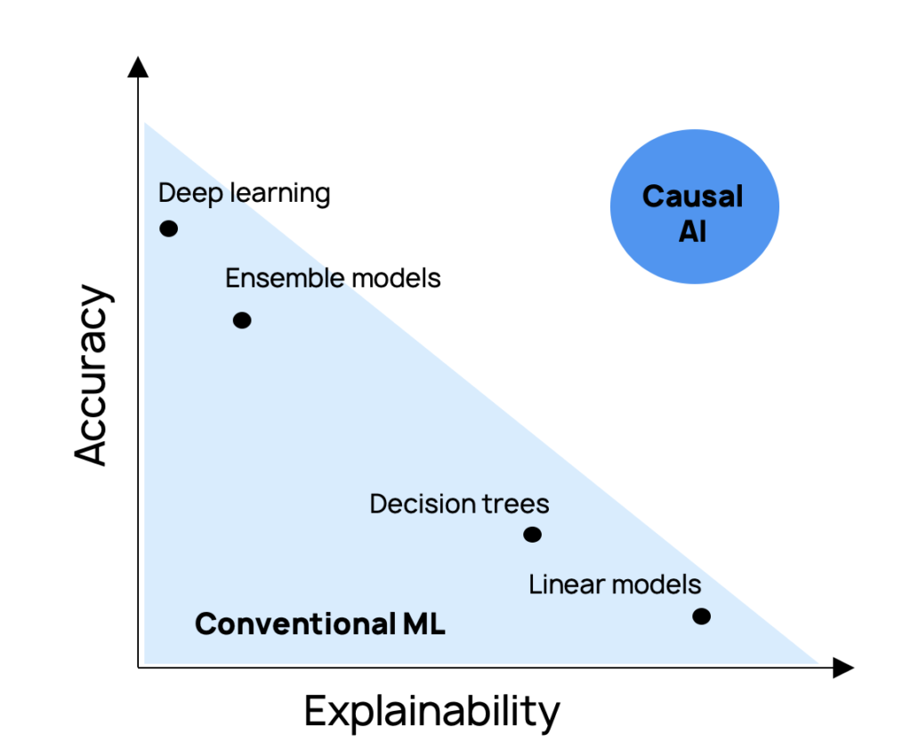
Motivation + Why This Paper Matters
XAI explains black-box AI, but often only at the level of correlations.
Causality provides tools for stronger, more trustworthy explanations.
Notes:
Explainability has become a major requirement for AI systems, but most current approaches are limited to showing correlations. They don’t capture deeper cause-effect reasoning, which is what humans naturally expect when we ask “why”.

Slide 3
Objective
Investigate the relationships between causality and XAI
How causality and XAI are complementary:
Jointly investigated since ancient times
Common goal: Usefulness to humans, be it by
  explaining in a human-comprehensible way what an AI system did
  OR
  designing the system in such a way that it reasons like humans
“counterfactual” is common terminology*

Slide 4
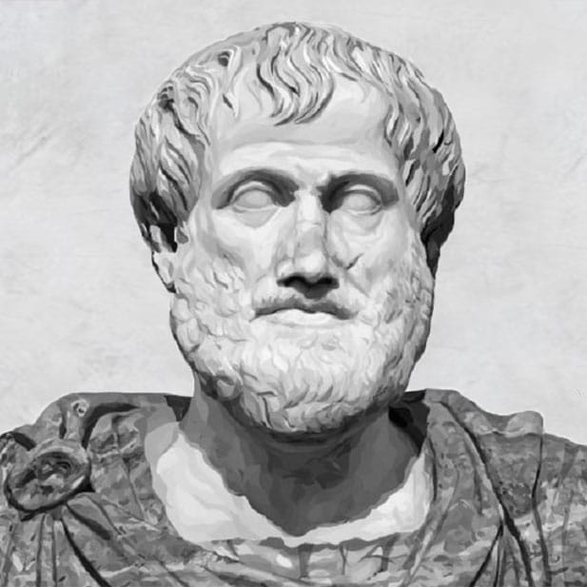
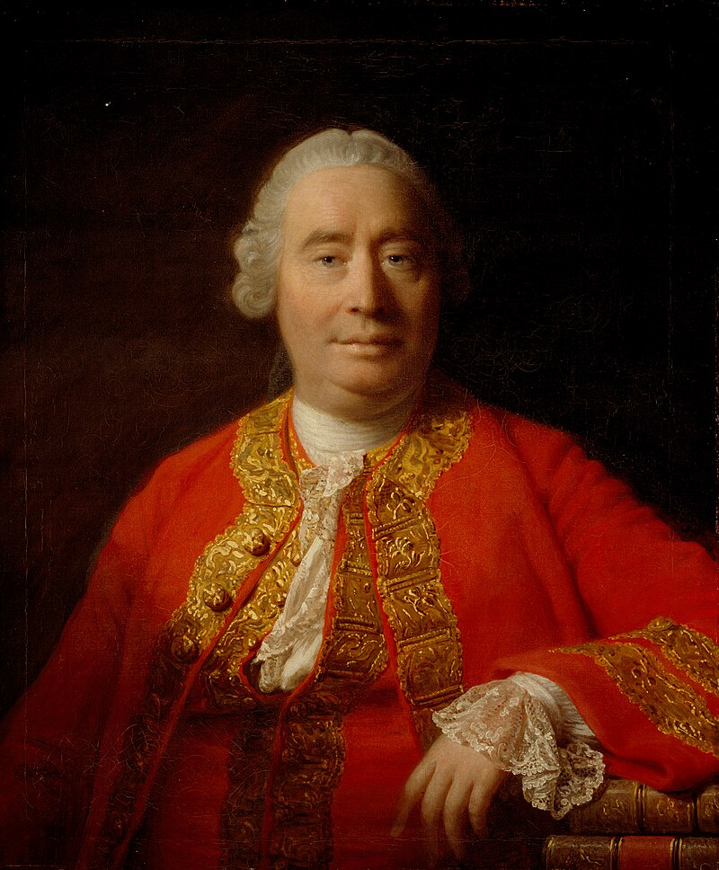
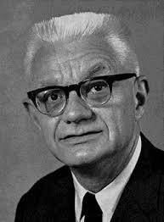


Causation and Explanation: Test of Time
300s BC
1700s
1948
1984
causality as the foundation of explanation
scientific explanations must be statistically relevant to the outcome to be explained
causation in terms of sufficient and necessary conditions
Deductive-Nomological (DN) model
Notes:
Aristotle, David Hume, Hempel and Oppenheim, Salmon

Slide 5
Why Do We Need XAI?
AI is pervasive: decisions in healthcare, finance, education, law…
Colorado AI Act, first comprehensive AI legislation in the US, goes into effect on February 1, 2026.
Opaque models: reluctance to trust or adopt AI fully
XAI aims:
  Explain to justify → provide reasons for decisions, reduce bias
  Explain to control → debug vulnerabilities
  Explain to improve → understand system behavior to make it more accurate and efficient
  Explain to discover → reveal new patterns/knowledge

Slide 6
Counterfactuals in Causality vs XAI
In Causality (Pearl’s Ladder):
Counterfactual = reasoning about imagined alternative worlds.
“What would have happened if I hadn’t turned on the heating?”
Abduction → action → prediction
In XAI:
Counterfactual Explanation (CFE) = minimal change in input that flips the model’s prediction.
“If income were $5k higher, the loan would be approved.”
Notes:
Causal CFs = “Why did the world turn out this way?”
XAI CFEs = “How would the model’s decision change if I tweak the input?”

Slide 7
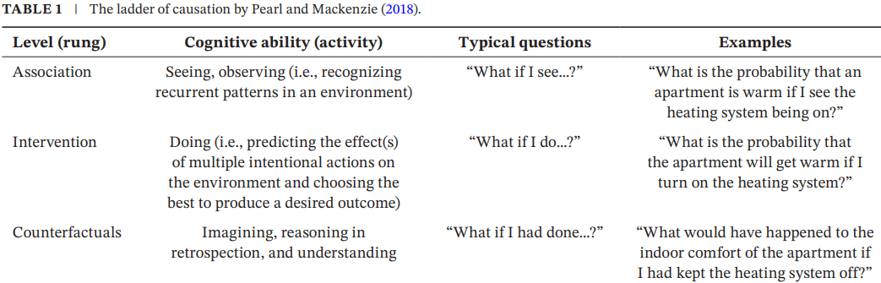


Slide 8
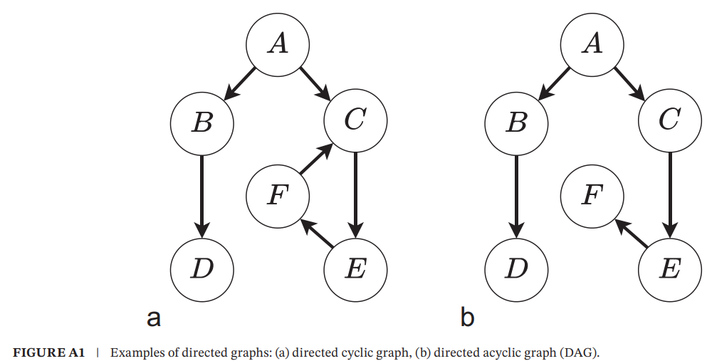
Much of the discussion of causality and qualitative modeling is occupied by DAGs.

Slide 9
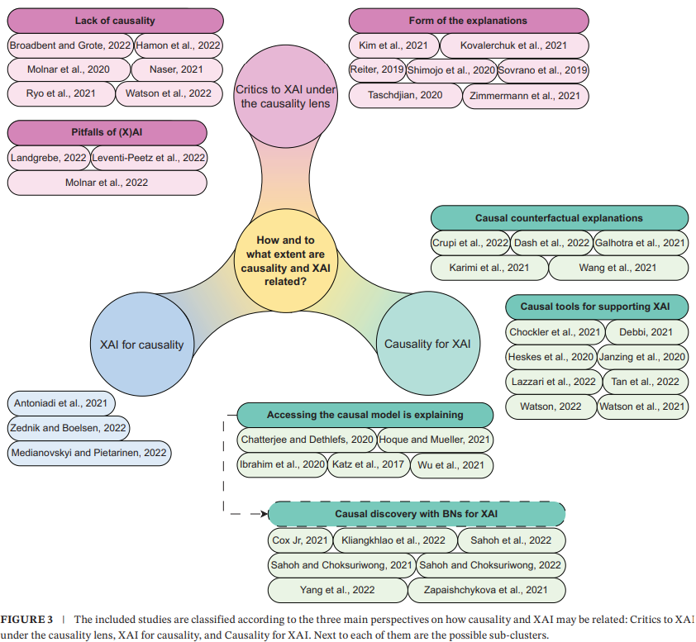
Notes:
Form: text, chat etc.
covers papers up to August 2022. Revised in 2024. Sub-clusters etc are still valid.

Slide 10
