Slide 1
Environmental microbiomes drive chemotactile sensation in octopus
Jordan Clemsen

Slide 2
Background

Slide 3
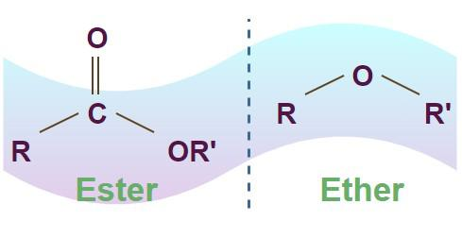
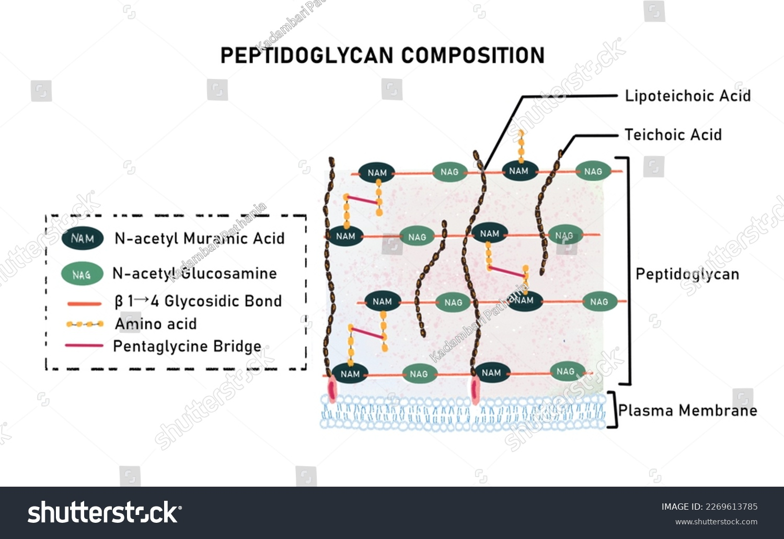
Review of microbiome
Bacteria
Archaea
Bacteriophages
Fungi
Protist
Pathogenic vs non-pathogenic
Relationship to host can be vague
Left == (How to Remember Ester vs Ether Quickly?, n.d.)
Right == (Peptidoglycan Murein Component Bacterial Cell Walls Stock Illustration 2269613785, n.d.)

Slide 4
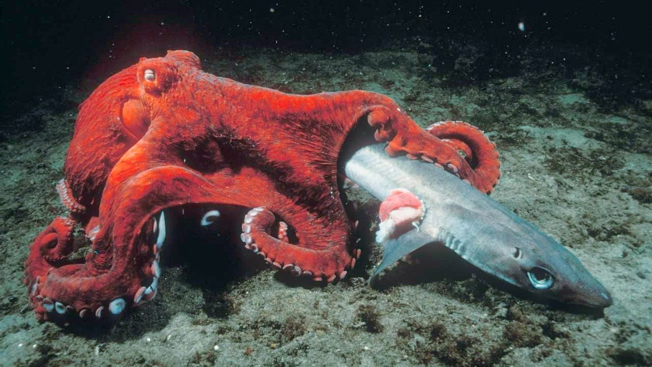
Octopuses
Females die after eggs hatch
9 brains = neural net
Near 360 vison
Radula (mollusk)
Supposedly exclusionary lifestyle
Opportunistic hunters
Chemotactile suckers
(WILD VERSUS, 2021)

Slide 5
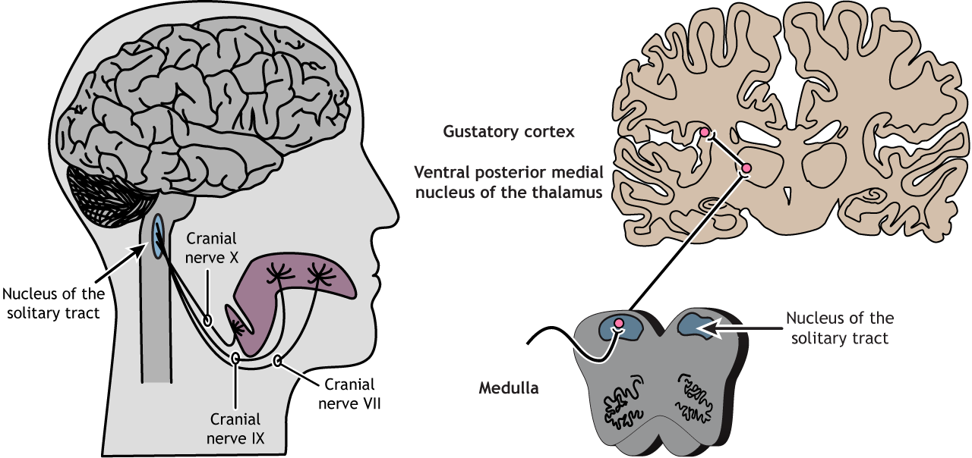
Gustation
5 tastes
Spice is touch and smell
Papilla
Camp from Gust
In octopuses, suckers to each ganglia
(Henley, 2021)

Slide 6
Methods

Slide 7
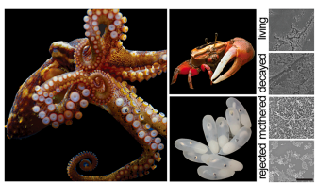
Animal husbandry
Caught california two spot octopuses
Male and female subjects housed 12 h light and dark cycle
Crab vs eggs and respective controls
Video scoring egg rejection, predation decision and floor exploration
(Sepela et al., 2025)

Slide 8
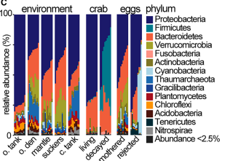
Microbiome
Osmium treated crab shells and egg casings dehydrated through ethanol
SEM
More eggs and crabs were rinsed and swabbed for 16S sequencing and culturing
Reads denoised with DADA2
Assigned taxonomy with QIIME/Uclust and BLAST, then PERMNOVA, Bray-Curtis
(Sepela et al., 2025)

Slide 9
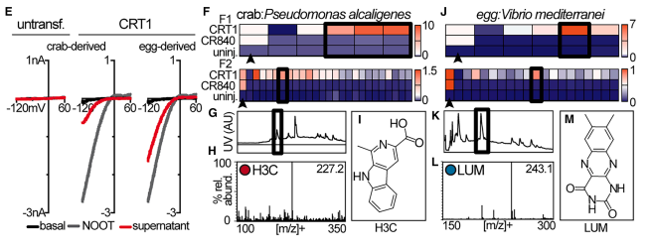
Ligands
Cultured bacteria grown then extracted using a resin then organic solvent
Eluted products separated and retested for activity peak
Identified active compounds via high res MS and NMR
Metabolites also extracted but used long wave UV to identify
CryoEM
(Sepela et al., 2025)

Slide 10
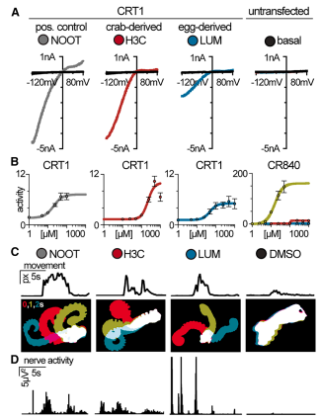
Ex vivo arm
Electrode recordings measured spiking
RMS applied with spike timing metrics with binding randomization
Video recording of arm movement after stimulus sorted by frame difference and "Stack based approaches"
Suckers adhesion recorded as fraction still attached to agarose gel after "liftoff"
(Sepela et al., 2025)

Slide 11
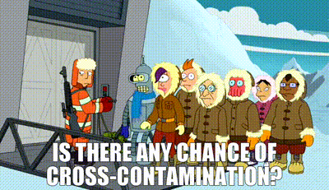
Discussion
Discrete compounds from microbiome detect environment
"Here, we discover that microbial ligands encode aversive cues for both predation and brooding"
CR agonists are enriched by decaying crabs
Limited by culturing method inducing cross contamination risk
Only one location and type of octopus
Frame is limited by camera
(Is There Any Chance of Cross-Contamination?, n.d.)

Slide 12
References
Henley, C. (2021). Taste. https://openbooks.lib.msu.edu/neuroscience/chapter/taste/
How to remember ester vs ether quickly? (n.d.). Retrieved January 14, 2026, from https://www.fescolo.com/blog/how-to-remember-ester-vs-ether-quickly.html
Is there any chance of cross-contamination? (n.d.). [Video recording]. Retrieved January 14, 2026, from https://ads.getyarn.io/yarn-clip/121d44b5-d2b0-4ce3-839b-cbf97fe33f29/gif
Peptidoglycan Murein Component Bacterial Cell Walls Stock Illustration 2269613785. (n.d.). Shutterstock. Retrieved January 14, 2026, from https://www.shutterstock.com/image-illustration/peptidoglycan-murein-component-bacterial-cell-walls-2269613785
Sepela, R. J., Jiang, H., Shin, Y.-H., Hautala, T. L., Clardy, J., Hibbs, R. E., & Bellono, N. W. (2025). Environmental microbiomes drive chemotactile sensation in octopus. Cell, 188(18), 4849-4860.e21. https://doi.org/10.1016/j.cell.2025.05.033
WILD VERSUS (Director). (2021, May 10). How Octopuses Hunt Sharks [Video recording]. https://www.youtube.com/watch?v=RU0DWpN6DOs

