Slide 1
Dimensionality Reduction Algorithms
--- Debbrata Saha

Slide 2
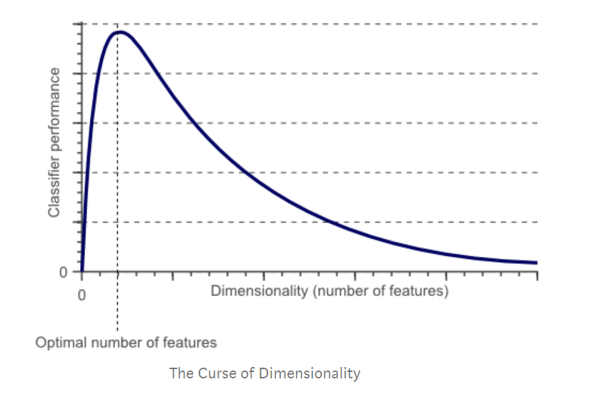
Curse of dimensionality
Overfitting
The more features we use, the more complex a model gets
Eventually cause the model to fit the training data too well, causing overfitting.
Unable to predict the real life test data accurately

Slide 3
Dimensionality Reduction
Less dimensions mean less computing. Less data means that algorithms train faster.
Less data means less storage space required
Removes redundant features and noise
Helps to remove the overfitting
Less misleading data means model accuracy improves

Slide 4
Dimensionality reduction algorithms
Linear
Principle Component Analysis (PCA)
Multi dimensional scaling (MDS)
Non linear
ISOMAP
Locally Linear Embedding(LLE)
T-SNE

Slide 5
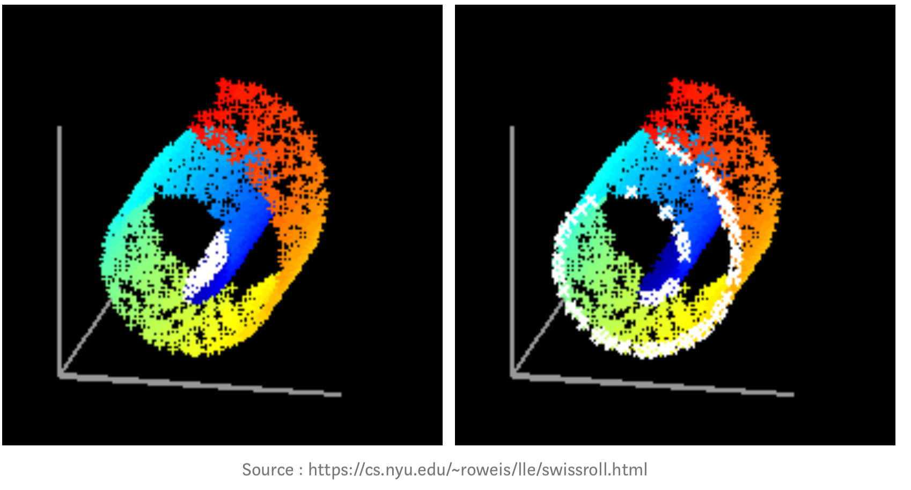
Locally Linear Embedding (LLE)
Unsupervised method for dimensionality reduction
Reduce dimensions while trying to preserve the geometric features of the original non-linear feature structure
Nonlinear Dimensionality Reduction by Locally Linear Embedding
Sam T. Roweis and Lawrence K. Saul
www.sciencemag.org SCIENCE VOL 290 22 DECEMBER 2000

Slide 6
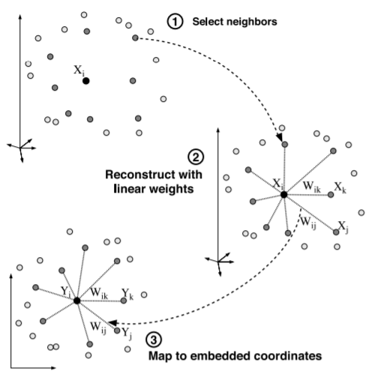


LLE

Slide 7
LLE
Solve small pieces at a time like piecewise regression
Have to optimize two objective functions

Slide 8
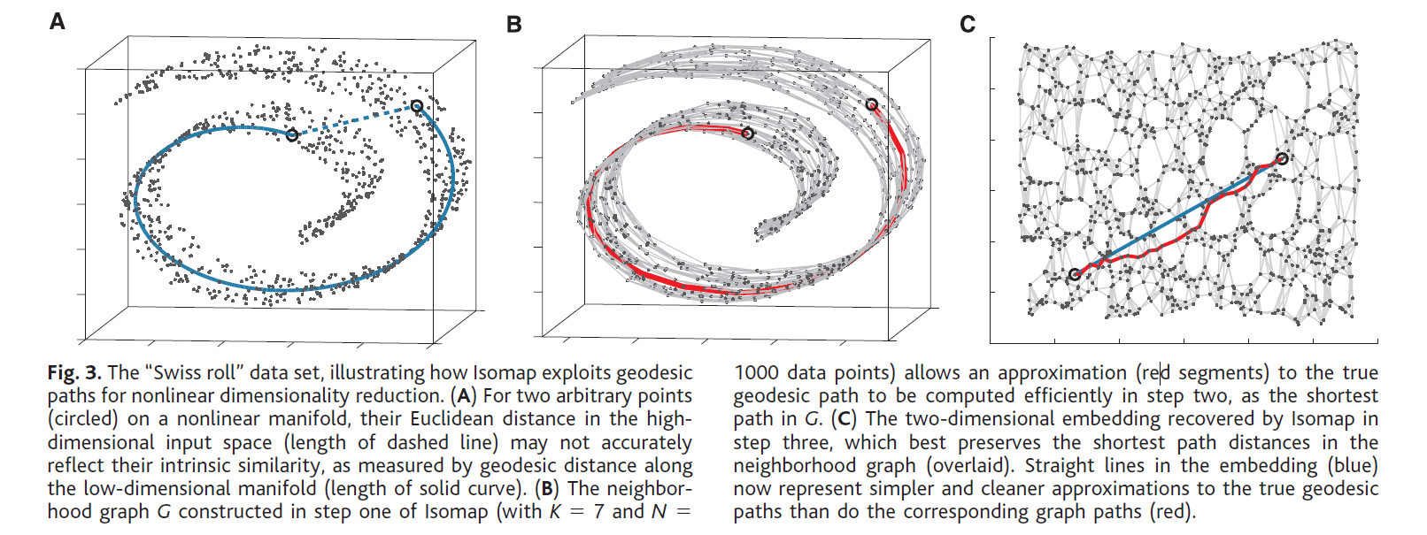
ISOMAP
A Global Geometric Framework for Nonlinear Dimensionality Reduction
Joshua B. Tenenbaum,* Vin de Silva, John C. Langford
www.sciencemag.org SCIENCE VOL 290 22 DECEMBER 2000

Slide 9
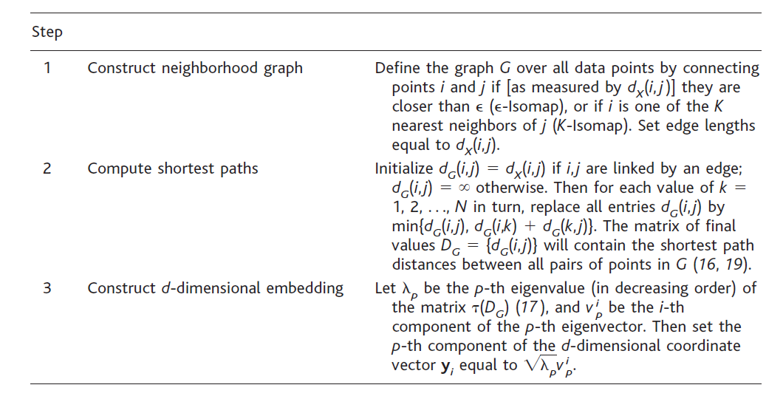

ISOMAP
Objective function:

Slide 10
T-SNE (t-Distributed Stochastic Neighbor Embedding)
Visualizing Data using t-SNE
Laurens van der Maaten, Geoffrey Hinton
Journal of Machine Learning Research 9 (2008) 2579-2605

Slide 11
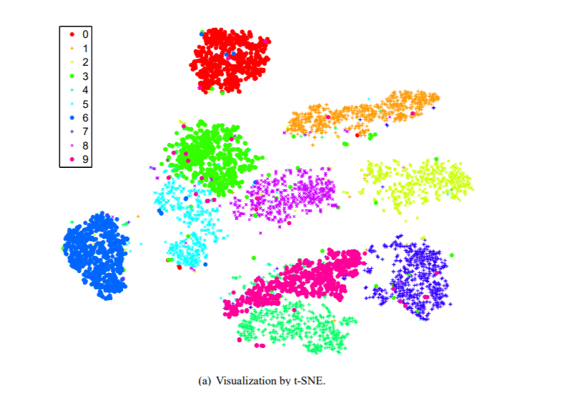
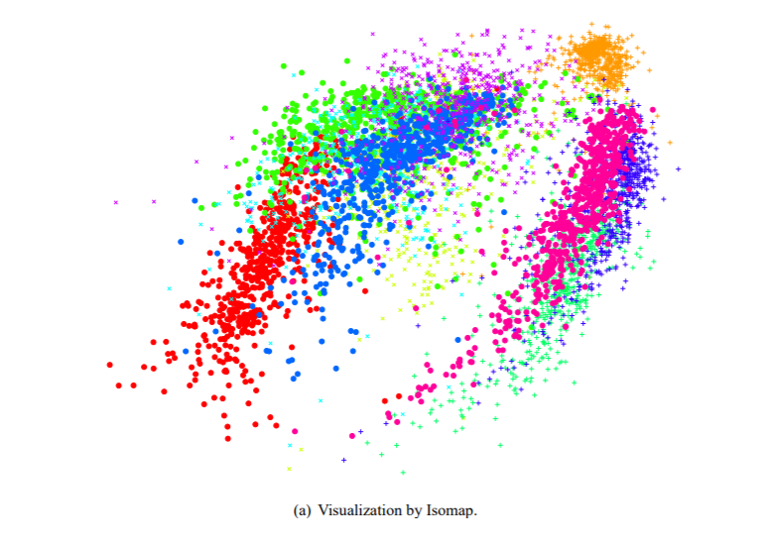
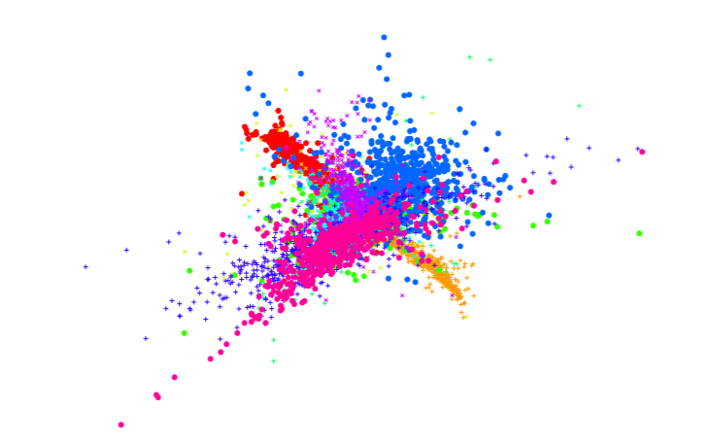
MNIST dataset layout
Visualization by t-SNE
Visualization by ISOMAP
Visualization by LLE

Slide 12
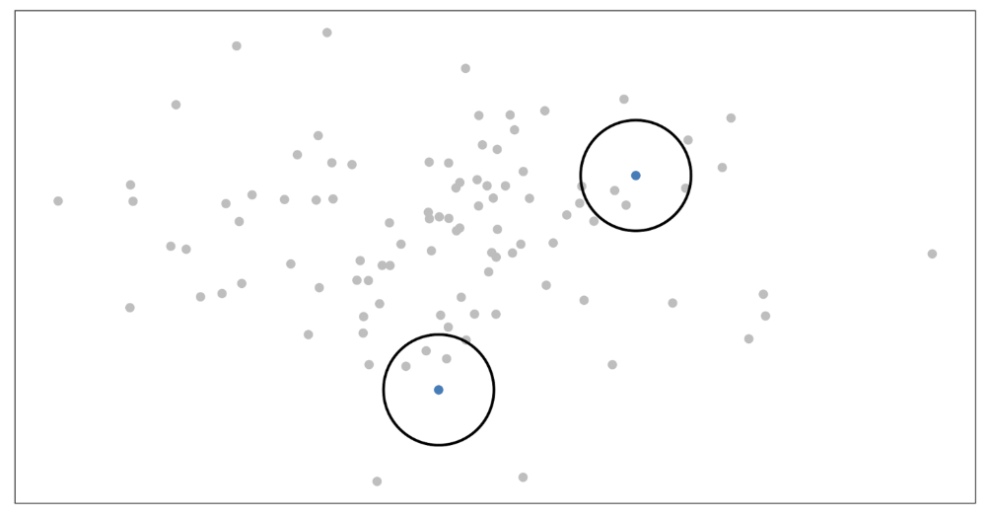



T-SNE procedure

Slide 13
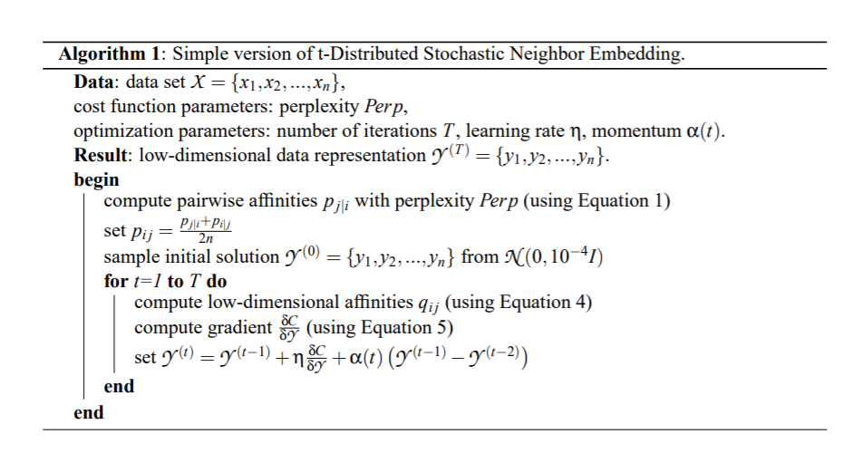
T-SNE Algorithm

Slide 14
Divide and concur
A method for solving constraint problems
Take advantage of the division into sub problems
Works iteratively and deterministically
Divide and concur: A general approach to constraint satisfaction
Simon Gravel and Veit Elser
Phys. Rev. E 78, 036706 – Published 22 September 2008

Slide 15
Method
Each iterative step is defined by two fundamental operations
In the first operations, the problem is divided into its constituent constraints
Each constraint is solved independently, ignoring possible conflicts between different constraints
In the second operation, conflicts between constraints are resolved by concur operation

Slide 16


Procedure
Suppose Y has n constraints.
Create n replicas for n constraints (, , )
Divide Step:
Apply associated projection on replica which acts separately on each of the replicas
Concur Step:
Replaces the value of each replica by the average value of all the replicas.

Slide 17
Sphere packing problem
Packing of n spheres in a finite D-dimensional volume
Each sphere must avoid n - 1 other spheres and lie within a certain volume
There are altogether n constraints per sphere
Create n replicas for each sphere

Slide 18
Sphere packing problem
Divide step:
Spheres = 9
9 replicas for each sphere

Slide 19
Sphere packing problem
Divide Step:

Slide 20
Sphere packing problem
Concur step: Replaces the value of each replica by the average value of all the replicas

