Slide 1
Making deep neural networks right for the right scientific reasons by interacting with their explanations

Slide 2
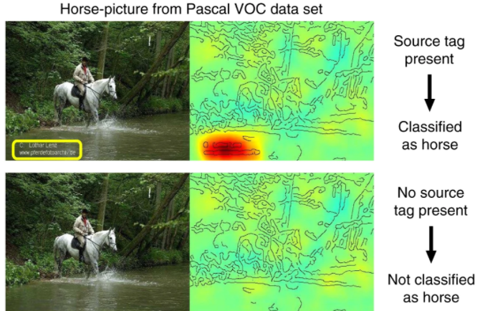
Right for the wrong reasons
Clever Hans
Models that predict from artifacts
Outliers in fMRI data
“We don’t know what we don’t know”
Although cleaning data should always be a priority, especially for complex data, sometimes we don’t know what needs to be cleaned

Slide 3
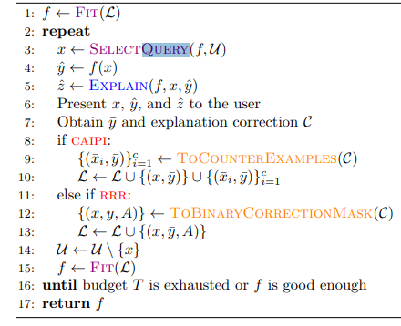
Explanatory Interactive Machine Learning
Fit a model given labelled data
Query the user for help
The user provides a sample x (labelled or unlabelled)
The model predicts f(x) and provides the prediction and the explanation
The user then adds a feedback sample to the training dataset and refits the model
Do this until either f is good enough, or the model has reached a predetermined number of queries

Slide 4
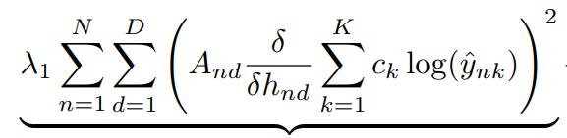
Interactive Queries
Domain expert queries
The model can directly ask the user (domain expert) for feedback
Counter example feedback (CAIPI)
At the query step, if the model is right for the wrong reason, the user can provide a labelled counter example to the model
Example: given query x, randomize the “irrelevant” features of x
Gradient-based corrections
When the explanation is a set of gradients, the user applies a penalty to the gradients that are outside of what the user considers to relevant (e.g. a binary mask) as an additional part of the loss function
In their particular implementation, they use grad-CAM, finding h (the last convolution layer), rescaling it to be the size of the binary matrix A, and increase the error based on a class-based penalty (c_{k})

Slide 5
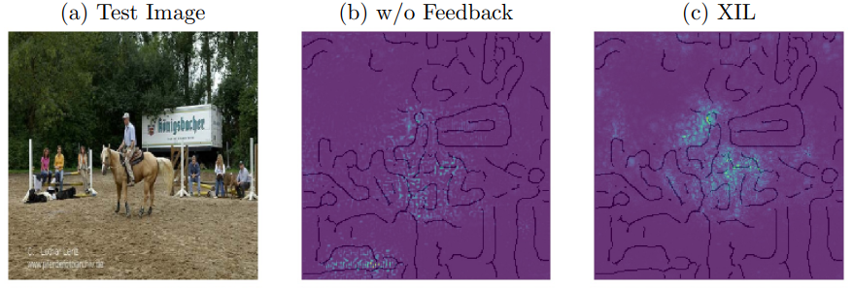
Results - VOC horse images
Using gradient masking

Slide 6
Spectral Relevance Analysis
Steps for SpRAy
This paper used Grad-CAM to compute relevancy maps
Create affinity matrix between all pairs of images/samples
Spectral Clustering using affinity matrix
Use eigengaps as a metric to select only the distinctive clusters
Clusters of images are presented to users/researchers who can then identify and conceptualize the “strategies” used by the model
https://www.nature.com/articles/s41467-019-08987-4
https://www.nature.com/articles/s41467-019-08987-4/figures/3

