Slide 1
Meshed-Memory Transformer for Image Captioning
William Ashbee

Slide 2

Preface: Transformers...again? Why?
I still don’t fully understand them, and I volunteered on short notice to lead today’s discussion, so you could help me fill in some gaps.
VIT (vision transformer from an image is worth 16x16 words) solved a problem I am working on out of the box while resnets and mlps required somewhat ridiculous modifications and lstms seem to fail.
Hinton (Mother duck) felt the need to talk about Transformers as a great model during his glom talk, and so I decided to focus on them since glom wasn’t a finished product.
I believe based on reviewing our previous discussion of transformers that there’s probably a lot of myth busting both in the favor and against to be done around them and much we can still learn.
I am interested in memory augmented networks because of neural turing machines.

Slide 3
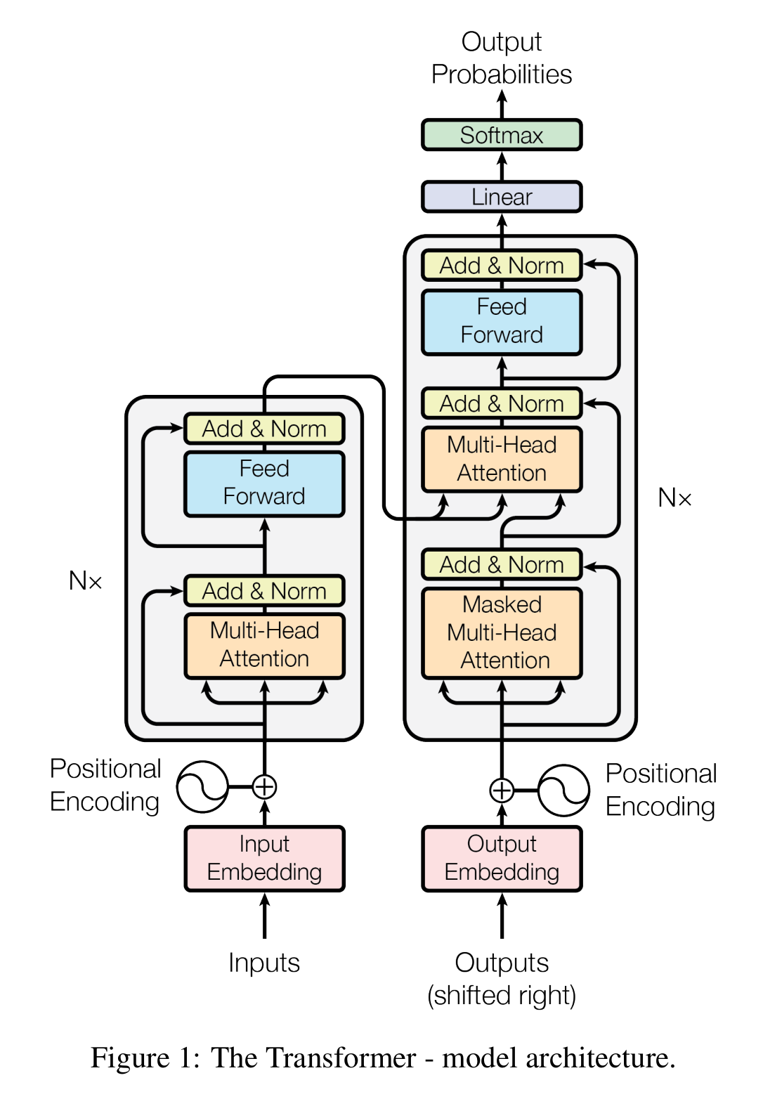
Background--attention is all you need.
Encoder: The encoder is composed of a stack of N = 6 identical layers. Each layer has two sub-layers. The first is a multi-head self-attention mechanism, and the second is a simple, position-wise fully connected feed-forward network. They employ a residual connection around each of the two sub-layers, followed by layer normalization. That is, the output of each sub-layer is LayerNorm(x + Sublayer(x)), where Sublayer(x) is the function implemented by the sub-layer itself.
Decoder: The decoder is also composed of a stack of N = 6 identical layers. In addition to the two sub-layers in each encoder layer, the decoder inserts a third sub-layer, which performs multi-head attention over the output of the encoder stack. Similar to the encoder, they employ residual connections around each of the sub-layers, followed by layer normalization. They also modify the self-attention sub-layer in the decoder stack to prevent positions from attending to subsequent positions. This masking, combined with fact that the output embeddings are offset by one position, ensures that predictions for position i can depend only on the known outputs at positions less than i.

Slide 4
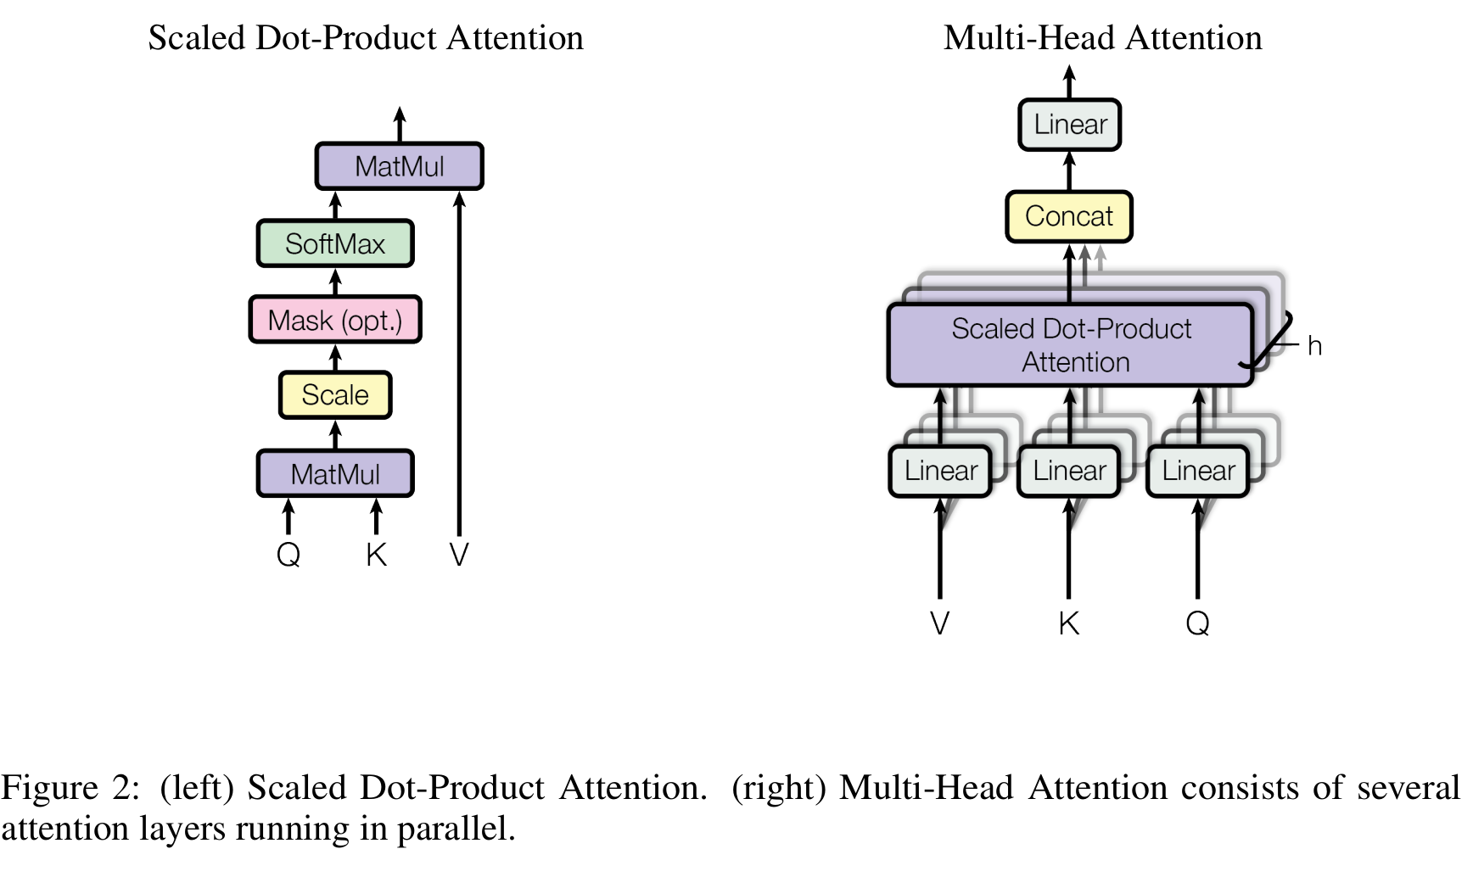
Background--Attention
An attention function can be described as mapping a query and a set of key-value pairs to an output, where the query, keys, values, and output are all vectors. The output is computed as a weighted sum of the values, where the weight assigned to each value is computed by a compatibility function of the query with the corresponding key.

Slide 5
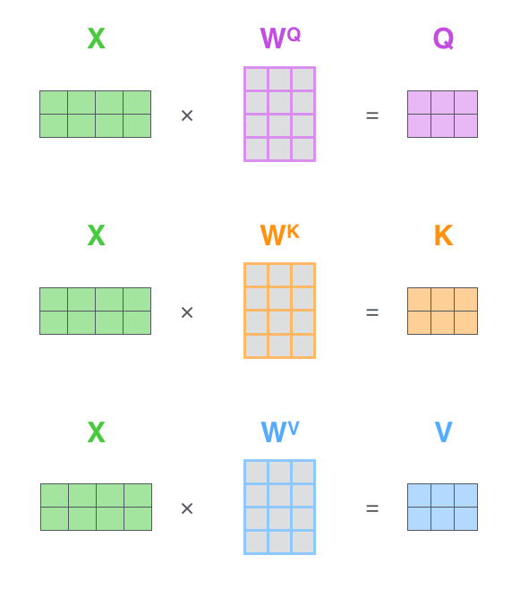

Background--Self Attention

Slide 6
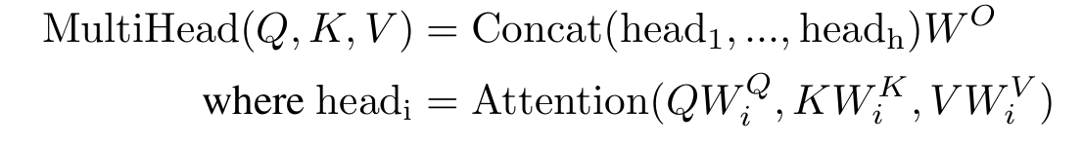
Background--Multi-Head Attention
Instead of performing a single attention function with d model -dimensional keys, values and queries, they found it beneficial to linearly project the queries, keys and values h times with different, learned linear projections.

Slide 7
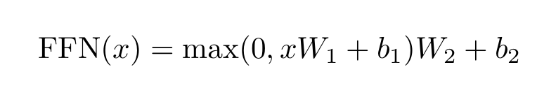
Position-wise Feed-Forward Networks
In addition to attention sub-layers, each of the layers in their encoder and decoder contains a fully connected feed-forward network, which is applied to each position separately and identically. This consists of two linear transformations with a ReLU activation in between.

Slide 8
Embeddings and softmax
Embeddings are used to convert the input tokens and output tokens to vectors. The learned linear transformation and softmax function are used to convert the decoder output to predicted next-token probabilities.

Slide 9
Positional Encoding
Since their model contains no recurrence and no convolution, in order for the model to make use of the order of the sequence, they must inject some information about the relative or absolute position of the tokens in the sequence.
To this end, they add "positional encodings" to the input embeddings at the bottoms of the encoder and decoder stacks. The positional encodings have the same dimension d model as the embeddings, so that the two can be summed. There are many choices of positional encodings, learned and fixed [9].

Slide 10
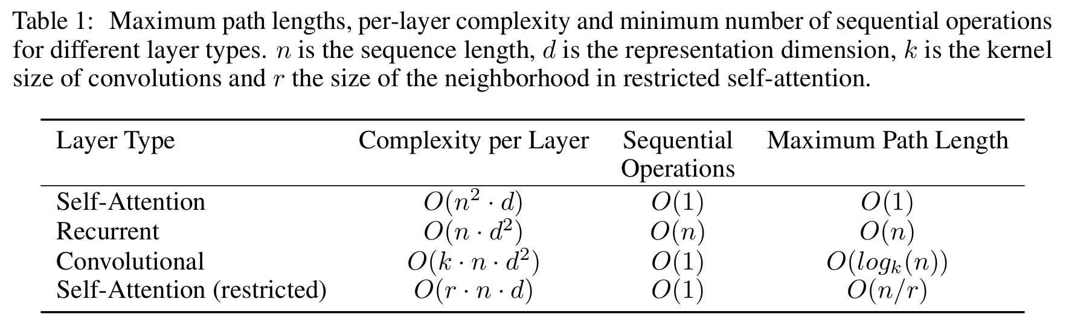
Why self-attention
total computational complexity per layer.
amount of computation that can be parallelized, as measured by the minimum number of sequential operations required.
The third is the path length between long-range dependencies in the network (shorter paths are better for gradient propagation).
Self-attention could yield more interpretable models (you may inspect attention weights and see what is salient to decisions).

Slide 11
Meshed-Memory Transformer for Image Captioning: Contributions
• They propose a novel fully-attentive image captioning algorithm. Their model encapsulates a multi-layer encoder for image regions and a multi-layer decoder which generates the output sentence. To exploit both low-level and high-level contributions, encoding and decoding layers are connected in a mesh-like structure, weighted through a learnable gating mechanism;
• In their visual encoder, relationships between image regions are encoded in a multi-level fashion exploiting learned a priori knowledge, which is modeled via persistent memory vectors;
• They show that the M 2 Transformer surpasses all previous proposals for image captioning, achieving a new state of the art on the online COCO evaluation server;
• As a complementary contribution, they conduct experiments to compare different fully-attentive architectures on image captioning and validate the performance of their model on novel object captioning, using the recently proposed nocaps dataset. Finally, to improve reproducibility and foster new research in the field, they will publicly release the source code and trained models of all experiments.

Slide 12
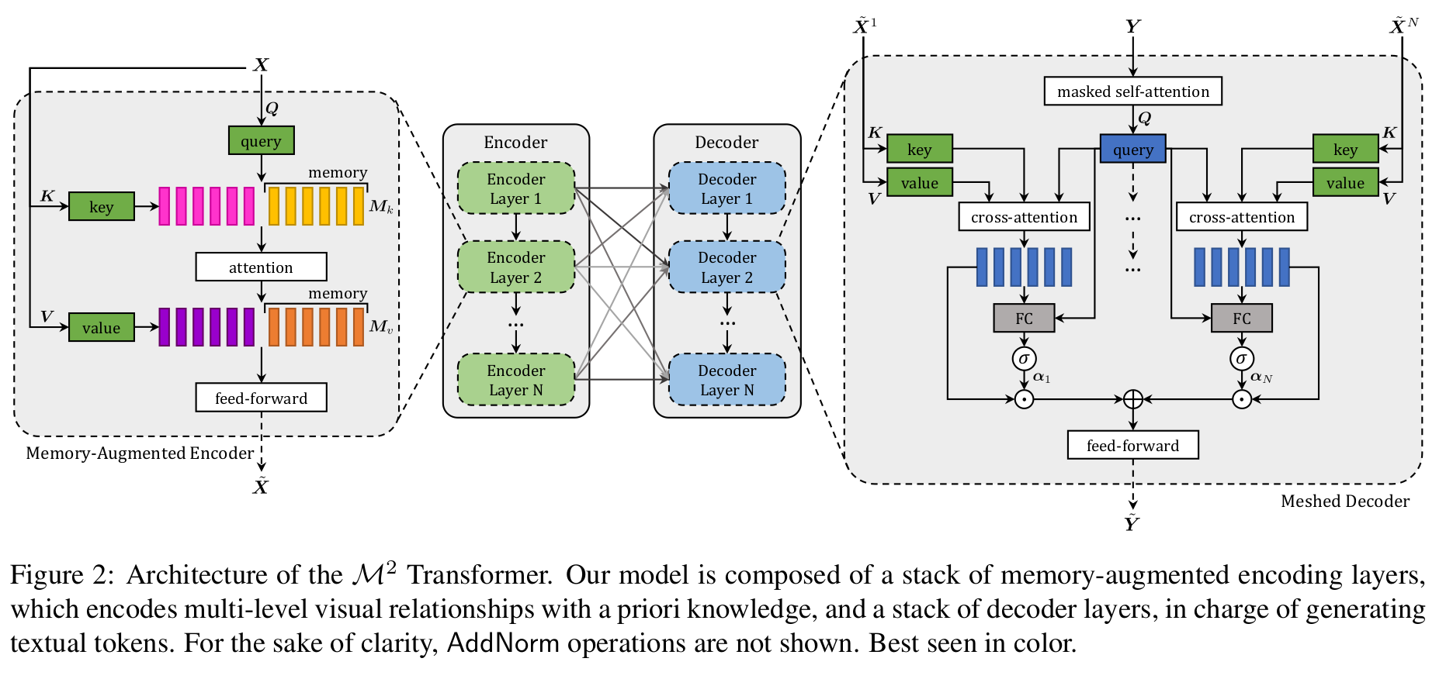
Meshed-Memory Transformer

Slide 13

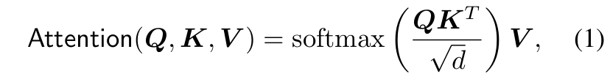
Memory-Augmented Encoder (encoder recap)
The output of the self-attention operator is a new set of elements S(X), with the same cardinality as X, in which each element of X is replaced with a weighted sum of the values,
i.e. of linear projections of the input (Eq. 1).

Slide 14
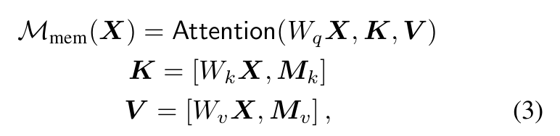
Memory-Augmented Attention
where M k and M v are learnable matrices with n m rows, and [·, ·] indicates concatenation.
Intuitively, by adding learnable keys and values, through attention it will be possible to retrieve learned knowledge which is not already embedded in X. At the same time, their formulation leaves the set of queries unaltered.
**I think the claim that this is extra priory memory is somewhat questionable. Why wouldn’t such a-priori knowledge be baked into the weight matrices for the key, query, and value. Also, in the ablation study, the memory doesn’t add that much value over the meshed attention in the decoder.

Slide 15
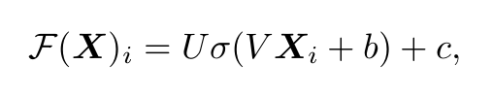
Encoding layer (feed forward affine transform)
where X i indicates the i-th vector of the input set, and
F(X) i the i-th vector of the output. Also, σ(·) is the ReLU activation function, V and U are learnable weight matrices, b and c are bias terms.

Slide 16
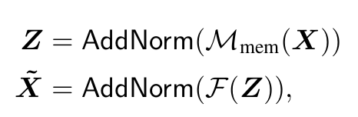
Encoding layer (Full notation)
Each of these sub-components (memory-augmented attention and position-wise feed-forward) is then encapsu-
lated within a residual connection and a layer norm operation. The complete definition of an encoding layer can be
finally written as:

Slide 17
Meshed Decoder
Their decoder is conditioned on both previously generated words and region encodings, and is in charge of generating the next tokens of the output caption

Slide 18
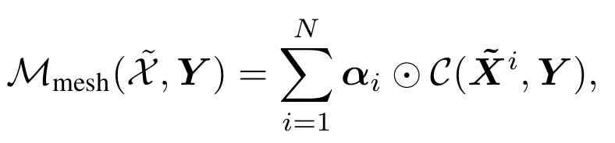
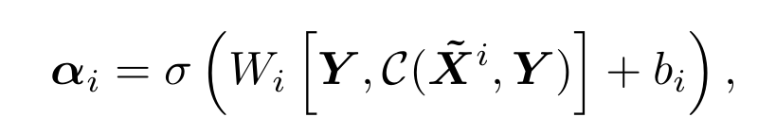
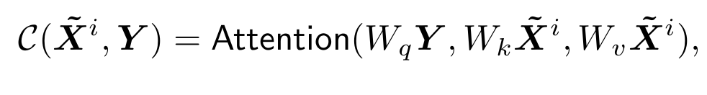
Meshed Cross-Attention.
￼
Given an input sequence of vectors Y , and outputs from all encoding layers X̃ , the Meshed Attention operator connects Y to all elements in X̃ through gated cross-attention

Slide 19
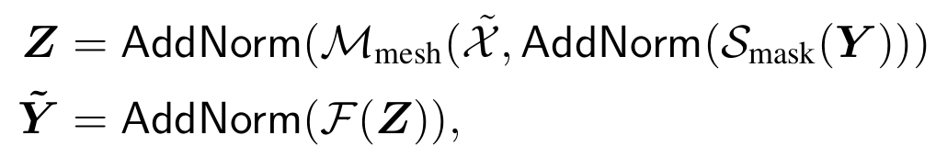
Architecture of decoding layers.
As the prediction of a word should only depend on previously predicted words, the decoder layer comprises a masked self-attention operation which connects queries derived from the t-th element of its input sequence Y with keys and values obtained from the left-hand subsequence, i.e. Y ≤t
What was missing from these equations is how decoder layer i is a function of decoder layer i-1.

Slide 20
My main questions about the decoder/encoder
Is it true that the encoder output for a single image at inference time should always be the same since it’s not conditioned on Y < t?
The decoder layer however is conditioned on Y<t. correct?
Is it accurate to say that the encoder output is fixed during caption generation, but the decoder is sequentially/iteratively predicting a word, then using that word to input back into the decoder until some end/halt token is generated?
Does the sequential aspect of the decoder undergo backpropagation through time during training or does the generation at each time step occur as a separate computation graph of other timesteps in training?
The encoder can be treated as a feature extractor. Correct?

Slide 21
Observations/thoughts
I think the main contribution of this paper is the meshed attention, which attends to multiple encoder layers rather than only the final layer.
I don’t think that the memory implemented in this paper is very robust. There is no write head. The memory matrix seems only like an extension of the key and value weight matrices’ capacity.
I speculate that one could extend transformers to be neural turing machines by putting the read head output of a neural turing machine where the memory matrix is located. Although, i am not sure how one would implement the write head.

